Slide 1
Operation Research
2013/03/11

Slide 2
Agenda
A Diet Problem (3.4 example 6)
A Work-Scheduling Problem
(3.5 example 7)
Homework Problems

Slide 3
A Diet Problem
My diet requires that all the food I eat come from one of the four “basic food groups” (chocolate cake, ice cream, soda, and cheesecake). At present the following four foods are available for consumption: brownies, chocolate ice cream, cola and pineapple cheesecake.

Slide 4
A Diet Problem (cont’d)
Type of Food | Calories | Chocolate(oz) | Sugar(oz) | Fat(oz)
Brownie | 400 | 3 | 2 | 2
Chocolate Ice Cream (1 scoop) | 200 | 2 | 2 | 4
Cola (1 bottle) | 150 | 0 | 4 | 1
Pineapple Cheesecake (1 piece) | 500 | 0 | 4 | 5

Slide 5
A Diet Problem (cont’d)
Each brownie costs 50¢, each scoop of chocolate ice cream costs 20¢, each bottle of cola costs 30¢, and each piece of pineapple cheesecake costs 80¢. Each day, I must ingest at least 500 calories, 6 oz of chocolate, 10 oz of sugar, and 8 oz of fat. Formulate a LP model that can be used to satisfy my daily nutritional requirements at minimum cost.

Slide 6
A Diet Problem (cont’d)
Step 1: Define Decision Variables
  At present the following four foods are available for consumption: brownies, chocolate ice cream, cola and pineapple cheesecake.
  x₁: number of brownies eaten daily
  x₂: number of scoops of chocolate ice cream
  eaten daily
  x₃: bottles of cola drunk daily
  x₄: pieces of pineapple cheesecake eaten
  daily

Slide 7
A Diet Problem (cont’d)
Step 2: Construct Objective Function
  Minimum total cost of diet
  Each brownie costs 50¢, each scoop of chocolate ice cream costs 20¢, each bottle of cola costs 30¢, and each piece of pineapple cheesecake costs 80¢.
  min z = 50x₁ + 20x₂ + 30x₃ + 80x₄

Slide 8
A Diet Problem (cont’d)
Step 3: Construct Constraints
  Each day, I must ingest at least 500 calories, 6 oz of chocolate, 10 oz of sugar, and 8 oz of fat.
  Constraint 1: at least 500 calories
  400x₁ + 200x₂ + 150x₃ + 500x₄ ≥ 500
  Constraint 2: at least 6 oz of chocolate
  3x₁ + 2x₂ ≥ 6

Slide 9
A Diet Problem (cont’d)
  Constraint 3: at least 10 oz of sugar
  2x₁ + 2x₂ + 4x₃ + 4x₄ ≥ 10
  Constraint 4: at least 8 oz of fat
  2x₁ + 4x₂ + 1x₃ + 5x₄ ≥ 8

Slide 10

A Diet Problem (cont’d)
Answer:
  min z = 50x₁ + 20x₂ + 30x₃ + 80x₄
  s.t. 400x₁ + 200x₂ + 150x₃ + 500x₄ ≥ 500
  3x₁ + 2x₂ ≥ 6
  2x₁ + 2x₂ + 4x₃ + 4x₄ ≥ 10
  2x₁ + 4x₂ + 1x₃ + 5x₄ ≥ 8
  $∀$ x_{i} ≥ 0

Slide 11
A Work-Scheduling Problem
A post office requires different numbers of full-time employees on different days of the week. Union rules state that each full-time employees must work five consecutive days and then receive two days off. For example, an employee who works Monday to Friday must be off on Saturday and Sunday.

Slide 12
A Work-Scheduling Problem (cont’d)
The post office wants to meet its daily requirements using only full-time employees. Formulate an LP that the post office can use to minimize the number of full-time employees who must be hired.

Slide 13
A Work-Scheduling Problem (cont’d)
Day | Number of Full-time Employees Required
1 = Monday | 17
2 = Tuesday | 13
3 = Wednesday | 15
4 = Thursday | 19
5 = Friday | 14
6 = Saturday | 16
7 = Sunday | 11

Slide 14
A Work-Scheduling Problem (cont’d)
Step 1: Define Decision Variable
  Union rules state that each full-time employees must work five consecutive days and then receive two days off.
  Define x_{i} = number of employees beginning
  work on day i (1=Mon… etc)

Slide 15

A Work-Scheduling Problem (cont’d)
Step 2: Construct Objective Function
  Formulate an LP that the post office can use to minimize the number of full-time employees who must be hired.
  min z = $\sum_{i=1}^{7}{x_{i}}$

Slide 16

A Work-Scheduling Problem (cont’d)
Step 3: Construct Constraints
  Union rules state that each full-time employees must work five consecutive days and then receive two days off.
  Monday: no x₂, x₃ ……
  Day i: no x_{(i+1) mod 7}, x_{(i+2) mod 7}
  Let R_{i} be Number of full-time employees
  required in day i (R={17,13,15,19,14,16,11})
  $\sum_{j=1}^{7}{x_{j}−x_{\left(i+1\right) mod 7}}− x_{\left(i+2\right)mod 7}≥R_{i}$

Slide 17

A Work-Scheduling Problem (cont’d)
Answer:
  min z = $\sum_{i=1}^{7}{x_{i}}$
  s.t. $\sum_{j=1}^{7}{x_{j}−x_{\left(i+1\right) mod 7}}− x_{\left(i+2\right)mod 7}≥R_{i}$
  $∀$ x_{i} ≥ 0
  $∀$ x_{i} is integer

Slide 18
Homework

Slide 19
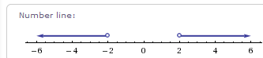
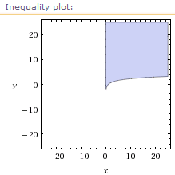
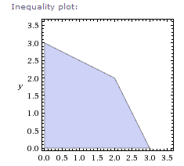
Question 3
Convex Set: 圖形任兩點連線仍在圖形之上
(a) (c)
(b)

Slide 20
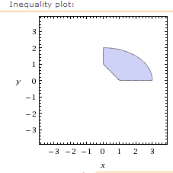
Question 3
(d)
(e) Feasible solution of linear programming
model is a convex set

Slide 21
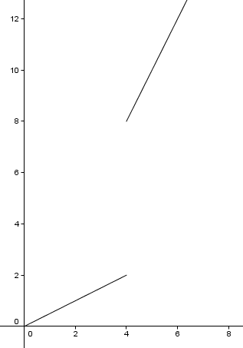
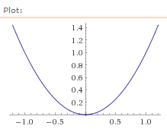
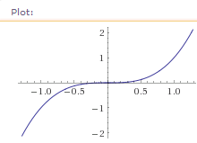
Question 4
Convex Function: 任兩點連線高於圖形
(a) (c)
(b)

Slide 22
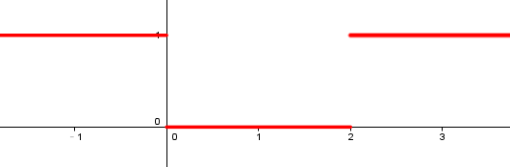
Question 4
(d)
(e) Linear Function: convex

Slide 23
Question 5
max => min: objective * (-1)
Ax ≤ b => ≥ : *(-1)
≤ : the same
= : both (additional row)

Slide 24
Question 6~11
如果題目有給變數要看清楚! (6)
仔細看題目的條件，從objective跟constraints敘述來思考定義變數
盡可能減少變數的數量
變數命名可以有意義(變數不多的狀況)
邏輯清楚

Slide 25

Question 1,2
Gaussian Elimination：留下對角線diagonal上的pivot，與右上半的數值
$\left[\begin{matrix}0 & 2 & 2 \\ 1 & 2 & 1 \\ 0 & 1 & −1\end{matrix}\right]$ -> $\left[\begin{matrix}1 & 2 & 1 \\ 0 & 2 & 2 \\ 0 & 1 & −1\end{matrix}\right]$ -> $\left[\begin{matrix}1 & 2 & 1 \\ 0 & 1 & 1 \\ 0 & 0 & −2\end{matrix}\right]$
-> $\left[\begin{matrix}1 & 2 & 1 \\ 0 & 1 & 1 \\ 0 & 0 & 1\end{matrix}\right]$

Slide 26

Question 1,2
Gauss-Jordan Elimination：只留下對角線diagonal上的pivot
$\left[\begin{matrix}0 & 2 & 2 \\ 1 & 2 & 1 \\ 0 & 1 & −1\end{matrix}\right]$ -> $\left[\begin{matrix}1 & 2 & 1 \\ 0 & 2 & 2 \\ 0 & 1 & −1\end{matrix}\right]$ -> $\left[\begin{matrix}1 & 2 & 1 \\ 0 & 1 & 1 \\ 0 & 0 & −2\end{matrix}\right]$
-> $\left[\begin{matrix}1 & 2 & 1 \\ 0 & 1 & 1 \\ 0 & 0 & 1\end{matrix}\right]$ -> $\left[\begin{matrix}1 & 2 & 0 \\ 0 & 1 & 0 \\ 0 & 0 & 1\end{matrix}\right]$ -> $\left[\begin{matrix}1 & 0 & 0 \\ 0 & 1 & 0 \\ 0 & 0 & 1\end{matrix}\right]$

