Slide 1
Statistics Lab
2012/12/12

Slide 2
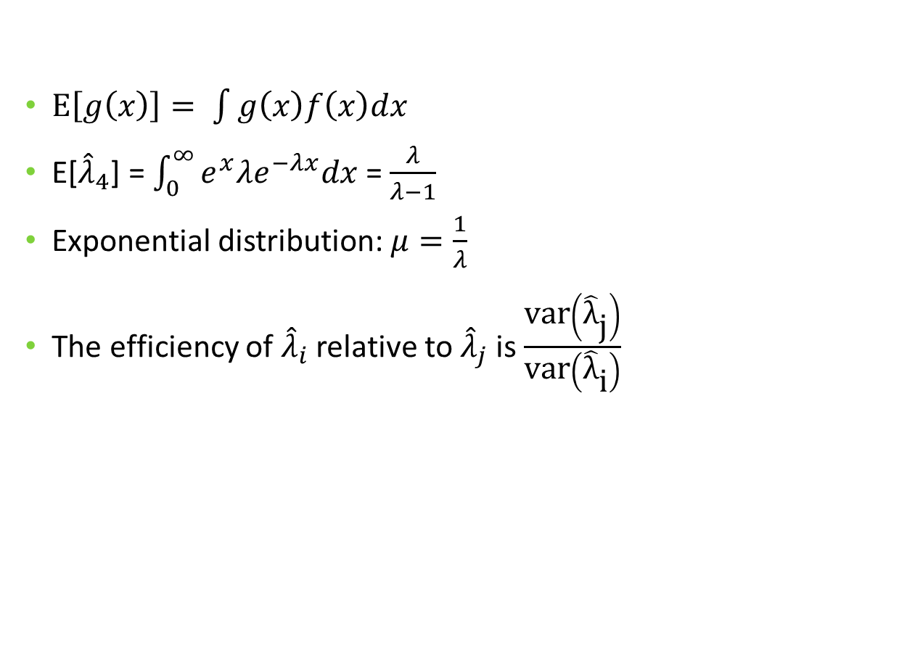
Q2
$\text{E}\left[g\left(x\right)\right]= \int{g\left(x\right)f\left(x\right)dx}$
E[${\hat{λ}}_{4}$] = $\int_{0}^{∞}{e^{x}λe^{−λx}dx}$ = $\frac{λ}{λ−1}$
Exponential distribution: $μ=\frac{1}{λ}$
The efficiency of ${\hat{λ}}_{i}$ relative to ${\hat{λ}}_{j}$ is $\frac{\text{var}\left({\hat{\text{λ}}}_{\text{j}}\right)}{\text{var}\left({\hat{\text{λ}}}_{\text{i}}\right)}$

Slide 3

Q3
a. T
  $μ±z\frac{σ}{\sqrt{n}}\sqrt{\frac{N−n}{N−1}}$, $\sqrt{\frac{N−n}{N−1}}$ is smaller when N get smaller
b. T
  $μ±z\frac{σ}{\sqrt{n}}$, z is larger when $1−α$ becomes larger,
  $z\frac{σ}{\sqrt{n}}$ is smaller when n becomes larger
c. T
d. F
  Only sample size matters

Slide 4
Q4
Different samples have different sample means
Constructing standard error, Use population standard deviation NOT sample standard deviation when population standard deviation is known.
  If population standard deviation is unknown => t distribution

Slide 5

Q5
Confidence level: $μ±z_{1−α}\frac{σ}{\sqrt{n}}\sqrt{\frac{N−n}{N−1}}$
  When population size is finite (n > 0.05N)

Slide 6
One more thing…
請用精確值, 計算過程中不要四捨五入

