Slide 1
Statistics
2012/12/26

Slide 2
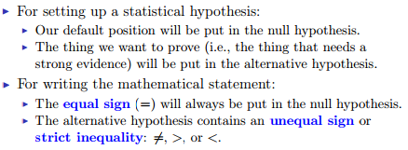
Writing Hypothesis

Slide 3
Writing Conclusion
1. compare p value (p) with significance level (α)
if p > α => not reject H₀
p < α => reject H₀
2. With significance level(α) there is enough/not enough
evidence to reject null hypothesis
3. The real conclusion! What we observe or what we should
do base on reject/not reject null hypothesis

Slide 4
Question 1
(a) Eating the product will/won’t harm one's health.
the amount of ingredient in the product is
larger/smaller than 5 mg
(b) Save money => Assume it is safe
(c) Protect customers => Assume it is not safe

Slide 5
Question 2
(b) Because we should make suggestions only if there is such a strong evidence, μ₁ > μ₂ should be put in the alternative hypothesis.

Slide 6

Question 3
(a) check if average willing-to-pay is larger than 60
(b) Pr($\overline{X}$ > 60 + d) = α
rejecting H₀ requires $\overline{X}$ to be much larger than 60

Slide 7
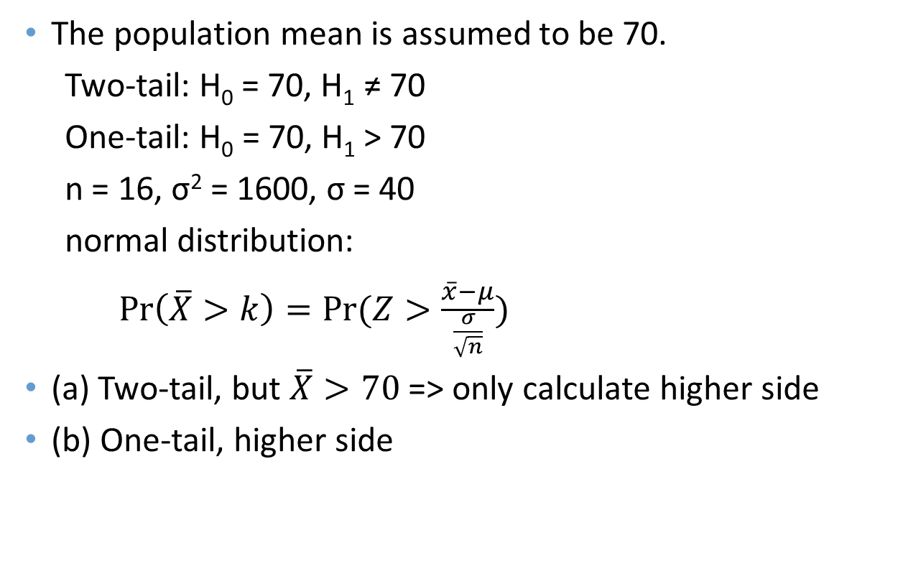
Question 4
The population mean is assumed to be 70.
Two-tail: H₀ = 70, H₁ ≠ 70
One-tail: H₀ = 70, H₁ > 70
n = 16, σ² = 1600, σ = 40
normal distribution:
$Pr\left(\overline{X}>k\right)=Pr⁡(Z>\frac{\overline{x}−μ}{\frac{σ}{\sqrt{n}}})$
(a) Two-tail, but $\overline{X}>70$ => only calculate higher side
(b) One-tail, higher side

Slide 8
Question 5
(a) significant level is determined
(b) p-value and significant are irrelevant
(d) p-value and critical values are irrelevant
(f) not reject H₀ ≠ H₀ is true
we just cannot prove it is wrong
(h) significance level is the probability of rejecting H₀
when H₀ is true. Pr(Type I error)
(i) significance level
(j) more possible to reject H₀, irrelevant to deviation

Slide 9
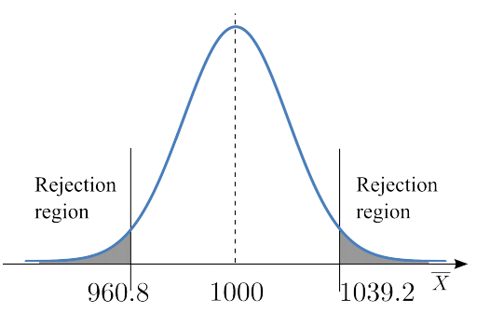
Question 6
(b)
d
d

Slide 10
Question 7
Probability increases when x decreases

