Slide 1
Algorithms
Homework Assignment #1
Wei-Hsien Chang

Slide 2
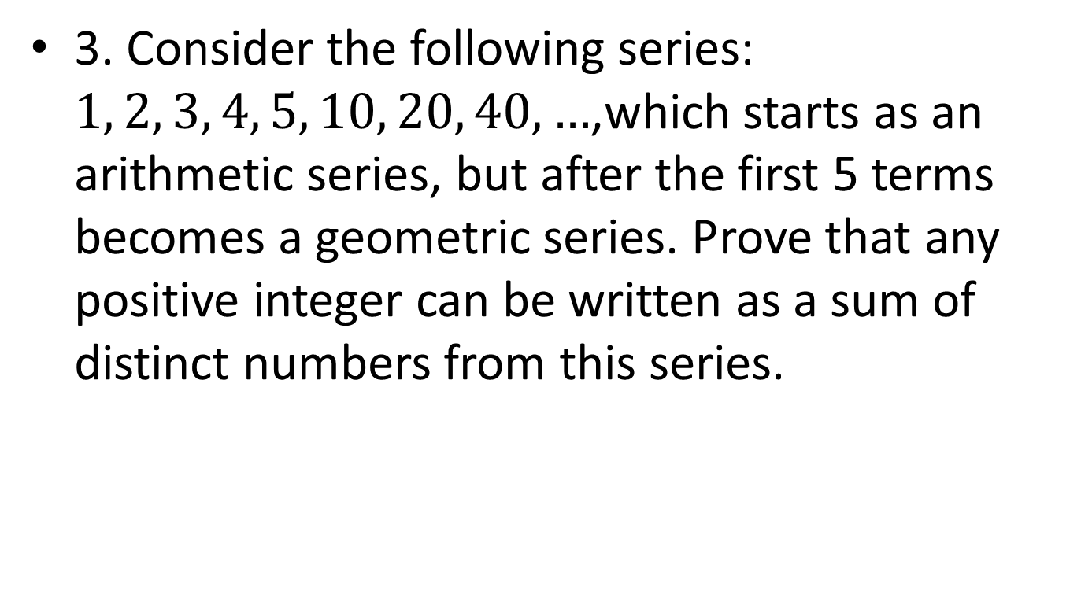
Problem 3
3. Consider the following series: $1, 2, 3, 4, 5, 10, 20, 40, …$,which starts as an arithmetic series, but after the first 5 terms becomes a geometric series. Prove that any positive integer can be written as a sum of distinct numbers from this series.

Slide 3
Problem 3 (cont.)
(Numbers < 10) and (Nmbers ≥ 10)
< 10
  1, 2, 3, 4, 5
  6, 7, 8, 9: (1, 2, 3, 4) + 5
≥ 10
  We have to prove the remain sequence S_{r}: 10, 20, 40, 80, … can compose to any positive number N multiplied by 10 (that is, number 10*N) with strong induction.

Slide 4
Base Case: N = 1, 10 is trivially proved.
N = 2, 20 is trivially proved.
Inductive Hypothesis: We assume that for all N s.t. 1<N<n can be summed up by some numbers of the sequence S_{r}.
Inductive Step: N = n
  When n is even(2k): Because k < n and no matter k is odd or even, we have the sum-up combination of k*10 (due to inductive hypothesis). For example, S_{k} = {a₁, a₂, …, a_{t}} are the subset of S_{r} that can sum up to k*10.
  There must exist a subset of S_{r} that can sum up to 2k*10, and the content of this subset is 2S_{k} = {2*a₁, 2*a₂, …, 2*a_{t}}. Because S_{r} is a geometric sequence with r=2, we know 2S_{k} will exist.
  When n is odd(2k+1): Because 2k < n, there exist a subset S_{k} from S_{r} that sum up to 10*2k. And we can observe that S_{k} will never contain “10” from S_{r.}
  So we can easily take “10” from S_{r} and add it into S_{k}. So that the new set will sum up to (2k+1)*10

Slide 5
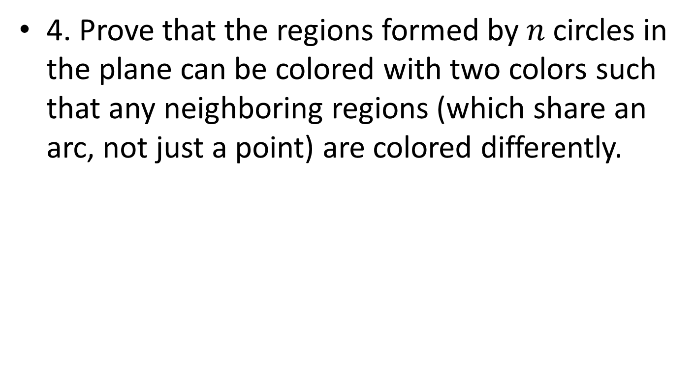
Problem 4
4. Prove that the regions formed by $n$ circles in the plane can be colored with two colors such that any neighboring regions (which share an arc, not just a point) are colored differently.

Slide 6
Problem 4 (cont.)
The proof is by Induction on the number (n) of circles
Base case: n=1, trivially proved
Induction Hypothesis: We assume that for all n s.t. 1<n<k, n circles can be colored as requirement.
Inductive Step: n=k (k>1)
  We call the graph with k circles G.

Slide 7
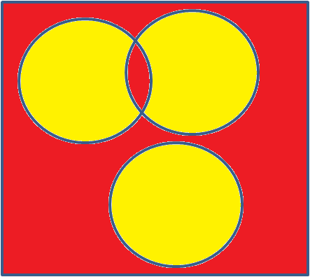
  Now we randomly remove 1 circle from G, get the remaining (k-1) circles, called G’.
  Because G’ has less than k circles, we can color it due to the induction hypothesis.
Notes:
Remove circle先不要著色

Slide 8
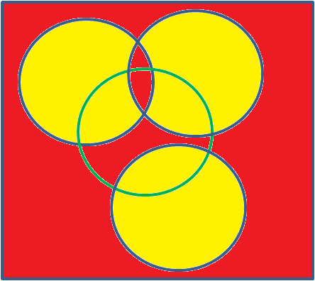
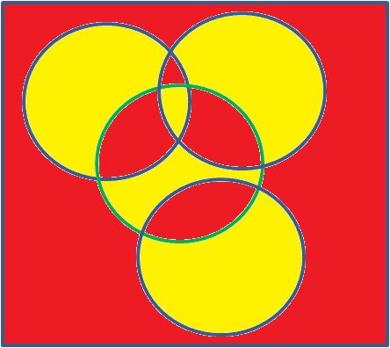
  Now we put the removed circle back, and we can notice several part of colored G’ has been covered.
  To meet the requirement, we flip the colors of the regions inside the circle.
The regions of G’ outside the circle need meet the requirement
The regions inside the circle meet the requirement.
The regions that share an arc on the circle are different color because they are in the same color in G’ and we flip one of them afterwards.
So G meets the requirement. We can prove it by induction.

