Slide 1
Algorithms
Homework Assignment #2
Jui-Shun Lai, Wei-Hsien Chang

Slide 2
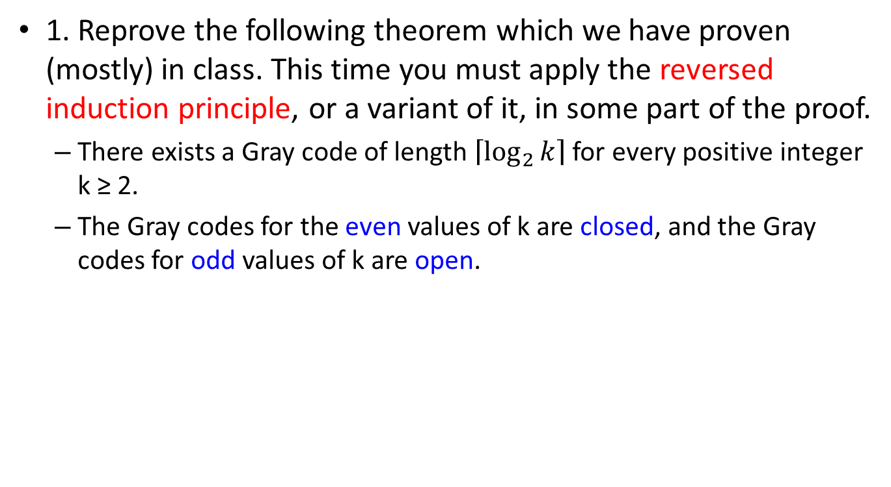
Problem 1
1. Reprove the following theorem which we have proven (mostly) in class. This time you must apply the reversed induction principle, or a variant of it, in some part of the proof.
  There exists a Gray code of length $\left\lceil \log_{2}{k}\right\rceil$ for every positive integer k ≥ 2.
  The Gray codes for the even values of k are closed, and the Gray codes for odd values of k are open.

Slide 3
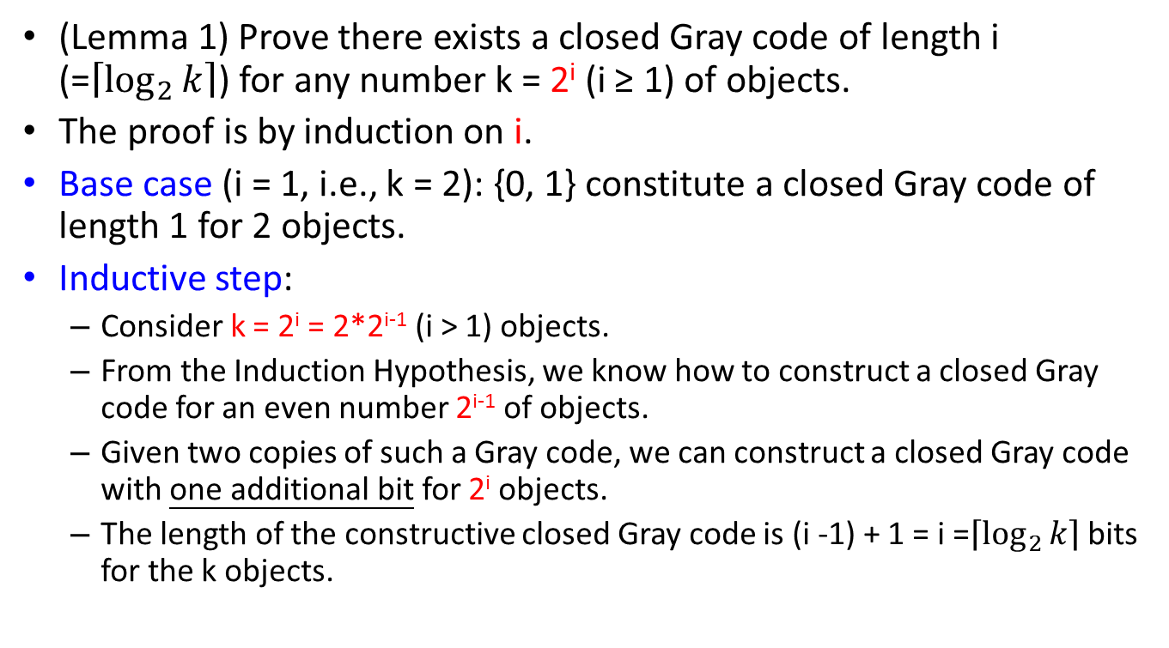
Problem 1 (cont.)
(Lemma 1) Prove there exists a closed Gray code of length i (=$\left\lceil \log_{2}{k}\right\rceil$) for any number k = 2^{i} (i ≥ 1) of objects.
The proof is by induction on i.
Base case (i = 1, i.e., k = 2): {0, 1} constitute a closed Gray code of length 1 for 2 objects.
Inductive step:
  Consider k = 2^{i} = 2*2^{i-1} (i > 1) objects.
  From the Induction Hypothesis, we know how to construct a closed Gray code for an even number 2^{i-1} of objects.
  Given two copies of such a Gray code, we can construct a closed Gray code with one additional bit for 2^{i} objects.
  The length of the constructive closed Gray code is (i -1) + 1 = i =$\left\lceil \log_{2}{k}\right\rceil$ bits for the k objects.
Notes:
給一偶數k個object的Gray code，增加1 bit 長度便可建2k個object的Gray code

Slide 4
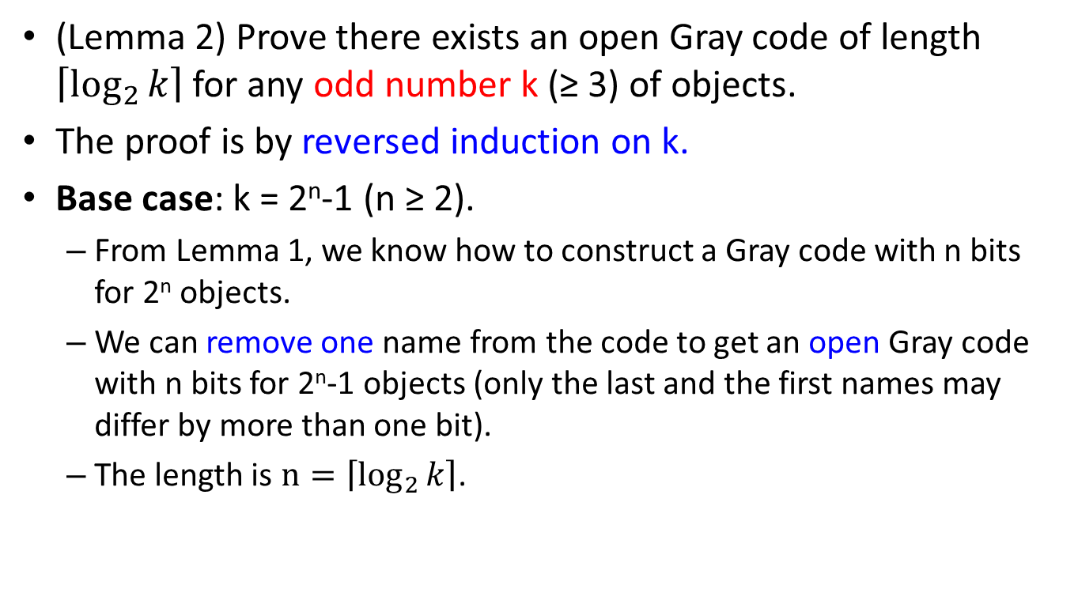
Problem 1 (cont.)
(Lemma 2) Prove there exists an open Gray code of length $\left\lceil \log_{2}{k}\right\rceil$ for any odd number k (≥ 3) of objects.
The proof is by reversed induction on k.
Base case: k = 2^{n}-1 (n ≥ 2).
  From Lemma 1, we know how to construct a Gray code with n bits for 2^{n} objects.
  We can remove one name from the code to get an open Gray code with n bits for 2^{n}-1 objects (only the last and the first names may differ by more than one bit).
  The length is $n=\left\lceil \log_{2}{k}\right\rceil$.

Slide 5
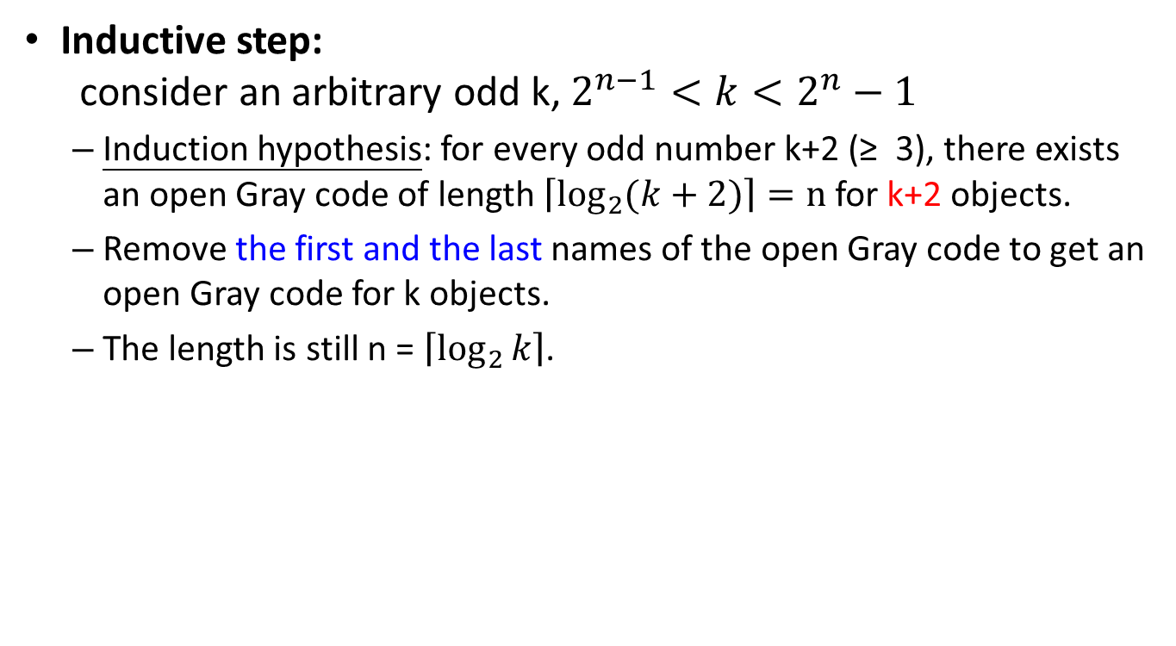
Problem 1 (cont.)
Inductive step:
consider an arbitrary odd k, $2^{n−1}<k<2^{n}−1$
  Induction hypothesis: for every odd number k+2 (≥ 3), there exists an open Gray code of length $\left\lceil \log_{2}{(k+2)}\right\rceil =n$ for k+2 objects.
  Remove the first and the last names of the open Gray code to get an open Gray code for k objects.
  The length is still n = $\left\lceil \log_{2}{k}\right\rceil$.

Slide 6
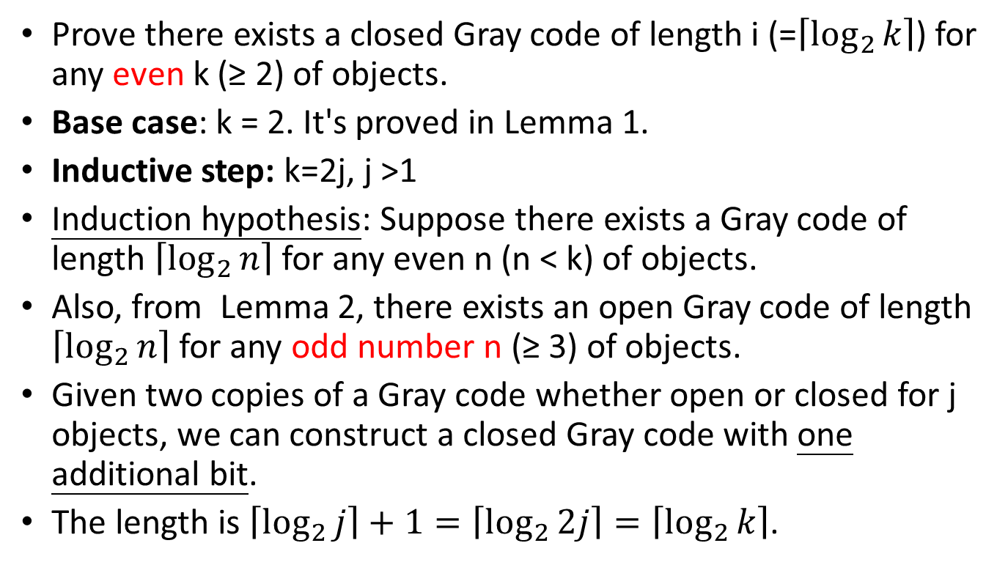
Problem 1 (cont.)
Prove there exists a closed Gray code of length i (=$\left\lceil \log_{2}{k}\right\rceil$) for any even k (≥ 2) of objects.
Base case: k = 2. It's proved in Lemma 1.
Inductive step: k=2j, j >1
Induction hypothesis: Suppose there exists a Gray code of length $\left\lceil \log_{2}{n}\right\rceil$ for any even n (n < k) of objects.
Also, from Lemma 2, there exists an open Gray code of length $\left\lceil \log_{2}{n}\right\rceil$ for any odd number n (≥ 3) of objects.
Given two copies of a Gray code whether open or closed for j objects, we can construct a closed Gray code with one additional bit.
The length is $\left\lceil \log_{2}{j}\right\rceil +1=\left\lceil \log_{2}{2j}\right\rceil =\left\lceil \log_{2}{k}\right\rceil$.
Notes:
Strong induction
對於所有小於n大於2的k個物件，Gray code長度是i

Slide 7
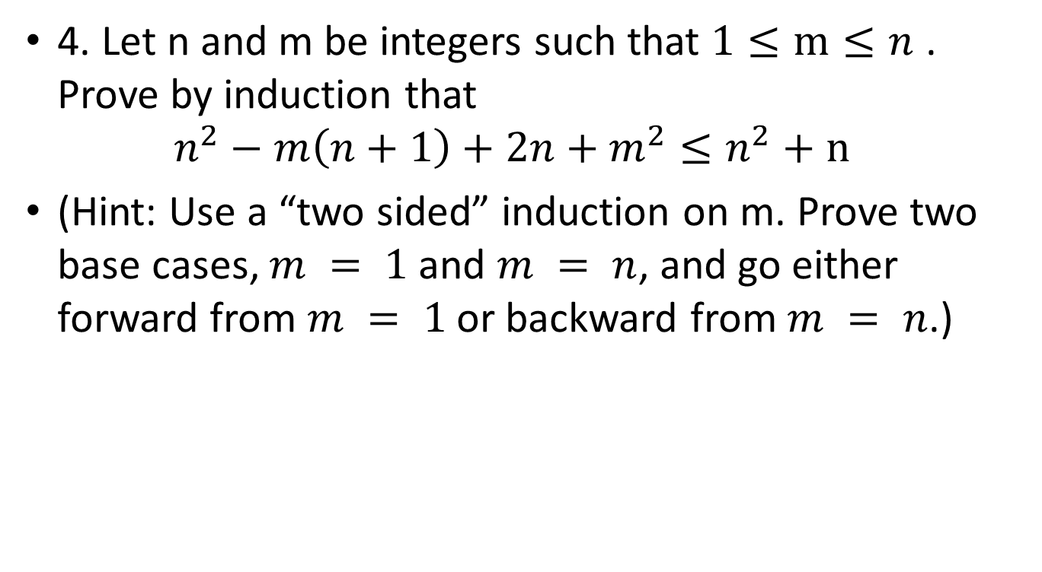
Problem 4
4. Let n and m be integers such that $1≤m≤n$ . Prove by induction that
$n^{2}−m\left(n+1\right)+2n+m^{2}≤n^{2}+n$
(Hint: Use a “two sided” induction on m. Prove two base cases, $m = 1$and $m = n$, and go either forward from $m = 1$or backward from $m = n$.)

Slide 8
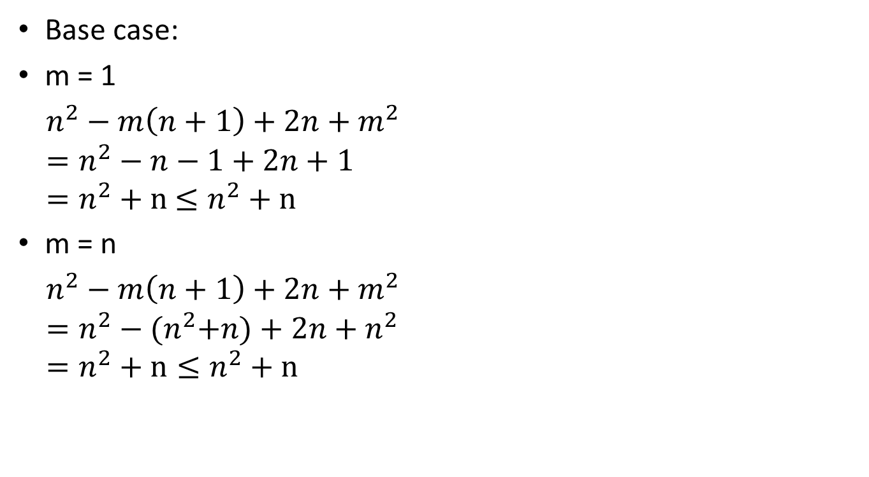
Problem 4 (cont.)
Base case:
m = 1
$n^{2}−m\left(n+1\right)+2n+m^{2}$
$=n^{2}−n−1+2n+1$
$=n^{2}+n$ $≤n^{2}+n$
m = n
$n^{2}−m\left(n+1\right)+2n+m^{2}$
$=n^{2}−{(n}^{2}+n)+2n+n^{2}$
$=n^{2}+n≤n^{2}+n$

Slide 9
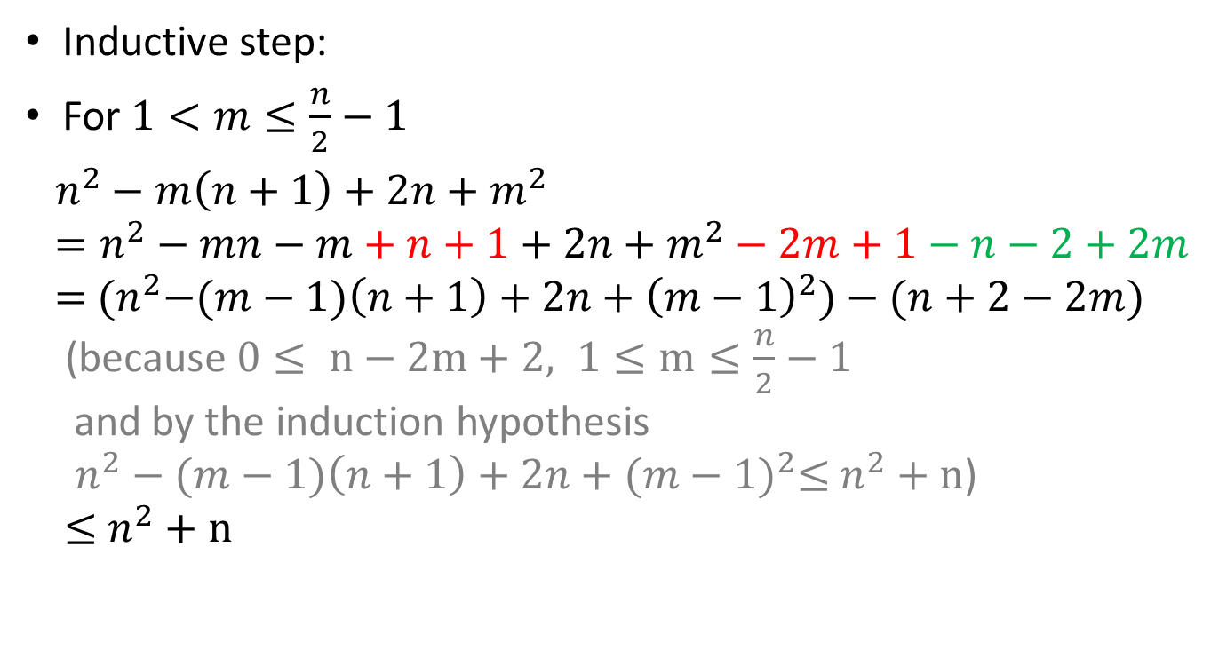
Problem 4 (cont.)
Inductive step:
For $1<m≤\frac{n}{2}−1$
$n^{2}−m\left(n+1\right)+2n+m^{2}$
$=n^{2}−mn−m+n+1+2n+m^{2}−2m+1−n−2+2m$
$=$ ${(n}^{2}−(m−1)\left(n+1\right)+2n+{\left(m−1\right)}^{2})−(n+2−2m)$
(because $0≤ n−2m+2, 1≤m≤\frac{n}{2}−1$
and by the induction hypothesis
$n^{2}−(m−1)\left(n+1\right)+2n+{(m−1)}^{2}≤$ $n^{2}+n$)
$≤$ $n^{2}+n$

Slide 10
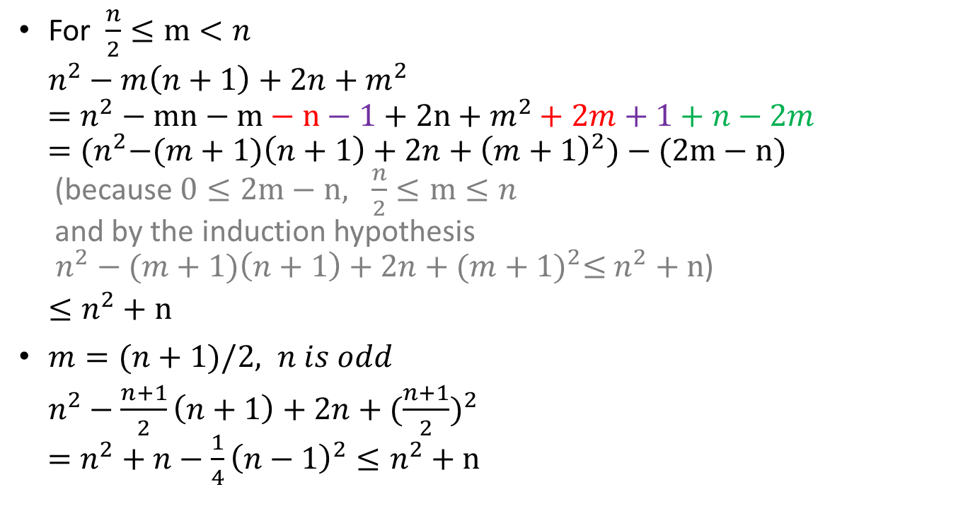
Problem 4 (cont.)
For $\frac{n}{2}≤m<n$
$n^{2}−m\left(n+1\right)+2n+m^{2}$
$=n^{2}−mn−m−n−1+2n+m^{2}+2m+1+n−2m$
$={(n}^{2}−(m+1)\left(n+1\right)+2n+{\left(m+1\right)}^{2})−(2m−n)$
(because $0≤2m−n, \frac{n}{2}≤m≤n$
and by the induction hypothesis
$n^{2}−(m+1)\left(n+1\right)+2n+{(m+1)}^{2}≤$ $n^{2}+n$)
$≤n^{2}+n$
$m=(n+1)/2, n is odd$
$n^{2}−\frac{n+1}{2}\left(n+1\right)+2n+({\frac{n+1}{2})}^{2}$
$=n^{2}+n−{\frac{1}{4}\left(n−1\right)}^{2}≤n^{2}+n$

Slide 11
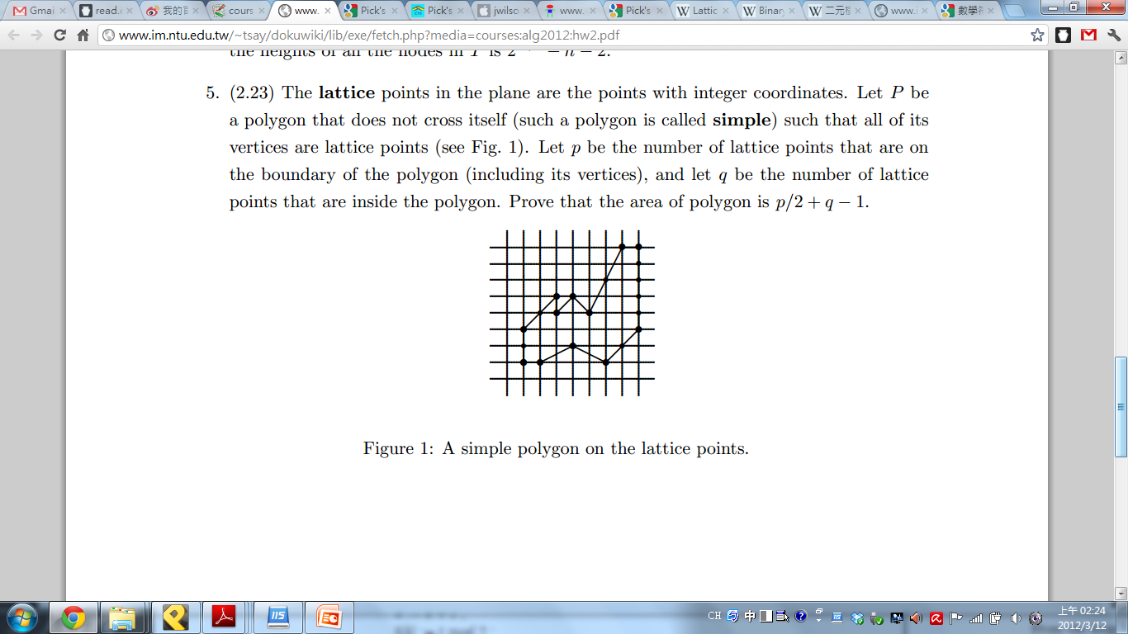
Problem 5
5. The lattice points in the plane are the points with integer coordinates.
  Let P be a polygon that does not cross itself (such a polygon is called simple) such that all of its vertices are lattice points (see Fig. 1).
  Let p be the number of lattice points that are on the boundary of the polygon (including its vertices),and
  let q be the number of lattice points that are inside the polygon.
  Prove that the area of polygon is p/2+q-1.

Slide 12
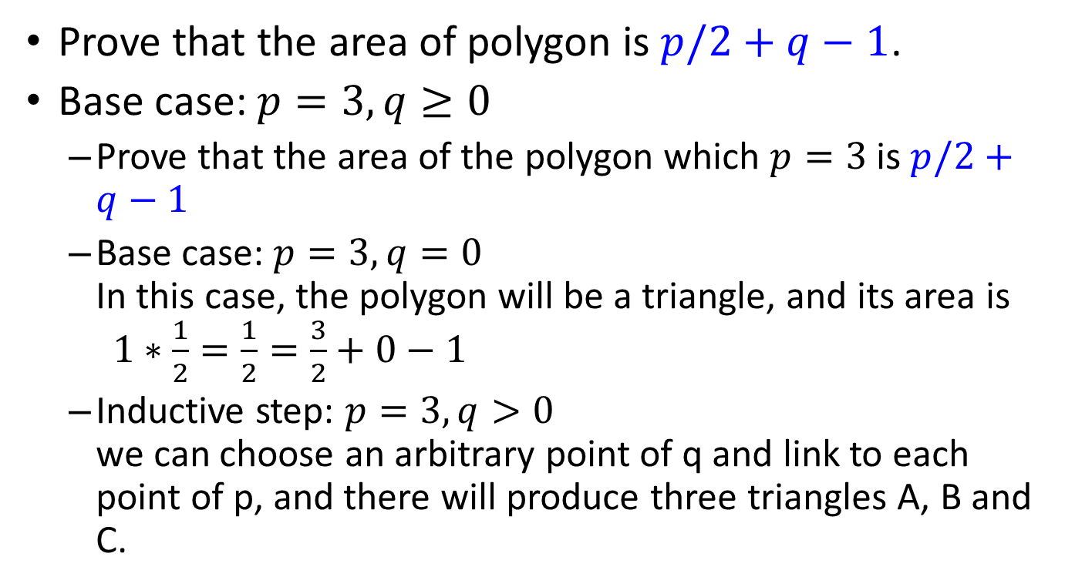
Problem 5 (cont.)
  Prove that the area of polygon is $p/2+q−1$.
Base case: $p=3, q≥0$
  Prove that the area of the polygon which $p=3$is $p/2+q−1$
  Base case: $p=3, q=0$
  In this case, the polygon will be a triangle, and its area is $1∗\frac{1}{2}=\frac{1}{2}=\frac{3}{2}+0−1$
  Inductive step: $p=3, q>0$
  we can choose an arbitrary point of q and link to each point of p, and there will produce three triangles A, B and C.

Slide 13
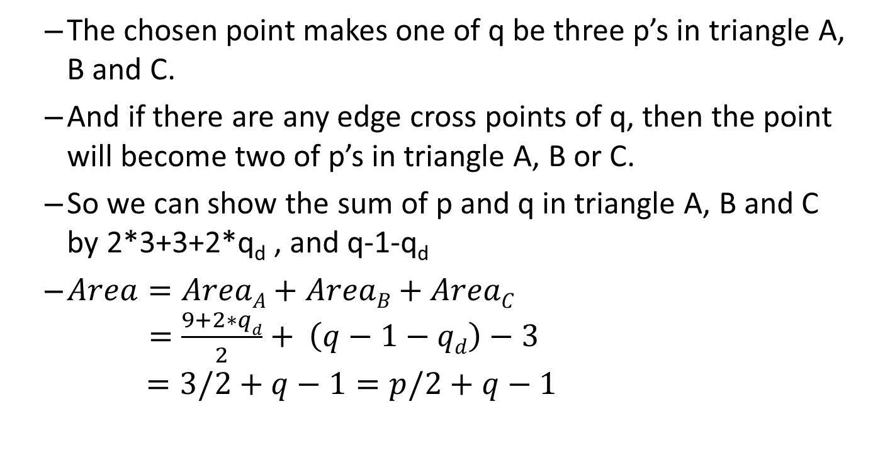
Problem 5 (cont.)
  The chosen point makes one of q be three p’s in triangle A, B and C.
  And if there are any edge cross points of q, then the point will become two of p’s in triangle A, B or C.
  So we can show the sum of p and q in triangle A, B and C by 2*3+3+2*q_{d} , and q-1-q_{d}
  $Area=AreaA+AreaB+AreaC$
  $=\frac{9+2∗qd}{2}+ \left(q−1−qd\right)−3$
  $=3/2+q−1=p/2+q−1$

Slide 14
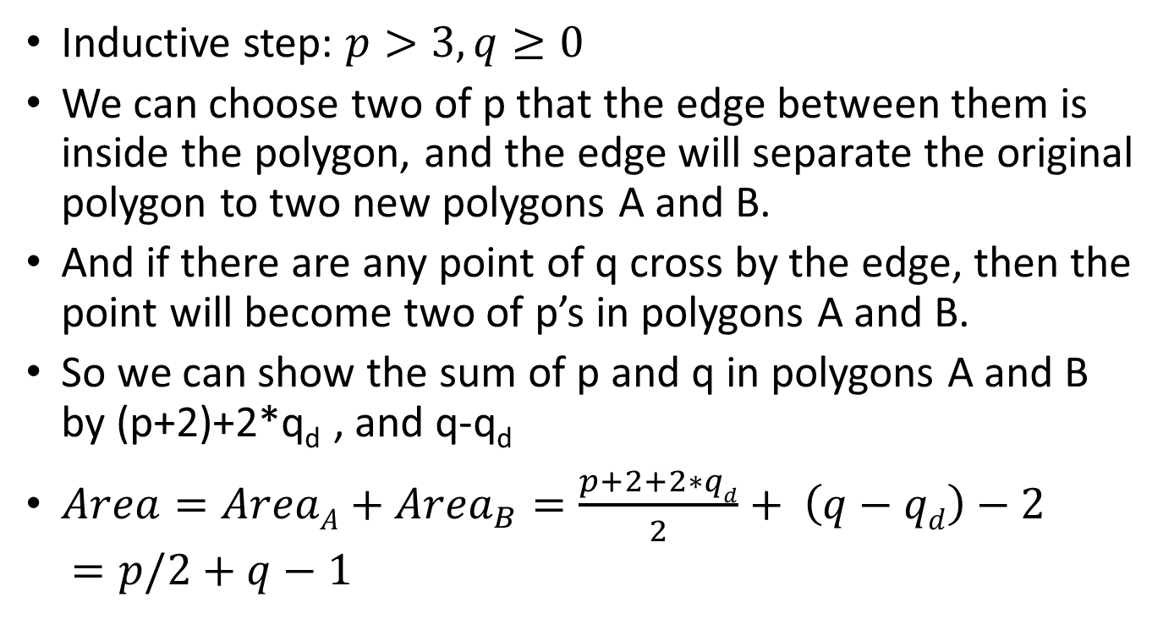
Problem 5 (cont.)
Inductive step: $p>3, q≥0$
We can choose two of p that the edge between them is inside the polygon, and the edge will separate the original polygon to two new polygons A and B.
And if there are any point of q cross by the edge, then the point will become two of p’s in polygons A and B.
So we can show the sum of p and q in polygons A and B by (p+2)+2*q_{d} , and q-q_{d}
$Area=AreaA+{Area}_{B}=\frac{p+2+2∗qd}{2}+ \left(q−qd\right)−2$
$=p/2+q−1$

