Slide 1
HW#3 solution
Jui-Shun Lai, Wei-Hsien Chang

Slide 2
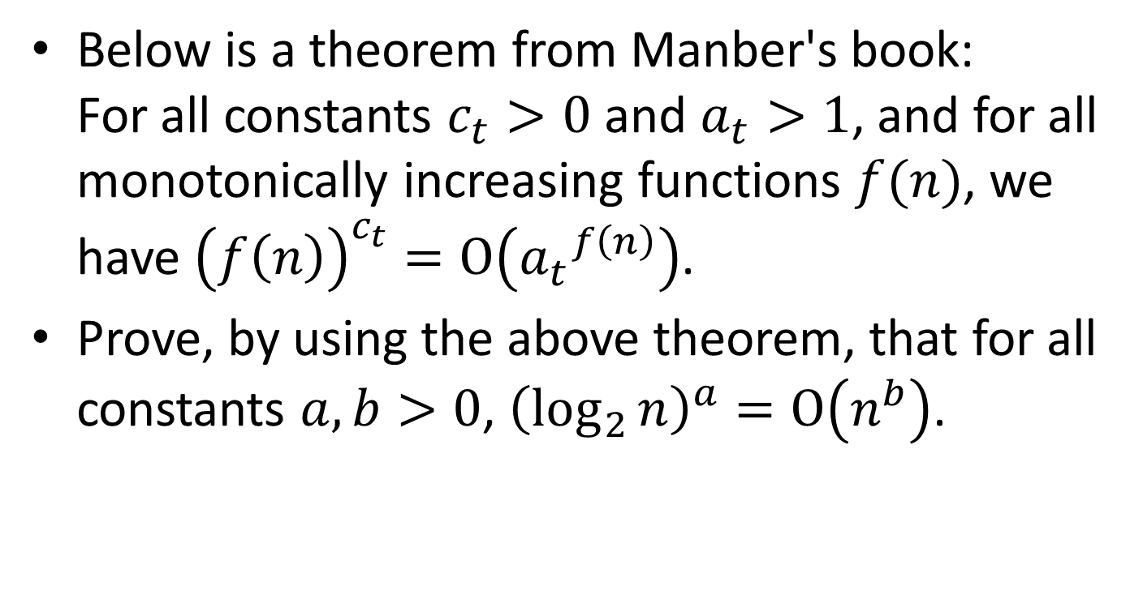
HW#3 Problem 1
Below is a theorem from Manber's book:
For all constants $c_{t}>0$ and $a_{t}>1$, and for all monotonically increasing functions $f(n)$, we have ${\left(f\left(n\right)\right)}^{c_{t}}=Ο\left({a_{t}}^{f\left(n\right)}\right)$.
Prove, by using the above theorem, that for all constants $a,b>0$, ${\left(\log_{2}{n}\right)}^{a}=Ο\left(n^{b}\right)$.

Slide 3
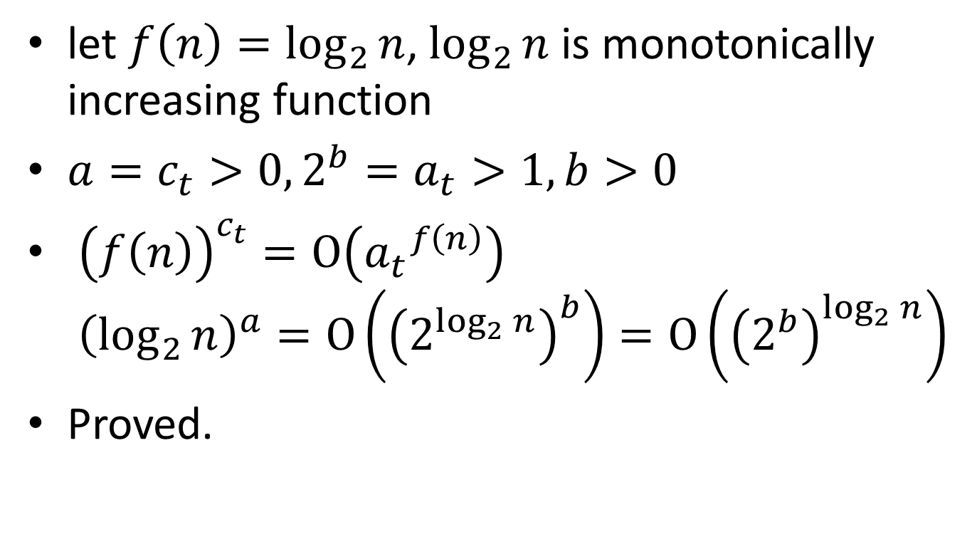
HW#3 Problem 1 (cont.)
let $f\left(n\right)=\log_{2}{n}$, $\log_{2}{n}$ is monotonically increasing function
${a=c}_{t}>0,{2^{b}=a}_{t}>1, b>0$
${\left(f\left(n\right)\right)}^{c_{t}}=Ο\left({a_{t}}^{f\left(n\right)}\right)$
${\left(\log_{2}{n}\right)}^{a}=Ο\left({\left(2^{\log_{2}{n}}\right)}^{b}\right)=Ο\left({\left(2^{b}\right)}^{\log_{2}{n}}\right)$
Proved.

Slide 4
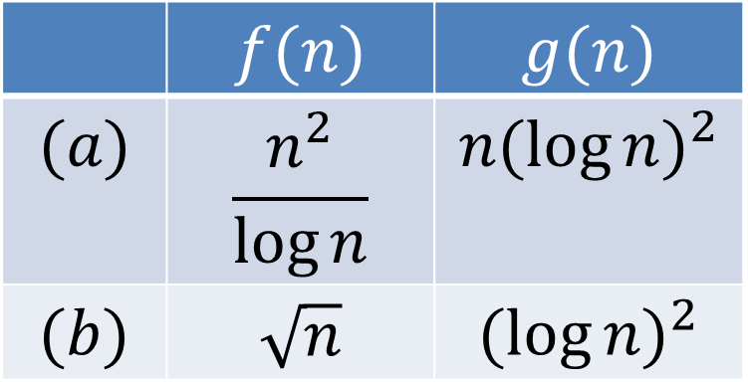
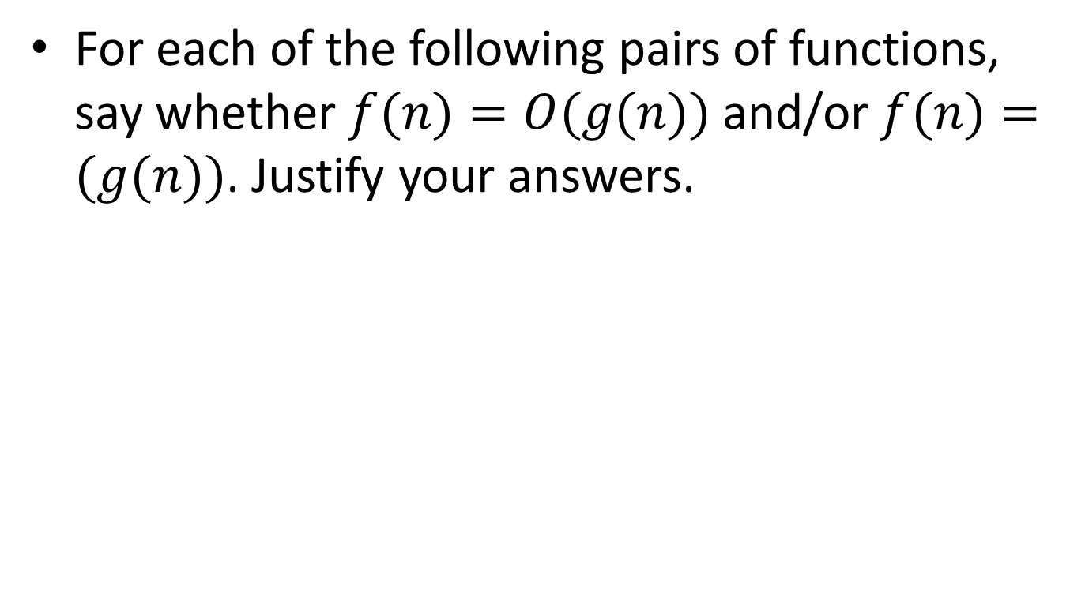
HW#3 Problem 2
For each of the following pairs of functions, say whether $f(n)=O(g(n))$and/or $f(n)=(g(n))$. Justify your answers.
 | $$f(n)$$ | $$g(n)$$
$$(a)$$ | $$\frac{n^{2}}{\log{n}}$$ | $$n{(\log{n})}^{2}$$
$$(b)$$ | $$\sqrt{n}$$ | $${(\log{n})}^{2}$$

Slide 5

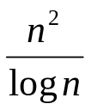
HW#3 Problem 2 (cont.)
You may use 2 or 10 as the base of log n
  Here we use
f(n) = ≧ c*g(n) = c*n*(log n)²
(2^{2x}/x) ≧ c * 2^{x} * x²
2x – log x ≧ log c + x + 2log x
x – 3logx – log c ≧ 0
x = log n
So, for c = 1, x ≧ 10(n ≧2¹⁰), f(n) ≧ c*g(n)
→ f(n) = Ω(g(n))
Notes:
n0常常找錯?
10為底則永遠對(希望將來都以2為底)，但希望可以轉成看得出來會對的樣子而非寫出一個c和n0就說證明了

Slide 6
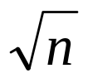
HW#3 Problem 2 (cont.)
(b) f(n) = ≧ c * g(n) = c * (log n)²
2^{x/2} ≧ c * x²
x/2 ≧ log c + 2log x
x = log n
So, for c = 1, x ≧ 16 (n ≧2¹⁶), f(n) ≦ c*g(n)
→ f(n) = O(g(n))
Notes:
都可以由Q1來解

Slide 7

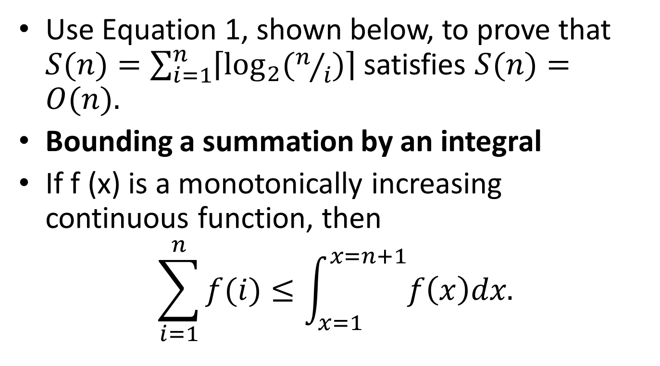
HW#3 Problem 5
Use Equation 1, shown below, to prove that $S(n)=\sum_{i=1}^{n}{\left\lceil \log_{2}{(n/i)}\right\rceil }$satisfies $S(n)=O(n).$
Bounding a summation by an integral
If f (x) is a monotonically increasing continuous function, then
$$\sum_{i=1}^{n}{f(i)≤\int_{x=1}^{x=n+1}{f\left(x\right)dx.}}$$
$$(1)$$

Slide 8
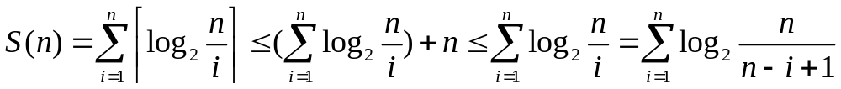
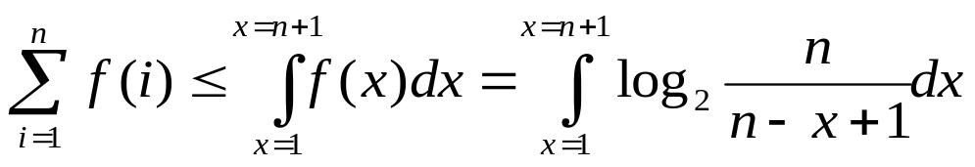
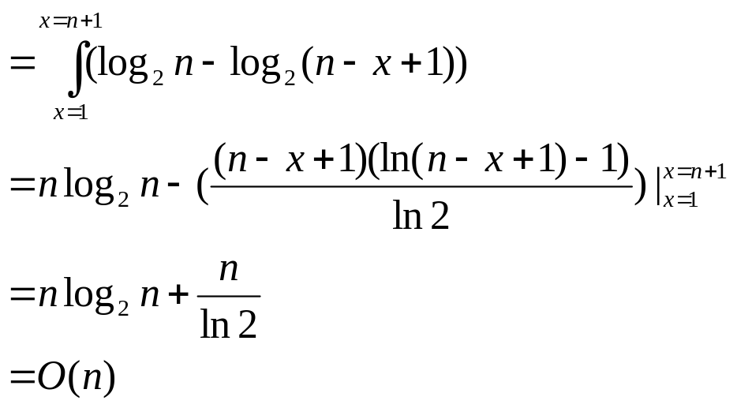
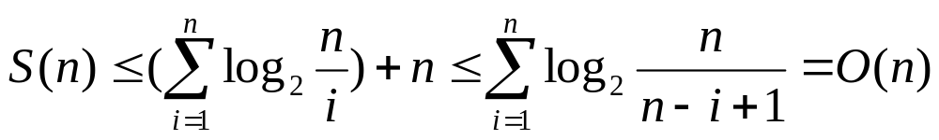
HW#3 Problem 5 (cont.)
f(n)
S(n) = O(n)
Notes:
高斯符號要記得帶掉 (2 pt)
log(n/i)非嚴格遞增方程式 (6 pt)
→ 高斯符號不帶掉的話，可以直接套E1(是嚴格遞增)，進去後再帶掉高斯符號亦可
積分方法 (10 pt)
結論 (2 pt)

