Slide 1
Algorithms
Homework Assignment #6
Jui-Shun Lai, Wei-Hsien Chang

Slide 2
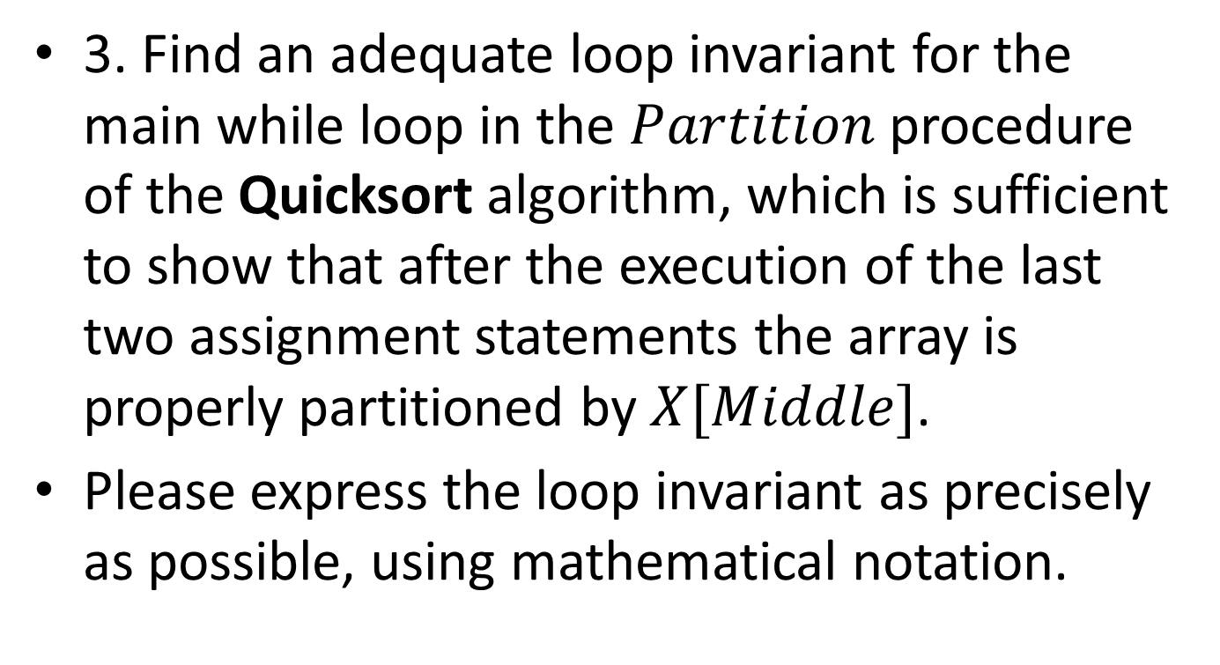
Problem 3
3. Find an adequate loop invariant for the main while loop in the $Partition$ procedure of the Quicksort algorithm, which is sufficient to show that after the execution of the last two assignment statements the array is properly partitioned by $X[Middle]$.
Please express the loop invariant as precisely as possible, using mathematical notation.

Slide 3


Problem 3 (cont.)
pivot := X[Left] ;
L := Left ; R := Right ;
while L < R do
while X[L] ≤ pivot and L ≤ Right do L := L + 1 ;
while X[R] > pivot and R ≥ Left do R := R-1 ;
if L < R then swap(X[L], X[R]) ;
(pivot = X[Left])
i (Left ≤ i < L → X[i] ≤ pivot)
j (R < j ≤ Right → pivot < X[j])
(Left ≤ L ≤ Right +1) (Left ≤ R ≤ Right)
((L ≥ R) → (L – 1 = R))

Slide 4

Problem 3 (cont.)
This loop invariant is maintained before and after every iteration of the loop. Note that the inequalities i < L and R < j in the second and third conjuncts are strict. After the while loop terminates with L ≥ R and the following two statements are executed, we can conclude:
which is the (post-)condition desired of the Partition algorithm, indicating that the algorithm is indeed correct.
pivot = X[Middle]
i (Left ≤ i ≤ Middle → X[i] ≤ pivot)
j (Middle < j ≤ Right → pivot < X[j])
Notes:
This is so because when the condition L < R does not hold, the statement swap(X[L], X[R]) will not be performed.

Slide 5
Problem 5
Prove that the sum of the heights of all nodes in a complete binary tree with n nodes is at most n-1.
Let G(n) denote the sum of the heights of all nodes in a complete binary tree with n nodes. For a full binary tree (a special case of complete binary trees) with n = 2^{h+1} - 1 nodes where h is the height of the tree, we already know that G(n) = 2^{h+1} - (h + 2) = n - (h + 1) ≤ n - 1. With this as a basis, we prove the general case of arbitrary complete binary trees by induction on the number n (≥ 1) of nodes.
Base Case(n = 1 or n = 2):
  Trivially proved
Notes:
G(n)公式可用induction證明

Slide 6
Problem 5 (cont.)
Inductive Step(n > 2):
If n = 2^{h+1} – 1 for some h > 1, the tree is full and we are done.
Otherwise, we say 2^{h+1} – 1 < n < 2^{h+2} – 1 and the tree is complete with height h+1 > 2. And we observe that at least one subtree of the root will be full and the other one is either full or complete.
There will be three cases:
  Left subtree is full and right subtree is complete (both height = h)
  Both Left and right subtree are full (h_{L} = h and h_{R} = h-1)
  Right subtree is full and left subtree is complete (h_{L} = h and h_{R} = h-1)
h
Notes:
對於full者以其高度套已知公式，對於complete者以其高度套induction hypothesis(<= n-1)
→ 新加的點(root)最後加入，高度為h+1
→ 全部height相加 <= (n-1)即得證

Slide 7
Problem 5 (cont.)
Then we can prove it by applying the formula in the beginning and induction hypothesis.
  For example:
    Let left sub-tree T_{L} consists n_{L} nodes and right sub-tree T_{R} consists n_{R} nodes
    G(T) = G(T_{L}) + G(T_{R}) + (h+1)
    = G(T_{L}) + (n_{R}-((h-1)+1)) + (h+1) (T_{R} is full)
    ≦ (n_{L}-1) + (n_{R}-h) + (h+1) (induction hyp.)
    = (n_{L}+n_{R}+1)-1 (proved)
h

