Slide 1
Algorithms
Homework Assignment #8
Jui-Shun Lai, Wei-Hsien Chang

Slide 2
Problem 1
Consider the problem of finding balance factors in binary trees discussed in class (see slides for “Design by Induction”). Solve this problem using DFS. You need only to define preWORK and postWORK.
Notes:
balance factor: the difference between the height of the node’s left and right sub-trees (left-right)

Slide 3
Problem 1 (cont.)
preWORK
v.height := 0;
v.balance_factor := 0;
postWORK
v.height := MAX(v.height, w.height+1);
if w = v.leftchild then
v.balance_factor := v.balance_factor + (w.height+1);
else if w = v.rightchild then
v.balance_factor := v.balance_factor - (w.height+1);
Notes:
preWORK: 一個node v被traverse到並要標記前的前置動作
postWORK: DFS到底沒有路後，從node w回溯到node v時的動作

Slide 4
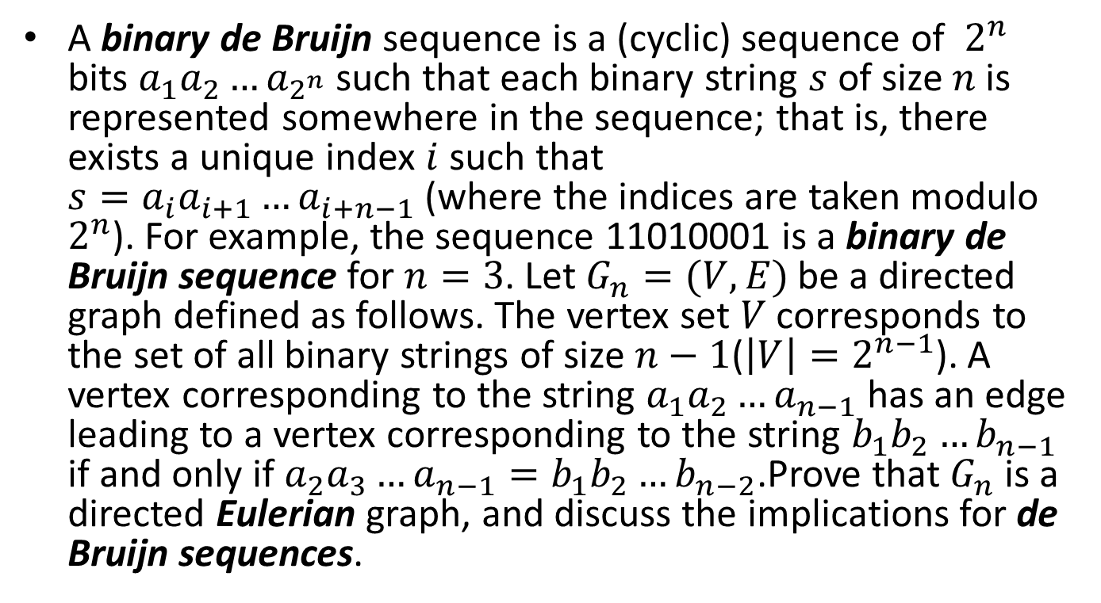
Problem 3
A binary de Bruijn sequence is a (cyclic) sequence of $2^{n}$ bits $a_{1}a_{2}{…a}_{2^{n}}$such that each binary string $s$ of size $n$is represented somewhere in the sequence; that is, there exists a unique index $i$ such that ${s=a}_{i}a_{i+1}{…a}_{i+n−1}$(where the indices are taken modulo $2^{n}$). For example, the sequence 11010001 is a binary de Bruijn sequence for $n=3$. Let $G_{n}=(V, E)$ be a directed graph defined as follows. The vertex set $V$ corresponds to the set of all binary strings of size $n−1$($\left|V\right|=2^{n−1}$). A vertex corresponding to the string $a_{1}a_{2}{…a}_{n−1}$ has an edge leading to a vertex corresponding to the string $b_{1}b_{2}{…b}_{n−1}$ if and only if $a_{2}a_{3}{…a}_{n−1}=b_{1}b_{2}{…b}_{n−2}$.Prove that $G_{n}$ is a directed Eulerian graph, and discuss the implications for de Bruijn sequences.

Slide 5
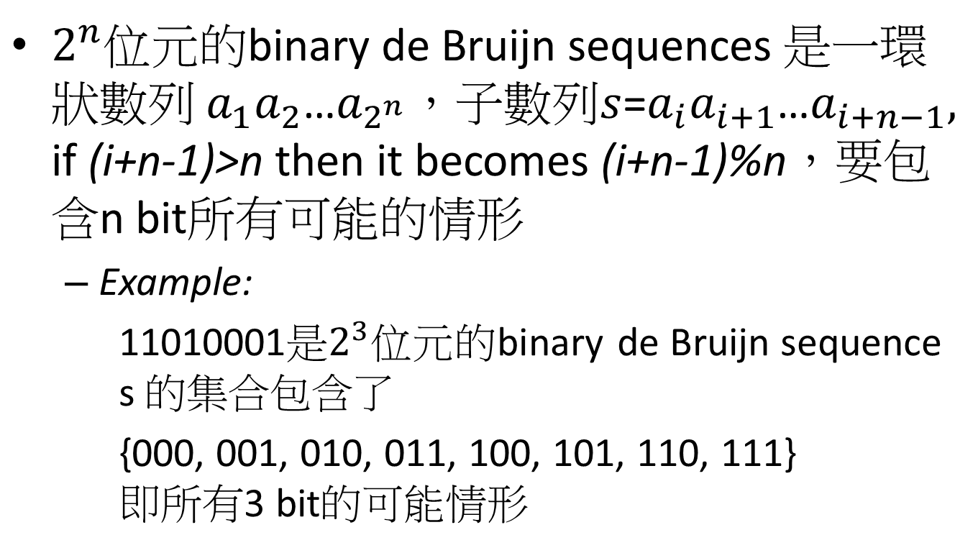
Problem 3 (cont.)
$2^{n}$位元的binary de Bruijn sequences 是一環狀數列 $a_{1}a_{2}$…$a_{2^{n}}$，子數列$s$=$a_{i}a_{i+1}$…$a_{i+n−1},$
if (i+n-1)>n then it becomes (i+n-1)%n，要包含n bit所有可能的情形
  Example:
  11010001是$2^{3}$位元的binary de Bruijn sequence
  s 的集合包含了
  {000, 001, 010, 011, 100, 101, 110, 111}
  即所有3 bit的可能情形

Slide 6
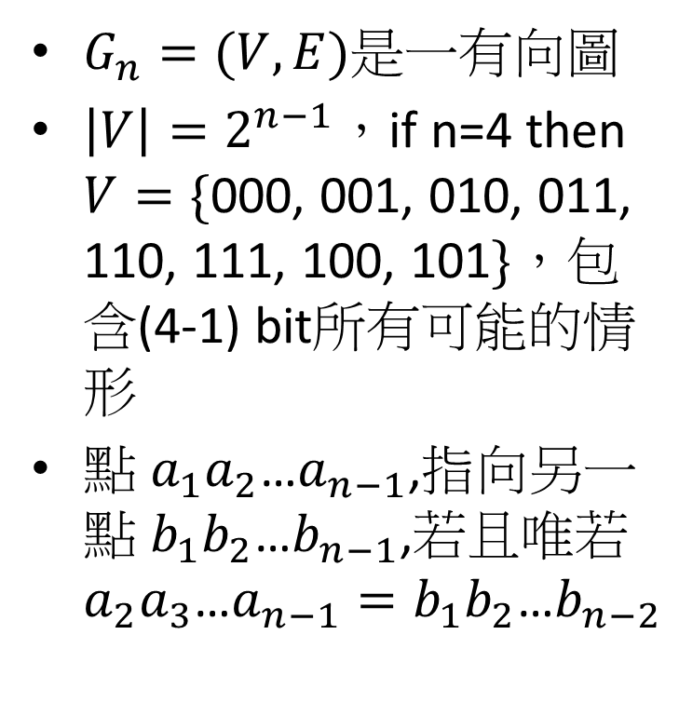
Problem 3 (cont.)
0
$G_{n}=(V, E)$是一有向圖
$\left|V\right|=2^{n−1}$，if n=4 then $V=\{$000, 001, 010, 011, 110, 111, 100, 101$\}$，包含(4-1) bit所有可能的情形
點 $a_{1}a_{2}$…$a_{n−1}$,指向另一點 $b_{1}b_{2}$…$b_{n−1}$,若且唯若$a_{2}a_{3}$…$a_{n−1}=b_{1}b_{2}$…$b_{n−2}$
000
0
1
100
1
001
0
010
0
0
1
1
1
101
1
1
110
011
0
0
1
111

Slide 7
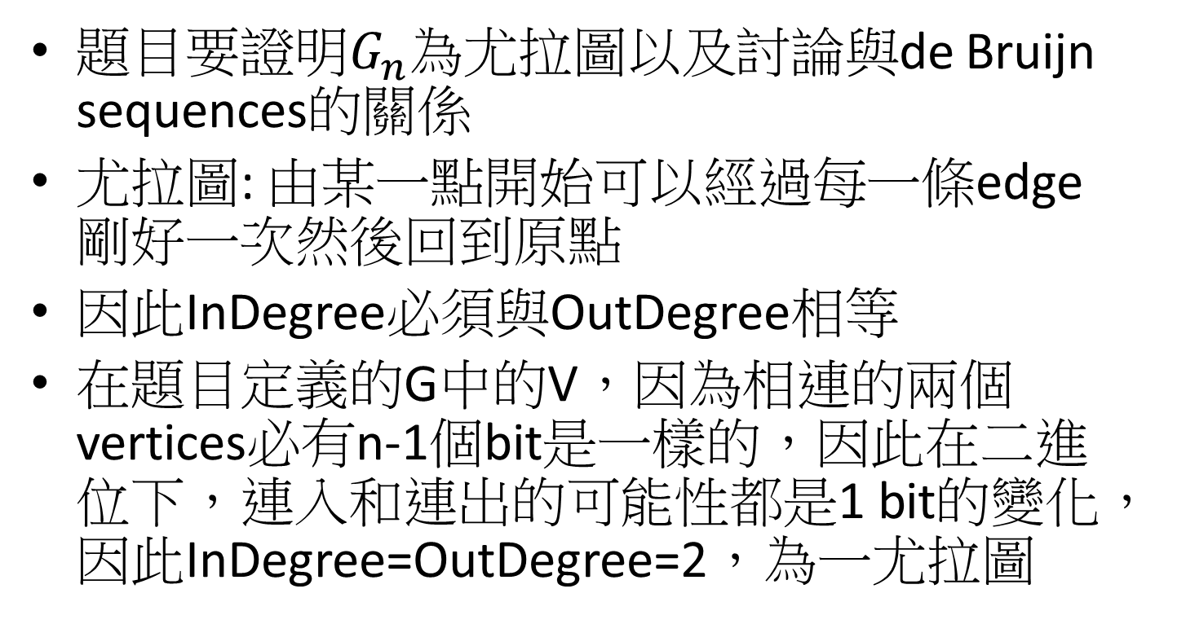
Problem 3 (cont.)
題目要證明$G_{n}$為尤拉圖以及討論與de Bruijn sequences的關係
尤拉圖: 由某一點開始可以經過每一條edge剛好一次然後回到原點
因此InDegree必須與OutDegree相等
在題目定義的G中的V，因為相連的兩個vertices必有n-1個bit是一樣的，因此在二進位下，連入和連出的可能性都是1 bit的變化，因此InDegree=OutDegree=2，為一尤拉圖

Slide 8
Problem 3 (cont.)
3bits de Bruijn sequences
每走過一個edge就納入後一個vertex的最後一個bit(該edge代表的變動bit)
  假設由00開始走: 00->00->01->11->11->10->01->10->00
得出的結果為:01110100, 長度為2^{n}
每個node中所含的數字會出現於走到該node的前兩個edge
  ex: “11” node, 01->11→11
而每個3bit的可能會由某node往下接二選一種edge得出
因此此sequences會包含所有3bits的可能性
0
00
01
1
1
0
0
1
10
11
0
1
n = 3

Slide 9
Problem 5
Given a directed acyclic graph G = (V,E), find a simple (directed) path in G that has the maximum number of edges among all simple paths in G. The algorithm should run in linear time.
Algorithm FindLongestPath(G)
Input: G = (V, E) (a directed acyclic graph)
Output: A Stack which records the longest path.
[length: the length of the path from a source vertex to the vertex which we are looking at, initial = 0]
Notes:
利用topological sort的方式traverse一個acyclic directed graph，同時每個node被traverse到時就更新目前到此node的最長路徑長度(length)
當traverse結束後，就可以再backward traverse回去記錄最長路徑

Slide 10
Problem 5 (cont.)
O(|V|+|E|)
begin
Initialize v.Indegree for every vertex v; //by DFS
for all vertices v in V do
if v.Indegree = 0 then put v in Queue; //begin of a path
repeat
remove vertex v from Queue;
for all edges (v, w) do
if v.length + 1 > w.length then //update the current longest path
w.length := v.length + 1;
w.pre := v;
w.Indegree := w.Indegree -1; //idea of topological sort
if w.Indegree = 0 then put w in Queue;
if Queue is empty then v_{path} := v; //used to get the whole path
until Queue is empty
put v_{path} on Stack;
while v_{path} has a predecessor do
put v_{path}.pre on Stack;
v_{path} := v_{path}.pre;
ouput: Stack
end
O(|V|)
O(|V| + |E|)
O(|V|)

