Slide 1
Algorithms
Homework Assignment #9
Jui-Shun Lai, Wei-Hsien Chang

Slide 2
Problem 1
Prove that if the costs of all edges in a given connected graph are distinct, then the graph has exactly one unique minimum-cost spanning tree.

Slide 3
Problem 1 (cont.)
Proof by contradiction
  Suppose there exists two minimum-cost spanning trees A and B.
  Sort by the cost of edge (e₁<e₂<…)
    A: {e₁, e₂, …} B: {e₁’, e₂’, …}
  Find the minimum of different cost edge e_{i} that e_{i} ≠ e_{i}’
  Assume e_{i} < e_{i}’, then B∪{e_{i}} will create a circle
  Find the maximum cost edge k in the circle
  Since all edge costs are distinct and k is the maximum cost edge in a cycle, k does not belong to any minimum spanning tree. So,
  k is in B → B is not minimum-cost spanning tree (Contradiction)

Slide 4
Problem 2
(a) Give an example of a weighted connected undirected graph G = (V, E) and a vertex v, such that the minimum-cost spanning tree of G is the same as the shortest-path tree rooted at v.
(b) Give an example of a weighted connected undirected graph G = (V, E) and a vertex v, such that the minimum-cost spanning tree of G is very different from the shortest path tree rooted at v. Can the two trees be completely disjoint?

Slide 5
Problem 2 (cont.)
(b) No, it is impossible that the two trees are completely disjointed.
Let T_{m} denote the minimum cost spanning tree of G
T_{s} be the shortest path tree rooted at v.
  v has only one edge
  The only edge must be both in T_{m} and in T_{s}.
  Otherwise v will be disconnected from T_{m} and from T_{s}
  v has more than one edge
Let (v, u) be the minimum weighted edge among all edges of v.
Then (v, u) must belong to both T_{m} and T_{s}.
  If (v, u) is not in T_{m}, T_{m} must include some other edge (v, w).
  But by replacing (v, w) with (v, u) in T_{m} => a new tree with lower weight
  If (v, u) is not in T_{s}, the shortest path π from v to u must include some other edge (v, w), but the edge (v, u) is shorter than π
Notes:
問題: 所有路徑cost一樣?

Slide 6
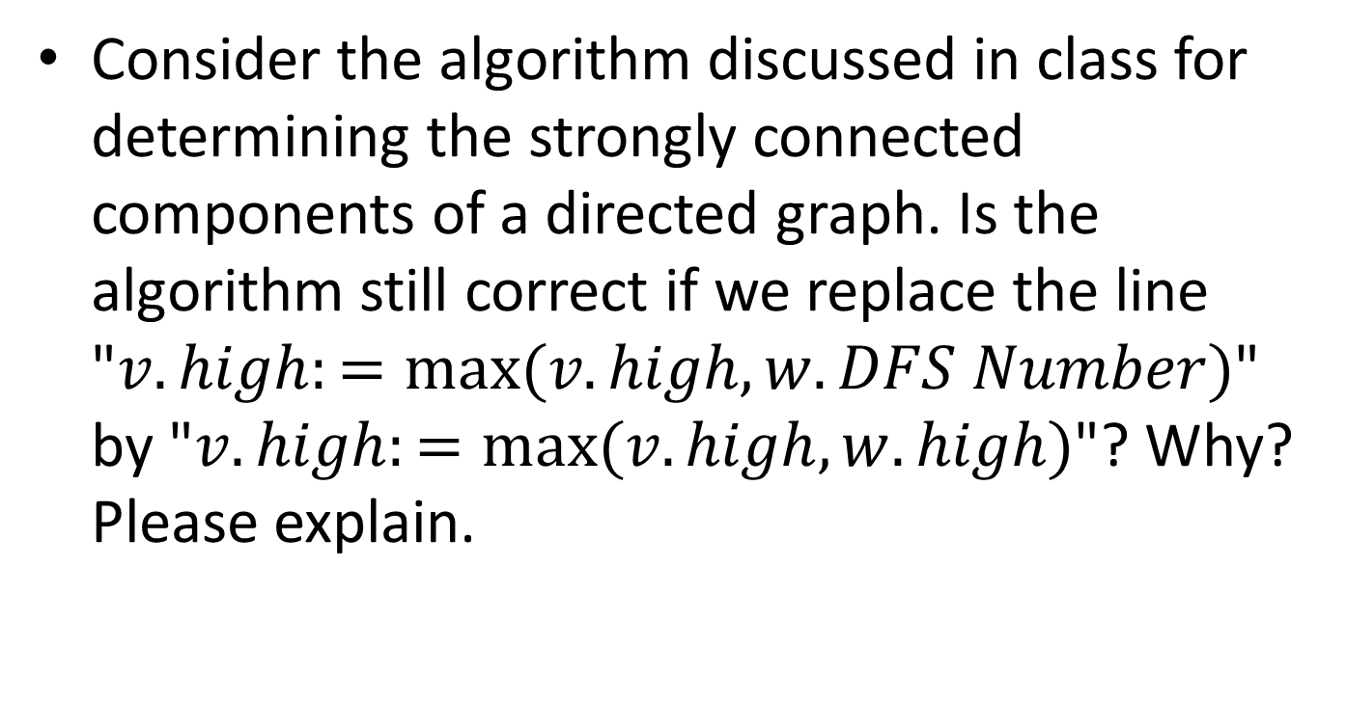
Problem 3
Consider the algorithm discussed in class for determining the strongly connected components of a directed graph. Is the algorithm still correct if we replace the line "$v.high:=max⁡(v.high, w.DFS Number)$" by "$v.high:=max⁡(v.high, w.high)$"? Why? Please explain.

Slide 7
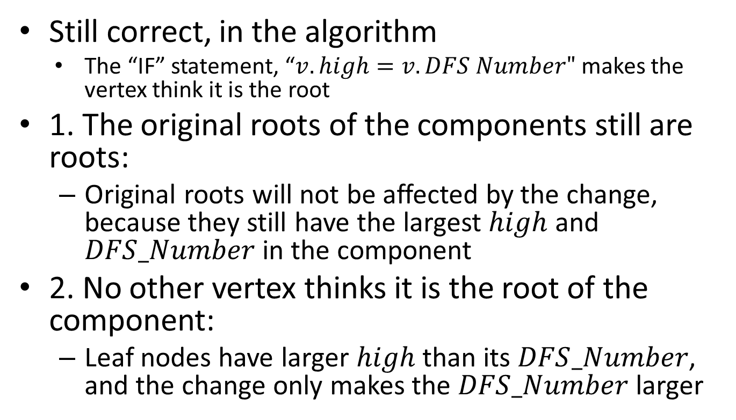
Problem 3 (cont.)
Still correct, in the algorithm
    The “IF” statement, “$v.high=v.DFS Number"$ makes the vertex think it is the root
1. The original roots of the components still are roots:
  Original roots will not be affected by the change, because they still have the largest $high$ and $DFS_Number$ in the component
2. No other vertex thinks it is the root of the component:
  Leaf nodes have larger $high$ than its $DFS_Number$, and the change only makes the $DFS_Number$ larger

Slide 8
Problem 5
Let G = (V, E) be a directed graph, and let T be a DFS tree of G.
Prove that the intersection of
  the edges of T
  the edges of any strongly connected component of G
  form a subtree of T

Slide 9
Problem 5 (cont.)
)
Proof by contradiction
  Suppose the intersection are two subtrees (T1, T2).
  Because T1 and T2 are strongly connected component , there is a cross edge from T1 to T2
  However, if DFS starts from T1, it will go through the unmarked vertexes in T2
  ) T1 and T2 will be in the same subtree
  (Contradiction)
T1
T2
Notes:
隱藏

