Slide 1
Algorithms HW#3
Solution
李孟、施舜元
2014

Slide 2
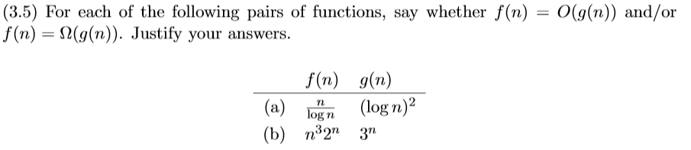
HW#3 Problem 2

Slide 3
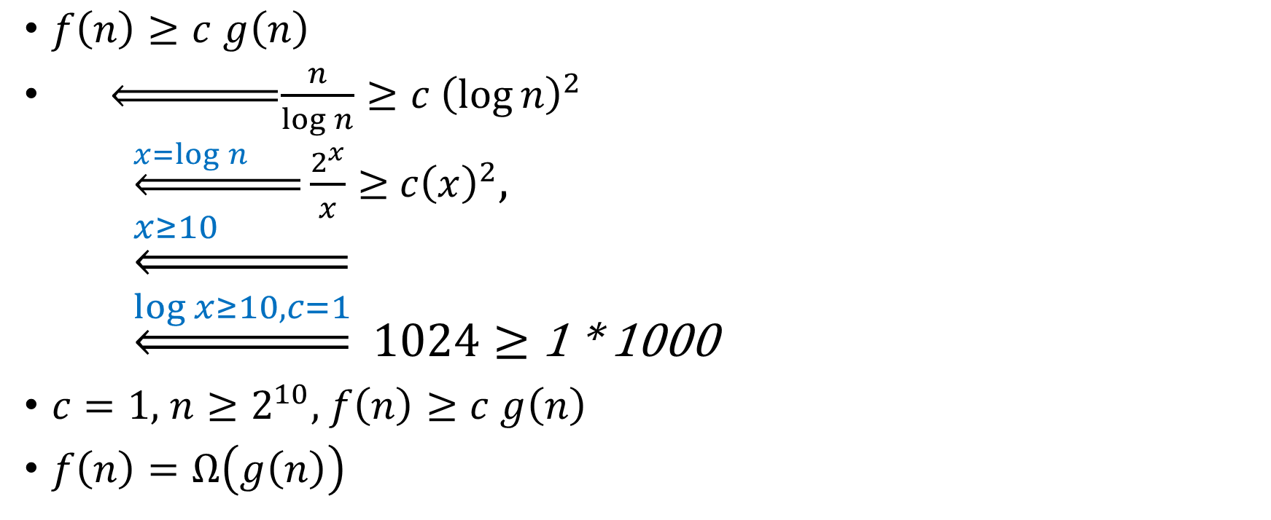

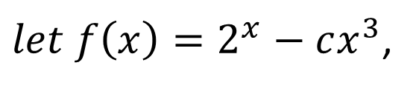

HW#3 Problem 2(a)
$f\left(n\right)≥c$ $g\left(n\right)$
$\underset{⇐}{ }\frac{n}{\log{n}}≥c{ \left(\log{n}\right)}^{2{}}$
    $\underset{⇐}{x=\log{n} }\frac{2^{x}}{x}≥{ c\left(x\right)}^{2}$,
    $$\underset{⇐}{x≥10 }$$
    $\underset{⇐}{\log{x≥10,c=1}}$ $1024≥$ 1 * 1000
$c=1,$ $n≥2^{10},$ $f\left(n\right)≥c$ $g\left(n\right)$
$f\left(n\right)=Ω\left(g\left(n\right)\right)$
$$2^{x}≥c⋅x^{3}$$
$let f\left(x\right)=2^{x}−cx^{3}$,
$$f\left(x\right),f^{′}\left(x\right),f^{′′}\left(x\right)>0$$
Notes:
Log沒寫底是2

Slide 4

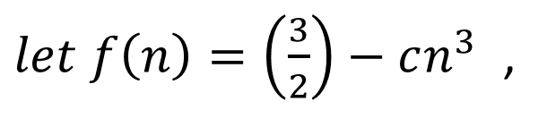
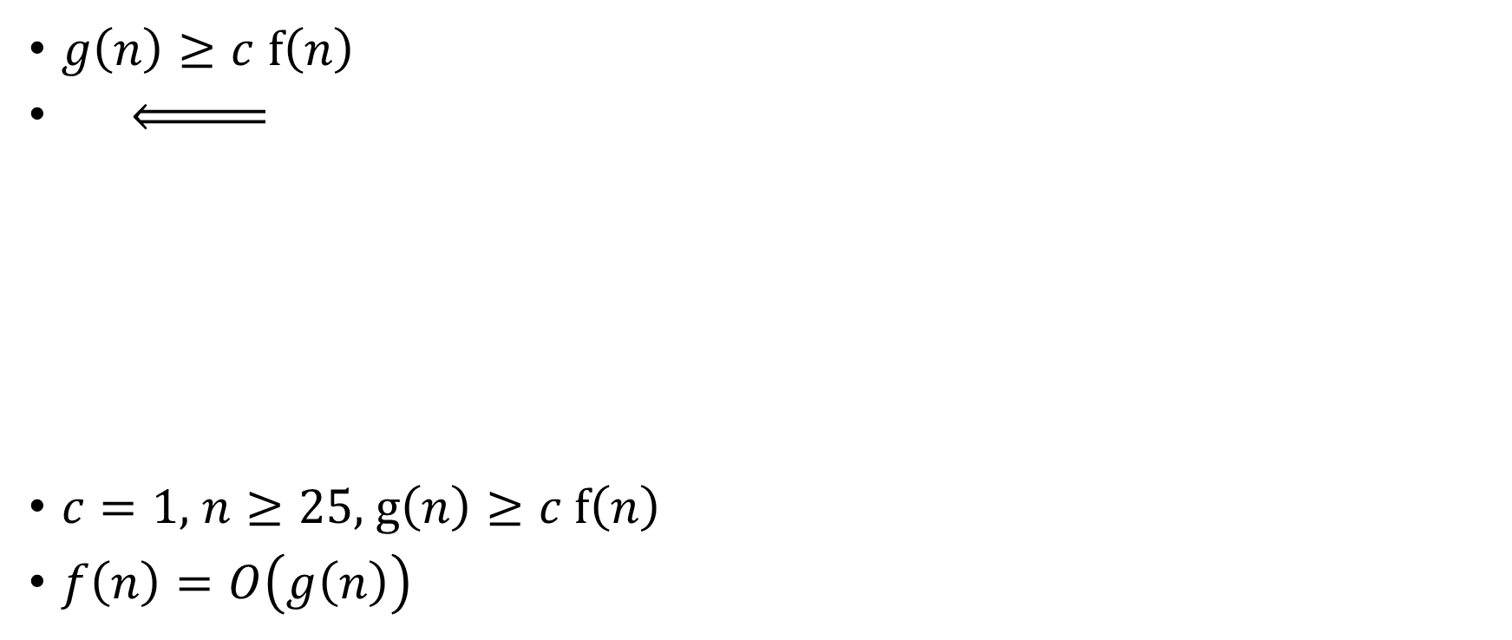
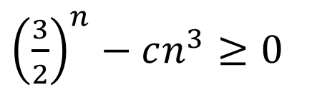
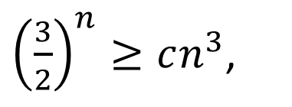


HW#3 Problem 2(b)
$g\left(n\right)≥c$ f$\left(n\right)$
$c=1,$ $n≥25,$ $g\left(n\right)≥c$ f$\left(n\right)$
$f\left(n\right)=O\left(g\left(n\right)\right)$
$$3^{n}≥{cn}^{3}2^{n}$$
${\left(\frac{3}{2}\right)}^{n}≥cn^{3}$,
${\left(\frac{3}{2}\right)}^{n}−cn^{3}≥0$
$let f\left(n\right)=\left(\frac{3}{2}\right)−cn^{3}$ ,
$f\left(25\right),f^{′}\left(25\right),f^{′′}\left(25\right)>0$
Notes:
可以做微分，發現

Slide 5
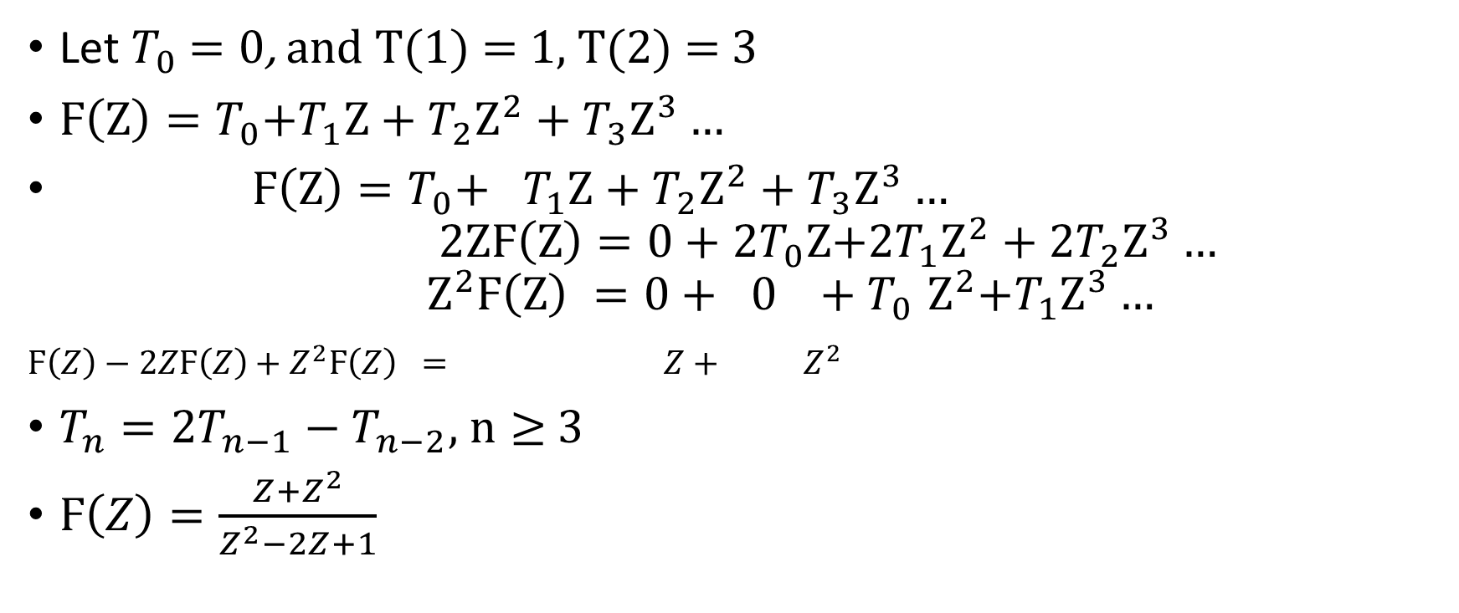
HW#3 Problem 4
Let $T_{0}$ $=0$, and T(1) = 1, T(2) = 3
$Ϝ\left(Z\right)=T_{0}{+T}_{1}Z+T_{2}Z^{2}+T_{3}Z^{3}…$
$Ϝ\left(Z\right)=T_{0}{+ T}_{1}Z+T_{2}Z^{2}+T_{3}Z^{3}…$
$$2ZϜ\left(Z\right)={0+2T}_{0}Z{+2T}_{1}Z^{2}+{2T}_{2}Z^{3}…$$
$$Z^{2}Ϝ\left(Z\right) {=0+ 0 +T}_{0}Z^{2}{+T}_{1}Z^{3}…$$
$Ϝ\left(Z\right)−2ZϜ\left(Z\right)+Z^{2}Ϝ\left(Z\right) = Z+ Z^{2}$
$T_{n}=2T_{n−1}−T_{n−2}$, $n≥$ 3
$Ϝ\left(Z\right)=\frac{Z+Z^{2}}{Z^{2}−2Z+1}$
Notes:
Z-transformation

Slide 6
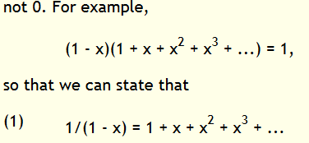
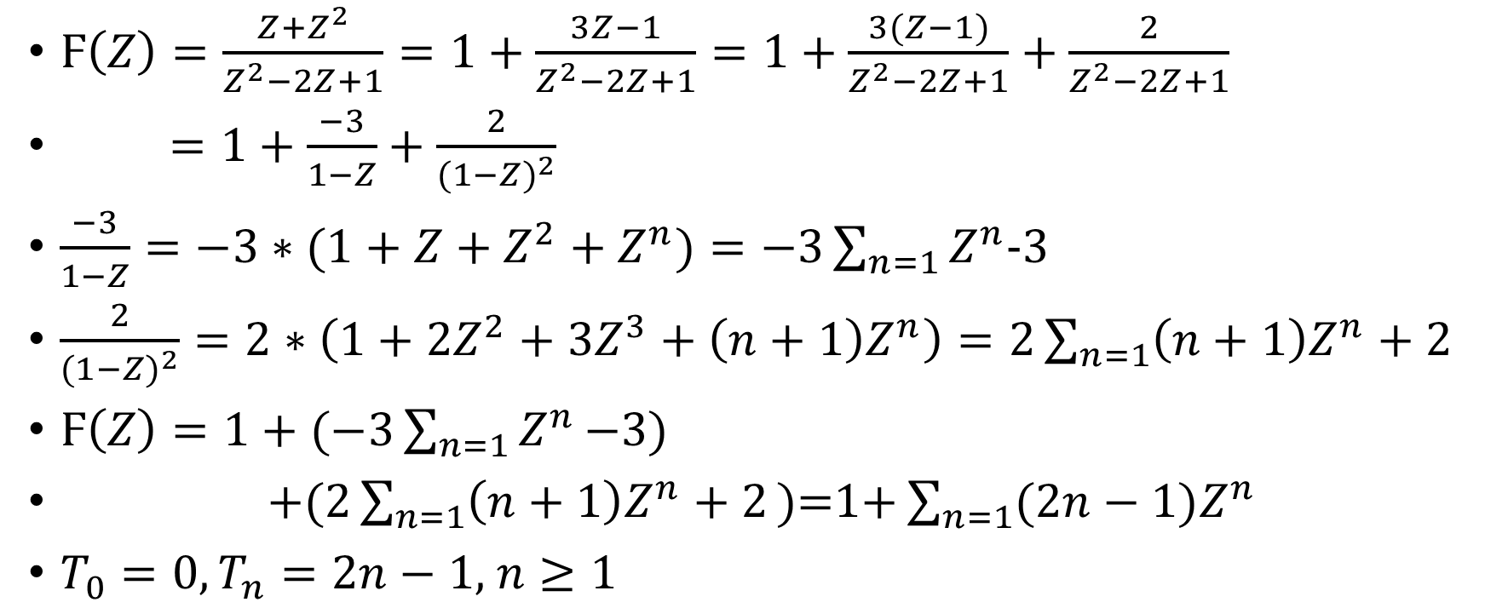
HW#3 Problem 4 (cont.)
$Ϝ\left(Z\right)=\frac{Z+Z^{2}}{Z^{2}−2Z+1}=1+\frac{3Z−1}{Z^{2}−2Z+1}=1+\frac{3(Z−1)}{Z^{2}−2Z+1}+\frac{2}{Z^{2}−2Z+1}$
$=1+\frac{−3}{1−Z}+\frac{2}{{(1−Z)}^{2}}$
$\frac{−3}{1−Z}=−3∗(1+$ $Z+Z^{2}+Z^{n})=−3\sum_{n=1}{Z^{n}}$-3
$\frac{2}{{(1−Z)}^{2}}=2∗\left(1+2Z^{2}+3Z^{3}+\left(n+1\right)Z^{n}\right)=2\sum_{n=1}{\left(n+1\right)Z^{n}+2}$
$Ϝ\left(Z\right)=1+(−3\sum_{n=1}{Z^{n}}\text{−3}\text{)}$
$\text{+(}2\sum_{n=1}{\left(n+1\right)Z^{n}+2}\text{)=1+}\sum_{n=1}{(2n−1)Z^{n}}$
${T_{0}=0,T}_{n}=2n−1,$ $n≥1$

Slide 7
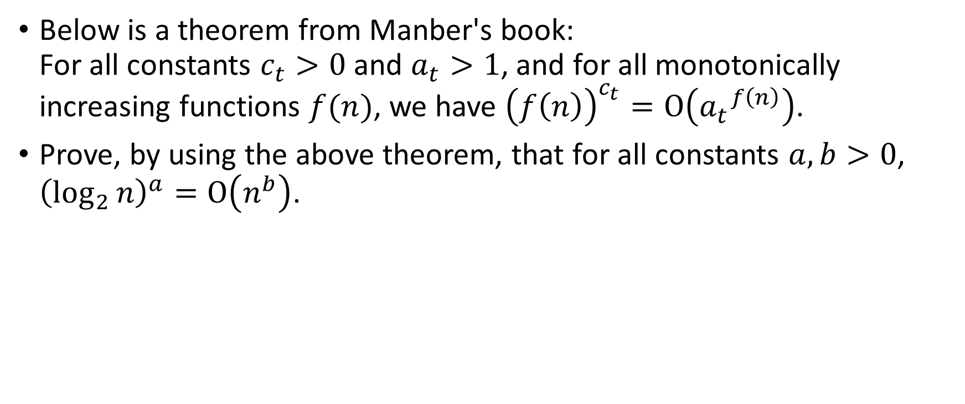
HW#3 Problem 1
Below is a theorem from Manber's book:
For all constants $c_{t}>0$ and $a_{t}>1$, and for all monotonically increasing functions $f(n)$, we have ${\left(f\left(n\right)\right)}^{c_{t}}=Ο\left({a_{t}}^{f\left(n\right)}\right)$.
Prove, by using the above theorem, that for all constants $a,b>0$, ${\left(\log_{2}{n}\right)}^{a}=Ο\left(n^{b}\right)$.

Slide 8
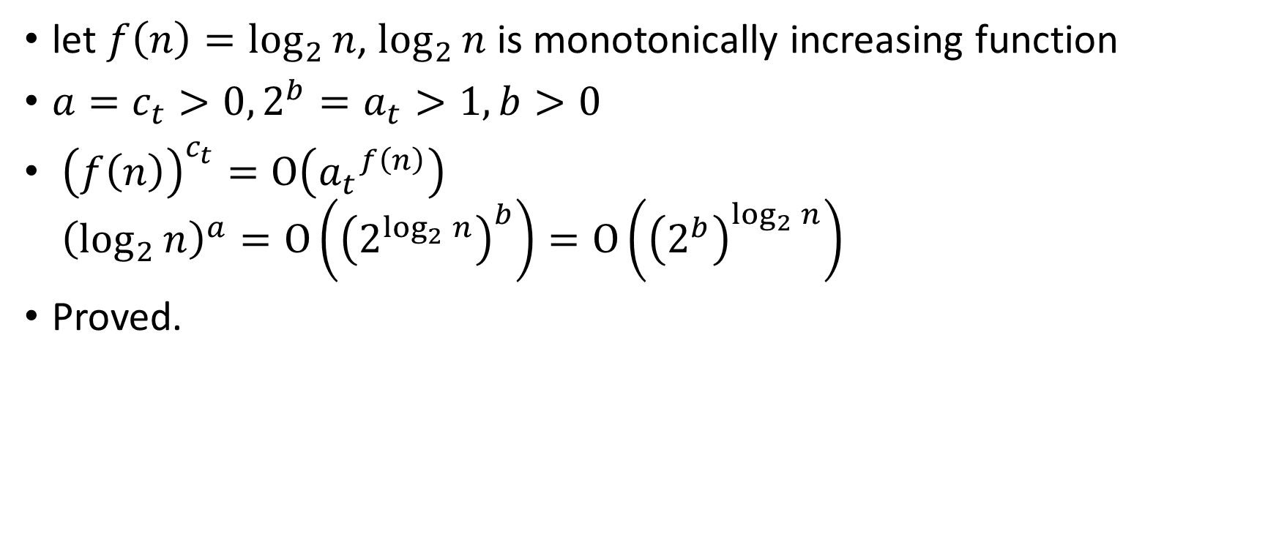
HW#3 Problem 1 (cont.)
let $f\left(n\right)=\log_{2}{n}$, $\log_{2}{n}$ is monotonically increasing function
${a=c}_{t}>0,{2^{b}=a}_{t}>1, b>0$
${\left(f\left(n\right)\right)}^{c_{t}}=Ο\left({a_{t}}^{f\left(n\right)}\right)$
${\left(\log_{2}{n}\right)}^{a}=Ο\left({\left(2^{\log_{2}{n}}\right)}^{b}\right)=Ο\left({\left(2^{b}\right)}^{\log_{2}{n}}\right)$
Proved.

Slide 9
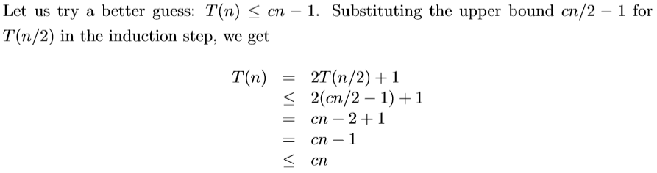
HW#3 Problem 3

Slide 10

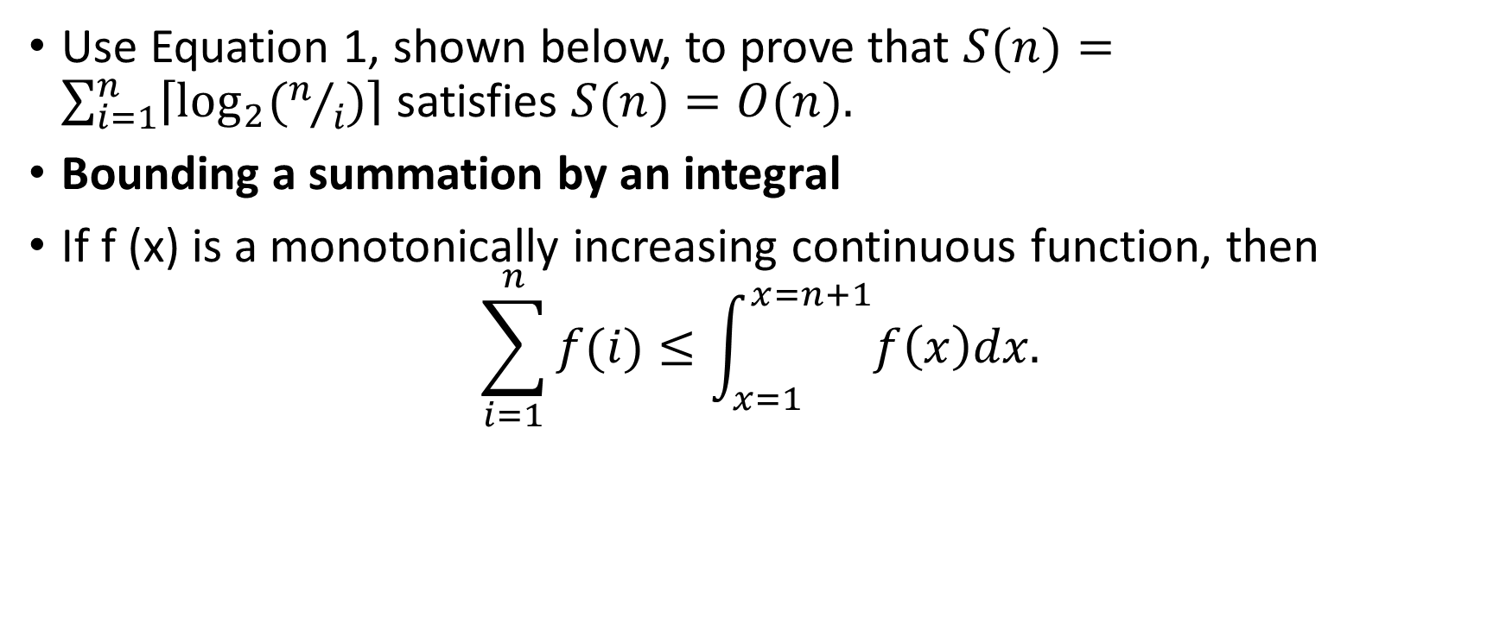
HW#3 Problem 5
Use Equation 1, shown below, to prove that $S(n)=\sum_{i=1}^{n}{\left\lceil \log_{2}{(n/i)}\right\rceil }$satisfies $S(n)=O(n).$
Bounding a summation by an integral
If f (x) is a monotonically increasing continuous function, then
$$\sum_{i=1}^{n}{f(i)≤\int_{x=1}^{x=n+1}{f\left(x\right)dx.}}$$
$$(1)$$

Slide 11
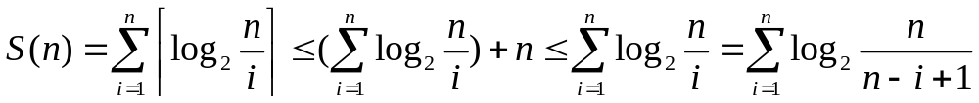
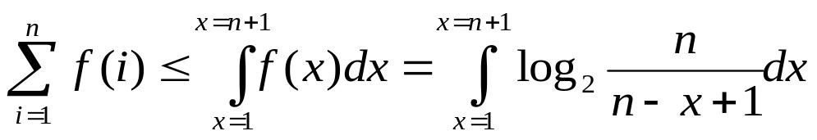
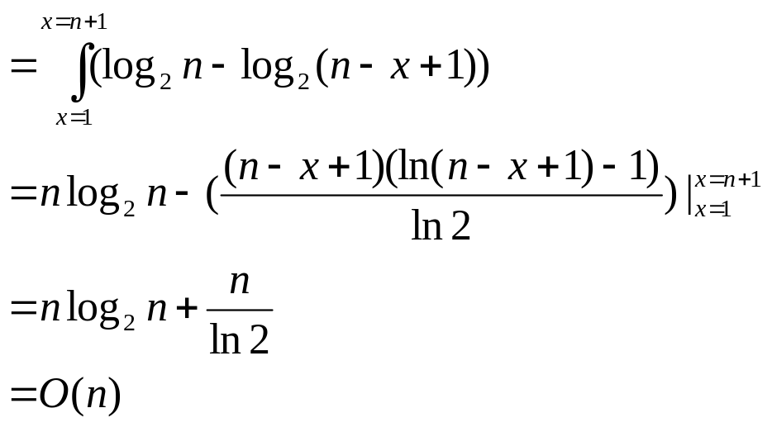
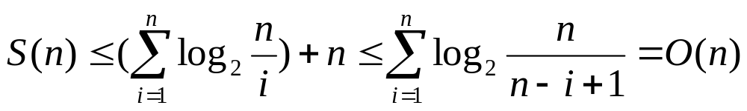
HW#3 Problem 5 (cont.)
f(n)
S(n) = O(n)
Notes:
高斯符號要記得帶掉 (2 pt)
log(n/i)非嚴格遞增方程式 (6 pt)
→ 高斯符號不帶掉的話，可以直接套E1(是嚴格遞增)，進去後再帶掉高斯符號亦可
積分方法 (10 pt)
結論 (2 pt)

