Slide 1
Algorithms
Homework Assignment #4
Jui-Shun Lai, Wei-Hsien Chang

Slide 2
HW#4 No.2
In algorithm Knapsack, we first checked whether the ith item is unnecessary (by checking P[i-1, j]).
  If there is a solution with the i-1 items, we take this solution.
We can also make the opposite choice, which is to take the solution with the i-th item if it exists (i.e., check P[i-1, j-k_{i}] first).
Which version do you think will have a better performance? (8pt) Redraw Fig. 5.11 (see slides) to reflect this choice.(12pt)
Notes:
題目原本為check P[i, j-k_{i}] first，應改為check P[i-1, j-k_{i}] first，
後面slides討論兩種的表格皆相同，perfomance皆為修改前的較好

Slide 3
Algorithm Original_Knapsack (S, K);
1 begin
2 P[0, 0].exist := true;
3 for k := 1 to K do
4 P[0, k].exist := false;
5 for i := 1 to n do
6 for k := 0 to K do
7 P[i, k].exist := false;
8 if P[i – 1, k].exist then
9 P[i, k].exist := true;
10 P[i, k].belong := false;
11 else if k - S[i] ≥ 0 then
12 if P[i-1, k - S[i]].exist then
13 P[i, k].exist := true;
14 P[i, k].belong := true;
15 end
Algorithm Modified_Knapsack (S, K);
1 begin
2 P[0, 0].exist := true;
3 for k := 1 to K do
4 P[0, k].exist := false;
5 for i := 1 to n do
6 for k := 0 to K do
7 P[i, k].exist := false;
8 if k - S[i] ≥ 0 then
9 if P[i – 1, k-S[i]].exist then
10 P[i, k].exist := true;
11 P[i, k].belong := true;
12 else if P[i – 1, k].exist then
13 P[i, k].exist := true;
14 P[i, k].belong := false;
15 end

Slide 4
HW#4 No.2
 | 0 | 1 | 2 | 3 | 4 | 5 | 6 | 7 | 8 | 9 | 10 | 11 | 12 | 13 | 14 | 15 | 16
 | O | - | - | - | - | - | - | - | - | - | - | - | - | - | - | - | -
k₁=2 | O | - | I | - | - | - | - | - | - | - | - | - | - | - | - | - | -
k₂=3 | O | - | O | I | - | I | - | - | - | - | - | - | - | - | - | - | -
k₃=5 | O | - | O | O | - | I | - | I | I | - | I | - | - | - | - | - | -
k₄=6 | O | - | O | O | - | O | I | O | I | I | O | I | - | I | I | - | I
The original algorithm will have a better performance because of the overhead
(checking k - S[i] ≥ 0)
9 if k - S[i] ≥ 0 then
10 if P[i – 1, k-S[i]].exist then
11 P[i, k].exist := true;
12 P[i, k].belong := true;
13 else if P[i – 1, k].exist then
14 P[i, k].exist := true;
15 P[i, k].belong := false;
Notes:
27O 15I
21O 21I

Slide 5
Algorithm Modified_Knapsack (S, K);
1 begin
2 P[0, 0].exist := true;
3 for k := 1 to K do
4 P[0, k].exist := false;
5 for i := 1 to n do
6 for k := 0 to K do
7 P[i, k].exist := false;
8 if k - S[i] ≥ 0 then
9 if P[i, k-S[i]].exist then
10 if P[i, k-S[i]].belong then
11 if P[i-1, k-S[i]].exist then
12 P[i, k].exist := true;
13 P[i, k].belong := true;
14 else if P[i – 1, k].exist then
15 P[i, k].exist := true;
16 P[i, k].belong := false;
17 else
18 P[i, k].exist := true;
19 P[i, k].belong := true;
20 else if P[i – 1, k].exist then
21 P[i, k].exist := true;
22 P[i, k].belong := false;
23 end
Algorithm Original_Knapsack (S, K);
1 begin
2 P[0, 0].exist := true;
3 for k := 1 to K do
4 P[0, k].exist := false;
5 for i := 1 to n do
6 for k := 0 to K do
7 P[i, k].exist := false;
8 if P[i – 1, k].exist then
9 P[i, k].exist := true;
10 P[i, k].belong := false;
11 else if k - S[i] ≥ 0 then
12 if P[i-1, k - S[i]].exist then
13 P[i, k].exist := true;
14 P[i, k].belong := true;
15 end

Slide 6
 | 0 | 1 | 2 | 3 | 4 | 5 | 6 | 7 | 8 | 9 | 10 | 11 | 12 | 13 | 14 | 15 | 16
 | O | - | - | - | - | - | - | - | - | - | - | - | - | - | - | - | -
k₁=2 | O | - | I | - | - | - | - | - | - | - | - | - | - | - | - | - | -
k₂=3 | O | - | O | I | - | I | - | - | - | - | - | - | - | - | - | - | -
k₃=5 | O | - | O | O | - | I | - | I | I | - | I | - | - | - | - | - | -
k₄=6 | O | - | O | O | - | O | I | O | I | I | O | I | - | I | I | - | I
8 if k - S[i] ≥ 0 then
9 if P[i, k-S[i]].exist then
10 if P[i, k-S[i]].belong then
11 if P[i-1, k-S[i]].exist then
12 P[i, k].exist := true;
13 P[i, k].belong := true;
14 else if P[i – 1, k].exist then
15 P[i, k].exist := true;
16 P[i, k].belong := false;
17 else
18 P[i, k].exist := true;
19 P[i, k].belong := true;
20 else if P[i – 1, k].exist then
21 P[i, k].exist := true;
22 P[i, k].belong := false;

Slide 7
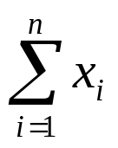
HW#4 No.3
Let x₁, x₂, …, x_{n} be a set of integers, and let S =
.
Design an algorithm to partition the set into two subsets of equal sum, or determine that it is impossible to do so. (15pt)
The algorithm should run in time O(nS).(5pt)

Slide 8

HW#4 No.3
m := 1;
Algorithm Partition into Two Subsets(x);
1 begin
2 S := ;
3 if S is odd then
4 print “no solution”;
5 else
6 K := S/2;
7 Knapsack(x, K);
8 if P[n, K].exist = false then
9 print “no solution.”;
10 else
11 l := 1;
12 m := 1;
13 for i := n to 1 do
14 if P[i, K].belong = true then
15 set1[l] := x[i];
16 l := l + 1;
17 if K-x[i]>0
18 K := K - x[i];
19 else
20 set2[m] := x[i];
21 m := m + 1;
22 print “set1:”;
23 for i := 1 to l - 1 do
24 print set1[i];
25 print “set2:”;
26 for i := 1 to m - 1 do
27 print set2[i];
28 end
O(n)
O(n)
O(n*S/2)
O(nS)
O(L)
O(m)

Slide 9
HW#4 No.4
In the towers of Hanoi puzzle, there are three pegs A, B, and C, with n (generalizing the original eight) disks of different sizes stacked in decreasing order on peg A.
The objective is to transfer all the disks on peg A to peg B, moving one disk at a time from one peg to one of the other two) and never having a larger disk stacked upon a smaller one.
  (a) Give an algorithm to solve the puzzle (7pt). Explain how induction works here (3pt).
  (b) Compute the total number of moves in the algorithm. Show the details of your calculation.(10pt)

Slide 10
HW#4 No.4
Algorithm Hanoi(n, A, B, C);
1 begin
2 if n=1 then
3 move from A to B
4 else if n>1
5 Hanoi(n-1, A, C, B);
6 move the largest disk from A to B
7 Hanoi(n-1, C, B, A);
8 end
(a)
Base case: 1 disk (move from A to B)
Induction hypothesis: Moving n-1 disks is available
Inductive step: To move n disks,
  (1) move n-1 disks from A to C (induction hypothesis)
  (2) move the largest disk to B (base case)
  (3) move n-1 disk from C to B (induction hypothesis)

Slide 11

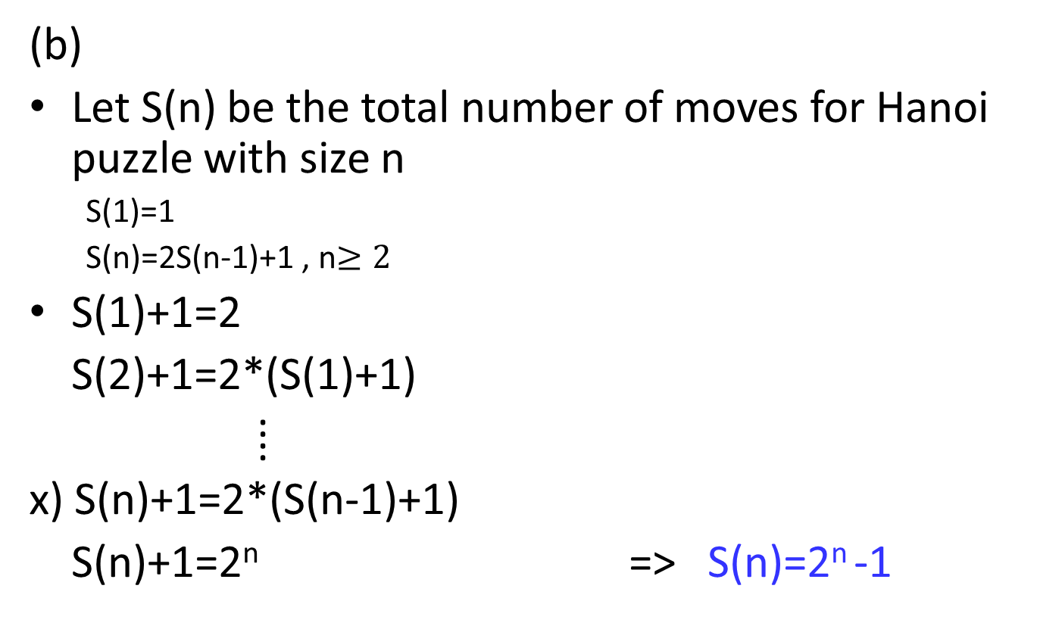
HW#4 No.4
(b)
Let S(n) be the total number of moves for Hanoi puzzle with size n
  S(1)=1
  S(n)=2S(n-1)+1 , n$≥2$
  S(1)+1=2
  S(2)+1=2*(S(1)+1)
  ⁞
  x) S(n)+1=2*(S(n-1)+1)
  S(n)+1=2^{n} => S(n)=2^{n} -1

Slide 12
HW#4 No.5
Write a non-recursive program (in suitable pseudocode) that prints the moves of the solution to the towers of Hanoi puzzle.
  (a) Give an algorithm to solve the puzzle (20pt).

Slide 13
HW#4 No.5
Algorithm Hanoi(n, A, B, C);
1 begin
2 create a stack stores(n, A, B, C)
3 while (stack not emtpy)
4 stack.pop(n,A,B,C)
5 if n=1 then
6 move from A to B
7 else if n>1
8 stack.push (n-1, C, B, A);
9 stack.push(1, A, B, C);
10 stack.push (n-1, A, C, B);
11 end
(a)
Base case: 1 disk (move from A to B)
Induction hypothesis: Moving n-1 disks is available
Inductive step: To move n disks,
  (1) move n-1 disks from A to C (induction hypothesis)
  (2) move the largest disk to B (base case)
  (3) move n-1 disk from C to B (induction hypothesis)
Because stack is LIFO

