Slide 1
Homework #1
Prepared by TAs (張子建, 唐維佋)
Algorithms 2015, NTU

Slide 2
Tips to writing induction proofs
Claiming your hypothesis with sufficient clues would be better.
Mark your hypothesis, basic step, induction steps clear.
A better format helps both you and us.
DO NOT PLAGIARIZE.

Slide 3
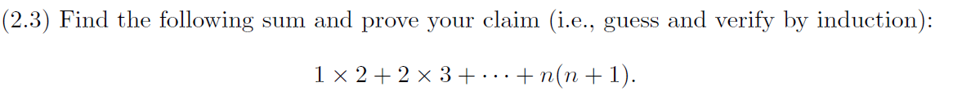
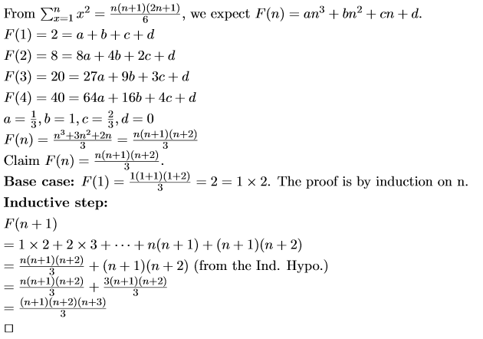
Problem 1
Simple Summarization Formula

Slide 4
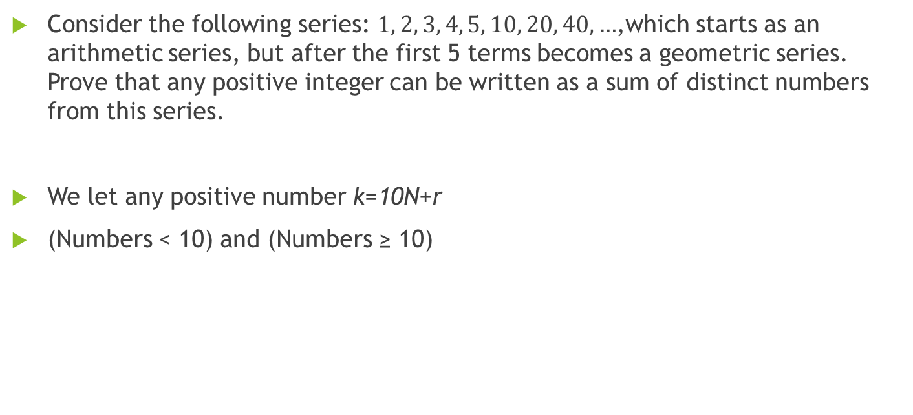
Problem 3
Consider the following series: $1, 2, 3, 4, 5, 10, 20, 40, …$,which starts as an arithmetic series, but after the first 5 terms becomes a geometric series. Prove that any positive integer can be written as a sum of distinct numbers from this series.
We let any positive number k=10N+r
(Numbers < 10) and (Numbers ≥ 10)

Slide 5
Problem 3 (cont.)
BASE CASE: Divided into 2 parts
  < 10
    1, 2, 3, 4, 5 : trivially proved: summed by themselves
    6, 7, 8, 9: (1, 2, 3, 4) + 5
  ≥ 10
    We have to prove the remain sequence Sr : 10, 20, 40, 80, … can compose to any positive number N multiplied by 10 (that is, number 10*N) with strong induction.
    N = 1, 10 is trivially proved.
    N = 2, 20 is trivially proved.

Slide 6
Problem 3 (cont.)
Inductive Step: N = n
  Inductive Hypothesis: We assume that for all N s.t. 1<N<n can be summed up by some numbers of the sequence Sr.
  When n is even(2x):
    Because x < n and no matter x is odd or even, we have the sum-up combination of x*10 (due to inductive hypothesis). For example, Sx = {a1, a2, …, at} are the subset of Sr that can sum up to x*10.
    There must exist a subset of Sr that can sum up to 2x*10, and the content of this subset is 2Sx = {2*a1, 2*a2, …, 2*at}. Because Sr is a geometric sequence with r=2, we know 2Sx will exist.
  When n is odd(2x+1):
    Because 2x < n, there exist a subset Sx from Sr that sum up to 10*2x. And we can observe that Sx will never contain “10” from Sr.
    So we can easily take “10” from Sr and add it into Sk. So that the new set will sum up to (2k+1)*10
So the hypothesis holds and works for all positive numbers.

Slide 7
Problem 4

Slide 8
Problem 4
Open
Open
Open
Boundary Triangle
Boundary Triangle
Open
Open
Open
People likely say that when we add one more line to the graph, then a new triangle will appear.
  But how to guarantee that this argument can hold forever?
Lemma: (It may not be the best way to solve the question!)
We say that the areas surrounded by lines are close area.
There always exists an edge or an angle of the existed triangle (let’s call it boundary triangles) that face forward to three open area.

Slide 9
Open
Open
Open
Open
Open
Open
New Triangle
still be a boundary triangle
Open
Open
Open
Open
Open
Open
Here, we can also easily discuss
that a close triangle being cut
through by a new line will not
decrease the total amount of the
triangles in the graph.
New Triangle
still be boundary triangle
Notes:
A two-staged proof seems better to me.
1. First argue the existence of a boundary triangle.
2. Then use the boundary triangle when you remove a line in the inductive
proof of the second stage.

Slide 10
Sometimes, the lemma may be destroyed by the
new line, but the new triangle still created with
the lemma holds.
Open
Open
Open
Open
Open
Open
Open
Open
Open
Open
Open
New Triangle
still be boundary triangle
Open
So we can prove the problem by induction on
the number of lines with the lemma.

Slide 11
Base Case: 3 lines that construct 1 triangle
Inductive hypothesis:
(n-1) (or even (n-2), (n-3), …) lines can construct at least (n-1)-2 triangles
Inductive step:
Consider a graph with n lines. (n>1)
Now we remove the right line from the graph. With the lemma, we know exactly one triangle will disappear, and the rest (n-1) lines can construct at least (n-1)-2 triangles (due to inductive hypothesis).
    Suppose ABC is a boundary triangle and the region adjacent to ABC and bordered on AB is open (that we can always find it out in the graph).
    Line AB is the one you should choose to remove.
So we know that n lines can construct at least (n-1)-2+1 = (n-2) triangles.

