Slide 1
Algorithms
HW #2
張子建、唐維佋

Slide 2
Problem 1
1. We can define anti-Gray codes in the following way. Instead of minimizing the difference between two consecutive strings, we can try to maximize it.
  1) Is it possible to design an encoding for any even number of objects such that each pair of two consecutive strings differ by k bits (where k is the number of bits in each string)?
  2) How about k - 1 bits (or k -2, k -3, etc.)? If it is possible, find an efficient construction.
    How about at least k - 1 bits (or k -2, k -3, etc.)? If it is possible, find an efficient construction.

Slide 3
Problem 1 (cont.)
It is impossible to design an encoding for an even number of objects such that each pair of two consecutive strings differ by K bits
  if we want to make each pair of two consecutive strings differ by k bits, we will find that we can only construct two-object anti-Gray codes because if we make the third string which is differ by K bits from the second, it will be the same as the first.
  Example:
  {000, 111, 000}
Notes:
給一偶數k個object的Gray code，增加1 bit 長度便可建2k個object的Gray code

Slide 4
Problem 1 (cont.)
We try to make each pair of two consecutive strings differ by at least k -1 bits.
  Construct Gray codes for the n/2 object (n is even)
01
1bits
1bits
11
00
1bits
1bits
10
Notes:
給一偶數k個object的Gray code，增加1 bit 長度便可建2k個object的Gray code

Slide 5
Problem 1 (cont.)
We try to make each pair of two consecutive strings differ by at least k -1 bits.
  Construct Gray codes for the n/2 object (n is even)
  Add 0-bit to all name in Gray code (00,01,10,11)
001
1bits
1bits
011
000
1bits
1bits
010
Notes:
給一偶數k個object的Gray code，增加1 bit 長度便可建2k個object的Gray code

Slide 6
Problem 1 (cont.)
We try to make each pair of two consecutive strings differ by at least k -1 bits.
  Repeat after each “name” in the list (000,001,010,011) => (000,000,001,001,010,010,011,011)
001
1bits
011
001
1bits
011
000
1bits
010
000
010
1bits
Notes:
給一偶數k個object的Gray code，增加1 bit 長度便可建2k個object的Gray code

Slide 7
Problem 1 (cont.)
We try to make each pair of two consecutive strings differ by at least k -1 bits.
  complement the duplicate “name” => (XOR) (000,111,001,110,010,101,011,100)
001
Kbits
K-1bits
001
001
011
110
100
Kbits
K-1bits
011
011
000
000
K-1bits
Kbits
010
101
000
111
010
Kbits
010
K-1bits
Notes:
給一偶數k個object的Gray code，增加1 bit 長度便可建2k個object的Gray code

Slide 8
Problem 1 (cont.)
The construction is correct if each pair of two consecutive strings differ by k or k-1 bits (which is the difference we can maximize) and there is no collision for all objects.
  Because each pair of consecutive strings differ by 1 bit in Gray codes , we insert a string between two original consecutive Gray code, which differ from previous string by k bits and next string by k-1 bits .
001
Kbits
K-1bits
001
011
110
100
Kbits
K-1bits
011
011
000
000
K-1bits
Kbits
010
101
000
111
010
Kbits
010
K-1bits

Slide 9
Problem 1 (cont.)
To see that there is no collision for all objects, we consider the p-th object in our construction.
  If p is odd, p does not conflict with 2k th object in Gray code Besides p does not conflict with other 2k+1 th object because we reversed the added 0-bit to “1” .
  Similarly, we can prove the case when p is even.
001
Kbits
K-1bits
001
001
011
110
100
Kbits
K-1bits
011
011
000
000
K-1bits
Kbits
010
101
000
111
010
Kbits
010
K-1bits

Slide 10
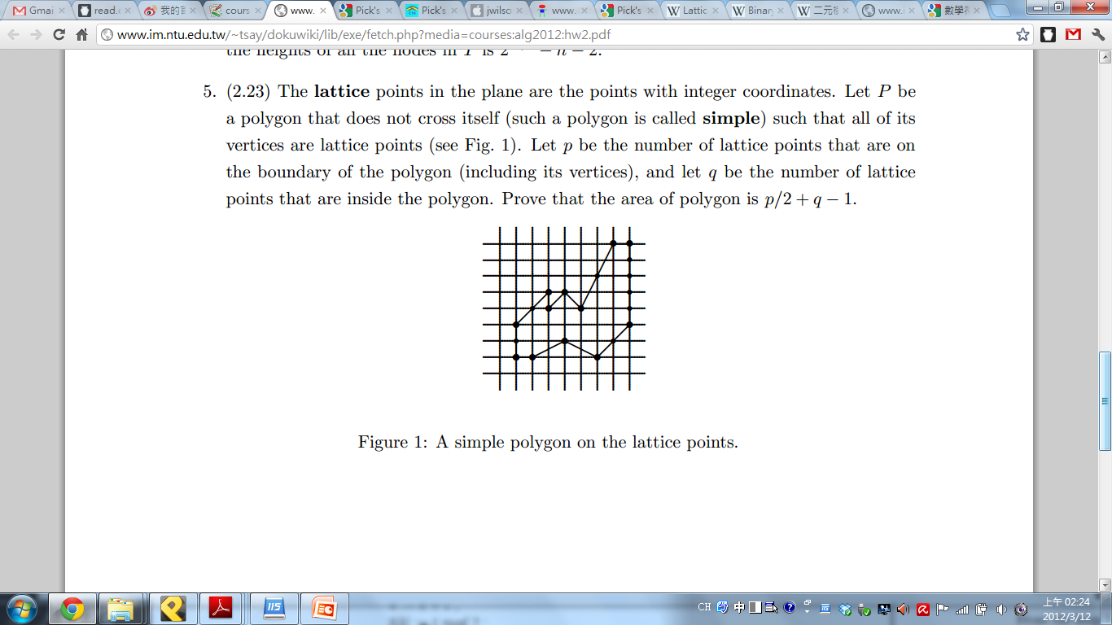
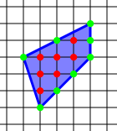
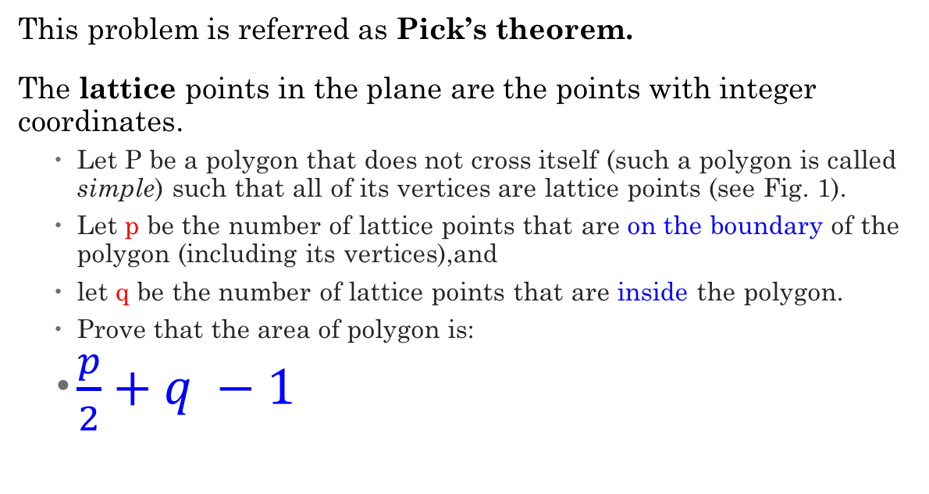
Problem 5
This problem is referred as Pick’s theorem.
The lattice points in the plane are the points with integer coordinates.
  Let P be a polygon that does not cross itself (such a polygon is called simple) such that all of its vertices are lattice points (see Fig. 1).
  Let p be the number of lattice points that are on the boundary of the polygon (including its vertices),and
  let q be the number of lattice points that are inside the polygon.
  Prove that the area of polygon is:
  $\frac{p}{2}+q −1$
(8/2) + 7 -1 = 10

Slide 11
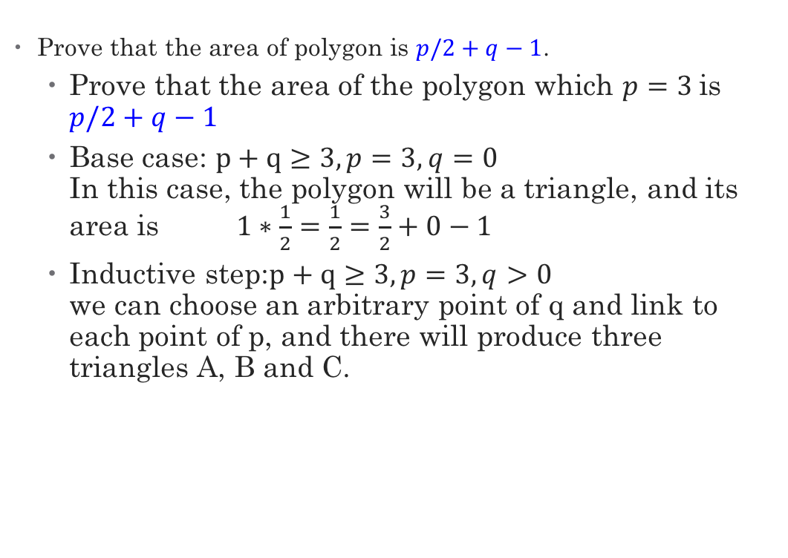
Problem 5 (cont.)
  Prove that the area of polygon is $p/2+q−1$.
  Prove that the area of the polygon which $p=3$is $p/2+q−1$
  Base case: $p+q≥3, p=3, q=0$
  In this case, the polygon will be a triangle, and its area is $1∗\frac{1}{2}=\frac{1}{2}=\frac{3}{2}+0−1$
  Inductive step:$p+q≥3, p=3, q>0$
  we can choose an arbitrary point of q and link to each point of p, and there will produce three triangles A, B and C.
Notes:
P = (0,0) (1,0) (0,1)
P = (0,0) (1,0) (0,2), q = (0,1)

Slide 12
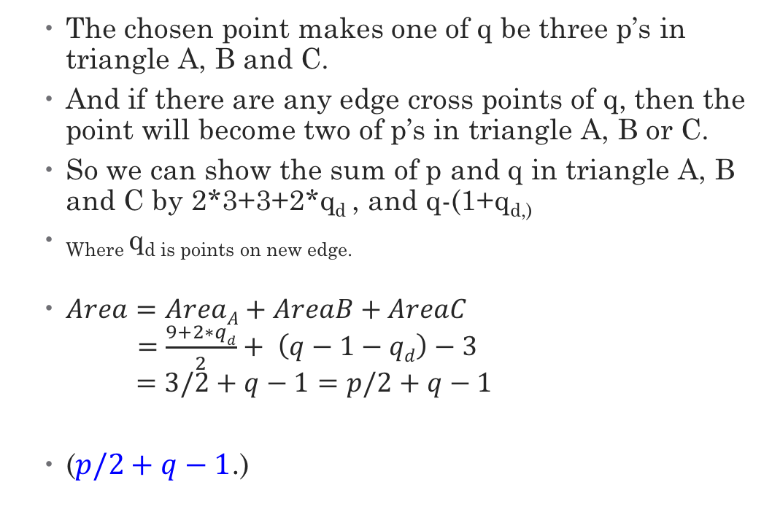
Problem 5 (cont.)
  The chosen point makes one of q be three p’s in triangle A, B and C.
  And if there are any edge cross points of q, then the point will become two of p’s in triangle A, B or C.
  So we can show the sum of p and q in triangle A, B and C by 2*3+3+2*q_{d} , and q-(1+q_{d,)}
  _{Where} q_{d is points on new edge.}
  $Area=AreaA+AreaB+AreaC$
  $=\frac{9+2∗qd}{2}+ \left(q−1−qd\right)−3$
  $=3/2+q−1=p/2+q−1$
  ($p/2+q−1$.)
Notes:
1 + qd :新圖型扣掉的量 (1: q, qd, q on new edges)
2*3 + make a copy

Slide 13

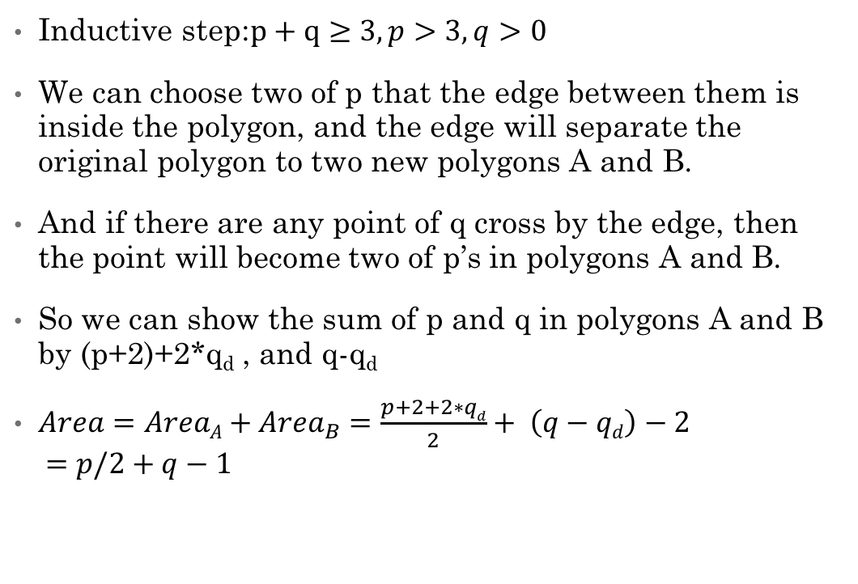
Problem 5 (cont.)
Inductive step:$p+q≥3, p>3, q>0$
We can choose two of p that the edge between them is inside the polygon, and the edge will separate the original polygon to two new polygons A and B.
And if there are any point of q cross by the edge, then the point will become two of p’s in polygons A and B.
So we can show the sum of p and q in polygons A and B by (p+2)+2*q_{d} , and q-q_{d}
$Area=AreaA+{Area}_{B}=\frac{p+2+2∗qd}{2}+ \left(q−qd\right)−2$
$=p/2+q−1$

