Slide 1
Homework #3
Prepared by TAs (張子建, 唐維佋)
Algorithms 2015, NTU

Slide 2
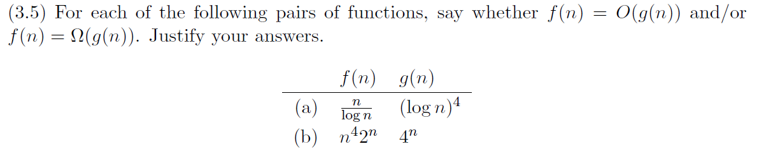
Problem 1

Slide 3

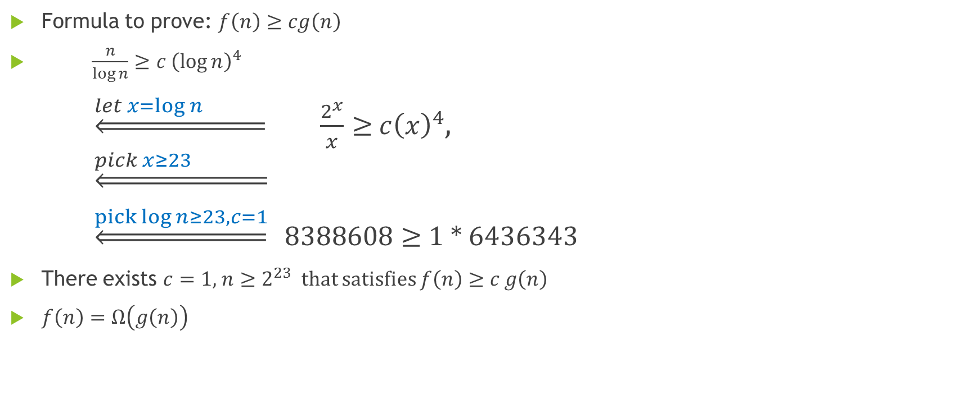

Problem 1(a)
Formula to prove: $f\left(n\right)≥cg\left(n\right)$
$\frac{n}{\log{n}}≥c{ \left(\log{n}\right)}^{4}$
    $\underset{⇐}{let x=\log{n} } \frac{2^{x}}{x}≥{ c\left(x\right)}^{4}$,
    $$\underset{⇐}{pick x≥23 }$$
    $\underset{⇐}{pick log{n≥23,c=1}}$ $8388608≥$ 1 * 6436343
There exists $c=1,$ $n≥2^{23}$ that satisfies $f\left(n\right)≥c$ $g\left(n\right)$
$f\left(n\right)=Ω\left(g\left(n\right)\right)$
$$2^{x}≥c⋅x^{5}$$
$$let f\left(x\right)=2^{x}−cx^{5}$$

Slide 4

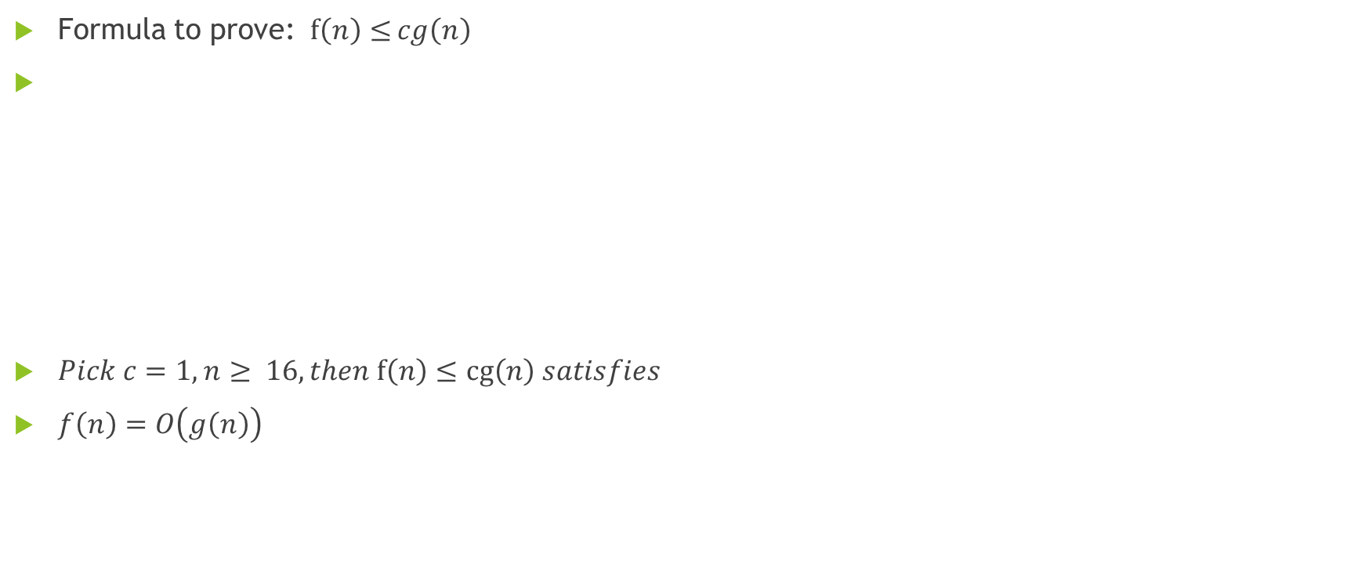


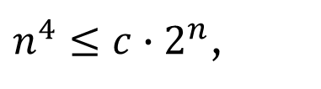
Problem 1(b)
Formula to prove: $f\left(n\right)≤$ $cg\left(n\right)$
$Pick c=1,$ $n≥ 16, then$ $f\left(n\right)≤cg\left(n\right) satisfies$
$f\left(n\right)=O\left(g\left(n\right)\right)$
$$n^{4}2^{n}≤{c∙4}^{n}$$
$n^{4}≤{c∙2}^{n}$,
${ c2}^{n}−n^{4}≥0$
$let f\left(n\right)={c2}^{n}−n^{4}$

Slide 5
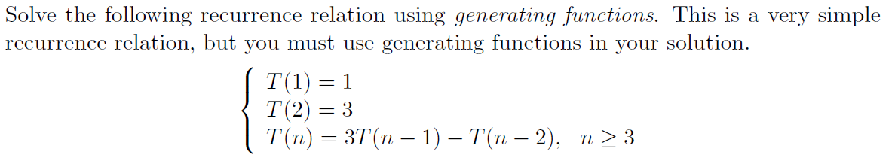
Problem 3

Slide 6
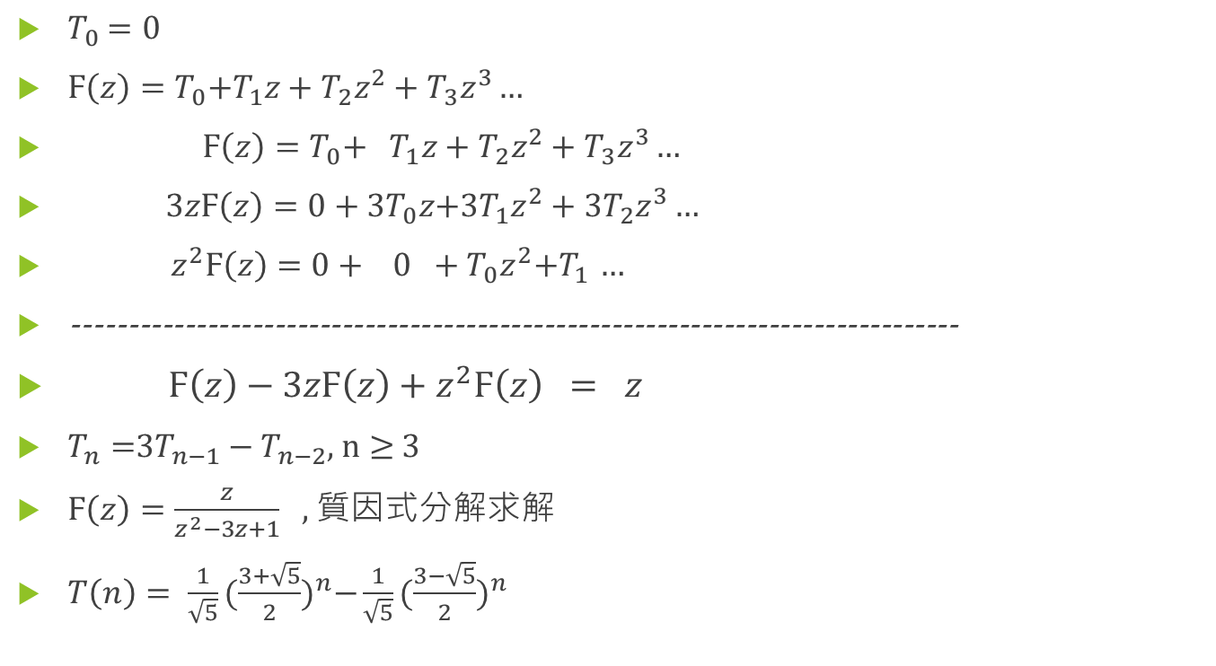
Problem 3
$T_{0}$ $=0$
$Ϝ\left(z\right)=T_{0}{+T}_{1}z+T_{2}z^{2}+T_{3}z^{3}…$
$Ϝ\left(z\right)=T_{0}{+ T}_{1}z+T_{2}z^{2}+T_{3}z^{3}…$
$3zϜ\left(z\right)={0+3T}_{0}z{+3T}_{1}z^{2}+{3T}_{2}z^{3}…$
$z^{2}Ϝ\left(z\right)={0+ 0 +T}_{0}z^{2}{+T}_{1}$ $…$
-------------------------------------------------------------------------------
$Ϝ\left(z\right)−3zϜ\left(z\right)+z^{2}Ϝ\left(z\right) = z$
$T_{n}=$3$T_{n−1}−T_{n−2}$, $n≥$ 3
$Ϝ\left(z\right)=\frac{z}{z^{2}−3z+1}$ , 質因式分解求解
$T\left(n\right)= \frac{1}{\sqrt{5}}{(\frac{3+\sqrt{5}}{2})}^{n}−\frac{1}{\sqrt{5}}{(\frac{3−\sqrt{5}}{2})}^{n}$

Slide 7
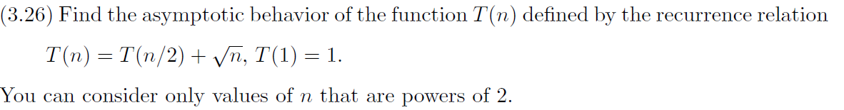
Problem 4

Slide 8
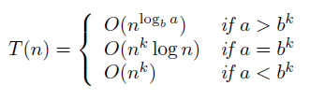
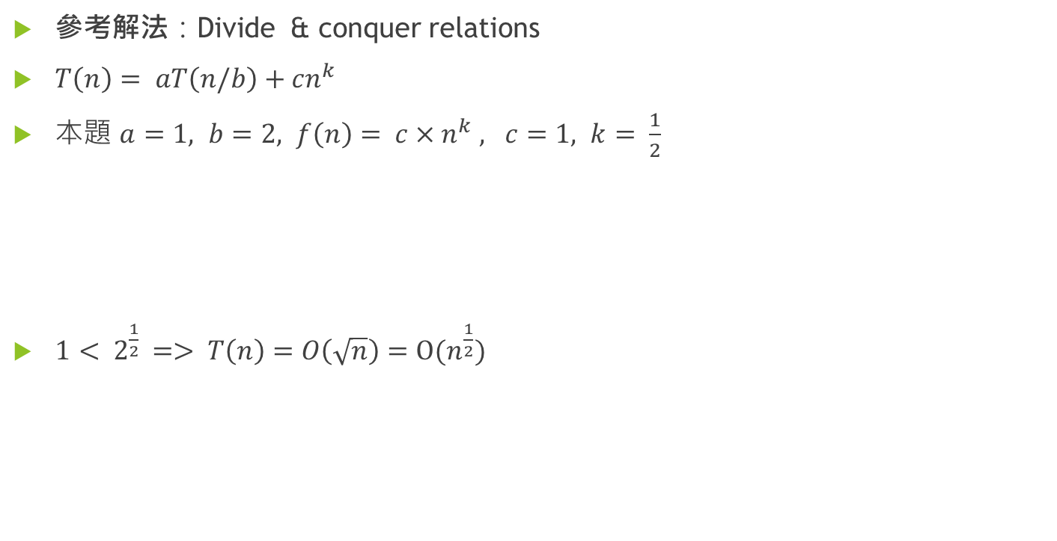
Problem 4
參考解法：Divide & conquer relations
$T\left(n\right)= aT\left(n/b\right)+cn^{k}$
本題 $a=1, b=2, f\left(n\right)= {c×n}^{k} , c=1, k= \frac{1}{2}$
$1< 2^{\frac{1}{2}}$ => $T\left(n\right)=O\left(\sqrt{n}\right)=\text{O}(n^{\frac{1}{2}})$

