Slide 1
  Algorithms HW6
Willy Chang, Wei-Shao Tang

Slide 2
Problem 3.
Find an adequate loop invariant for the main while loop in the Partition procedure of the Quicksort algorithm, which is sufficient to show that after the execution of the last two assignment statements the array is properly partitioned by X[Middle].
Please express the loop invariant as precisely as possible, using mathematical notation.

Slide 3
Problem 3 (Cont’d).
loop invariant guarantees the objective can be satisfied when procedure is done.
Objective: The array is properly partitioned by X[Middle].
A good start could be writing the objective in mathematical notation.

Slide 4
Problem 3 (Cont’d).
Algorithm Partition (X, Left, Right)
begin
pivot := X[Left];
L : = Left; R := Right;
while L < R do
while X[L] <= pivot and L <= Right do L := L + 1;
while X[R] > pivot and R >= Left do R := R - 1;
if L < R then swap(X[L], X[R]);
Middle := R;
swap(X[Left], X[Middle]);
end

Slide 5
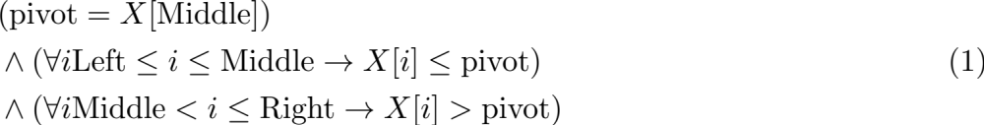
Problem 3 (Cont’d).
properly partitioned.
Left ~ (Middle - 1) | Middle | (Middle + 1) ~ Right
less or equal to pivot | pivot | greater than pivot
Notes:
\begin{equation}
\begin{aligned}
&(\text{pivot} = X[\text{Middle}]) \\
&\wedge (\forall i \text{Left} \leq i \leq \text{Middle} \rightarrow X[i] \leq \text{pivot}) \\
&\wedge (\forall i \text{Middle} < i \leq \text{Right} \rightarrow X[i] > \text{pivot}) \\
\end{aligned}
\end{equation}

Slide 6
Problem 3 (Cont’d).
Algorithm Partition (X, Left, Right)
begin
pivot := X[Left];
L : = Left; R := Right;
while L < R do
while X[L] <= pivot and L <= Right do L := L + 1;
while X[R] > pivot and R >= Left do R := R - 1;
if L < R then swap(X[L], X[R]);
Middle := R;
swap(X[Left], X[Middle]);
end

Slide 7
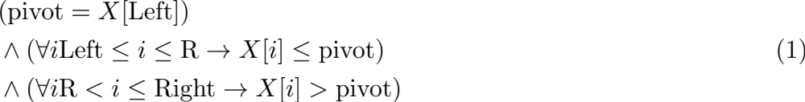
Problem 3 (Cont’d).
Algorithm Partition (X, Left, Right)
begin
pivot := X[Left];
L : = Left; R := Right;
while L < R do
while X[L] <= pivot and L <= Right do L := L + 1;
while X[R] > pivot and R >= Left do R := R - 1;
if L < R then swap(X[L], X[R]);
Middle := R;
swap(X[Left], X[Middle]);
end
That’s what holds right after the main while loop.
Notes:
\begin{equation}
\begin{aligned}
&(\text{pivot} = X[\text{Left}]) \\
&\wedge (\forall i \text{Left} \leq i \leq \text{R} \rightarrow X[i] \leq \text{pivot}) \\
&\wedge (\forall i \text{R} < i \leq \text{Right} \rightarrow X[i] > \text{pivot}) \\
\end{aligned}
\end{equation}

Slide 8
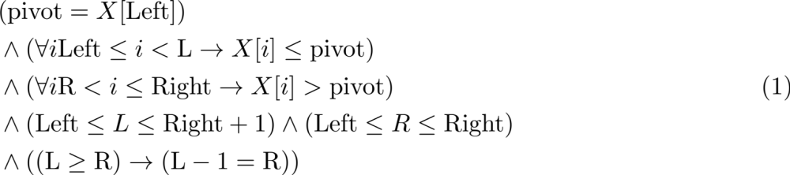
Problem 3 (Cont’d).
while L < R do
while X[L] <= pivot and L <= Right do L := L + 1;
while X[R] > pivot and R >= Left do R := R - 1;
if L < R then swap(X[L], X[R]);
Notes:
\begin{equation}
\begin{aligned}
&(\text{pivot} = X[\text{Left}]) \\
&\wedge (\forall i \text{Left} \leq i < \text{L} \rightarrow X[i] \leq \text{pivot}) \\
&\wedge (\forall i \text{R} < i \leq \text{Right} \rightarrow X[i] > \text{pivot}) \\
&\wedge (\text{Left} \leq L \leq \text{Right} + 1) \wedge (\text{Left} \leq R \leq \text{Right}) \\
&\wedge ((\text{L} \geq \text{R}) \rightarrow (\text{L} -1 = \text{R}))
\end{aligned}
\end{equation}

Slide 9
Problem 3 (Cont’d).
Note that the inequalities i < L and R < j in the second and third conjuncts are strict. (we haven’t moved pivot yet.)
The fourth & the fifth conjuncts:
The last conjunct indicates when the while condition is over.
Left |  |  | Right, R | L
4 | 1 | 2 | 3

Slide 10
Problem 5.
You are given a set of n coins {C1, C2, C3 … Cn}, among which at least n - 1 are identical "true" coins and at most one coin is "false". A false coin is either lighter or heavier than a true coin. Also, you are given a balance scale, which you may use to compare the total weight of any m coins with that of any other m coins. The problem is to find the "false" coin, or show that there is no such coin, by making some sequence of comparisons using the balance scale.
(a) For the case of n = 12, design a scheme to find the false coin (if there is one) with only three comparisons using the balance. Please use {C1, C2, C3 … Cn} to identify the coins in your scheme.
(b) Prove that, when n = 12, it is not possible to find the false coin with just two comparisons, implying that using just three comparisons is optimal. (Hint: think about decision trees and how many possible outcomes there can be.)

Slide 11
Problem 5 (Cont’d).
First weighing | Second weighing | Third weighing
C1C2C3C4 = C5C6C7C8 | C1C9 = C10C11 | C1 = C12 (no fake coin)
 |  | C1 > C12 (C12 light)
 |  | C1 < C12 (C12 heavy)
 | C1C9 > C10C11 | C10 = C11 (C9 heavy)
 |  | C10 > C11 (C11 light)
 |  | C10 < C11 (C10 light)
 | C1C9 < C10C11 | C10 = C11 (C9 light)
 |  | C10 > C11 (C10 heavy)
 |  | C10 < C11 (C11 heavy)
Notes:
first weighing: the suspect lies in C9 ~ C12
second weighing: we used C1 to compare the rest.
equation: either one side is too heavy or the other side is too light.

Slide 12
Problem 5 (Cont’d).
First weighing | Second weighing | Third weighing
C1C2C3C4 > C5C6C7C8 | C1C2C5 = C3C6C12 | C7 = C8, C4 heavy
 |  | C7 > C8, C8 ligher
 |  | C7 < C8, C7 ligher
 | C1C2C5 > C3C6C12 | C1 = C2, C6 lighter
 |  | C1 > C2, C1 heavier
 |  | C1 < C2, C2 heavier
 | C1C2C5 < C3C6C12 | C3 = C12, C5 light
 |  | C3 > C12, C3 heavier
 |  | C3 < C12, (impossible)
Notes:
第一次秤重不平衡的話，從重的地方拿兩個然後從輕的地方拿一個放到秤重上面。
第三秤重等式同一邊不會是嫌疑犯 (ex: if C5 is heavier, which would be false in first weighing.)
找出前兩次秤重方向同一遍的成員

Slide 13
Problem 5 (Cont’d).
First weighing | Second weighing | Third weighing
C1C2C3C4 < C5C6C7C8 | C1C2C5 = C3C6C12 | C7 = C8, C4 ligher
 |  | C7 > C8, C7 heavy
 |  | C7 < C8, C8 heavy
 | C1C2C5 > C3C6C12 | C3 = C12, C5 heavier
 |  | C3 > C12, (impossible)
 |  | C3 < C12, lighter
 | C1C2C5 < C3C6C12 | C1 = C2, C6 heavier
 |  | C1 > C2, C2 lighter
 |  | C1 < C2, C1 lighter
Notes:
第三秤重等式同一邊不會是嫌疑犯

Slide 14
Problem 5 (Cont’d).
False coins (lighter or heavier) for 12 coins: 12 * 2 = 24
No false coin: 24 + 1 = 25 possible outcomes
One comparison can have >, = , < (3 outcomes)
3^2 = 9 < 25
However, 3^3 = 27 > 25, Hence, three comparisons is optimal.

