Slide 1
  Algorithms HW7
Willy Chang, Wei-Shao Tang
Notes:
To edit the equation: using Latexit (OS X) or Laeqed (Windows, Linux)

Slide 2
Problem 3.
Let A and B be two sets, both with n elements, such that A resides in computer P and B in computer Q.
P and Q can communicate by sending messages, and they can perform any kind of local computation.
Design an algorithm to find the nth smallest element (i.e., the median) of the union of A and B.
  You can assume, for simplicity, that all the elements are distinct.
  Your goal is to minimise the number of messages, where a message can contain one element or one integer.
  Please present your algorithm in an adequate pseudo code and make assumptions wherever necessary.
  What is the number of messages in the worst case?

Slide 3
Problem 3 (Cont’d).
For A, B, we have them performed FindNthElement.
FindNthElement(X, Left, Right)
Input: : X (the sorted array that stores the set)
Left (the left boundary of the remaining array, set to 1 initially)
Right (the right boundary of the remaining array, set to n initially)
Output: the nth smallest element of the union of A and B.

Slide 4
Problem 3 (Cont’d).
Algorithm FindNthElement(X, Left, Right)
begin
Middle:= Floor(Left + Right / 2);
EvenFlag := (Right - Left) mod 2;
my_mid := X[Middle];
Send(my_mid);
Receive(other_mid);
if my_mid = other_mid then
return my_mid;
if Left = Right then
return min(my_mid, other_mid);
if my_mid > other_mid then
FindNthElement(X, Left, Middle);
else
FindNthElement(X, Middle + EvenFlag, Right);
end

Slide 5
Problem 3 (Cont’d).
{1, 2, 3} | {4, 5, 6}
{2, 3} | {4, 5}
{3} | {4} | min(3, 4) = 3
Worst case: 2*log n (one exchange takes 2 times, it takes log n exchange if each number of elements decrease by half every time.)

Slide 6
Problem 4.
Design an algorithm that, given a set of integers S = { x1, x2 …. , xn }, find a nonempty subset of S named R, such that
Before presenting your algorithm, please argue why such a nonempty subset must exist.
Notes:
\begin{equation}
\begin{aligned}
(\sum_{x_{i} \in R}^{} x_{i}) \equiv 0 \bmod n
\end{aligned}
\end{equation}

Slide 7
Problem 4. (Cont’d)
Design an algorithm that, given a set of integers S = { x1, x2 …. , xn }, find a nonempty subset of S named R, such that
To say in plain English, we want to find a subset R which sum is dividable by n.
Before presenting your algorithm, please argue why such a nonempty subset must exist.

Slide 8
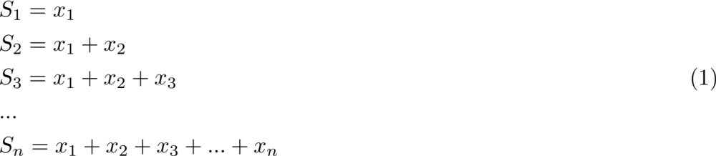
Problem 4. (Cont’d)
The nonempty subset must exist:
Among all S, either one of them is dividable by n (reminder is 0), or two of them which have the same reminder.
  (since we got n-1 reminders and n items of S, by pigeonhole principle.)
If two of them have the same reminder, we can get the subset by find their difference, which cannot be empty since each S is not identical.
Hence, the non-empty subset must exist.
Notes:
\begin{equation}
\begin{aligned}
& S_{1} = x_{1} \\
& S_{2} = x_{1} + x_{2} \\
& S_{3} = x_{1} + x_{2} + x_{3} \\
& ... \\
& S_{n} = x_{1} + x_{2} + x_{3} + ... + x_{n}
\end{aligned}
\end{equation}

Slide 9
Problem 4. (Cont’d)
We can use an array to store the result of computing sum(Si) % n.
According to the previous proof, we can expect:
  one of them is 0, and we’re done.
  two of them have the same value.
    their difference is what we want.
Note Si = Si-1 + Xi
The order affects the output subset, but it doesn’t affect the existence of the solution.

Slide 10
Problem 4. (Cont’d)
Algorithm FindSubset(S, n)
begin
sum := 0; // Si = Si-1 + Xi
self:=-1;
for i := 0 to n-1 do // It happens to be all reminders of n
count[i].exist := false;
sum := S[i] + sum;
k[i] := sum % n;
if k[i] = 0 then
self:= i; // If some of them is dividable by n
break;
else if count[k[i]].exist then // There's an array with the same reminder.
count[k[i]].array2 := i;
break;
else // It’s the first one.
count[k[i]].exist := true;
count[k[i]].array1 := i;
od

Slide 11
Problem 4. (Cont’d)
// Determine the subset array range
if self != -1 then // The self array
start:= 0;
end:= i;
else // We want Si - Sj
start:=count[k[i]].array1+1;
end:= count[k[i]].array2;
for j := start to end do
print S[j];
od
end

