Slide 1
Algorithms
Homework Assignment #8
Willy Chang, Wei-Shao Tang

Slide 2
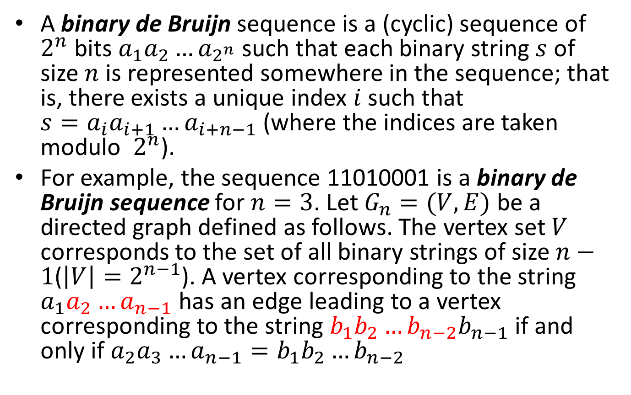
Problem 4
A binary de Bruijn sequence is a (cyclic) sequence of $2^{n}$ bits $a_{1}a_{2}{…a}_{2^{n}}$such that each binary string $s$ of size $n$is represented somewhere in the sequence; that is, there exists a unique index $i$ such that ${s=a}_{i}a_{i+1}{…a}_{i+n−1}$(where the indices are taken modulo $2^{n}$).
For example, the sequence 11010001 is a binary de Bruijn sequence for $n=3$. Let $G_{n}=(V, E)$ be a directed graph defined as follows. The vertex set $V$ corresponds to the set of all binary strings of size $n−1$($\left|V\right|=2^{n−1}$). A vertex corresponding to the string $a_{1}a_{2}{…a}_{n−1}$ has an edge leading to a vertex corresponding to the string $b_{1}b_{2}{…b_{n−2}b}_{n−1}$ if and only if $a_{2}a_{3}{…a}_{n−1}=b_{1}b_{2}{…b}_{n−2}$

Slide 3
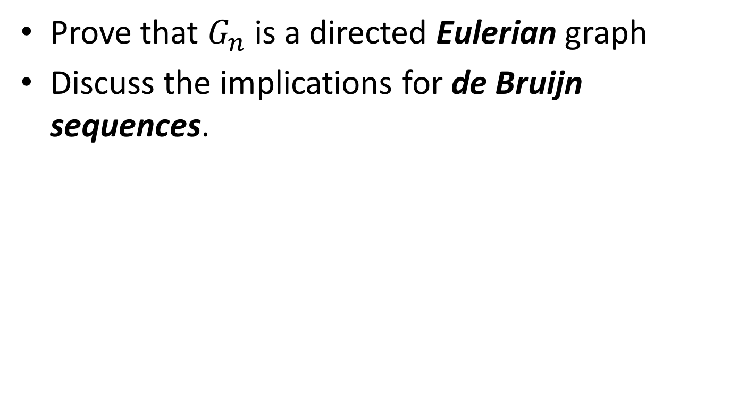
Problem 4
Prove that $G_{n}$ is a directed Eulerian graph
Discuss the implications for de Bruijn sequences.

Slide 4
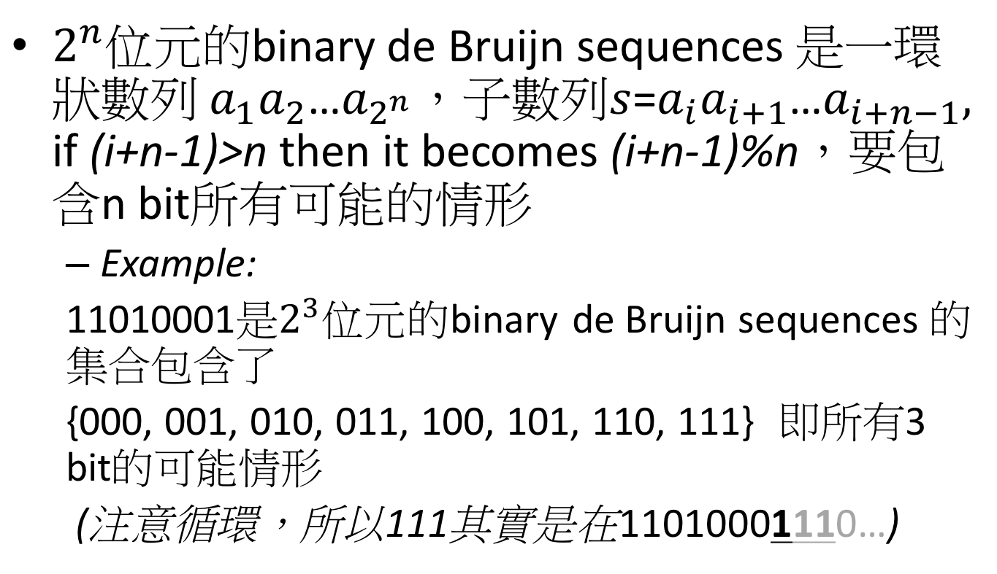
Problem 4 (cont.)
$2^{n}$位元的binary de Bruijn sequences 是一環狀數列 $a_{1}a_{2}$…$a_{2^{n}}$，子數列$s$=$a_{i}a_{i+1}$…$a_{i+n−1},$
if (i+n-1)>n then it becomes (i+n-1)%n，要包含n bit所有可能的情形
  Example:
  11010001是$2^{3}$位元的binary de Bruijn sequences 的集合包含了
  {000, 001, 010, 011, 100, 101, 110, 111} 即所有3 bit的可能情形
  (注意循環，所以111其實是在11010001110…)

Slide 5
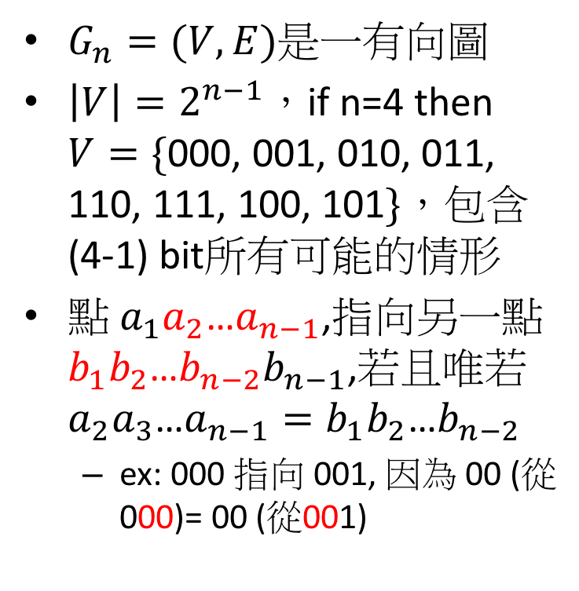
Problem 4 (cont.)
0
$G_{n}=(V, E)$是一有向圖
$\left|V\right|=2^{n−1}$，if n=4 then $V=\{$000, 001, 010, 011, 110, 111, 100, 101$\}$，包含(4-1) bit所有可能的情形
點 $a_{1}a_{2}$…$a_{n−1}$,指向另一點 $b_{1}b_{2}$…${b_{n−2}b}_{n−1}$,若且唯若$a_{2}a_{3}$…$a_{n−1}=b_{1}b_{2}$…$b_{n−2}$
  ex: 000 指向 001, 因為 00 (從000)= 00 (從001)
000
0
1
100
1
001
0
010
0
0
1
1
1
101
1
1
110
011
0
0
1
111

Slide 6
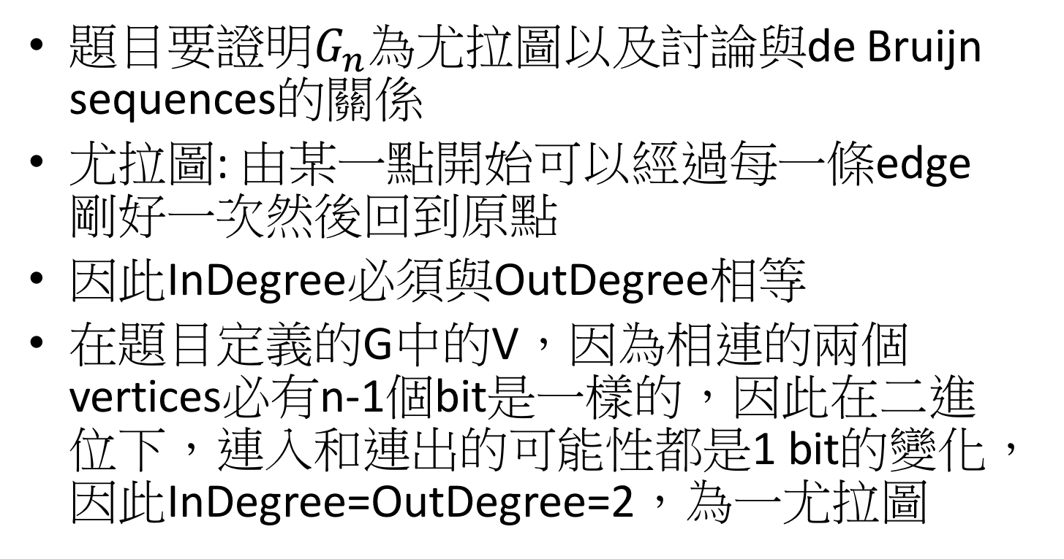
Problem 4 (cont.)
題目要證明$G_{n}$為尤拉圖以及討論與de Bruijn sequences的關係
尤拉圖: 由某一點開始可以經過每一條edge剛好一次然後回到原點
因此InDegree必須與OutDegree相等
在題目定義的G中的V，因為相連的兩個vertices必有n-1個bit是一樣的，因此在二進位下，連入和連出的可能性都是1 bit的變化，因此InDegree=OutDegree=2，為一尤拉圖

Slide 7
Problem 4 (cont.)
3bits de Bruijn sequences
每走過一個edge就納入後一個vertex的最後一個bit(該edge代表的變動bit)
  假設由00開始走: 00->00->01->11->11->10->01->10->00
得出的結果為:01110100, 長度為2^{n}
每個node中所含的數字會出現於走到該node的前兩個edge
  ex: “11” node, 01->11→11
而每個3bit的可能會由某node往下接二選一種edge得出
因此此sequences會包含所有3bits的可能性
0
00
01
1
1
0
0
1
10
11
0
1
n = 3

Slide 8
Problem 5
Given a directed acyclic graph G = (V,E), find a simple (directed) path in G that has the maximum number of edges among all simple paths in G. The algorithm should run in linear time.
Algorithm FindLongestPath(G)
Input: G = (V, E) (a directed acyclic graph)
Output: A Stack which records the longest path.
[length: the length of the path from a source vertex to the vertex which we are looking at, initial = 0]
Notes:
利用topological sort的方式traverse一個acyclic directed graph，同時每個node被traverse到時就更新目前到此node的最長路徑長度(length)
當traverse結束後，就可以再backward traverse回去記錄最長路徑

Slide 9
Problem 5 (cont.)
O(|V|+|E|)
begin
Initialize v.Indegree for every vertex v; //by DFS
for all vertices v in V do
if v.Indegree = 0 then put v in Queue; //begin of a path
repeat
remove vertex v from Queue;
for all edges (v, w) do
if v.length + 1 > w.length then //update the current longest path
w.length := v.length + 1;
w.pre := v;
w.Indegree := w.Indegree -1; //idea of topological sort
if w.Indegree = 0 then put w in Queue;
if Queue is empty then v_{path} := v; //used to get the whole path
until Queue is empty
put v_{path} on Stack;
while v_{path} has a predecessor do
put v_{path}.pre on Stack;
v_{path} := v_{path}.pre;
ouput: Stack
end
O(|V|)
O(|V| + |E|)
O(|V|)

