Slide 1
Algorithms
TA Session #2
2016/03/28
Prepared by Willy & Po-Chuan

Slide 2
Solution for HW#4

Slide 3
Q1
Recover package contents from Knapsack algorithm

Slide 4
Solution
Find the maximum k such that
P[ n, k ].exist is true.
Let x = n, and y = k
While y > 0
if P[ x, y ].belong = false
--x
else
report x is in the bag
y -= S[ x ]
--x

Slide 5
Trivia
The above code runs in O(N) time.
You may answer in C/C++ code or pseudo code, but make sure that you use the belong member.

Slide 6
Q2
Consider taking the i-th element first

Slide 7
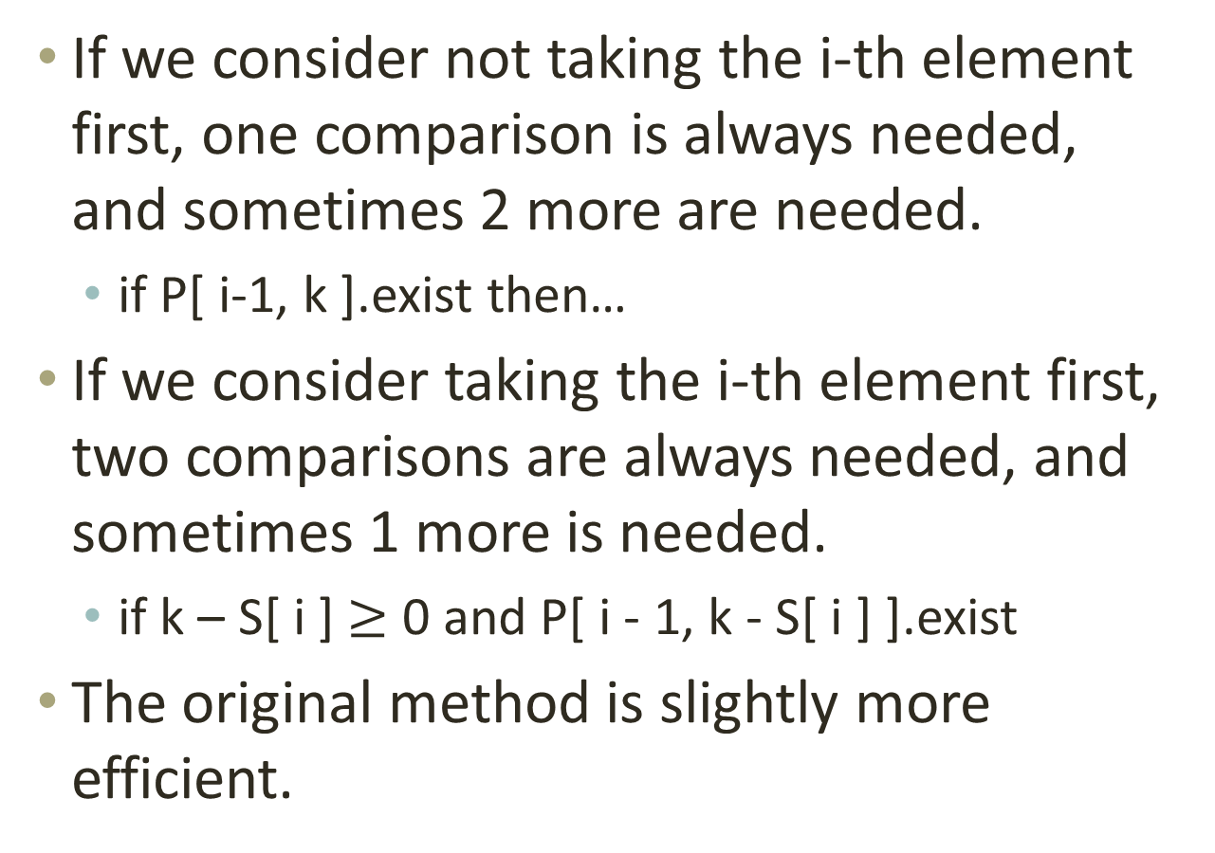
Which one is more efficient?
If we consider not taking the i-th element first, one comparison is always needed, and sometimes 2 more are needed.
  if P[ i-1, k ].exist then…
If we consider taking the i-th element first, two comparisons are always needed, and sometimes 1 more is needed.
  if k – S[ i ] $≥$ 0 and P[ i - 1, k - S[ i ] ].exist
The original method is slightly more efficient.

Slide 8
Redraw the figure
 | 0 | 1 | 2 | 3 | 4 | 5 | 6 | 7 | 8 | 9 | 10 | 11 | 12 | 13 | 14 | 15 | 16
 | O | - | - | - | - | - | - | - | - | - | - | - | - | - | - | - | -
k₁=2 | O | - | I | - | - | - | - | - | - | - | - | - | - | - | - | - | -
k₂=3 | O | - | O | I | - | I | - | - | - | - | - | - | - | - | - | - | -
k₃=5 | O | - | O | O | - | I | - | I | I | - | I | - | - | - | - | - | -
k₄=6 | O | - | O | O | - | O | I | O | I | I | O | I | - | I | I | - | I

Slide 9
Q3
Merge the projector

Slide 10
Pseudo code
Mark all partition points of blue and red.
For each marker:
Check the blue/red height between the next marker
Update the height with the lower one
Move the marker to the next marker

Slide 11
Q4
Knapsack problem – unlimited version

Slide 12
Modifications
Original code
Modified code
P[ i, k ].belong := false
if P[ i - 1, k - S[ i ] ].exist
P[ i, k ].belong := true
P[ i, k ].belong := 0
if P[ i, k - S[ i ] ].exist
P[ i, k ].belong :=
P[ i, k - S[ i ] ].belong + 1

Slide 13
Q5
Break a set into two with an equal sum

Slide 14
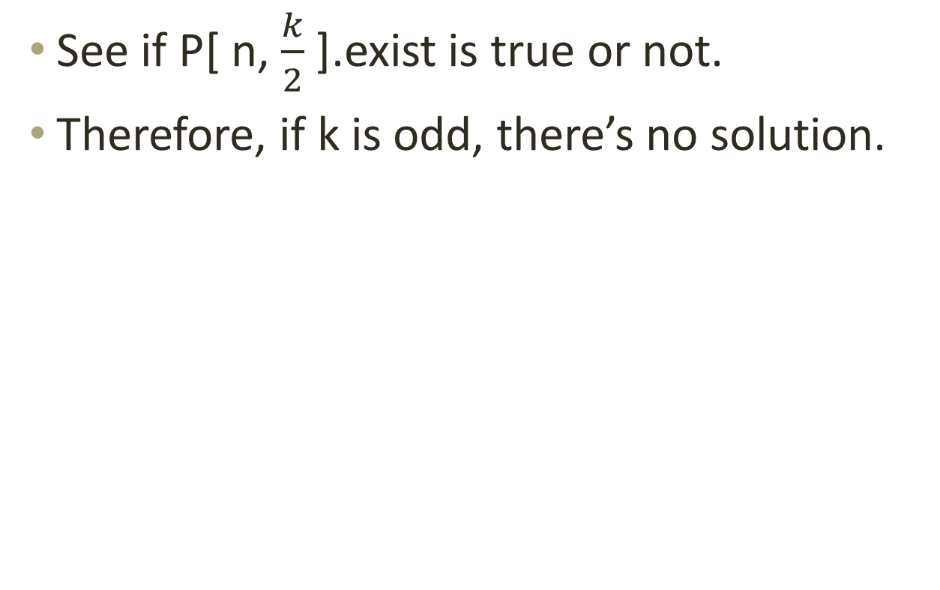
How to check the feasibility?
See if P[ n, $\frac{k}{2}$ ].exist is true or not.
Therefore, if k is odd, there’s no solution.

Slide 15
How to get the contents?
Apply the same procedure as we just discussed in problem 1.

