Slide 1
Algorithm HW #6
Prepared by Po-Chuan

Slide 2
Problem 1
AVL Tree Insertion

Slide 3
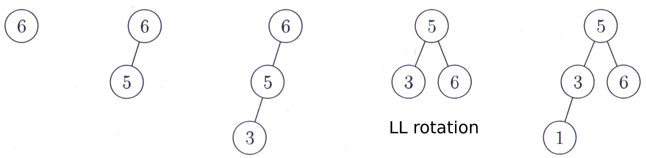
Part 1

Slide 4
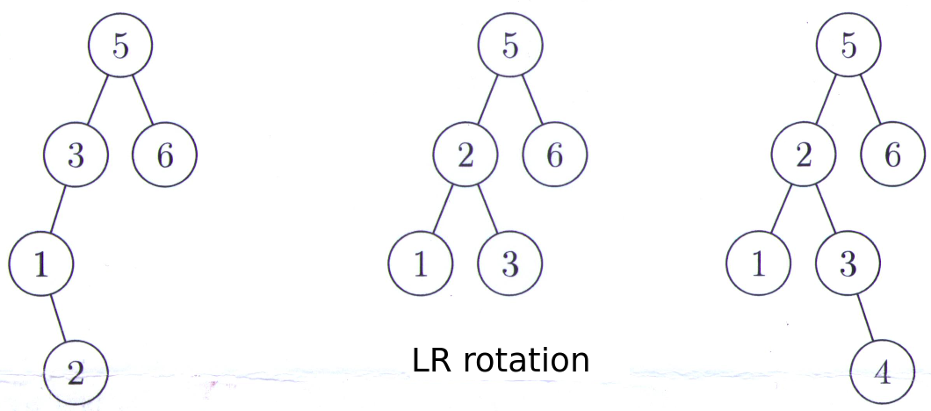
Part 2

Slide 5
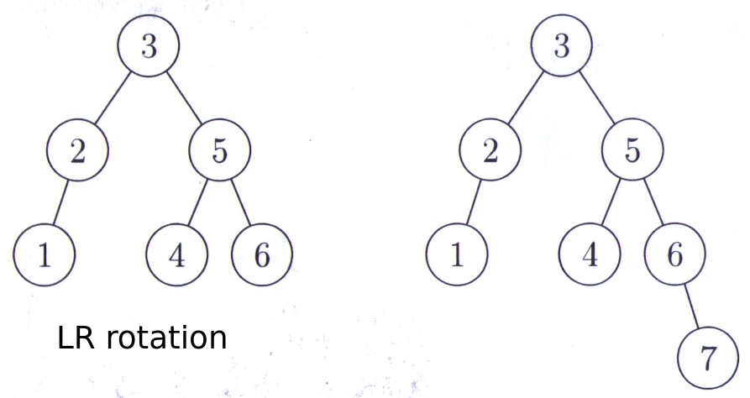
Part 3

Slide 6
Problem 2
Quicksort Partition

Slide 7
(a)
7 | 13 | 9 | 10 | 16 | 12 | 2 | 1 | 11 | 6 | 14 | 5 | 4 | 8 | 3 | 15
 | 3 |  |  |  |  |  |  |  |  |  |  |  |  | 13
 |  | 4 |  |  |  |  |  |  |  |  |  | 9
 |  |  | 5 |  |  |  |  |  |  |  | 10
 |  |  |  | 6 |  |  |  |  | 16
 |  |  |  |  | 1 |  | 12
2 |  |  |  |  |  | 7

Slide 8
(b)
7 | 13 | 9 | 10 | 16 | 12 | 2 | 1 | 11 | 6 | 14 | 5 | 4 | 8 | 3 | 15
1 | 2 | 4 | 5 | 6 | 3 | 7 | 12 | 11 | 16 | 14 | 10 | 9 | 8 | 13 | 15
1 | 2 | 3 | 4 | 6 | 5 | 7 | 12 | 11 | 16 | 14 | 10 | 9 | 8 | 13 | 15
1 | 2 | 3 | 4 | 5 | 6 | 7 | 12 | 11 | 16 | 14 | 10 | 9 | 8 | 13 | 15
1 | 2 | 3 | 4 | 5 | 6 | 7 | 10 | 11 | 8 | 9 | 12 | 14 | 16 | 13 | 15
1 | 2 | 3 | 4 | 5 | 6 | 7 | 8 | 9 | 10 | 11 | 12 | 14 | 16 | 13 | 15
1 | 2 | 3 | 4 | 5 | 6 | 7 | 8 | 9 | 10 | 11 | 12 | 13 | 14 | 16 | 15
1 | 2 | 3 | 4 | 5 | 6 | 7 | 8 | 9 | 10 | 11 | 12 | 13 | 14 | 15 | 16

Slide 9
For problem 3~5, please refer to 2015 slides.

Slide 10
Problem 3
Loop Invariant

Slide 11
Problem 4
Sum of the heights of all nodes in a full binary tree

Slide 12
Problem 5
False coin decision tree

