Slide 1
Algorithms ‘16
HW7 (hints)
Willy Chang, Po-Chuan Chien

Slide 2
Problem 1
Compute the next table as in the KMP algorithm for the string ababbaabab.
Show the details of your calculation.
Algorithm Compute_Next (B, m);
begin
next[1] := 1; next[2] := 0;
for i := 3 to m do
j := next[i -1] + 1;
  while b_{i-1} ≠ b_{j} and j > 0 do
  j := next[j] + 1;
next[i] := j
end

Slide 3
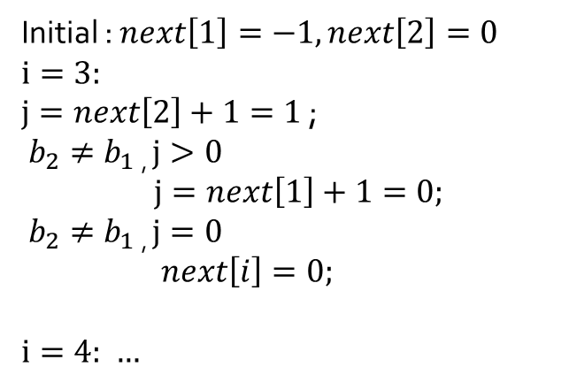
Problem 1 (cont.)
i | 1 | 2 | 3 | 4 | 5 | 6 | 7 | 8 | 9 | 10
B | a | b | a | b | b | a | a | b | a | b
next | -1 | 0
0
Initial : $next\left[1\right]=−1, next\left[2\right]=0$
$$i=3:$$
$j=next\left[2\right]+1=1$ ;
$b_{2}≠b_{1}$ , $j>0$
$j=next\left[1\right]+1=0;$
$b_{2}≠b_{1}$ , $j=0$
$next\left[i\right]=0;$
$i=4:$ …

Slide 4
Problem 2
Modify the KMP string matching algorithm to find the largest prefix of B that matches a substring of A. In other words, you do not need to match all of B inside A; instead, you want to find the largest match (but it has to start with b1).

Slide 5
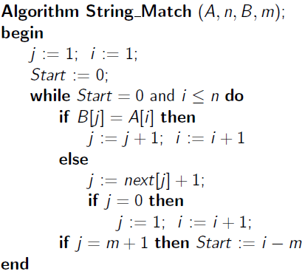
Problem 2 (cont.)
Record each Start
you found

Slide 6
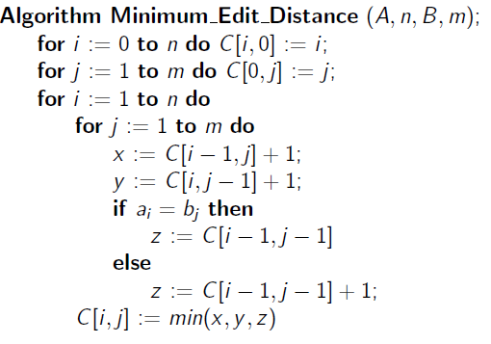
Problem 3
Given two strings bbaab and baaabb, compute the minimal cost matrix C[0..5, 0..6] for changing the first string character by character to the second one. Aside from giving the cost matrix, please show the details of how the entry C[5, 6] is computed.

Slide 7
Problem 3 (cont.)
i\j |  | b | a | a | a | b | b
 | 0 | 1 | 2 | 3 | 4 | 5 | 6
b | 1 | 0
b | 2
a | 3
a | 4
b | 5
$C\left[5,6\right]=\min\left(C\left[4,5\right]+1,C\left[4,6\right],C\left[5,5\right]\right)= ?$

Slide 8

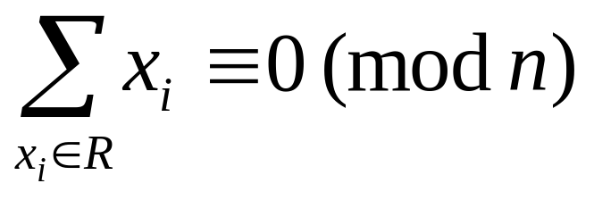
Problem 4
Design an algorithm that, given a set of integers S = {x₁, x₂, …, x_{n}}, finds a nonempty subset , such that

Slide 9
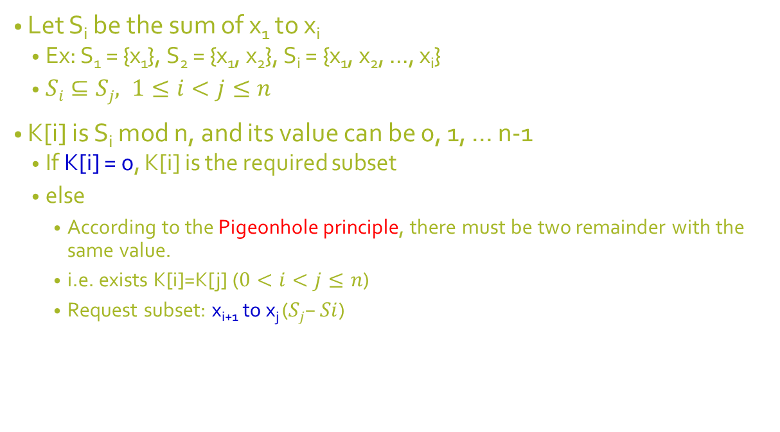
Problem 4 (cont.)
Let S_{i} be the sum of x₁ to x_{i}
  Ex: S₁ = {x₁}, S₂ = {x₁, x₂}, S_{i} = {x₁, x₂, …, x_{i}}
  $Si⊆Sj, 1≤i<j≤n$
K[i] is S_{i} mod n, and its value can be 0, 1, … n-1
  If K[i] = 0, K[i] is the required subset
  else
    According to the Pigeonhole principle, there must be two remainder with the same value.
    i.e. exists K[i]=K[j] ($0<i<j≤n$)
    Request subset: x_{i+1} to x_{j} ($Sj–Si$)
Notes:
Si為從x1加到xi
餘數可能為 0…n-1
S1~Sn共n個數，鴿籠原理，必有兩數的餘數相同(Rm=Rn)，取Rm-Rn

Slide 10
Problem 4 (cont.)
Algorithm FindSubset(S, n)
begin
sum := 0;
self:=-1;
for i := 0 to n-1 do
count[i].exist := false;
sum := S[i] + sum;
k[i] := sum mod n;
if k[i] = 0 then
self:= i;
break;
else if count[k[i]].exist then
count[k[i]].array2 := i;
break;
else
count[k[i]].array1 := i;
count[k[i]].value ++;
od
if self != -1 then
start:= 0;
end:= i;
else
start:=count[k[i]].array1+1;
end:= count[k[i]].array2;
for j := start to end do
print S[j];
od
end

Slide 11
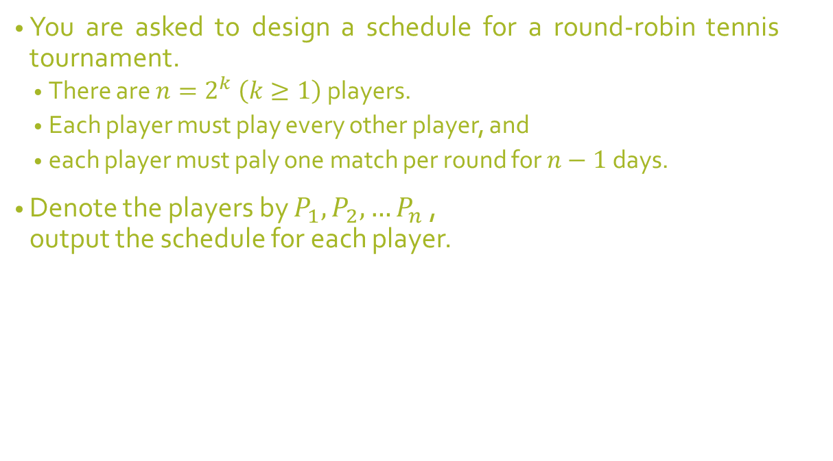
Problem 5
You are asked to design a schedule for a round-robin tennis tournament.
  There are $n=2^{k} \left(k≥1\right)$ players.
  Each player must play every other player, and
  each player must paly one match per round for $n−1$days.
Denote the players by $P_{1},P_{2}, …P_{n}$ ,
output the schedule for each player.

Slide 12
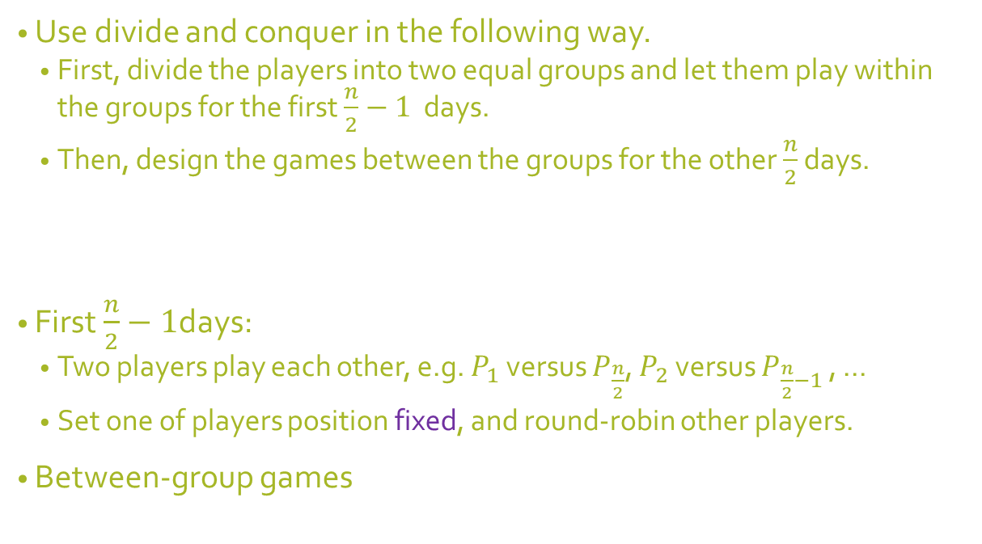
Problem 5 (cont.)
Use divide and conquer in the following way.
  First, divide the players into two equal groups and let them play within the groups for the first $\frac{n}{2}−1$ days.
  Then, design the games between the groups for the other $\frac{n}{2}$ days.
First $\frac{n}{2}−1$days:
  Two players play each other, e.g. $P_{1}$ versus $P_{\frac{n}{2}}$, $P_{2}$ versus $P_{\frac{n}{2}−1}$ , …
  Set one of players position fixed, and round-robin other players.
Between-group games

