Slide 1
Homework #2
Bo-Ren Xiao

Slide 2
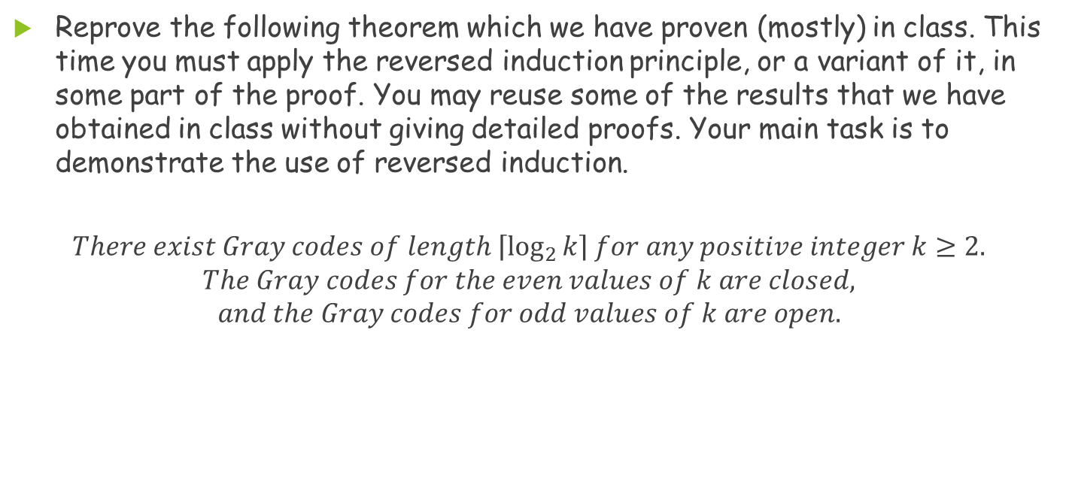
Problem1
Reprove the following theorem which we have proven (mostly) in class. This time you must apply the reversed induction principle, or a variant of it, in some part of the proof. You may reuse some of the results that we have obtained in class without giving detailed proofs. Your main task is to demonstrate the use of reversed induction.
$$There exist Gray codes of length \left\lceil \log_{2}{k}\right\rceil for any positive integer k≥2.$$
$$The Gray codes for the even values of k are closed,$$
$$and the Gray codes for odd values of k are open.$$

Slide 3
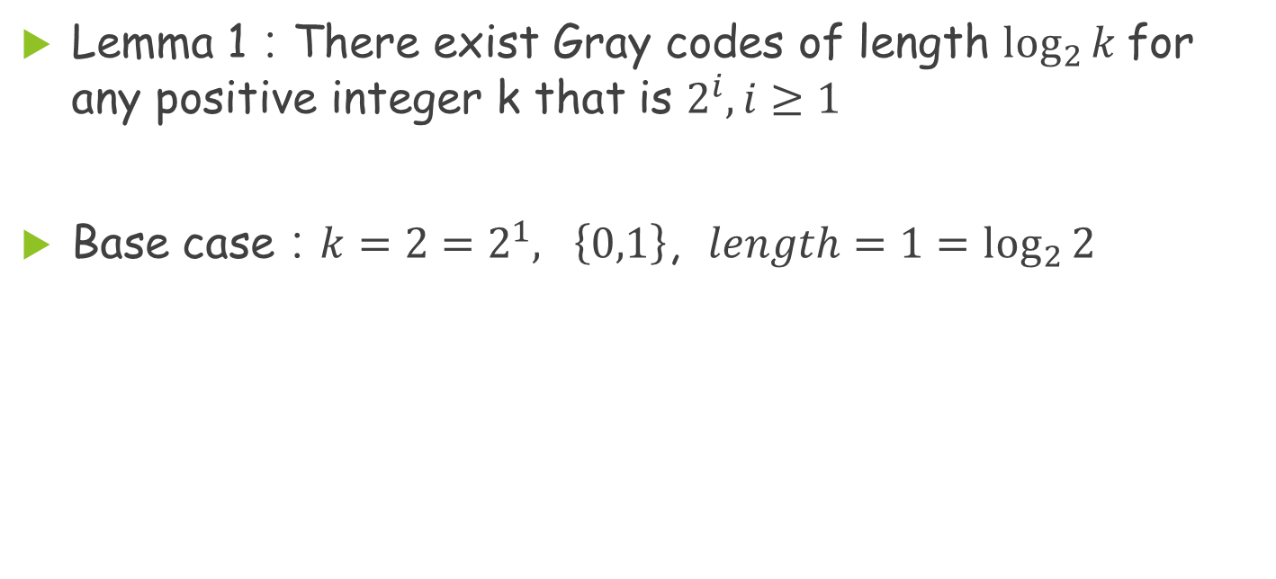
Problem 1(Cont.)
Lemma 1：There exist Gray codes of length $\log_{2}{k}$for any positive integer k that is $2^{i},i≥1$
Base case：$k=2=2^{1}, \left\{0,1\right\}$, $length=1=\log_{2}{2}$

Slide 4
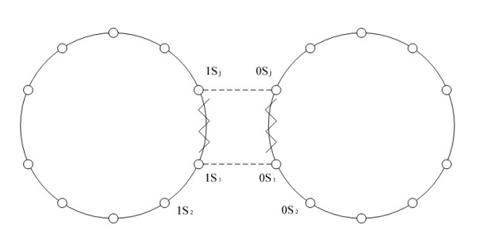
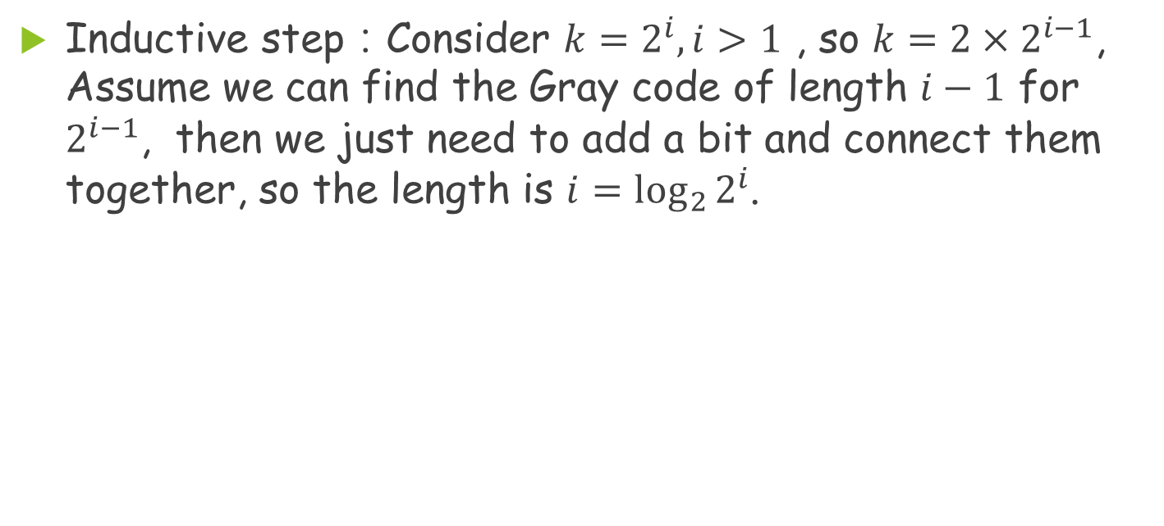
Problem 1(Cont.)
Inductive step：Consider $k=2^{i}, i>1$ , so $k=2×2^{i−1}$, Assume we can find the Gray code of length $i−1$ for $2^{i−1}$, then we just need to add a bit and connect them together, so the length is $i=\log_{2}{2^{i}}$.

Slide 5
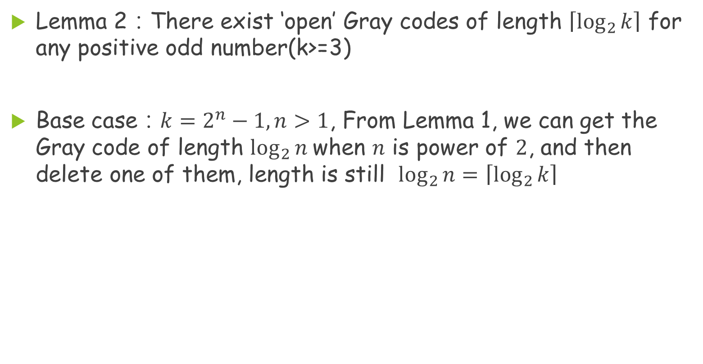
Problem 1(Cont.)
Lemma 2：There exist ‘open’ Gray codes of length $\left\lceil \log_{2}{k}\right\rceil$ for any positive odd number(k>=3)
Base case：$k=2^{n}−1, n>1$, From Lemma 1, we can get the Gray code of length $\log_{2}{n}$when $n$ is power of $2$, and then delete one of them, length is still $\log_{2}{n}=\left\lceil \log_{2}{k}\right\rceil$

Slide 6
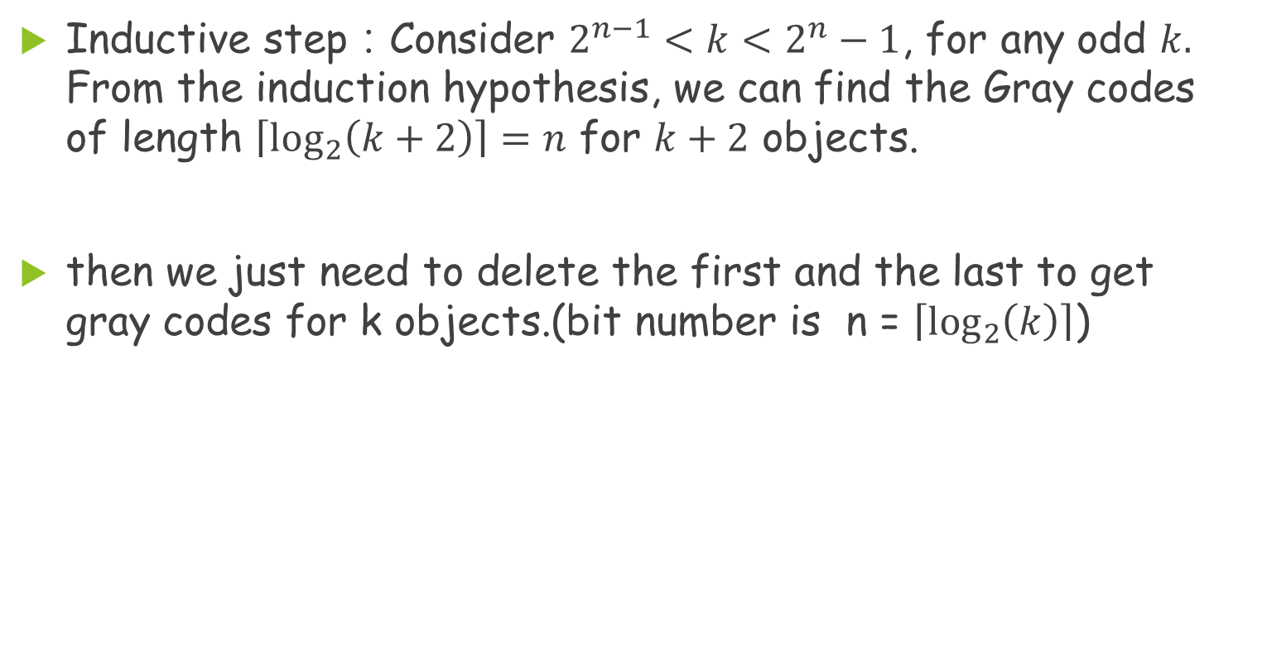
Problem 1(Cont.)
Inductive step：Consider $2^{n−1}<k<2^{n}−1$, for any odd $k.$ From the induction hypothesis, we can find the Gray codes of length $\left\lceil \log_{2}\left(k+2\right)\right\rceil =n$ for $k+2$ objects.
then we just need to delete the first and the last to get gray codes for k objects.(bit number is n = $\left\lceil \log_{2}\left(k\right)\right\rceil$)

Slide 7
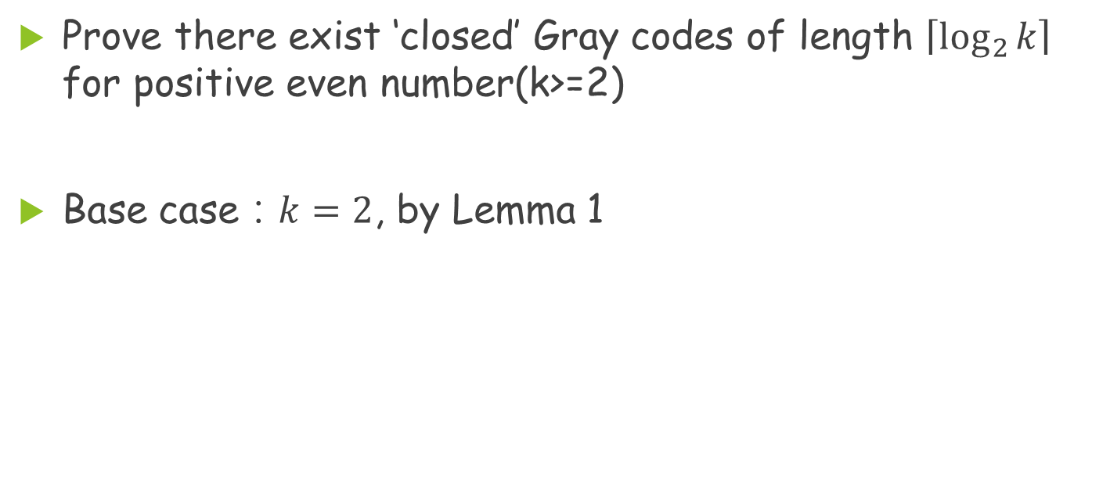
Problem 1 (Cont.)
Prove there exist ‘closed’ Gray codes of length $\left\lceil \log_{2}{k}\right\rceil$ for positive even number(k>=2)
Base case：$k=2$, by Lemma 1

Slide 8
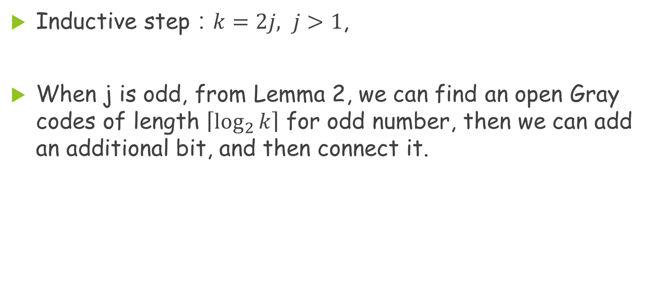
Problem 1 (Cont.)
Inductive step：$k=2j, j>1$,
When j is odd, from Lemma 2, we can find an open Gray codes of length $\left\lceil \log_{2}{k}\right\rceil$ for odd number, then we can add an additional bit, and then connect it.

Slide 9
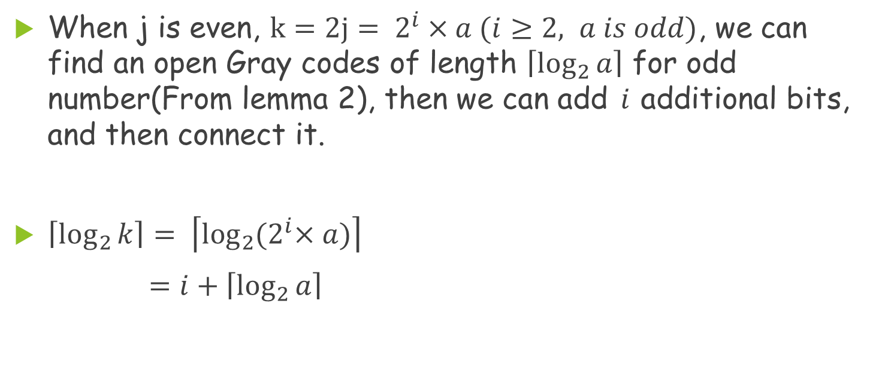
Problem 1 (Cont.)
When j is even, $k=2j= 2^{i}×a (i≥2, a is odd)$, we can find an open Gray codes of length $\left\lceil \log_{2}{a}\right\rceil$ for odd number(From lemma 2), then we can add $i$additional bits, and then connect it.
$\left\lceil \log_{2}{k}\right\rceil = \left\lceil \log_{2}{{(2}^{i}×a)}\right\rceil$
$=i+\left\lceil \log_{2}{a}\right\rceil$

Slide 10
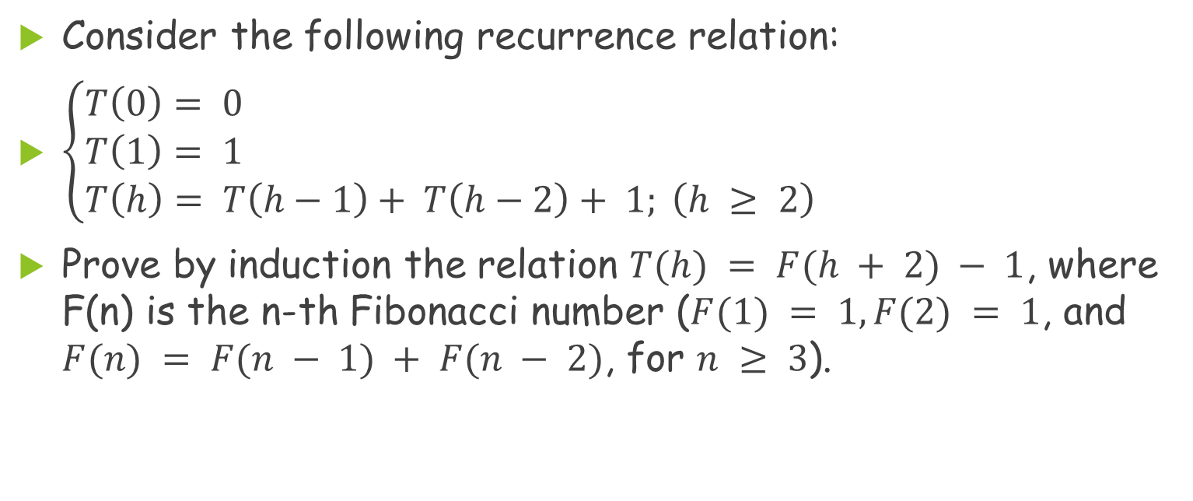
Problem 2
Consider the following recurrence relation:
$\left\{\begin{aligned}&T\left(0\right)= 0 \\ &T\left(1\right)= 1 \\ &T\left(h\right)= T\left(h−1\right)+ T\left(h−2\right)+ 1; \left(h ≥ 2\right) \end{aligned}\right.$
Prove by induction the relation $T(h) = F(h + 2) − 1$, where F(n) is the n-th Fibonacci number ($F(1) = 1, F(2) = 1$, and $F(n) = F(n − 1) + F(n − 2)$, for $n ≥ 3$).

Slide 11
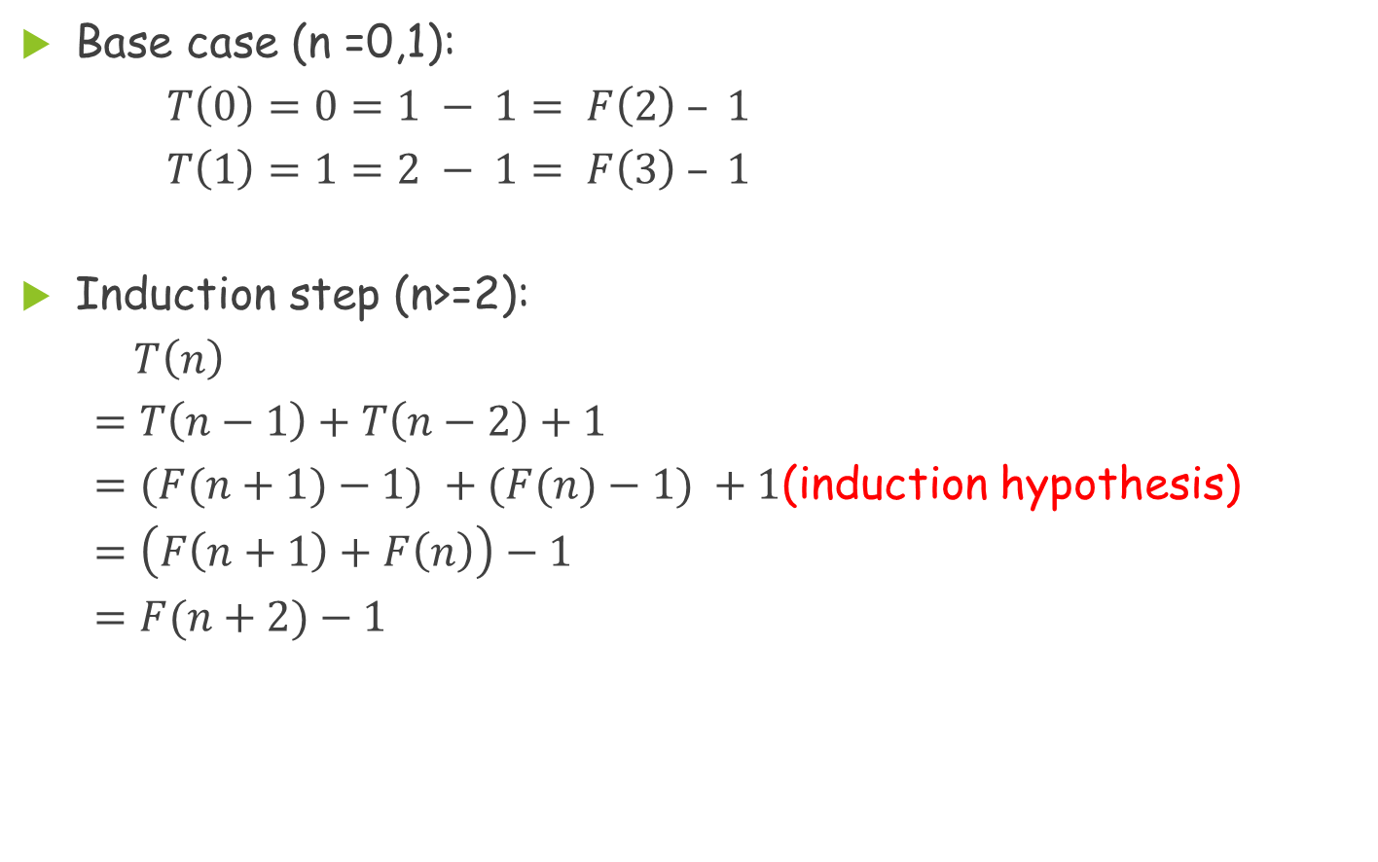
Problem 2(Cont.)
Base case (n =0,1):
$T\left(0\right)=0=1 − 1= F\left(2\right) – 1$
$T\left(1\right)=1=2 − 1= F\left(3\right) – 1$
  Induction step (n>=2):
  $T\left(n\right)$
  $=T\left(n−1\right)+T\left(n−2\right)+1$
  $=(F(n+1)−1) +(F(n)−1) +1$(induction hypothesis)
  $=\left(F\left(n+1\right)+F\left(n\right)\right)−1$
  $=F(n+2)−1$

Slide 12
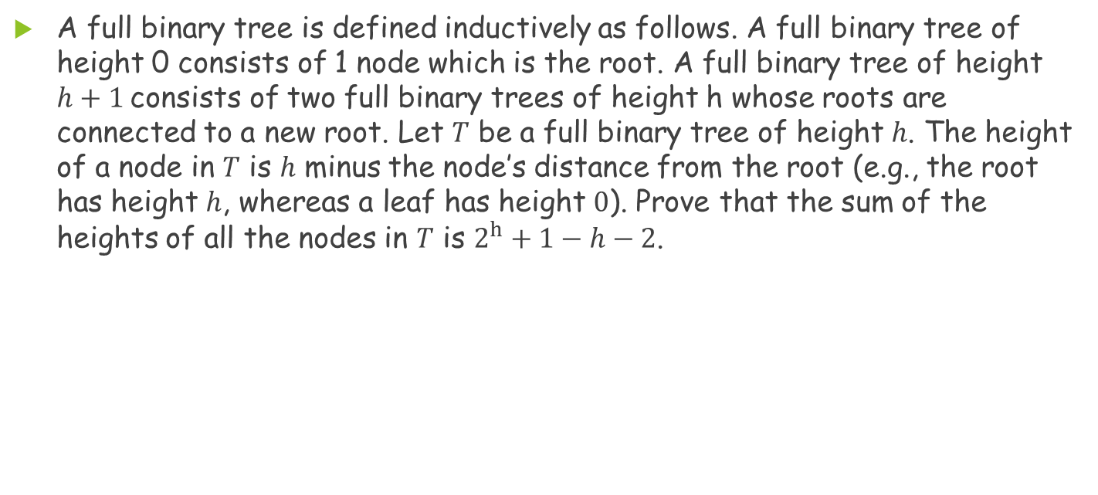
Problem 3
A full binary tree is defined inductively as follows. A full binary tree of height 0 consists of 1 node which is the root. A full binary tree of height $h+1$consists of two full binary trees of height h whose roots are connected to a new root. Let $T$ be a full binary tree of height $h$. The height of a node in $T$ is $h$ minus the node’s distance from the root (e.g., the root has height $h$, whereas a leaf has height $0$). Prove that the sum of the heights of all the nodes in $T$ is $2^{h}+1−h−2$.

Slide 13
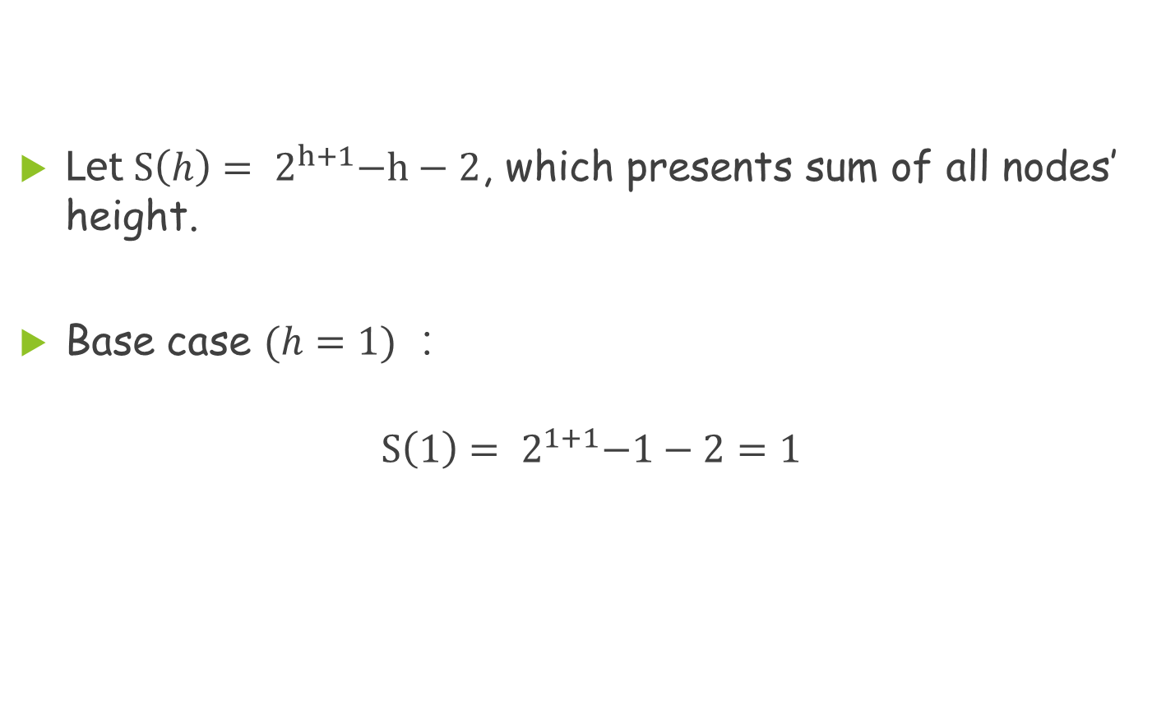
Problem 3(Cont.)
Root
Root
Let${ S\left(h\right)= 2}^{h+1}−h−2$, which presents sum of all nodes’ height.
Base case $(h=1)$：
$${ S\left(1\right)= 2}^{1+1}−1−2=1$$

Slide 14
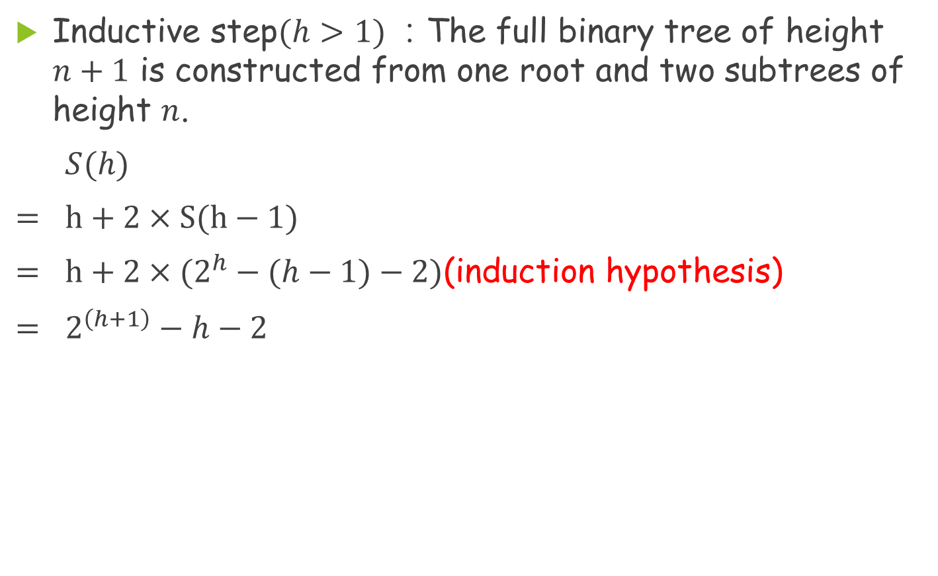
Problem 3(Cont.)
Inductive step$(h>1)$：The full binary tree of height $n+1$ is constructed from one root and two subtrees of height $n$.
$S(h)$
$=$ $h+2×S(h−1)$
  $=$ $h+2×(2^{h}−(h−1)−2)$(induction hypothesis)
$=$ $2^{\left(h+1\right)}−h−2$

Slide 15
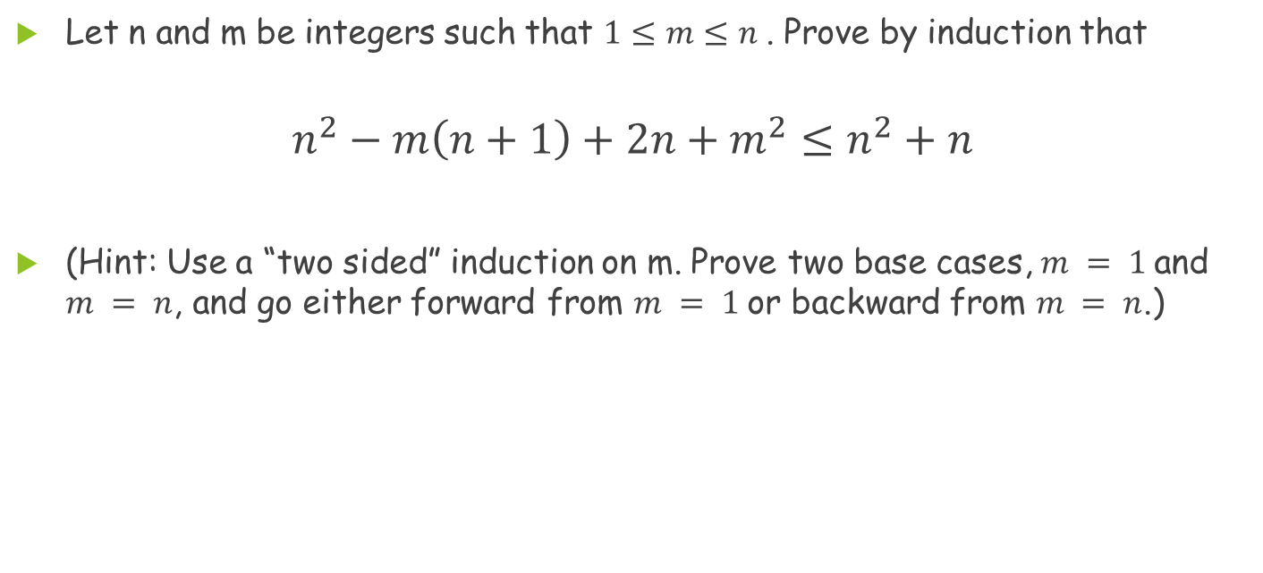
Problem 4
Let n and m be integers such that $1≤m≤n$. Prove by induction that
$$n^{2}−m\left(n+1\right)+2n+m^{2}≤n^{2}+n$$
(Hint: Use a “two sided” induction on m. Prove two base cases, $m = 1$and $m = n$, and go either forward from $m = 1$or backward from $m = n$.)

Slide 16
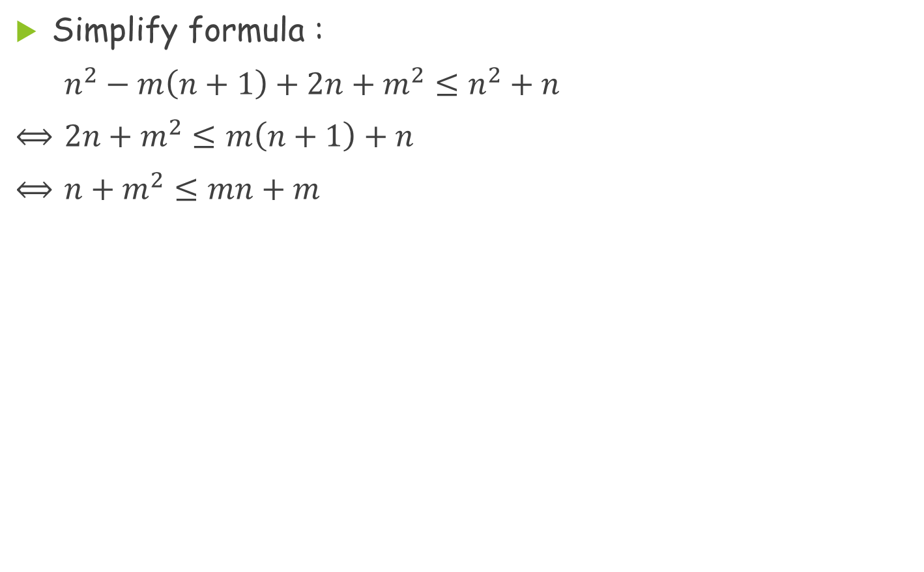
Problem 4(Cont.)
Simplify formula :
$n^{2}−m\left(n+1\right)+2n+m^{2}≤n^{2}+n$
$⟺$ $2n+m^{2}≤m\left(n+1\right)+n$
$⟺$ $n+m^{2}≤mn+m$

Slide 17
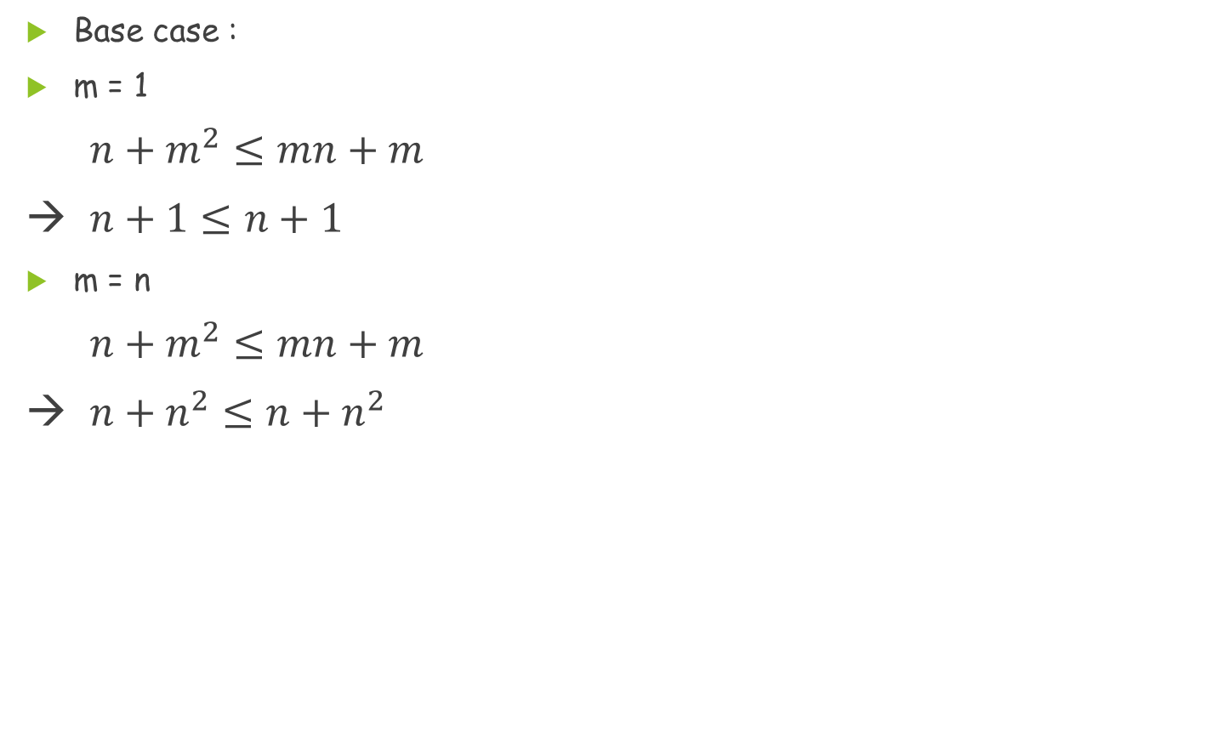
Problem 4(Cont.)
Base case :
m = 1
$n+m^{2}≤mn+m$
→ $n+1≤n+1$
m = n
$n+m^{2}≤mn+m$
→ $n+n^{2}≤n+n^{2}$

Slide 18
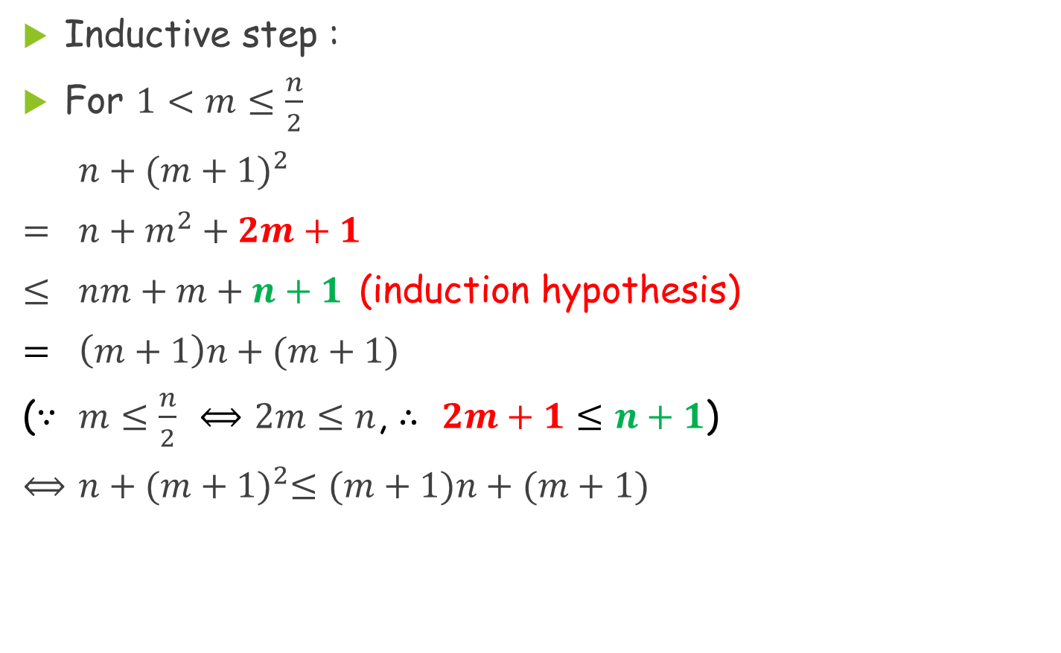
Problem 4(Cont.)
Inductive step :
For $1<m≤\frac{n}{2}$
$n+{(m+1)}^{2}$
$=$ $n+m^{2}+2m+1$
$≤$ $nm+m+n+1$ (induction hypothesis)
$=$ $\left(m+1\right)n+(m+1)$
($∵$ $m≤\frac{n}{2}$ $⟺$ $2m≤n$, $∴$ $2m+1≤$ $n+1$)
$⟺$ $n+{(m+1)}^{2}≤(m+1)n+(m+1)$

Slide 19
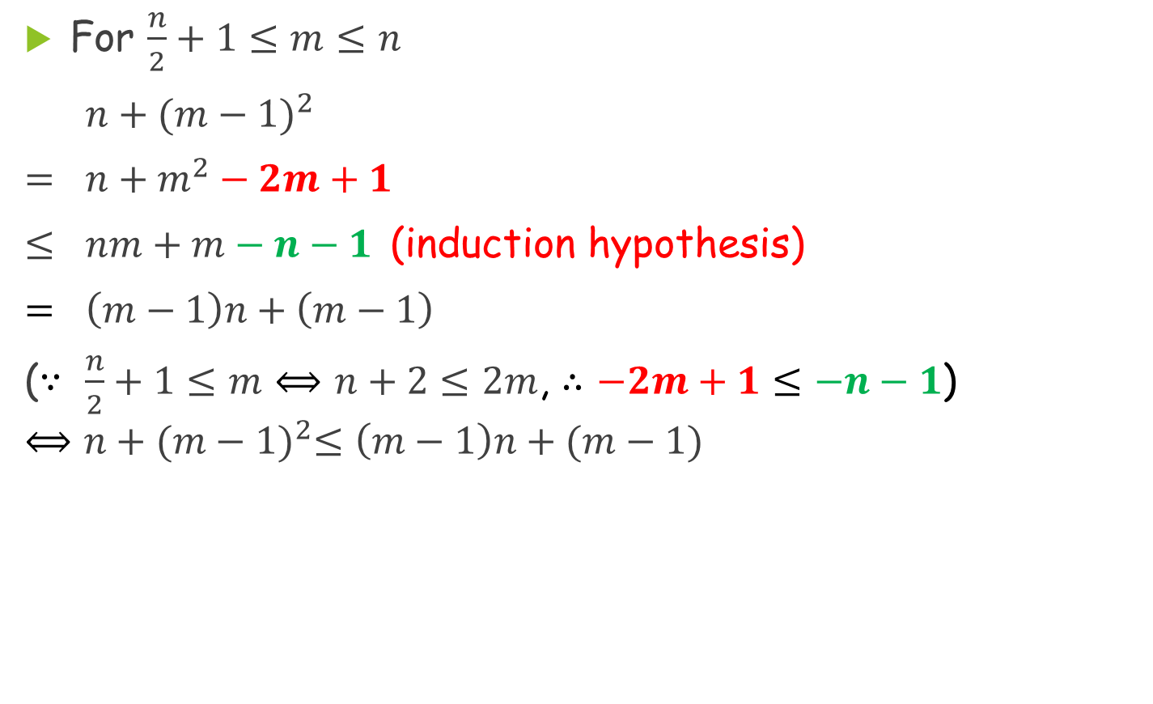
Problem 4(Cont.)
For $\frac{n}{2}+1≤m≤n$
$n+{(m−1)}^{2}$
$=$ $n+m^{2}−2m+1$
$≤$ $nm+m−n−1$ (induction hypothesis)
$=$ $\left(m−1\right)n+\left(m−1\right)$
($∵$ $\frac{n}{2}+1≤m$ $⟺$ $n+2≤2m$, $∴$ $−2m+1≤−n−1$)
$$⟺n+{(m−1)}^{2}≤\left(m−1\right)n+(m−1)$$

Slide 20
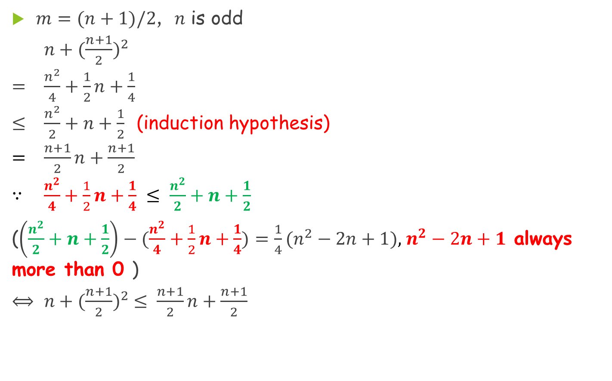
Problem 4(Cont.)
$m=(n+1)/2$, 𝑛 is odd
$n+{(\frac{n+1}{2})}^{2}$
$=$ $\frac{n^{2}}{4}+\frac{1}{2}n+\frac{1}{4}$
$≤$ $\frac{n^{2}}{2}+n+\frac{1}{2}$ (induction hypothesis)
$=$ $\frac{n+1}{2}n+\frac{n+1}{2}$
$∵$ $\frac{n^{2}}{4}+\frac{1}{2}n+\frac{1}{4} ≤ \frac{n^{2}}{2}+n+\frac{1}{2}$
($\left(\frac{n^{2}}{2}+n+\frac{1}{2}\right)−(\frac{n^{2}}{4}+\frac{1}{2}n+\frac{1}{4})=\frac{1}{4}(n^{2}−2n+1)$, $n^{2}−2n+1$ always more than 0 )
$⟺$ $n+{(\frac{n+1}{2})}^{2} ≤ \frac{n+1}{2}n+\frac{n+1}{2}$

Slide 21
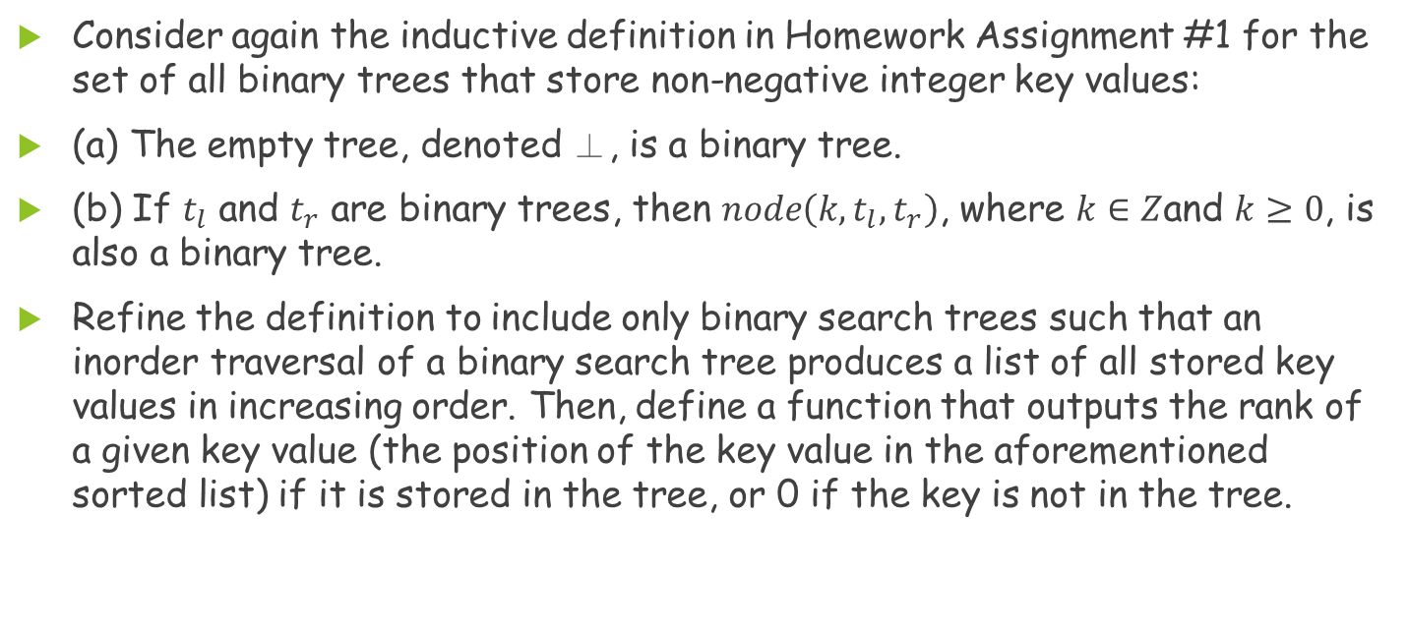
Problem 5
Consider again the inductive definition in Homework Assignment #1 for the set of all binary trees that store non-negative integer key values:
(a) The empty tree, denoted ⊥, is a binary tree.
(b) If $t_{l}$ and $t_{r}$ are binary trees, then $node\left(k,t_{l},t_{r}\right)$, where $k∈Z$and $k≥0$, is also a binary tree.
Refine the definition to include only binary search trees such that an inorder traversal of a binary search tree produces a list of all stored key values in increasing order. Then, define a function that outputs the rank of a given key value (the position of the key value in the aforementioned sorted list) if it is stored in the tree, or 0 if the key is not in the tree.

Slide 22
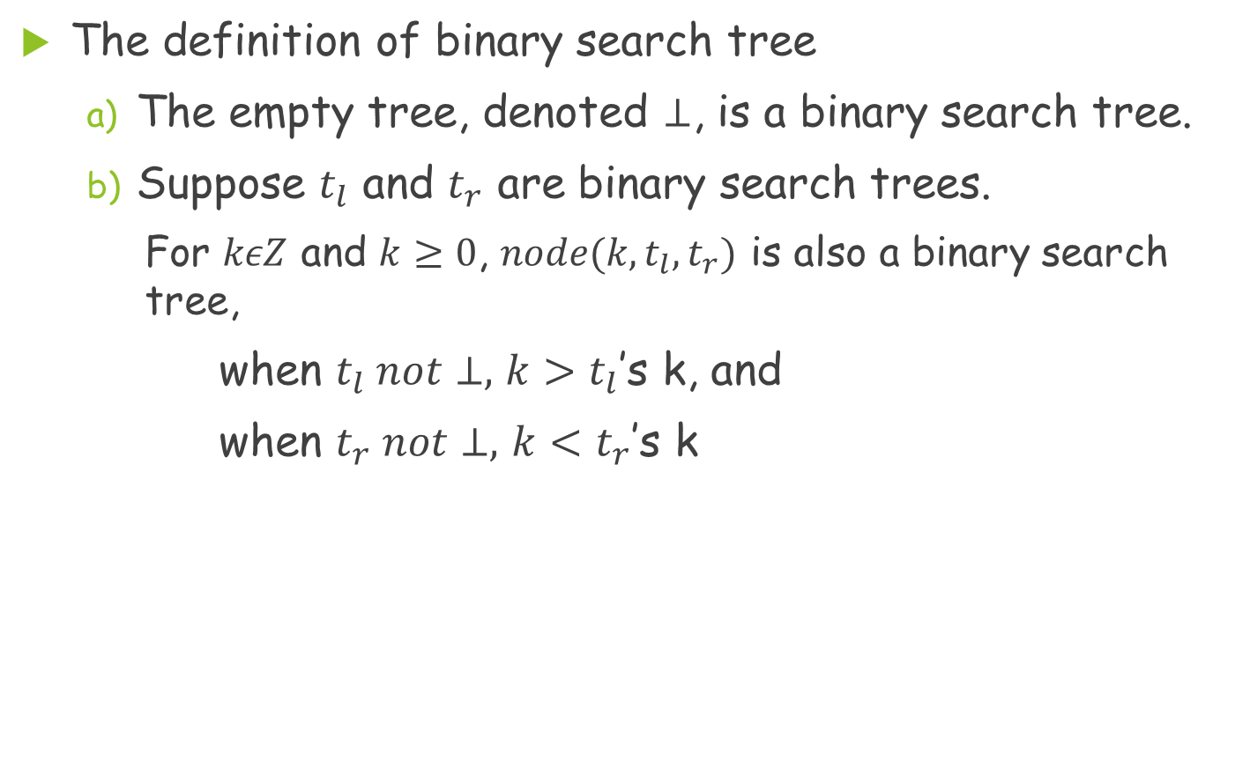
Problem 5(Cont.)
The definition of binary search tree
  The empty tree, denoted $⊥$, is a binary search tree.
  Suppose $t_{l}$ and $t_{r}$ are binary search trees.
    For $kεZ$ and $k≥0$, $node({k, t}_{l},t_{r})$ is also a binary search tree,
    when $t_{l} not⊥,$ $k>t_{l}$’s k, and
    when $t_{r} not⊥,$ $k<t_{r}$’s k

Slide 23
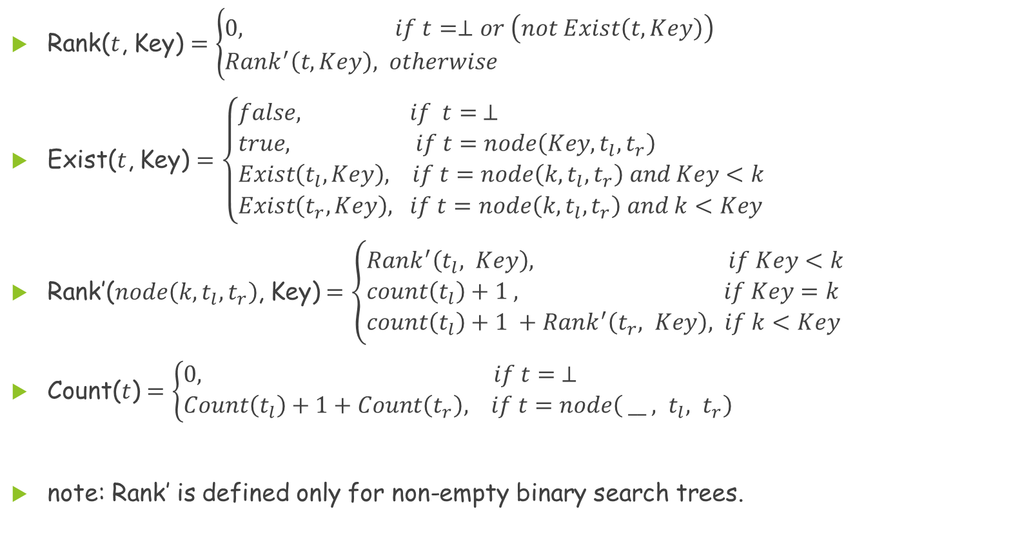
Problem 5(Cont.)
Rank($t$, Key) $=\left\{\begin{aligned}&0, if t=⊥or \left(not Exist\left(t,Key\right)\right) \\ &Rank^{′}\left(t,Key\right), otherwise\end{aligned}\right.$
Exist($t$, Key) $=\left\{\begin{aligned}&false, if t= ⊥ \\ &true, if t=node\left(Key,t_{l},t_{r}\right) \\ &Exist\left(t_{l},Key\right), if t=node\left(k,t_{l},t_{r}\right) and Key<k \\ &Exist\left(t_{r},Key\right), if t=node\left(k,t_{l},t_{r}\right) and k<Key\end{aligned}\right.$
Rank′($node\left(k,t_{l},t_{r}\right)$, Key)$=\left\{\begin{aligned}&Rank^{′}\left(t_{l}, Key\right), if Key<k \\ &count\left(t_{l}\right)+1 , if Key=k \\ &count\left(t_{l}\right)+1 +Rank^{′}\left(t_{r}, Key\right), if k<Key\end{aligned}\right.$
Count($t$) $=\left\{\begin{aligned}&0, if t= ⊥ \\ &Count\left(t_{l}\right)+1+Count\left(t_{r}\right), if t=node\left({{ __ , t}_{l}, t}_{r}\right)\end{aligned}\right.$
note: Rank’ is defined only for non-empty binary search trees.

