Slide 1
Homework #8
Boren Xiao

Slide 2
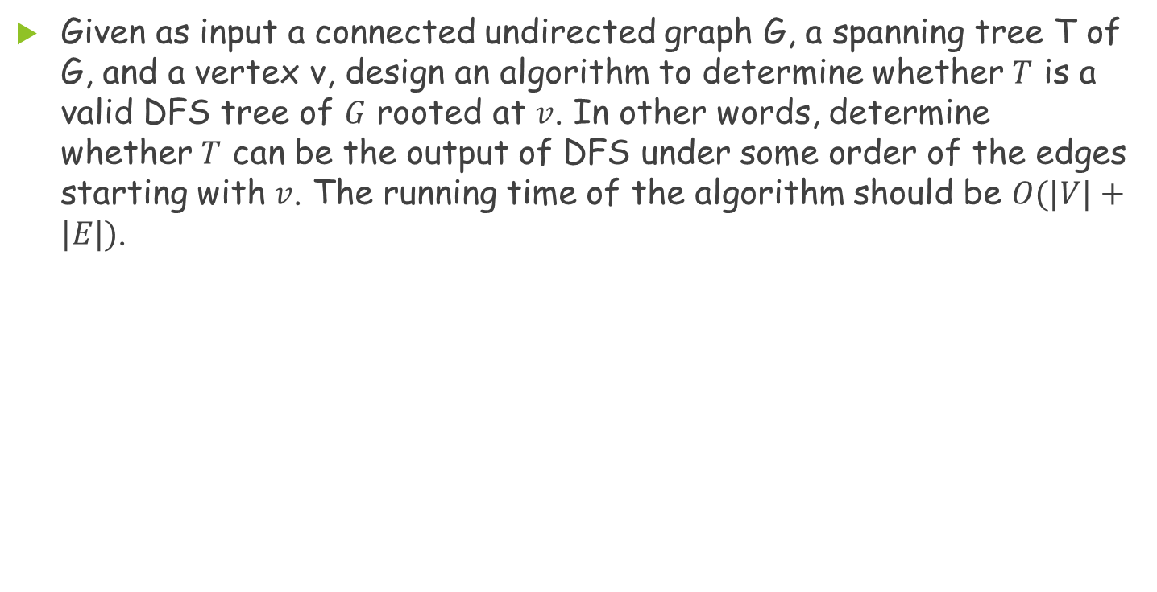
Problem 1
Given as input a connected undirected graph G, a spanning tree T of G, and a vertex v, design an algorithm to determine whether $T$ is a valid DFS tree of $G$ rooted at $v$. In other words, determine whether $T$ can be the output of DFS under some order of the edges starting with $v$. The running time of the algorithm should be $O(|V|+|E|)$.

Slide 3
Problem 1(Cont.)
To Do：
  Use DFS to traverse spanning tree T and mark vertex
  Check if spanning tree‘ s every edge is in G
  Check if spanning tree contains cycle
  After DFS, check if any adjacent vertex in G has not been marked

Slide 4
Problem 1(Cont.)
Graph G
Wrong edge
BFS
DFS_1
DFS_2

Slide 5
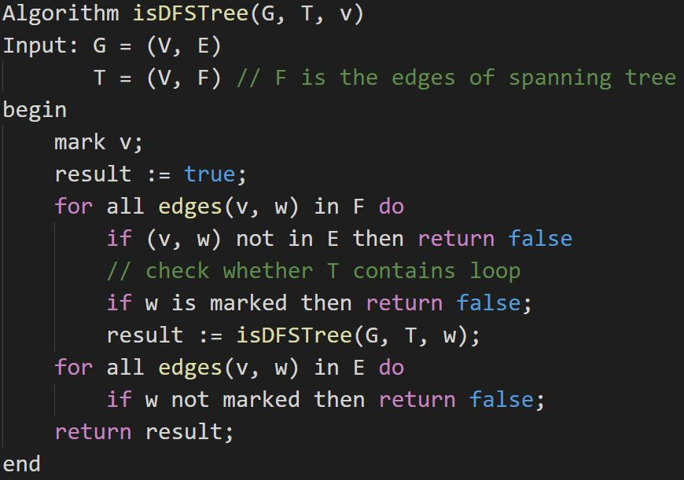
Problem 1(Cont.)

Slide 6
Problem 2
Describe an efficient implementation of the algorithm discussed in class for finding an Eulerian circuit in a graph. The algorithm should run in linear time and space. (Hint: the discovery of a cycle and that of the Eulerian circuits in individual connected components with the cycle removed, in the induction step, can be interweaved.)

Slide 7
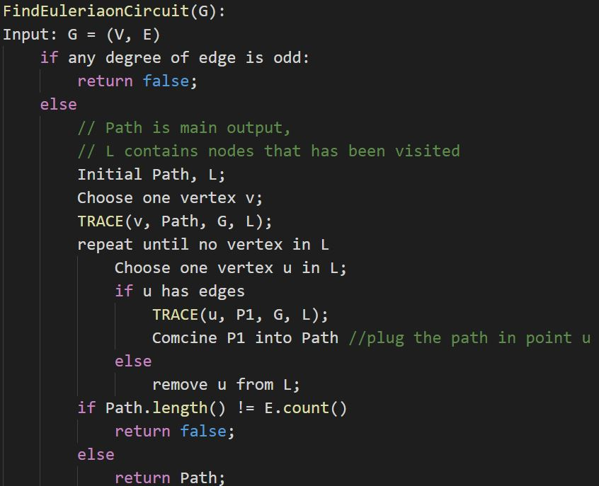
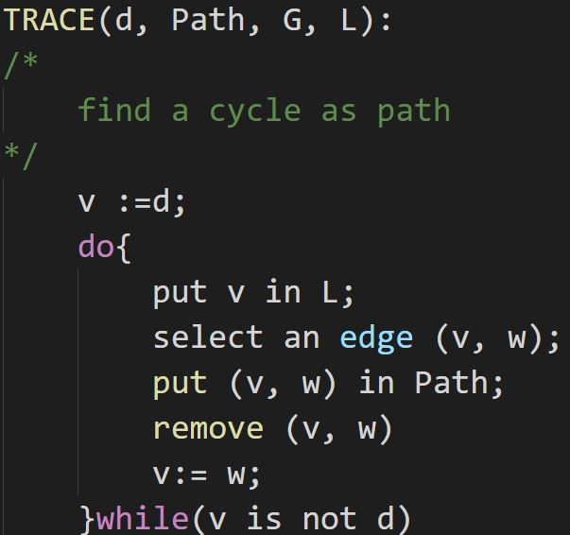
Problem 2(Cont.)
Solution1

Slide 8
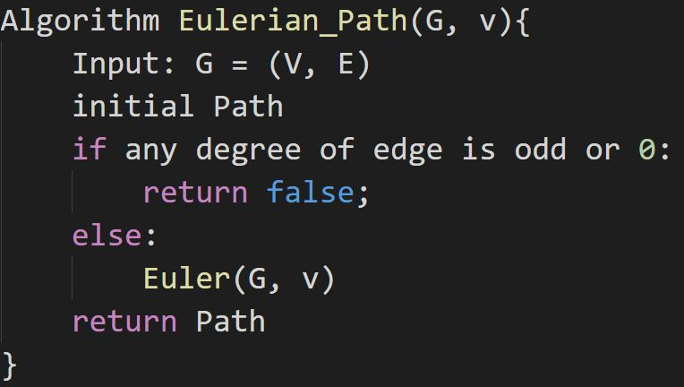
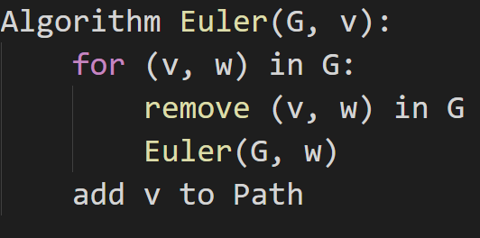
Problem 2(Cont.)
Solution2

Slide 9

Problem 3
A binary de Bruijn sequence is a cyclic sequence of $2^{n}$ bits $a_{1},a_{2},…,a_{2^{n}}$ such that each binary string $s$ of size $n$ is represented somewhere in the sequence; that is, there exists a unique index $i$ such that $s=a_{i},a_{i+1}, …,a_{i+n−1}$ (where the indices are taken modulo $2^{n}$ ). For example, the sequence $11010001$ is a binary de Bruijn sequence for $n=3$. Let $G_{n}=(V, E)$ be a directed graph defined as follows. The vertex set $V$ corresponds to the set of all binary strings of size $n−1 (|V|=2^{n−1} )$.A vertex corresponding to the string $a_{1},a_{2},…,a_{n−1}$has an edge leading to a vertex corresponding to the string $b_{1},b_{2},…,b_{n−1}$ if and only if $a_{2},a_{3},…,a_{n−1}= b_{1},b_{2}, …,b_{n−2}$. Prove that $G_{n}$ is a directed Eulerian graph, and discuss the implications for de Bruijn sequences.

Slide 10
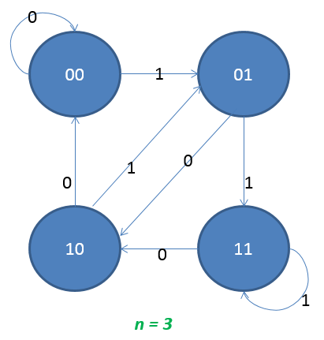

Problem 3(Cont.)
For the definition, the adjacent vertex has the $n−1$ same bits.
In the binary system, the way to connect to next vertex is only 0 or 1. So, the inDegree of all the vertex $=$ the outDegree $=$ 2.
Therefore, there is an Eulerian circuit.
For n-bits de Bruijn sequences, the number in the node is composed by the previous $n−1$ edges. E.g. $n=3,$the number
of 11, is composed by 00->01->11
So the sequences are included all the n-bits group.

Slide 11
Problem 4
In the topological sorting algorithm that we discussed in class for directed acyclic graphs, DFS is used to calculate the indegree of each vertex in the input graph. Please give a detailed description of this calculation in adequate pseudocode.

Slide 12
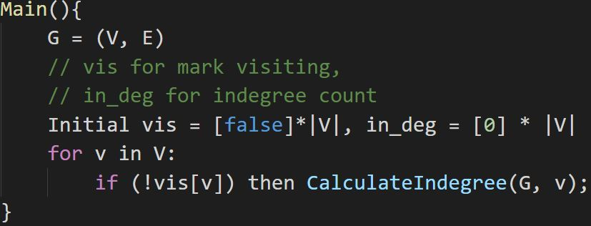
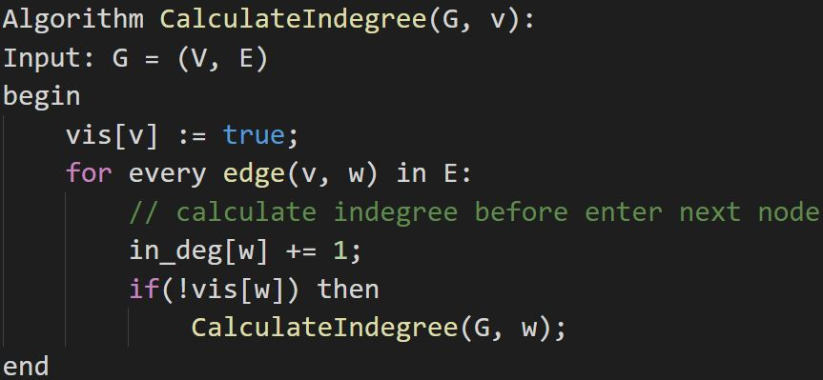
Problem 4(Cont.)

Slide 13
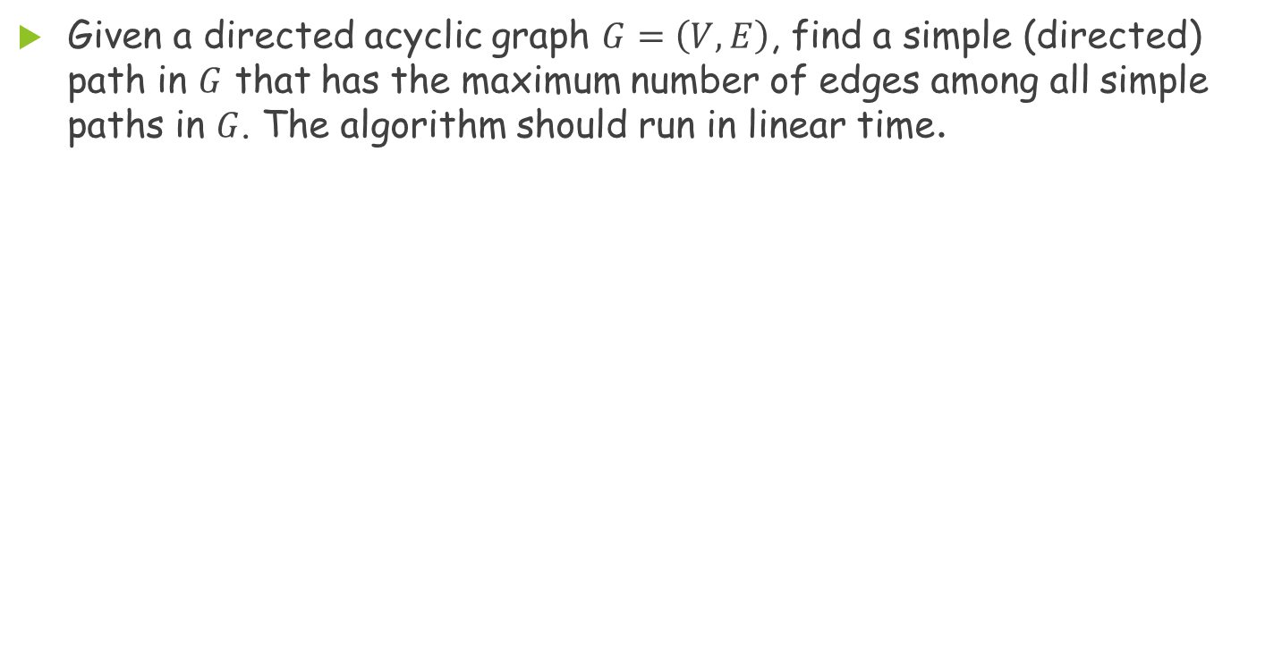
Problem 5
Given a directed acyclic graph $G=\left(V, E\right)$, find a simple (directed) path in $G$ that has the maximum number of edges among all simple paths in $G$. The algorithm should run in linear time.

Slide 14
Problem 5(Cont.)
0
0
0
0
0
0
0
0
0

Slide 15
Problem 5(Cont.)
1
0
0
0
0
0
0
1
0

Slide 16
Problem 5(Cont.)
1
2
0
0
0
0
2
1
0

Slide 17
Problem 5(Cont.)
1
2
0
0
0
0
3
1
0

Slide 18
Problem 5(Cont.)
1
2
4
5
6
0
3
1
4

Slide 19
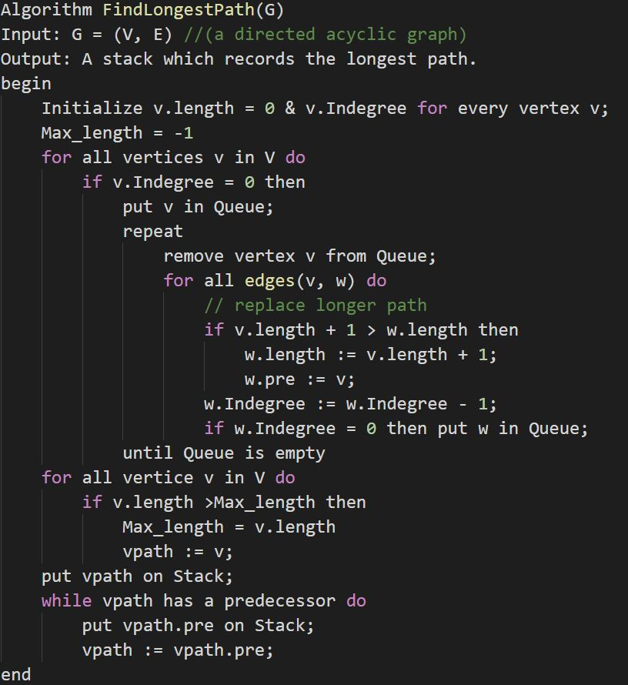
Problem 5(Cont.)
Step1:
calculate each vertex’s longest path by BFS
Step2:
find a vertex which has the longest length and put it into stack

