Slide 1
Algorithms 2018
HW9
Carlos Chang
2018.06.12

Slide 3
Problem 1.
Proof by contradiction
  Suppose there exist two minimum-cost spanning trees A and B on a graph.
  Sort by the cost of edge (e₁<e₂<…)
    A: {e₁, e₂, …} B: {e₁’, e₂’, …}
  Let e_{i} be the minimum cost edge in A but not B.
  Let e_{j}’ be the minimum cost edge in B but not A .
  Assume e_{i} < e_{j}’, then B∪{e_{i}} will create a cycle
  Let e_{k}’ be the maximum cost edge of the cycle
  Since all edge costs are distinct and e_{k}’ is the maximum cost edge in a cycle, e_{k}’ does not belong to any minimum spanning tree. But e_{k}’ is in B
  → B is not minimum-cost spanning tree (Contradiction)
  → The original statement proved true.

Slide 4
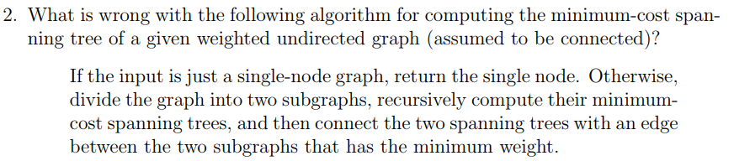

Slide 5
Problem 2
How to divide the graph correctly is a critical problem.
However, the algorithm does not mention how to divide the graph into two subgraphs at all.
The algorithm will be failed if it divides the graph like following example.
5
1
10
5
5
10
5
1
10

Slide 6
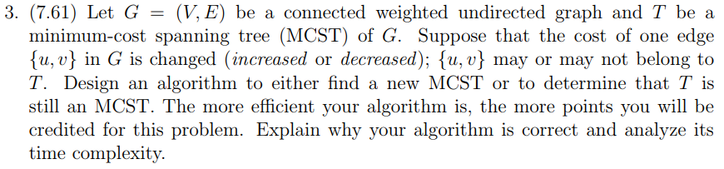

Slide 7
Problem 3. (cont.)
{u, v}
T1
T2
f
 | {u, v} in T | {u, v} NOT in T
{u, v} increase | Delete {u, v} edge from T T becomes two subtrees T1, T2. Find the minimum cost edge f that connecting T1 and T2. If f= {u, v} ) same MCST else add the edge k to T. (※Lemma) | Same MCST
{u, v } decrease | Same MCST | Add {u, v} edge to T. There is a cycle in T. Find the maximum cost edge k in the cycle. Delete the edge k from T.
Lemma: Adding additional edge k to a minimal cost spanning tree T, it will create a cycle .
In the cycle, k is the maximum cost edge.

Slide 8
Input: G(V, E): undirected graph, T: MCST, e={u, v} 2 G
Output: T’: new MCST or print “No Change”
Algorithm newMCST (G, T, e);
1 begin
2 w := e.weight;
3 new_edge := e;
4 if e ∈ T and e increases then
5 T’ := T - e;
6 T1 := DFS_Tree(T’, u);
7 T2 := DFS_Tree(T’, v);
8 for all edges k connecting T1 and T2 do
9 if k.weight < w then
10 w := k.weight;
11 new_edge := k;
12 if k = e then
13 print “No Change”
14 else
15 T’ := T’ + new_edge;
16 return T’;
17 else if e ∉ T and e decreases then
18 T’ := T + e;
19 C := Find_Cycle(T, e);
20 for all edge k in C do
21 if k.weight > w then
22 w := k.weight;
23 new_edge := k;
24 T’ := T’ – new_edge;
25 if new_edge = e then
26 print “No Change”
27 else
28 return T’;
29 else
30 print “No Change”
O(|V|+|E|)
O(|V|)
O(|V1|+|E1|)
O(|V2|+|E2|)
O(|E|)
Time Complexity: O(|V|+|E|)

Slide 9
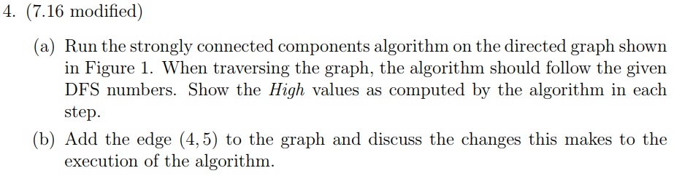
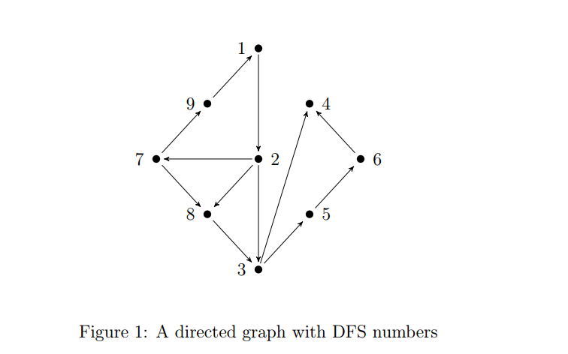

Slide 10
(a)
Vertex | 1 | 2 | 3 | 4 | 5 | 6 | 7 | 8 | 9
DFS_N | 9 | 8 | 7 | 6 | 5 | 4 | 3 | 2 | 1
1 | 9 | - | - | - | - | - | - | - | -
2 | 9 | 8 | - | - | - | - | - | - | -
3 | 9 | 8 | 7 | - | - | - | - | - | -
4 | 9 | 8 | 7 | 6 | - | - | - | - | -
3 | 9 | 8 | 7 | 6 | - | - | - | - | -
5 | 9 | 8 | 7 | 6 | 5 | - | - | - | -
6 | 9 | 8 | 7 | 6 | 5 | 4 | - | - | -
5 | 9 | 8 | 7 | 6 | 5 | 4 | - | - | -
3 | 9 | 8 | 7 | 6 | 5 | 4 | - | - | -
2 | 9 | 8 | 7 | 6 | 5 | 4 | - | - | -
7 | 9 | 8 | 7 | 6 | 5 | 4 | 3 | - | -
8 | 9 | 8 | 7 | 6 | 5 | 4 | 3 | 2 | -
7 | 9 | 8 | 7 | 6 | 5 | 4 | 3 | 2 | -
9 | 9 | 8 | 7 | 6 | 5 | 4 | 3 | 2 | 9
7 | 9 | 8 | 7 | 6 | 5 | 4 | 9 | 2 | 9
2 | 9 | 9 | 7 | 6 | 5 | 4 | 9 | 2 | 9
1 | 9 | 9 | 7 | 6 | 5 | 4 | 9 | 2 | 9
1
9
4
7
2
6
8
8
5
3

Slide 11
(b)
1
9
4
7
2
6
8
8
5
3

Slide 12
(b)
Vertex | 1 | 2 | 3 | 4 | 5 | 6 | 7 | 8 | 9
DFS_N | 9 | 8 | 7 | 6 | 5 | 4 | 3 | 2 | 1
1 | 9 | - | - | - | - | - | - | - | -
2 | 9 | 8 | - | - | - | - | - | - | -
3 | 9 | 8 | 7 | - | - | - | - | - | -
4 | 9 | 8 | 7 | 6 | - | - | - | - | -
5 | 9 | 8 | 7 | 6 | 5 | - | - | - | -
6 | 9 | 8 | 7 | 6 | 5 | 6 | - | - | -
5 | 9 | 8 | 7 | 6 | 6 | 6 | - | - | -
3 | 9 | 8 | 7 | 6 | 6 | 6 | - | - | -
2 | 9 | 8 | 7 | 6 | 6 | 6 | - | - | -
7 | 9 | 8 | 7 | 6 | 6 | 6 | 3 | - | -
8 | 9 | 8 | 7 | 6 | 6 | 6 | 3 | 2 | -
7 | 9 | 8 | 7 | 6 | 6 | 6 | 3 | 2 | -
9 | 9 | 8 | 7 | 6 | 6 | 6 | 3 | 2 | 9
7 | 9 | 8 | 7 | 6 | 6 | 6 | 9 | 2 | 9
2 | 9 | 9 | 7 | 6 | 6 | 6 | 9 | 2 | 9
1 | 9 | 9 | 7 | 6 | 6 | 6 | 9 | 2 | 9

Slide 13


Slide 14
Problem 5
Let G = (V, E) be a directed graph, and let T be a DFS tree of G.
Prove:
The intersection of
  The edges of T
  The edges of any strongly connected components of G
Forms a subtree of T.

Slide 15
Problem 5
Prove by contradiction:
  Suppose the intersection results in two subtrees of T.
  Let them as t1 and t2.
  Because t1 and t2 are in the same SCC, there must be an edge between them no matter what the direction it is.
  Also, the DFS tree must contains that edge, so if the intersection results are t1 and t2, T is not a DFS tree. (Contradiction)
  The original statement is proved true.

Slide 16
HW5

Slide 17
至ceiba課程網站公佈欄觀看成績
務必在符合測試情境下測試
環境因素也要考慮

