Slide 1
Data Abstraction
Yih-Kuen Tsay
Dept. of Information Management
National Taiwan University
Based on [Carrano and Henry 2013]
With help from Chien Chin Chen

Slide 2
About “Problem Solving”
In a program-development-centric course (such as data structures), we consider problems that require a program as the final solution.
So, solving a problem means to analyze the problem statement for understanding its requirements and develop a computer program that meets the requirements.
Note that there are problems that cannot be solved, even if they have been specified precisely.

Slide 3
How Should We Approach It? (1/3)
Where did you begin when you wrote your last program?
  After reading (or writing) the problem specification?
Many of us simply begin to write code.
  Then spend a lot of time debugging and praying for correct results.
Coding without a solution design increases debugging time.

Slide 4
How Should We Approach It? (2/3)
Certainly, with this kind of training (or struggling), our programming skills are better now than when we wrote our first program.
But what if we are writing a really large program?
A team of programmers for a large software development project requires
  an overall plan,
  organization, and
  communication

Slide 5
How Should We Approach It? (3/3)
Software engineering provides techniques for facilitating the development of large computer programs.
One central technique: modularity
  Modularity keeps the complexity of a large program manageable by systematically controlling the interaction of its components.

Slide 6
Modularity and Data Abstraction (1/2)
A modular program is
  easier to write,
  easier to read, and
  easier to modify.
It also
  eliminates redundancies and
  isolates errors.

Slide 7
Modularity and Data Abstraction (2/2)
A modular program usually consists of
  existing modules and
  modules you have to write.
Modules communicate with one another through a clear set of specifications.
Data abstraction aims to ensure that a module’s specifications
  detail how the module behaves and
  be independent of the module’s implementation.

Slide 8
Object-Oriented Solutions
An object-oriented (OO) solution is a program that consists of a system of interacting classes of objects.
  Each object has characteristics (attributes) and behaviors (funcitons) related to the solution.
  A class is a set of objects having the same type.
Object-oriented analysis and design helps us discover and describe these objects and classes (to construct a solution, i.e., a program).

Slide 9
Object-Oriented Programming (1/2)
An object-oriented language enables us to build classes of objects.
A class encompasses
  Attributes (characteristics) of objects of a single type
    Typically data.
    Called data members.
  Behaviors (operations)
    Typically operate on the data.
    Called methods or member functions.

Slide 10
Object-Oriented Programming (2/2)
Principles of object-oriented programming:
  Encapsulation:
    Objects combine data and operations.
    Hides inner details.
  Inheritance:
    Classes can inherit properties from other classes.
    Existing classes can be reused.
  Polymorphism:
    Objects can determine appropriate operations at execution time.

Slide 11
More about OO Solutions (1/3)
A solution is an object-oriented program consisting of modules.
A module is a self-contained unit of code; it can be
  A single, stand-alone function.
  A method of a class.
  A class.
  A group of several functions or classes working closely together.
  Some block of code.

Slide 12
More about OO Solutions (2/3)
Functions and methods (or modules) implement algorithms.
  Algorithm: a step-by-step recipe for performing a task within a finite period of time.
  Algorithms often operate on a collection of data.

Slide 13
More about OO Solutions (3/3)
When designing a solution, your challenge is to create a good set of modules.
  Modules must store, move, and alter data.
  Modules use algorithms to communicate with one another.
Problem solving is to organize data collection and provide efficient operations on the data.

Slide 14
Object-Oriented Analysis and Design (1/3)
Analysis
  Understand what the problem is and what the requirements of a solution are.
    What a solution (program) must do.
    Not how to implement the solution.
  Generates an accurate understanding of what end users will expect the solution to be.
Design
  Explores (describes) a solution to a problem.
  To fulfill the requirements discovered during analysis.

Slide 15
Object-Oriented Analysis and Design (2/3)
Object-oriented analysis (OOA)
  Expresses an understanding of the problem and the requirements of a solution in terms of objects within the problem domain.
  Objects can represent
    Real-world objects. e.g., car, rabbit.
    Software systems. e.g., stack, queue.
    Ideas.
Using OOA, you describe objects and their interactions among one another.

Slide 16
Object-Oriented Analysis and Design (3/3)
Object-oriented design (OOD)
  Describes a solution in terms of software objects and how objects will collaborate with one another to fulfill the requirements of the problem.
    Collaboration → call each other’s operations.
    Collaborations should be meaningful and minimal.
During OOD, you may create one or more models of a solution.
  Some emphasize interactions among objects.
  Others emphasize relationships among objects.

Slide 17
Achieving a Better Solution
Analysis and design improve solutions.
If you have generated many correct but different solutions, what aspects of one solution make it better than the others?
What aspects lead to a better solution?

Slide 18
Cohesion and Coupling (1/2)
Cohesion:
  A highly cohesive module performs one well-defined task.
  The name of a module promotes self-documenting, easy-to-understand code.
    E.g., a function called sort should do nothing but sort.
  Easy to reuse in other software projects.
  Easy to revise or correct.
  Robust: less likely to be affected by change; performs well under unusual conditions.
  Promotes low coupling.
Guideline: if a module (class or function) has too many responsibilities, it should be split into multiple modules.

Slide 19
Cohesion and Coupling (2/2)
Coupling:
  Modules with low coupling are independent of one another.
    Dependent → calling other’s methods.
  A system of modules with low coupling is
    easier to change (a change to one module won’t affect another),
    easier to understand,
    easier to reuse, and
    has increased cohesion.
  Coupling cannot be and should not be eliminated entirely.
    Objects must collaborate to get work done.
    But it should be kept to minimum.

Slide 20
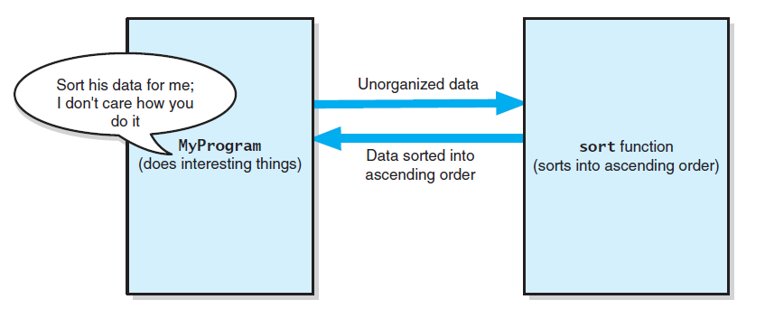
Separation of Concerns
The task sort is a module separate from
the MyProgram module
Source: FIGURE 1-1 in [Carrano and Henry 2013].

Slide 21
Specification of a Module
What it does
But not how it does it

Slide 22
Operation Contracts (1/3)
A contract shows the responsibilities of one module to another.
  Used to document code, particularly in header files.
Begin the contract during analysis and finish during design.
  Does not describe how the module will perform its task.
A module’s operation contract specifies its
  purpose,
  assumptions, and
  input and output.

Slide 23
Operation Contracts (2/3)
Precondition:
  Statement of conditions that must exist before a module executes.
Postcondition:
  Statement of conditions that exist after a module executes.
Example of module contract:
sort(anArray, num)
// Sorts an array.
// Precondition: anArray is an array of num integers; num > 0.
// Postcondition: The integers in anArray are sorted.
purpose
pretty vague,
sort? descending or ascending order?
Precondition & postcondition

Slide 24
Operation Contracts (3/3)
Revised specifications:
sort(anArray, num)
// Sorts an array into ascending order.
// Precondition: anArray is an array of num
// integers; 1 <= num <= MAX_ARRAY, where
// MAX_ARRAY is a global constant that specifies
// the maximum size of anArray.
// Postcondition: anArray[0] <= anArray[1] <= ...
// <= anArray[num-1], num is unchanged.
Documentation is very important!!
You, the programmer, may forget everything about your programs.

Slide 25
Options for Unusual Conditions
Assume they will never occur
Ignore the invalid situations
Guess at the client’s intent
Return a value that signals a problem
Throw an exception

Slide 26
Abstraction (1/3)
Abstraction
  Separates the purpose of a module from its implementation.
  Specifications for each module are written before implementation.
Modularity and abstraction complement each other.
  Modularity breaks a solution into modules.
  Abstraction specifies each module clearly.

Slide 27
Abstraction (2/3)
Functional abstraction
  To separate the purpose of a function from its implementation.
  For example, C++ standard library function, cout.
Functional abstraction is essential to a team project.
  You will have to use modules (functions) written by others, frequently without knowledge of their implementations.

Slide 28
Abstraction (3/3)
Data abstraction
  To focus on what you will do to data, not on the implementation of the operations.
Data structure:
  Implementation of an ADT.
  A construct that you can define within a programming language to store a collection of data.
  E.g., array-based or link-based implementation of ADT bag.

Slide 29
Information Hiding (1/2)
Information hiding
  Abstraction helps to hide details within a module.
  Public view of a module:
    Described by its specifications.
  Private view of a module:
    Implementation details that the specifications should not disclose.
    Ensure that no other module can tamper with these hidden details.

Slide 30
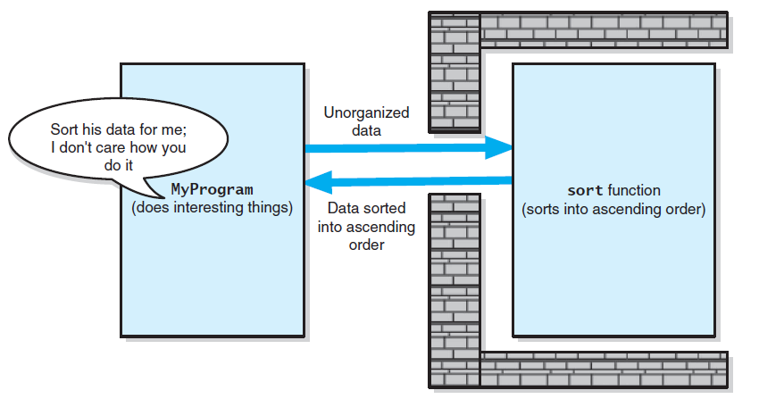
Information Hiding (2/2)
Tasks communicate through a slit in wall
Source: FIGURE 1-2 in [Carrano and Henry 2013].

Slide 31
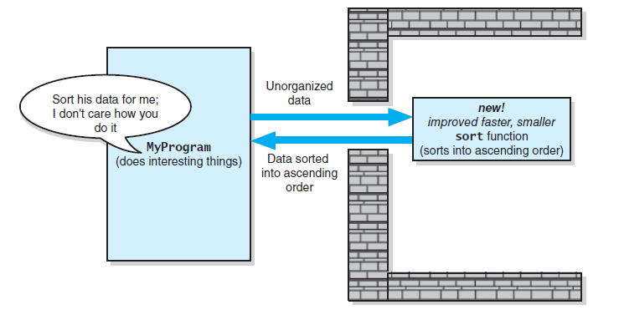
Minimal and Complete Interfaces (1/2)
A revised implementation communicates through
the same slit in the wall
Source: FIGURE 1-3 in [Carrano and Henry 2013].

Slide 32
Minimal and Complete Interfaces (2/2)
Minimal and complete interfaces:
  Interface of a class:
    declares publicly accessible methods (and data).
  Complete interface:
    Provides methods for any reasonable task consistent with the responsibilities of the class.
    Very important.
  Minimal interface:
    Easy to understand a class.
    Provides only essential methods.
    Less important than completeness.

Slide 33
Signature of an Interface
Signature: the interface for a method or function.
  Name of method/function.
  Arguments (number, order, type).
  Qualifiers such as const.
  Return type

Slide 34
Abstract Data Types (1/4)
Common operations on data
  Add
  Remove
  Query (ask a question)
To be able to think abstractly, it is essential to define Abstract Data Types (ADTs).

Slide 35
Abstract Data Types (2/4)
An Abstract Data Type (ADT) is a collection of data and a set of operations on the data.
It is organized in a way that the following two groups of things are separated:
  the specification of the data and the specification of the operations
  the representation (how the data is stored) of the data and the implementation of the operations

Slide 36
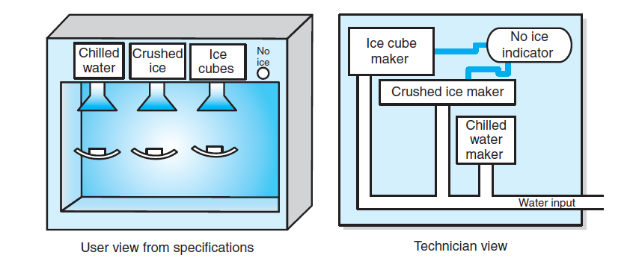
Abstract Data Types (3/4)
A dispenser of chilled water, crushed ice, and
ice cubes
Source: FIGURE 1-4 in [Carrano and Henry 2013].

Slide 37
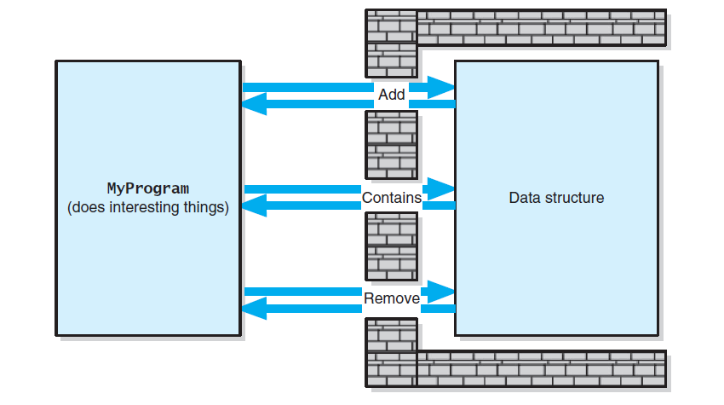
Abstract Data Type (4/4)
A wall of ADT operations isolates a data structure from
the program that uses it
Source: FIGURE 1-5 in [Carrano and Henry 2013].

Slide 38
Designing an ADT
Questions to ask when designing an ADT for a solution to a problem:
  What data are involved?
  How the data is to be operated and hence what operations are needed?
The design of an ADT should evolve naturally during the problem-solving process.

Slide 39
Example – An Appointment Book (1/6)
Imagine that you want to create a computerized appointment book.
What is an appointment?
  Suppose you are concerned only with its
  Date and time
  Purpose (the nature of the appointment)
So, an adequate ADT contains a collection of data items that are appointments, each with a date, time, and purpose.

Slide 40
Example – An Appointment Book (2/6)
What can one do with an appointment book?
  Make an appointment
  Cancel an appointment
  Check whether there is an appointment at a given time
  Get the purpose of an appointment
  Etc.

Slide 41
Example – An Appointment Book (3/6)
    // Returns true if an appointment exists for the date and time specified, // false otherwise.
+isAppointment(apptDate: Date, apptTime: Time): boolean
// Inserts the appointment for the date, time, and purpose specified
// as long as it does not conflict with an existing appointment.
// Returns true if successful, false otherwise.
  +makeAppointment(apptDate: Date, apptTime: Time, purpose: string): boolean

Slide 42
Example – An Appointment Book (4/6)
  // Deletes the appointment for the date and time specified.
  // Returns true if successful, false otherwise.
+cancelAppointment(apptDate: Date, apptTime:Time): boolean
    // Gets the purpose of the appointment at the given date and time,
    // if one exists.
    // Otherwise, returns an empty string.
+getAppointmentPurpose(apptDate: Date, apptTime:Time): string

Slide 43
Example – An Appointment Book (5/6)
One may use the operations from the ADT appointment book to design other applications or modules.
// Change the date or time of an appointment
Get from user: oldDate, oldTime, newDate, newTime
// Get purpose of appointment
oldPurpose = apptBook.getAppointmentPurpose(oldDate, oldTime)
if (oldPurpose is not an empty string) {
// See whether a new date/time is available
if (apptBook.isAppointment(newDate, newTime))
// New date/time is booked
write(“You already have an appointment at “, newTime,
“ on “, newDate)

Slide 44
Example – An Appointment Book (6/6)
else { // New date/time is available
apptBook.cancleAppointment(oldDate, oldTime);
if (apptBook.makeAppointment(newDate, newTime, oldPurpose))
write(“Your appointment has been rescheduled to ”,
newTime, “ on ”, newDate)
}
}
else
write(“You do not have an appointment at “, oldTime,
“ on “, oldDate)
You can design applications of the ADT operations
without knowing how the ADT is implemented.

Slide 45
ADTs That Suggest Other ADTs (1/2)
The design of an ADT may suggest other ADTs for its implementation.
Suppose you want to design a database of recipes.
This database is an ADT.
  Data: recipes.
  Operations:
    insertRecipe
    deleteRecipe
    retrieveRecipe

Slide 46
ADTs That Suggest Other ADTs (2/2)
Suppose you want to design an operation that scales a recipe retrieved from the database.
  If the recipe is for n people, you want to revise it so that it will serve m people.
  Each recipe contains measurements such as 2_{1/2} cups, 1 tablespoon, and ¼ teaspoon.
This problem suggests another ADT — measurement
  Data: measures (quantity, unit).
  Operations: getMeasure, setMeasure, scaleMeasure, convertMeasure.
The representation of quantity may suggest yet another ADT.
When you eventually implement the scale operation, you can use the ADT measurement.

Slide 47
The ADT Bag
A bag is a container, containing a finite number of objects.
Objects in a bag have no particular order.
Objects in a bag may be duplicated.
We will assume that all objects in a bag are of the same type.

Slide 48
Identifying Behaviors of a Bag (1/3)
Counting:
  Get the number of items currently in the bag.
  See whether the bag is empty.
Add/Remove:
  Add a given object to the bag.
  Remove an occurrence of a specific object from the bag.
  Remove all objects from the bag.

Slide 49
Identifying Behaviors of a Bag (2/3)
More counting:
  Count the number of times certain object occurs in bag.
Query:
  Test whether the bag contains a particular object.
  Look at all objects in the bag.

Slide 50
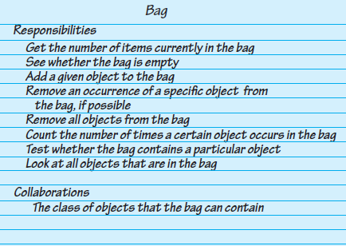
Identifying Behaviors of a Bag (3/3)
A CRC card for a class Bag
Source: FIGURE 1-6 in [Carrano and Henry 2013].

Slide 51
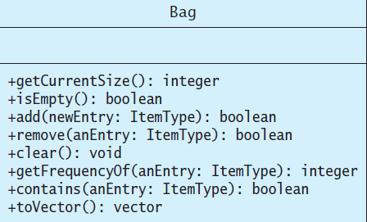
Specifying Data and Operations
UML notation for the class Bag
Source: FIGURE 1-7 in [Carrano and Henry 2013].

Slide 52
A C++ Interface of the ADT Bag
# include < vector >
template < class ItemType >
class BagInterface {
public:
virtual int getCurrentSize () const = 0; virtual bool isEmpty () const = 0;
virtual bool add (const ItemType & newEntry) = 0;
virtual bool remove (const ItemType & anEntry) = 0
virtual void clear () = 0;
virtual int getFrequencyOf (const ItemType & anEntry) const = 0;
virtual bool contains (const ItemType & anEntry) const = 0;
virtual vector < ItemType > toVector () const = 0;
};
Note: see LISTING 1-1 in [Carrano and Henry 2013] (on Page 47) for further details.

Slide 53
Using the ADT Bag (1/2)
# include < iostream >
# include < string >
# include "Bag.h”
using namespace std;
int main ()
{ string clubs [] = {"Joker", "Ace", "Two", "Three", "Four", "Five", "Six", "Seven", "Eight", "Nine", "Ten", "Jack", "Queen", "King"};
// Create our bag to hold cards.
Bag < string > grabBag;
// Place six cards in the bag.
grabBag.add (clubs [1]); grabBag.add (clubs [2]); grabBag.add (clubs [4]); grabBag.add (clubs [8]); grabBag.add (clubs [10]); grabBag.add (clubs [12]);
// Get friend’s guess and check it.
int guess = 0;

Slide 54
Using the ADT Bag (2/2)
while (!grabBag.isEmpty ()) {
cout << "What is your guess?"
<< "(1 for Ace to 13 for King):";
cin >> guess;
if (grabBag.contains (clubs [guess])) {
cout << "You get the card!\n";
grabBag.remove (clubs [guess]);
}
else {
cout << "Sorry, card was not in the bag.\n";
}
}
cout << "No more cards in the bag. Game over!\n";
return 0;
};
Note: see LISTING 1-2 in [Carrano and Henry 2013] (on Page 49) for further details.

