Slide 1
Stacks:
The ADT and Its Uses
Yih-Kuen Tsay
Dept. of Information Management
National Taiwan University
Based on [Carrano and Henry 2013]
With help from Chien Chin Chen

Slide 2
Developing an ADT by Need (1/5)
Specifications of an abstract data type for a particular problem can emerge during the design of a solution to the problem.
Example: a program reads a line typed from a keyboard.
  An ADT (an object of that type) to store the input line.
  C:\>copy 1.txt 2.txt[enter]
  C:\>coo[←]py 1.txt 2.txt[enter]
Use backspace to erase the typo you just made.

Slide 3
Developing an ADT by Need (2/5)
Initial draft of a solution:
Two operations needed:
  Add (a new element)
  Remove (the most recently added element)
while (not end of line)
{ Read a new character ch
if (ch is not a ‘←’)
Add ch to the ADT
else
Remove from the ADT the item
that was added most recently
}

Slide 4
Developing an ADT by Need (3/5)
What if you type a ← when the ADT is empty?
There are three options:
  Report an error and terminate
  Throw an exception
  Ignore the ← and continue
Will take the third option.

Slide 5
Developing an ADT by Need (4/5)
Taking the empty case into account:
A third operation:
  Determine whether the ADT is empty
while (not end of line)
{ Read a new character ch
if (ch is not a ‘←’)
Add ch to the ADT
else if (the ADT is not empty)
Remove from the ADT the item
that was added most recently
else
Ignore the ‘←’
}

Slide 6
Developing an ADT by Need (5/5)
This solution implies three operations of the ADT:
  Add a new item to the ADT.
  Remove from the ADT the item that was added most recently.
  Determine whether the ADT is empty.
Suppose you would like to display the input line.
  Need a way to look at the element added most recently.
  So, a fourth operation of the ADT: view the item that was added most recently.
This is usually called a stack.

Slide 7
The ADT Stack (1/4)
Four operations identified for the ADT stack:
  Determine whether a stack is empty.
  Add a new item to the stack.
  Remove the item that was added most recently.
  View the item that was added most recently.
The last-in, first-out (LIFO) property.
  The last item placed on the stack will be the first item removed.
A related first-in, first-out (FIFO) property will be discussed when we introduce queues.

Slide 8
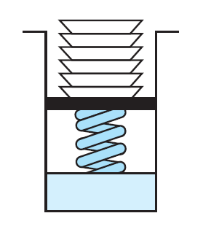
The ADT Stack (2/4)
A stack of cafeteria plates
Source: FIGURE 6-1 in [Carrano and Henry 2013].

Slide 9
The ADT Stack (3/4)
Stores a finite number of objects that are
  not necessarily distinct,
  having the same data type, and
  ordered by when they were added.
Provides four operations
  isEmpty(): determines whether this stack is empty
  push(newEntry): Adds newEntry to the top of this stack
  pop(): Removes the top of this stack
  peek(): Returns the top of this stack

Slide 10
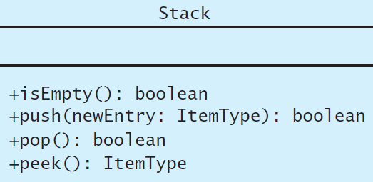
The ADT Stack (4/4)
A UML diagram for the class stack
Source: FIGURE 6-2 in [Carrano and Henry 2013].

Slide 11
A C++ Interface for Stacks (1/2)
/** @file StackInterface.h */
#ifndef _STACK_INTERFACE
#define _STACK_INTERFACE
template<class ItemType>
class StackInterface {
{
public:
/** Sees whether this stack is empty.
@return True if the stack is empty, or false if not. */
virtual bool isEmpty() const = 0;
/** Adds a new entry to the top of this stack.
@post If the operation was successful, newEntry is at the top of the stack.
@param newEntry The object to be added as a new entry.
@return True if the addition is successful or false if not. */
virtual bool push(const ItemType& newEntry) = 0;

Slide 12
A C++ Interface for Stacks (2/2)
/** Removes the top of this stack.
@post If the operation was successful, the top of the stack has been removed.
@return True if the removal is successful or false if not. */
virtual bool pop() = 0;
/** Returns the top of this stack.
@pre The stack is not empty.
@post The top of the stack has been returned, and the stack is unchanged.
@return The top of the stack. */
virtual ItemType peek() const = 0;
}; // end StackInterface
#endif

Slide 13
Using the ADT Stack in a Solution (1/2)
Use the ADT stack’s operations for the input line processing problem:
readAndCorrect(): Stack
aStack = a new empty stack
Read newChar
while (newChar is not the end-of-line symbol) {
if (newChar is not ‘←’)
aStack.push(newChar)
else if (!aStack.isEmpty())
aStack.pop()
Read newChar
}
return aStack

Slide 14
Using the ADT Stack in a Solution (2/2)
Use the ADT stack’s operations to display the input line:
display(aStack: Stack)
bStack = a new empty stack
while (!aStack.isEmpty()) {
bStack.push(aStack.peek())
aStack.pop()
}
while (!bStack.isEmpty()) {
newChar = bStack.peek()
bStack.pop()
Write newChar
aStack.push(newChar)
}
Advance to new line

Slide 15
Axioms for Stack
(new Stack()).isEmpty() = true
(new Stack()).pop() = false
(new Stack()).peek() = error
(aStack.push(item)).isEmpty() = false
(aStack.push(item)).peek() = item
(aStack.push(item)).pop() = true
Note: will assume pop() returns the updated object in Exercise 6.15.

Slide 16
Checking for Balanced Braces (1/5)
A stack can be used to verify whether a program contains balanced braces.
  In C++, braces “{“ and “}” are used to delimit groups of statements (blocks).
    if(condition)
    {statements;}
    else
    {statements;}
  An example of balanced braces:
    abc{defg{ijk}{l{mn}}op}qr
  An example of unbalanced braces:
    abc{def}}{ghij{kl}m
Unbalanced!!

Slide 17
Checking for Balanced Braces (2/5)
Requirements for balanced braces:
  Traverse the string from left to right.
  Each time you encounter a “}”, it matches an already encountered “{”.
    “{“ is the one that most recently encountered.
  When you reach the end of the string, you have matched each “{”.

Slide 18
Checking for Balanced Braces (3/5)
A solution using stack:
checkBraces(aString: string): boolean
aStack = a new empty stack
balancedSoFar = true
i = 0
while (balancedSoFar and i < length of aString)
{ ch = character at position i in aString
i++
if (ch is a ‘{‘)
aStack.push(‘{‘)

Slide 19
Checking for Balanced Braces (4/5)
else if (ch is a ‘}’)
if (!aStack.isEmpty())
aStack.Pop()
else
balancedSoFar = false
} // end while
if (balancedSoFar and astack.isEmpty())
aString has balanced braces
else
aString does not have balanced braces
Ensure no
unbalanced open
brace.

Slide 20
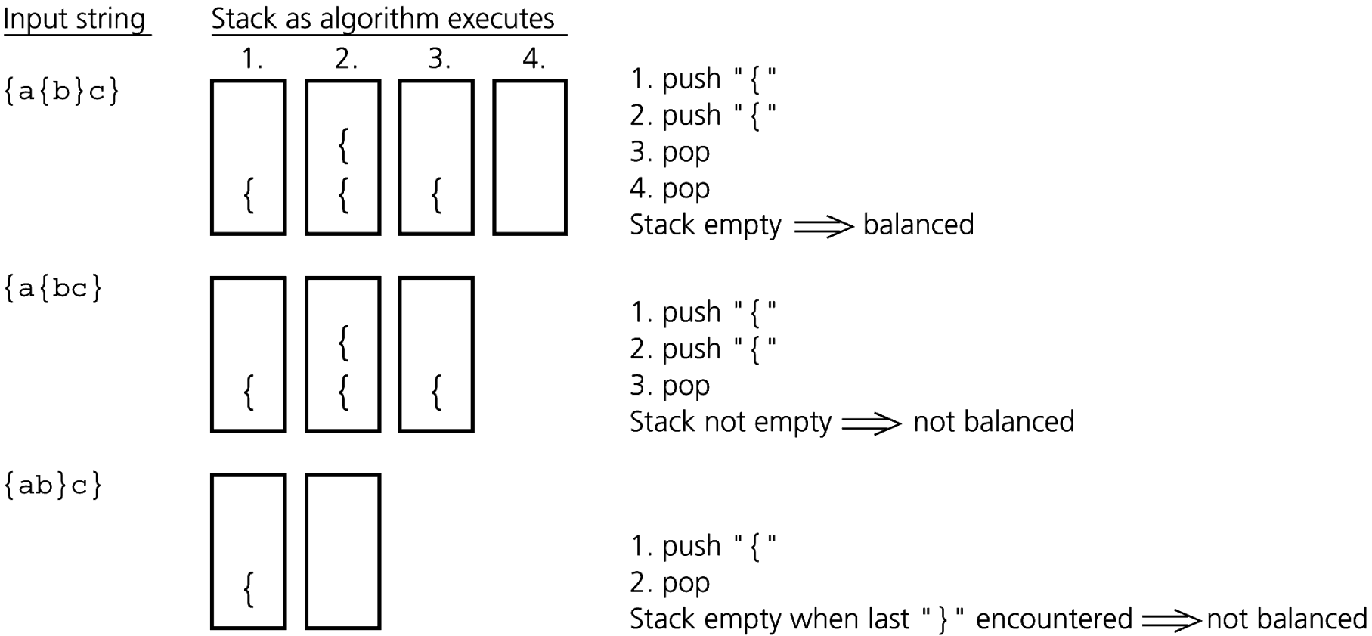
Checking for Balanced Braces (5/5)
unbalanced open brace
unbalanced close brace
Source: FIGURE 6-3 in [Carrano and Henry 2013].

Slide 21
Recognizing Strings in a Language (1/4)
Consider L = {w$w’ : w is a possibly empty string of characters other than $, w’ = reverse(w) }
Examples:
  A$A:
  ABC$CBA:
  AB$AB:
Yes.
Yes.
NO!!
The second half is not
the reverse of the first half.

Slide 22
Recognizing Strings in a Language (2/4)
A solution using a stack:
  Traverse the first half of the string, pushing each character onto a stack.
  Once you reach the $, for each character in the second half of the string, match a popped character off the stack.

Slide 23
Recognizing Strings in a Language (3/4)
The algorithm for recognizing L.
recognizeString(aString: string): boolean
aStack = a new empty stack
i = 0
ch = character at position i in aString
while (ch is not a ‘$’) {
aStack.push(ch)
i++
ch = character at position i in aString
}
// Skip the $
i++
push each character in the first half,
one by one, on the stack

Slide 24
Recognizing Strings in a Language (4/4)
// Match the reverse of s
inLanguage = true // Assume string is in language
while (inLanguage and i < length of aString) {
if (!aStack.isEmpty()) {
stackTop = aStack.peek()
aStack.pop()
ch = character at position i in aString
if (stackTop equals ch)
i++
else
inLanguage = false
}
else
inLanguage = false
}
if (inLanguage and aStack.isEmpty())
aString is in Language
else
aString is not in Language
ensure no
unmatched chars
in the first half.

Slide 25
Algebraic Expressions
Infix expressions:
  An operator appears between its operands.
    Example: a + b
Prefix expressions:
  An operator appears before its operands.
    Example: + a b
Postfix expressions:
  An operator appears after its operands.
    Example: a b +
operator
operand

Slide 26
Ambiguity of Infix expressions (1/3)
a + b * c means
  a + b then * c, or
  b * c then + a ?
Infix expressions require precedence rules, associativity rules, and the use of parentheses to avoid ambiguity.
Precedence rules determine which operators should be evaluated earlier.
  E.g., * precedes +, so a + b * c → a + (b * c).
  See the bottom cover and its opposite page of the text book for the precedence rules of the C++ operators.

Slide 27
Ambiguity of Infix expressions (2/3)
If you want another interpretation, you must use parentheses:
  E.g., (a + b) * c.
How to treat equal precedence?
  a / b * c = (a / b) * c or a / (b * c) ?
Associativity rules specify the evaluation sequence of operators with the same precedence.
  Binary operators mostly associate to the left (i.e., evaluate from left to right)
  a + b + c = (a + b) + c; a / b * c = (a / b) * c.

Slide 28
Ambiguity of Infix expressions (3/3)
The advantage of prefix and postfix expressions is that they never need precedence rules, association rules, or parentheses.
  They can avoid the ambiguity in evaluating infix expressions.
  E.g.,
    ab+c* = (ab+)c*
    2 3 4 + * = 2 (3 4 +) *

Slide 29
Evaluating Postfix Expressions (1/4)
Here, we only consider the binary operators *, /, +, and – (left-to-right association).
A postfix calculator:
  Guideline: an operator is always applied to the two operands that immediately precede it.
  E.g., 2 3 4 + *
  2
  2 3
  2 3 4
  2 3 4 +
  2 7
  2 7 *
  14
When encounter an operator,
the calculator must be able to retrieve
the operands entered most recently.

Slide 30
Evaluating Postfix Expressions (2/4)
Evaluating postfix expressions using a stack:
  When an operand is entered, the calculator
    pushes it onto a stack.
  When an operator is entered, the calculator
    pops the top two operands from the stack,
    evaluate the operation, and
    pushes the result of the operation onto the stack.

Slide 31
Evaluating Postfix Expressions (3/4)
An algorithm that evaluates postfix expressions:
for (each character ch in the string) {
if (ch is an operand)
Push the value of ch onto the stack
else {
// ch is an operator named op
operand2 = top of stack
Pop the stack
operand1 = top of stack
Pop the stack
result = operand1 op operand2
Push result onto the stack
}
}
either an operand or an operator

Slide 32
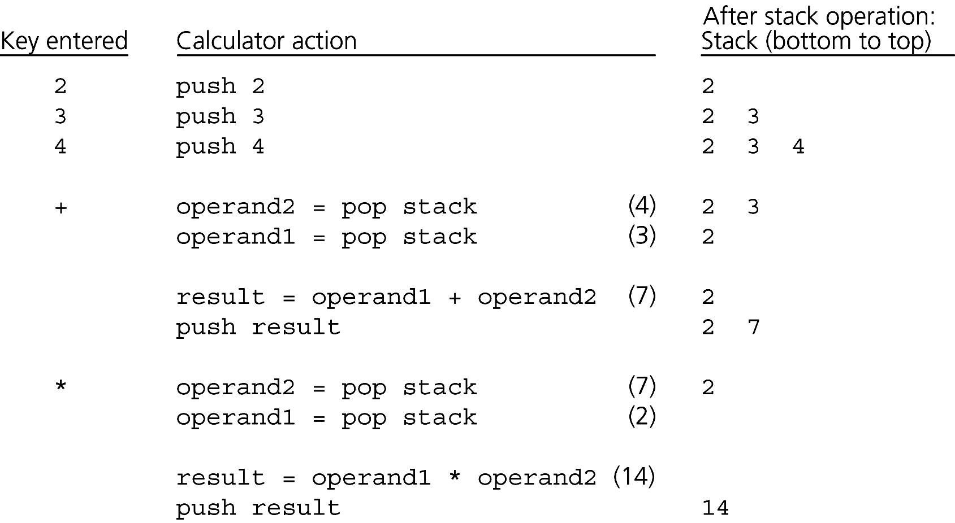
Evaluating Postfix Expressions (4/4)
Evaluating 2 3 4 + * (postfix expression of 2*(3+4))
Source: FIGURE 6-4 in [Carrano and Henry 2013].

Slide 33
Infix Expressions to Postfix Expressions (1/12)
We are used to writing infix expressions in programs.
  Compilers would help us translate them into postfix form executed by computers.
How do compilers compile an infix expression in your programs?
  By converting it into an equivalent postfix expression.
  Computer can evaluate the postfix expression using the previous algorithm.

Slide 34
Infix Expressions to Postfix Expressions (2/12)
The infix expressions here allow:
  Parentheses,
  Operator precedence,
  Left-to-right association. (such as +, -, *, and /)
  E.g., (a + b) * c / d – e.
  And we assume the expressions are syntactically correct.

Slide 35
Infix Expressions to Postfix Expressions (3/12)
Facts about converting from infix to postfix:
    2 * (3 + 4) → 2 3 4 + *
  Operands always stay in the same order with respect to one another.
  An operator will move only “to the right” with respect to the operands.
  All parentheses are removed.
Key points: 1) preserve the order of the operands.
2) place operators in appropriate locations.

Slide 36
Infix Expressions to Postfix Expressions (4/12)
Factors that determine the placement of the operators in the postfix expression:
  Precedence
    a*b+c → a b * c +
    a+b*c → a b c * +
  Left-to-right association
    a+b-c → a b + c -
    a-b+c → a b - c +
  Parentheses
    (a+b)*c → a b + c *
    a+b*c → a b c * +

Slide 37
Infix Expressions to Postfix Expressions (5/12)
Steps as you process the infix expression:
  When encountering an “operand”,
    append the operand to the end of the output string postfixExpr.
    Justification:
      The order of the operands in the postfix expression is the same as the order in the infix expression.
      The operands that appear to the left of an operator in the infix expression also appear to its left in the postfix expression.
initially, postfixExpr is empty

Slide 38
Infix Expressions to Postfix Expressions (6/12)
When encountering an “operator”,
  If the stack is empty, push the operator onto the stack.
  If the stack is not empty,
      1. while:
        the stack is not empty and
        the top of the stack is not a ‘(‘, and
        the top of the stack is not a lower precedence operator.
      pop the top operator from the stack and append it to postfixExp.
      Push the operator onto the stack
This step orders the operators by precedence and
in accordance with left-to-right association.

Slide 39
Infix Expressions to Postfix Expressions (7/12)
Case 1:
  Infix:
  Postfix:
  Stack:
Case 2:
  Infix:
  Postfix:
  Stack:
w
+
x
*
w
x
high
*
+
operator
precedence
+
low
w
+
x
-
w
x
+
+
empty
-
in accordance with left-to-right association

Slide 40
Infix Expressions to Postfix Expressions (8/12)
Case 3:
  Infix:
  Postfix:
  Stack:
w
+
x
*
y
-
w
x
y
*
+
+
*
+
empty
-

Slide 41
Infix Expressions to Postfix Expressions (9/12)
When reaching the end of the string,
  pop all operators from stack and append them to postfixExpr.
When encountering a ‘(‘,
  push it onto the stack.
When encountering a ‘)’,
  keep popping operators off the stack and append them to the end of postfixExp
    until you encounter a ‘(‘, the matching open parenthesis.

Slide 42
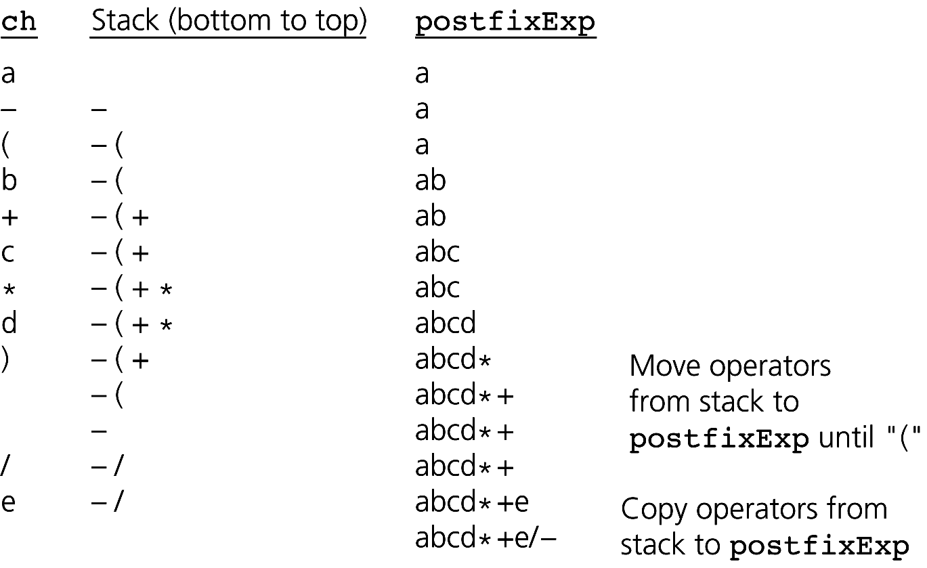
Infix Expressions to Postfix Expressions (10/12)
Convert the infix expression a - (b + c * d) / e
Source: FIGURE 6-5 in [Carrano and Henry 2013].

Slide 43
Infix Expressions to Postfix Expressions (11/12)
for (each character ch in the infix expression) {
switch (ch) {
case operand: // Append operand to end of PE
postfixExp = postfixExp + ch
break
case ‘(’: // Save ‘(’ on stack
aStack.push(ch)
break
case operator: // Process operators of higher prec.
while (!aStack.isEmpty() and
aStack.peek() is not a ‘(’ and
precedence(ch) <= precedence(aStack.peek())) {
postfixExp = postfixExp + aStack.peek()
aStack.pop()
}
aStack.push(ch) // Save the operator
break

Slide 44
Infix Expressions to Postfix Expressions (12/12)
case ‘)’: // Pop stack until matching ‘(‘
while (aStack.peek() is not a ‘(’) {
postfixExp = postfixEP + aStack.peek()
aStack.pop()
}
aStack.pop() // Remove the matching ‘(’
break
}
}
// Append to postfixExp the operators remaining in the stack
while (!aStack.isEmpty()) {
postfixExp = postfixExp + aStack.peek()
aStack.pop()
}

Slide 45
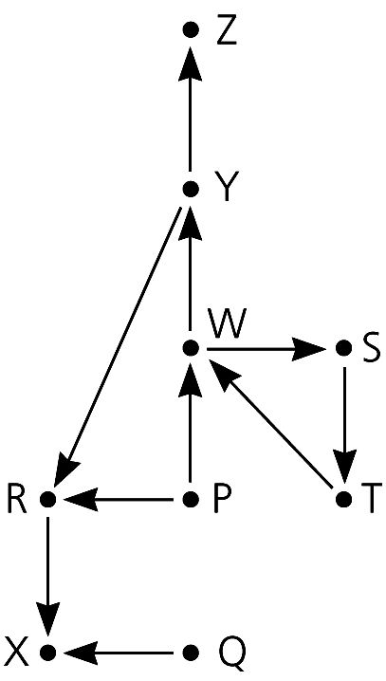
Searching a Flight Map
vertices: cities
High Planes Airline Company (HPAir):
  The flight map for HPAir is a directed graph.
For each customer request, indicate whether a sequence of HPAir flights exists from the origin city to the destination city.
arrows: flights
a directed path: a sequence of directed edges,
e.g., P → W → Y → Z.
Source: FIGURE 6-6 in [Carrano and Henry 2013].

Slide 46
Searching with a Stack (1/9)
The solution performs an exhaustive search.
  Beginning at the origin city, the solution will try every possible sequence of flights until either
    it finds a sequence that gets to the destination city, or
    it determines that no such sequence exists.
Backtracking can be used to recover from choosing a wrong city.

Slide 47
Searching with a Stack (2/9)
Example of backtracking:
  Origin: P.
  Destination: Z.
  Current search path: P → R → X.
    It is a mistake to go to X.
    Backtrack to R and try other possibilities.
Source: FIGURE 6-6 in [Carrano and Henry 2013].
dead-end

Slide 48
Searching with a Stack (3/9)
How to backtrack?
  You have to maintain (remember) information about the order of cities you visited.
    Use stack to maintain the order.
      Each time you decide to visit a city, you push its name onto the stack.
      Backtrack: pop a city from the stack.
top: currently visited city
X
R
P
R
P
pop
origin
current search path: P → R
stack
stack
current search path: P → R → X

Slide 49
Searching with a Stack (4/9)
Problem of circling:
  Origin: P.
  Destination: Z.
  Current search path: P → R → X.
  P → R.
  P → R → X.
  ...
To avoid circling:
  Mark the visited cities.
  When choosing the next city, restrict to unmarked cities.
circling
Source: FIGURE 6-6 in [Carrano and Henry 2013].

Slide 50
Searching with a Stack (5/9)
Available operations for the ADT flight map:
In the following, let the class Map be an implementation of the ADT.
// Marks a city as visited.
+markVisited(aCity: City): void
// Clears marks on all cities.
+unvisitAll(): void
// Returns the next unvisited city, if any,
// adjacent to a given city.
// Returns a sentinel value, otherwise.
+getNextCity(fromCity: City): City

Slide 51
Searching with a Stack (6/9)
bool Map::isPath(City originCity, City destinationCity)
{ bool success;
Stack aStack;
unvisitAll(); // clear marks on all cities
// push origin city onto aStack, mark it visited
aStack.push(originCity);
markVisited(originCity);

Slide 52
Searching with a Stack (7/9)
City topCity = aStack.peek(); // get the currently
// visited city
while (!aStack.isEmpty() && (topCity != destinationCity))
{
// find an unvisited city adjacent to the city on the
// top of the stack
City nextCity = getNextCity(topCity);
if (nextCity == NO_CITY)
aStack.pop(); // no city found; backtrack
else {
aStack.push(nextCity);
markVisited(nextCity);
}
if (!aStack.isEmpty())
topCity = aStack.peek(); // get the currently // visited city
} // end while

Slide 53
Searching with a Stack (8/9)
return !aStack.isEmpty();
} // end isPath

Slide 54
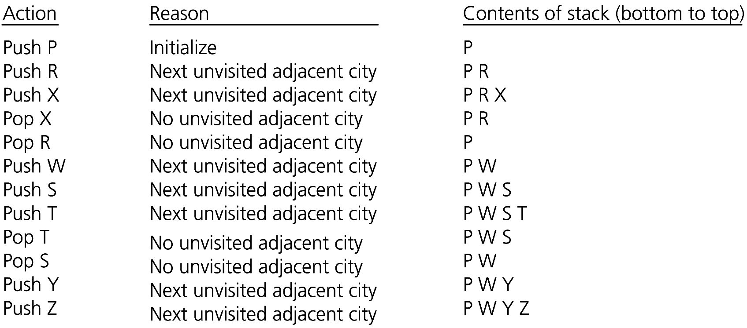
Searching with a Stack (9/9)
  Origin: P
  Destination: Z
: visited.
Source: FIGURE 6-9 in [Carrano and Henry 2013].

Slide 55
A Recursive Solution (1/5)
A draft version of the recursive search strategy:
To fly from the origin to the destination:
Select a city C adjacent to the origin
Fly from the origin to city C
if (C is the destination city)
Terminate – the destination is reached
else
Fly from city C to the destination.
base case
recursive search

Slide 56
A Recursive Solution (2/5)
Possible outcomes of the last recursive search strategy:
  You eventually reach the destination city and can conclude that it is possible to fly from the origin to the destination.
  You reach a city C from which there are no departing flights.
  You go around in circles.

Slide 57
A Recursive Solution (3/5)
A refined recursive search strategy:
bool Map::isPath(City originCity, City destinationCity)
{
bool result, done;
// Mark the current city as visited
markVisited(originCity);
// base case: the destination is reached
if (originCity == destinationCity)
return true;
base case

Slide 58
A Recursive Solution (4/5)
indicate whether we found the path or not
else // try a flight to each unvisited city
{ done = false;
City nextCity = getNextcity(originCity);
while(!done && (nextCity != NO_CITY)) {
done = isPath(nextCity, destinationCity);
if (!done)
nextCity = getNextCity(originCity);
} // end while
result = done;
} // end if
return result;
} // end isPath
searh it,
recursive call
for each unvisited neighbor city
conclude the search result in the unvisited city.
true: there is a path.
false: no path, backtrack to the caller.

Slide 59
A Recursive Solution (5/5)
Origin: W.
Destination: V.
: visited
isPath(W,V)
isPath(Y,V)
isPath(X,V)
Y
done = true;
W
done = false;
backtracking
done = false;
backtracking
X
isPath(Z,V)
isPath(V,V)
done = false;
backtracking
Z
return true;
V
Very similar to the stack-based algorithm!!

Slide 60
Stacks and Recursion (1/3)
The two algorithms (stack-based and recursive algorithms) employ different techniques to implement the identical search strategy.
Similarities:
  Visiting city P, then R, then X:
X
R
P
Stack:
originCity = P
destinationCity = Z
originCity = R
destinationCity = Z
originCity = X
destinationCity = Z
Box trace:

Slide 61
Stacks and Recursion (2/3)
Similarities:
  Backtracking from city X to R to P:
X
R
P
Stack:
originCity = P
destinationCity = Z
originCity = R
destinationCity = Z
originCity = X
destinationCity = Z
Box trace:

Slide 62
Stacks and Recursion (3/3)
It is always possible to capture the actions of a recursive function by using a stack.
Typically, stacks are used by compilers to implement recursive methods.
  During execution, each recursive call generates an activation record that is pushed onto a stack.
Stacks can be used to implement a non-recursive version of a recursive algorithm,
  to make it more efficient.

Slide 63
Summary
ADT stack operations have a last-in, first-out (LIFO) behavior.
Stack applications:
  Algorithms that operate on algebraic expressions.
  Searching flight maps.
A strong relationship exists between recursion and stacks.

