Slide 1
Algorithm Efficiency
Yih-Kuen Tsay
Dept. of Information Management
National Taiwan University
Based on [Carrano and Henry 2013]
With help from Chien Chin Chen

Slide 2
A Larger Picture
Efficiency is just one aspect in evaluating a solution/program.
What is a good computer program?
Aspects to consider:
  Efficiency: time and memory required to execute
  Ease of use
  Correctness (consequence of errors)
  Effort required to develop, maintain, modify, and expand

Slide 3
Programs vs. Algorithms
The underlying algorithm (including the objects and how they interact) has the most significant impact on the efficiency of a program.
Three fundamental problems with comparing programs instead of algorithms:
  How are the algorithms coded?
    Different implementations, different run times
  What computer should you use?
    Faster on one computer, but slower on another
  What data should the programs use?
    Different data sets, different run times

Slide 4
Measuring Algorithm Efficiency (1/4)
Analysis of algorithms:
  Provides tools for contrasting the efficiency of different algorithms.
    Time and space efficiency
  Concerns with significant differences in efficiency, not reductions in computing costs due to clever coding tricks
We will focus on time efficiency.

Slide 5
Measuring Algorithm Efficiency (2/4)
Algorithm analysis should be independent of :
  Specific implementations
  Computers
  Data
How?
  Counting the number of significant operations in a particular solution.
  Significant operations are those which consume most computing time.

Slide 6
Measuring Algorithm Efficiency (3/4)
We have compared solutions by looking at the number of operations that each solution requires.
An algorithm’s execution time is related to the number of operations it requires.
This is usually expressed in terms of the number, n, of items the algorithm must process.

Slide 7
Measuring Algorithm Efficiency (4/4)
Example: traversal of a linked list of n nodes.
  n + 1 assignments, n + 1 comparisons, n writes.
  Suppose each assignment, comparison, and write takes respectively a, c, and w time units.
  The traversal takes (n + 1)×(a + c) + n×w time units.
Example: the Towers of Hanoi with n disks.
  2^{n} - 1 moves.
  If each move takes the same time m, then the solution takes (2^{n} - 1 )×m time units.
Node<ItemType>* curPtr = headPtr;
while (curPtr != nullptr) {
cout << curPtr->getItem() << endl;
curPtr = curPtr->getNext();
} // end while
← 1 assignment
← n+1 comparisons
← n writes
← n assignments

Slide 8
Algorithm Growth Rates (1/3)
An algorithm’s time requirements can be measured as a function of the problem size (instance characteristic).
  Number of nodes in a linked list
  Size of an array
  Number of items in a stack
  Number of disks in the Towers of Hanoi problem
Algorithm efficiency is typically a concern for large problems only.

Slide 9
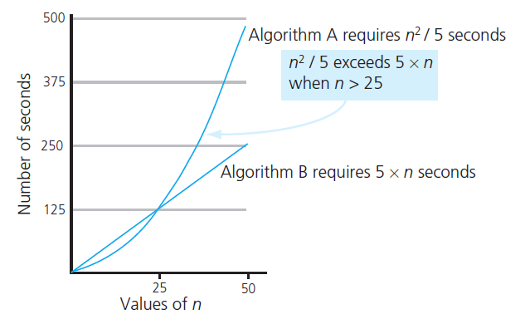
Algorithm Growth Rates (2/3)
Source: FIGURE 10-1 in [Carrano and Henry 2013].

Slide 10
Algorithm Growth Rates (3/3)
An algorithm’s growth rate:
  How quickly the algorithm’s time requirement grows as a function of the problem size.
    Algorithm A requires time proportional to n².
    Algorithm B requires time proportional to n.
    Algorithm B is faster than algorithm A.
  n² and n above are growth-rate functions.
Will study a mathematical notation for specifying an algorithm’s order in terms of the size of the problem.
  Algorithm A is O(n²) - order n².
  Algorithm B is O(n) - order n.

Slide 11
Analysis and Big O Notation (1/5)
Definition of the order of an algorithm:
  Algorithm A is order f(n) – denoted O(f(n)) – if constants k and n₀ exist such that A requires no more than k × f(n) time units to solve a problem of size n ≥ n₀.
The function f(n) is called the algorithm’s growth-rate function.
Because of the capital O to denote order, it is called the Big O Notation.
Examples:
  Traversal of a linked list is O(n)
  The Towers of Hanoi is O(2^{n})

Slide 12
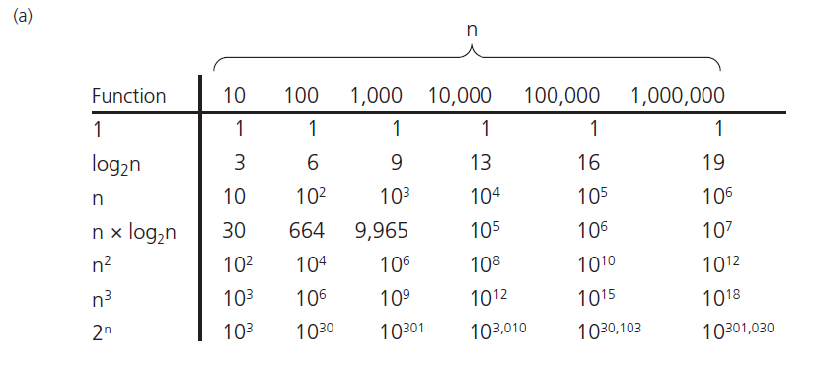
Analysis and Big O Notation (2/5)
  O(1) < O(log₂n) < O(n) < O(n × log₂n) < O(n²) < O(n³) < O(2^{n}).
constant
logarithmic
linear
n log n
quadratic
cubic
exponential
Source: FIGURE 10-3(a) in [Carrano and Henry 2013].

Slide 13
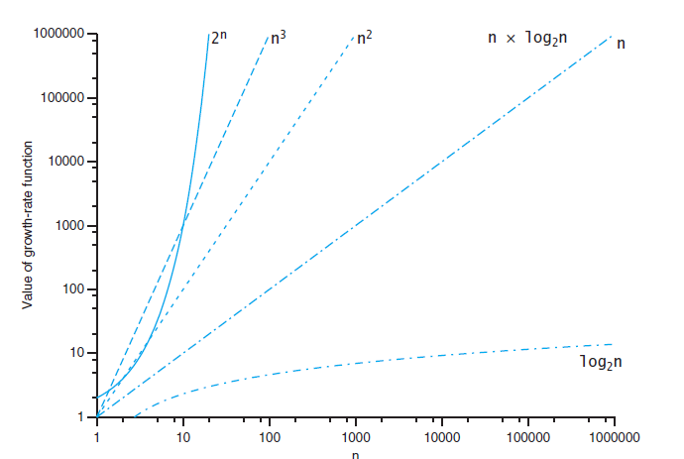
Analysis and Big O Notation (3/5)
Source: FIGURE 10-3(b) in [Carrano and Henry 2013].

Slide 14
Analysis and Big O Notation (4/5)
Properties of growth-rate functions:
  O(n³ + 3n) is O(n³): ignore low-order terms.
  O(5 f(n)) = O(f(n)): ignore a multiplicative constant in the high-order term.
  O(f(n)) + O(g(n)) = O(f(n) + g(n)).
  O(f(n)) × O(g(n)) = O(f(n) × g(n)).

Slide 15
Analysis and Big O Notation (5/5)
An algorithm may require different times to solve different problems of the same size.
Best-case analysis
  A determination of the minimum amount of time that an algorithm requires to solve problems of size n.
Worst-case analysis
  A determination of the maximum amount of time that an algorithm requires to solve problems of size n.
  Easier to calculate and more common.
Average-case analysis
  A determination of the average amount of time that an algorithm requires to solve problems of size n.
  Usually hard to calculate.

Slide 16
Keeping Your Perspective (1/2)
Only significant differences in efficiency are interesting.
Frequency of operations:
  When choosing an ADT’s implementation, consider how frequently particular ADT operations occur in a given application.
  However, some seldom-used but critical operations must be efficient.
    E.g., an air traffic control system.

Slide 17
Keeping Your Perspective (2/2)
If the problem size is always small, you can probably ignore an algorithm’s efficiency.
  Order-of-magnitude analysis focuses on large problems.
Weigh the trade-offs between an algorithm’s time requirements and its memory requirements.
Compare algorithms for both style and efficiency.

Slide 18
Efficiency of Searching Algorithms (1/2)
Sequential search
  Strategy:
    Look at each item in the data collection in turn.
    Stop when the desired item is found, or the end of the data is reached.
  Efficiency
    Worst case:
O(n)

Slide 19
Efficiency of Searching Algorithms (2/2)
Binary search of a sorted array
  Strategy:
    Repeatedly divide the array in halves.
    Determine which half could contain the item, and discard the other half.
  Efficiency
    Worst case:
    For large arrays, the binary search has an enormous advantage over a sequential search.
      At most 20 comparisons to search an array of one million items.
Note, however, there is an overhead of maintaining the array in sorted order.
O(log₂n)

