Slide 1
Sorting Algorithms and
Their Efficiency
Yih-Kuen Tsay
Dept. of Information Management
National Taiwan University
Based on [Carrano and Henry 2013]
With help from Chien Chin Chen

Slide 2
Sorting Algorithms
Sorting:
  A process that organizes a collection of data into either ascending or descending order.
  The sort key
    The part of a data item that we consider when sorting a data collection.
Categories of sorting algorithms.
  An internal sort:
    Requires that the collection of data fit entirely in the computer’s main memory.
  An external sort:
    The collection of data will not fit in the computer’s main memory all at once, but must reside in secondary storage.

Slide 3
Determining Efficiency
Sorting in general compares, exchanges, or moves items.
  We should count these operations.
  Such operations are more expensive than ones that control loops or manipulate array indexes, particularly when the data to be sorted are complex.
A sorting algorithm typically proceeds in stages/iterations.
To determine its execution time, we calculate
  The number of iterations
  The number of steps/operations in each iteration

Slide 4
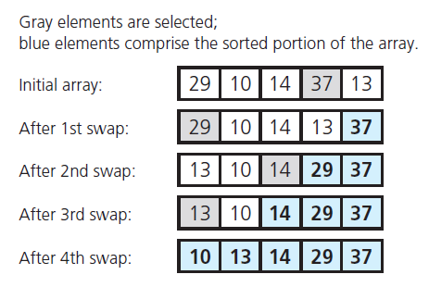
Selection Sort (1/8)
Source: FIGURE 11-1 in [Carrano and Henry 2013].

Slide 5
Selection Sort (2/8)
/** Finds the largest item in an array.
@pre The size of the array is >= 1.
@post The arguments are unchanged.
@param theArray The given array.
@param size The number of elements in theArray.
@return The index of the largest entry in the array. */
int findIndexofLargest(const ItemType theArray[], int size);
/** Sorts the items in an array into ascending order.
@pre None.
@post The array is sorted into ascending order; the size of
the array is unchanged.
@param theArray The array to sort.
@param n The size of theArray. */
void selectionSort(ItemType theArray[], int n)

Slide 6
Selection Sort (3/8)
void selectionSort(ItemType theArray[], int n)
{
// last = index of the last item in the subarray of items yet
// to be sorted;
// largest = index of the largest item found
for (int last = n - 1; last >= 1; last--) {
// At this point, theArray[last+1..n-1] is sorted, and its
// entries are greater than those in theArray[0..last].
// Select the largest entry in theArray[0..last]
int largest = findIndexofLargest(theArray, last + 1);
// Swap the largest entry, theArray[largest], with
// theArray[last]
std::swap(theArray[largest], theArray[last]);
} // end for
} // end selectionSort

Slide 7
Selection Sort (4/8)
int findIndexofLargest(const ItemType theArray[], int size)
{
int indexSoFar = 0; // Index of largest entry found so far
for (int currentIndex = 1; currentIndex < size;
currentIndex++) {
// At this point, theArray[indexSoFar] >= all entries in
// theArray[0..currentIndex - 1]
if (theArray[currentIndex] > theArray[indexSoFar])
indexSoFar = currentIndex;
} // end for
return indexSoFar; // Index of largest entry
} // end findIndexofLargest

Slide 8
Selection Sort (5/8)
Again,
  Sorting in general compares, exchanges, or moves items.
  Such operations are the more expensive ones.
The for loop in the function selectionSort executes n-1 times.
  findIndexOfLargest and swap are called n-1 times.

Slide 9
Selection Sort (6/8)
Each call to findIndexOfLargest causes its loop to execute last (or size – 1) times.
  The loop executes a total of:
    (n-1) + (n-2) + … + 1 = times.
  Each execution of the loop performs one comparison:
    The calls of findIndexOfLargest require n×((n-1)/2 comparisons.
n×(n-1)/2

Slide 10
Selection Sort (7/8)
The n-1 calls to swap require:
  3×(n-1) moves.
Together, a Selection sort of n items requires:
  n×(n-1)/2 + 3(n-1)
  = n²/2 + 5n/2 -3 major operations.
Thus, Selection sort is O(n²).

Slide 11
Selection Sort (8/8)
Does not depend on the initial arrangement of the data.
  Best case = worst case = average case = O(n²)
  Only appropriate for small n!!

Slide 12
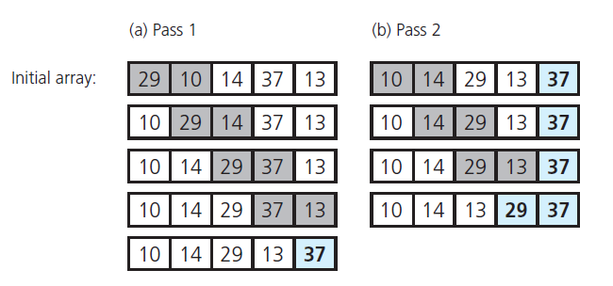
Bubble Sort (1/4)
Source: FIGURE 11-2 in [Carrano and Henry 2013].

Slide 13
Bubble Sort (2/4)
/** Sorts the items in an array into ascending order.
@pre None.
@post theArray is sorted into ascending order; n is unchanged.
@param theArray The given array.
@param n The size of theArray. */
void bubbleSort(ItemType theArray[], int n)
{
bool sorted = false; // False when swaps occur
int pass = 1;
while (!sorted && (pass < n)) {
// At this point, theArray[n+1-pass..n-1] is sorted
// and all of its entries are > the entries in
// theArray[0..n-pass]

Slide 14
Bubble Sort (3/4)
while (!sorted && (pass < n)) {
// At this point, theArray[n+1-pass..n-1] is sorted
// and all of its entries are > the entries in
// theArray[0..n-pass]
sorted = true; // Assume sorted
for (int index = 0; index < n - pass; index++) {
// At this point, all entries in theArray[0..index-1]
// are <= theArray[index]
int nextIndex = index + 1;
if (theArray[index] > theArray[nextIndex]) {
// Exchange entries
std::swap(theArray[index], theArray[nextIndex]);
sorted = false;
// Signal exchange
} // end if
} // end for
// Assertion: theArray[0..n-pass-1] < theArray[n-pass]
pass++;
} // end while
} // end bubbleSort

Slide 15
Bubble Sort (4/4)
Analysis:
  In the worst case, the bubble sort requires at most n-1 passes through the array.
    Pass 1 requires n-1 comparisons and at most n-1 exchanges.
    Pass 2 require n-2 comparisons and at most n-2 exchanges.
    ...
    Require a total of
      (n-1) + (n-2) + … + 1 = n*(n-1)/2 comparisons.
      (n-1) + (n-2) + … + 1 = n*(n-1)/2 exchanges.
        Each exchange require 3 moves.
    Thus, altogether there are: 2 * n*(n-1) = O(n²)
  In the best case: require only one pass.
    n-1 comparisons and no exchanges: O(n)

Slide 16
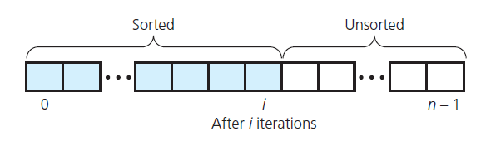
Insertion Sort (1/5)
Source: FIGURE 11-3 in [Carrano and Henry 2013].

Slide 17
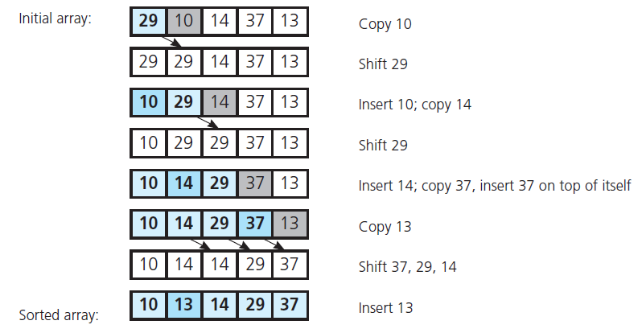
Insertion Sort (2/5)
Source: FIGURE 11-4 in [Carrano and Henry 2013].

Slide 18
Insertion Sort (3/5)
/** Sorts the items in an array into ascending order.
@pre None.
@post theArray is sorted into ascending order; n is unchanged.
@param theArray The given array.
@param n The size of theArray. */
void insertionSort(ItemType theArray[], int n)
{
// unsorted = first index of the unsorted region,
// loc = index of insertion in the sorted region,
// nextItem = next item in the unsorted region.
// Initially, sorted region is theArray[0],
// unsorted region is theArray[1..n-1].
// In general, sorted region is theArray[0..unsorted-1],
// unsorted region theArray[unsorted..n-1]
for (int unsorted = 1; unsorted < n; unsorted++) {

Slide 19
Insertion Sort (4/5)
for (int unsorted = 1; unsorted < n; unsorted++) {
// At this point, theArray[0..unsorted-1] is sorted.
// Find the right position (loc) in theArray[0..unsorted]
// for theArray[unsorted], which is the first entry in the
// unsorted region; shift, if necessary, to make room
ItemType nextItem = theArray[unsorted];
int loc = unsorted;
while ((loc > 0) && (theArray[loc - 1] > nextItem)) {
// Shift theArray[loc - 1] to the right
theArray[loc] = theArray[loc - 1];
loc--;
} // end while
// At this point, theArray[loc] is where nextItem belongs
// Insert nextItem into sorted region
theArray[loc] = nextItem;
} // end for
} // end insertionSort

Slide 20
Insertion Sort (5/5)
Analysis:
  In the worst case, the outer for loop executes n-1 times.
  This loop contains an inner for loop that executes at most unsorted times.
    unsorted ranges from 1 to n-1.
    Number of comparisons and moves:
      2 ×[1+2+…+(n-1)] = n×(n-1).
  The outer loop moves data items twice per iteration, or 2×(n-1) times.
  Together, there are n*(n-1) + 2×(n-1) = n²+n-2 major operations in the worst case, O(n²).
    Prohibitively inefficient for large arrays.
Notes:
Descending order

Slide 21
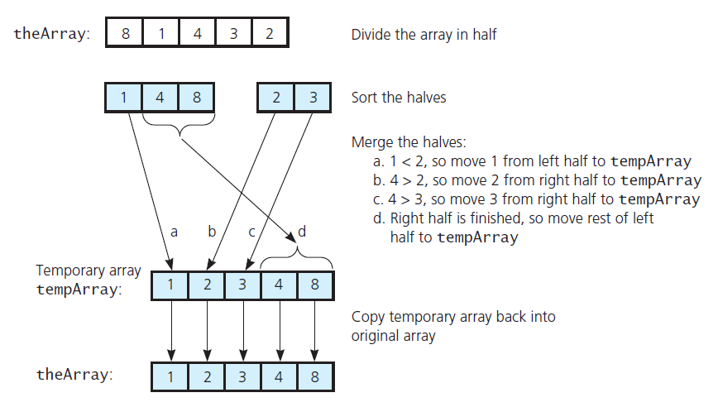
Merge Sort (1/11)
Source: FIGURE 11-5 in [Carrano and Henry 2013].

Slide 22
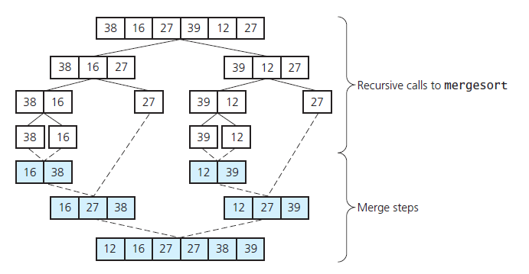
Merge Sort (2/11)
Source: FIGURE 11-6 in [Carrano and Henry 2013].

Slide 23
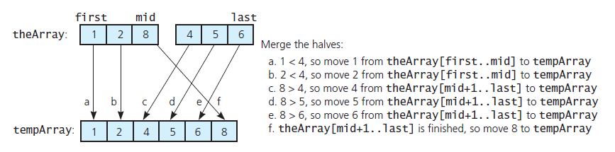
Merge Sort (3/11)
A worst-case instance of the merge step
Source: FIGURE 11-7 in [Carrano and Henry 2013].

Slide 24
Merge Sort (4/11)
const int MAX_SIZE = maximum-number-of-items-in-array;
/** Merges two sorted array segments theArray[first..mid] and
theArray[mid+1..last] into one sorted array.
@pre first <= mid <= last. The subarrays theArray[first..mid]
and theArray[mid+1..last] are each sorted in increasing
order.
@post theArray[first..last] is sorted.
@param theArray The given array.
@param first The index of the beginning of the first segment
in theArray.
@param mid The index of the end of the first segment in
theArray; mid + 1 marks the beginning of the second
segment.
@param last The index of the last element in the second
segment in theArray.
@note This function merges the two subarrays into a temporary
array and copies the result into the original array
theArray. */
void merge(ItemType theArray[], int first, int mid, int last)

Slide 25
Merge Sort (5/11)
void merge(ItemType theArray[], int first, int mid, int last)
{
ItemType tempArray[MAX_SIZE]; // Temporary array
// Initialize the local indices to indicate the subarrays
int first1 = first; // Beginning of first subarray
int last1 = mid; // End of first subarray
int first2 = mid + 1; // Beginning of second subarray
int last2 = last; // End of second subarray
// While both subarrays are not empty, copy the
// smaller item into the temporary array
int index = first1; // Next available location in tempArray
while ((first1 <= last1) && (first2 <= last2))
// At this point, tempArray[first..index-1] is in order
if (theArray[first1] <= theArray[first2])
tempArray[index++] = theArray[first1++];
else
tempArray[index++] = theArray[first2++];

Slide 26
Merge Sort (6/11)
// Finish off the first subarray, if necessary
while (first1 <= last1)
// At this point, tempArray[first..index-1] is in order
tempArray[index++] = theArray[first1++];
// Finish off the second subarray, if necessary
while (first2 <= last2)
// At this point, tempArray[first..index-1] is in order
tempArray[index++] = theArray[first2++];
// Copy the result back into the original array
for (index = first; index <= last; index++)
theArray[index] = tempArray[index];
} // end merge

Slide 27
Merge Sort (7/11)
/** Sorts the items in an array into ascending order.
@pre theArray[first..last] is an array.
@post theArray is sorted into ascending order.
@param theArray The given array.
@param first The index of the first entry to consider.
@param last The index of the last entry to consider. */
void mergeSort(ItemType theArray[], int first, int last)
{
if (first < last) {
// Sort each half
int mid = first + (last – first) / 2; // Index of midpoint
// Sort left half theArray[first..mid]
mergeSort(theArray, first, mid);
// Sort right half theArray[mid+1..last]
mergeSort(theArray, mid + 1, last);
// Merge the two halves
merge(theArray, first, mid, last);
} // end if
} // end mergeSort

Slide 28
Mergesort (8/11)
Analysis (worst case):
  The merge step of the algorithm requires the most effort.
    Each merge step merges theArray[first…mid] and theArray[mid+1…last].
    If the number of items in the two array segment is m:
      Merging the segments requires at most:
        m-1 comparisons.
        m moves from the original array to the temporary array.
        m moves from the temporary array back to the original array.
      Each merge requires 3×m-1 major operations.

Slide 29
Mergesort (9/11)
n
Level 0
Merge n items:
3×n-1 operations
or O(n)
n/2
n/2
Level 1
Merge two n/2 items:
2×(3×n/2-1) operations
3n-2 operations
or O(n)
n/4
n/4
n/4
n/4
Level 2
Each level requires
O(n) operations
. . .
1
1
1
1
1
1
Level log₂n
(or 1 + log₂n rounded down)
Each level O(n) operations & O(log₂n) levels → O(n×log₂n)

Slide 30
Mergesort (10/11)
Analysis:
  Worst case:
  Average case:
  Performance is independent of the initial order of the array items.
  Advantage:
    Mergesort is an extremely fast algorithm.
  Disadvantage:
    Mergesort requires a second array as large as the original array.
O(n × log₂n).
O(n × log₂n).

Slide 31
Merge Sort (11/11)
A variant of the last three loops of merging:
if (first2 > last2) {
// Finish off the first subarray
while (first1 <= last1)
// At this point, tempArray[first..index-1] is in order
tempArray[index++] = theArray[first1++];
else
// Need not finish off the second subarray, as the
// items are already in their eventual correct places.
// Remember not to copy “them” back from tempArray
last = first2 - 1;
// Copy the result back into the original array
for (index = first; index <= last; index++)
theArray[index] = tempArray[index];
} // end merge

Slide 32
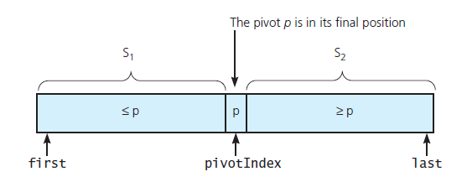
Quick Sort (1/8)
The basic idea: use the partition procedure
Apply the same to S₁ and S₂ recursively.
A partition about a pivot
Source: FIGURE 11-9 in [Carrano and Henry 2013].

Slide 33
Quick Sort (2/8)
Draft of the algorithm in pseudocode:
// Sorts theArray[first..last].
quickSort(theArray: ItemArray, first: integer, last: integer): void
if (first < last) {
Choose a pivot item p from theArray[first..last]
Partition the items of theArray[first..last] about p
// The partition is theArray[first..pivotIndex..last],
// which may be depicted as S₁ | p | S₂
quickSort(theArray, first, pivotIndex - 1) // Sort S₁
quickSort(theArray, pivotIndex + 1, last) // Sort S₂
}
// If first >= last, there is nothing to do

Slide 34
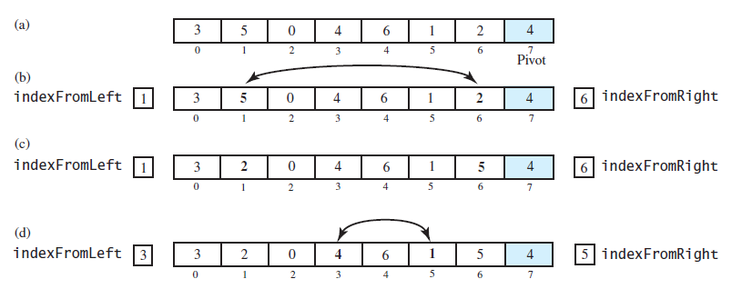
Partition (1/4)
Source: FIGURE 11-10 in [Carrano and Henry 2013].

Slide 35
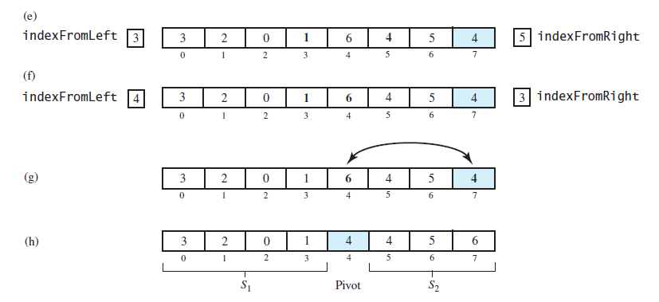
Partition (2/4)
Source: FIGURE 11-10 in [Carrano and Henry 2013].

Slide 36
Partition (3/4)
// Partition with simple pivot selection
partition(theArray: ItemArray, first: integer, last: integer): integer
// Choose last entry as pivot
// May also choose another and exchange it with last entry
pivotIndex = last
pivot = theArray[pivotIndex]
// Determine the regions S₁ and S₂
indexFromLeft = first
indexFromRight = last – 1
done = false
while (not done) {
// Locate first entry on left that is ≥ pivot
while (thearray[indexFromLeft] < pivot)
indexFromLeft = indexFromLeft + 1
// Locate first entry on right that is ≤ pivot
while (thearray[indexFromRight] > pivot)
indexFromRight = indexFromRight – 1

Slide 37
Partition (4/4)
if (indexFromLeft < indexFromFight) {
Interchange theArray[indexFromLeft] and
theArray[indexFromFight]
indexFromLeft = indexFromLeft + 1
indexFromRight = indexFromRight – 1
}
else
done = true
}
// Place pivot in proper position between S₁ and S₂, and
// mark its new location
Interchange theArray[pivotIndex] and theArray[indexFromLeft]
pivotINdex = indexFromLeft
return pivotIndex

Slide 38
Quick Sort (3/8)
/** Sorts an array into ascending order. Uses the quick sort
with median-of-three pivot selection for arrays of at least
MIN_SIZE entries, and uses the insertion sort for other
arrays.
@pre theArray[first..last] is an array.
@post theArray[first..last] is sorted.
@param theArray The given array.
@param first The first element to consider in theArray.
@param last The last element to consider in theArray. */
void quickSort(ItemType theArray[], int first, int last)

Slide 39
Quick Sort (4/8)
void quickSort(ItemType theArray[], int first, int last)
{
if (last - first + 1 < MIN_SIZE)
insertionSort(theArray, first, last);
else {
// Create the partition: S1 | Pivot | S2
int pivotIndex = partition(theArray, first, last);
// Sort subarrays S1 and S2
quickSort(theArray, first, pivotIndex - 1);
quickSort(theArray, pivotIndex + 1, last);
} // end if
} // end quickSort

Slide 40
Quicksort (5/8)
The major effort in the quicksort function occurs during the partition step.
Worst case:
  The worst case behavior for quicksort occurs when the partition produces one sub-problem with n-1 elements and one with 0 elements.
    And unbalanced partition arises in each recursive call.
    When the array is already sorted and the smallest item is chosen as the pivot.
  Because S₂ decreases in size by one at each recursive call to quicksort. The maximum number of recursive calls to quicksort will occur.

Slide 41
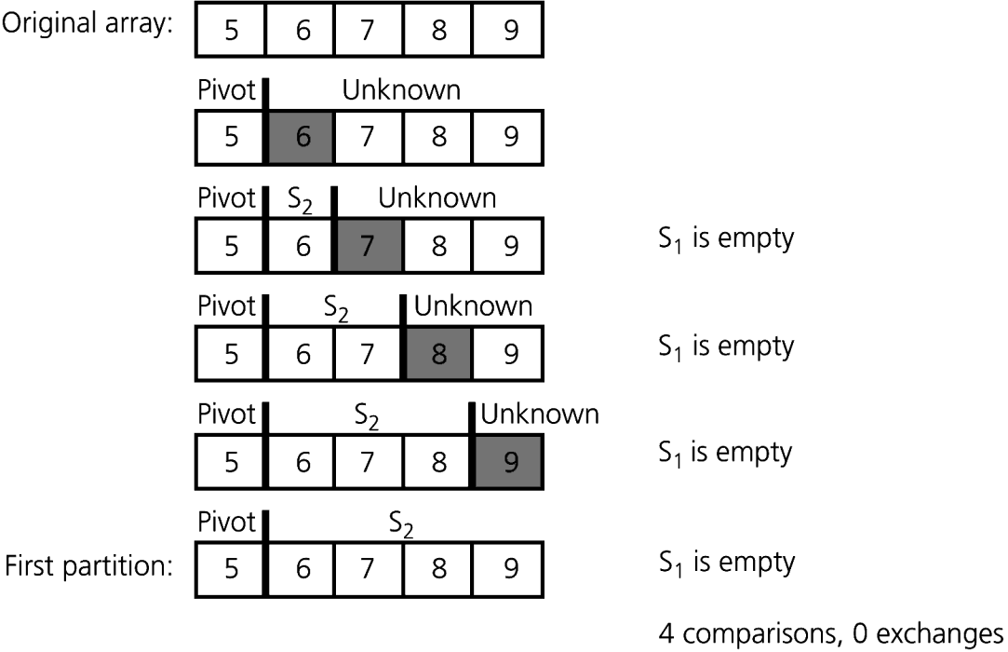
Quicksort (6/8)
For an array of n items:
  In the worst case, the 1st partition requires n-1 comparisons to partition the n items in the array.
On the next recursive call to quicksort:
  Partition is passed n-1 items.
  So it will require n-2 comparisons to partition them.
Therefore, quicksort requires:
  (n-1) + (n-2) + … + 1 = n×(n-1)/2 comparisons.
  O(n²).

Slide 42
Quicksort (7/8)
When S₁ and S₂ contain about the same number of items, there would be about log₂n levels of recursive calls to quickSort, like in mergeSort.
The average case of Quick sort is O(n × log₂n).
Quicksort is usually extremely fast in practice.
Even if the worst case occurs, quicksort’s performance is acceptable for moderately large arrays.

Slide 43
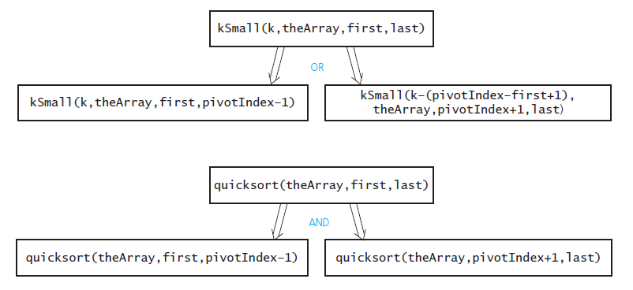
Quick Sort (8/8)
Source: FIGURE 11-13 in [Carrano and Henry 2013].

Slide 44
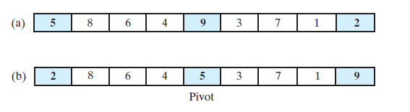
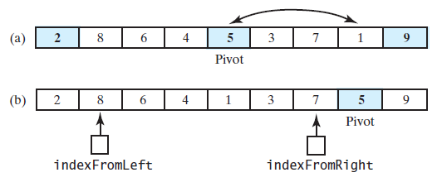
Improved Partition (1/4)
Medium-of-three pivot selection:
Sort the three in order and put away the pivot
Source: FIGURES 11-11 and 11-12 in [Carrano and Henry 2013].

Slide 45
Improved Partition (2/4)
sortFirstMiddleLast(theArray: ItemArray, first: integer,
mid: integer, last: integer): void
if (theArray[first] > theArray[mid]
Interchange theArray[first] and theArray[mid]
if (theArray[mid] > theArray[last]
Interchange theArray[mid] and theArray[last]
if (theArray[first] < theArray[mid]
Interchange theArray[first] and theArray[mid]

Slide 46
Improved Partition (3/4)
// Partition with medium-of-three pivot selection.
partition(theArray: ItemArray, first: integer, last: integer): integer
// Choose pivot and reposition it
mid = first + (last – first) / 2
sortFirstMiddleLast(theArray, first, mid, last)
Interchange theArray[mid] and theArray[last – 1]
pivotIndex = last - 1
pivot = theArray[pivotIndex]
// Determine the regions S₁ and S₂
indexFromLeft = first + 1
indexFromRight = last – 2
done = false
while (not done) {
// Locate first entry on left that is ≥ pivot
while (thearray[indexFromLeft] < pivot)
indexFromLeft = indexFromLeft + 1
// Locate first entry on right that is ≤ pivot
while (thearray[indexFromRight] > pivot)
indexFromRight = indexFromRight – 1

Slide 47
Improved Partition (4/4)
if (indexFromLeft < indexFromFight) {
Interchange theArray[indexFromLeft] and
theArray[indexFromFight]
indexFromLeft = indexFromLeft + 1
indexFromRight = indexFromRight – 1
}
else
done = true
}
// Place pivot in proper position between S₁ and S₂, and
// mark its new location
Interchange theArray[pivotIndex] and theArray[indexFromLeft]
pivotINdex = indexFromLeft
return pivotIndex

Slide 48
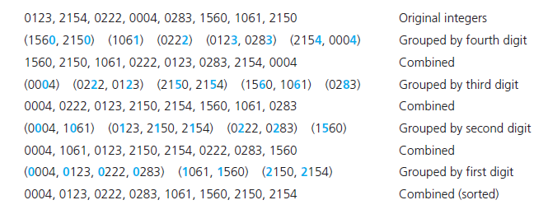
Radix Sort (1/4)
A radix sort of eight four-digit integers
Source: FIGURE 11-14 in [Carrano and Henry 2013].

Slide 49
Radix Sort (2/4)
The algorithm in pseudocode:
// Sorts n d-digit integers in the array theArray
radixSort(theArray: ItemArray, n: integer, d: integer): void
for (j = d downto 1) {
Initialize 10 groups to empty
Initialize a counter for each group to 0
for (i = 0 through n – 1) {
k = j-th digit of the Array[i]
Place theArray[i] at the end of group k
Increase k-th counter by 1
}
Replace the items in theArray with all the items in group 0,
followed by all the items in group 1, and so on.
}

Slide 50
Radix Sort (3/4)
To sort n d-digit numbers, Radix sort requires:
  n moves each time it forms groups.
  n moves to combine them into one group.
Totally, 2×n×d moves.
Thus, the Radix sort is O(n), if we treat d as a constant.

Slide 51
Radix Sort (4/4)
Despite its efficiency, radix sort has some difficulties that make it inappropriate as a general-purpose sorting algorithm.
  To sort integers, you need to accommodate 10 groups (0, 1, …, 9).
  Each group must be able to hold n strings.
  For large n, this requirement demands substantial memory!
Radix sort is more appropriate when using chains than arrays to store data.

Slide 52
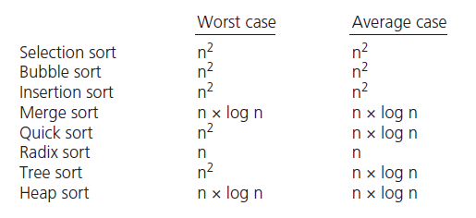
Comparison
Note: Tree sort and Heap sort will be covered later in the course.
Source: FIGURE 11-15 in [Carrano and Henry 2013].

