Slide 1
Queues:
Implementations
Yih-Kuen Tsay
Dept. of Information Management
National Taiwan University
Based on [Carrano and Henry 2013]
With help from Chien Chin Chen

Slide 2
Implementations of the ADT Queue
Like stacks and lists, queues can have
  an array-based implementation or
  a link-based implementation.
We can also use the ADT list to implement a queue.
Using another ADT is easier, though it may not be as efficient as direct implementations.
We will next consider a link-based implementation and then an array-based implementation.

Slide 3
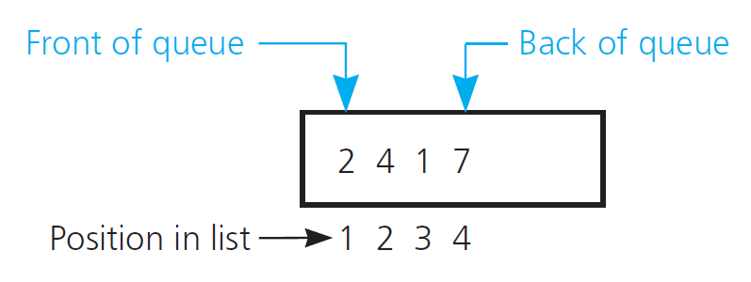
Implementation with the ADT List (1/6)
An implementation of queue with list
Source: FIGURE 14-1 in [Carrano and Henry 2013].

Slide 4
Implementation with the ADT List (2/6)
/** ADT queue: ADT list implementation.
@file ListQueue.h */
#ifndef _LIST_QUEUE
#define _LIST_QUEUE
#include "QueueInterface.h"
#include "LinkedList.h"
#include "PrecondViolatedExcep.h"
template<class ItemType>
class ListQueue: public QueueInterface<ItemType>
{
private:
LinkedList<ItemType>* listPtr; // Pointer to list of queue
// items

Slide 5
Implementation with the ADT List (3/6)
public:
ListQueue();
ListQueue(const ListQueue& aQueue);
~ListQueue();
bool isEmpty() const;
bool enqueue(const ItemType& newEntry);
bool dequeue();
/** @throw PrecondViolatedExcep if queue is empty. */
ItemType peekFront() const throw(PrecondViolatedExcep);
}; // end ListQueue
#include "ListQueue.cpp"
#endif

Slide 6
Implementation with the ADT List (4/6)
/** ADT queue: ADT list implementation.
@file ListQueue.cpp */
#include "ListQueue.h" // Header file
template<class ItemType>
ListQueue<ItemType>::ListQueue()
{
listPtr = new LinkedList<ItemType>();
} // end default constructor
template<class ItemType>
ListQueue<ItemType>::ListQueue(const ListQueue & aQueue):
listPtr(aQueue.listPtr)
{ } // end copy constructor
template<class ItemType>
ListQueue<ItemType>::~ListQueue()
{ } // end destructor

Slide 7
Implementation with the ADT List (5/6)
template<class ItemType>
bool ListQueue<ItemType>::isEmpty() const
{
return listPtr->isEmpty();
} // end isEmpty
template<class ItemType>
bool ListQueue<ItemType>::enqueue(const ItemType& newEntry)
{
return listPtr->insert(listPtr->getLength() + 1, newEntry);
} // end enqueue
template<class ItemType>
bool ListQueue<ItemType>::dequeue()
{
return listPtr->remove(1);
} // end dequeue

Slide 8
Implementation with the ADT List (6/6)
template<class ItemType>
ItemType ListQueue<ItemType>::peekFront() const
throw (PrecondViolatedExcep)
{
if (isEmpty())
throw PrecondViolatedExcep("peekFront() called with empty
queue.");
// Queue is not empty; return front
return listPtr->getEntry(1);
} // end peekFront
// end of implementation file

Slide 9
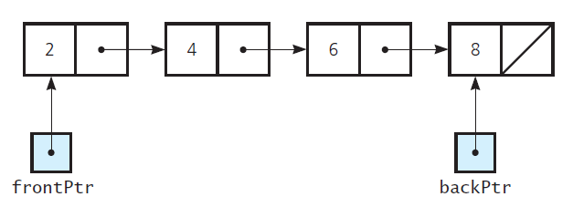
A Link-Based Implementation (1/11)
A chain of linked nodes with head and tail pointers
Source: FIGURE 14-2 in [Carrano and Henry 2013].

Slide 10
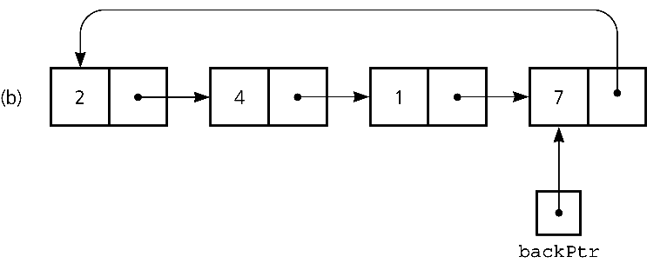
A Link-Based Implementation (2/11)
██
A circular chain of linked nodes with one external pointer
Source: FIGURE 14-3 in [Carrano and Henry 2013].

Slide 11
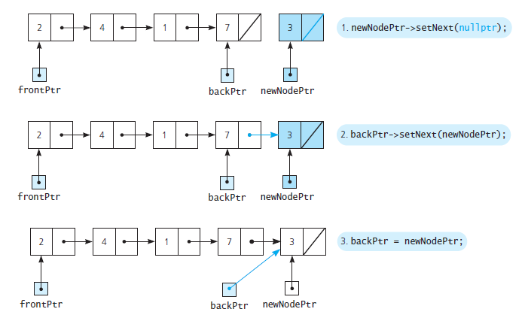
A Link-Based Implementation (3/11)
Adding an item to a nonempty queue
Source: FIGURE 14-4 in [Carrano and Henry 2013].

Slide 12
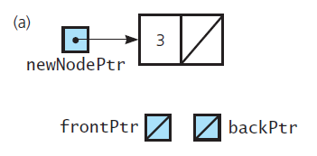
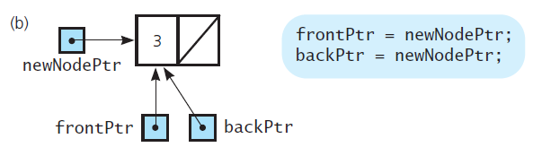
A Link-Based Implementation (4/11)
Adding an item to an empty queue
Source: FIGURE 14-5 in [Carrano and Henry 2013].

Slide 13
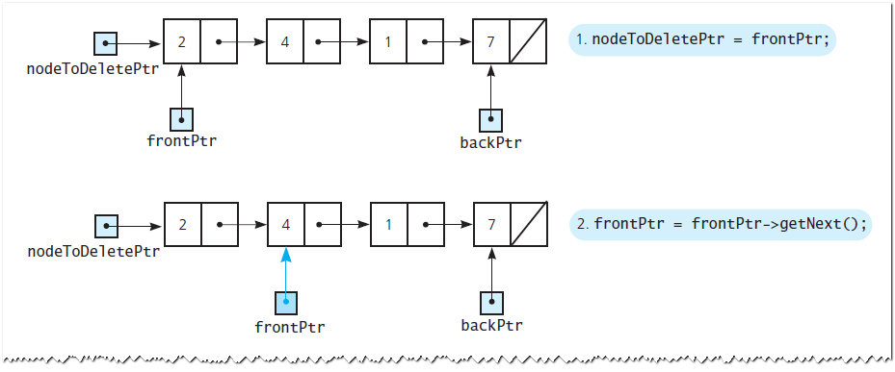
A Link-Based Implementation (5/11)
Removing an item from a queue
Source: FIGURE 14-6 in [Carrano and Henry 2013].

Slide 14
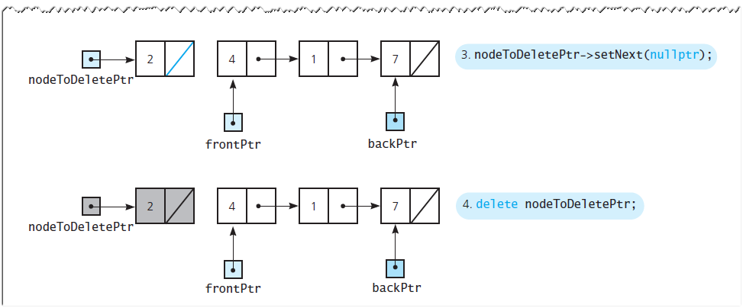
A Link-Based Implementation (6/11)
Removing an item from a queue
Source: FIGURE 14-6 in [Carrano and Henry 2013].

Slide 15
A Link-Based Implementation (7/11)
/** ADT queue: Link-based implementation.
@file LinkedQueue.h */
#ifndef _LINKED_QUEUE
#define _LINKED_QUEUE
#include "QueueInterface.h"
#include "Node.h"
#include "PrecondViolatedExcep.h"
template<class ItemType>
class LinkedQueue:public QueueInterface<ItemType>
{
private:
// The queue is implemented as a chain of linked nodes that
// has two external pointers, a head pointer for the front
// of the queue and a tail pointer for the back of the
// queue.
Node<ItemType>* backPtr;
Node<ItemType>* frontPtr;

Slide 16
A Link-Based Implementation (8/11)
public:
LinkedQueue();
LinkedQueue(const LinkedQueue& aQueue);
~LinkedQueue();
bool isEmpty() const;
bool enqueue(const ItemType& newEntry);
bool dequeue();
/** @throw PrecondViolatedExcep if the queue is empty */
ItemType peekFront() const throw(PrecondViolatedExcep);
}; // end LinkedQueue
#include "LinkedQueue.cpp"
#endif

Slide 17
A Link-Based Implementation (9/11)
template<class ItemType>
class LinkedQueue<ItemType>:enQueue(const ItemType& newEntry)
{
Node<ItemType>* newNodePtr = new Node<ItemType>(newEntry);
// Insert the new node
if (isEmpty())
frontPtr = newNodePtr;
else
backPtr->setNext(newNodePtr);
backPtr = newNodePtr;
return true;
} // end enqueue

Slide 18
A Link-Based Implementation (10/11)
template<class ItemType>
class LinkedQueue<ItemType>:deQueue()
{
bool result = false;
if (!isEmpty()) {
// Queue is not empty; remove front
Node<ItemType>* nodeToDeletePtr = frontPtr;
if (frontPtr == backPtr) {
// Special case: one node in queue
frontPtr = nullPtr;
backPtr = nullPtr;
}
else
frontPtr = frontPtr->getNext();

Slide 19
A Link-Based Implementation (11/11)
// Return deleted node to system
nodeToDelete->setNext(nullPtr);
delete nodeToDeletePtr;
result = true;
} // end if
return result;
} // end dequeue

Slide 20
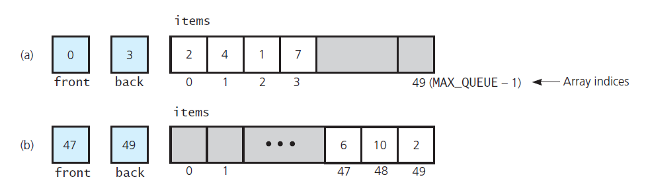
A Naïve Array-Based Implementation
A naïve array-based implementation
Source: FIGURE 14-7 in [Carrano and Henry 2013].

Slide 21
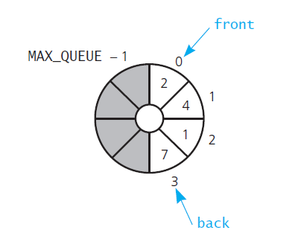
Implementation with a Circular Array (1/11)
Implementation of queue with a circular array
Source: FIGURE 14-8 in [Carrano and Henry 2013].

Slide 22
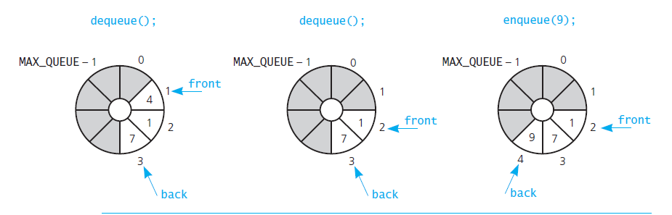
Implementation with a Circular Array (2/11)
A scenario of three operations on a queue
Source: FIGURE 14-9 in [Carrano and Henry 2013].

Slide 23
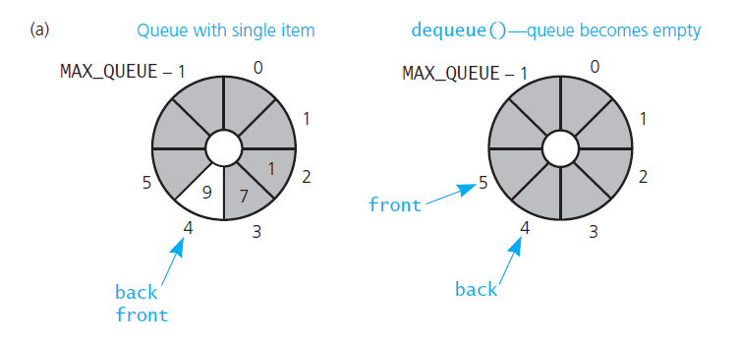
Implementation with a Circular Array (3/11)
front passes back when the queue becomes empty
Source: FIGURE 14-10 in [Carrano and Henry 2013].

Slide 24
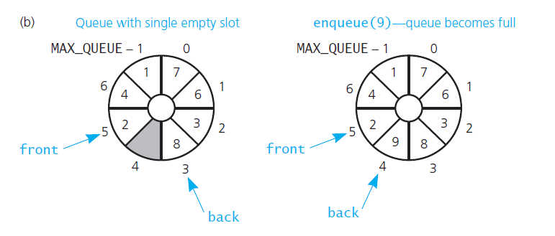
Implementation with a Circular Array (4/11)
back catches up to front when the queue becomes full
Source: FIGURE 14-10 in [Carrano and Henry 2013].

Slide 25
Implementation with a Circular Array (5/11)
/** ADT queue: Circular array-based implementation.
@file ArrayQueue.h */
#ifndef _ARRAY_QUEUE
#define _ARRAY_QUEUE
#include "QueueInterface.h"
#include "PrecondViolatedExcep.h“
const int MAX_QUEUE = 50;
template<class ItemType>
class ArrayQueue: public QueueInterface<ItemType>
{
private:
ItemType items[MAX_QUEUE]; // Array of queue items
int front; // Index to front of queue
int back; // Index to back of queue
int count; // Number of items currently in the queue

Slide 26
Implementation with a Circular Array (6/11)
public:
ArrayQueue();
// Copy constructor and destructor supplied by compiler
bool isEmpty() const;
bool enqueue(const ItemType& newEntry);
bool dequeue();
/** @throw PrecondViolatedExcep if queue is empty. */
ItemType peekFront() const throw(PrecondViolatedExcep);
} // end ArrayQueue
#include "ArrayQueue.cpp"
#endif

Slide 27
Implementation with a Circular Array (7/11)
/** ADT queue: Circular array-based implementation.
@file ArrayQueue.cpp */
#include "ArrayQueue.h" // Header file
template<class ItemType>
ArrayQueue<ItemType>::ArrayQueue(): front(0),
back(MAX_QUEUE - 1), count (0)
{
} // end default constructor
template<class ItemType>
bool ArrayQueue<ItemType>::isEmpty() const
{
return count == 0;
} // end isEmpty

Slide 28
Implementation with a Circular Array (8/11)
template<class ItemType>
bool ArrayQueue<ItemType>::enqueue(const ItemType& newEntry)
{
bool result = false;
if (count < MAX_QUEUE) {
// Queue has room for another item
back = (back + 1) % MAX_QUEUE;
items[back] = newEntry;
count++; result = true;
} // end if
return result;
} // end enqueue

Slide 29
Implementation with a Circular Array (9/11)
template<class ItemType>
bool ArrayQueue<ItemType>::dequeue()
{
bool result = false;
if (!isEmpty()) {
front = (front + 1) % MAX_QUEUE;
count--;
result = true;
} // end if
return result;
} // end dequeue

Slide 30
Implementation with a Circular Array (10/11)
template<class ItemType>
ItemType ArrayQueue<ItemType>::peekFront() const
throw(PrecondViolatedExcep)
{
// Enforce precondition
if (isEmpty())
throw PrecondViolatedExcep("peekFront() called with empty
queue");
// Queue is not empty; return front
return items[front];
} // end peekFront

Slide 31
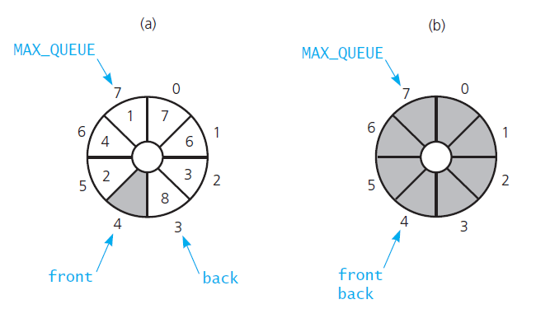
Implementation with a Circular Array (11/11)
A more time-efficient implementation with MAX_QUEUE+1 entries,
but using only MAX_QUEUE of them.
Source: FIGURE 14-11 in [Carrano and Henry 2013].

Slide 32
Comparing Implementations
Fixed-size vs. dynamic-size:
  A statically allocated array-based implementation
    Fixed-size queue that may get full.
  A link-based implementation
    No size restriction on the queue.
    To use a link-based implementation of the ADT list or not?
      Direct link-based implementation is more efficient
      But, the ADT list approach is much simpler to write and saves programming time.

Slide 33
Implementations of Priority Queues
Using a sorted list (not covered)
Using a heap (will be covered later)

