Slide 1
Heaps
Yih-Kuen Tsay
Dept. of Information Management
National Taiwan University
Based on [Carrano and Henry 2013]
With help from Chien Chin Chen

Slide 2
Introduction
We are about to study a special kind of complete binary tree, called heap.
A heap provides an efficient implementation of the ADT priority queue.
It is also useful for sorting.
Do not confuse such a heap with the heap in the execution environment of a program, which contains the collection of memory cells available for dynamic allocation.

Slide 3
The ADT Heap (1/6)
A heap is a complete binary tree that either is empty or whose root
  contains a value greater than or equal to the value in each of its children, and
  has heaps as its subtrees.
A heap so defined is often called a maxheap, as the root contains the item with the largest value.
If we would replace “greater” with “less” in the definition, the root would contain the item with the smallest value.
Such a heap is called a minheap.

Slide 4
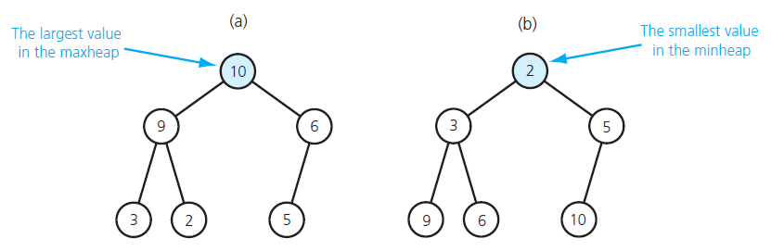
The ADT Heap (2/6)
(a) a maxheap; (b) a minheap
Source: FIGURE 17-1 in [Carrano and Henry 2013].

Slide 5
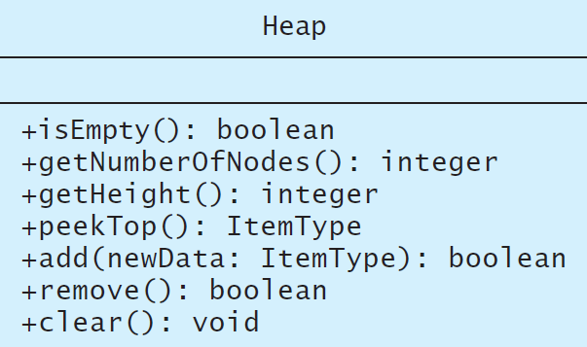
The ADT Heap (3/6)
A UML diagram for the class Heap
Source: FIGURE 17-2 in [Carrano and Henry 2013].

Slide 6
The ADT Heap (4/6)
Data
  A finite number of objects in hierarchical order.
Operations
  isEmpty()
    Task: Determines whether this heap is empty.
    Input: None.
    Output: True if the heap is empty; false, otherwise.
  getNumberOfNodes()
    Task: Gets the number of nodes in this heap.
    Input: None.
    Output: The number of nodes in this heap.

Slide 7
The ADT Heap (5/6)
Operations (cont’d)
  getHeigt()
    Task: Gets the height of this heap.
    Input: None.
    Output: The height of this heap.
  peekTop()
    Task: Gets the data in the root (top) of this heap.
    Input: None. Assumes the heap is not empty.
    Output: The item in the root of the heap.
  add(newData)
    Task: Inserts newData into this heap.
    Input: newData is the data item to be inserted.
    Output: True if the insertion is successful; false, otherwise

Slide 8
The ADT Heap (6/6)
Operations (cont’d)
  remove()
    Task: Removes the item in the root of this heap.
    Input: None.
    Output: True if the removal is successful; false, otherwise
  clear()
    Task: Removes all nodes from this heap.
    Input: None.
    Output: The heap is empty.

Slide 9
Heaps vs. Binary Search Trees
Both are binary trees.
While a binary search tree can be seen as sorted, a heap is ordered in a much weaker sense (but still very useful).
While binary search trees come in many different shapes, heaps are always complete binary trees (and hence balanced without overhead).

Slide 10
A C++ Interface for the ADT Heap (1/3)
/** Interface for the ADT heap.
@file HeapInterface.h */
#ifndef _HEAP_INTERFACE
#define _HEAP_INTERFACE
template<class ItemType>
class HeapInterface
{
public:
/** Sees whether this heap is empty.
@return True if the heap is empty, or false if not. */
virtual bool isEmpty() const = 0;

Slide 11
A C++ Interface for the ADT Heap (2/3)
/** Gets the number of nodes in this heap.
@return The number of nodes in the heap. */
virtual int getNumberOfNodes() const = 0;
/** Gets the height of this heap.
@return The height of the heap. */
virtual int getHeight() const = 0;
/** Gets the data that is in the root (top) of this heap.
For a maxheap, the data is the largest value in the heap;
for a minheap, the data is the smallest value in the heap.
@pre The heap is not empty.
@post The roots data has been returned, and the heap is
unchanged.
@return The data in the root of the heap. */
virtual ItemType peekTop() const = 0;

Slide 12
A C++ Interface for the ADT Heap (3/3)
/** Adds a new node containing the given data to this heap.
@param newData The data for the new node.
@post The heap contains a new node.
@return True if the addition is successful, or
false if not. */
virtual bool add(const ItemType& newData) = 0;
/** Removes the root node from this heap.
@return True if the removal is successful, or
false if not. */
virtual bool remove() = 0;
/** Removes all nodes from this heap. */
virtual void clear() = 0;
}; // end HeapInterface
#endif

Slide 13
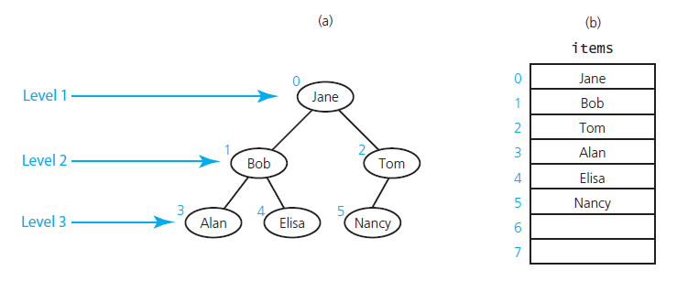
Complete Binary Trees in an Array (1/2)
(a) level-by-level numbering; (b) an array-based implementation
Source: FIGURE 17-3 in [Carrano and Henry 2013].

Slide 14
Complete Binary Trees in an Array (2/2)
The tree nodes are numbered 0 through n level-by-level, i.e., from top to bottom and left to right.
Place the tree nodes in an array according in numeric order, i.e., items[i] contains node numbered i.
Given any node items[i], one can easily locate both of its children and its parent:
  Left child (if it exists): items[2*i+1]
  Right child (if it exists): items[2*i+2]
  Parent (if it exists): items[(i-1)/2]

Slide 15
An Array-Based Implementation (1/10)
Private data members:
  items: an array of heap items
  itemcount: the number of items in the heap
  maxItems: the maximum capacity of the heap
Operations
  peektop()
    return items[0] (if the heap is not empty)
  remove()
    removing the root of a heap would leave two disjoint heaps
    replace the root with the last item, resulting in a semiheap
    trickle the new root down the tree, getting a new heap

Slide 16
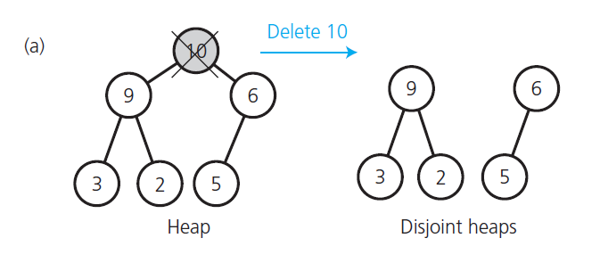
Converting a Semiheap into a Heap (1/9)
Disjoint heaps after a removal
Source: FIGURE 17-4 in [Carrano and Henry 2013].

Slide 17
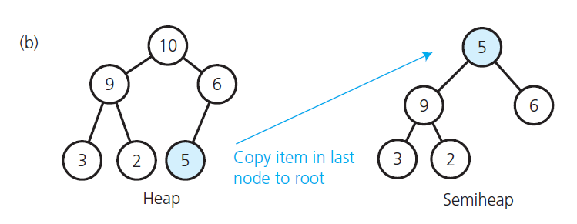
Converting a Semiheap into a Heap (2/9)
A semiheap
Source: FIGURE 17-4 in [Carrano and Henry 2013].

Slide 18
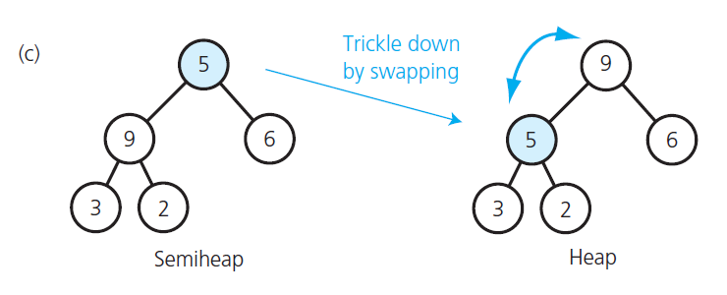
Converting a Semiheap into a Heap (3/9)
The restored heap
Source: FIGURE 17-4 in [Carrano and Henry 2013].

Slide 19
Converting a Semiheap into a Heap (4/9)
// Converts a semiheap rooted at index root into a heap.
heapRebuild(root: integer, items: ArrayType,
itemCount: integer)
// Recursively trickle the item at index root down to
// its proper position by swapping it with its larger child,
// if the child is larger than the item.
// If the item is at a leaf, nothing needs to be done.
if (root is not a leaf) {
// root must have a left child; assume it is
// the larger child
largerChildIndex = 2 * rootIndex + 1 // Left child index
if (root has a right child) {
rightChildIndex = largerChildIndex + 1
// Right child index
if (items[rightChildIndex] > items[largerChildIndex])
largerChildIndex = rightChildIndex
// Larger child index
}

Slide 20
Converting a Semiheap into a Heap (5/9)
// If the item in root is smaller than the item
// in the larger child, swap items
if (items[rootIndex] < items[largerChildIndex]) {
Swap items[rootIndex] and items[largerChildIndex]
// Transform the semiheap rooted at largerChildIndex
// into a heap
heapRebuild(largerChildIndex, items, itemCount)}
}
// Else root is a leaf, so you are done

Slide 21
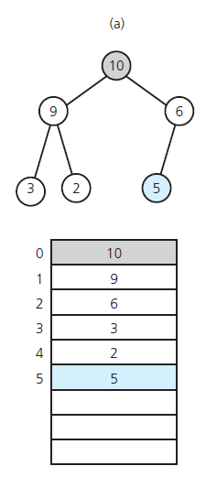
Converting a Semiheap into a Heap (6/9)
Array representation of a heap
Source: FIGURE 17-5 in [Carrano and Henry 2013].

Slide 22
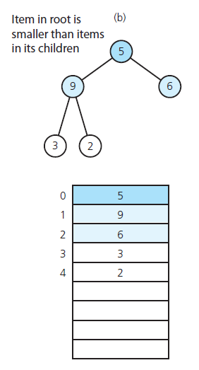
Converting a Semiheap into a Heap (7/9)
Array representation of a semiheap
Source: FIGURE 17-5 in [Carrano and Henry 2013].

Slide 23
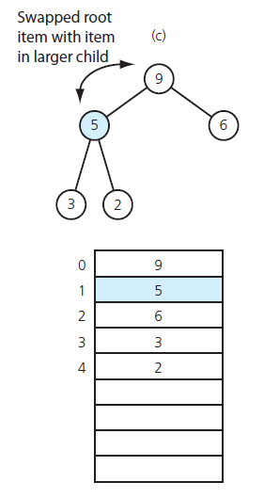
Converting a Semiheap into a Heap (8/9)
Array representation of a restored heap (from a semiheap)
Source: FIGURE 17-5 in [Carrano and Henry 2013].

Slide 24
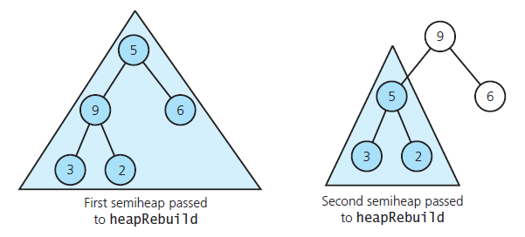
Converting a Semiheap into a Heap (9/9)
Recursive calls to heapRebuild
Source: FIGURE 17-6 in [Carrano and Henry 2013].

Slide 25
An Array-Based Implementation (2/10)
Complexity of remove()
  Trickling down by one level takes constant time.
  O(log n)
Operations (cont’d)
  add(newData)
    It is the opposite of remove.
    Place the new entry as the new last item
    Trickle the new last item up the tree

Slide 26
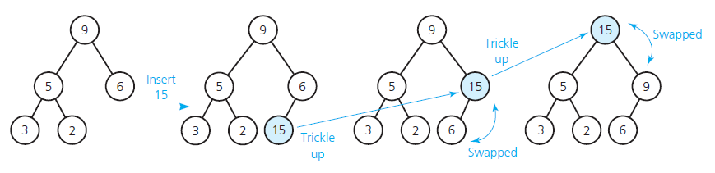
Insertion into a Heap (1/2)
Insertion into a heap
Source: FIGURE 17-7 in [Carrano and Henry 2013].

Slide 27
Insertion into a Heap (2/2)
// Insert newData into the bottom of the tree
items[itemCount] = newData
// Trickle new item up to the appropriate spot in the tree
newDataIndex = itemCount
inPlace = false
while ((newDataIndex >= 0) and !inPlace) {
parentIndex = (newDataIndex – 1) / 2
if (items[newDataIndex] < items[parentIndex])
inPlace = true
else {
Swap items[newDataIndex] and items[parentIndex]
newDataIndex = parentIndex
}
}
itemCount++

Slide 28
An Array-Based Implementation (3/10)
/** Array-based implementation of the ADT heap.
@file ArrayMaxHeap.h */
#ifndef _ARRAY_MAX_HEAP
#define _ARRAY_MAX_HEAP
#include "HeapInterface.h"
#include "PrecondViolatedExcep.h"
template<class ItemType>
class ArrayMaxHeap: public HeapInterface<ItemType>
{
private:
static const int ROOT_INDEX = 0; // Helps with readability
static const int DEFAULT_CAPACITY = 21; // Small capacity
// to test for a full heap
ItemType* items; // Array of heap items
int itemCount; // Current count of heap items
int maxItems; // Maximum capacity of the heap

Slide 29
An Array-Based Implementation (4/10)
// --------------------------------------------------------
// Most of the private utility methods use an array index
// as a parameter and in calculations. This should be safe,
// even though the array is an implementation detail, since
// the methods are private.
// --------------------------------------------------------
// Returns the array index of the left child (if it exists).
int getLeftChildIndex(const int nodeIndex) const;
// Returns the array index of the right child (if it
// exists).
int getRightChildIndex(int nodeIndex) const;
// Returns the array index of the parent node.
int getParentIndex(int nodeIndex) const;
// Tests whether this node is a leaf.
bool isLeaf(int nodeIndex) const;
// Converts a semiheap to a heap.
void heapRebuild(int subTreeRootIndex);
// Creates a heap from an unordered array.
void heapCreate();

Slide 30
An Array-Based Implementation (5/10)
public:
ArrayMaxHeap();
ArrayMaxHeap(const ItemType someArray[],
const int arraySize);
virtual ~ArrayMaxHeap();
// HeapInterface Public Methods:
bool isEmpty() const;
int getNumberOfNodes() const;
int getHeight() const;
ItemType peekTop() const throw(PrecondViolatedExcep);
bool add(const ItemType& newData);
bool remove();
void clear();
}; // end ArrayMaxHeap
#include "ArrayMaxHeap.cpp"
#endif

Slide 31
An Array-Based Implementation (6/10)
template<class ItemType>
ArrayMaxHeap<ItemType>::
ArrayMaxHeap(const ItemType someArray[], const int arraySize):
itemCount(arraySize), maxItems(2*arraySize)
{
// Allocate the array
items = new ItemType[2*arraySize]
// Copy given values into the array
for (int i = 0; i < itemCount; i++)
items[i] = someArray[i];
// Reorganize the array into a heap
heapCreate();
} // end constructor

Slide 32
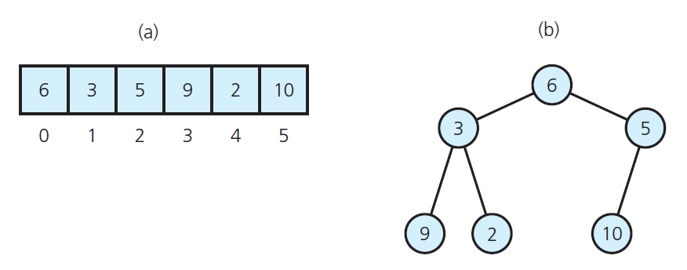
An Array-Based Implementation (7/10)
(a) contents of an array; (b) the corresponding complete binary tree
Source: FIGURE 17-8 in [Carrano and Henry 2013].

Slide 33
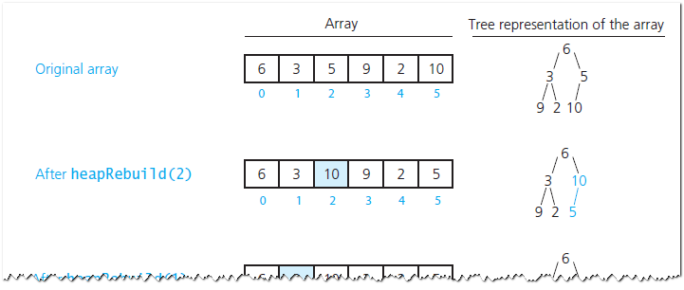
An Array-Based Implementation (8/10)
Transforming an array into a heap
Source: FIGURE 17-9 in [Carrano and Henry 2013].

Slide 34
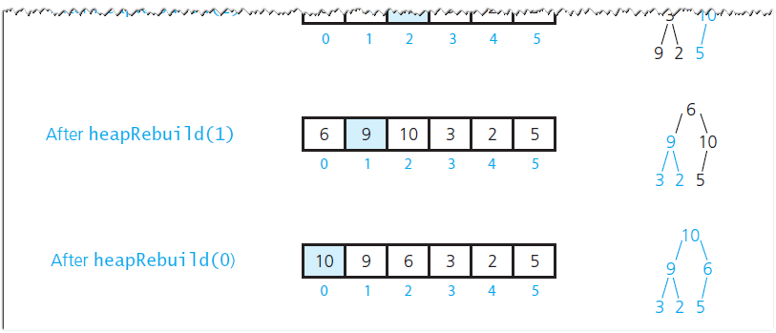
An Array-Based Implementation (9/10)
Transforming an array into a heap
Source: FIGURE 17-9 in [Carrano and Henry 2013].

Slide 35
An Array-Based Implementation (10/10)
template<class ItemType>
void ArrayMaxHeap<ItemType>::heapCreate()
{
for (int index = itemCount / 2; index >= 0; index--)
heapebuild(index);
} // end heapCreate

Slide 36
Implementation of Priority Queue (1/5)
/** ADT priority queue: Heap-based implementation.
@file Heap_PriorityQueue.h */
#ifndef _HEAP_PRIORITY_QUEUE
#define _HEAP_PRIORITY_QUEUE
#include "ArrayMaxHeap.h"
#include "PriorityQueueInterface.h"
template<class ItemType>
class Heap_PriorityQueue:
public PriorityQueueInterface<ItemType>,
private ArrayMaxHeap<ItemType>
{

Slide 37
Implementation of Priority Queue (2/5)
public:
Heap_PriorityQueue();
bool isEmpty() const;
bool add(const ItemType& newEntry);
bool remove();
/** @pre The priority queue is not empty. */
ItemType peek() const throw(PrecondViolatedExcep);
}; // end Heap_PriorityQueue
#include "Heap_PriorityQueue.cpp"
#endif

Slide 38
Implementation of Priority Queue (3/5)
/** Heap-based implementation of the ADT priority queue.
@file Heap_PriorityQueue.cpp */
#include "Heap_PriorityQueue.h"
template<class ItemType>
Heap_PriorityQueue<ItemType>::Heap_PriorityQueue() {
{
ArrayMaxHeap<ItemType>();
} // end constructor
template<class ItemType>
bool Heap_PriorityQueue<ItemType>::isEmpty() const
{
return ArrayMaxHeap<ItemType>::isEmpty();
} // end isEmpty
template<class ItemType>
bool Heap_PriorityQueue<ItemType>::add(const ItemType&
newEntry)
{
return ArrayMaxHeap<ItemType>::add(newEntry);
} // end add

Slide 39
Implementation of Priority Queue (4/5)
template<class ItemType>
bool Heap_PriorityQueue<ItemType>::remove()
{
return ArrayMaxHeap<ItemType>::remove();
} // end remove
template<class ItemType>
ItemType Heap_PriorityQueue<ItemType>::peek() const
throw (PrecondViolatedExcep)
{
try {
return ArrayMaxHeap<ItemType>::peekTop();
}
catch(PrecondViolatedExcep e) {
throw PrecondViolatedExcep("Attempted peek into an
empty priority queue.");
} // end try/catch
} // end peek

Slide 40
Implementation of Priority Queue (5/5)
If the maximum number of items is known, the heap is better (than a binary search tree)
  A heap is complete, and hence always balanced
  An overhead is required to keep a search tree balanced.
We will soon study how to keep a search tree balanced.
When there are many items, but a few distinct priority values,
  Associate a queue with each priority value

Slide 41
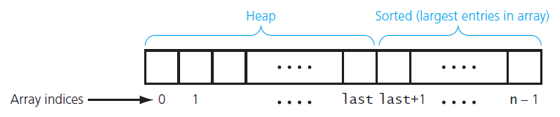
Heap Sort (1/7)
Heap sort partitions an array into two regions
Source: FIGURE 17-10 in [Carrano and Henry 2013].

Slide 42
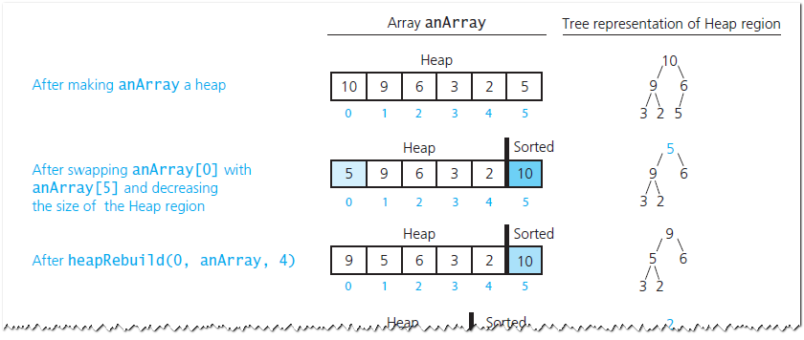
Heap Sort (2/7)
A trace of heap sort
Source: FIGURE 17-11 in [Carrano and Henry 2013].

Slide 43
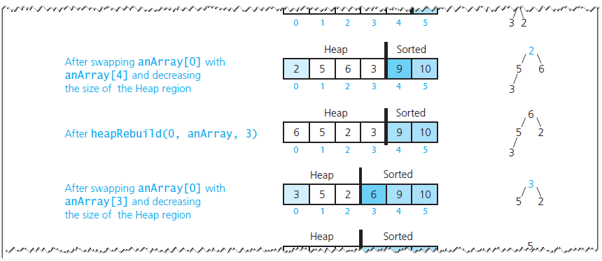
Heap Sort (3/7)
A trace of heap sort
Source: FIGURE 17-11 in [Carrano and Henry 2013].

Slide 44
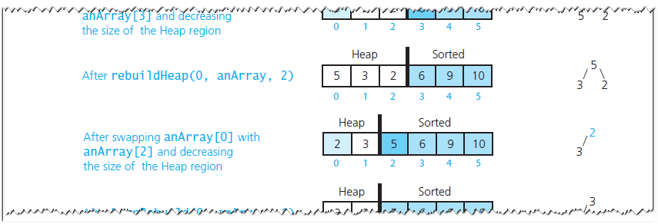
Heap Sort (4/7)
A trace of heap sort
Source: FIGURE 17-11 in [Carrano and Henry 2013].

Slide 45
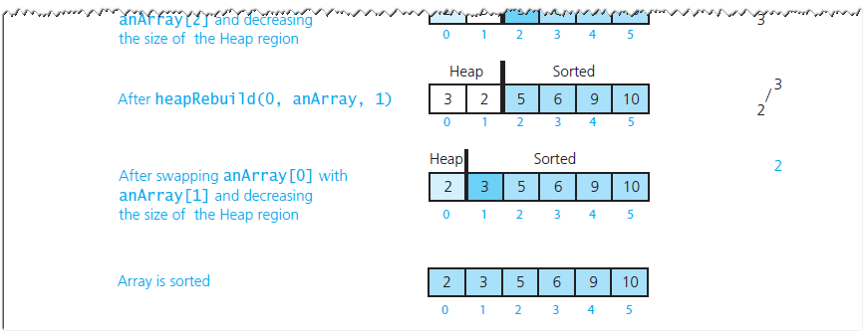
Heap Sort (5/7)
A trace of heap sort
Source: FIGURE 17-11 in [Carrano and Henry 2013].

Slide 46
Heap Sort (6/7)
// Sorts anArray[0..n-1].
heapSort(anArray: ArrayType, n:integer)
// Build initial heap
for (index = n / 2 down to 0) {
// Assertion: The tree rooted at index is a semiheap
heapRebuild(index, anArray, n)
// Assertion: The tree rooted at index is a heap
}
// Assertion: anArray[0] is the largest item in
// heap anArray[0..n-1]

Slide 47
Heap Sort (7/7)
// Move the largest item in the Heap region--the root
// anArray[0]--to the beginning of the Sorted region by
// swapping items and adjusting the size of the regions
Swap anArray[0] and anArray[n - 1]
heapSize = n - 1 // Decrease the size of the Heap region,
// expand the Sorted region
while (heapSize > 1) {
// Make the Heap region a heap again
heapRebuild(0, anArray, heapSize)
// Move the largest item in the Heap region--the root
// anArray[0]--to the beginning of the Sorted region by
// swapping items and adjusting the size of the regions
Swap anArray[0] and anArray[heapSize - 1]
heapSize-- // Decrease the size of the Heap region,
// expand the Sorted region
}

