Slide 1
Heaps
Yih-Kuen Tsay
Dept. of Information Management
National Taiwan University
Based on [Carrano and Henry 2013]
With help from Chien Chin Chen

Slide 2
Introduction
We are about to study a special kind of complete binary tree, called heap.
A heap provides an efficient implementation of the ADT priority queue.
It is also useful for sorting.
Do not confuse such a heap with the heap in the execution environment of a program, which contains the collection of memory cells available for dynamic allocation.

Slide 3
The ADT Heap (1/6)
A heap is a complete binary tree that either is empty or whose root
  contains a value greater than or equal to the value in each of its children, and
  has heaps as its subtrees.
A heap so defined is often called a maxheap, as the root contains the item with the largest value.
If we would replace “greater” with “less” in the definition, the root would contain the item with the smallest value.
Such a heap is called a minheap.

Slide 4
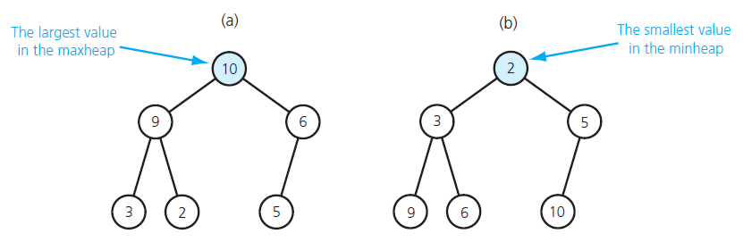
The ADT Heap (2/6)
(a) a maxheap; (b) a minheap
Source: FIGURE 17-1 in [Carrano and Henry 2013].

Slide 5
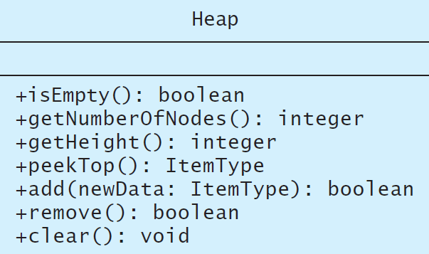
The ADT Heap (3/6)
A UML diagram for the class Heap
Source: FIGURE 17-2 in [Carrano and Henry 2013].

Slide 6
The ADT Heap (4/6)
Data
  A finite number of objects in hierarchical order.
Operations
  isEmpty()
    Task: Determines whether this heap is empty.
    Input: None.
    Output: True if the heap is empty; false, otherwise.
  getNumberOfNodes()
    Task: Gets the number of nodes in this heap.
    Input: None.
    Output: The number of nodes in this heap.

Slide 7
The ADT Heap (5/6)
Operations (cont’d)
  getHeigt()
    Task: Gets the height of this heap.
    Input: None.
    Output: The height of this heap.
  peekTop()
    Task: Gets the data in the root (top) of this heap.
    Input: None. Assumes the heap is not empty.
    Output: The item in the root of the heap.
  add(newData)
    Task: Inserts newData into this heap.
    Input: newData is the data item to be inserted.
    Output: True if the insertion is successful; false, otherwise

Slide 8
The ADT Heap (6/6)
Operations (cont’d)
  remove()
    Task: Removes the item in the root of this heap.
    Input: None.
    Output: True if the removal is successful; false, otherwise
  clear()
    Task: Removes all nodes from this heap.
    Input: None.
    Output: The heap is empty.

Slide 9
Heaps vs. Binary Search Trees
Both are binary trees.
While a binary search tree can be seen as sorted, a heap is ordered in a much weaker sense (but still very useful).
While binary search trees come in many different shapes, heaps are always complete binary trees (and hence balanced without overhead).

Slide 10
A C++ Interface for the ADT Heap (1/3)
/** Interface for the ADT heap.
@file HeapInterface.h */
#ifndef _HEAP_INTERFACE
#define _HEAP_INTERFACE
template<class ItemType>
class HeapInterface
{
public:
/** Sees whether this heap is empty.
@return True if the heap is empty, or false if not. */
virtual bool isEmpty() const = 0;

Slide 11
A C++ Interface for the ADT Heap (2/3)
/** Gets the number of nodes in this heap.
@return The number of nodes in the heap. */
virtual int getNumberOfNodes() const = 0;
/** Gets the height of this heap.
@return The height of the heap. */
virtual int getHeight() const = 0;
/** Gets the data that is in the root (top) of this heap.
For a maxheap, the data is the largest value in the heap;
for a minheap, the data is the smallest value in the heap.
@pre The heap is not empty.
@post The roots data has been returned, and the heap is
unchanged.
@return The data in the root of the heap. */
virtual ItemType peekTop() const = 0;

Slide 12
A C++ Interface for the ADT Heap (3/3)
/** Adds a new node containing the given data to this heap.
@param newData The data for the new node.
@post The heap contains a new node.
@return True if the addition is successful, or
false if not. */
virtual bool add(const ItemType& newData) = 0;
/** Removes the root node from this heap.
@return True if the removal is successful, or
false if not. */
virtual bool remove() = 0;
/** Removes all nodes from this heap. */
virtual void clear() = 0;
}; // end HeapInterface
#endif

Slide 13
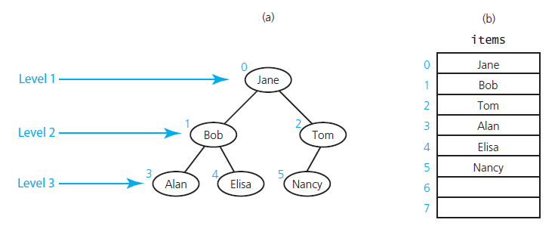
Complete Binary Trees in an Array (1/2)
(a) level-by-level numbering; (b) an array-based implementation
Source: FIGURE 17-3 in [Carrano and Henry 2013].

Slide 14
Complete Binary Trees in an Array (2/2)
The tree nodes are numbered 0 through n level-by-level, i.e., from top to bottom and left to right.
Place the tree nodes in an array according to the numeric order, i.e., items[i] contains node numbered i.
Given any node items[i], one can easily locate both of its children and its parent:
  Left child (if it exists): items[2*i+1]
  Right child (if it exists): items[2*i+2]
  Parent (if it exists): items[(i-1)/2]

Slide 15
An Array-Based Implementation (1/10)
Private data members:
  items: an array of heap items
  itemcount: the number of items in the heap
  maxItems: the maximum capacity of the heap
Operations
  peektop()
    return items[0] (if the heap is not empty)
  remove()
    removing the root of a heap would leave two disjoint heaps
    replace the root with the last item, resulting in a semiheap
    trickle the new root down the tree, getting a new heap

Slide 16
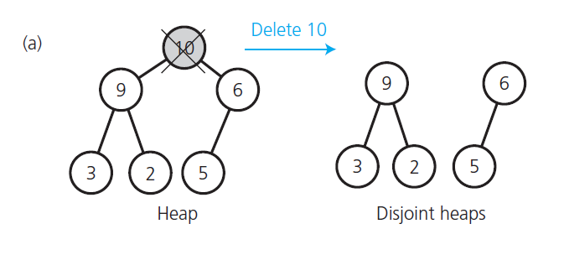
Converting a Semiheap into a Heap (1/9)
Disjoint heaps after a removal
Source: FIGURE 17-4 in [Carrano and Henry 2013].

Slide 17
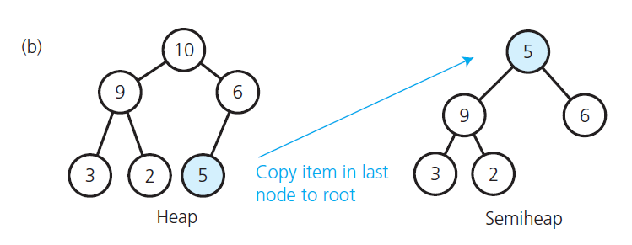
Converting a Semiheap into a Heap (2/9)
A semiheap
Source: FIGURE 17-4 in [Carrano and Henry 2013].

Slide 18
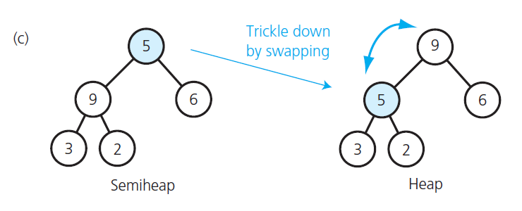
Converting a Semiheap into a Heap (3/9)
The restored heap
Source: FIGURE 17-4 in [Carrano and Henry 2013].

Slide 19
Converting a Semiheap into a Heap (4/9)
// Converts a semiheap rooted at index root into a heap.
heapRebuild(root: integer, items: ArrayType,
itemCount: integer)
// Recursively trickle the item at index root down to
// its proper position by swapping it with its larger child,
// if the child is larger than the item.
// If the item is at a leaf, nothing needs to be done.
if (root is not a leaf) {
// root must have a left child; assume it is
// the larger child
largerChildIndex = 2 * rootIndex + 1 // Left child index
if (root has a right child) {
rightChildIndex = largerChildIndex + 1
// Right child index
if (items[rightChildIndex] > items[largerChildIndex])
largerChildIndex = rightChildIndex
// Larger child index
}

Slide 20
Converting a Semiheap into a Heap (5/9)
// If the item in root is smaller than the item
// in the larger child, swap items
if (items[rootIndex] < items[largerChildIndex]) {
Swap items[rootIndex] and items[largerChildIndex]
// Transform the semiheap rooted at largerChildIndex
// into a heap
heapRebuild(largerChildIndex, items, itemCount)}
}
// Else root is a leaf, so you are done

Slide 21
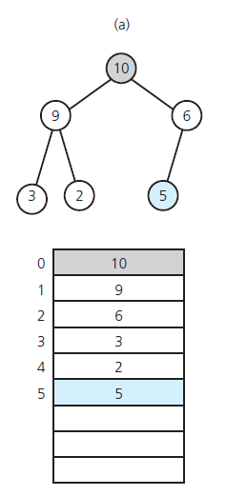
Converting a Semiheap into a Heap (6/9)
Array representation of a heap
Source: FIGURE 17-5 in [Carrano and Henry 2013].

Slide 22
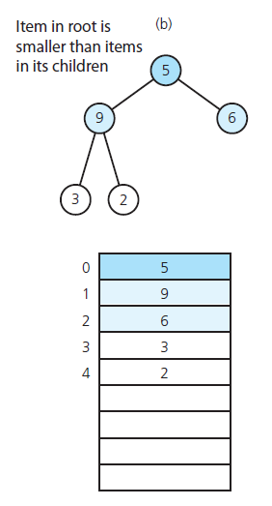
Converting a Semiheap into a Heap (7/9)
Array representation of a semiheap
Source: FIGURE 17-5 in [Carrano and Henry 2013].

Slide 23
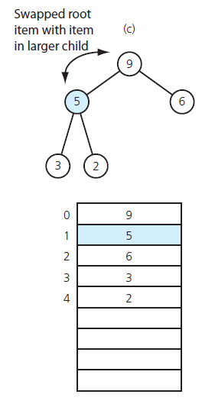
Converting a Semiheap into a Heap (8/9)
Array representation of a restored heap (from a semiheap)
Source: FIGURE 17-5 in [Carrano and Henry 2013].

Slide 24
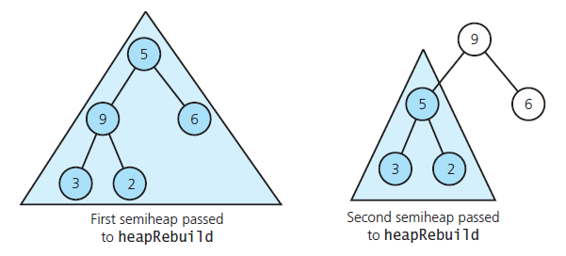
Converting a Semiheap into a Heap (9/9)
Recursive calls to heapRebuild
Source: FIGURE 17-6 in [Carrano and Henry 2013].

Slide 25
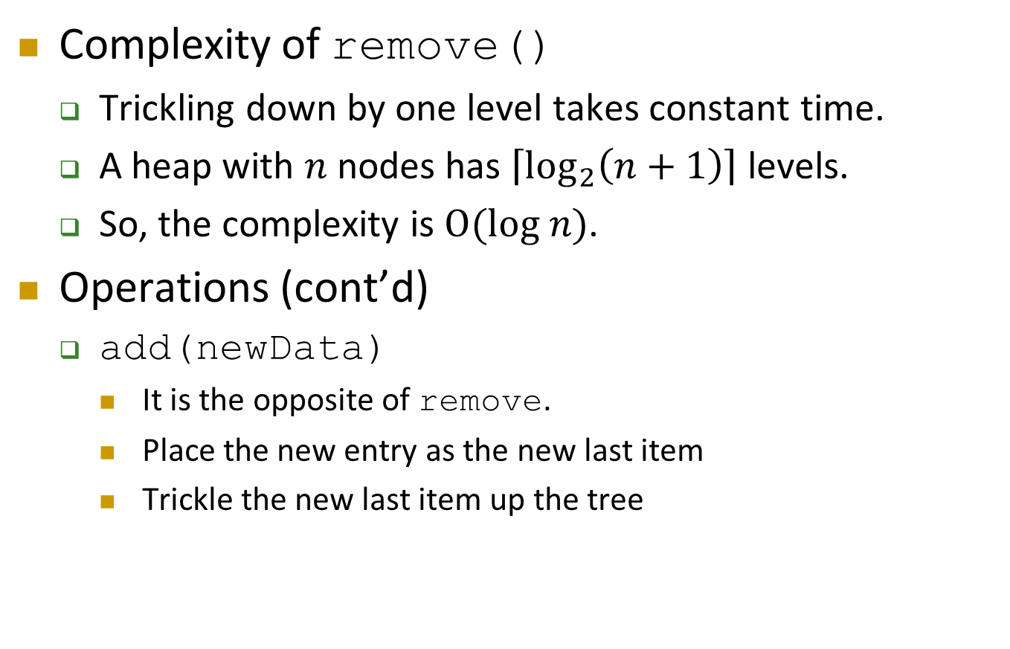
An Array-Based Implementation (2/10)
Complexity of remove()
  Trickling down by one level takes constant time.
  A heap with $n$ nodes has $\left\lceil \log_{2}\left(n+1\right)\right\rceil$ levels.
  So, the complexity is $O(log n)$.
Operations (cont’d)
  add(newData)
    It is the opposite of remove.
    Place the new entry as the new last item
    Trickle the new last item up the tree

Slide 26
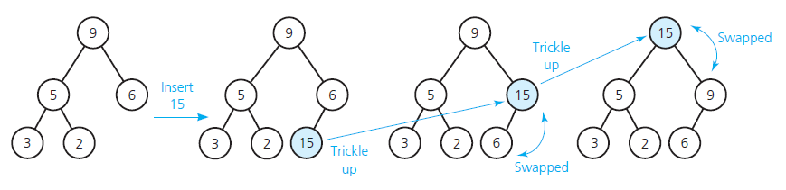
Insertion into a Heap (1/2)
Insertion into a heap
Source: FIGURE 17-7 in [Carrano and Henry 2013].

Slide 27
Insertion into a Heap (2/2)
// Insert newData into the bottom of the tree
items[itemCount] = newData
// Trickle new item up to the appropriate spot in the tree
newDataIndex = itemCount
inPlace = false
while ((newDataIndex >= 0) and !inPlace) {
parentIndex = (newDataIndex – 1) / 2
if (items[newDataIndex] < items[parentIndex])
inPlace = true
else {
Swap items[newDataIndex] and items[parentIndex]
newDataIndex = parentIndex
}
}
itemCount++

Slide 28
An Array-Based Implementation (3/10)
/** Array-based implementation of the ADT heap.
@file ArrayMaxHeap.h */
#ifndef _ARRAY_MAX_HEAP
#define _ARRAY_MAX_HEAP
#include "HeapInterface.h"
#include "PrecondViolatedExcep.h"
template<class ItemType>
class ArrayMaxHeap: public HeapInterface<ItemType>
{
private:
static const int ROOT_INDEX = 0; // Helps with readability
static const int DEFAULT_CAPACITY = 21; // Small capacity
// to test for a full heap
ItemType* items; // Array of heap items
int itemCount; // Current count of heap items
int maxItems; // Maximum capacity of the heap

Slide 29
An Array-Based Implementation (4/10)
// --------------------------------------------------------
// Most of the private utility methods use an array index
// as a parameter and in calculations. This should be safe,
// even though the array is an implementation detail, since
// the methods are private.
// --------------------------------------------------------
// Returns the array index of the left child (if it exists).
int getLeftChildIndex(const int nodeIndex) const;
// Returns the array index of the right child (if it
// exists).
int getRightChildIndex(int nodeIndex) const;
// Returns the array index of the parent node.
int getParentIndex(int nodeIndex) const;
// Tests whether this node is a leaf.
bool isLeaf(int nodeIndex) const;
// Converts a semiheap to a heap.
void heapRebuild(int subTreeRootIndex);
// Creates a heap from an unordered array.
void heapCreate();

Slide 30
An Array-Based Implementation (5/10)
public:
ArrayMaxHeap();
ArrayMaxHeap(const ItemType someArray[],
const int arraySize);
virtual ~ArrayMaxHeap();
// HeapInterface Public Methods:
bool isEmpty() const;
int getNumberOfNodes() const;
int getHeight() const;
ItemType peekTop() const throw(PrecondViolatedExcep);
bool add(const ItemType& newData);
bool remove();
void clear();
}; // end ArrayMaxHeap
#include "ArrayMaxHeap.cpp"
#endif

Slide 31
An Array-Based Implementation (6/10)
template<class ItemType>
ArrayMaxHeap<ItemType>::
ArrayMaxHeap(const ItemType someArray[], const int arraySize):
itemCount(arraySize), maxItems(2*arraySize)
{
// Allocate the array
items = new ItemType[2*arraySize]
// Copy given values into the array
for (int i = 0; i < itemCount; i++)
items[i] = someArray[i];
// Reorganize the array into a heap
heapCreate();
} // end constructor

Slide 32
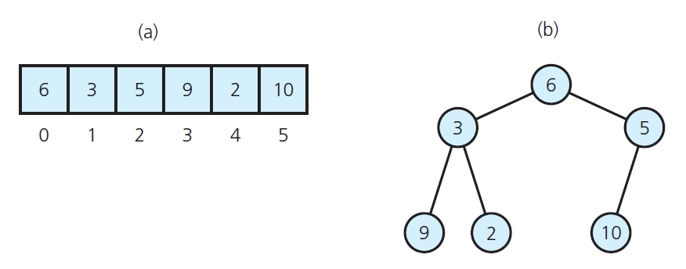
An Array-Based Implementation (7/10)
(a) contents of an array; (b) the corresponding complete binary tree
Source: FIGURE 17-8 in [Carrano and Henry 2013].

Slide 33
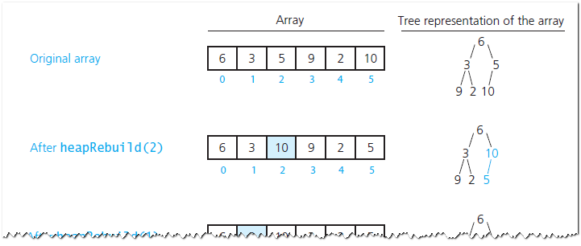
An Array-Based Implementation (8/10)
Transforming an array into a heap
Source: FIGURE 17-9 in [Carrano and Henry 2013].

Slide 34
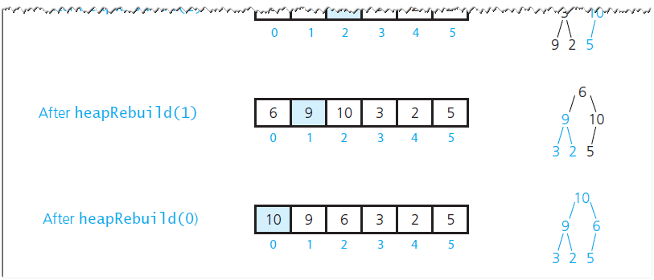
An Array-Based Implementation (9/10)
Transforming an array into a heap
Source: FIGURE 17-9 in [Carrano and Henry 2013].

Slide 35
An Array-Based Implementation (10/10)
template<class ItemType>
void ArrayMaxHeap<ItemType>::heapCreate()
{
for (int index = itemCount / 2; index >= 0; index--)
heapebuild(index);
} // end heapCreate

Slide 36
Implementation of Priority Queue (1/5)
/** ADT priority queue: Heap-based implementation.
@file Heap_PriorityQueue.h */
#ifndef _HEAP_PRIORITY_QUEUE
#define _HEAP_PRIORITY_QUEUE
#include "ArrayMaxHeap.h"
#include "PriorityQueueInterface.h"
template<class ItemType>
class Heap_PriorityQueue:
public PriorityQueueInterface<ItemType>,
private ArrayMaxHeap<ItemType>
{

Slide 37
Implementation of Priority Queue (2/5)
public:
Heap_PriorityQueue();
bool isEmpty() const;
bool add(const ItemType& newEntry);
bool remove();
/** @pre The priority queue is not empty. */
ItemType peek() const throw(PrecondViolatedExcep);
}; // end Heap_PriorityQueue
#include "Heap_PriorityQueue.cpp"
#endif

Slide 38
Implementation of Priority Queue (3/5)
/** Heap-based implementation of the ADT priority queue.
@file Heap_PriorityQueue.cpp */
#include "Heap_PriorityQueue.h"
template<class ItemType>
Heap_PriorityQueue<ItemType>::Heap_PriorityQueue() {
{
ArrayMaxHeap<ItemType>();
} // end constructor
template<class ItemType>
bool Heap_PriorityQueue<ItemType>::isEmpty() const
{
return ArrayMaxHeap<ItemType>::isEmpty();
} // end isEmpty
template<class ItemType>
bool Heap_PriorityQueue<ItemType>::add(const ItemType&
newEntry)
{
return ArrayMaxHeap<ItemType>::add(newEntry);
} // end add

Slide 39
Implementation of Priority Queue (4/5)
template<class ItemType>
bool Heap_PriorityQueue<ItemType>::remove()
{
return ArrayMaxHeap<ItemType>::remove();
} // end remove
template<class ItemType>
ItemType Heap_PriorityQueue<ItemType>::peek() const
throw (PrecondViolatedExcep)
{
try {
return ArrayMaxHeap<ItemType>::peekTop();
}
catch(PrecondViolatedExcep e) {
throw PrecondViolatedExcep("Attempted peek into an
empty priority queue.");
} // end try/catch
} // end peek

Slide 40
Implementation of Priority Queue (5/5)
If the maximum number of items is known, the heap is better (than a binary search tree)
  A heap is complete, and hence always balanced
  An overhead is required to keep a search tree balanced.
We will soon study how to keep a search tree balanced.
When there are many items, but a few distinct priority values,
  Associate a queue with each priority value

Slide 41
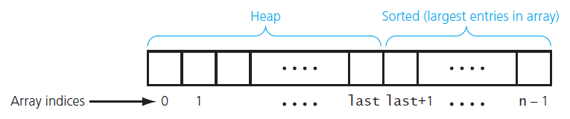
Heap Sort (1/7)
Heap sort partitions an array into two regions
Source: FIGURE 17-10 in [Carrano and Henry 2013].

Slide 42
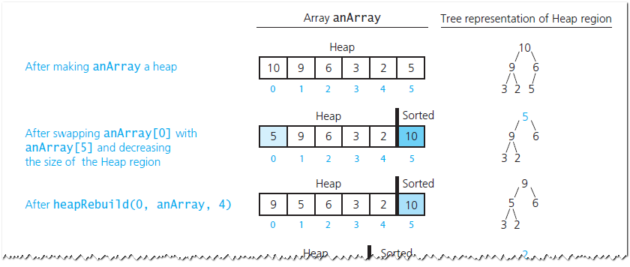
Heap Sort (2/7)
A trace of heap sort
Source: FIGURE 17-11 in [Carrano and Henry 2013].

Slide 43
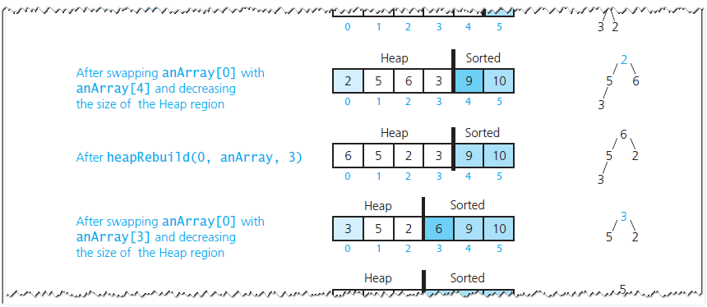
Heap Sort (3/7)
A trace of heap sort
Source: FIGURE 17-11 in [Carrano and Henry 2013].

Slide 44
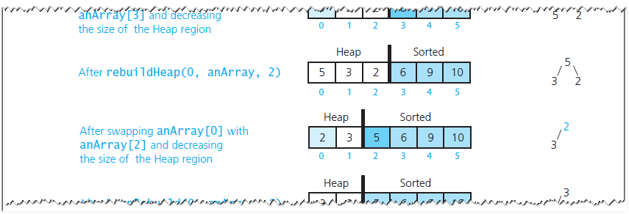
Heap Sort (4/7)
A trace of heap sort
Source: FIGURE 17-11 in [Carrano and Henry 2013].

Slide 45
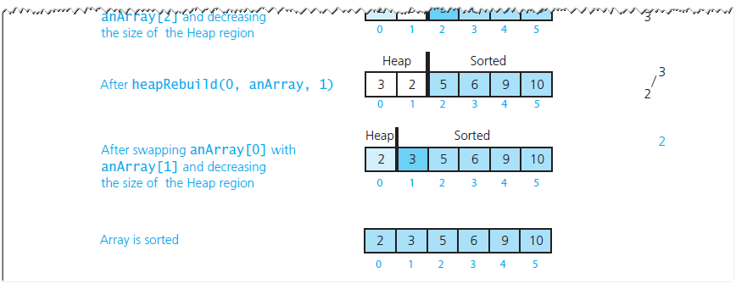
Heap Sort (5/7)
A trace of heap sort
Source: FIGURE 17-11 in [Carrano and Henry 2013].

Slide 46
Heap Sort (6/7)
// Sorts anArray[0..n-1].
heapSort(anArray: ArrayType, n:integer)
// Build initial heap
for (index = n / 2 down to 0) {
// Assertion: The tree rooted at index is a semiheap
heapRebuild(index, anArray, n)
// Assertion: The tree rooted at index is a heap
}
// Assertion: anArray[0] is the largest item in
// heap anArray[0..n-1]

Slide 47
Heap Sort (7/7)
// Move the largest item in the Heap region--the root
// anArray[0]--to the beginning of the Sorted region by
// swapping items and adjusting the size of the regions
Swap anArray[0] and anArray[n - 1]
heapSize = n - 1 // Decrease the size of the Heap region,
// expand the Sorted region
while (heapSize > 1) {
// Make the Heap region a heap again
heapRebuild(0, anArray, heapSize)
// Move the largest item in the Heap region--the root
// anArray[0]--to the beginning of the Sorted region by
// swapping items and adjusting the size of the regions
Swap anArray[0] and anArray[heapSize - 1]
heapSize-- // Decrease the size of the Heap region,
// expand the Sorted region
}

