Slide 1
Hashing
Yih-Kuen Tsay
Dept. of Information Management
National Taiwan University
Based on [Carrano and Henry 2013]

Slide 2
Prelude
We will first study the ADT Dictionary, for problems that must manage data by value.
The main goal is to evaluate several possible implementations using value-oriented data structures.
In particular, we shall analyze how efficiently the implementations support the various dictionary operations.
This motives the use of more sophisticated data structures to achieve better efficiency.

Slide 3
Outline
The ADT Dictionary
Possible Implementations
Selecting an Implementation
Hashing
  Basic idea
  Resolving collisions
  Efficiency of hashing
  Hashing for the ADT Dictionary
Note: balanced search trees are covered in a separate lecture.

Slide 4
The ADT Dictionary (1/2)
When sorting a collection of data, the criterion you use is called the sort key.
When searching a collection of data for specific information, it is called the search key.
Sorting or searching involves values instead of positions.
Applications that require such value-oriented operations are prevalent, e.g.,
  Find the phone number of a person, or
  Delete all information about the employ with a particular ID.

Slide 5
The ADT Dictionary (2/2)
Value-oriented ADTs studied so far:
  Sorted list
  Binary search tree
The dictionary is another value-oriented ADT, allowing you to look up information easily.
It is also called map or table.
A dictionary stores items (objects) that contain several pieces of data.
The retrieval of an item is facilitated by search on a specified search key.

Slide 6
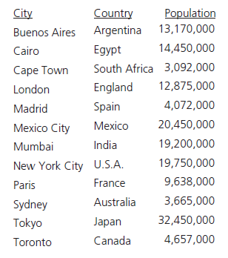
An Example Problem Domain
Consider the need for searches through this data based on other than the name of the city
A collection of data about certain cities.
Source: FIGURE 18-1 in [Carrano and Henry 2013].

Slide 7
ADT Dictionary Operations (1/3)
Test whether a dictionary is empty.
Get the number of items in a dictionary.
Insert a new item into a dictionary.
Remove an item with a given search key from a dictionary.
Remove all items from a dictionary.
Note: we will assume all search keys are distinct.

Slide 8
ADT Dictionary Operations (2/3)
Get an item with a given search key from a dictionary.
Test whether a dictionary contains an item with a given search key.
Traverse the items in a dictionary.
  May or may not be in sorted search-key order
  Has a visit function as an argument

Slide 9
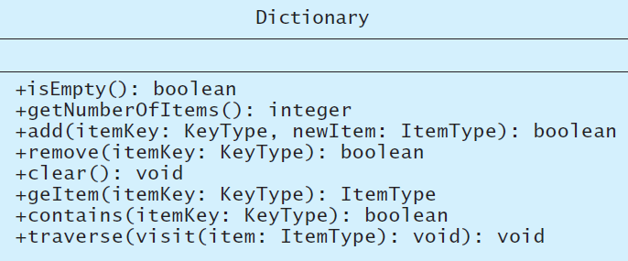
ADT Dictionary Operations (3/3)
A UML diagram for a class of dictionaries.
Source: FIGURE 18-2 in [Carrano and Henry 2013].

Slide 10
About the Traverse Operation
Consider the collection of data about cities.
Below are two usages of the traverse operation:
  To display, in alphabet order, the name of each city and its population, pass displayItem as visit:
  To increase the population of each city by 10 percent (order not important), pass updatePopulation as visit:
displayItem(anItem: ItemType): void
Display anItem.getName()
Display anItem.getPopulation()
updatePopulation(anItem: ItemType): void
anItem.setPopulation(1.1 * anItem.getPopulation())

Slide 11
A C++ Interface for Dictionary (1/4)
/** An interface for the ADT dictionary.
@file DictionaryInterface.h */
#ifndef _DICTIONARY_INTERFACE
#define _DICTIONARY_INTERFACE
#include “NotFoundException.h”
template<class KeyType, class ItemType>
class DictionaryInterface
{
public:
/** Sees whether this dictionary is empty.
@return True if the dictionary is empty;
otherwise returns false. */
virtual bool isEmpty() const = 0;
/** Gets the number of items in this dictionary.
@return The number of items in the dictionary. */
virtual int getNumberOfItems() const = 0;

Slide 12
A C++ Interface for Dictionary (2/4)
/** Inserts an item into this dictionary according to the item’s
search key.
@pre The search key of the new item differs from all search keys
presently in the dictionary.
@post If the insertion is successful, newItem is in its proper
position within the dictionary.
@param searchKey The search key associated with the item to be
inserted.
@param newItem The item to add to the dictionary.
@return True if item was successfully added, or false if not. */
virtual bool add(const KeyType& searchKey, const ItemType& newItem)
= 0;
/** Removes an item with the given search key from this dictionary.
@post If the item whose search key equals searchKey existed in
the dictionary, the item was removed.
@param searchKey The search key of the item to be removed.
@return True if the item was successfully removed, or false if
not. */
virtual bool remove(const KeyType& searchKey) = 0;

Slide 13
A C++ Interface for Dictionary (3/4)
/** Removes all entries from this dictionary. */
virtual void clear() = 0;
/** Retrieves an item with a given search key from a dictionary.
@post If the retrieval is successful, the item is returned.
@param searchKey The search key of the item to be retrieved.
@return The item associated with the search key.
@throw NotFoundException if the item does not exist. */
virtual ItemType getItem(const KeyType & searchKey) const
throw (NotFoundException) = 0;
/** Sees whether this dictionary contains an item with a given
search key.
@post The dictionary is unchanged.
@param searchKey The search key of the item to be retrieved.
@return True if an item with the given search key exists in
the dictionary. */
virtual bool contains(const KeyType& searchKey) const = 0;

Slide 14
A C++ Interface for Dictionary (4/4)
/** Traverses this dictionary and calls a given client
function once for each item.
@post The given functions action occurs once for each
item in the dictionary and possibly alters the item.
@param visit A client function. */
virtual void traverse(void visit(ItemType&)) const = 0;
}; // end DictionaryInterface
#endif

Slide 15
Possible Implementations (1/5)
We will investigate both linear and nonlinear implementations.
Arrays and lists of linked nodes are considered linear, as they store data items one after another.
Possible linear implementations of Dictionary:
  Sorted (by search key), array-based
  Sorted (by search key), link-based
  Unsorted, array-based
  Unsorted, link-based

Slide 16

Possible Implementations (2/5)
A dictionary entry
Source: FIGURE 18-3 in [Carrano and Henry 2013].

Slide 17
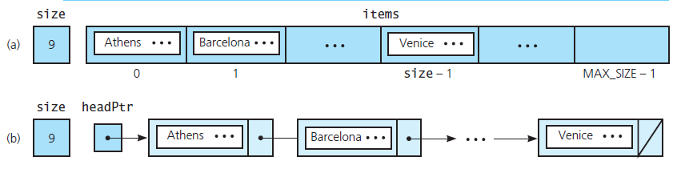
Possible Implementations (3/5)
The data members for two sorted linear implementations of the ADT dictionary for data about cities: (a) array based; (b) link based
Source: FIGURE 18-4 in [Carrano and Henry 2013].

Slide 18
A C++ Interface for Dictionary Entries (1/2)
/** A class of entry objects for an array-based
implementation of the ADT dictionary.
@file Entry.h */
#ifndef _ENTRY
#define _ENTRY
template<class KeyType, class ItemType>
class Entry
{
private:
ItemType item;
KeyType searchKey;
protected:
void setKey(const KeyType& searchKey);

Slide 19
A C++ Interface for Dictionary Entries (2/2)
public:
Entry();
Entry(ItemType newEntry, KeyType searchKey);
ItemType getItem() const;
KeyType getKey() const;
void setItem(const ItemType& newEntry);
bool operator==(const Entry<KeyType,
ItemType>& rightHandItem) const;
bool operator>(const Entry<KeyType,
ItemType>& rightHandItem) const;
}; // end Entry
#include "Entry.cpp"
#endif

Slide 20
Possible Implementations (4/5)
There are other choices than linear implementations:
  Binary search tree
  Hash table (main topic of this lecture)
  Balanced search tree (covered in a separate lecture)

Slide 21
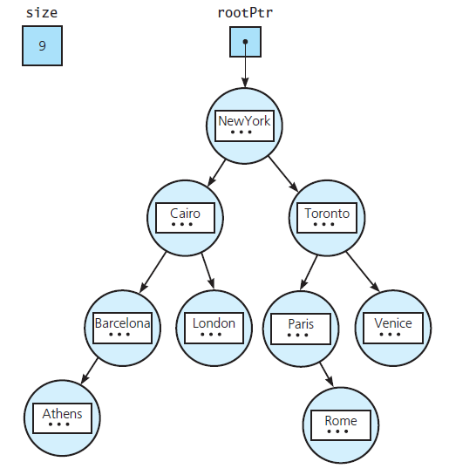
Possible Implementations (5/5)
The data members for a binary search tree implementation of the ADT dictionary for data about cities
Source: FIGURE 18-5 in [Carrano and Henry 2013].

Slide 22
Sorted Array-Based Implementation (1/5)
Data members similar to those for other ADTs
  An array items of data items
    An item contains both a search key and some other data
  A count itemCount of the items
  A maximum number maxItems of items
For a sorted dictionary, method traverse should visit the data in such a way that their search keys are in sorted order.
Method add bears the responsibility for keeping the array items sorted

Slide 23
Sorted Array-Based Implementation (2/5)
/** An array-based implementation of the ADT dictionary
that organizes its data items in sorted search-key order.
Search keys in the dictionary are unique.
@file ArrayDictionary.h */
#ifndef _ARRAY_DICTIONARY
#define _ARRAY_DICTIONARY
#include "DictionaryInterface.h"
#include "Entry.h"
#include "NotFoundException.h“
template<class KeyType, class ItemType>
class ArrayDictionary: public DictionaryInterface<KeyType,
ItemType >
{

Slide 24
Sorted Array-Based Implementation (3/5)
private:
static const int DEFAULT_CAPACITY = 21; // Small capacity
// to test for a full dictionary
Entry<KeyType, ItemType> *items; // Array of dictionary
// entries
int itemCount; // Current count of dictionary items
int maxItems; // Maximum capacity of the dictionary
void destroyDictionary();
int findEntryIndex(int firstIndex, int lastIndex,
const KeyType& searchKey) const;

Slide 25
Sorted Array-Based Implementation (4/5)
public:
ArrayDictionary();
ArrayDictionary(int maxNumberOfEntries);
ArrayDictionary(const ArrayDictionary<KeyType, ItemType>&
dict);
virtual ~ArrayDictionary();
bool isEmpty() const;
int getNumberOfItems() const;
bool add(const KeyType& searchKey, const ItemType& newItem);
bool remove(const KeyType& searchKey);
void clear();

Slide 26
Sorted Array-Based Implementation (5/5)
ItemType getItem(const KeyType& searchKey) const
throw (NotFoundException);
bool contains(const KeyType& searchKey) const;
/** Traverses the items in this dictionary in sorted
search-key order and calls a given client function
once for each item. */
void traverse (void visit(ItemType&)) const;
}; // end ArrayDictionary
#include "ArrayDictionary.cpp"
#endif

Slide 27
Method add (1/2)
template<class KeyType, class ItemType>
bool ArrayDictionary<KeyType, ItemType>::add(const ItemType&
newItem, const KeyType& searchKey)
{
bool ableToInsert = (itemCount < maxItems);
if (ableToInsert) {
// Make room for new entry by shifting all entries at
// positions >= newPosition toward the end of the array
// (no shift if newPosition == itemCount + 1).
// Performing a binary search doesn’t help here, because
// we need to shift the entries while looking for the
// insertion location.

Slide 28
Method add (2/2)
int index = itemCount;
// Short-circuit evaluation is important
while ((index > 0) &&
(searchKey < items[index - 1].getKey())) {
items[index] = items[index - 1];
index--;
} // end while
// Insert new entry
items[index] = Entry<KeyType, ItemType>(newItem,
searchKey);
itemCount++; // Increase count of entries
} // end if
return ableToInsert;
} // end add

Slide 29
Binary Search Tree Implementation (1/6)
Linear implementations may be fine for specific cases, but they are not general enough.
We now consider a nonlinear implementation using binary search trees.
The dictionary class will use composition
  A binary search tree as one of its data members
  Reuse of the class BinarySearchTree discussed earlier

Slide 30
Binary Search Tree Implementation (2/6)
/** A binary search tree implementation of the ADT
dictionary that organizes its data items in sorted search-
key order. Search keys in the dictionary are unique.
@file TreeDictionary.h */
#ifndef _TREE_DICTIONARY
#define _TREE_DICTIONARY
#include "DictionaryInterface.h"
#include "BinarySearchTree.h"
#include "Entry.h"
#include "NotFoundException.h"
template<class KeyType, class ItemType>
class TreeDictionary: public DictionaryInterface<KeyType,
ItemType>
{
private:
// Binary search tree of dictionary entries
BinarySearchTree<Entry<KeyType, ItemType>> itemTree;
void traversalHelper(Entry<KeyType, ItemType>& theEntry);

Slide 31
Binary Search Tree Implementation (3/6)
public:
TreeDictionary();
TreeDictionary(int maxNumberOfEntries);
TreeDictionary(const TreeDictionary<KeyType, ItemType>&
dict);
virtual ~TreeDictionary();
bool isEmpty() const;
int getNumberOfItems() const;
bool add(const KeyType& searchKey,
const ItemType& newItem);
bool remove(const KeyType& searchKey);
void clear();

Slide 32
Binary Search Tree Implementation (4/6)
ItemType getItem(const KeyType& searchKey) const
throw (NotFoundException);
bool contains(const KeyType& searchKey) const;
/** Traverses the items in this dictionary in sorted
search-key order and calls a given client function once
for each item. */
void traverse(void visit(ItemType&)) const;
}; // end TreeDictionary
#include "TreeDictionary.cpp"
#endif

Slide 33
Binary Search Tree Implementation (5/6)
template<class KeyType, class ItemType>
class TreeDictionary<KeyType, ItemType>::add(
const KeyType& searchKey, const ItemType& newItem)
{
return itemTree.add(Entry<KeyType, ItemType>
(newItem, searchKey));
} // end add
template<class KeyType, class ItemType>
class Entry<KeyType, ItemType>::operator==(
const Entry<KeyType, ItemType>& rightHandItem) const
{
return (searchKey == rightHandItem.getKey())
} // end add
template<class KeyType, class ItemType>
class Entry<KeyType, ItemType>::operator>(
const Entry<KeyType, ItemType>& rightHandItem) const
{
return (searchKey > rightHandItem.getKey())
} // end add

Slide 34
Binary Search Tree Implementation (6/6)
template<class KeyType, class ItemType>
class TreeDictionary<KeyType, ItemType>::remove(const
KeyType& searchKey)
{
return itemTree.remove(Entry<KeyType, ItemType>
(ItemType(), searchKey));
} // end remove
Create the item portion

Slide 35
Selecting an Implementation (1/5)
Reasons for considering linear implementations (though they are not general enough)
  Perspective, Efficiency, and Motivation
One implementation may support some (but not all) of the operations more efficiently than another.
Questions to ask
  What operations are needed?
  How often is each operation required?

Slide 36
Selecting an Implementation (2/5)
Three Scenarios
  Insertion and traversal in no particular order
    An array or linked chain may be adequate.
    Which is better?
  Retrieval (e.g., synonyms of a word)
    Is a binary search of a linked chain possible?
    How much more efficient is a binary search of an array than a sequential search of a linked chain?
  Insertion, removal, retrieval, and traversal in sorted order (e.g., a catalog of books) – add/remove must:
    Find the appropriate position in the dictionary.
    Insert into (or remove from) this position.

Slide 37
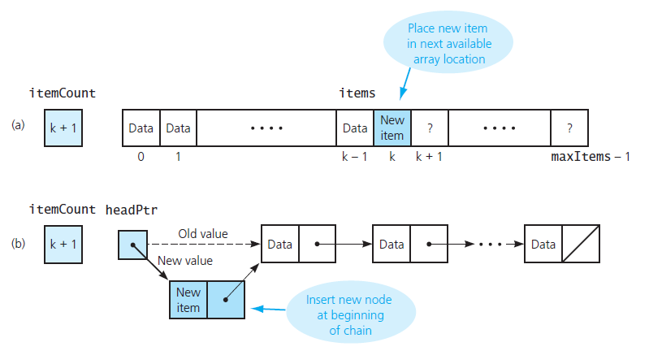
Selecting an Implementation (3/5)
Insertion for unsorted linear implementations: (a) array based; (b) link based
Source: FIGURE 18-6 in [Carrano and Henry 2013].

Slide 38
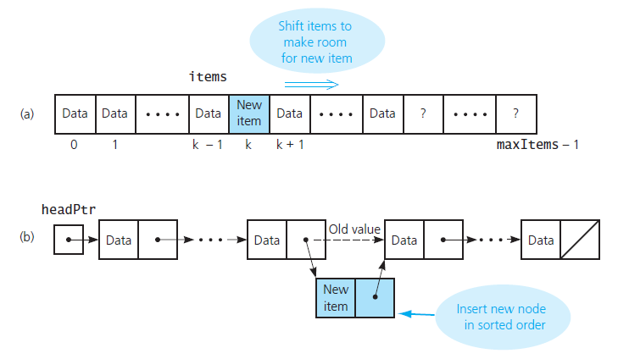
Selecting an Implementation (4/5)
Insertion for sorted linear implementations: (a) array based; (b) pointer based
Source: FIGURE 18-7 in [Carrano and Henry 2013].

Slide 39
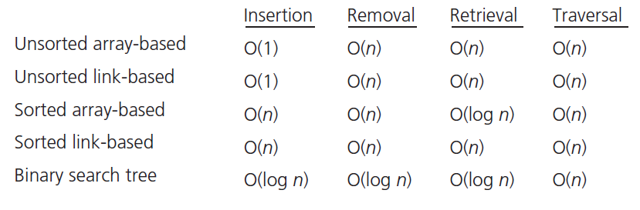
Selecting an Implementation (5/5)
The average-case order of the ADT dictionary operations for various implementations
Source: FIGURE 18-8 in [Carrano and Henry 2013].

Slide 40
Hashing: the Basic Idea (1/4)
Binary search tree retrieval is O(log n) at best.
For more stringent timing requirements, we weed a different strategy to locate an item.
Consider a magic box called an “address calculator”
  Place/retrieve the item from that address in an array
  Ideally, map to a unique number for each key

Slide 41
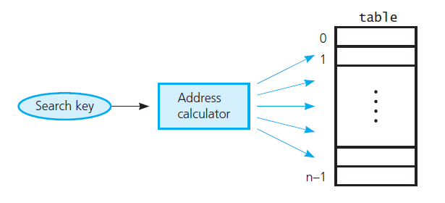
Hashing: the Basic Idea (2/4)
Address calculator
Source: FIGURE 18-9 in [Carrano and Henry 2013].

Slide 42
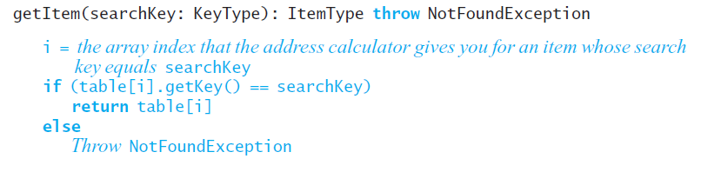
Hashing: the Basic Idea (3/4)
Pseudocode for getItem

Slide 43
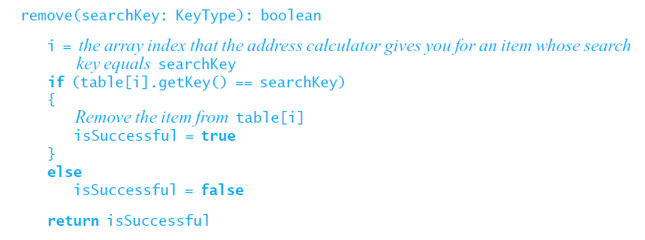
Hashing: the Basic Idea (4/4)
Pseudocode for remove

Slide 44
Hash Functions
May assume that hash functions operate on integers, since any string of characters can be converted into an integer.
Possible algorithms:
  Selecting digits
  Folding (adding the digits in some way)
  Modulo arithmetic
  Converting a character string into an integer
    Use ASCII values
    Factor the results, Horner’s rule

Slide 45
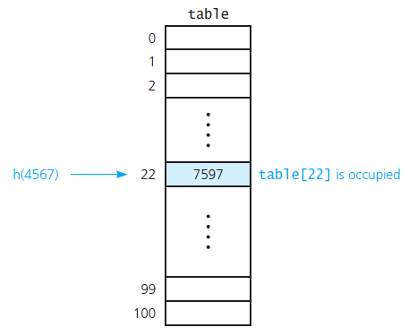
Resolving Collisions (1/7)
A collision
Source: FIGURE 18-10 in [Carrano and Henry 2013].

Slide 46
Resolving Collisions (2/7)
Approach 1: Open addressing
  Probe for another available location
  Can be done linearly or quadratically
  Removal requires specify state of an item
    Occupied, emptied, removed
  Clustering is a problem
  Double hashing can reduce clustering

Slide 47
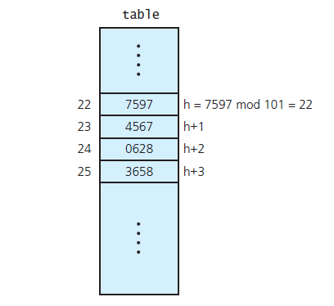
Resolving Collisions (3/7)
Linear probing with h ( x ) = x mod 101
Source: FIGURE 18-11 in [Carrano and Henry 2013].

Slide 48
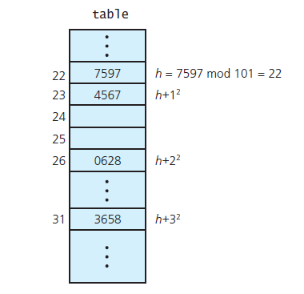
Resolving Collisions (4/7)
Quadratic probing with h ( x ) = x mod 101
Source: FIGURE 18-12 in [Carrano and Henry 2013].

Slide 49
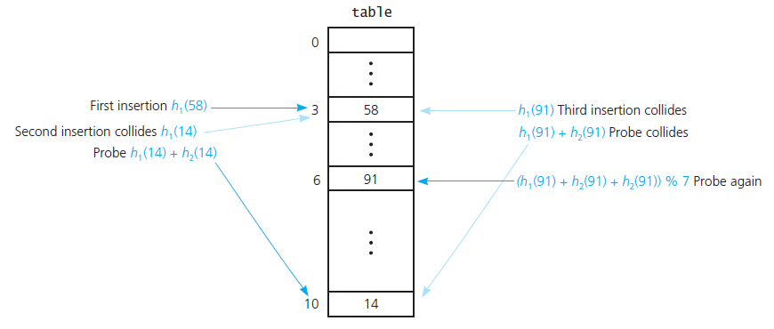
Resolving Collisions (5/7)
Double hashing during the insertion of 58, 14, and 91
h₁(key) = key mod 11; h₂(key) = 7 – (key mod 7)
Source: FIGURE 18-13 in [Carrano and Henry 2013].

Slide 50
Resolving Collisions (6/7)
Approach 2: Restructuring the hash table
  Each hash location can accommodate more than one item
  Each location is a “bucket” or an array itself
  Alternatively, design the hash table as an array of linked chains – called “separate chaining”

Slide 51
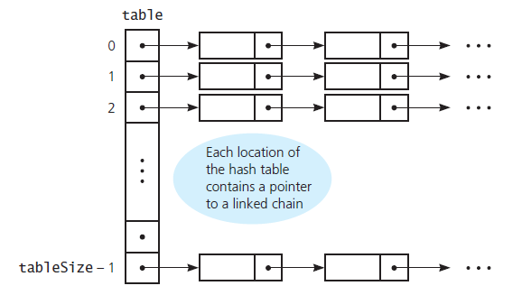
Resolving Collisions (7/7)
Separate chaining
Source: FIGURE 18-14 in [Carrano and Henry 2013].

Slide 52
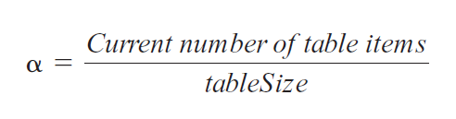
The Efficiency of Hashing (1/6)
Efficiency of hashing involves the load factor alpha (α)

Slide 53
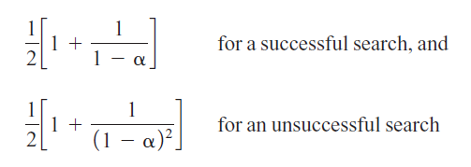
The Efficiency of Hashing (2/6)
Linear probing – average value for a given α
Note: these are approximations!

Slide 54
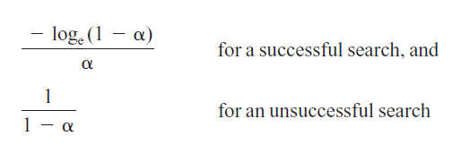
The Efficiency of Hashing (3/6)
Quadratic probing and double hashing – efficiency for a given α
Note: these are approximations!

Slide 55
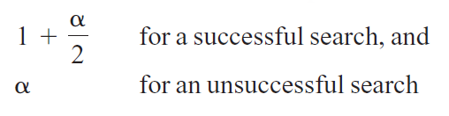
The Efficiency of Hashing (4/6)
Separate chaining – efficiency for a given α
Note: these are approximations!

Slide 56
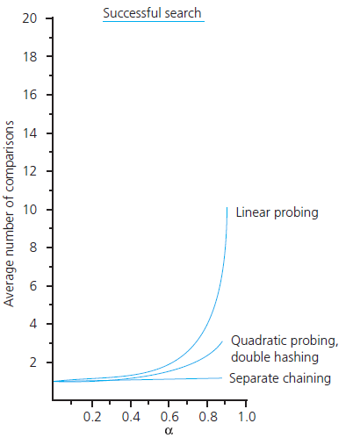
The Efficiency of Hashing (5/6)
The relative efficiency of four
collision-resolution methods
Source: FIGURE 18-15 in
[Carrano and Henry 2013].

Slide 57
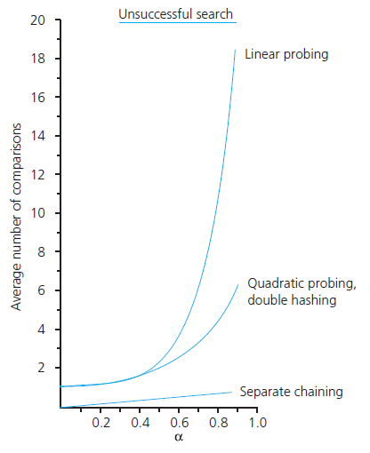
The Efficiency of Hashing (6/6)
The relative efficiency of four
collision-resolution methods
Source: FIGURE 18-15 in
[Carrano and Henry 2013].

Slide 58
Maintaining Hashing Performance
Collisions and their resolution typically cause the load factor α to increase
To maintain efficiency, restrict the size of α
  α ≤ 0.5 for open addressing
  α ≤ 1.0 for separate chaining
If the load factor exceeds these limits
  Increase the size of the hash table
  Rehash with a new hashing function

Slide 59
What Constitutes a Good Hash Function?
Easy and fast to compute?
Scatter data evenly throughout the hash table?
How well does it scatter random data?
How well does it scatter non-random data?
Note: traversal in sorted order is inefficient when using hashing

Slide 60
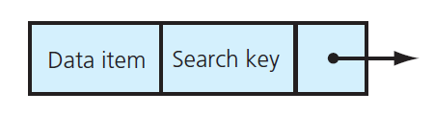
Hashing and Separate Chaining (1/8)
A dictionary entry when separate chaining is used
Source: FIGURE 18-16 in [Carrano and Henry 2013].

Slide 61
Hashing and Separate Chaining (2/8)
/** A class of entry objects for a hashing implementation of
the ADT dictionary.
@file HashedEntry.h */
#ifndef _HASHED_ENTRY
#define _HASHED_ENTRY
#include "Entry.h“
template<class KeyType, class ItemType>
class HashedEntry: public Entry<KeyType, ItemType>
{
private:
HashedEntry<KeyType, ItemType>* nextPtr;

Slide 62
Hashing and Separate Chaining (3/8)
public:
HashedEntry();
HashedEntry(ItemType newEntry, KeyType searchKey);
HashedEntry(ItemType newEntry, KeyType searchKey,
HashedEntry<KeyType, ItemType>* nextEntryPtr);
void setNext(HashedEntry<KeyType, ItemType>* nextEntryPtr);
HashedEntry<KeyType, ItemType>* getNext() const;
}; // end HashedEntry
#include "HashedEntry.cpp"
#endif

Slide 63
Hashing and Separate Chaining (4/8)
template<class KeyType, class ItemType>
bool HashedDictionary<KeyType, ItemType>::add(const
ItemType& newItem, const KeyType& searchKey)
{
// Create entry to add to dictionary
HashedEntry<KeyType, ItemType>* entryToAddPtr =
new HashedEntry<KeyType, ItemType>(newItem, searchKey);
// Compute the hashed index into the array
int itemHashIndex = getHashIndex(searchKey);

Slide 64
Hashing and Separate Chaining (5/8)
// Add the entry to the chain at itemHashIndex
if (hashTable[itemHashIndex] == nullptr) {
hashTable[itemHashIndex] = entryToAddPtr;
}
else {
entryToAddPtr->setNext (hashTable[itemHashIndex]);
hashTable[itemHashIndex] = entryToAddPtr;
} // end if
return true;
} // end add

Slide 65
Hashing and Separate Chaining (6/8)
template<class KeyType, class ItemType>
bool HashedDictionary<KeyType, ItemType>::remove(const
KeyType& searchKey)
{
bool itemFound = false;
// Compute the hashed index into the array
int itemHashIndex = getHashIndex(searchKey);

Slide 66
Hashing and Separate Chaining (7/8)
if (hashTable[itemHashIndex] != nullptr) {
// Special case - first node has target
if (searchKey == hashTable[itemHashIndex]->getKey()) {
HashedEntry<KeyType, ItemType>* entryToRemovePtr =
hashTable[itemHashIndex];
hashTable[itemHashIndex] =
hashTable[itemHashIndex]->getNext();
delete entryToRemovePtr;
entryToRemovePtr = nullptr; // For safety
itemFound = true;
}
else { // Search the rest of the chain
HashedEntry<KeyType, ItemType>* prevPtr =
hashTable[itemHashIndex];
HashedEntry<KeyType, ItemType>* curPtr =
prevPtr->getNext();

Slide 67
Hashing and Separate Chaining (8/8)
while ((curPtr != nullptr) && !itemFound) {
// Found item in chain so remove that node
if (searchKey == curPtr->getKey()) {
prevPtr->setNext(curPtr->getNext());
delete curPtr;
curPtr = nullptr; // For safety
itemFound = true;
}
else { // Look at next entry in chain
prevPtr = curPtr;
curPtr = curPtr->getNext();
} // end if
} // end while
} // end if (a match occurs on the first node or not …)
} // end if (the case of “a chain exists to search”)
return itemFound;
} // end remove

