Slide 1
Data Structures
TA Class #1
By Po-Chuan & Carlos
105/10/17

Slide 2
Preface
Few things before we start

Slide 3
When doing your homework
Write in nice & clear format.
Remember to write down your student ID.
Please DO indent your code, and use monospaced fonts.
Answer all requirements one by one. Don’t skip any of them!
Do NOT hand in your homework in sheets unstapled.
Use the International Edition.

Slide 4
Assignment #1
Average score = 59.9

Slide 5
Problem 1-1
Parking fee

Slide 6
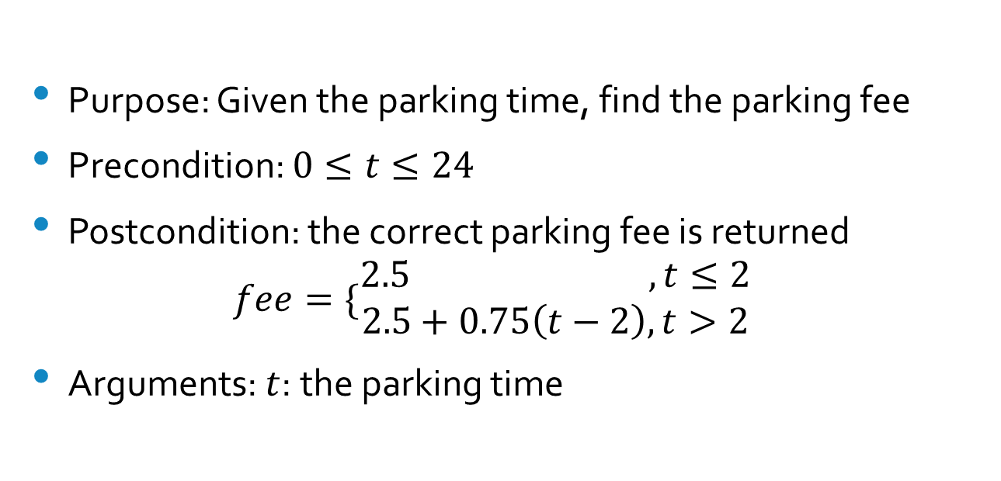
Solution
Purpose: Given the parking time, find the parking fee
Precondition: $0≤t≤24$
Postcondition: the correct parking fee is returned
$fee=\{\begin{matrix}2.5 ,t≤2 \\ 2.5+0.75\left(t−2\right), t>2\end{matrix}$
Arguments: $t$: the parking time

Slide 7
Problem 1-3
The appointment book

Slide 8
Part A. change purpose of a appointment
/* This is a pseudocode, not C++, function.
* Appointment book is implemented in ADT
* Please do not compile this code
*
* No new function is required. (But if you treat the following
* as a new function, that's also ok.)
* This function uses existing functions like isAppointment,
* cancelAppointment, and makeAppointment.
*/

Slide 9
// Change the purpose of an appointment
updatePurpose( date: Date, time: Time, newPurpose: String )
{
// Make sure the appointment exists
if ( apptBook.isAppointment( date, time ) )
{
// The appointment does exist
apptBook.cancelAppointment( date, time );
if( apptBook.makeAppointment( date, time, newPurpose ) )
write( “Purpose of the appointment updated." );
}
else // The appointment doesn't exist
write( "No appointment at the given date & time." );
}

Slide 10
Part B. list all appointments in a day
/*
* No new function is required. (But if you treat the following
* as a new function, that's also ok.)
* This function uses existing functions like isAppointment, getAppointmentPurpose.
*/

Slide 11
Part B. list all appointments in a day
// Print all appointments for a given date
getDateAppointment( apptDate: Date )
{
// Iterate through all possible times on the given day
for( Time time: Date )
// If the appointment exists
if ( apptBook.isAppointment( date, time ) )
write( apptBook.getAppointmentPurpose( date, time ), " at ", date, time );
}

Slide 12
Problem 1-5
Remove elements in a bag & Javadoc comment style

Slide 13
Javadoc comment style
Look at https://en.wikipedia.org/wiki/Javadoc
Begins with /** and ends with */
@param
@return
No blank lines between comment and code body
Paragraphs in comment are separated by <p>

Slide 14
#include<bits/stdc++.h>
using namespace std;
/**
* Class bag --- simulation of a bag of strings
* Note that this problem asks you to comment in Javadoc style, so
* please DO comment your functions, or you'll lose some marks.
* <p>
* Also, use `<p>' to separate paragraphs between descriptions when
* needed, and there’s no blank lines between comment & function.

Slide 15
*
* @author Po-Chuan
* @version 1.5
* @since 2015-10-12
*/
class bag
{
private:
vector<string> items;

Slide 16
public:
/**
* Remove items in bag and count how many items are removed.
* <p>
* This function iterates through the bag, searches for items and
* removes those matched with the parameter. After iteration,
* this function returns the number of items removed.
*
* @param s the item to be removed
* @return the number of the items that were removed
*/
int remove( const string s )

Slide 17
int remove( const string s )
{
/*
* # of items removed
*/
int rm = 0;
/*
* If the bag is empty, i is equal to s.end() and returns 0 immediately.
* If none was found, no erase commands are invoked. A zero is returned.
*/
for ( auto i = s.begin(); i != s.end(); ++i )
if ( *i == s ) // Matched with target
i = s.erase( i ), ++rm; // Erase and add 1 to the counter
return rm;
}
};

Slide 18
Just some more…
We use vector as a container here. You may use other containers.
You can use getFrequencyOf() to count the number of objects.

Slide 19
Problem 1-7
Intersection of 2 bags

Slide 20
#include<bits/stdc++.h> // vector, iterator, and algorithm
using namespace std;
template<typename T>
class bag
{
private:
/* Use vector to hold contents */
vector<T> contents;
/* For internal use only, but it can also be public */
void insert( const T& val )
{
contents.push_back( val );
}

Slide 21
/* Sort set contents */
void sort()
{
sort( contents.begin(), contents.end() );
}
public:
/* Do NOT use bag&.
* We'll modify B a bit, so pass by non-constant value */
bag<T> intersection( bag B )

Slide 22
/* Specify the start & end point */
typename vector<T>::iterator
first1 = A.contents.begin(),
first2 = B.contents.begin(),
last1 = A.contents.end(),
last2 = B.contents.end();
/* Insert new elements from here */
insert_iterator< vector<T> > result( merge.contents, merge.contents.begin() );
/* Main intersection process */
/* You can also use
set_intersection( first1, last1, first2, last2, result ); */

Slide 23
while ( first1 != last1 && first2 != last2 )
{
if ( *first1 < *first2 )
++first1;
else if ( *first2 < *first1 )
++first2;
else
{
*result = *first1;
++result;
++first1;
++first2;
}
}

Slide 24
/* Return the merged bag */
return merge;
}
};

Slide 25
Just some more…
Another way to solve it is getFrequencyOf().
For each kind of element in set A, count the frequency of that in set B.
Insert the minimum of the 2 frequencies into the merged result.
set_intersection() is listed here as a reference.

Slide 26
Problem 5
Intersection, using peek()

Slide 27
The code
template<typename T>
bag<T> intersection( bag<T> a, bag<T> b )
{
bag<T> v;
while( !a.isEmpty() && !b.isEmpty() )
{
T item = a.peek();
if( b.contains( item ) )
v.add( item );

Slide 28
The code
a.remove( item );
b.remove( item );
}
return v;
}

Slide 29
Assignment #2
Average:67.7

Slide 30
Problem 2-1
Recursive function: getSum()

Slide 31
Appropriate Pre-condition
0 <= lower <= upper <= (size of x) - 1

Slide 32
What does this problem want?
List the criterion of a recursive function(the 4 questions)
Show how the function meets each criteria

Slide 33
Criteria A.
Define the problem in terms of a smaller problem of the same type
One action of getSum() is to call itself
Calculation of sum is made by adding the first element to the sum of the following array, which is smaller than the current array

Slide 34
Criteria B.
How does each recursive call diminish the size of the problem?
At each recursive call to getSum(), the size of the array you need to compute is diminished by 1

Slide 35
Criteria C.
What instance of the problem can serve as the base case?
The function handles the sum of x differently from all the other ones: It does not generate a recursive call. Rather, you know that getSum(x) is the element itself (x[lower]). Thus, the base case occurs when lower=upper.

Slide 36
Criteria D.
As the problem size diminishes, will you reach this base case?
Given that 0 <= lower <= upper, criteria B. assures you that you will always reach the base case.

Slide 37
Problem 2-10
Implement recursive functions: writeLine(), writeBlock()

Slide 38
int writeLine(char symbol, int times)
{
if( times == 1 ) {
cout << symbol;
return 0;
} else {
cout << symbol;
return writeLine(symbol, times - 1);
}
}

Slide 39
writeBlock()
Extend from writeLine()

Slide 40
int writeBlock(char symbol, int times, int lines)
{
if( times == 1 ){
cout << symbol << endl;
return 0;
} else if ( lines == 1 ){
cout << symbol;
return writeBlock(symbol, times – 1, lines);
} else {
writeBlock(symbol, times, 1);
return writeBlock(symbol, times, lines - 1);
}
}

Slide 41
Problem 2-16
Box trace of binary search

Slide 42
Box trace
Please refer to your textbook or slide
Shows the information during each recursion of the process

Slide 43
Part A. Box 1
Target = 5
First = 0
Last = 7
Mid = 3
Target < x[ 3 ]
Search the left part(X point)

Slide 44
Part A. Box 2
Target = 5
First = 0
Last = 3 - 1 = 2
Mid = 1
Target = x[ 1 ]
Return 1

Slide 45
Part C. Box 1
Target = 16
First = 0
Last = 7
Mid = 3
Target > x[ 3 ]
Search the right part(Y point)

Slide 46
Part C. Box 2
Target = 16
First = 3 + 1 = 4
Last = 7
Mid = 5
Target < x[ 5 ]
Search the left part(X point)

Slide 47
Part C. Box 3
Target = 16
First = 4
Last = 5 – 1 = 4
Mid = 4
Target > x[ 4 ]
Search the right part(Y point)

Slide 48
Part C. Box 4
Target = 16
First = 4 + 1 = 5
Last = 4
First > Last
Return -1 (not found)

Slide 49
Problem 2-19
Indent the rabbit function

Slide 50
How to solve this problem?
Keep the recursion depth, either as a parameter or as a global variable
Print the information of each function call after tabs

Slide 51
int rabbit( int n, int depth )
{
for(int i = depth; i > 0; i--) {
cout << “\t”;
}
cout <<Enter rabbit: n = " << n << endl;
for(int i = depth; i > 0; i--){
cout << “\t”;
}

Slide 52
if( n <= 2 ) {
cout << “Leave rabbit : n = ” << n << “value = 1” <<endl;
return 1;
} else {
int sum = rabbit(n-1, depth+1) + rabbit(n-1, depth+1);
cout << “Leave rabbit : n = ” << n << “value = ” << sum << endl;
return sum;
}
}

Slide 53
Problem 2-23
Euclidean algorithm

Slide 54
Part A. the proof
gcd( a, b ) = gcd( b, a mod b )
Set X = gcd( a, b ), then set a = mX, b = nX.
gcd( m, n ) = 1
Set a = bq + r, q and r are integers
a - bq = r

Slide 55
Part A. the proof (cont.)
By Common Divisor Divides Integer Combination, all common divisors of a and b divide r
Since we can extract X from the calculation first, and
gcd( m, n ) = 1
Every common factors of (a, b) will appear in common factors of (b, r). (The reverse also holds.)
gcd(a, b) = gcd(b, r) = gcd(b, a mod b)

Slide 56
Part B. when b > a…
Suppose b > a in gcd( a, b )
The next recursive call will be
gcd( b, a mod b ) = gcd( b, a )
The recursion swaps these 2 numbers and continues as usual without a problem

Slide 57
Part C-1. Will it end?
If a == b, then b is their GCD, and the function ends immediately
Otherwise, the parameters a and b will get smaller each time
a > b > (a mod b) > 0 (by definition)
termination of the process can be done in finite steps

Slide 58
Part C-2: Why the base case is appropriate?
When (a mod b) = 0, b is the greatest common divisor of a and b (by definition.)
Therefore, no further recursion calls are required, and the best case is appropriate

Slide 59
The end~
Hope you did a good job in this assignment.
Average score is 59.9 and 67.7.
By the TAs
105/10/17

