Slide 1
Data Structures TA
Session #4
Prepared by Carlos and Po-Chuan
2016/12/26

Slide 2
Assignment #6
ave = 86.1 stddev = 18

Slide 3
Q1
Append list

Slide 4
The problem
Write a C++ function that, given as input two objects of a class that implements the ADT list, returns a new list obtained from concatenating the two lists (by appending the second to the end of the first). The function should behave like a client of the ADT list, independent from its implementation

Slide 5
Sample code
template <typename ItemType>
List<ItemType>::concatenate_list(List<ItemType> A_list, List<ItemType> B_list)
{
List<Itemtype> newList = new List<ItemType>();
int alen = A_list.getLength();
int blen = B_list.getLength();
for (int i=1; i<alen; i++)
newList.insert(i, a.getEntry(i));
for (int i=1; i<blen; i++)
newList.insert(i+alen, b.getEntry(i));
return newList;
}

Slide 6
Q2 exercise 10.8
O( log N )

Slide 7
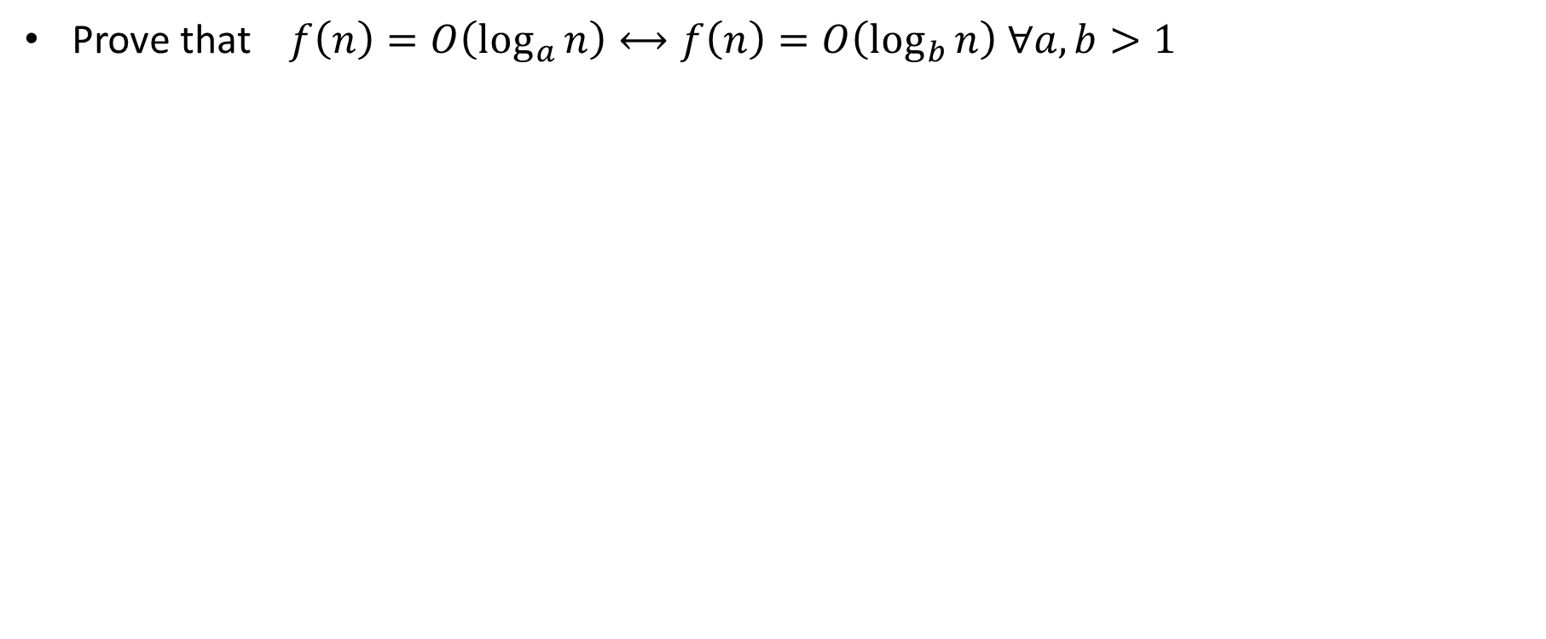
The problem
Prove that$f\left(n\right)=O\left(\log_{a}{n}\right)⟷f\left(n\right)=O\left(\log_{b}{n}\right) ∀a, b>1$

Slide 8
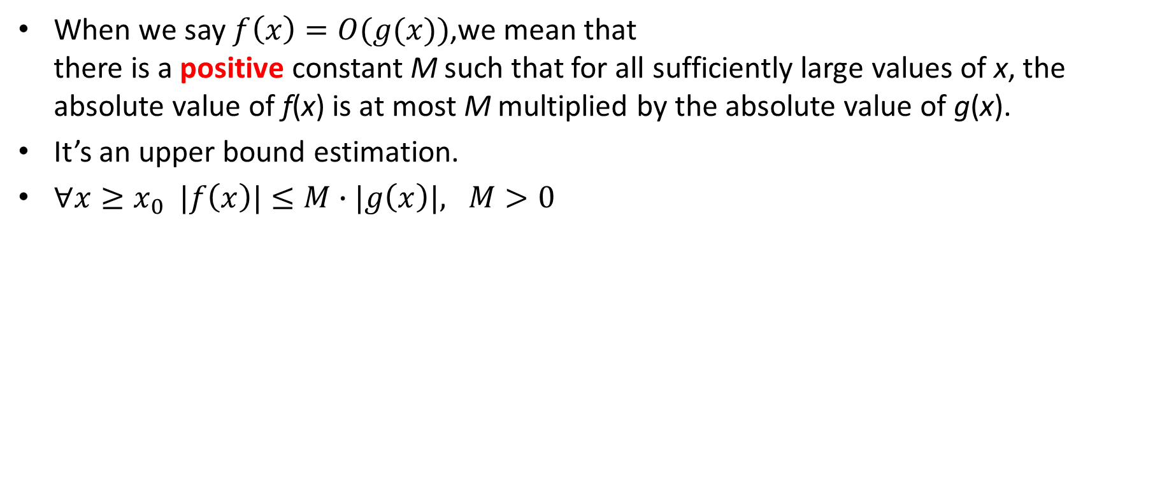
Please recall the definition of O(n)
When we say $f\left(x\right)=O(g(x))$,we mean that
there is a positive constant M such that for all sufficiently large values of x, the absolute value of f(x) is at most M multiplied by the absolute value of g(x).
It’s an upper bound estimation.
$∀x≥x_{0} |f\left(x\right)|≤M∙|g\left(x\right)|, M>0$

Slide 9
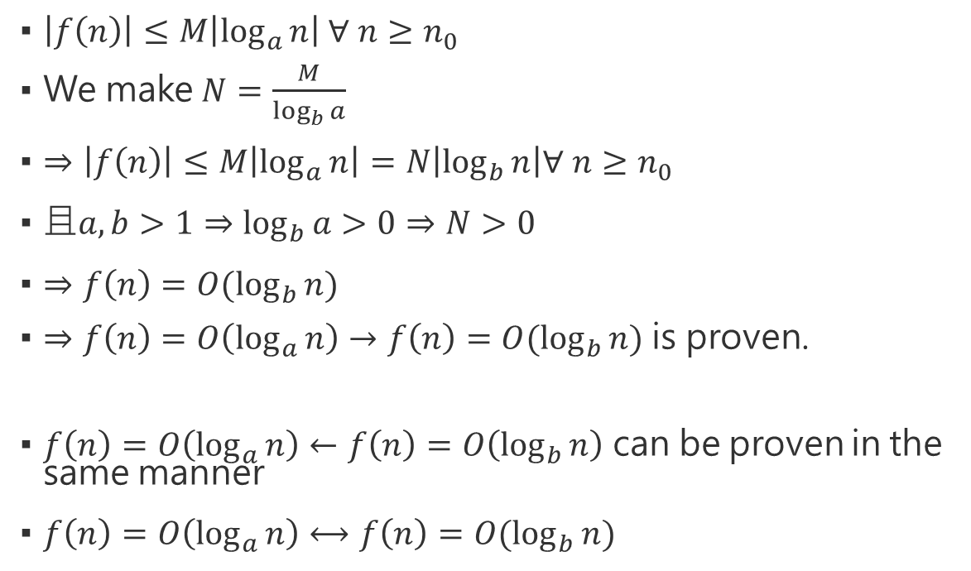
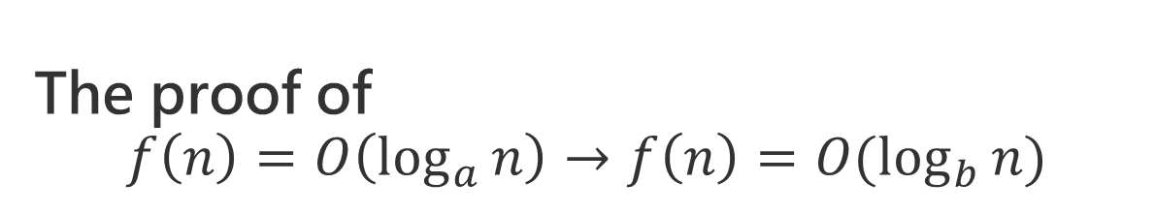
The proof of
$$f\left(n\right)=O\left(\log_{a}{n}\right)→f\left(n\right)=O(\log_{b}{n})$$
$\left|f\left(n\right)\right|≤M\left|\log_{a}{n}\right| ∀ n≥n_{0}$
We make $N=\frac{M}{\log_{b}{a}}$
$⇒\left|f\left(n\right)\right|≤M\left|\log_{a}{n}\right|=N\left|\log_{b}{n}\right|∀ n≥n_{0}$
$且a,b>1⇒\log_{b}{a}>0⇒N>0$
$⇒f\left(n\right)=O(\log_{b}{n})$
$⇒f\left(n\right)=O\left(\log_{a}{n}\right)→f\left(n\right)=O(\log_{b}{n})$ is proven.
$f\left(n\right)=O\left(\log_{a}{n}\right)←f\left(n\right)=O\left(\log_{b}{n}\right)$ can be proven in the same manner
$f\left(n\right)=O\left(\log_{a}{n}\right)⟷f\left(n\right)=O(\log_{b}{n})$

Slide 10
Q3 exercise 10.10
(midterm)
Partition

Slide 11
Sample solution
template <typename ItemType>
void seperateList(ItemType Array[], int n)
{
for( int lSide = 0, rSide = n - 1;; )
{
while( lSide < rSide && Array[lSide] < 0 )
lSide++;
while( lSide < rSide && Array[rSide] >= 0 )
rSide--;
if( rSide < lSide )
break;
std::swap(Array[lSide], Array[rSide]);
}
}
Notes:
改用同學的寫法

Slide 12
Q4 exercise 14.10
(midterm)
Trace merge sort

Slide 13
The problem
Trace the merge sort algorithm as it sorts the following array into ascending order. List the calls to mergeSort and merge in the order in which they occur. 20 80 40 25 60 30
20 | 80 | 40 | 25 | 60 | 30
20 | 80 | 40
25 | 60 | 30
20 | 80
40
25 | 60
30
20
80
25
60
Notes:
mergeSort(ItemType theArray[], int first, int last)
merge(ItemType theArray[], int first, int mid, int last)

Slide 14
20 | 80 | 40 | 25 | 60 | 30
20 | 80 | 40
25 | 60 | 30
mergeSort
20 | 80
40
25 | 60
30
20
80
25
60
20 | 80
25 | 60
merge
20 | 40 | 80
25 | 30 | 60
20 | 25 | 30 | 40 | 60 | 80

Slide 15
Q5 exercise 11.16
(midterm)
Stable or not

Slide 16
Target algorithms
Insertion sort => stable
Bubble sort => stable
Merge sort => stable
Radix sort => stable
Selection sort => unstable
Quick sort => unstable

Slide 17
Assignment #7
ave = 81.3 stddev = 12.4

Slide 18
Q1 exercise 13.11
(modified)
Bank queue tracing

Slide 19
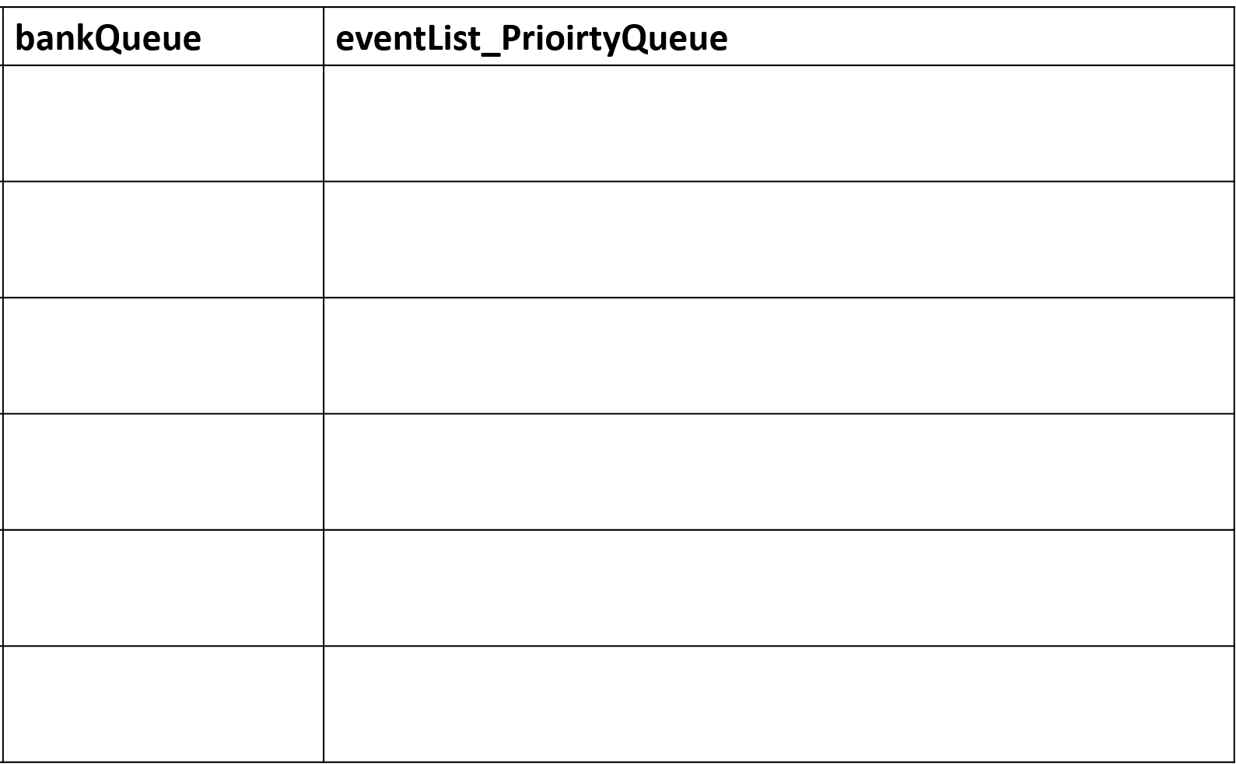
The result
0
A 5 8
A 9 6
A 13 4
A 25 5
A 28 6
A 32 4
5
A 9 6
A 13 4
D 13
A 25 5
A 28 6
A 32 4
9
A 9 6
A 13 4
D 13
A 25 5
A 28 6
A 32 4
13
A 13 4
D 19
A 25 5
A 28 6
A 32 4
19
D 23
A 25 5
A 28 6
A 32 4
23
A 25 5
A 28 6
A 32 4

Slide 20
The result
25
A 28 6
D 30
A 32 4
28
A 28 6
D 30
A 32 4
30
A 32 4
D 36
32
A 32 4
D 36
36
D 40
40

Slide 21
Q2 exercise 13.14
peekFront() axiom

Slide 22
a.
What is the base case?
  When there’s only 1 element in the queue
What is the recursive step?
  aQueue.peekFront() = bQueue.enqueue( item ).peekFront(), where bQueue is equal to aQueue except the tail of aQueue

Slide 23
a.
What is the significance of isEmpty?
  Used to determine whether the base case has been reached
Why peekFront() for queue is recursive, and peekFront() for stack is not?
  Because we can directly access the front of a stack, while for queue, we have to skip elements one by one to reach the front

Slide 24
b. Canonical form of a queue
Yes, any queue can be represented in a canonical form
An empty queue is in a canonical form
Suppose a queue with n elements is in a canonical form
We can build any queue with n+1 elements by enqueuing an element
By M.I., the proposition is proven

Slide 25
Q3 exercise 14.7
When the queue is implemented as a list

Slide 26
Notice
There are many possible answers, depending on the design of the algorithm
If your explanation is reasonable, it will be accepted

Slide 27
Comparison (enqueue)
a. Array based
b. List based
Time complexity: O( 1 )
Directly add an element at the end of the array
Time complexity: O( 1 )
Directly add an element at the end of the list

Slide 28
Comparison (dequeue)
a. Array based
b. List based
Time complexity: O( N )
Since we have to move all of the remaining N-1 elements to the previous cell
Time complexity: O( 1 )
Only modify the head of the list

Slide 29
Q4 exercise 15.10
BST

Slide 30
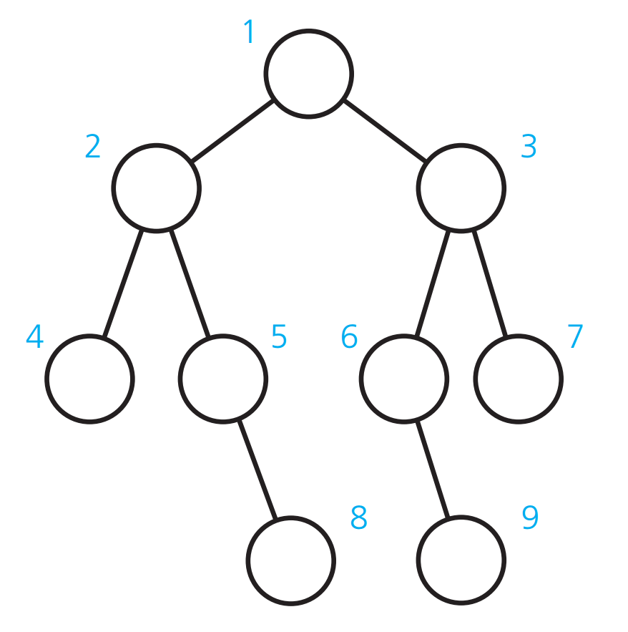
The BST

Slide 31
a. Which node comes just before the root?
Node 8
Since the node is smaller than the root, it must be in the left sub-tree
The answer is the maximum element in the sub-tree
To find the maximum of a tree, keep going right until you meet a node without a right child, and the destination has the maximum element

Slide 32
2 traversal results
Pre-order:
Post-order:
1 2 4 5 8 3 6 9 7
4 8 5 2 9 6 7 3 1

Slide 33
Q5 exercise 15.11
(modified)
BST insertion

Slide 34
Notice
The input is modified
Do not need to refer to the figure on the textbook, and start from an empty tree
  But if you start your work from the figure, it’s also ok
Make sure you’re using the international edition

Slide 35
90, 45, 65, 27, 57, and 10
90
45
27
65
10
57

Slide 36
10, 57, 27, 65, 45, and 90
10
57
27
65
45
90

Slide 37
Assignment #8
ave = 72.1 stddev = 20.7

Slide 38
Q1 exercise 15.15
How many shapes?

Slide 39
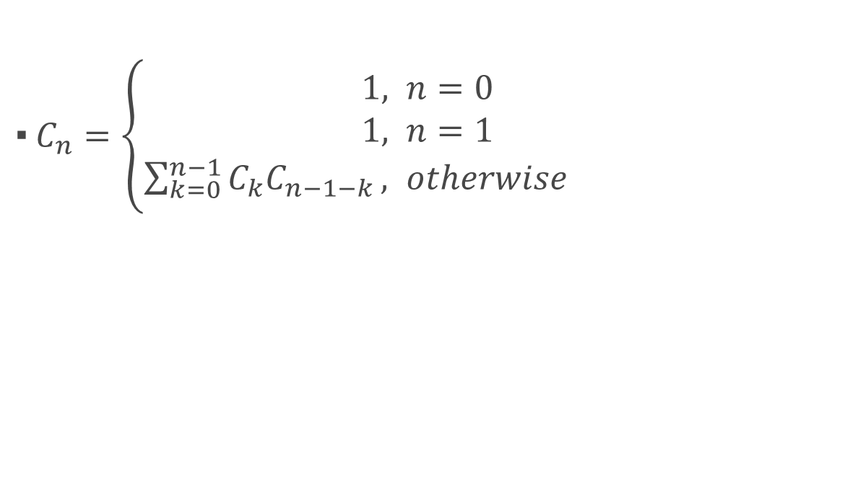
Binary Tree
$C_{n}=\left\{\begin{aligned} 1, n=0 \\ 1, n=1 \\ \sum_{k=0}^{n−1}{C_{k}C_{n−1−k}}, otherwise\end{aligned}\right.$

Slide 40
Binary Search Tree
$C_{n}=\left\{\begin{aligned} 1, n=0 \\ 1, n=1 \\ \sum_{k=0}^{n−1}{C_{k}C_{n−1−k}}, otherwise\end{aligned}\right.$

Slide 41
Q2 exercise 15.21
Prove that a strictly binary tree with n leaves has exactly 2n-1 nodes

Slide 42
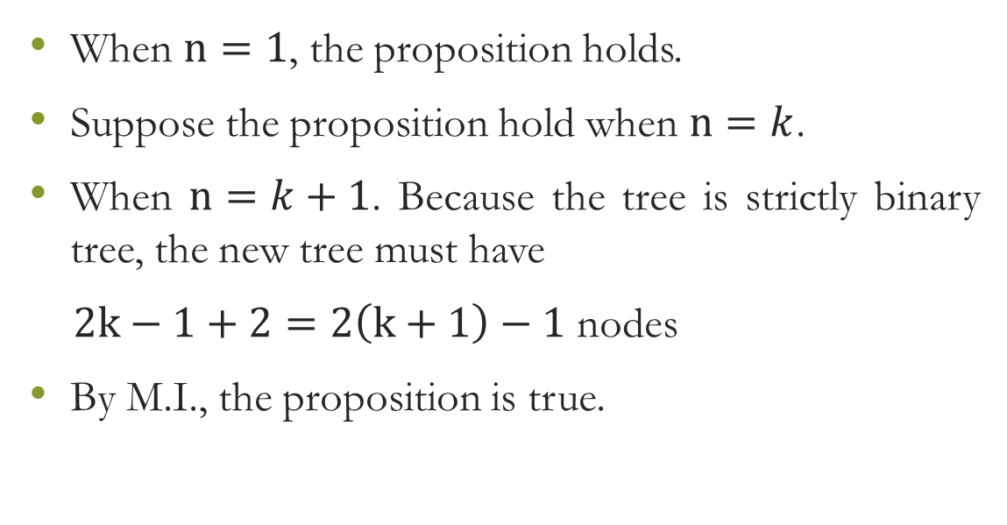
The proof
When $n=1$, the proposition holds.
Suppose the proposition hold when $n=k$.
When $n=k+1$. Because the tree is strictly binary tree, the new tree must have
$2k−1+2=2\left(k+1\right)−1$ nodes
By M.I., the proposition is true.

Slide 43
Q3 exercise 16.13
How many nodes at the certain level

Slide 44
template <typename ItemType>
int::getNodesAtLevel(TreeNode<ItemType>* root, int level){
if(level > root->getHeight() || *root == null){
return 0;
} else if ( level = 1 ) {
return 1;
} else {
return getNodesAtLevel(root->getLeftChildptr(), level - 1) + getNodesAtLevel(root-> getRightChildptr(), level - 1)
}

Slide 45
Q4 exercise 16.14
Level-order traversal implementation
Hint: using BFS

Slide 46
The pseudocode
Queue<node> bfs;
bfs.enqueue( root );
while bfs is not empty
print bfs.peekFront()
bfs.enqueue( bfs.peekFront().leftChild )
bfs.enqueue( bfs.peekFront().rightChild ) bfs.dequeue()

Slide 47
Q5 exercise 17.13
Implement the heap sort

Slide 48
#include <iostream>
using namespace std;
void max_heapify(int *a, int i, int n)
{
int j = 2*i, temp = a[i];
while (j <= n)
{
if (j < n && a[j+1] > a[j])
j = j+1;
if (temp > a[j])
break;
else if (temp <= a[j])
{
a[j/2] = a[j];
j = 2*j;
}
}
a[j/2] = temp;
return;
}

Slide 49
void heapsort(int *a, int n)
{
int i, temp;
for (i = n; i >= 2; i--)
{
temp = a[i];
a[i] = a[1];
a[1] = temp;
max_heapify(a, 1, i - 1);
}
}

Slide 50
void build_maxheap(int *a, int n)
{
int i;
for(i = n/2; i >= 1; i--)
{
max_heapify(a, i, n);
}
}

Slide 51
int main()
{
int n, i, x;
cout<<"Enter no of elements of arrayn";
cin>>n;
int a[20];
for (i = 1; i <= n; i++)
{
cout<<"Enter element"<<(i)<<endl;
cin>>a[i];
}
build_maxheap(a,n);
heapsort(a, n);
cout<<"nnSorted Arrayn";
for (i = 1; i <= n; i++)
{
cout<<a[i]<<endl;
}
return 0;
}

