Slide 1
Data Abstraction
Yih-Kuen Tsay
Dept. of Information Management
National Taiwan University
Based on [Carrano and Henry 2013]
With help from Chien Chin Chen

Slide 2
Overview
Fundamental principles for dealing with the complexity of a large computer program
  Principles of (object-oriented) programming
  Design and documentation
The role of data abstraction (and algorithms) in problem solving
  Apply data abstraction to increase modularity
  Conceptually, build a “wall” between a program and its data structures
Abstract data types (ADTs) first and then their implementations (data structures)

Slide 3
To Become a Better Programmer
Where did you begin (after reading, or writing, the problem specification), when you wrote your last program?
Many beginners simply begin to write code.
  Then spend a lot of time debugging and praying for correct results.
What if you are writing a really large program?
Coding without a solution design increases debugging time (probably exponentially).

Slide 4
Programming vs. Problem Solving
In a program-development-centric course (such as Data Structures), we consider problems that require a program as the final solution.
Solving a problem means to
  gain an understanding of the problem,
  design a conceptual solution, and
  implement the solution as a computer program.
Other issues: user workflows and possible changes.
Note: there are problems that cannot be solved (totally), even if they have been specified precisely.

Slide 5
Object-Oriented Solutions
An object-oriented (OO) solution is a program that consists of a system of interacting classes of objects.
  Each object has characteristics (attributes) and behaviors (functions) related to the solution.
  A class is a set of objects having the same type.
Object-oriented analysis and design helps us discover and describe these objects and classes (to construct a solution, i.e., a program).

Slide 6
Object-Oriented Analysis and Design (1/3)
Analysis (in general)
  Understand what the problem is and what the requirements of a solution are.
    What a solution (program) must do.
    Not how to implement the solution.
  Generates an accurate understanding of what end users will expect the solution to be.
Design (in general)
  Explores (describes) a solution to a problem.
  To fulfill the requirements discovered during analysis.

Slide 7
Object-Oriented Analysis and Design (2/3)
Object-oriented analysis (OOA)
  Expresses an understanding of the problem and the requirements of a solution in terms of relevant objects within the problem domain.
  Objects can represent
    Real-world objects, e.g., cars
    Software systems, e.g., stacks
    Ideas
Using OOA, you describe the objects and their interactions among one another.

Slide 8
Object-Oriented Analysis and Design (3/3)
Object-oriented design (OOD)
  Describes a solution in terms of software objects and how the objects will collaborate with one another to fulfill the requirements of the problem.
    Objects collaborate by calling on one another to perform operations.
    Collaborations should be meaningful and minimal.
During OOD, you may create one or more models of a solution.
  Some emphasize interactions among objects.
  Others emphasize relationships among objects.

Slide 9
More about OO Solutions (1/2)
From the OO perspective, a solution is an object-oriented program consisting of modules.
A module is a self-contained unit of code; it can be
  A single, stand-alone function.
  A method of a class.
  A class.
  A group of several functions or classes working closely together.
  Some block of code.

Slide 10
More about OO Solutions (2/2)
Functions/methods (or modules) implement algorithms.
  An algorithm is a step-by-step recipe/procedure for performing a task within a finite period of time.
  Algorithms often operate on a collection of data.
When designing a solution, your challenge is to create a good set of modules.
  Modules must store, move, and alter data.
  Modules use methods to communicate with one another.
Problem solving is to organize data collection and provide efficient operations on the data.

Slide 11
Object-Oriented Programming (1/2)
An object-oriented language enables us to build classes of objects.
A class combines
  Attributes (characteristics) of objects of a single type
    Typically data
    Called data members
  Behaviors (operations)
    Often operating on the data
    Called methods or member functions

Slide 12
Object-Oriented Programming (2/2)
Principles of object-oriented programming:
  Encapsulation
    Objects combine data and operations (behaviors).
    Hides inner details.
  Inheritance
    Classes can inherit properties from other classes.
    Existing classes can be reused.
  Polymorphism
    Objects can determine appropriate operations at execution time.

Slide 13
Achieving a Better Solution
Analysis and design improve solutions.
If you have generated many correct but different solutions, what aspects of one solution make it better than the others?
What aspects lead to a better solution?

Slide 14
Cohesion and Coupling (1/2)
Cohesion: A highly cohesive module performs one well-defined task.
Advantages brought by a highly cohesive module:
  if well named, promotes self-documenting, easy-to-understand code.
    E.g., a function called sort should do nothing but sort.
  Easy to reuse in other software projects.
  Much easier to maintain (revise or correct).
  More robust: less likely to be affected by change; performs well under unusual conditions.
Guideline: if a module (class or function) has too many responsibilities, it should be split into multiple modules.

Slide 15
Cohesion and Coupling (2/2)
Coupling is a measure of the dependence among modules, which could involve sharing data structures or calling each other’s methods.
A system of modules with low coupling is
  more adaptable to change,
  easier to understand,
  easier to reuse, and
  has increased cohesion.
Coupling cannot be and should not be eliminated entirely.
    Objects must collaborate to get work done.
    But the coupling should be kept to minimum.

Slide 16
Specification of a Module
What it does
But not how it does it

Slide 17
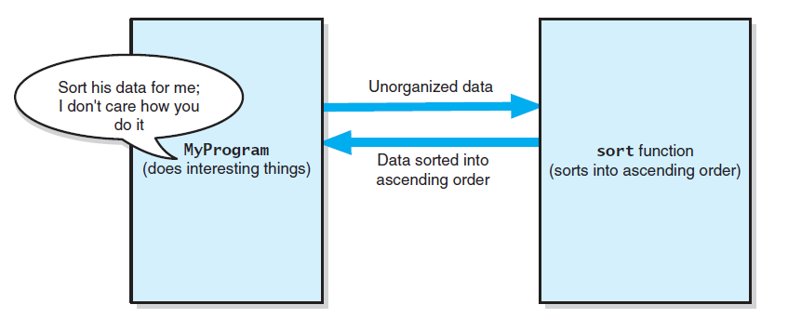
Separation of Concerns
The task sort is a module separate from
the MyProgram module
Source: FIGURE 1-1 in [Carrano and Henry 2013].

Slide 18
Operation Contracts (1/3)
An operation contract documents how a module can be used and what limitations it has.
Begin the contract during analysis and finish during design.
  Used to document code, particularly in header files.
  Does not describe how the module will perform its task.
A module’s operation contract specifies its
  purpose,
  assumptions, and
  input and output.

Slide 19
Operation Contracts (2/3)
Precondition:
  Statement of conditions that must exist before a module (function) executes.
Postcondition:
  Statement of conditions that exist after a module (function) executes.
Example of module contract:
// Sorts an array.
// Precondition: anArray is an array of num integers; num > 0.
// Postcondition: The integers in anArray are sorted.
sort(anArray, num)
purpose
pretty vague,
sort? descending or ascending order?
Precondition & postcondition

Slide 20
Operation Contracts (3/3)
Revised specifications:
// Sorts an array into ascending order.
// Precondition: anArray is an array of num
// integers; 1 <= num <= MAX_ARRAY, where
// MAX_ARRAY is a global constant that specifies
// the maximum size of anArray.
// Postcondition: anArray[0] <= anArray[1] <= ...
// <= anArray[num-1], num is unchanged.
sort(anArray, num)
Documentation is very important!!
You, the programmer, may forget everything about your programs.

Slide 21
Options for Unusual Conditions
Assume they will never occur
  State the assumption as a precondition
Ignore the invalid situations
  Do nothing if given invalid data
Guess at the client’s intention
Return a value that signals a problem
Throw an exception
  Often a desirable way

Slide 22
Abstraction (1/3)
Abstraction separates the purpose of a module from its implementation.
Specifications for each module are written before implementation.
Modularity and abstraction complement each other.
  Modularity breaks a solution into modules.
  Abstraction specifies each module clearly.

Slide 23
Abstraction (2/3)
Functional abstraction separates the purpose of a function from its implementation.
  For example, C++ standard library function, cout.
Functional abstraction is essential to a team project.
  You will have to use modules (functions) written by others, frequently without knowledge of their implementations.

Slide 24
Abstraction (3/3)
Consider now a collection of data and a set of operations on the data.
Data abstraction focuses on what the operations do to data, not on their implementation.
Data structure:
  Implementation of an ADT.
  A construct that you can define within a programming language to store a collection of data.
  E.g., array-based or link-based implementation of ADT bag.

Slide 25
Information Hiding (1/2)
The principle of information hiding tells you to
  hide private details within a module and
  make the private details inaccessible from outside a module,
  so as to ensure that no other module can tamper with these hidden details.

Slide 26
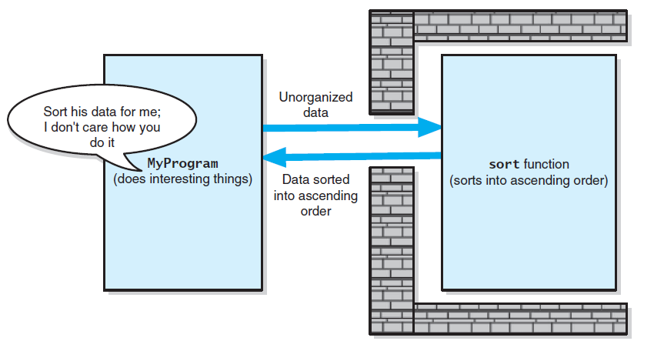
Information Hiding (2/2)
Tasks communicate through a slit in wall
Source: FIGURE 1-2 in [Carrano and Henry 2013].

Slide 27
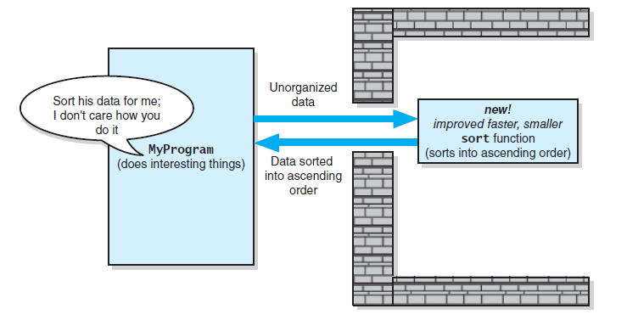
Minimal and Complete Interfaces (1/2)
A revised implementation communicates through
the same slit in the wall
Source: FIGURE 1-3 in [Carrano and Henry 2013].

Slide 28
Minimal and Complete Interfaces (2/2)
The interface of a class identifies the publicly accessible methods (and data).
A complete interface provides methods for accomplishing any reasonable task consistent with the responsibilities of the class.
    Very important
    A minimal interface provides only essential methods.
    Easier for understanding and maintenance
    Less important than completeness

Slide 29
Signature of an Interface
The interface to a method or function is called its signature.
It includes
  Name of the method/function.
  Arguments (number, order, type).
  Qualifiers such as const.
  Return type (this is excluded in the textbook)

Slide 30
Abstract Data Types (1/4)
Common operations on data
  Add
  Remove
  Query (ask a question)
To be able to think abstractly, it is essential to define Abstract Data Types (ADTs).

Slide 31
Abstract Data Types (2/4)
An Abstract Data Type (ADT) is a collection of data and a set of operations on the data.
It is organized in a way that the following two groups of things are separated:
  the specification of the data and the specification of the operations
  the representation (how the data is stored) of the data and the implementation of the operations

Slide 32
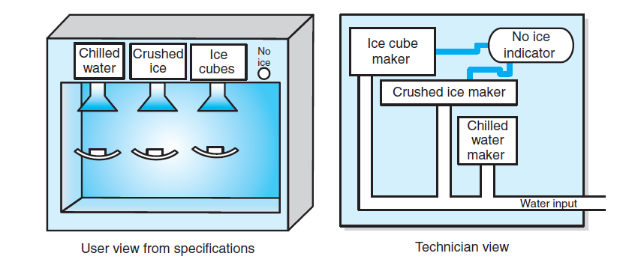
Abstract Data Types (3/4)
A dispenser of chilled water, crushed ice, and
ice cubes
Source: FIGURE 1-4 in [Carrano and Henry 2013].

Slide 33
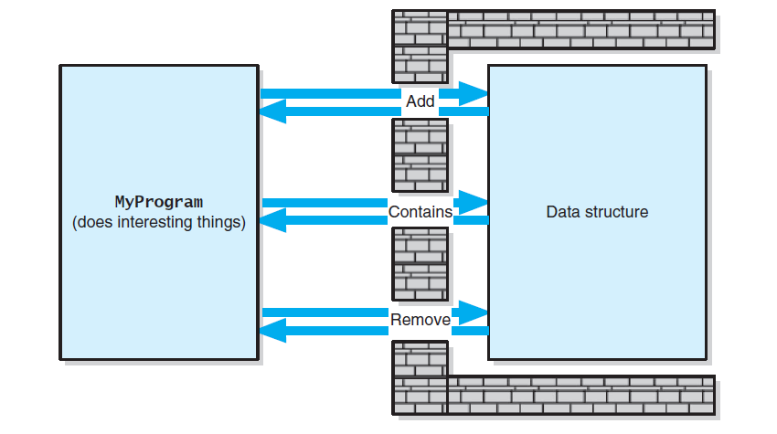
Abstract Data Type (4/4)
A wall of ADT operations isolates a data structure from
the program that uses it
Source: FIGURE 1-5 in [Carrano and Henry 2013].

Slide 34
Designing an ADT
Questions to ask when designing an ADT for a solution to a problem:
  What data are involved?
  How the data is to be operated and hence what operations are needed?
The design of an ADT should evolve naturally during the problem-solving process.

Slide 35
Example – An Appointment Book (1/6)
Imagine that you want to create a computerized appointment book.
What is an appointment?
  Suppose you are concerned only with its
  Date and time
  Purpose (the nature of the appointment)
So, an adequate ADT contains a collection of data items that are appointments, each with a date, time, and purpose.

Slide 36
Example – An Appointment Book (2/6)
What can one do with an appointment book?
  Make an appointment
  Cancel an appointment
  Check whether there is an appointment at a given time
  Get the purpose of an appointment
  Etc.

Slide 37
Example – An Appointment Book (3/6)
    // Returns true if an appointment exists for the date and time specified,
    // false otherwise.
  +isAppointment(apptDate: Date, apptTime: Time): boolean
// Inserts the appointment for the date, time, and purpose specified
// as long as it does not conflict with an existing appointment.
// Returns true if successful, false otherwise.
  +makeAppointment(apptDate: Date, apptTime: Time, apptPurpose: string): boolean

Slide 38
Example – An Appointment Book (4/6)
  // Deletes the appointment for the date and time specified.
  // Returns true if successful, false otherwise.
  +cancelAppointment(apptDate: Date, apptTime:Time): boolean
    // Gets the purpose of the appointment at the given date and time,
    // if one exists.
    // Otherwise, returns an empty string.
  +getAppointmentPurpose(apptDate: Date, apptTime:Time): string

Slide 39
Example – An Appointment Book (5/6)
One may use the operations from the ADT appointment book to design other applications or modules.
// Change the date or time of an appointment
Get from user: oldDate, oldTime, newDate, newTime
// Get purpose of appointment
oldPurpose = apptBook.getAppointmentPurpose(oldDate, oldTime)
if (oldPurpose is not an empty string) {
// See whether a new date/time is available
if (apptBook.isAppointment(newDate, newTime))
// New date/time is booked
write(“You already have an appointment at “, newTime,
“ on “, newDate)

Slide 40
Example – An Appointment Book (6/6)
else {
// New date/time is available
apptBook.cancleAppointment(oldDate, oldTime);
if (apptBook.makeAppointment(newDate, newTime, oldPurpose))
write(“Your appointment has been rescheduled to ”,
newTime, “ on ”, newDate)
}
}
else
write(“You do not have an appointment at “, oldTime,
“ on “, oldDate)
You can design applications of the ADT operations
without knowing how the ADT is implemented.

Slide 41
ADTs That Suggest Other ADTs (1/2)
The design of an ADT may suggest other ADTs for its implementation.
Suppose you want to design a database of recipes.
This database is an ADT.
  Data: recipes.
  Operations:
    insertRecipe
    deleteRecipe
    retrieveRecipe

Slide 42
ADTs That Suggest Other ADTs (2/2)
Suppose you want to design an operation that scales a recipe retrieved from the database.
  If the recipe is for n people, you want to revise it so that it will serve m people.
  Each recipe contains measurements such as 2_{1/2} cups, 1 tablespoon, and ¼ teaspoon.
This problem suggests another ADT — measurement
  Data: measures (quantity, unit).
  Operations: getMeasure, setMeasure, scaleMeasure, convertMeasure.
The representation of quantity may suggest yet another ADT.
When you eventually implement the scale operation, you can use the ADT measurement.

Slide 43
The ADT Bag
A bag is a container, containing a finite number of objects.
Objects in a bag have no particular order.
Objects in a bag may be duplicated.
We will assume that all objects in a bag are of the same type.

Slide 44
Identifying Behaviors of a Bag (1/3)
Counting:
  Get the number of items currently in the bag.
  See whether the bag is empty.
Add/Remove:
  Add a given object to the bag.
  Remove an occurrence of a specific object from the bag.
  Remove all objects from the bag.

Slide 45
Identifying Behaviors of a Bag (2/3)
More counting:
  Count the number of times certain object occurs in bag.
Query:
  Test whether the bag contains a particular object.
  Look at all objects in the bag.

Slide 46
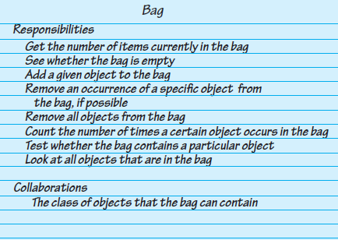
Identifying Behaviors of a Bag (3/3)
A class-responsibility-collaboration (CRC) card for a class Bag
Source: FIGURE 1-6 in [Carrano and Henry 2013].

Slide 47
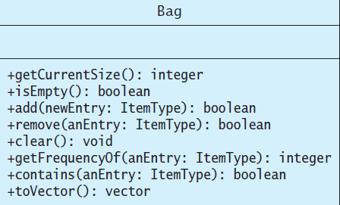
Specifying Data and Operations (1/2)
UML notation for the class Bag
Source: FIGURE 1-7 in [Carrano and Henry 2013].

Slide 48
Specifying Data and Operations (2/2)
getCurrentSize()
  Task: Reports the current number of objects in this bag.
  Input: None.
  Output: The number of objects currently in this bag.
add(newEntry)
  Task: Adds a given object to this bag.
  Input: newEntry is an object.
  Output: True if the addition succeeds, or false otherwise.

Slide 49
A C++ Interface of the ADT Bag
#include <vector>
using namespace std;
template <class ItemType>
class BagInterface {
public:
virtual int getCurrentSize() const = 0;
virtual bool isEmpty() const = 0;
virtual bool add(const ItemType& newEntry) = 0;
virtual bool remove(const ItemType& anEntry) = 0
virtual void clear() = 0;
virtual int getFrequencyOf(const ItemType& anEntry) const = 0;
virtual bool contains(const ItemType& anEntry) const = 0;
virtual vector<ItemType> toVector() const = 0;
};
Note: see LISTING 1-1 in [Carrano and Henry 2013] (on Page 47) for further details.

Slide 50
Using the ADT Bag (1/2)
#include <iostream>
#include <string>
#include "Bag.h”
using namespace std;
int main()
{ string clubs[] = {"Joker", "Ace", "Two", "Three", "Four", "Five", "Six", "Seven", "Eight", "Nine", "Ten", "Jack", "Queen", "King"};
// Create our bag to hold cards.
Bag<string> grabBag;
// Place six cards in the bag.
grabBag.add(clubs [1]); grabBag.add(clubs [2]); grabBag.add(clubs [4]); grabBag.add(clubs [8]); grabBag.add(clubs [10]); grabBag.add(clubs [12]);
// Get friend’s guess and check it.
int guess = 0;

Slide 51
Using the ADT Bag (2/2)
while (!grabBag.isEmpty()) {
cout << "What is your guess?"
<< "(1 for Ace to 13 for King):";
cin >> guess;
if (grabBag.contains(clubs[guess])) {
cout << "You get the card!\n";
grabBag.remove(clubs[guess]);
}
else {
cout << "Sorry, card was not in the bag.\n";
}
}
cout << "No more cards in the bag. Game over!\n";
return 0;
};
Note: see LISTING 1-2 in [Carrano and Henry 2013] (on Page 49) for further details.

