Slide 1
Lists:
Implementations
Yih-Kuen Tsay
Dept. of Information Management
National Taiwan University
Based on [Carrano and Henry 2013]
With help from Chien Chin Chen

Slide 2
Array-Based Implementation (1/2)
Tasks of ADT Implementation:
  Choose a data structure to represent the ADT’s data.
  Write functions that access the data in accordance with the ADT operation specifications.
Array as the data structure for lists:
  Using an array to represent a list is a natural choice.
    Both an array and a list identify their items by numbers.
  However, an array has a fixed size, but a list can have an arbitrary length.
    You need a variable to keep track of the length of the list.

Slide 3
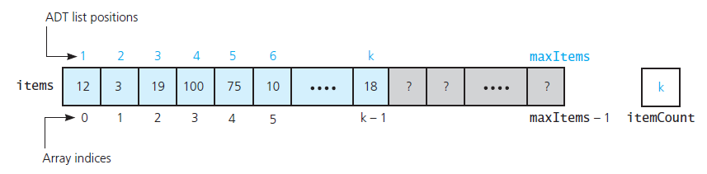
Array-Based Implementation (2/2)
A list’s k^{th} item is stored in items[k-1].
Source: FIGURE 9-1 in [Carrano and Henry 2013].

Slide 4
An Array-Based List: ArrayList.h (1/2)
/** ADT list: Array-based implementation.
@file ArrayList.h */
#ifndef _ARRAY_LIST
#define _ARRAY_LIST
#include "ListInterface.h"
#include "PrecondViolatedExcep.h" // See Stacks: Implementations
template<class ItemType>
class ArrayList: public ListInterface<ItemType>
{
private:
static const int DEFAULT_CAPACITY = 100;
ItemType items[DEFAULT_CAPACITY]; // Array of list items
int itemCount; // Current count of list items
int maxItems; // Maximum capacity of the list

Slide 5
An Array-Based List: ArrayList.h (2/2)
public:
ArrayList();
// Copy constructor and destructor are supplied by compiler
bool isEmpty() const;
int getLength() const;
bool insert(int newPosition, const ItemType& newEntry);
bool remove(int position);
void clear();
/** @throw PrecondViolatedExcep if position < 1 or
position > getLength(). */
ItemType getEntry(int position) const throw (PrecondViolatedExcep);
/** @throw PrecondViolatedExcep if position < 1 or
position > getLength(). */
void setEntry (int position, const ItemType & newEntry)
throw (PrecondViolatedExcep);
}; // end ArrayList
#include “ArrayList.cpp”
#endif

Slide 6
An Array-Based List: ArrayList.cpp (1/7)
/** @file ArrayList.cpp */
#include “ArrayList.h" // header file
template<class ItemType>
ArrayList<ItemType>::ArrayList(): itemCount(0),
maxItems(DEFAULT_CAPACITY)
{
} // end default constructor
template<class ItemType>
bool ArrayList<ItemType>::isEmpty() const
{
return itemCount == 0;
} // end isEmpty
template<class ItemType>
int ArrayList<ItemType>::getLength() const
{
return itemCount;
} // end getLength

Slide 7
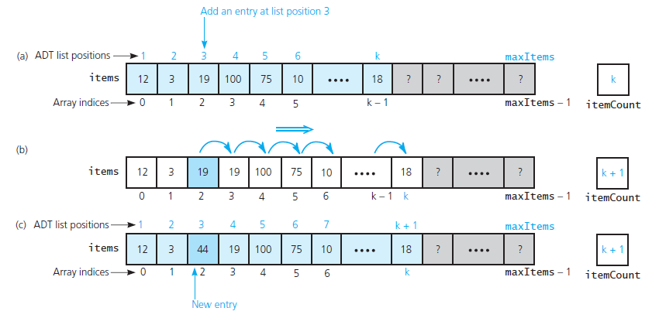
An Array-Based List: ArrayList.cpp (2/7)
To insert an item, make room in the array.
  Insertion of item 44 at position 3:
k
Source: FIGURE 9-2 in [Carrano and Henry 2013].

Slide 8
An Array-Based List: ArrayList.cpp (3/7)
template<class ItemType>
bool ArrayList<ItemType>::insert(int newPosition,
const ItemType& newEntry)
{
bool ableToInsert = (newPosition >= 1) &&
(newPosition <= itemCount + 1) &&
(itemCount < maxItems);
if (ableToInsert) {
// Make room for new entry by shifting all items at
// positions >= newPosition toward the end of the array
// (no shift if newPosition == itemCount + 1)
for (int pos = itemCount; pos >= newPosition; pos--)
items[pos] = items[pos-1];
// insert newEntry
items[newPosition - 1] = newEntry;
itemCount++; // Increase count of entries
} // end if
return ableToInsert;
} // end insert

Slide 9
An Array-Based List: ArrayList.cpp (4/7)
template<class ItemType>
ItemType ArrayList<ItemType>::getEntry(int position) const
throw (PrecondViolatedExcep)
{
// Enforce precondition
bool ableToGet = (position >= 1) && (position <= itemCount);
if (ableToGet)
return items[position - 1];
else {
string message = “getEntry() called with an empty list or”;
message = message + “invalid position.”;
throw(PrecondViolatedExcep(message));
} // end if
} // end getEntry

Slide 10
An Array-Based List: ArrayList.cpp (5/7)
template<class ItemType>
ItemType ArrayList<ItemType>::setEntry(int position,
const ItemType& newEntry)
throw (PrecondViolatedExcep)
{
// Enforce precondition
bool ableToSet = (position >= 1) && (position <= itemCount);
if (ableToSet)
items[position - 1] = newEntry;
else {
string message = “setEntry() called with an empty list or”;
message = message + “invalid position.”;
throw(PrecondViolatedExcep(message));
} // end if
} // end setEntry

Slide 11
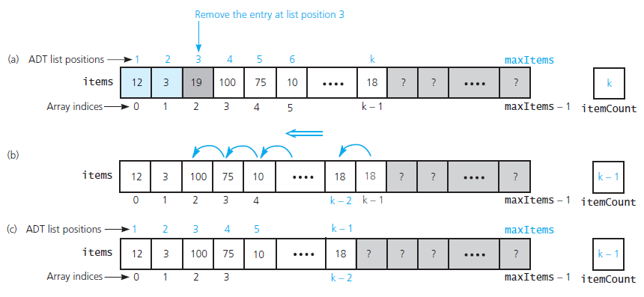
An Array-Based List: ArrayList.cpp (6/7)
After deleting an item, fill the gap thus caused.
  Removal of the entry at position 3:
Fill the gap caused by the deleted item.
k
Source: FIGURE 9-3 in [Carrano and Henry 2013].

Slide 12
An Array-Based List: ArrayList.cpp (7/7)
template<class ItemType>
bool ArrayList<ItemType>::remove(int position)
{
bool ableToRemove = (position >= 1) && (position <= itemCount);
if (ableToRemove) {
// Remove entry by shifting all entries after the one at
// position toward the beginning of the array
// (no shift if position == itemCount)
for (int fromIndex = position, toIndex = fromIndex - 1;
fromIndex < itemCount; fromIndex++, toIndex++)
items[toIndex] = items[fromIndex];
itemCount--; // Decrease count of entries
} // end if
return ableToRemove;
} // end remove

Slide 13
Link-Based Implementation (1/2)
An array has a fixed size.
  But the ADT list can have an arbitrary length.
Using an array, data must be shifted during insertions and deletions.
  A time-consuming process.
A link-based implementation avoids those problems.

Slide 14
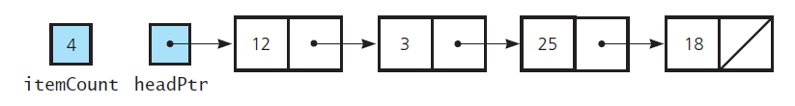
Link-Based Implementation (2/2)
Representation of the ADT list using pointers
  An item in the ADT list is represented as a node in the linked list.
  Here headPtr points to the first node in the linked list.
  In addition, the variable itemCount is the current number of entries on the list.
Source: FIGURE 9-4 in [Carrano and Henry 2013].

Slide 15
A Link-Based List: LinkedList.h (1/2)
/** ADT list: Link-based implementation.
@file LinkedList.h */
#ifndef _LINKED_LIST
#define _LINKED_LIST
#include "ListInterface.h"
#include “Node.h" // See Link-Based Implementations
#include "PrecondViolatedExcep.h“ // See Stacks: Implementations
template<class ItemType>
class LinkedList: public ListInterface<ItemType>
{
private:
Node<ItemType>* headPtr; // Pointer to first node in the chain
// (contains the first entry in the list)
int itemCount; // Current count of list items
/** Locates a specified node in a linked list.
@ pre position >= 1 and position <= itemCount
@ return A pointer to the node at the given position. */
Node<ItemType>* getNodeAt(int position) const;

Slide 16
A Link-Based List: LinkedList.h (2/2)
public:
LinkedList();
LinkedList(const LinkedList<ItemType>& aList));
virtual ~LinkedList();
bool isEmpty() const;
int getLength() const;
bool insert(int newPosition, const ItemType& newEntry);
bool remove(int position);
void clear();
/** @throw PrecondViolatedExcep if position < 1 or
position > getLength(). */
ItemType getEntry(int position) const throw (PrecondViolatedExcep);
/** @throw PrecondViolatedExcep if position < 1 or
position > getLength(). */
void setEntry (int position, const ItemType & newEntry)
throw (PrecondViolatedExcep);
}; // end LinkedList
#include “LinkedList.cpp”
#endif

Slide 17
Constructor and Destructor
The default constructor:
A destructor is required for dynamically allocated memory.
template<class ItemType>
LinkedList<ItemType>::LinkedList(): headPtr(nullptr), itemCount(0)
{
} // end default constructor
template<class ItemType>
LinkedList<ItemType>::~LinkedList()
{
clear();
} // end destructor
Method clear invokes remove repeatedly
until the list is empty, and remove deallocates
the nodes it removes.
template<class ItemType>
void LinkedList<ItemType>::clear()
{
while (!isEmpty())
remove(1);
} // end clear

Slide 18
The getEntry method
template<class ItemType>
ItemType LinkedList<ItemType>::getEntry(int position) const
throw(PrecondViolatedExcep)
{
// Enforce precondition
bool ableToGet = (position >= 1) && (position <= itemCount);
if (ableToGet) {
Node<ItemType>* nodePtr = getNodeAt(position);
return nodePtr->getItem();
}
else {
string message = “getEntry() called with an empty list or “;
message = message + “invalid position”;
throw (PrecondViolatedExcep(message));
} // end if
} // end getEntry

Slide 19
The getNodeAt method
Locates the node at a given position by traversing the chain.
template<class ItemType>
Node<ItemType>* LinkedList<ItemType>::getNodeAt(int position) const
{
// Debugging check of precondition
assert( (position >= 1) && (position <= itemCount) );
// Count from the beginning of the chain.
Node<ItemType>* curPtr = headPtr;
for (int skip = 1; skip < position; skip++)
curPtr = curPtr->getNext();
return curPtr;
} // end getNodeAt

Slide 20
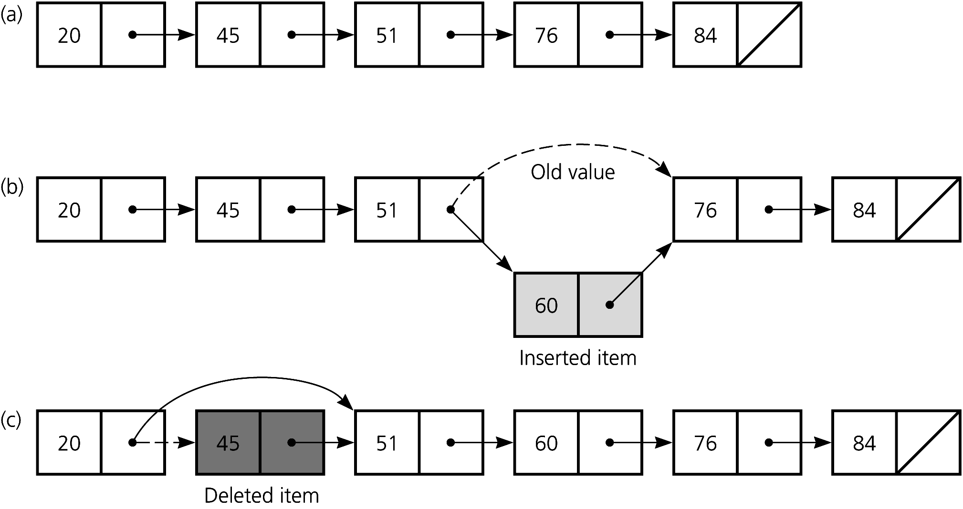
Overview of Insertion and Deletion
Insertion or deletion with pointer modifications.
Source: [Carrano 2007].

Slide 21
Inserting a Node into a Specified Position (1/2)
Insert a new node pointed to by newNodePtr between the two nodes that prevPtr and curPtr point to.
    1. newNodePtr->setNext(curPtr);
    2. prevPtr->setNext(newNodePtr);
...
20
40
...
100
2.
1.
30
prevPtr
curPtr
Can we reverse the operation
sequence ?
YES!!
newNodePtr

Slide 22
Inserting a Node into a Specified Position (2/2)
Inserting at the end of a linked list is not a special case:
1. newNodePtr->setNext(curPtr);
  2. prevPtr->setNext(newNodePtr);
...
96
100
2.
102
1.
prevPtr
newNodePtr
curPtr

Slide 23
Deleting a Specified Node (1/3)
Deleting an interior node N:
  Suppose that node N is pointed to by an external variable curPtr.
  Variable prevPtr points to the node the precedes N.
  prevPtr->setNext(curPtr->next);
Node N
...
5
8
10
...
100
prevPtr
curPtr

Slide 24
Deleting a Specified Node (2/3)
Deleting at the end of a linked list is not a special case:
prevPtr->setNext(curPtr->getNext());
...
96
85
100
prevPtr
curPtr

Slide 25
Deleting a Specified Node (3/3)
Note that node N pointed to by curPtr still exists after its deletion from the linked list.
Return deleted node to the system.
curPtr->setNext(nullptr);
delete curPtr;
curPtr = nullptr;
Three steps to delete a node:
  Locate the node that you want to delete.
  Disconnect this node from the linked list by changing pointers.
  Return the node to the system.

Slide 26
Using Recursion
Let us consider a recursive implementation of the insertion operation.
The insert method will need a new private helper function insertNode, which is recursive and takes three arguments:
  position: the location (relative to the current subchain) to insert
  newNodePtr: the new node to insert
  subChainPtr: the head of the current subchain (which is some suffix portion of the original linked list)

Slide 27
Recursively Adding a Node at the Head (1/2)
The current list (before the insertion):
After method insert creates a node, before calling insertNode (with headPtr for subChainPtr):
As insertNode(1, newNodePtr, headPtr) begins execution:
headPtr
12
3
25
18
newNodePtr
50
headPtr
12
3
25
18
subChainPtr

Slide 28
Recursively Adding a Node at the Head (2/2)
After the new node is linked to the beginning:
After method insert assigns to headPtr the returned reference:
headPtr
12
3
25
18
subChainPtr
50
headPtr
12
3
25
18
subChainPtr
50

Slide 29
Recursively Adding a Node in the Middle (1/2)
As insertNode(3, newNodePtr, headPtr) begins execution:
Recursive call insertNode(2, newNodePtr, subChainPtr->getNext()):
Recursive call insertNode(1, newNodePtr, subChainPtr->getNext()):
  An item
headPtr
12
3
25
18
subChainPtr
headPtr
12
3
25
18
subChainPtr
headPtr
12
3
25
18
subChainPtr

Slide 30
Recursively Adding a Node in the Middle (2/2)
After a new node is added to the head of subchain:
After the returned pointer is assigned to afterPtr:
After subChainPtr->setNext(afterPtr) executes:
headPtr
12
3
25
18
subChainPtr
50
headPtr
12
3
25
18
subChainPtr
50
afterPtr
headPtr
12
3
25
18
subChainPtr
50

Slide 31
Comparison and Summary
Reasons for choosing an array-based or a link-based implementation are similar as in the cases of Bags and Stacks.
Other differences:
  An array-based list provides direct access to any of its elements, while a link-based list requires a traversal.
  Adding an entry to or removing an entry from an array-based list requires shifting of other entries.
  Inserting an item into a linked list does not shift data, an important advantage over array-based implementations.
  Adding or removing an entry at or near the end of a link-based list requires a time-consuming traversal.

