Slide 1
Tree Implementations
Yih-Kuen Tsay
Dept. of Information Management
National Taiwan University
Based on [Carrano and Henry 2013]
With help from Chien Chin Chen

Slide 2
The Nodes in a Binary Tree
The first step in implementing trees is to choose a data structure to represent nodes.
Since each node must contain both data and “pointers” to the node’s children, it is natural to make each node an object!
  Thus, we will use a C++ class to define the nodes in the tree.
If we place these nodes in an array, the “pointers” in the nodes are array indices.
If the nodes are a part of a linked chain, we use C++ pointers to link them together.

Slide 3
An Array-Based Representation (1/3)
An array-based implementation of a tree uses an array of nodes, so a class of such trees could have the following data members:
TreeNode<ItemType> tree[MAX_NODES]; // array of
// tree nodes
int root; // index of root
int free; // index of free list
  root is an index to the tree’s root node within the array tree.
    If the tree is empty, root is -1.
As the tree changes due to insertions and removals, its nodes may not be in contiguous elements of the array!
    You have to establish a collection of available nodes, which is called a free list.
    free is the index to the first node in the free list.

Slide 4
An Array-Based Representation (2/3)
Let’s name our class of nodes TreeNode.
  Here, we focus on binary trees.
The class TreeNode for an array-based implementation of the ADT binary tree:
template<class ItemType>
class TreeNode
{
private:
ItemType item; // data portion
int leftChild; // index to left child
int rightChild; // index to right child
public:
TreeNode();
TreeNode(const ItemType& nodeItem, int left, int right);
...
}; // end TreeNode
-1 if a node has
no left/right child

Slide 5
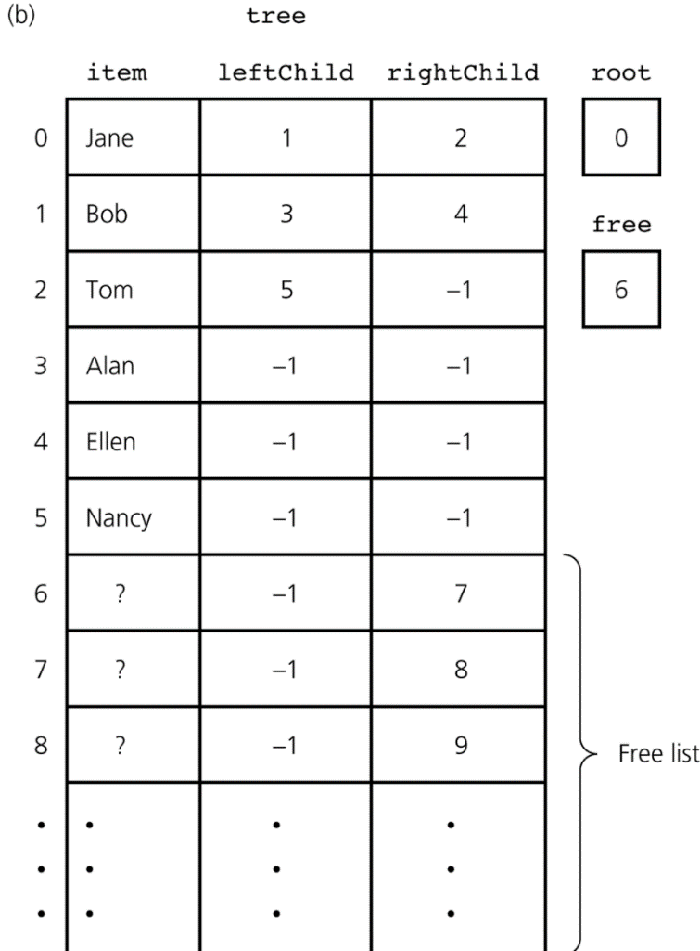
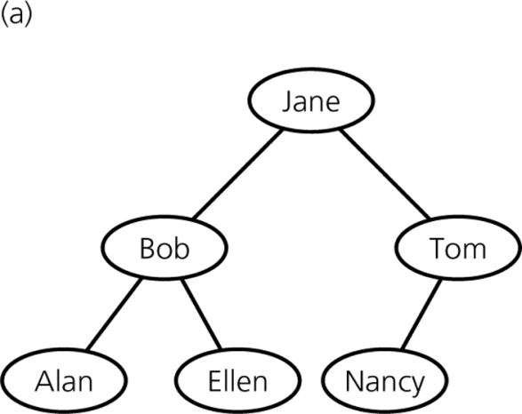
An Array-Based Representation (3/3)
free is the index of the first node in the free list, but the next available node is not necessarily at index free+1.
We link the available nodes by making the rightChild of each node the index of the next node in the free list.
Source: FIGURE 16-1 in [Carrano and Henry 2013].

Slide 6
A Link-Based Representation (1/3)
The most common way of implementing a tree is to use C++ pointers to link the nodes in the tree.
template<class ItemType>
class BinaryNode
{
private:
ItemType item; // data portion
BinaryNode<ItemType>* leftChildPtr; // pointer to left child
BinaryNode<ItemType>* rightChildPtr; // pointer to right child
public:
BinaryNode();
BinaryNode(const ItemType& anItem);
BinaryNode(const ItemType& anItem,
BinaryNode<ItemType>* leftPtr,
BinaryNode<ItemType>* rightPtr);

Slide 7
A Link-Based Representation (2/3)
void setItem(const ItemType& anItem);
ItemType getItem() const;
bool isLeaf() const;
BinaryNode<ItemType>* getLeftChildPtr() const;
BinaryNode<ItemType>* getRightChildPtr() const;
void setLeftChildPtr(BinaryNode<ItemType>* leftPtr);
void setRightChildPtr(BinaryNode<ItemType>* rightPtr);
}; // end BinaryNode

Slide 8
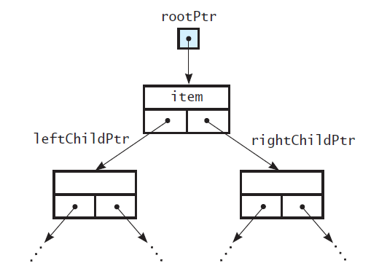
A Link-Based Representation (3/3)
A class of link-based binary trees will declare one data member--a pointer rootPtr--to point to the tree’s root.
  If the tree is empty, rootPtr contains nullptr.
rootPtr->getLeftChildPtr() points to the root of the left subtree.
rootPtr->getRightChildPtr() points to the root of the right subtree.
If either of these subtrees is empty, the pointer to it would be nullptr.
Source: FIGURE 16-2 in [Carrano and Henry 2013].

Slide 9
A Link-Based Implementation of Binary Tree (1/19)
Below is the header file of the class BinaryNodeTree.
  The protected methods – called by the public methods to perform their operations recursively.
  These methods require pointers (implementation details) as arguments. As such, they should not be public and available to clients of the class.
...
template<class ItemType>
class BinaryNodeTree: public BinaryTreeInterface<ItemType>
{
private:
BinaryNode<ItemType>* rootPtr;
protected:
int getHeightHelper(BinaryNode<ItemType>* subTreePtr) const;
int getNumberOfNodesHelper(BinaryNode<ItemType>* subTreePtr) const;
...

Slide 10
A Link-Based Implementation of Binary Tree (2/19)
The public section declares constructors, allowing a client to define binary trees in a variety of circumstances:
  An empty tree
  From the given data for its root, which is its only node
  From the data and two pointers for the root and its two subtrees
public:
//------------------------------------------------------------
// Constructor and Destructor Section.
//------------------------------------------------------------
BinaryNodeTree();
BinaryNodeTree(const ItemType& rootItem);
BinaryNodeTree(const ItemType& rootItem,
const BinaryNodeTree<ItemType>* leftTreePtr,
const BinaryNodeTree<ItemType>* rightTreePtr);
BinaryNodeTree(const BinaryNodeTree<ItemType>& tree);
virtual ~BinaryNodeTree();
copy constructor

Slide 11
A Link-Based Implementation of Binary Tree (3/19)
The public methods inherited from BinaryTreeInterface.
//------------------------------------------------------------
// Public BinaryTreeInterface Methods Section.
//------------------------------------------------------------
bool isEmpty() const;
int getHeight() const;
int getNumberOfNodes() const;
ItemType getRootData() const throw(PrecondViolatedExcep);
void setRootData(const ItemType& newData);
bool add(const ItemType& newData); // Adds a node
bool remove(const ItemType& data); // Removes a node
void clear();
ItemType getEntry(const ItemType& anEntry) const
throw(NotFoundException);
bool contains(const ItemType& anEntry) const;

Slide 12
A Link-Based Implementation of Binary Tree (4/19)
The traversal methods inherited from BinaryTreeInterface.
//------------------------------------------------------------
// Public Traversals Section.
//------------------------------------------------------------
void preorderTraverse(void visit(ItemType&)) const;
void inorderTraverse(void visit(ItemType&)) const;
void postorderTraverse(void visit(ItemType&)) const;
//------------------------------------------------------------
// Overloaded Operator Section.
//------------------------------------------------------------
BinaryNodeTree& operator=(const BinaryNodeTree& rightHandSide);
}; // end BinaryNodeTree

Slide 13
A Link-Based Implementation of Binary Tree (5/19)
Implementation of the constructors:
template<class ItemType>
BinaryNodeTree<ItemType>::BinaryNodeTree(): rootPtr(nullptr)
{
} // end default constructor
template<class ItemType>
BinaryNodeTree<ItemType>::BinaryNodeTree(const ItemType& rootItem)
{
rootPtr = new BinaryNode<ItemType>(rootItem, nullptr, nullptr);
} // end constructor
template<class ItemType>
BinaryNodeTree<ItemType>::BinaryNodeTree(const ItemType& rootItem,
const BinaryNodeTree<ItemType>* leftTreePtr,
const BinaryNodeTree<ItemType>* rightTreePtr)
{
rootPtr = new BinaryNode<ItemType>(rootItem,
copyTree(leftTreePtr->rootPtr),
copyTree(rightTreePtr->rootPtr));
} // end constructor

Slide 14
A Link-Based Implementation of Binary Tree (6/19)
For example, the following statements invoke these three constructors:
  BinaryNodeTree<string> tree1;
  BinaryNodeTree<string>* tree2Ptr = new BinaryNodeTree<string>(“A”);
  BinaryNodeTree<string>* tree3Ptr = new BinaryNodeTree<string>(“B”);
  BinaryNodeTree<string>* tree4Ptr = new BinaryNodeTree<string>(“C”, tree2Ptr, tree3Ptr);
tree1 is an empty binary tree;
tree2Ptr and tree3Ptr each point to binary trees that have only a root node.
tree4Ptr points to a binary tree whose root contains “C” and has subtrees pointed to by tree2Ptr and tree3Ptr.

Slide 15
A Link-Based Implementation of Binary Tree (7/19)
The protected method copyTree uses a recursive preorder traversal to copy each node in the tree.
template<class ItemType>
BinaryNode<ItemType>* BinaryNodeTree<ItemType>::
copyTree(const BinaryNode<ItemType>* treePtr) const
{
BinaryNode<ItemType>* newTreePtr = nullptr;
// Copy tree nodes during a preorder traversal
if (treePtr != nullptr) {
// Copy node
newTreePtr = new BinaryNode<ItemType>(treePtr->getItem(),
nullptr, nullptr);
newTreePtr->setLeftChildPtr(copyTree(treePtr->getLeftChildPtr()));
newTreePtr->setRightChildPtr(copyTree(treePtr->getRightChildPtr()));
} // end if
return newTreePtr;
} // end copyTree

Slide 16
A Link-Based Implementation of Binary Tree (8/19)
The copy constructor then looks like this:
template<class ItemType>
BinaryNodeTree<ItemType>::BinaryNodeTree(const BinaryNodeTree<ItemType>&
treePtr)
{
rootPtr = copyTree(treePtr.rootPtr);
} // end copy constructor

Slide 17
A Link-Based Implementation of Binary Tree (9/19)
The destructor calls destroyTree(rootPtr) to delete each node in the tree in a recursive postorder manner.
The destructor then only needs to make the call destroyTree(rootPtr).
template<class ItemType>
void BinaryNodeTree<ItemType>::destroyTree(BinaryNode<ItemType>*
subTreePtr)
{
if (subTreePtr != nullptr) {
destroyTree (subTreePtr->getLeftChildPtr());
destroyTree (subTreePtr->getRightChildPtr());
delete subTreePtr;
} // end if
} // end destroyTree
template<class ItemType>
BinaryNodeTree<ItemType>::~BinaryNodeTree()
{
destroyTree(rootPtr);
} // end destructor

Slide 18
A Link-Based Implementation of Binary Tree (10/19)
Another recursive example:
template<class ItemType>
int BinaryNodeTree<ItemType>::getHeightHelper(
BinaryNode<ItemType>* subTreePtr) const
{
if (subTreePtr == nullptr)
return 0;
else
return 1 + max(getHeightHelper(subTreePtr->getLeftChildPtr()),
getHeightHelper(subTreePtr->getRightChildPtr()));
} // end getHeightHelper
template<class ItemType>
int BinaryNodeTree<ItemType>::getHeight() const
{
return getHeightHelper(rootPtr);
} // end getHeight

Slide 19
A Link-Based Implementation of Binary Tree (11/19)
The method add:
  The specification of the public method add does not indicate where the new node should be in the tree.
    We have flexibility in how we define the method.
  Let’s add the new node so that the resulting tree is balanced.
template<class ItemType>
bool BinaryNodeTree<ItemType>::add(const ItemType& newData)
{
BinaryNode<ItemType>* newNodePtr = new BinaryNode<ItemType>(newData);
rootPtr = balancedAdd(rootPtr, newNodePtr);
return true;
} // end add

Slide 20
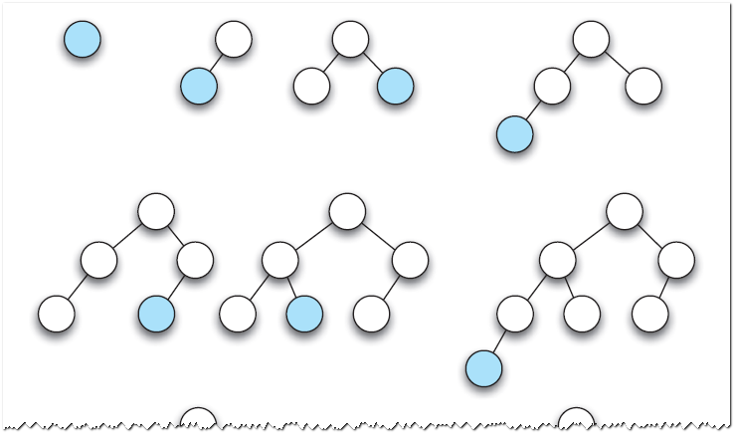
A Link-Based Implementation of Binary Tree (12/19)
Adding nodes to an initially empty tree.
Source: FIGURE 16-3 in [Carrano and Henry 2013].

Slide 21
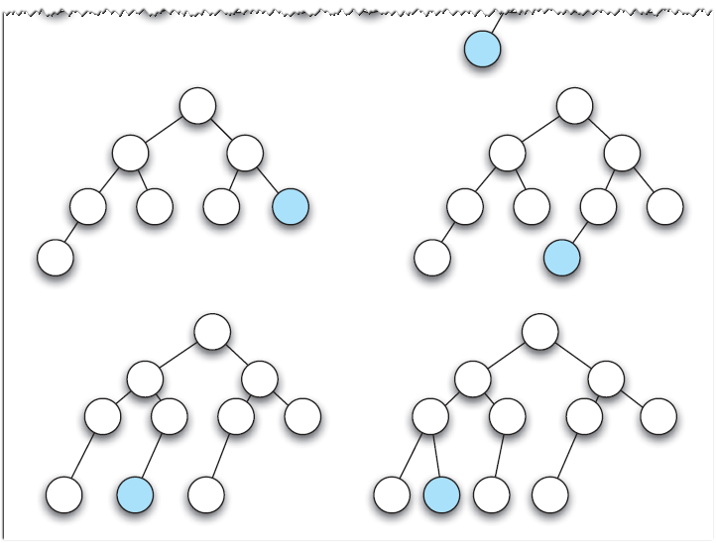
A Link-Based Implementation of Binary Tree (13/19)
Adding nodes to a tree.
Source: FIGURE 16-3 in [Carrano and Henry 2013].

Slide 22
A Link-Based Implementation of Binary Tree (14/19)
template<class ItemType>
BinaryNode<ItemType>* BinaryNodeTree<ItemType>::balancedAdd(
BinaryNode<ItemType>* subTreePtr,
BinaryNode<ItemType>* newNodePtr)
{
if (subTreePtr == nullptr)
return newNodePtr;
else {
BinaryNode<ItemType>* leftPtr = subTreePtr->getLeftChildPtr();
BinaryNode<ItemType>* rightPtr = subTreePtr->getRightChildPtr();
if (getHeightHelper(leftPtr) > getHeightHelper(rightPtr)) {
rightPtr = balancedAdd(rightPtr, newNodePtr);
subTreePtr->setRightChildPtr(rightPtr);
}
else {
leftPtr = balancedAdd(leftPtr, newNodePtr);
subTreePtr->setLeftChildPtr(leftPtr);
}
return subTreePtr;
}
}

Slide 23
A Link-Based Implementation of Binary Tree (15/19)
The traversals:
  The public traversal methods each calls a protected method that performs the actual recursive traversal.
function as a parameter
template<class ItemType>
void BinaryNodeTree<ItemType>::inorder(void visit(ItemType&),
BinaryNode<ItemType>* treePtr) const
{
if (treePtr != nullptr) {
inorder(visit, treePtr->getLeftChildPtr());
ItemType theItem = treePtr->getItem();
visit(theItem);
inorder(visit, treePtr->getRightChildPtr());
}
}
template<class ItemType>
void BinaryNodeTree<ItemType>::inorderTraverse(
void visit(ItemType&)) const
{
inorder(visit,rootPtr);
}

Slide 24
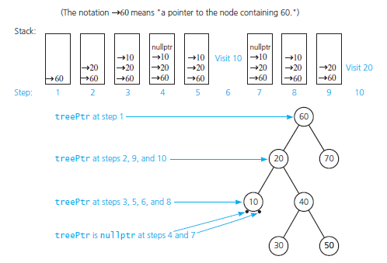
A Link-Based Implementation of Binary Tree (16/19)
Source: FIGURE 16-4 in [Carrano and Henry 2013].

Slide 25
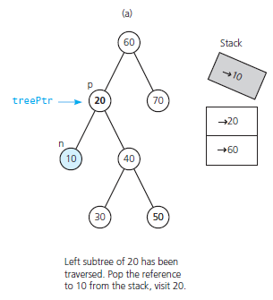
A Link-Based Implementation of Binary Tree (17/19)
Source: FIGURE 16-5 in [Carrano and Henry 2013].

Slide 26
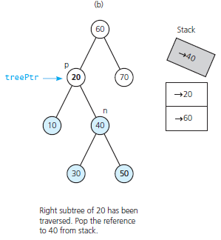
A Link-Based Implementation of Binary Tree (18/19)
Source: FIGURE 16-5 in [Carrano and Henry 2013].

Slide 27
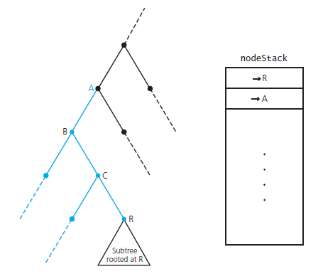
A Link-Based Implementation of Binary Tree (19/19)
Avoiding returns to nodes B and C.
Source: FIGURE 16-6 in [Carrano and Henry 2013].

Slide 28
A Link-Based Implementation of BST (1/23)
Since a binary search tree (BST) is a binary tree, its implementation can use the same node objects as for a binary-tree implementation.
  We will use the class BinaryNode.
  We assume that the data items in the binary search tree are unique.
The recursive search algorithm is the basis of the insertion, removal, and retrieval operations on a binary search tree.

Slide 29
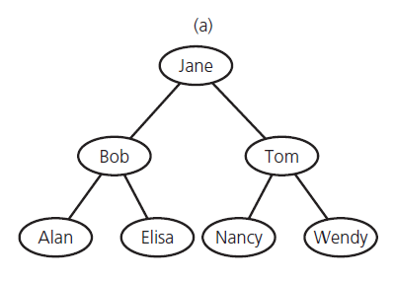
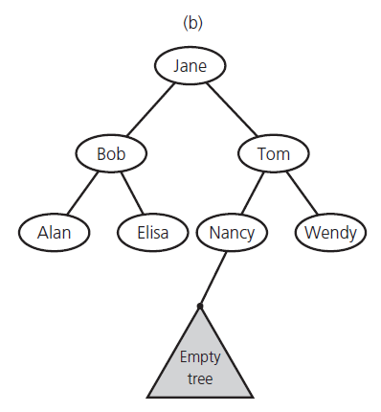
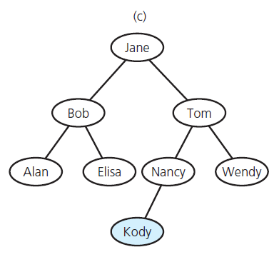
A Link-Based Implementation of BST (2/23)
Looking for Kody.
After Kody is inserted.
Source: FIGURE 16-7 in [Carrano and Henry 2013].

Slide 30
A Link-Based Implementation of BST (3/23)
Adding a new entry:
  You insert a new entry into a binary search tree in the same place that the search algorithm would look for it.
  Because searching for an entry that is not in the binary search tree always ends at an empty subtree … YOU ALWAYS INSERT A NEW ITEM AS A NEW LEAF!
  Adding a leaf requires only a change to the appropriate pointer of the parent.
template<class ItemType>
bool BinarySearchTree<ItemType>::add(const ItemType& newData)
{
BinaryNode<ItemType>* newNodePtr = new BinaryNode<ItemType>(newData);
rootPtr = insertInorder(rootPtr, newNodePtr);
return true;
} // end add

Slide 31
A Link-Based Implementation of BST (4/23)
// pseudocode of insertInorder
insertInorder(subTreePtr:: BinaryNodePointer,
newNodePtr: BinaryNodePointer): BinaryNodePointer
if (subTreePtr is nullptr)
return newNodePtr
else if (subTreePtr->getItem() > newNodePtr->getItem()) {
tempPtr = insertInorder(subTreePtr->getLeftChildPtr(), newNodePtr)
subTreePtr->setLeftChildPtr(tempPtr)
}
else {
tempPtr = insertInorder(subTreePtr->getRightChildPtr(),
newNodePtr)
subTreePtr->setRightChildPtr(tempPtr)
}
return subTreePtr

Slide 32
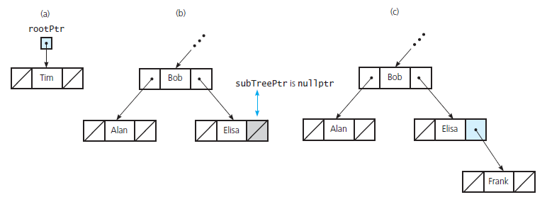
A Link-Based Implementation of BST (5/23)
Insertion into
an empty tree.
Searching for Frank.
Insertion of Frank as a leaf.
Source: FIGURE 16-8 in [Carrano and Henry 2013].

Slide 33
A Link-Based Implementation of BST (6/23)
Removing is more complicated than adding an entry.
  First, you use the search algorithm to locate the specified item.
    If it is found, you must remove it from the tree.
  Assuming that removeValue locates the target in a particular node N.

Slide 34
A Link-Based Implementation of BST (7/23)
removeValue(subTreePtr: BinaryNodePointer, target: ItemType,
success: boolean&): BinaryNodePointer
if (subTreePtr == nullptr) {
success = false
return nullptr
}
else if (subTreePtr->getItem() == target) {
subTreePtr = removeNode(subTreePtr)
success = true
return subTreePtr
}
else if (subTreePtr->getItem() > target) {
tempPtr = removeValue(subTreePtr->getLeftChildPtr(), target, success)
subTreePtr->setLeftChildPtr(tempPtr)
return subTreePtr
}
else {
tempPtr = removeValue(subTreePtr->getRightChildPtr(), target, success)
subTreePtr->setRightChildPtr(tempPtr)
return subTreePtr
}

Slide 35
A Link-Based Implementation of BST (8/23)
The essential task is to remove the target N from the tree (removeNode).
  There are three cases to consider:
    N is a leaf
    N has only one child
    N has two children
  Case 1 is the easiest. You need only set the pointer in its parent to nullptr.

Slide 36
A Link-Based Implementation of BST (9/23)
Case 2 is a bit more involved.
If N has only one child:
  N has only a left child
  N has only a right child
The two possibilities are symmetrical, so we illustrate the solution for a left child.

Slide 37
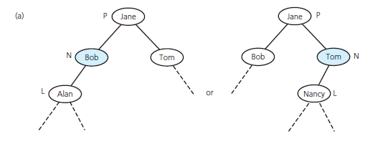
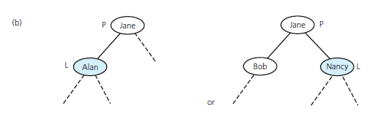
A Link-Based Implementation of BST (10/23)
Let L take the place of N as one of P’s children…
Does this adoption preserve the binary search tree property?
Source: FIGURE 16-9(a) in [Carrano and Henry 2013].
Source: FIGURE 16-9(b) in [Carrano and Henry 2013].
Yes, the binary search tree property is preserved!!

Slide 38
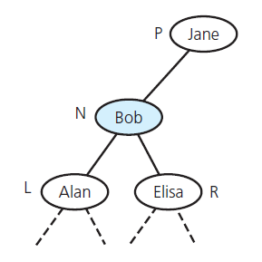
A Link-Based Implementation of BST (11/23)
Case 3 is the most difficult case.
N’s parent has room for only one N’s children as a replacement for N!!
Source: FIGURE 16-10 in [Carrano and Henry 2013].

Slide 39
A Link-Based Implementation of BST (12/23)
In fact, you can find another node that is easier to delete and delete it instead of N.
  This strategy may sound like cheating …
  But remember that the client expects only a certain entry to be removed from the ADT.
  It has no right, because of the WALL between the program and the ADT implementation, to expect a particular node in the tree to be deleted.

Slide 40
A Link-Based Implementation of BST (13/23)
Removing strategy:
  Locate another node M that is easier to remove from the tree than the node N.
  Copy the item that is in M to N, thus effectively removing from the tree the item originally in N.
  Remove the node M from the tree.
But … what kind of node M is easier to remove??

Slide 41
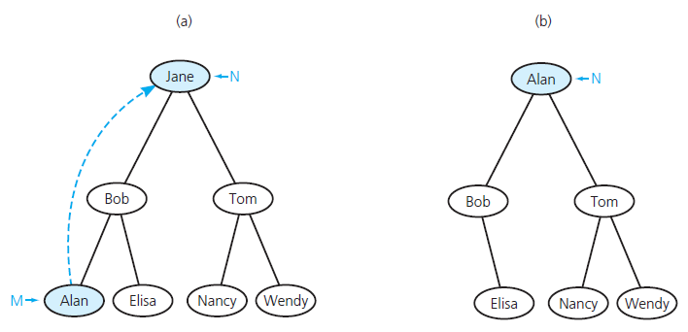
A Link-Based Implementation of BST (14/23)
M should have a single child or no children.
  After replacing N by M, you must also preserve the tree’s status as a binary search tree!!
Source: FIGURE 16-9(b) in [Carrano and Henry 2013].

Slide 42
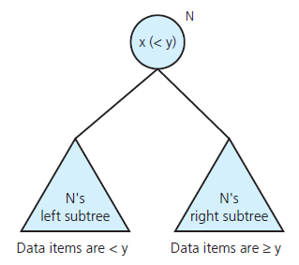
A Link-Based Implementation of BST (15/23)
Search key x can be
replaced by y.
Source: FIGURE 16-12 in [Carrano and Henry 2013].

Slide 43
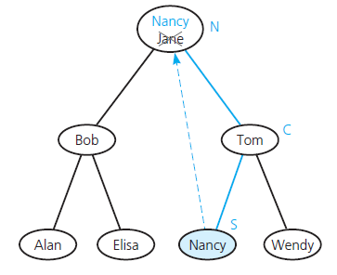
A Link-Based Implementation of BST (16/23)
There are two suitable possibilities for the replacement.
  You can copy into N the item that is immediately before/after N in the sorted order.
  Suppose that we decide to use the node y whose entry comes immediately after N’s entry x.
    This entry is called x’s inorder successor.
Source: FIGURE 16-13 in [Carrano and Henry 2013].

Slide 44
A Link-Based Implementation of BST (17/23)
How can you locate this node?
Because N has two children, the inorder successor is in the leftmost node of N’s right subtree.
  You follow N’s right-child pointer to its right child C (must be present).
  Then, you descend the tree rooted at C by taking left branches at each node … until you encounter a node S with no left child.
  Copy the item in S into N.
  REMOVE S!!
    Because S has no left child you can remove S from the tree as one of the two easy cases.

Slide 45
A Link-Based Implementation of BST (18/23)
Pseudocode of removeNode
removeNode(N: BinaryNode)
if (N is a leaf)
Remove N from the tree
else if (N has only one child C) {
if (N was a left child of its parent P)
Make C the left child of P
else
Make C the right child of P
}
else {
Find S, the node that contains N’s inorder successor
Copy the item from node S into node N
Remove S from the tree by using the previous technique
for a leaf or a node with one child
}

Slide 46
A Link-Based Implementation of BST (19/23)
// Remove node N, pointed to by nodePtr
removeNode(nodePtr: BinaryNodePointer): BinaryNodePointer
if (N is a leaf) {
delete nodePtr
nodePtr = nullptr
return nodePtr
}
else if (N has only one child C) {
if (C is the left child)
nodeToConnectPtr = nodePtr->getLeftChildPtr()
else
nodeToConnectPtr = nodePtr->getRightChildPtr()
delete nodePtr
nodePtr = nullptr
return nodeToConnectPtr
}
Erratum!!

Slide 47
A Link-Based Implementation of BST (20/23)
else {
tempPtr = removeLeftmostNode(nodePtr->getRightChildPtr(),
newNodeValue)
nodePtr->setRightChildPtr(tempPtr)
nodePtr->setItem(newNodeValue)
return nodePtr
}

Slide 48
A Link-Based Implementation of BST (21/23)
// Removes the leftmost node in the subtree pointed to by nodePtr
// Sets inorderSuccessor to the value in that node
// Returns a pointer to the revised subtree
removeLeftmostNode(nodePtr: BinaryNodePointer,
inorderSuccessor: ItemType&): BinaryNodePointer
if (nodePtr->getLeftChildPtr() == nullptr) {
inorderSuccessor = nodePtr->getItem()
return removeNode(nodePtr)
}
else {
tempPtr = removeLeftmostNode(nodePtr->getLeftChildPtr(),
inorderSuccesssor)
nodePtr->setLeftChildPtr(tempPtr)
return nodePtr
}
Erratum!!

Slide 49
A Link-Based Implementation of BST (22/23)
The public method remove:
remove(target: ItemType): boolean
success = false
rootPtr = removeValue(rootPtr, target, success)
return success

Slide 50
A Link-Based Implementation of BST (23/23)
Retrieving an entry – getEntry:
  Call findNode to recursively checks whether the desired target is in a binary search tree.
  It checks the return value, and returns the desired target or throws an exception
findNode(subTreePtr: BinaryNodePointer, target: itemType):
BinaryNodePointer
if (subTreePtr == nullPtr)
return nullptr
else if (subTreePtr->getItem() == target)
return subTreePtr;
else if (subTreePtr->getItem() > target)
return findNode(subTreePtr->getLeftChildPtr(), target)
else
return findNode(subTreePtr->getRightChildPtr(), target)

Slide 51
Saving a BST in a File (1/7)
Saving a binary search tree and then restoring it to its original shape:
  Uses preorder traversal to save the tree to a file.
60
60
20
70
20
70
restore
(using add)
10
40
save
10
40
30
50
30
50
Preorder:
60
20
10
40
30
50
70
Source: adapted from FIGURE 16-15 in [Carrano and Henry 2013].

Slide 52
Saving a BST in a File (2/7)
Saving a binary search tree and then restoring it to a balanced shape:
  Uses inorder traversal to save the tree to a file.
    To make the data sorted.
  To restore, need the number of nodes in the tree.
    Can determine the middle item and, in turn, the number of nodes in the left and right subtrees of the tree’s root.

Slide 53
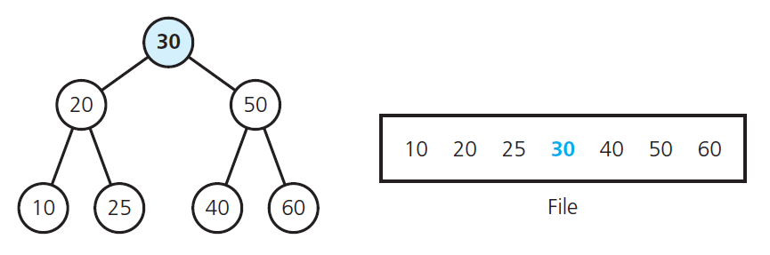
Saving a BST in a File (3/7)
A full tree saved in a file by using inorder traversal.
Source: FIGURE 16-16 in [Carrano and Henry 2013].

Slide 54
Saving a BST in a File (4/7)
Restoring a full binary search tree with n nodes:
readFullTree(treePtr: BinaryNodePointer, n: integer): BinaryNodePointer
if (n > 0) {
treePtr = pointer to new node with nullptr as its child pointers
// Construct the left subtree
leftPtr = readFullTree(treePtr->getLeftChildPtr(), n / 2)
treePtr->setLeftChildPtr(leftPtr)
// Get the root
rootItem = next item from file
treePtr->setItem(rootItem)
// Construct the right subtree
rightPtr = readFullTree(treePtr->getRightChildPtr(), n / 2)
treePtr->setRightChildPtr(rightPtr)
return treePtr
}
else
return nullptr
Erratum!!

Slide 55
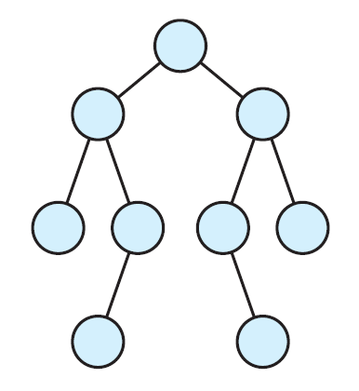
Saving a BST in a File (5/7)
If the tree to be restored is not full:
  The first thing that comes into mind is that the resorted tree should be complete.
  But … you care only about minimizing the height of the restored tree. It does not matter where the nodes on the last level go.
Source: FIGURE 16-17 in [Carrano and Henry 2013].

Slide 56
Saving a BST in a File (6/7)
The method readFullTree is correct even if the tree is not full.
However, you have to be a bit careful when computing the sizes of the left and right subtrees of the tree’s root.
  If n is odd, both subtrees are of size n/2.
  If n is even, you have to deal with the fact that one subtree will have one more node than the other.
  In this case, we put the extra node in the left subtree.

Slide 57
Saving a BST in a File (7/7)
readTree(treePtr: BinaryNodePointer, n: integer): BinaryNodePointer
if (n > 0) {
treePtr = pointer to new node with nullptr as its child
pointers
// Construct the left subtree
leftPtr = readTree(treePtr->getLeftChildPtr(), n / 2)
treePtr->setLeftChildPtr(leftPtr)
// Get the root
rootItem = next item from file
treePtr->setItem(rootItem)
// Construct the right subtree
rightPtr = readTree(treePtr->getRightChildPtr(), (n - 1) / 2)
treePtr->setRightChildPtr(rightPtr)
return treePtr
}
else
return nullptr
Erratum!!

Slide 58
Tree Sort (1/2)
Tree Sort
  Uses the ADT binary search tree to sort an array of integers into ascending order.
treeSort(anArray: array, n: integer)
Insert anArray’s entries into a binary search tree bst
Traverse bst in inorder. As you visit bst’s
nodes, copy their data items into successive
locations of anArray

Slide 59
Tree Sort (2/2)
Analysis:
  Insertion:
    Each insertion into a binary search tree requires O(logn) operations in the average case.
    And O(n) operations in the worst case.
    Thus, n-node insertions require O(n log n) operations in the average case, and O(n²) operations in the worst case.
  The inorder traversal:
    O(n) in all cases.
  Sum up:
    Average case: O(n log n)
    Worst case: O(n²)

Slide 60
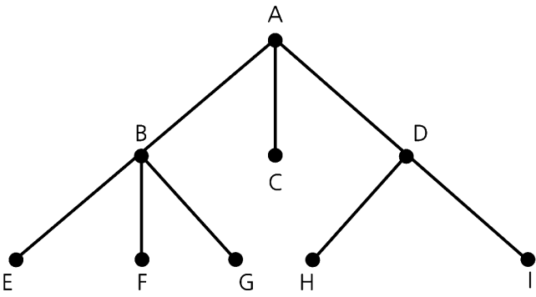
General Trees (1/3)
Each node can have an arbitrary number of children.
Source: FIGURE 16-18 in [Carrano and Henry 2013].

Slide 61
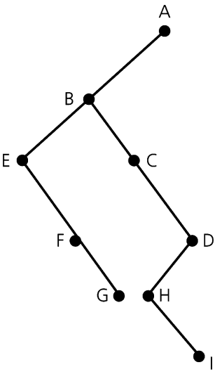
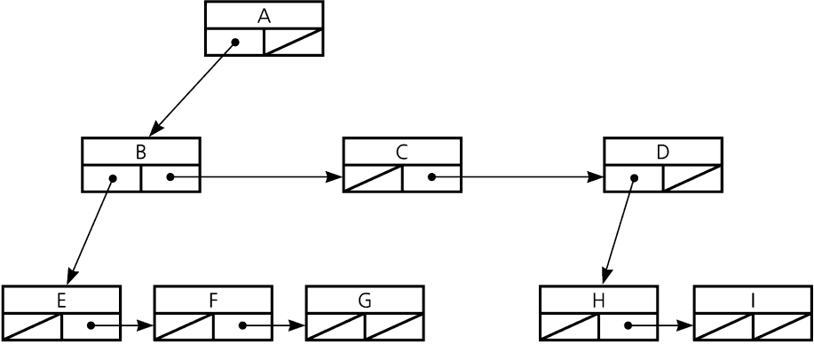
General Trees (2/3)
A binary tree can represent a general tree.
  Each node has two pointers:
    The left pointer points to the node’s oldest (first) child.
    The right pointer points to the node’s next sibling.
Source: FIGURE 16-19 in [Carrano and Henry 2013].

Slide 62
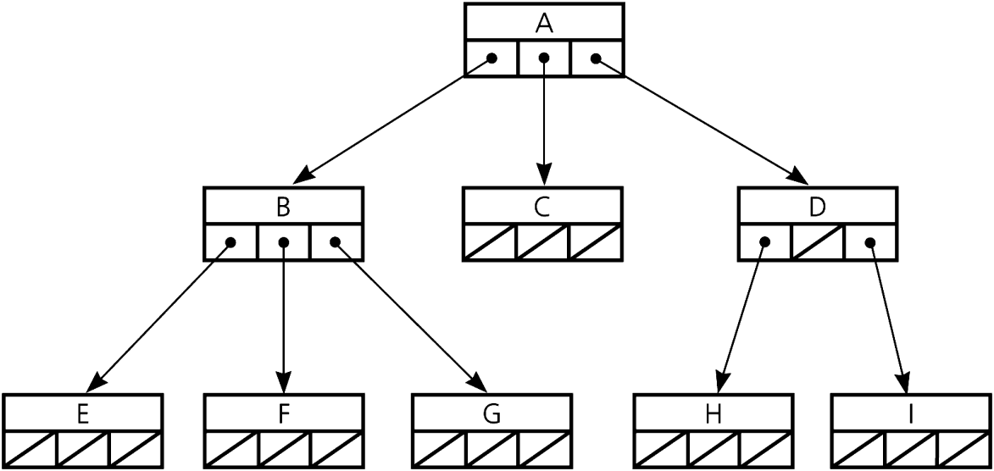
General Trees (3/3)
An n-ary tree is a general tree whose nodes can have no more than n children each.
In implementation, each node points directly to its children.
Source: FIGURE 16-20 in [Carrano and Henry 2013].

