Slide 1
Hashing
Yih-Kuen Tsay
Dept. of Information Management
National Taiwan University
Based on [Carrano and Henry 2013]

Slide 2
Outline
The basic idea
Resolving collisions
Efficiency of hashing
Hashing for the ADT Dictionary

Slide 3
The Basic Idea (1/4)
Binary search tree retrieval is O(log n) at best.
For more stringent timing requirements, we weed a different strategy to locate an item.
Consider a magic box called an “address calculator”
  Place/retrieve the item from that address in an array
  Ideally, map to a unique number for each key
Note: direct improvements on binary search trees will be covered in a separate lecture.

Slide 4
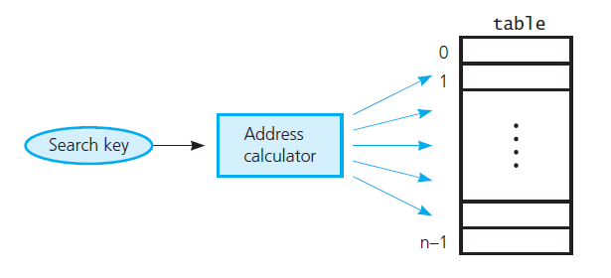
The Basic Idea (2/4)
Address calculator
Source: FIGURE 18-9 in [Carrano and Henry 2013].

Slide 5
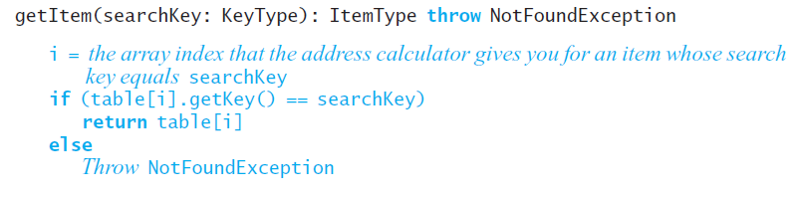
The Basic Idea (3/4)
Pseudocode for getItem

Slide 6
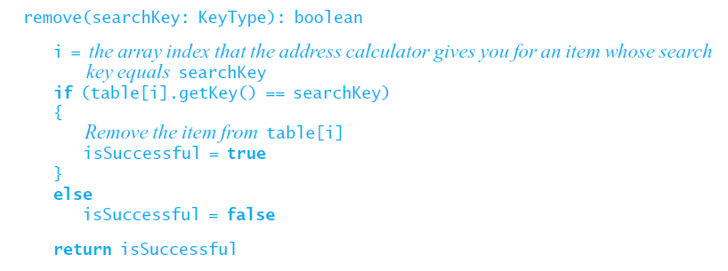
The Basic Idea (4/4)
Pseudocode for remove

Slide 7
Hash Functions
May assume that hash functions operate on integers, since any string of characters can be converted into an integer.
Possible algorithms:
  Selecting digits
  Folding (adding the digits in some way)
  Modulo arithmetic
  Converting a character string into an integer
    Use ASCII values
    Factor the results, Horner’s rule

Slide 8
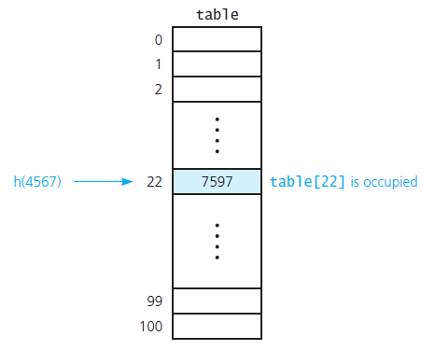
Resolving Collisions (1/7)
A collision
Source: FIGURE 18-10 in [Carrano and Henry 2013].

Slide 9
Resolving Collisions (2/7)
Approach 1: Open addressing
  Probe for another available location
  Can be done linearly or quadratically
  Removal requires specify state of an item
    Occupied, emptied, removed
  Clustering is a problem
  Double hashing can reduce clustering

Slide 10
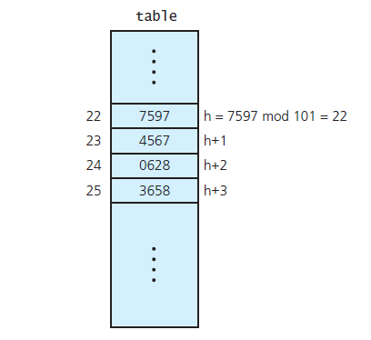
Resolving Collisions (3/7)
Linear probing with h ( x ) = x mod 101
Source: FIGURE 18-11 in [Carrano and Henry 2013].

Slide 11
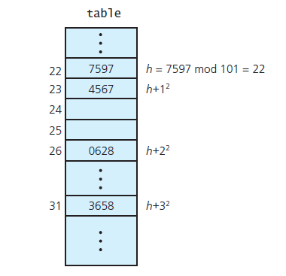
Resolving Collisions (4/7)
Quadratic probing with h ( x ) = x mod 101
Source: FIGURE 18-12 in [Carrano and Henry 2013].

Slide 12
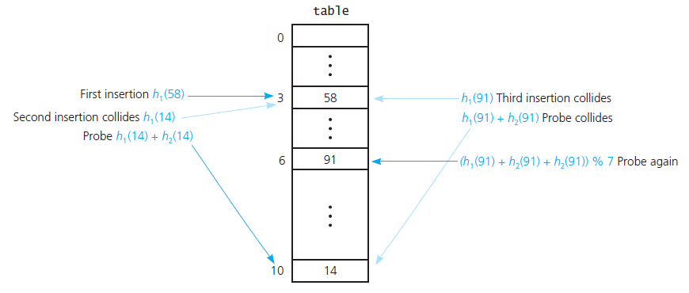
Resolving Collisions (5/7)
should be % 11
Double hashing during the insertion of 58, 14, and 91
h₁(key) = key mod 11; h₂(key) = 7 – (key mod 7)
Source: FIGURE 18-13 in [Carrano and Henry 2013].

Slide 13
Resolving Collisions (6/7)
Approach 2: Restructuring the hash table
  Each hash location can accommodate more than one item
  Each location is a “bucket” or an array itself
  Alternatively, design the hash table as an array of linked chains – called “separate chaining”

Slide 14
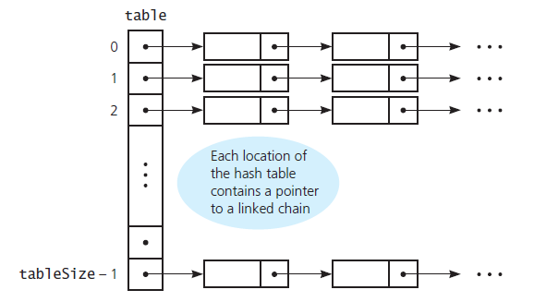
Resolving Collisions (7/7)
Separate chaining
Source: FIGURE 18-14 in [Carrano and Henry 2013].

Slide 15
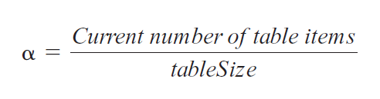
The Efficiency of Hashing (1/6)
Efficiency of hashing involves the load factor alpha (α)
As α increases, search times increase and hashing efficiency decreases.

Slide 16
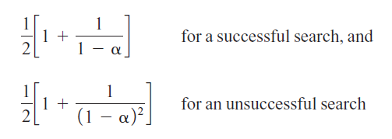
The Efficiency of Hashing (2/6)
Linear probing: average number of comparisons for a given α
Note: these are approximations!

Slide 17
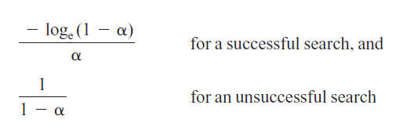
The Efficiency of Hashing (3/6)
Quadratic probing and double hashing: average number of comparisons for a given α
Note: these are approximations!

Slide 18
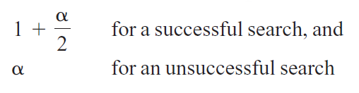
The Efficiency of Hashing (4/6)
For separate chaining, α also equals the average length of each linked chain.
Average number of comparisons for a given α
Note: these are approximations!

Slide 19
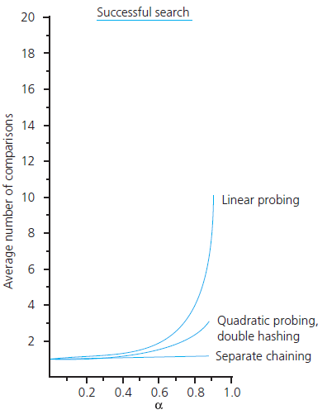
The Efficiency of Hashing (5/6)
The relative efficiency of four
collision-resolution methods
Source: FIGURE 18-15 in
[Carrano and Henry 2013].

Slide 20
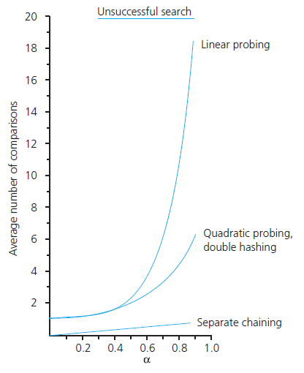
The Efficiency of Hashing (6/6)
The relative efficiency of four
collision-resolution methods
Source: FIGURE 18-15 in
[Carrano and Henry 2013].

Slide 21
Maintaining Hashing Performance
Collisions and their resolution typically cause the load factor α to increase
To maintain efficiency, restrict the size of α
  α ≤ 0.5 for open addressing
  α ≤ 1.0 for separate chaining
If the load factor exceeds these limits
  Increase the size of the hash table, and
  Rehash with a new hashing function

Slide 22
What Constitutes a Good Hash Function?
Easy and fast to compute?
Scatter data evenly throughout the hash table?
How well does it scatter random data?
How well does it scatter non-random data?
Note: traversal in sorted order is inefficient when using hashing

Slide 23
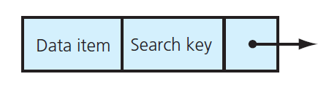
Hashing and Separate Chaining (1/8)
A dictionary entry when separate chaining is used
Source: FIGURE 18-16 in [Carrano and Henry 2013].

Slide 24
Hashing and Separate Chaining (2/8)
/** A class of entry objects for a hashing implementation of
the ADT dictionary.
@file HashedEntry.h */
#ifndef _HASHED_ENTRY
#define _HASHED_ENTRY
#include "Entry.h“
template<class KeyType, class ItemType>
class HashedEntry: public Entry<KeyType, ItemType>
{
private:
HashedEntry<KeyType, ItemType>* nextPtr;

Slide 25
Hashing and Separate Chaining (3/8)
public:
HashedEntry();
HashedEntry(ItemType newEntry, KeyType searchKey);
HashedEntry(ItemType newEntry, KeyType searchKey,
HashedEntry<KeyType, ItemType>* nextEntryPtr);
void setNext(HashedEntry<KeyType, ItemType>* nextEntryPtr);
HashedEntry<KeyType, ItemType>* getNext() const;
}; // end HashedEntry
#include "HashedEntry.cpp"
#endif

Slide 26
Hashing and Separate Chaining (4/8)
template<class KeyType, class ItemType>
bool HashedDictionary<KeyType, ItemType>::add(const
ItemType& newItem, const KeyType& searchKey)
{
// Create entry to add to dictionary
HashedEntry<KeyType, ItemType>* entryToAddPtr =
new HashedEntry<KeyType, ItemType>(newItem, searchKey);
// Compute the hashed index into the array
int itemHashIndex = getHashIndex(searchKey);

Slide 27
Hashing and Separate Chaining (5/8)
// Add the entry to the chain at itemHashIndex
if (hashTable[itemHashIndex] == nullptr) {
hashTable[itemHashIndex] = entryToAddPtr;
}
else {
entryToAddPtr->setNext (hashTable[itemHashIndex]);
hashTable[itemHashIndex] = entryToAddPtr;
} // end if
return true;
} // end add

Slide 28
Hashing and Separate Chaining (6/8)
template<class KeyType, class ItemType>
bool HashedDictionary<KeyType, ItemType>::remove(const
KeyType& searchKey)
{
bool itemFound = false;
// Compute the hashed index into the array
int itemHashIndex = getHashIndex(searchKey);

Slide 29
Hashing and Separate Chaining (7/8)
if (hashTable[itemHashIndex] != nullptr) {
// Special case - first node has target
if (searchKey == hashTable[itemHashIndex]->getKey()) {
HashedEntry<KeyType, ItemType>* entryToRemovePtr =
hashTable[itemHashIndex];
hashTable[itemHashIndex] =
hashTable[itemHashIndex]->getNext();
delete entryToRemovePtr;
entryToRemovePtr = nullptr; // For safety
itemFound = true;
}
else { // Search the rest of the chain
HashedEntry<KeyType, ItemType>* prevPtr =
hashTable[itemHashIndex];
HashedEntry<KeyType, ItemType>* curPtr =
prevPtr->getNext();

Slide 30
Hashing and Separate Chaining (8/8)
while ((curPtr != nullptr) && !itemFound) {
// Found item in chain so remove that node
if (searchKey == curPtr->getKey()) {
prevPtr->setNext(curPtr->getNext());
delete curPtr;
curPtr = nullptr; // For safety
itemFound = true;
}
else { // Look at next entry in chain
prevPtr = curPtr;
curPtr = curPtr->getNext();
} // end if
} // end while
} // end if (a match occurs on the first node or not …)
} // end if (the case of “a chain exists to search”)
return itemFound;
} // end remove

