Slide 1
Balanced Search Trees
Yih-Kuen Tsay
Dept. of Information Management
National Taiwan University
Based on [Carrano and Henry 2013]

Slide 2
Introduction (1/2)
The performance of a search tree is closely related to the height of the tree.
The height of a search tree is affected by insertions and removals.
Possible range of the height of a binary tree:
  Minimum: log₂ (n + 1)
  Maximum: n
Various search trees can retain balance despite insertions and removals:
  2-3 trees, 2-3-4 trees, red-black trees, AVL trees, etc.

Slide 3
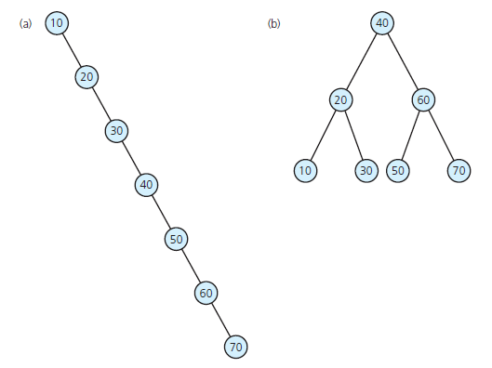
Introduction (2/2)
A binary search tree of maximum height; (b) a binary search tree of minimum height
Source: FIGURE 19-1 in [Carrano and Henry 2013].

Slide 4
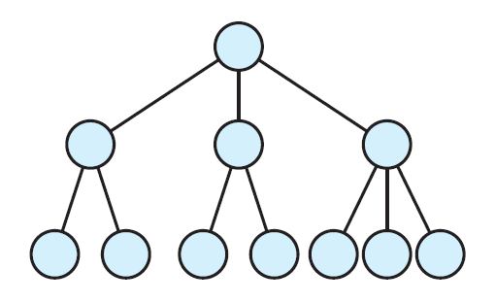
2-3 Trees (1/6)
A 2-3 tree is a (search) tree in which
  each internal node has either 2 or 3 children and
  all leaves are at the same level.
2-node
3-node
A 2-3 tree of height 3
Source: FIGURE 19-2 in [Carrano and Henry 2013].

Slide 5
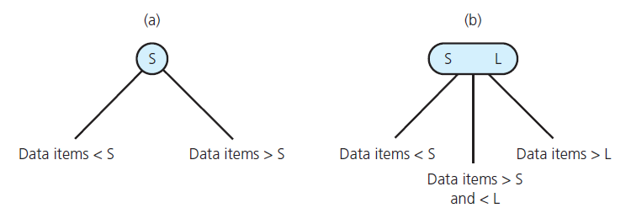
2-3 Trees (2/6)
Rules for placing data items in a 2-3 tree
The rules imply that a node may contain either one or two data items.
Source: FIGURE 19-3 in [Carrano and Henry 2013].

Slide 6
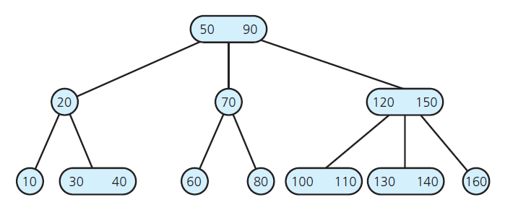
2-3 Trees (3/6)
A 2-3 tree
Source: FIGURE 19-4 in [Carrano and Henry 2013].

Slide 7
2-3 Trees (4/6)
/** A class of nodes for a link-based 2-3 tree.
@file TriNode.h */
#ifndef _TRI_NODE
#define _TRI_NODE
template<class ItemType>
class TriNode
{
private:
ItemType smallItem, largeItem; // Data portion
TriNode<ItemType> *leftChildPtr; // Left-child pointer
TriNode<ItemType> *midChildPtr; // Middle-child pointer
TriNode<ItemType> *rightChildPtr; // Right-child pointer
public:
TriNode();
TriNode(const ItemType& anItem);
TriNode(const ItemType& anItem, TriNode<ItemType>* leftPtr,
TriNode<ItemType>* midPtr, TriNode<ItemType>* rightPtr);

Slide 8
2-3 Trees (5/6)
bool isLeaf() const;
bool isTwoNode() const;
bool isThreeNode() const;
ItemType getSmallItem() const;
ItemType getLargeItem() const;
void setSmallItem(const ItemType& anItem);
void setLargeItem(const ItemType& anItem);
TriNode<ItemType>* getLeftChildPtr() const;
TriNode<ItemType>* getMidChildPtr() const;
TriNode<ItemType>* getRightChildPtr() const;
void setLeftChildPtr(TriNode<ItemType>* leftPtr);
void setMidChildPtr(TriNode<ItemType>* midPtr);
void setRightChildPtr(TriNode<ItemType>* rightPtr);
}; // end TriNode
#include "TriNode.cpp"
#endif

Slide 9
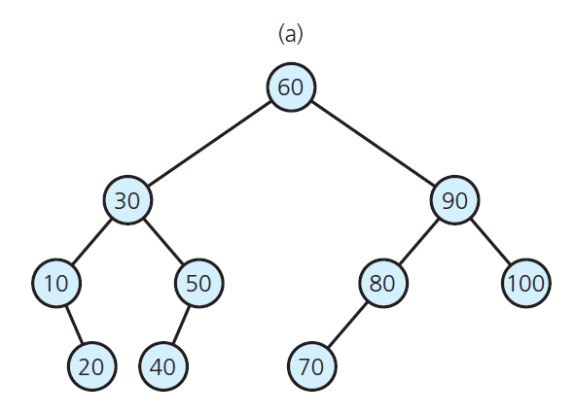
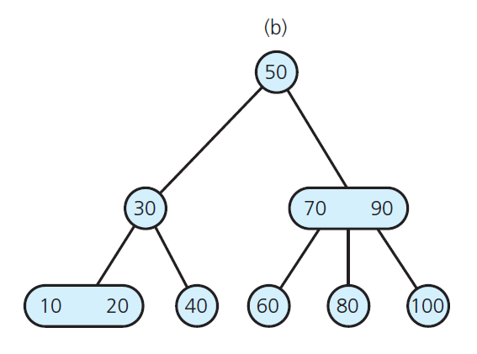
2-3 Trees (6/6)
A balanced binary search tree and a 2-3 tree with the same entries
Source: FIGURE 19-5 in [Carrano and Henry 2013].

Slide 10
2-3 Trees: Search (1/4)
The height of a 2-3 tree is at most log₂ (n + 1).
Searching a 2-3 tree visits few nodes than a binary search tree (in the worst case).
However, visiting a node of a 2-3 tree requires more comparisons than a node of a binary tree.

Slide 11
2-3 Trees: Search (2/4)
// Traverses a nonempty 2-3 tree in sorted order
inorder(23Tree: TwoThreeTree): void
Let r be the root node of 23Tree
if (r is a leaf)
Visit the data item(s)
else if (r has two data items) {
inorder(left subtree of r)
Visit the first data item
inorder(middle subtree of r)
Visit the second data item
inorder(right subtree of r)
}
else {
// r has one data item
inorder(left subtree of r)
Visit the data item
inorder(right subtree of r)
}

Slide 12
2-3 Trees: Search (3/4)
// Locates the value target in a nonempty 2-3 tree.
// Returns the located entry, or throws an exception.
findItem(23Tree: TwoThreeTree, target: ItemType): ItemType
Let r be the root node of 23Tree
if (target is in r) {
treeItem = the data portion of r
return treeItem // Success
}
else if (r is a leaf)
throw NotFoundException // Failure

Slide 13
2-3 Trees: Search (4/4)
else if (r has two data items) {
if (target < smaller item in r)
return findItem(left subtree of r, target)
else if (target < larger item in r)
return findItem(middle subtree of r, target)
else
return findItem(right subtree of r, target)
}
else {
// r has one data item
if (target < data item in r)
return findItem(left subtree of r, target)
else
return findItem(right subtree of r, target)
}

Slide 14
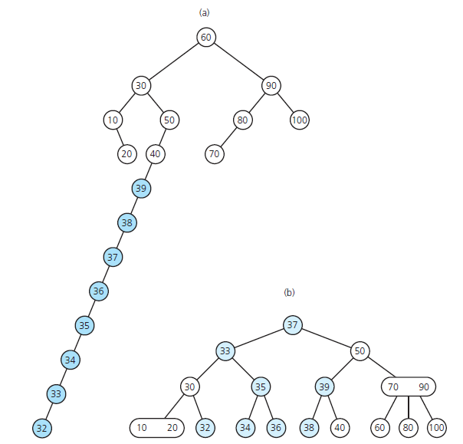
2-3 Trees: Insertion (1/11)
original
After inserting 39, 38,
37, …, 33, 32 to 19-5(a)
(b) After inserting 39, 38,
37, …, 33, 32 to 19-5(b)
original
Source: FIGURE 19-6 in
[Carrano and Henry 2013].

Slide 15
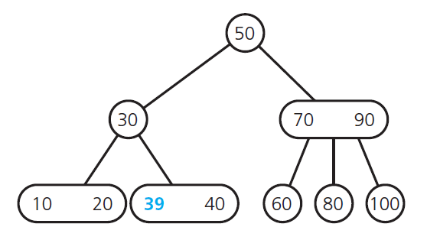
2-3 Trees: Insertion (2/11)
After inserting 39 into the tree in Figure 19-5(b)
Source: FIGURE 19-7 in [Carrano and Henry 2013].

Slide 16
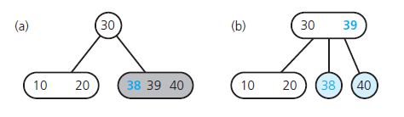
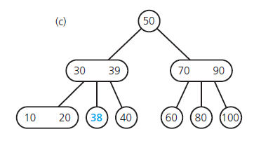
2-3 Trees: Insertion (3/11)
Inserting 38 into the tree in Figure 19-7
Source: FIGURE 19-8 in [Carrano and Henry 2013].

Slide 17
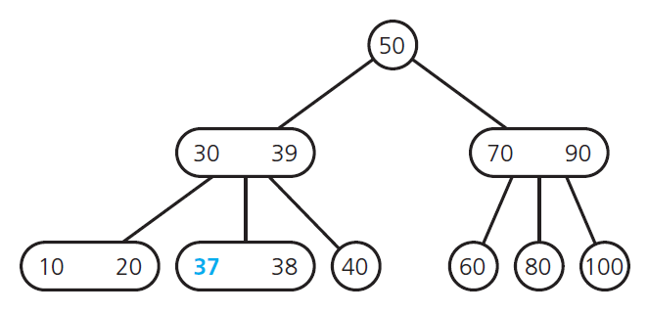
2-3 Trees: Insertion (4/11)
After inserting 37 into the tree in Figure 19-8(c)
Source: FIGURE 19-9 in [Carrano and Henry 2013].

Slide 18
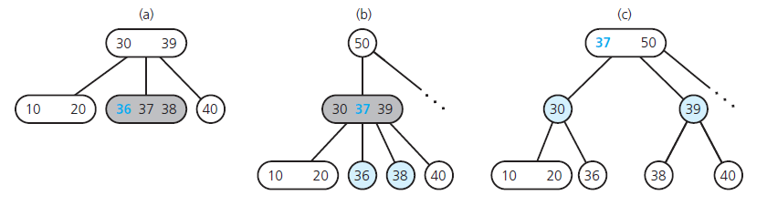
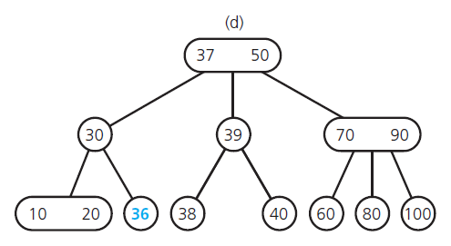
2-3 Trees: Insertion (5/11)
Inserting 36 into the tree in Figure 19-7
Source: FIGURE 19-10 in [Carrano and Henry 2013].

Slide 19
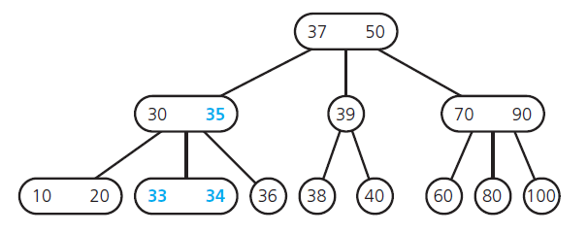
2-3 Trees: Insertion (6/11)
After inserting 35, 34, 33 into the tree in Figure 19-8(c)
Source: FIGURE 19-11 in [Carrano and Henry 2013].

Slide 20
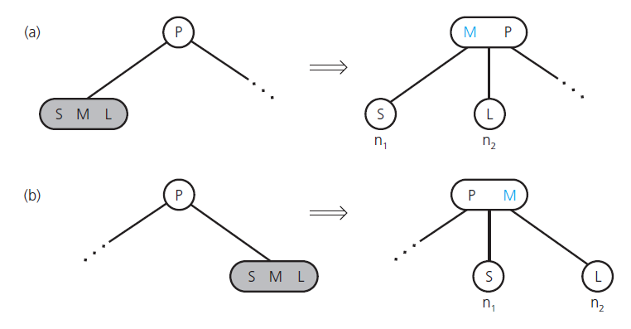
2-3 Trees: Insertion (7/11)
Splitting a leaf in a 2-3 tree
Source: FIGURE 19-12 in [Carrano and Henry 2013].

Slide 21
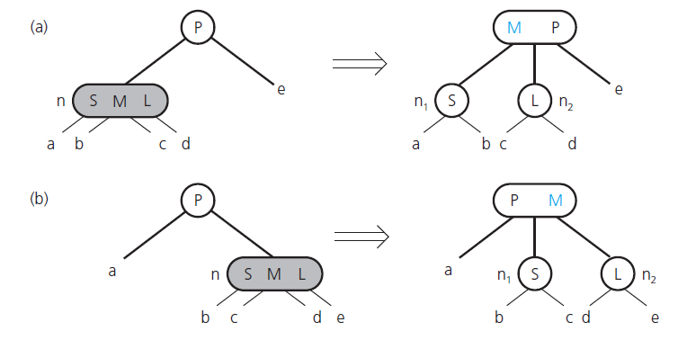
2-3 Trees: Insertion (8/11)
Splitting an internal node in a 2-3 tree
Source: FIGURE 19-13 in [Carrano and Henry 2013].

Slide 22
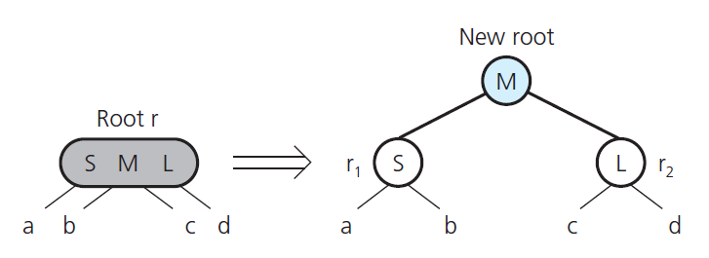
2-3 Trees: Insertion (9/11)
Splitting the root in a 2-3 tree
Source: FIGURE 19-14 in [Carrano and Henry 2013].

Slide 23
2-3 Trees: Insertion (10/11)
// Inserts a new item into a 2-3 tree whose items are
// distinct and differ from the new item.
insertItem(23Tree: TwoThreeTree, newItem: ItemType)
Locate the leaf, leafNode, in which newItem belongs
Add newItem to leafNode
if (leafNode has three items)
split(leafNode)

Slide 24
2-3 Trees: Insertion (11/11)
// Splits node n, which contains three items.
// Note: If n is not a leaf, it has four children.
split(n: TwoThreeNode)
if (n is the root)
Create a new node p
else
Let p be the parent of n
Replace n by two nodes, n1 and n2, with p as their parent
Give n1 the item in n with the smallest value
Give n2 the item in n with the largest value
if (n is not a leaf) {
n1 becomes the parent of n’s two leftmost children
n2 becomes the parent of n’s two rightmost children
}
Move the item in n that has the middle value up to p
if (p now has three items)
split(p)

Slide 25
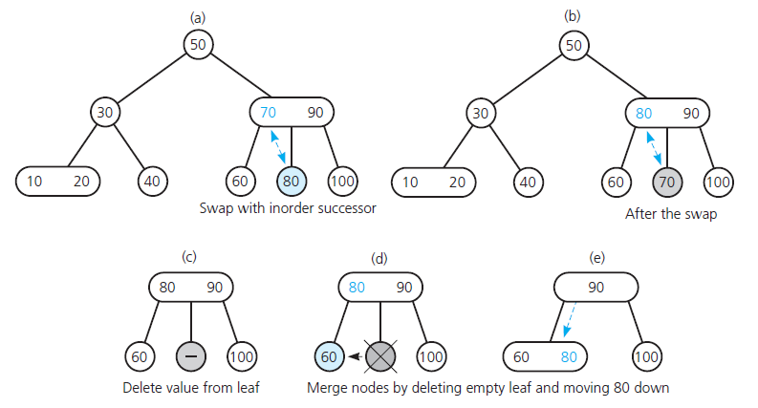
2-3 Trees: Deletion (1/11)
Removing 70 from the tree in Figure 19.5(b)
Source: FIGURE 19-17 in [Carrano and Henry 2013].

Slide 26
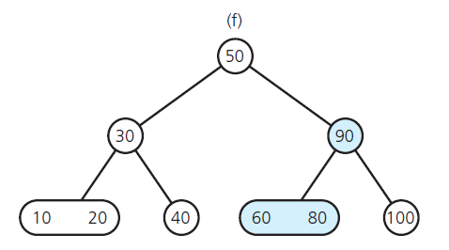
2-3 Trees: Deletion (2/11)
After removing 70 from the tree in Figure 19.5(b)
Source: FIGURE 19-15 in [Carrano and Henry 2013].

Slide 27
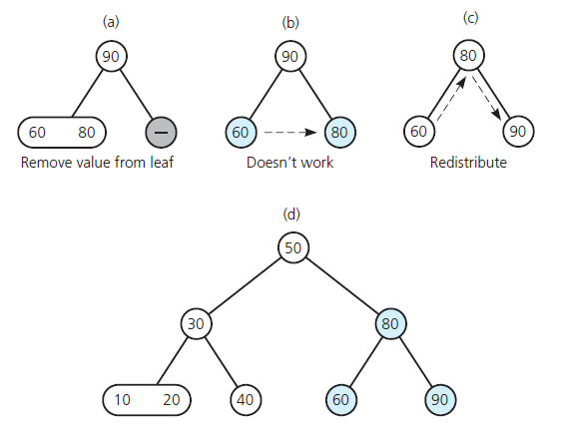
2-3 Trees: Deletion (3/11)
Removing 100 from the tree in Figure 19.15(f)
Source: FIGURE 19-16 in [Carrano and Henry 2013].

Slide 28
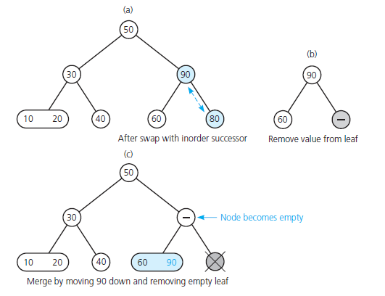
2-3 Trees: Deletion (4/11)
Removing 80 from the tree in Figure 19.16(d)
Source: FIGURE 19-17 in [Carrano and Henry 2013].

Slide 29
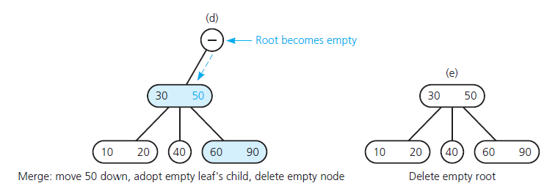
2-3 Trees: Deletion (5/11)
Removing 80 from the tree in Figure 19.16(d)
Source: FIGURE 19-17 in [Carrano and Henry 2013].

Slide 30
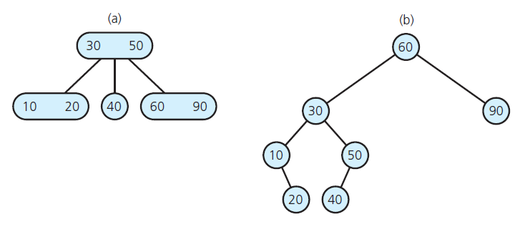
2-3 Trees: Deletion (6/11)
Results of removing 70, 100, 80 from Figure 15
Source: FIGURE 19-18 in [Carrano and Henry 2013].

Slide 31
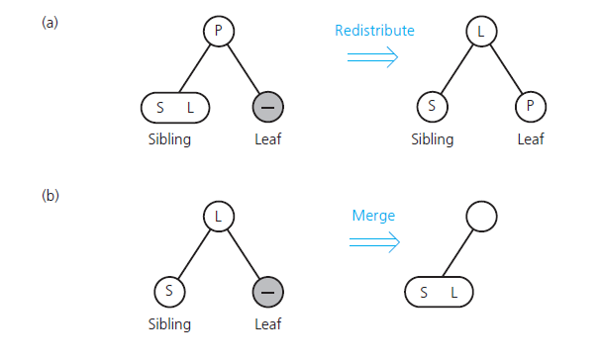
2-3 Trees: Deletion (7/11)
Redistributing values and merging a leaf
Source: FIGURE 19-19 in [Carrano and Henry 2013].

Slide 32
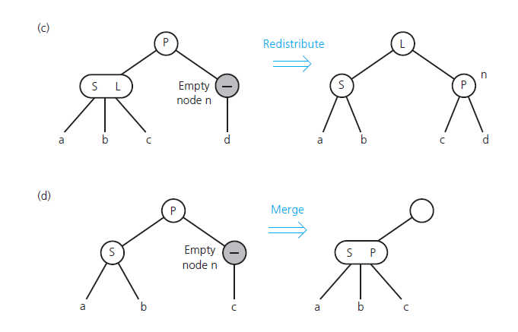
2-3 Trees: Deletion (8/11)
Redistributing values and children and merging internal nodes
Source: FIGURE 19-19 in [Carrano and Henry 2013].

Slide 33
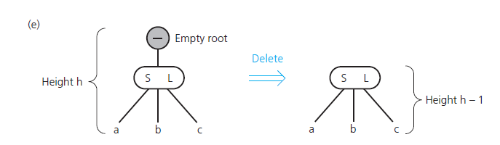
2-3 Trees: Deletion (9/11)
Deleting the root
Source: FIGURE 19-19 in [Carrano and Henry 2013].

Slide 34
2-3 Trees: Deletion (10/11)
// Removes the given data item from a 2-3 tree.
// Returns true if successful, and false otherwise.
removeItem(23Tree: TwoThreeTree, dataItem: ItemType): boolean
Attempt to locate dataItem
if (dataItem is found) {
if (dataItem is not in a leaf)
Swap dataItem with its inorder successor, which
is determined to be in leafNode
// The removal always begins at a leaf
Remove dataItem from leafNode
if (leafNode now has no items)
fixTree(leafNode)
return true
}
else
return false

Slide 35
2-3 Trees: Deletion (11/11)
// Completes the removal when node n is empty by either
// deleting the root, redistributing values, or merging nodes.
// Note: If n is internal, it has one child.
fixTree(n: TwoThreeNode)
if (n is the root)
Delete the root
else {
Let p be the parent of n
if (some sibling of n has two items) {
Distribute items among n, the sibling, and p
if (n is internal)
Move the appropriate child from the sibling to n
}
else { // Merge the node
Choose an adjacent sibling s of n
Bring the appropriate item down from p into s
if (n is internal) Move n’s child to s
Remove node n
if (p is now empty) fixTree(p)
}
}

Slide 36
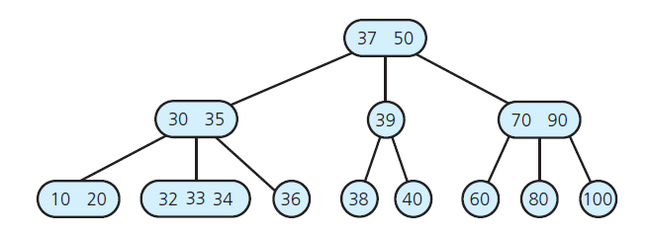
2-3-4 Trees (1/2)
A 2-3-4 tree
Source: FIGURE 19-20 in [Carrano and Henry 2013].

Slide 37
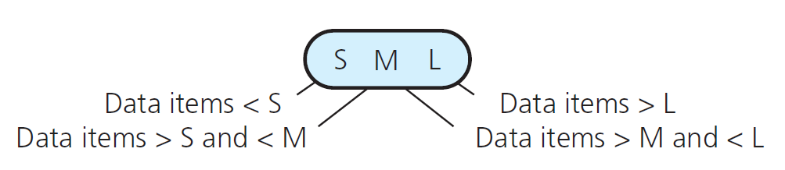
2-3-4 Trees (2/2)
A 4-node in a 2-3-4 tree
Source: FIGURE 19-21 in [Carrano and Henry 2013].

Slide 38
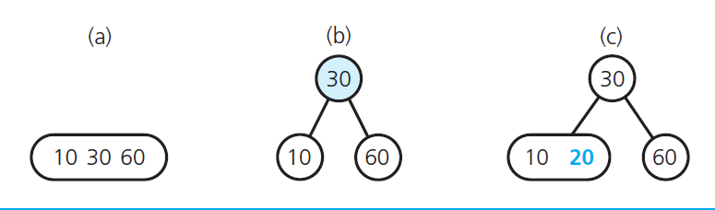
2-3-4 Trees: Insertion (1/11)
Inserting 20 into a one-node 2-3-4 tree
the original tree;
after splitting the node;
after inserting 20
Source: FIGURE 19-22 in [Carrano and Henry 2013].

Slide 39
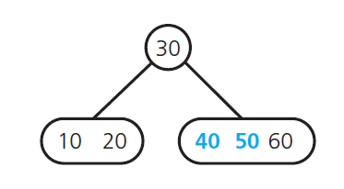
2-3-4 Trees: Insertion (2/11)
After inserting 50, 40 into the tree in Figure 19-22(c)
Source: FIGURE 19-23 in [Carrano and Henry 2013].

Slide 40
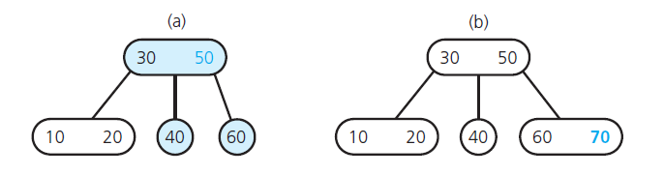
2-3-4 Trees: Insertion (3/11)
Inserting 70 into the tree in Figure 19-23
(a) after splitting the 4-node with 40, 50, and 60;
(b) after inserting 70
Source: FIGURE 19-24 in [Carrano and Henry 2013].

Slide 41
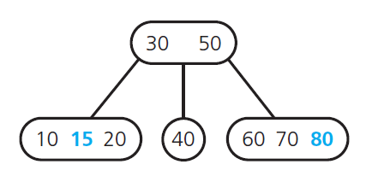
2-3-4 Trees: Insertion (4/11)
After inserting 80 and 15 into the tree in Figure 19-24(b)
Source: FIGURE 19-25 in [Carrano and Henry 2013].

Slide 42
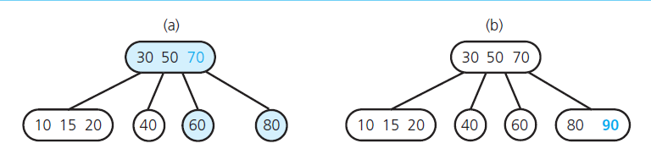
2-3-4 Trees: Insertion (5/11)
Inserting 90 into the tree in Figure 19-25
after splitting the 4-node with 60, 70, and 80
after inserting 90
Source: FIGURE 19-26 in [Carrano and Henry 2013].

Slide 43
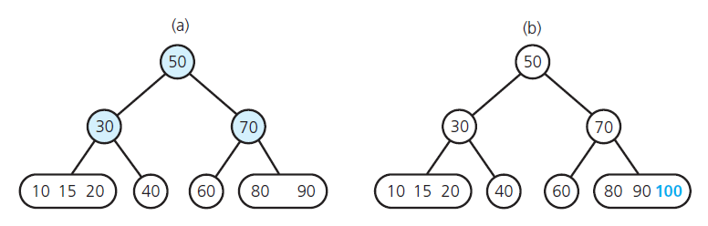
2-3-4 Trees: Insertion (6/11)
After inserting 100 into the tree in Figure 19-26(b)
Source: FIGURE 19-27 in [Carrano and Henry 2013].

Slide 44
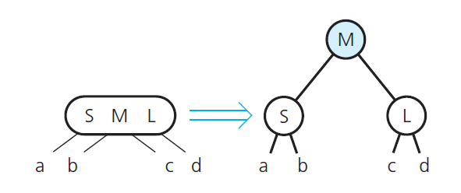
2-3-4 Trees: Insertion (7/11)
Splitting a 4-node root during insertion
Source: FIGURE 19-28 in [Carrano and Henry 2013].

Slide 45
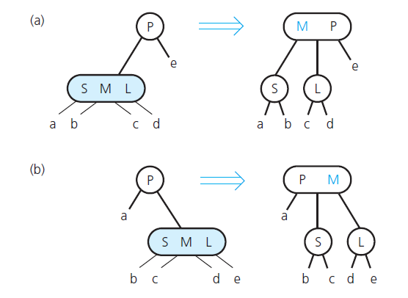
2-3-4 Trees: Insertion (8/11)
Splitting a 4-node whose parent is a 2-node
Source: FIGURE 19-29 in [Carrano and Henry 2013].

Slide 46
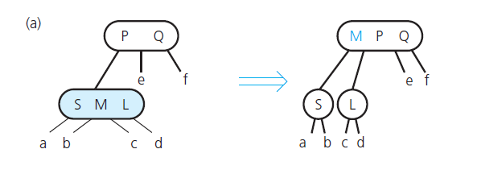
2-3-4 Trees: Insertion (9/11)
Splitting a 4-node whose parent is a 3-node during insertion
Source: FIGURE 19-30 in [Carrano and Henry 2013].

Slide 47
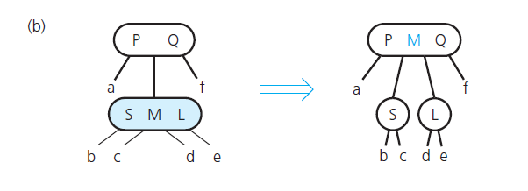
2-3-4 Trees: Insertion (10/11)
Splitting a 4-node whose parent is a 3-node during insertion
Source: FIGURE 19-30 in [Carrano and Henry 2013].

Slide 48
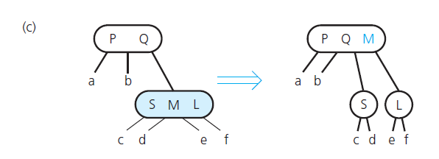
2-3-4 Trees: Insertion (11/11)
Splitting a 4-node whose parent is a 3-node during insertion
Source: FIGURE 19-30 in [Carrano and Henry 2013].

Slide 49
2-3-4 Trees: Removal
It is similar to that for a 2-3 tree at the beginning.
  Locate the node n with the item I to be removed
  Swap I with I‘s inorder successor, which is in a leaf
  If that leaf is a 3 or 4-node, simply discard I
  If that leaf is a 2-node, …
The trick is to ensure that leaf will be a 3 or 4-node.
During the search of n, transform every 2-node encountered into a 3 or 4-node, by reversing the steps of splitting.

Slide 50
2-3-4 Trees vs. 2-3 Trees
Insertions and deletions in a 2-3-4 tree, requiring juts one pass, are more efficient than in a 2-3 tree, though all in O(log n).
A node in a 2-3-4 tree requires more storage.
However, a 2-3-4 tree can be transformed into a special binary tree, to reduce storage requirements.

Slide 51
Red-Black Trees (1/5)
A red-black tree is a special binary search tree that represents a 2-3-4 tree.
It retains the advantages of a 2-3-4 tree without the storage overhead.
Each 3-node or 4-node in the original 2-3-4 tree is represented by an equivalent binary search tree.
Pointers to nodes generated from a 3-node or 4-node are called red pointers, while others are black pointers.

Slide 52
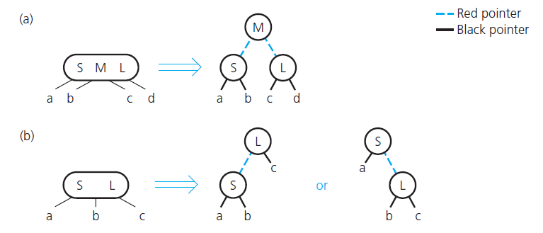
Red-Black Trees (2/5)
two possibilities
Red-black representation of a 4-node and a 3-node
Source: FIGURE 19-31 in [Carrano and Henry 2013].

Slide 53
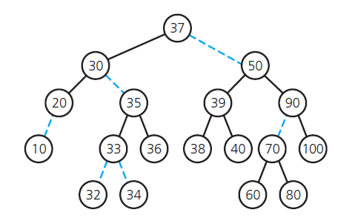
Red-Black Trees (3/5)
A red-black tree representing the tree in Figure 19-20
Source: FIGURE 19-32 in [Carrano and Henry 2013].

Slide 54
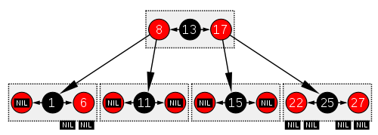
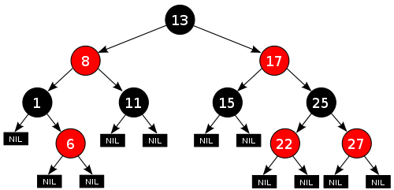
Red-Black Trees (4/5)
Another red-black tree and its corresponding 2-3-4 tree
Source: Wikipedia page of “Red-black tree”

Slide 55
Red-Black Trees (5/5)
Searching and traversing
  A red-black tree is a binary search tree.
  So, search and traverse it by using algorithms for binary search trees.
Inserting and removing
  Adjust the 2-3-4 insertion and removal algorithms to accommodate the red-black representation

Slide 56
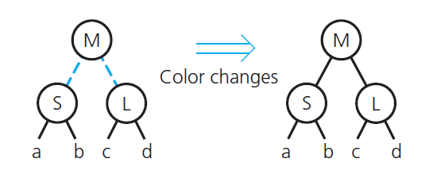
Red-Black Trees: Insertion (1/6)
Splitting a red-black representation of a 4-node root
Source: FIGURE 19-33 in [Carrano and Henry 2013].

Slide 57
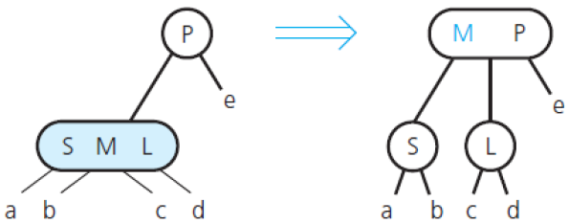
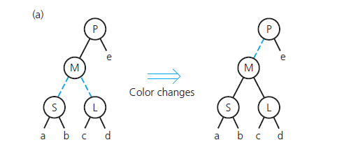
Red-Black Trees: Insertion (2/6)
Splitting a red-black representation of a 4-node whose parent is a 2-node
Source: FIGURE 19-34 in [Carrano and Henry 2013].

Slide 58
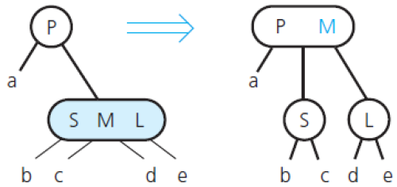
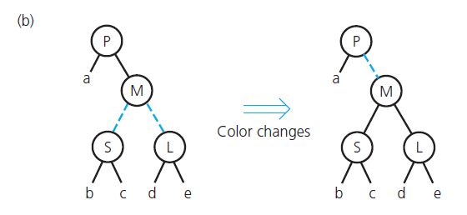
Red-Black Trees: Insertion (3/6)
Splitting a red-black representation of a 4-node whose parent is a 2-node
Source: FIGURE 19-34 in [Carrano and Henry 2013].

Slide 59
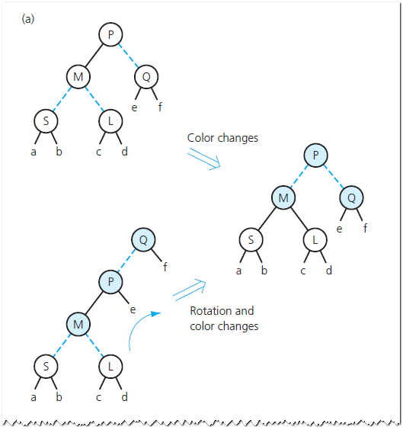
Red-Black Trees: Insertion (4/6)
Splitting a red-black
representation of a
4-node whose parent
is a 3-node
Source: FIGURE 19-35 in
[Carrano and Henry 2013].

Slide 60
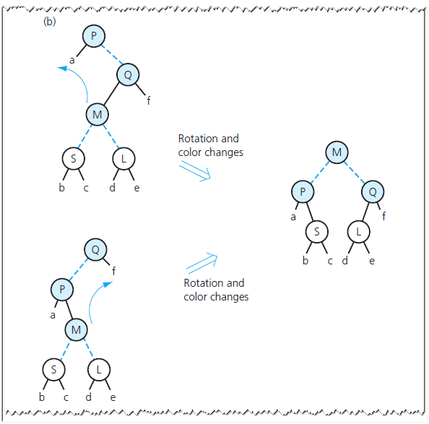
Red-Black Trees: Insertion (5/6)
Splitting a red-black
representation of a
4-node whose parent
is a 3-node
Source: FIGURE 19-35 in
[Carrano and Henry 2013].

Slide 61

Red-Black Trees: Insertion (6/6)
Splitting a red-black
representation of a
4-node whose parent
is a 3-node
Source: FIGURE 19-35 in
[Carrano and Henry 2013].

