Slide 1
Data Structures
TA Session #1
By Hung-Chih & Carlos
106/10/16

Slide 2
Preface
Few things before we start

Slide 3
When doing your homework
Write in nice & clear format.
Remember to write down your student ID and name.
Use A4-size sheets.
Answer each question one by one.
Do NOT hand in your homework in sheets unstapled.
Use the International Edition.

Slide 4
More than homework
Think more situations while writing programs.
What should you get after this class?

Slide 5
Assignment #1
Average score = 54.3

Slide 6
Problem 1-2
Fraction addition

Slide 7
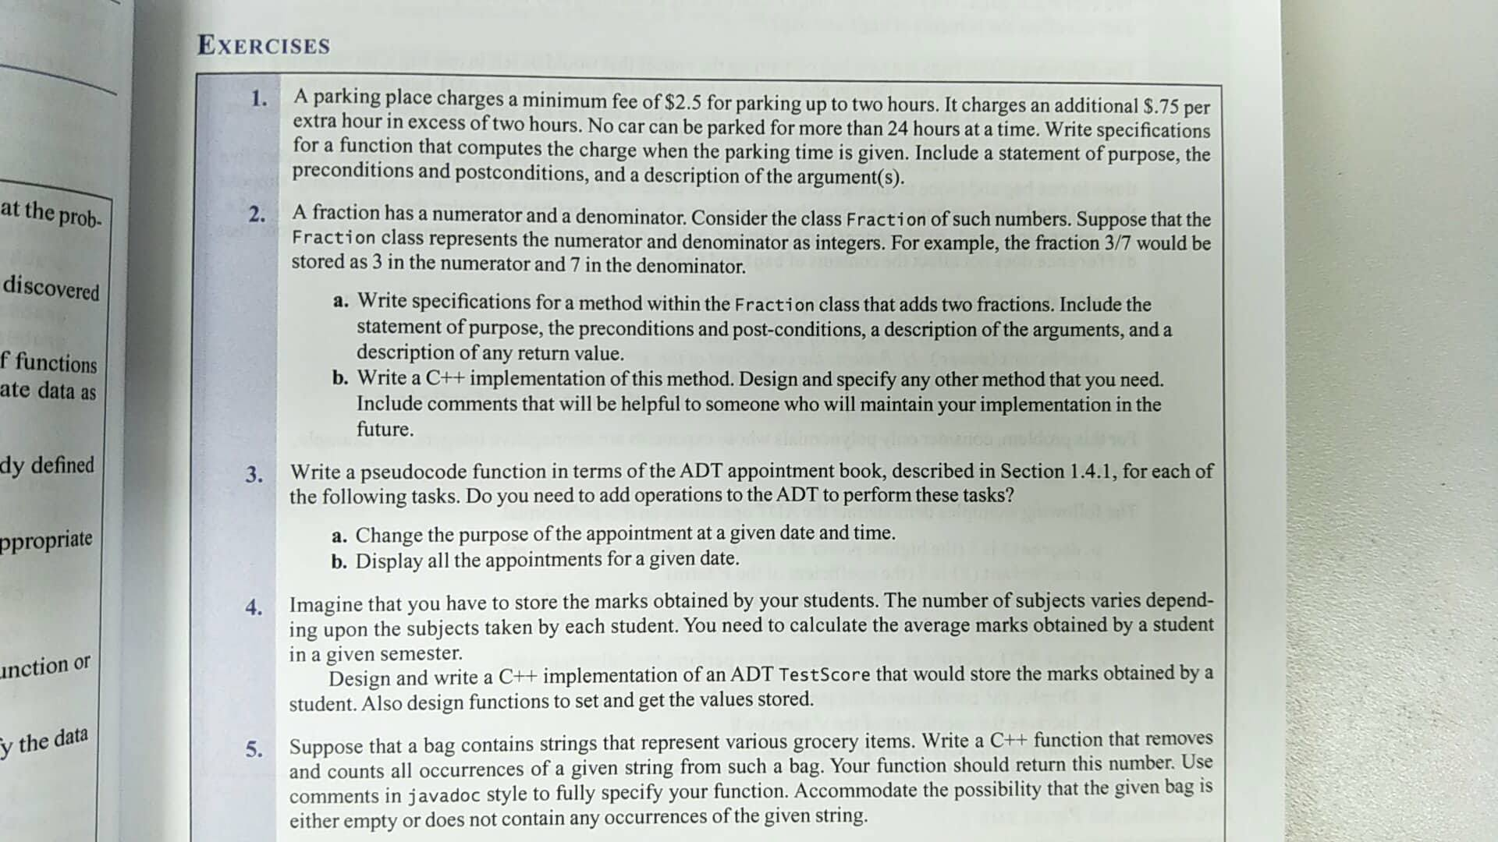

Slide 8
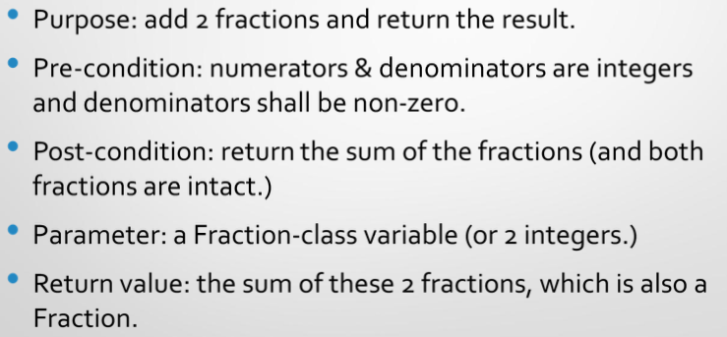
Part A. Method for addition

Slide 9
Part B. C++ implementation
Class Fraction {
private:
int N, D, M = 1;
int GCD(int a, int b);
public:
Fraction(int , int);
Fraction add(const Fraction);
void reduce();
}

Slide 10
/* GCD on nominator and denominator */
int Fraction::gcd(int a, int b)
{
if(a % b == 0)
return b;
else
return gcd(b, a%b);
}

Slide 11
/* Reduce the fraction to the simple form */
void reduce()
{
if(N)
{
g = gcd( N, D );
N = N / g;
D = D / g;
}
}

Slide 12
Part B. C++ implementation
/* Constructor */
Fraction::Fraction (int n, int d) {
if (n * d < 0)
M = -1;
if (!d)
throw “Denominator should not be 0!”
if (!n)
d = 1
N = abs(n);
D = abs(d);
reduce();
}

Slide 13
Part B. C++ implementation
/* Add 2 fractions */
Fraction::Fraction add(const Fraction addEnd) {
Fraction sum(N * M * addEnd.D + addEnd.N * D,
D * addEnd.D)
return sum;
}

Slide 14
Problem 1-3
The appointment book

Slide 16
Part A. change purpose of a appointment
/* This is a pseudocode, not C++, function.
* Appointment book is implemented in ADT
* Please do not compile this code
*
* No new function is required. (But if you treat the following
* as a new function, that's also ok.)
* This function uses existing functions like isAppointment,
* cancelAppointment, and makeAppointment.
*/

Slide 17
// Change the purpose of an appointment
updatePurpose( date: Date, time: Time, newPurpose: String )
{
// Make sure the appointment exists
if ( apptBook.isAppointment( date, time ) )
{
// The appointment does exist
apptBook.cancelAppointment( date, time );
if( apptBook.makeAppointment( date, time, newPurpose ) )
write( “Purpose of the appointment updated." );
}
else // The appointment doesn't exist
write( "No appointment at the given date & time." );
}

Slide 18
Part B. list all appointments in a day
/*
* No new function is required. (But if you treat the following
* as a new function, that's also ok.)
* This function uses existing functions like isAppointment, getAppointmentPurpose.
*/

Slide 19
Part B. list all appointments in a day
// Print all appointments for a given date
getDateAppointment( apptDate: Date )
{
// Iterate through all possible times on the given day
for (each time) 假設time是enum
// If the appointment exists
if ( apptBook.isAppointment( date, time ) )
write( apptBook.getAppointmentPurpose( date, time ), " at ", date, time );
}

Slide 20
Problem 1-5
Remove elements in a bag & Javadoc comment style

Slide 22
Javadoc comment style
Look at https://en.wikipedia.org/avadoc
Begins with /** and ends with */
@param
@return
No blank lines between comment and code body
Paragraphs in comment are separated by <p>

Slide 23
#include<bits/stdc++.h>
using namespace std;
/**
* Class bag --- simulation of a bag of strings
* Note that this problem asks you to comment in Javadoc style, so
* please DO comment your functions, or you'll lose some marks.
* <p>
* Also, use `<p>' to separate paragraphs between descriptions when
* needed, and there’s no blank lines between comment & function.

Slide 24
*
* @author Po-Chuan
* @version 1.5
* @since 2015-10-12
*/
class mybag
{
private:
bag<string> items;

Slide 25
public:
/**
* Remove items in bag and count how many items are removed.
* <p>
* This function iterates through the bag, searches for items and
* removes those matched with the parameter. After iteration,
* this function returns the number of items removed.
*
* @param s the item to be removed
* @return the number of the items that were removed
*/
int remove( const string s )

Slide 26
int remove( const string s )
{
/*
* # of items removed
*/
int rm = 0;
/*
* If the bag is empty, i is equal to s.end() and returns 0 immediately.
* If none was found, no erase commands are invoked. A zero is returned.
*/
While(items.contains(s)) {
items.remove(s);
rm ++;
}
return(rm);
};

Slide 27
Just some more…
We use vector as a container here. You may use other containers.
You can use getFrequencyOf() to count the number of objects.

Slide 28
Problem 1-8
difference of 2 bags

Slide 29
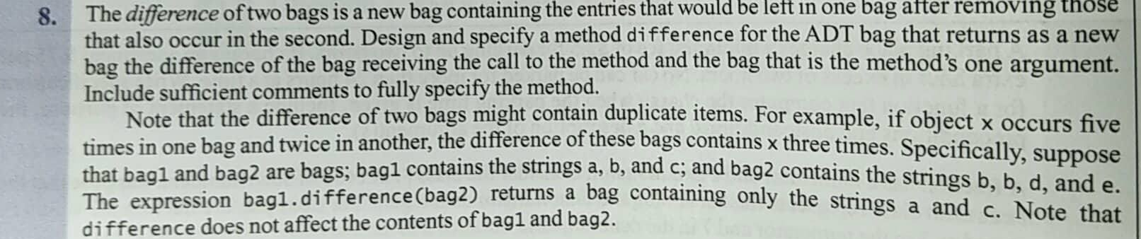

Slide 30
#include<bits/stdc++.h> // vector, iterator, and algorithm
using namespace std;
template<typename T>
class bag
{
private:
/* Use vector to hold contents */
vector<T> contents;
public
void add( const T& val )
{
contents.push_back( val );
}

Slide 31
vector<T> toVector() {
return (contents);
}
/* Do NOT use bag&
* if you'll modify B a bit, pass by non-constant value */
bag<T> intersection( bag Bbag ) {
/* copy contents */
vector<T> B = Bbag.toVector();
bag<T> R;
for (auto a = A.begin(); a != A.end(); ++a) {
R.add(a);
}

Slide 32
for (auto b = B.begin(); b != B.end() ; ++b)
{
if (R.contains(b))
R.remove(b);
}
return R;
}

Slide 33
Problem 5
difference, using peek()

Slide 34
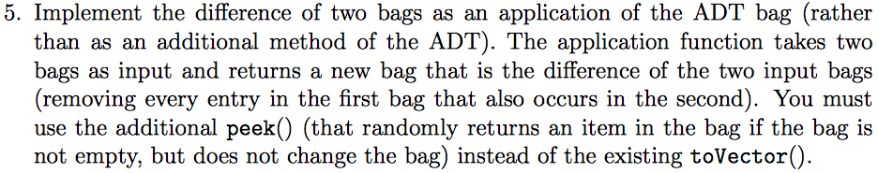

Slide 35
The code
template<typename T>
bag<T> difference( bag<T> a, bag<T> b )
{
while( !b.isEmpty() )
{
T item = b.peek();
if( a.contains( item ) )
a.remove( item );
b.remove( item );
}
return a;
}

Slide 36
Assignment #2
Average:79.7

Slide 37
Problem 2-9
Digit sum of a given positive decimal integer

Slide 38
int getDigitSum(int n)
{
if( n < 0 ) {
throw std::invalid_argument(“not a positive number");;
} else if( n < 10 ) {
return n;
} else {
return (n % 10) + getDigitSum(n / 10);
}
}

Slide 39
Problem 2-10
Implement recursive functions: writeLine(), writeBlock()

Slide 40
writeLine()

Slide 41
Version 0
int writeLine(char symbol, int times)
{
if( times == 1 ) {
cout << symbol;
return 0;
} else {
cout << symbol;
return writeLine(symbol, times - 1);
}
}

Slide 42
Version 1.0
void writeLine(char symbol, int times)
{
if( times <= 0 ) {
//do nothing
} else {
cout << symbol;
writeLine(symbol, times - 1);
}
}

Slide 43
Version 1.1
void writeLine(char symbol, int times)
{
if( times > 0 ) {
cout << symbol;
writeLine(symbol, times - 1);
}
}

Slide 44
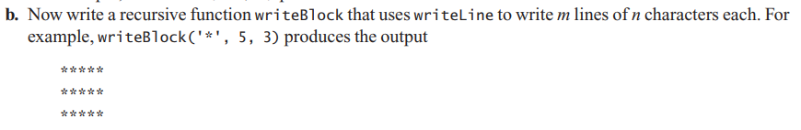
writeBlock()

Slide 45
void writeBlock(char symbol, int times, int lines)
{
if ( lines > 0 ) {
writeLine(symbol, times);
cout << endl;
writeBlock(symbol, times, lines - 1);
}
}

Slide 46
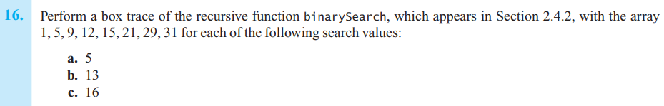
Problem 2-16

Slide 47
Box trace
Shows the information during each recursion of the process

Slide 48
Part A
target = 5
first = 0
last = 7
mid = (0+7)/2 = 3
target < anArray[3]=12
X: binarySearch = 1
Return 1
target = 5
first = 0
last = 3-1=2
mid = (0+2)/2 = 1
target = anArray[1]
Return 1

Slide 49
Part B
target = 13
first = 0
last = 7
mid = (0+7)/2 = 3
target > anArray[3]=12
Y: binarySearch = -1
Return -1
target = 13
first = 3+1=4
last = 7
mid = (4+7)/2 = 5
target < anArray[5]=21
X: binarySearch = -1
Return -1
target = 13
first = 4
last = 5-1=4
mid = (4+4)/2 = 4
target < anArray[4]=15
X: binarySearch = -1
Return -1
target = 13
first = 4
last = 4-1=3
first > last
Return -1

Slide 50
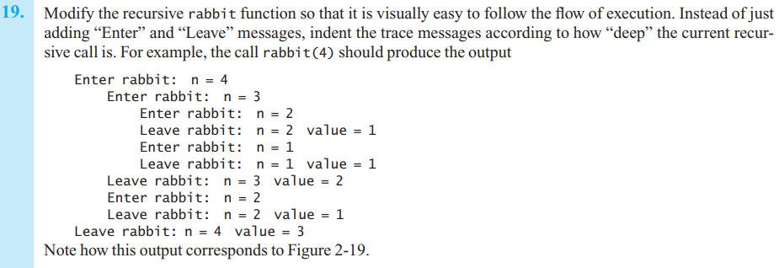
Problem 2-19

Slide 51
How to solve this problem?
Keep the recursion depth, either as a parameter or as a global variable
Print the information of each function call after tabs
But rabbit function should be called as one-argument function.

Slide 52
int Rabbit( int n, int depth = 0 )
{
for(int i = depth; i > 0; i--) {
cout << “\t”;
}
cout <<Enter rabbit: n = " << n << endl;
for(int i = depth; i > 0; i--){
cout << “\t”;
}

Slide 53
if( n <= 2 ) {
cout << “Leave rabbit : n = ” << n << “value = 1” << endl;
return 1;
} else {
int sum = Rabbit(n-1, depth+1) + Rabbit(n-2, depth+1);
cout << “Leave rabbit : n = ” << n << “value = ” << sum << endl;
return sum;
}
}

Slide 54
Problem 2-23
Euclidean algorithm

Slide 55
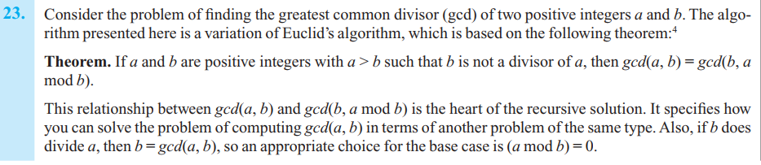
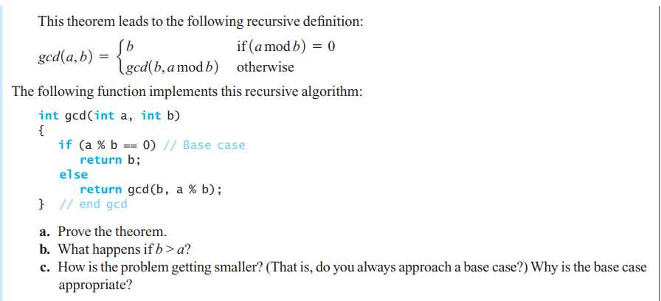

Slide 56
Part A. the proof
Theorem : if a and b are positive integers and a > b such that b is not a divisor of a, then gcd( a, b ) = gcd( b, a mod b )

Slide 57
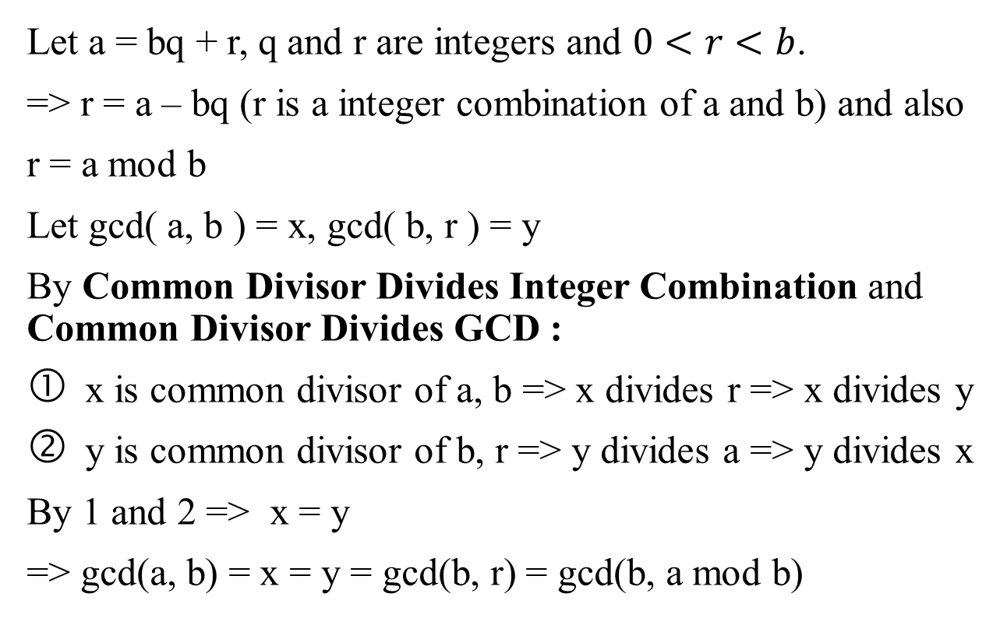
Part A. the proof (cont.)
Let a = bq + r, q and r are integers and $0<r<b$.
=> r = a – bq (r is a integer combination of a and b) and also
r = a mod b
Let gcd( a, b ) = x, gcd( b, r ) = y
By Common Divisor Divides Integer Combination and Common Divisor Divides GCD :
x is common divisor of a, b => x divides r => x divides y
y is common divisor of b, r => y divides a => y divides x
By 1 and 2 => x = y
=> gcd(a, b) = x = y = gcd(b, r) = gcd(b, a mod b)

Slide 58
Part B. when b > a…
Suppose b > a in gcd( a, b )
The recursive call will be
gcd( a, b ) = gcd( b, a mod b ) = gcd( b, a ) = …
The recursion swaps these 2 numbers and continues as usual.

Slide 59
Part C-1. How is the problem getting smaller?
If a % b = 0, then b is their GCD, and the function ends immediately.
If not, because a > b > (a mod b) > 0 (by definition)
The parameters a and b will get smaller each recursive call.

Slide 60
Part C-2: Why the base case is appropriate?
When a % b = 0, b is the GCD of a and b => The process terminates and no further recursion calls are required.
Otherwise, a and b will get smaller after each recursive call.
Because of the property of natural number, b will be 1 in finite steps in the worst case.
1 is a divisor of any positive integer => The process will terminate in finite steps
Therefore, the base case is appropriate.

Slide 61
The end~
Hope you did a good job in these assignments.
By the TAs
106/10/16

