Slide 1

Data structures
TA session #4
prepared by Hung-Chih Chen & Carlos Chang

Slide 2
Assignment #6
AVERAGE: 75.8

Slide 3
Q1 exercise 10.8

Slide 4
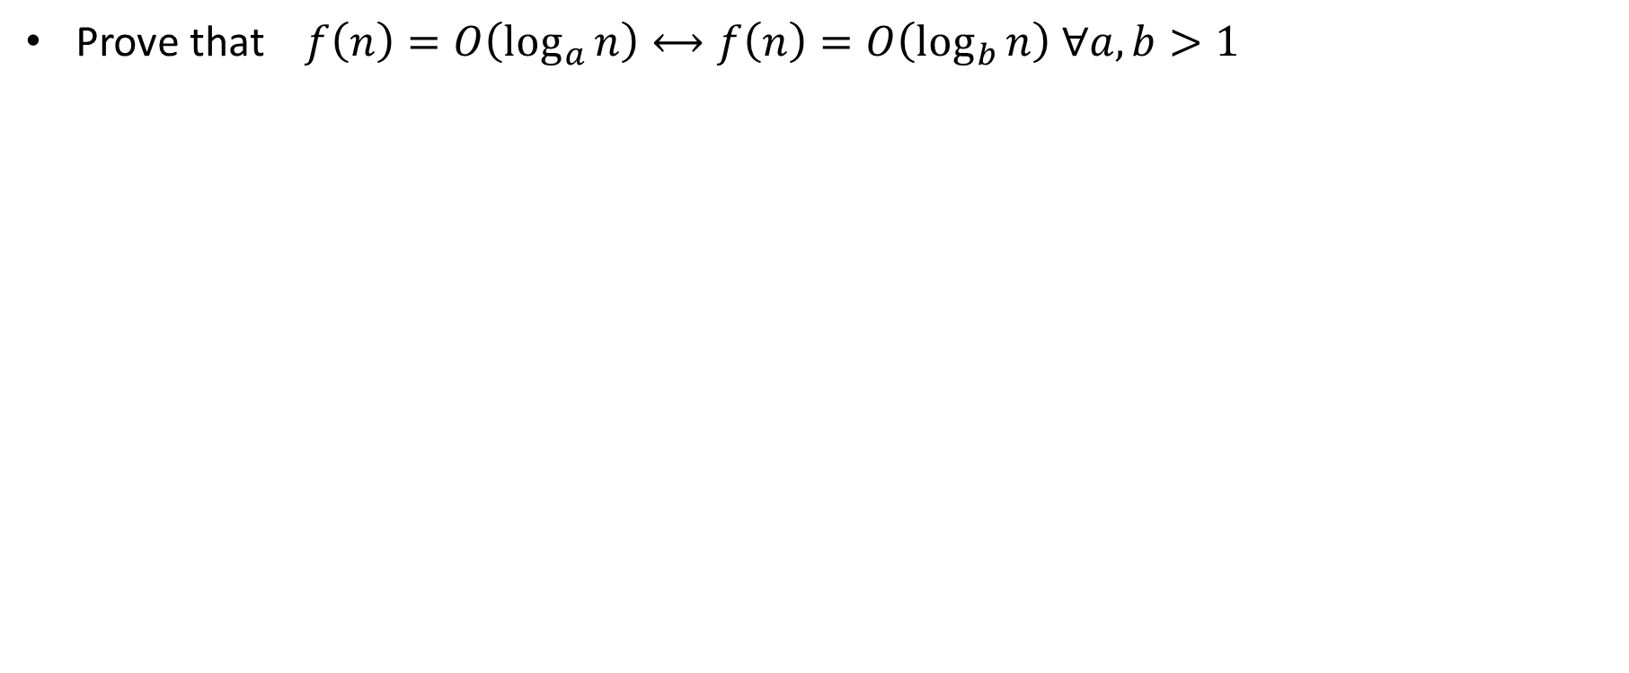
The problem
Prove that$f\left(n\right)=O\left(\log_{a}{n}\right)⟷f\left(n\right)=O\left(\log_{b}{n}\right) ∀a, b>1$

Slide 5
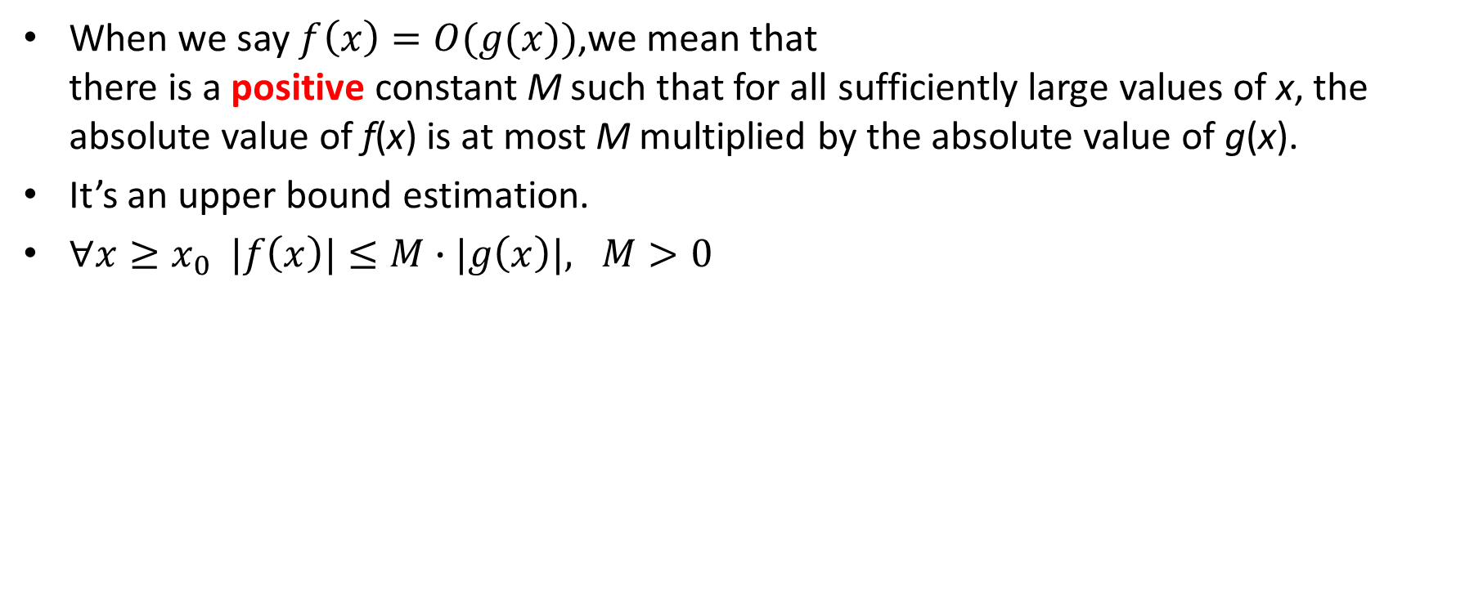
Please recall the definition of O(n)
When we say $f\left(x\right)=O(g(x))$,we mean that
there is a positive constant M such that for all sufficiently large values of x, the absolute value of f(x) is at most M multiplied by the absolute value of g(x).
It’s an upper bound estimation.
$∀x≥x_{0} |f\left(x\right)|≤M∙|g\left(x\right)|, M>0$

Slide 6
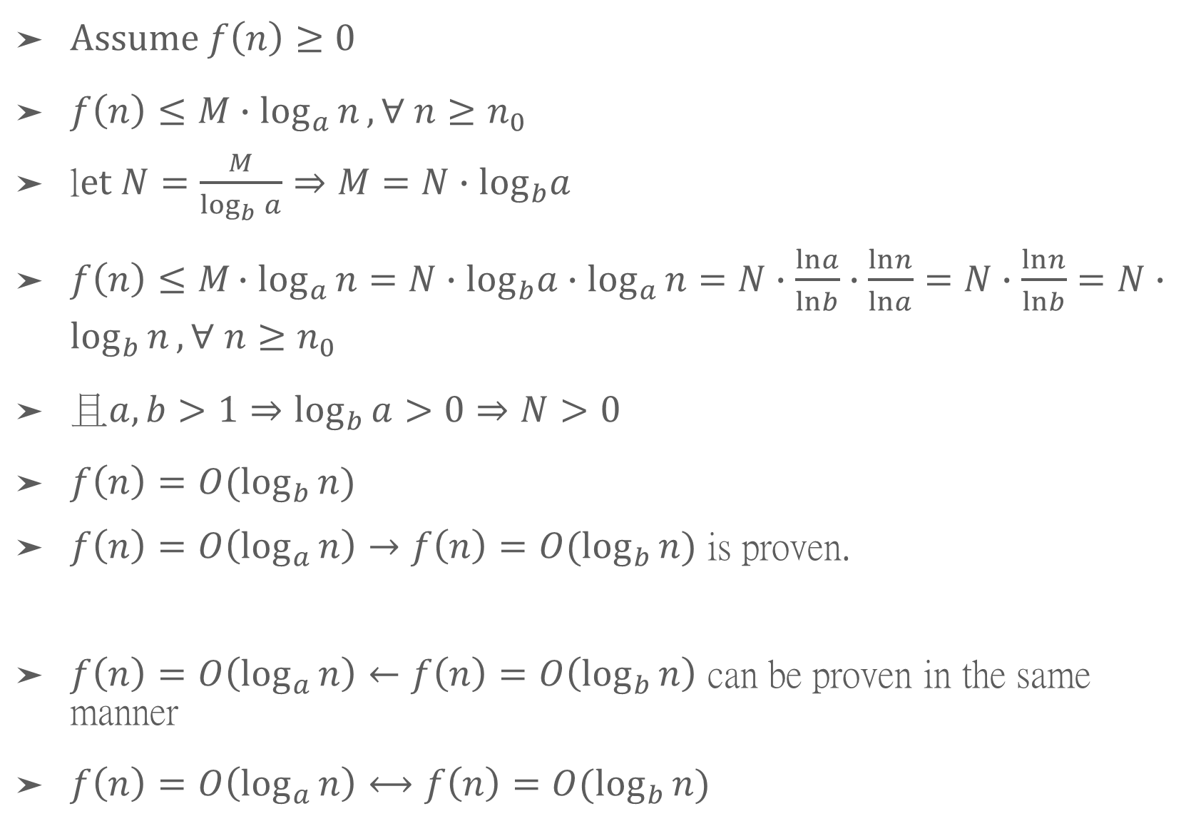
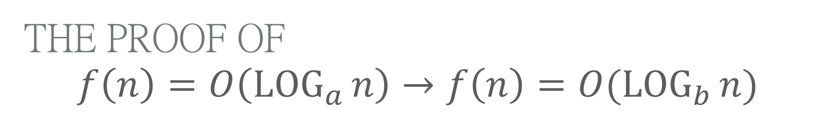
The proof of
$$f\left(n\right)=O\left(\log_{a}{n}\right)→f\left(n\right)=O(\log_{b}{n})$$
Assume $f\left(n\right)≥0$
$f\left(n\right)≤M∙\log_{a}{n},∀ n≥n_{0}$
l$et N=\frac{M}{\log_{b}{a}}⇒M=N∙\log_{b}a$
$f\left(n\right)≤M∙\log_{a}{n}=N∙\log_{b}a∙\log_{a}{n}=N∙\frac{lna}{lnb}∙\frac{lnn}{lna}=N∙\frac{lnn}{lnb}=N∙\log_{b}{n}, ∀ n≥n_{0}$
$且a,b>1⇒\log_{b}{a}>0⇒N>0$
$f\left(n\right)=O(\log_{b}{n})$
$f\left(n\right)=O\left(\log_{a}{n}\right)→f\left(n\right)=O(\log_{b}{n})$ is proven.
$f\left(n\right)=O\left(\log_{a}{n}\right)←f\left(n\right)=O\left(\log_{b}{n}\right)$ can be proven in the same manner
$f\left(n\right)=O\left(\log_{a}{n}\right)⟷f\left(n\right)=O(\log_{b}{n})$

Slide 7
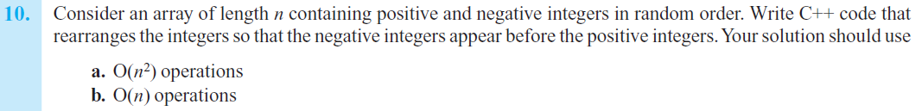
Q2 exercise 10.10(b)

Slide 8
Sample solution
template <typename ItemType>
void seperateList(ItemType Array[], int n)
{
const int PIVOT = 0;
int lside = 0;
int rside = n – 1;
while( true )
{
while( lSide < rSide && Array[lSide] < PIVOT )
lSide++;
while( lSide < rSide && Array[rSide] >= PIVOT )
rSide--;
if( rSide < lSide )
break;
std::swap(Array[lSide], Array[rSide]);
}
}
Notes:
改用同學的寫法

Slide 9
Q3 exercise 11.10

Slide 10
mergeSort(theArray, 0, 5)
20 | 80 | 40 | 25 | 60 | 30
mergeSort(theArray, 0, 2)
mergeSort(theArray, 0, 1)
mergeSort(theArray, 0, 0)
mergeSort(theArray, 1, 1)
merge(theArray, 0,0,1)
20 | 80 | 40 | 25 | 60 | 30
mergeSort(theArray, 2, 2)
merge(theArray, 0,1,2)
20 | 40 | 80 | 25 | 60 | 30
mergeSort(theArray, 3, 5)
mergeSort(theArray, 3, 4)
mergeSort(theArray, 3, 3)
mergeSort(theArray, 4, 4)
merge(theArray, 3, 3, 4)
20 | 40 | 80 | 25 | 60 | 30
mergeSort(theArray, 5, 5)
merge(theArray, 3,4,5)
20 | 40 | 80 | 25 | 30 | 60
merge(theArray, 0,2,5)
20 | 25 | 30 | 40 | 60 | 80

Slide 11
Q4 exercise 11.12

Slide 12
Assume MIN_SIZE = 2
15 | 72 | 58 | 47 | 20 | 40 | 10
quicksort(theArray, 0, 6)
partition(theArray, 0, 6)
15 | 72 | 58 | 47 | 20 | 40 | 10
quicksort(theArray, 1, 6)
partition(theArray, 1, 6)
10 | 72 | 58 | 47 | 20 | 40 | 15
quicksort(theArray, 2, 5)
partition(theArray, 2, 6)
10 | 15 | 58 | 47 | 20 | 40 | 72
quicksort(theArray, 2, 5)
partition(theArray, 2, 5)
10 | 15 | 58 | 47 | 20 | 40 | 72
quicksort(theArray, 3, 3)
10 | 15 | 20 | 40 | 58 | 47 | 72
quicksort(theArray, 4, 5)
partition(theArray, 4, 5)
10 | 15 | 20 | 40 | 58 | 47 | 72
10 | 15 | 20 | 40 | 47 | 58 | 72
PS : The calls to Insertion sort are omitted in this slide

Slide 13
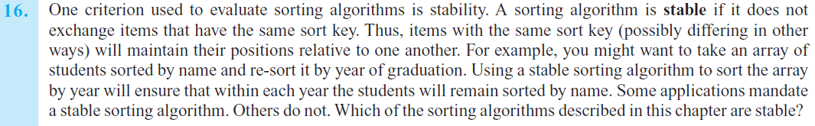
Q5 exercise 11.16

Slide 14
Target algorithms
Insertion sort => stable
Bubble sort => stable
Merge sort => stable
Radix sort => stable
Selection sort => unstable
Quick sort => unstable

Slide 15
Assignment #7
AVERAGE: 68.6

Slide 16
Q1 13.11
Bank queue tracing

Slide 17
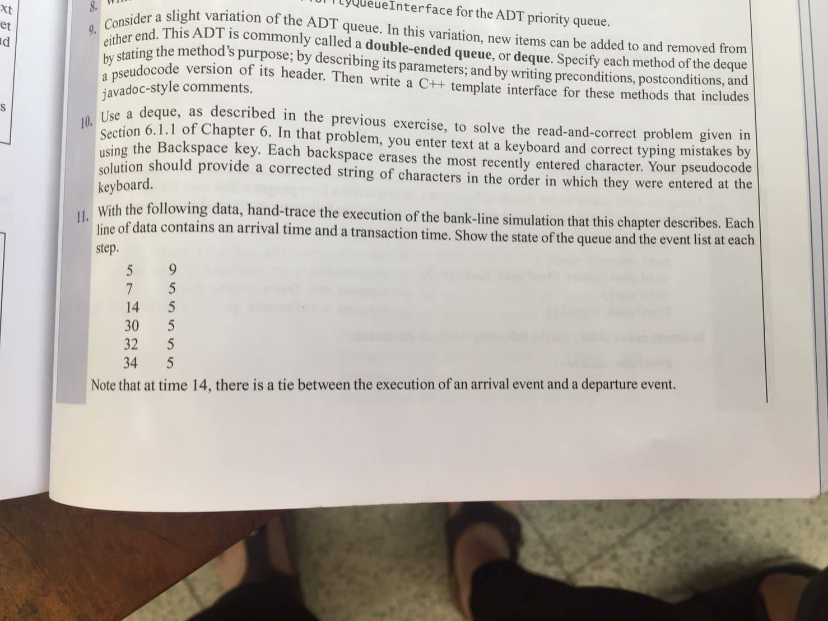

Slide 18
time | bankQueue | eventList_PriorityQueue
0
4
8
13
19
25
27
28
32
34
38
A 4 9
A 8 6
A 13 6
A 25 2
A 28 6
A 32 4
A 8 6
A 13 6
D 13 -
A 25 2
A 28 6
A 32 4
A 8 6
A 13 6
D 13 -
A 25 2
A 28 6
A 32 4
A 13 6
D 19 -
A 25 2
A 28 6
A 32 4
A 25 2
D 25 -
A 28 6
A 32 4
D 27 -
A 28 6
A 32 4
A 28 6
A 32 4
A 32 4
D 34 -
A 32 4
D 34 -
D 38 -

Slide 19
Q2 13.14
peekFront() axiom

Slide 20
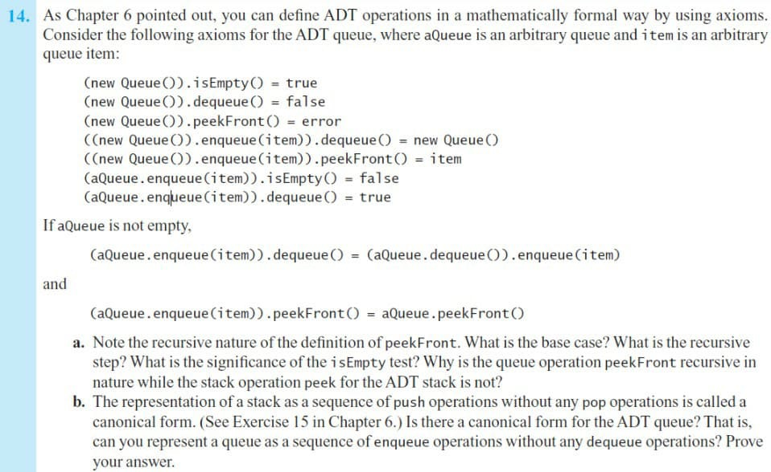

Slide 21
a.
What is the base case?
  When there is only one element in the queue
What is recursive step?
  aQueue.enqueue(item).peekFront() = aQueue.peekFront()
What is significance of isEmpty?
  Used to determine whether the base case has been reached
Why peekFront() for queue is recursive, and peekFront() for stack is not?
  Because we can directly access the front of a stack, while for queue, we have to skip elements one by one to reach the front.

Slide 22
B. canonical form of a queue
Yes, any queue can be represented in a canonical form
Base case:
    1. An empty queue is in a canonical form
Inductive step:
    1. Suppose a queue with n elements is in a canonical form
    2. We can build any queue with n+1 elements by enqueuing an element
By M.I., the proposition is proven
(new Queue)
(((new Queue).enqueue(item1))…enqueue(item n))
(((new Queue).enqueue(item1))…enqueue(item n)).enqueue(item n+1)

Slide 23
Q3 14.6
count vs extra element

Slide 24
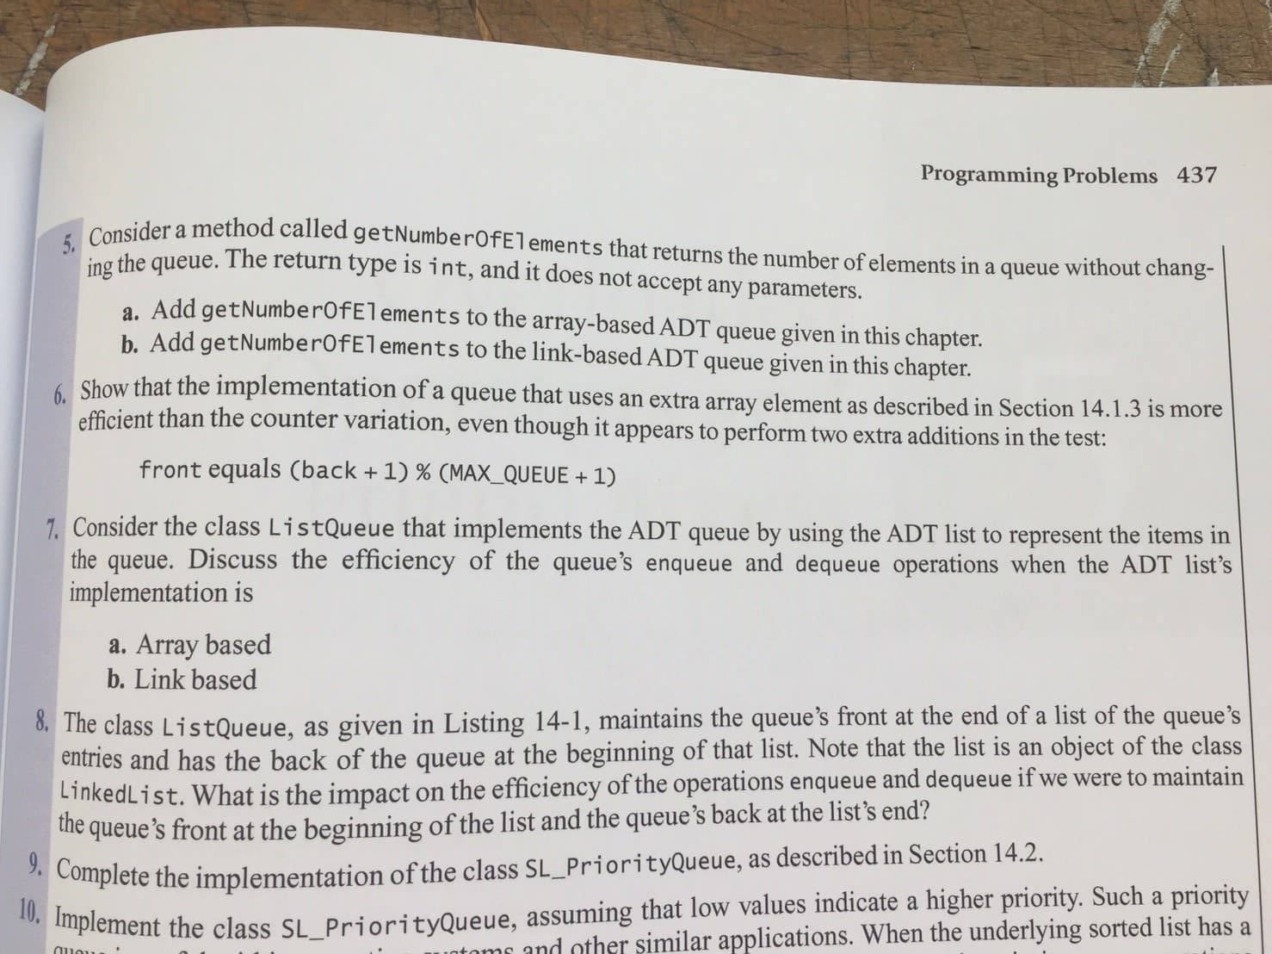

Slide 25
 | counter | extra array element
enqueue() | if(count < MAX_QUEUE){ back = (back + 1) % MAX_QUEUE; items[back] = newEntry; count++;} | if(front != (back+1)%(MAX_QUEUE+1)){ back = (back + 1) % (MAX_QUEUE+1); items[back] = newEntry; }
dequeue() | if(!isEmpty){ front = (front + 1) % MAX_QUEUE; count–-;} | if(!isEmpty) front = (front+1) % (MAX_QUEUE+1);
isEmpty() | return count == 0; | return front == back;
MAX_QUEUE+1 是 const

Slide 26
Q4 15.7
tree visit

Slide 27
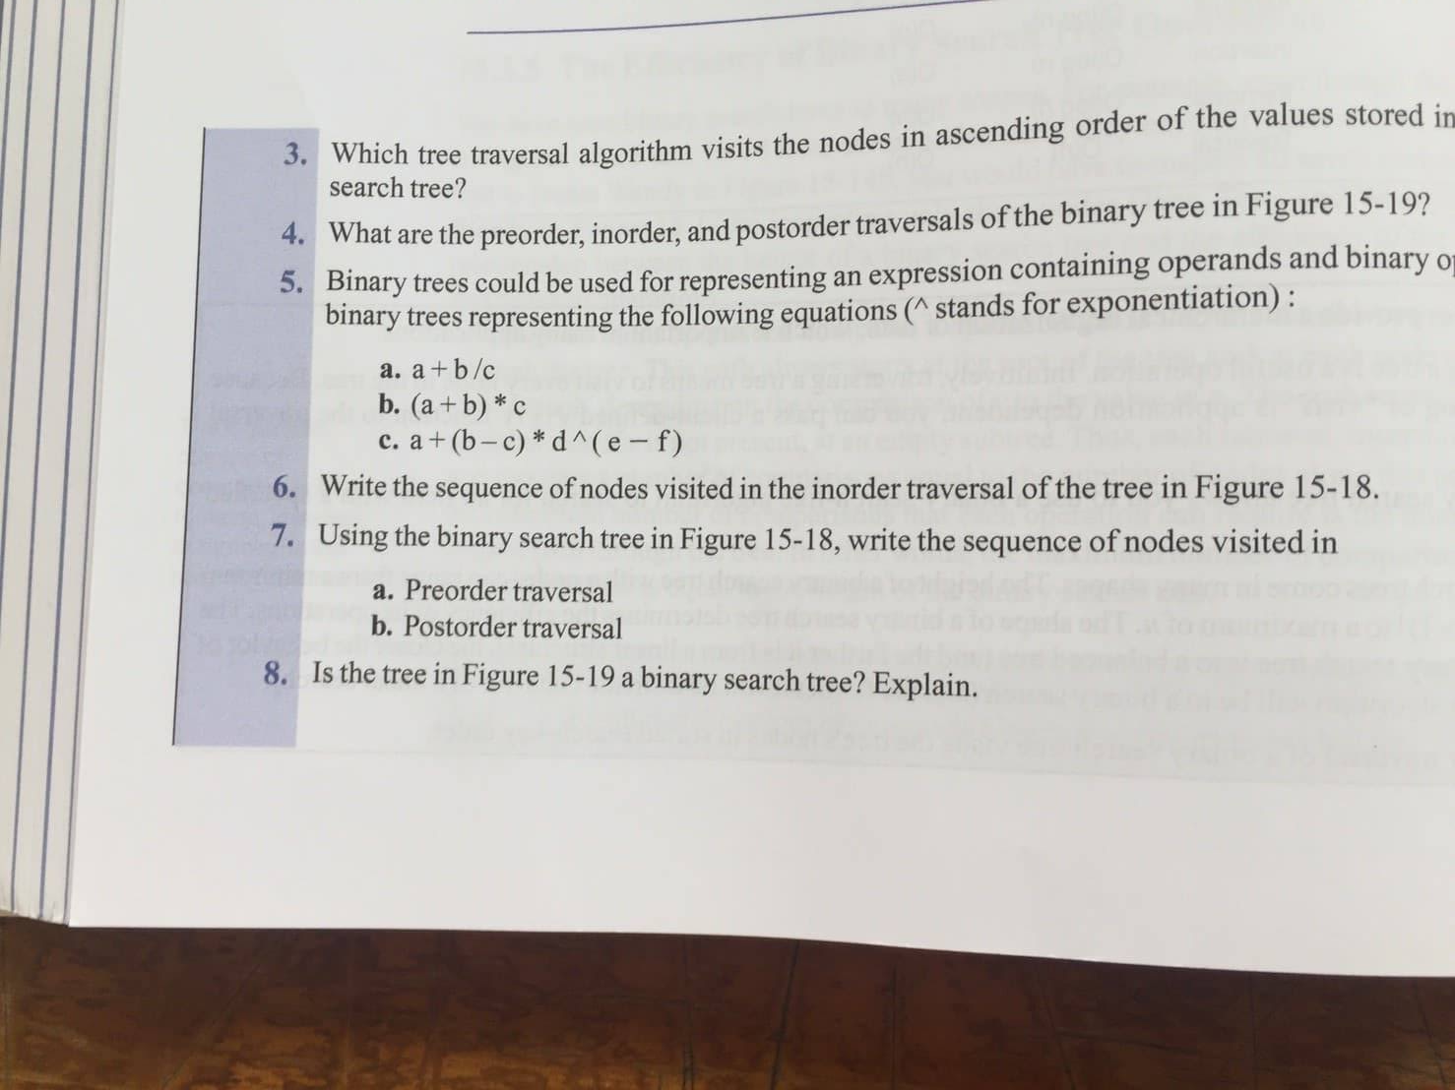

Slide 28
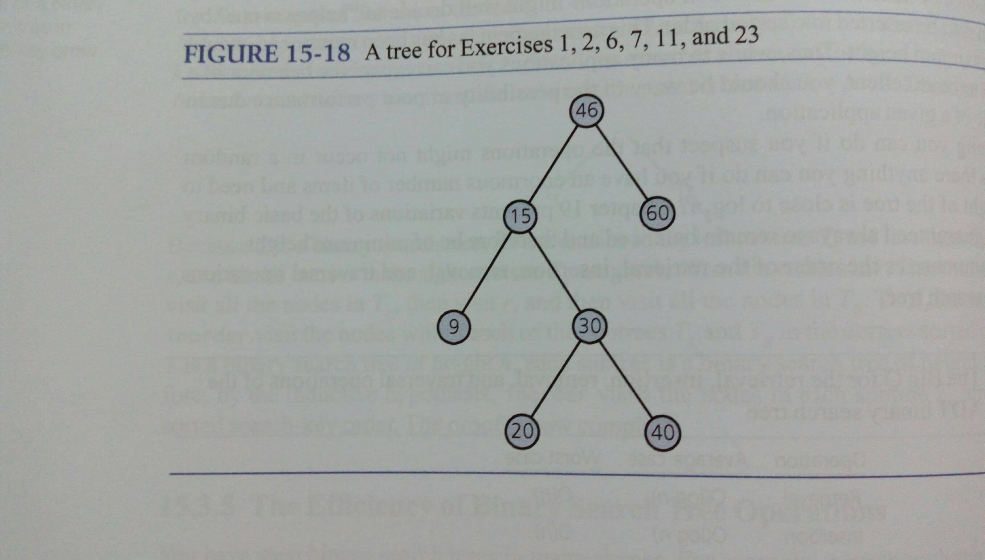

Slide 29
46
15
60
9
30
20
40
pre-order | 46 | 15 | 9 | 30 | 20 | 40 | 60
post-order | 9 | 20 | 40 | 30 | 15 | 60 | 46
in-order | 9 | 15 | 20 | 30 | 40 | 46 | 60

Slide 30
Q5 15.11
binary search tree insert

Slide 31
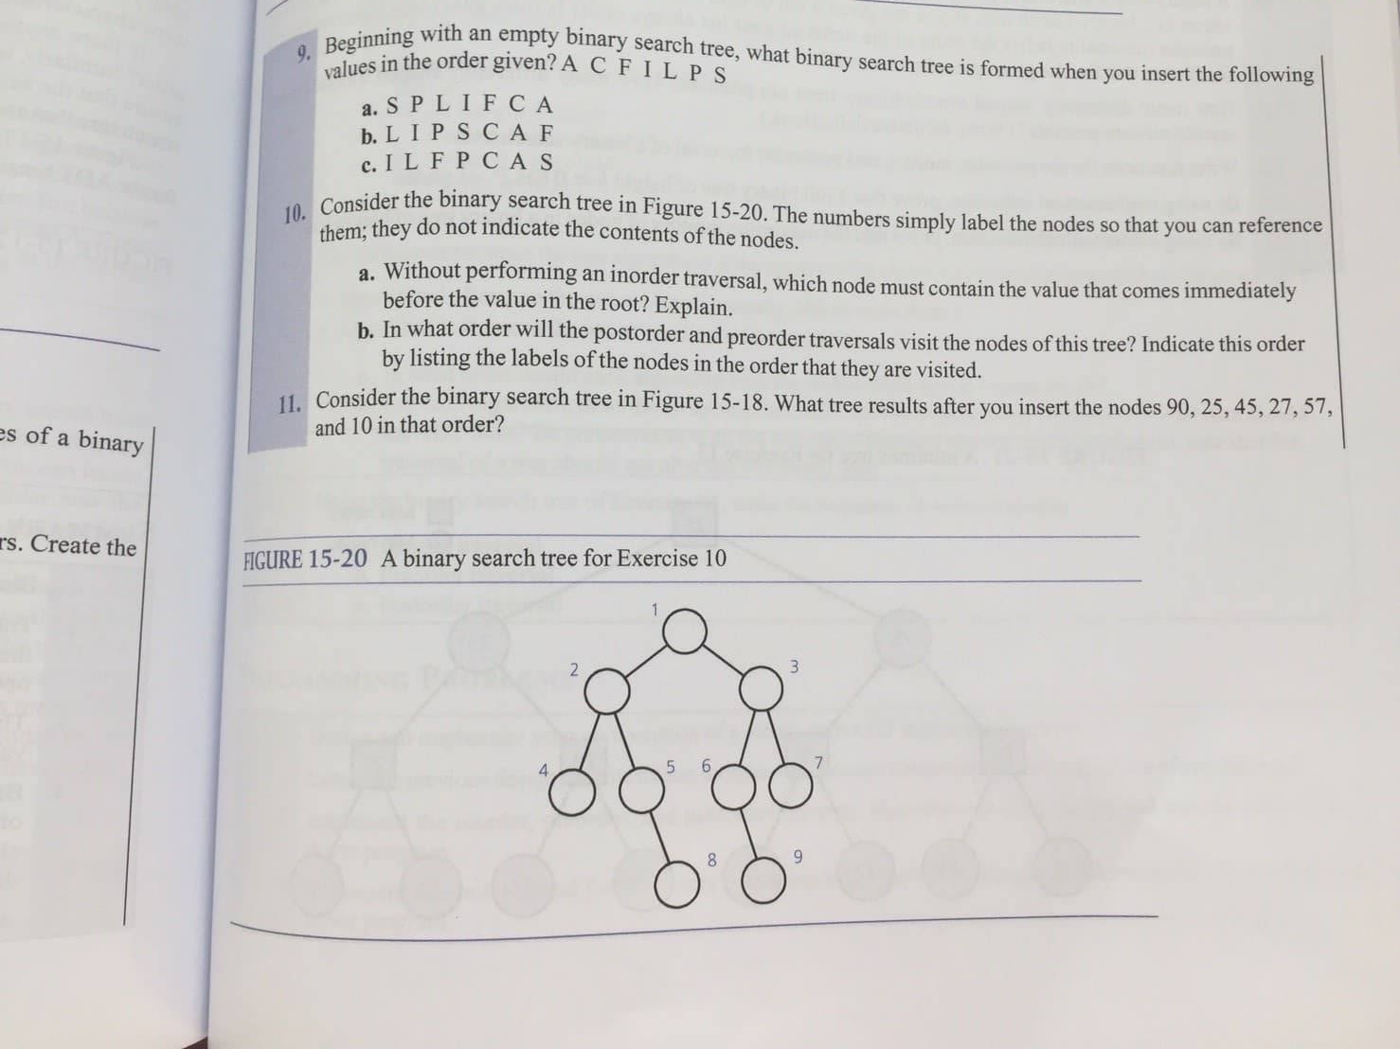

Slide 33
80 55 45 27 57 10
46
15
60
9
30
55
80
10
20
40
57
27
45

Slide 34
10 57 27 45 55 80
46
15
60
9
30
57
80
10
20
40
55
27
45

Slide 35
Assignment #8
AVERAGE: 78

Slide 36
Q1 15.15
different shape

Slide 37
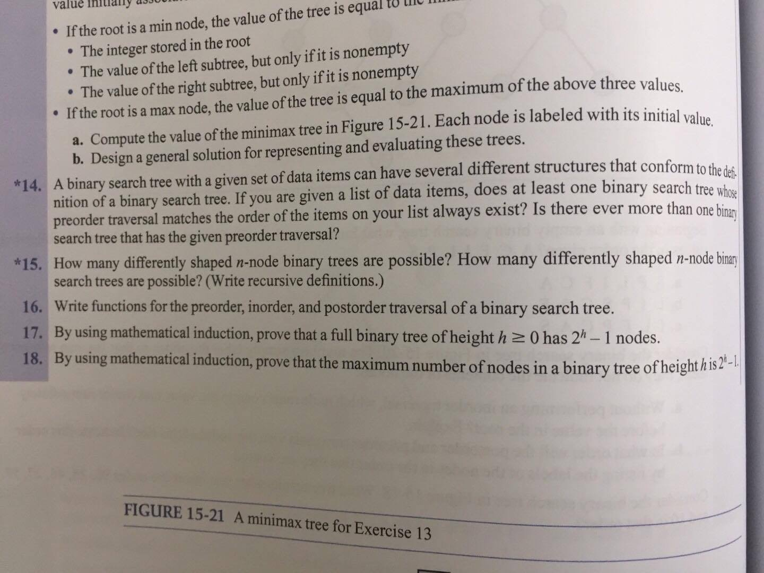

Slide 38
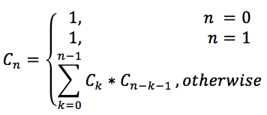
binary tree
X
binary search tree

Slide 39
Q2 15.20
subtree

Slide 40
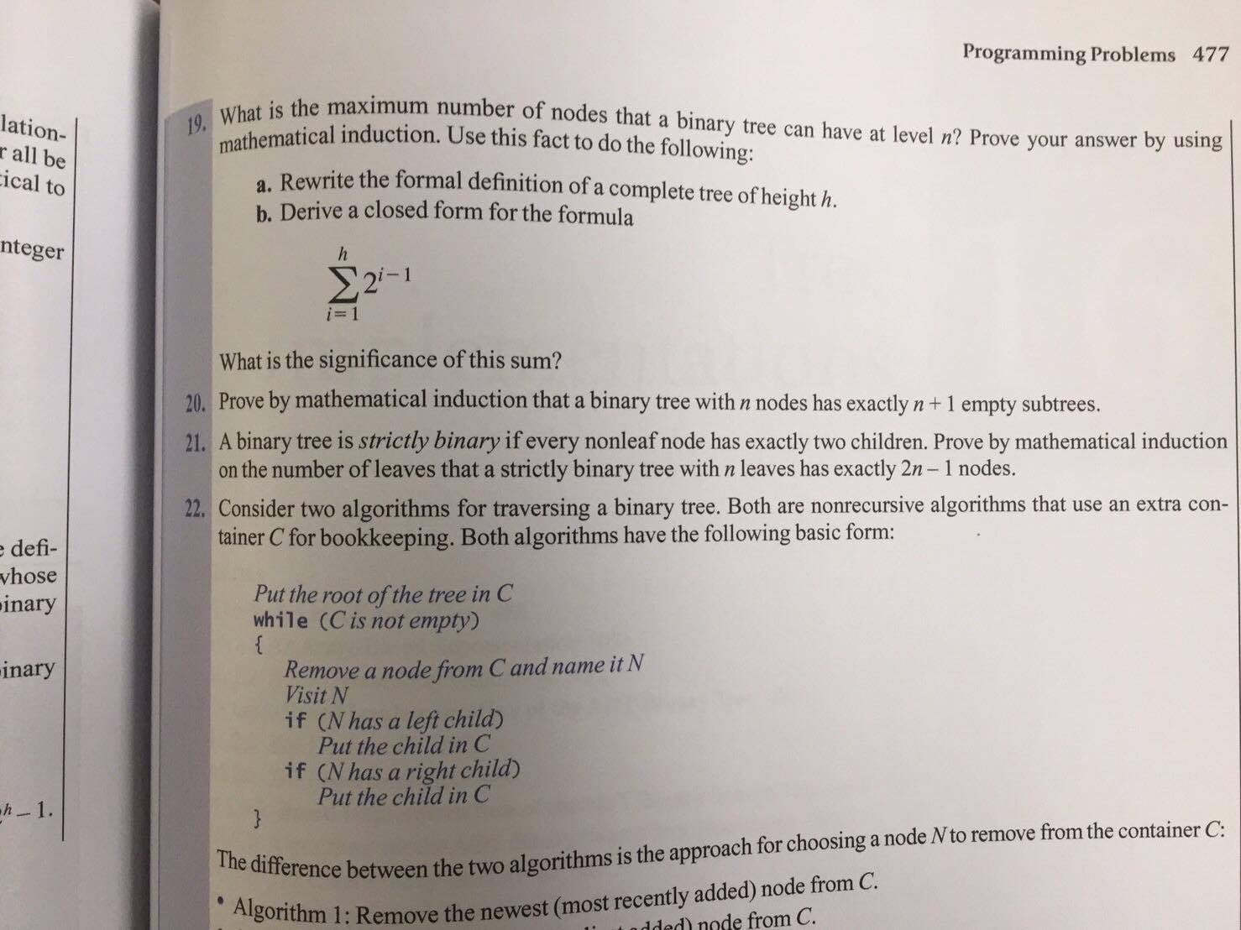

Slide 41
base case(n = 1):
    an one node binary tree has 1+1 subtrees
inductive step:
    1. k = 1 -> 1+1 subtrees
    2. k = n+1 When adding a new node, the node will take a subtree and create two subtrees. So (n+1) node subtree has
    (n+1)-1+2 = n+2 subtrees
By M.I., the proposition is proven

Slide 42
Q3 16.14
level order implement

Slide 43
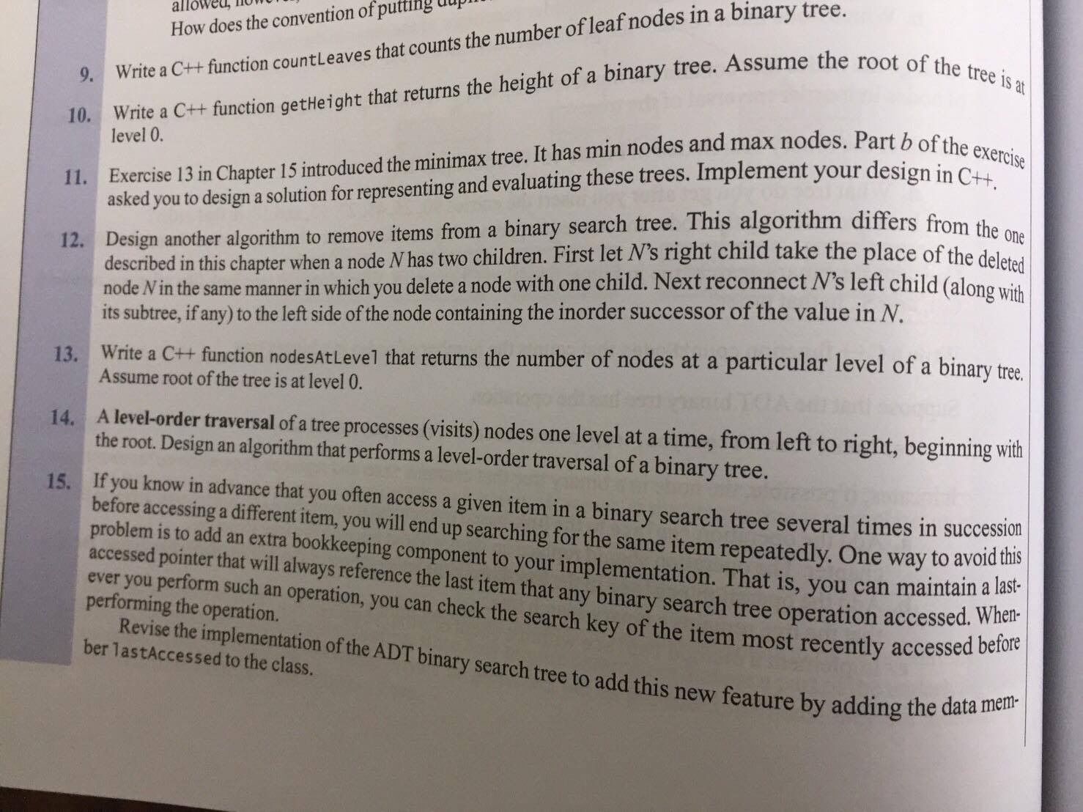

Slide 44
0
1
2
3
4
5
6
print | bfs queue
 | 0
0 | 1 | 2
0 1 | 2 | 3 | 4
0 1 2 | 3 | 4 | 5 | 6
0 1 2 3 | 4 | 5 | 6
0 1 2 3 4 | 5 | 6
0 1 2 3 4 5 | 6
0 1 2 3 4 5 6

Slide 45
Queue<node> bfs;
bfs.enqueue( root );
while bfs is not empty
    print bfs.peekFront()
    bfs.enqueue( bfs.peekFront().leftChild )
    bfs.enqueue( bfs.peekFront().rightChild )
    bfs.dequeue()

Slide 46
Q4 16.17b
preorder implement

Slide 47
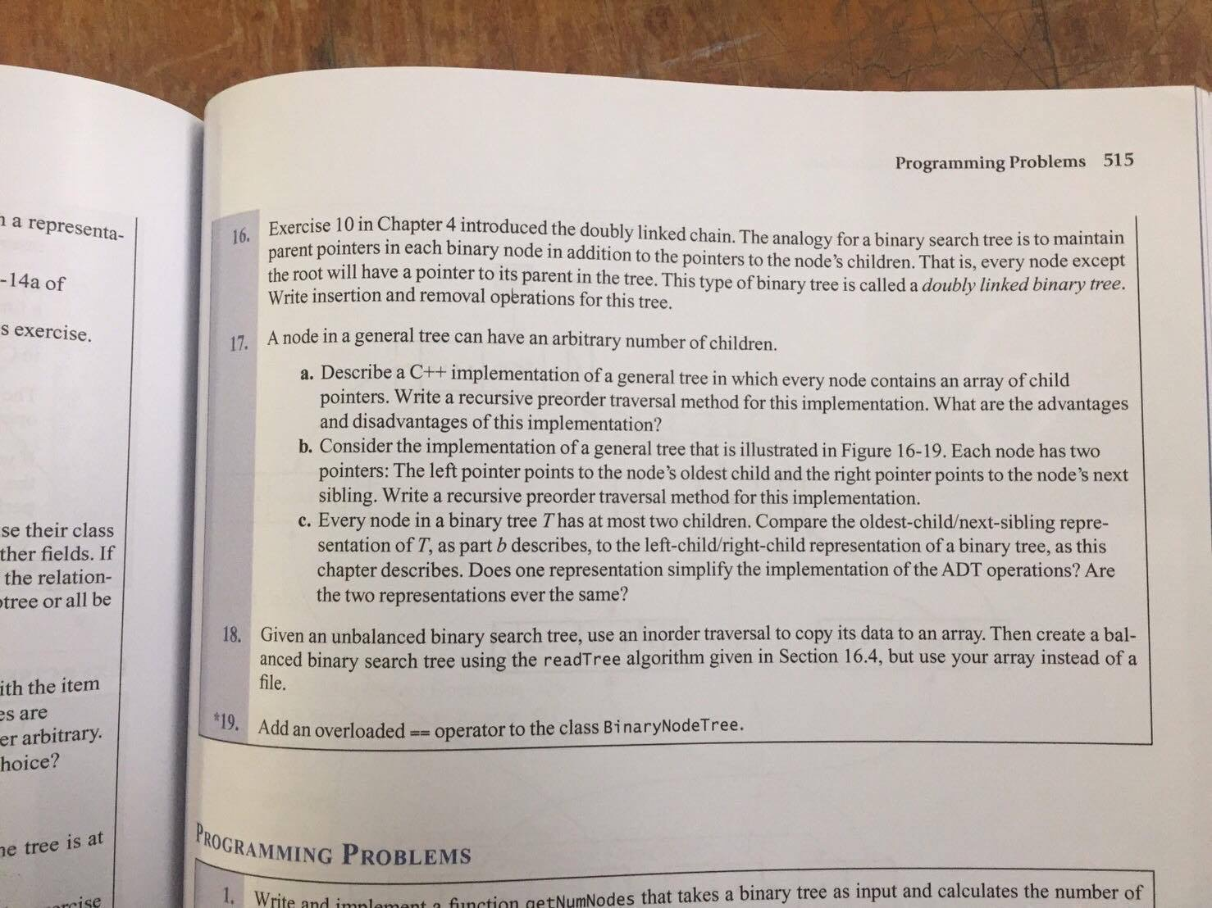

Slide 48
a
a
b
b
c
d
c
d
template<typename T>
void preorder( GeneralTree<T>* root )
{
    cout << root‐>getItem() << endl;
    if ( root‐>getLeftChildPtr() != nullptr )
        preorder( root‐>getLeftChildPtr() );
    if ( root‐>getRightChildPtr() != nullptr )
        preorder( root‐>getRightChildPtr() );
}

Slide 49
Q5 17.14
reverse heapsort

Slide 50
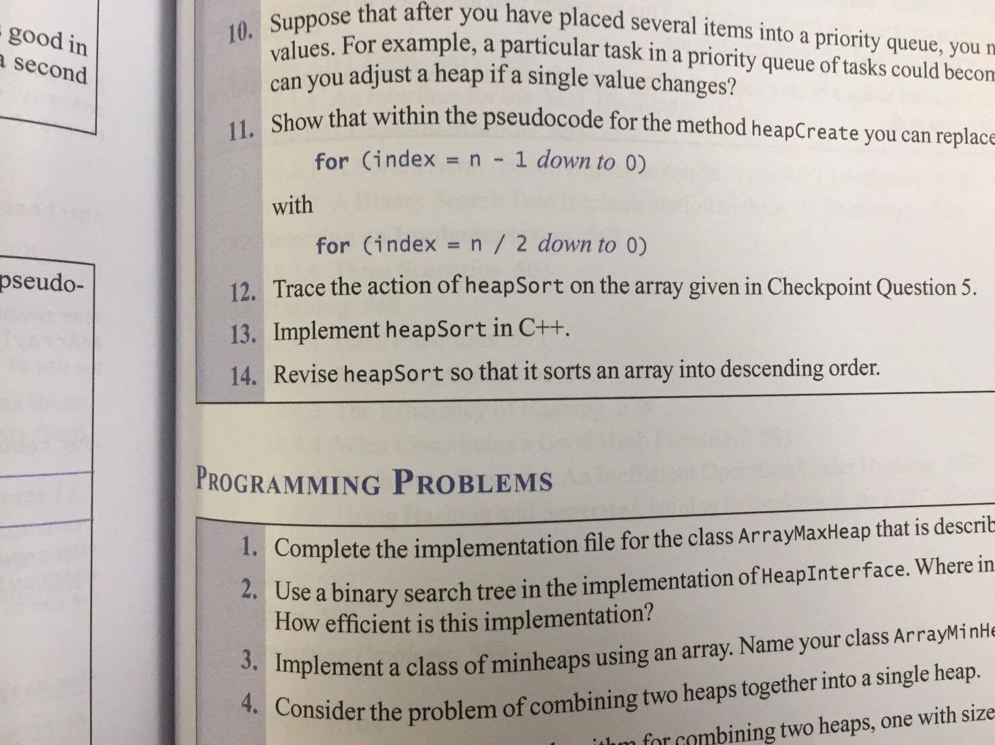

Slide 51
void swap(int &p1, int &p2){
int temp = p1;
p1 = p2;
p2 = temp;
}
void heapRebuild(int* array, int root, int length){
int left = 2*root + 1;
int right = 2*root + 2;
int min = - 1;
if (left <= length-1 && array[left] < array[root])
min = left;
else
min = root;
if (right <= length-1 && array[right] < array[min])
min = right;
if (min != root) {
swap(array[min], array[root]);
heapRebuild(array, min, length);
}
}

Slide 52
void heapRebuild(){
for (int i = itemCount/2; i >= 0 ; i--) {
heapRebuild(items, i, itemCount);
}
}
void HeapSort(){
heapRebuild();
for (int i = itemCount-1;i >=1; i--) {
swap(items[i], items[0]);
heapRebuild(items,0,i);
}
}

