Slide 1
Through Machine Reading to Big Mechanism
Keh-Yih Su
Institute of Information Science, Academia Sinica
Dept. Info. Mgmt., National Taiwan Univ.
March 30, 2018

Slide 2
What NLP Looks for?
Given a sentence
  Determining “who” did “what” to “whom,” “where,” “when,” and “how.”
Given a document
  Determining the relationship between different discourse-units (sentences)

Slide 3
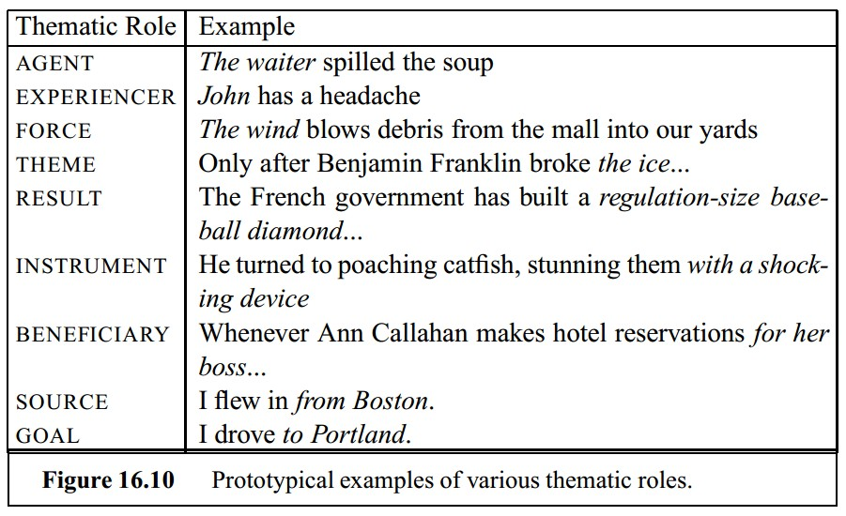
Commonly-used Thematic Roles (2)

Slide 4
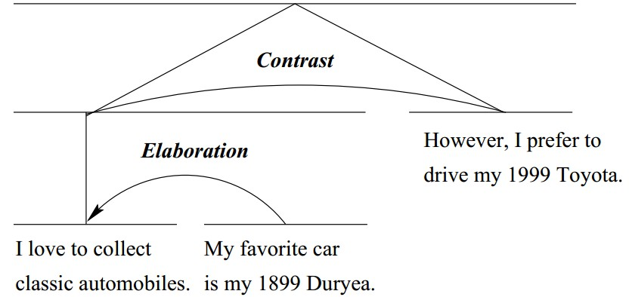
RST Relation (4)
Rhetorical structure analyses are built up hierarchically.
  We may use one pair of related texts as a satellite or nucleus in another higher-level relation.

Slide 5
position ：= initial + rate * 60
lexical analyzer
[Aho 86]
id₁ ：= id₂ + id₃ * 60
syntax analyzer
：=
id₁
+
SYMBOL TABLE
id₂
*
1
position | …
initial | …
rate | …
id₃
60
2
semantic analyzer
3
：=
id₁
+
4
id₂
*
id₃
inttoreal
60

Slide 6
C
intermediate code generator
[Aho 86]
temp1 ：＝ inttoreal (60)
temp2 ：＝ id3 * temp1
temp3 ：＝ id2 + temp2
id1 ：＝ temp3
code optimizer
temp1 ：＝ id3 * 60.0
id1 ：＝ id2 + temp1
code generator
Binary Code

Slide 7
source program
lexical
analyzer
[Aho 86]
syntax
analyzer
semantic
analyzer
error
handler
symbol-table
manager
intermediate code generator
code
optimizer
code
generator
target program

Slide 8
Natural Language is more complicated
Ambiguity (岐義) --- For decoder
  Many different ways to interpret a given sentence.
  #1: “[I saw [the boy] [with a telescope]]"
  #2: “[I saw [the boy [with a telescope]]]"
Ill-Formedness (不合設定, 非正規) --- For decoder
  Language is involving, and no rule-set could completely cover various cases to appear tomorrow
  New Words: Singlish, bioinformatics, etc.
  New Usage: missing verb in "Which one?" …

Slide 9
Various Kinds of Ambiguities (1)
Sentence Segmentation:
  An English “Period” might not be the Sentence-Delimiter (e.g., Eq. 3, Mr. King, etc.)
  Should Chinese “Comma” be regarded as the Sentence-Delimiter?
Tokenization:
  English Split-Idiom and Compound-Noun matching
  Word Segmentation (no space between Chinese chars)
  [[土地公有] 政策] or [[土地公] 有政策] ?
  [這個[討論][會]很熱烈] or [這個[討論會]很熱烈] ?
  Order: tens of candidates per sentence
Notes:
Split-Idiom: Turn the light on. Compound: Green House

Slide 10
Various Kinds of Ambiguities (2)
Lexical: “The current design ….”
  "current": noun vs. adjective
  “design": noun vs. verb
  Order: hundreds of candidates per sentence
Notes:
Split-Idiom: Turn the light on. Compound: Green House

Slide 11
Various Kinds of Ambiguities (3)
Syntactic:
  “[I saw [the boy [in the park]] [with a telescope]]"
  “[I saw [the boy [in the park [with a telescope]]]]"
  Order: several hundreds to thousands (even millions)
  ⬄ Analogy in artificial language: dangling-else problem [Aho 86]
    " [ IF (...) then [ IF (...) then (...) ELSE (...) ] ] "
    " [ IF (...) then [ IF (...) then (...) ] ELSE (...) ] “
    Choose the nearest “IF”, if not particularly specified

Slide 12
Various Kinds of Ambiguities (4)
Semantic:
  Lexicon-Sense:
    Eng: Bank (money vs. river), Take (90+ senses)
    Chn: 方便, 生產, 打 (打人, 打電話, 打蛋, 打電玩, ...)
  Case: Agent vs. Patient
  --- "[The police] were ordered [to stop drinking] by midnight”
  --- “他們 答應 張三 可以 參加 會議 .”
Pragmatic:
  Example: “你好厲害哦” (different intentions)

Slide 13
Various Kinds of Ill-formedness (1)
Unknown Words (not found in dictionaries)
  Due to vocabulary size, proper noun, typing error, breeding words (e.g., Singlish: Singapore English; Linsanity), new technical terms (e.g., bioinformatics), abbreviation (NLP, ML, 海陸兩會,客服, 活儲, 新流感)
Incomplete Lexicon Information (Known Words)
  Known usage, but missing desired information (e.g., part-of-speech)
  New usage (e.g., “Please xerox a copy for me.”)
Notes:
P8

Slide 14
Various Kinds of Ill-formedness (2)
Un-grammatical sentences (cannot be parsed by the given grammar)
  Example: "Which one?" , “這部電影不錯看”
Semantic constrain violation
  Example: “My car drinks gasoline like water.” (subject-verb agreement), “他很機車”
Ontology violation
  Example: There is a plastic bird on the desk. Can this bird fly? (Sowa 2000).
Notes:
P8

Slide 15
Machine Translation is harder
The computer system has to make choices even when the human isn’t (normally) aware that a choice exists.
  Example from Margaret King:
    The farmer’s wife sold the cow because she needed money.
    The farmer’s wife sold the cow because she wasn’t giving enough milk.
  Another example:
    The mother with babies under four….
    The mother with babies under forty…..

Slide 16
    Knowledge Processing Era is Coming
  Data, Information, Knowledge, Insight
    Shift the burden to the machine
  To simplify processing, data/knowledge had better be structuralized
    Database for data processing
    Knowledge-base for knowledge processing
  Most knowledge in the world is expressed in unstructured free text
    NLP is the tool to convert text into structuralized information

Slide 17
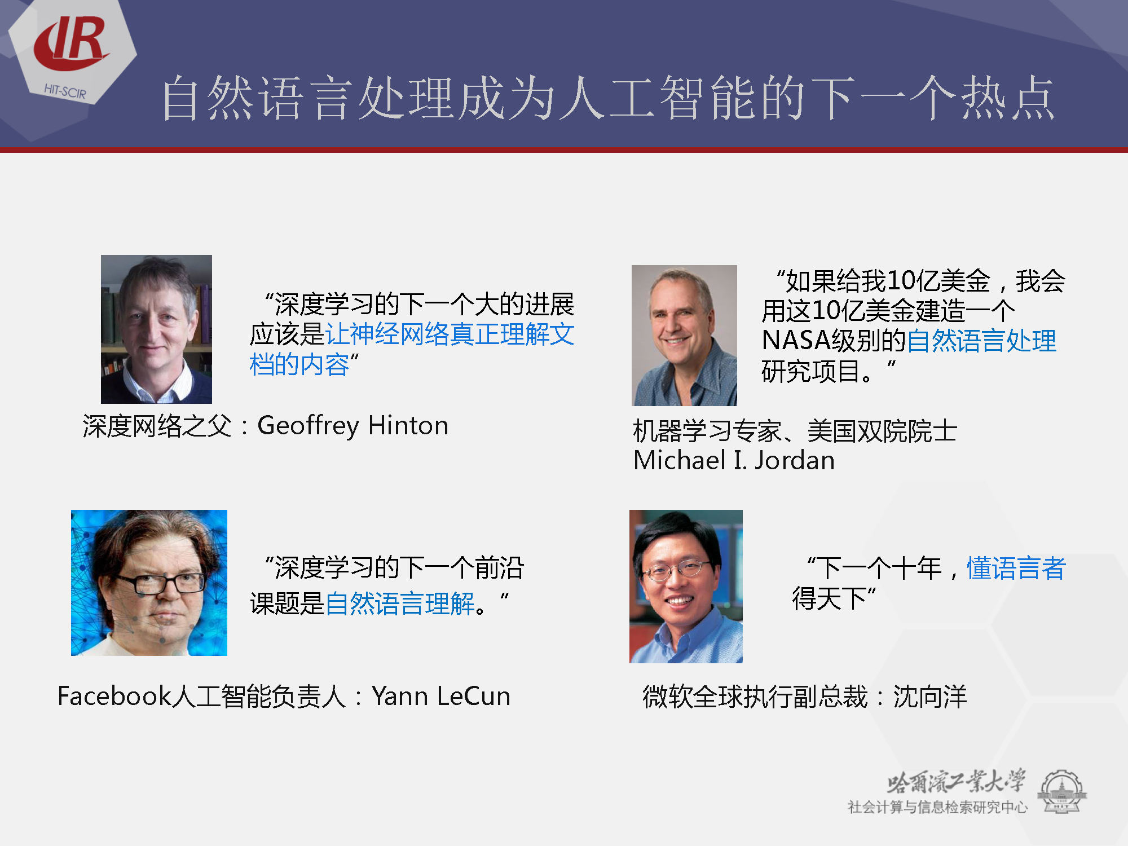

Slide 18
    Big Data alone is not enough
  Big Data aims to explore the correlation between surface features, not their causality relationship
  Only provide surface information, not true knowledge
    Event_A -> Event_B: O(mxn)
  The causality relationship can greatly reduce the complexity that we need to handle, and can interpret the observed phenomena concisely and easily
    For example, exploring signaling pathways in cancer biology

Slide 19
    Why Big Mechanism?
  Big Mechanism
    DARPA, July 2014
    Seek “why” behind big data
  Why Big Mechanism?
    Evolution of our brain capability cannot compete with the knowledge growing speed
    Each researcher is forced to focus on a very narrow topic, unaware of progress in other disciplines
    Many complicated systems are studied piecewisely, and their literatures and data are fragmented
    Need a mechanism to handle complicated systems in which interactions have important causal effects.

Slide 20
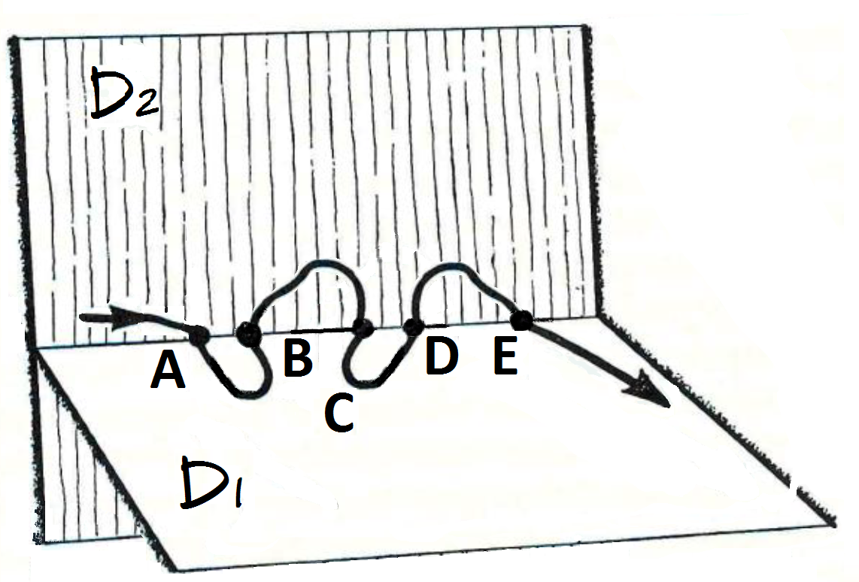
Bisociative Knowledge Discovery
Swanson, 1986: Associating fish oil with Raynaud’s syndrome (because both had a relationship to blood viscosity)
inference on them.

Slide 21
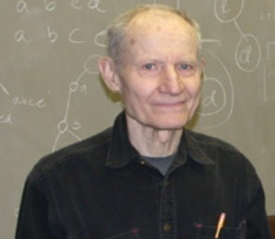
Undiscovered Public Knowledge (Swanson, 1986)
  Individual units of literature are independently created
  “The logical connections among the units may be unintended by and even unknown to their creators”
  Swanson’s famous prediction
    “Fish oil and Raynaud’s syndrome”
      雷諾氏徵候群: 是一種交感神經過度反應的症狀，當接觸冰冷時血管收縮會更厲害，容易使腳底發紅、發紫，進而走路不穩。
    “Migraine–Magnesium”
      由缺鎂引起的偏頭痛症

Slide 22
    Why Machine Reading?
  How is Machine Reading related to Big Mechanism?
    The pre-requisite for Big Mechanism that is that we can read each document and learn its associated knowledge
    Machine Reading is able to give the answer that is implied in the text
      Open-domain Q&A only aims to find out the text passage that contains the answer

Slide 23
    What is Machine Reading (MR)?
  Read the given text/document, convert the content into logical form, and then perform inference on it.
  Evaluated by Reading Comprehension Test
  An inter-discipline research (NLP+KRR+ML)
    Natural Language Processing (NLP)
    Knowledge Representation and Reasoning (KRR)
    Machine Learning (ML)

Slide 24


MOST Project
  Project： Design a generic/meta MR framework via building three different MR systems:
    Solving the Math Word Problem in daily life;
    Answering the problems associated with the elementary school social studies text;
    Acquiring the interactive relations between different bio-chemical entities embedded in the bio-medical document.
  Project Coordinator： Keh-Yih Su (蘇克毅)
  Other PIs： Wen-Lian Hsu (許聞廉), Lun-Wei Ku (古倫維)
Period：3 Years (2016/Aug.-2019/July)

Slide 25
Academia Sinica Thematic Project
  Project： Cross-Lingual Cross-Document Knowledge Discovery at Micro and Macro Levels (結合微觀與巨觀之跨語言跨文件知識發掘)
  Project Coordinator： Keh-Yih Su (蘇克毅)
  Other PIs： Hsin-Hsi Chen (陳信希), Lun-Wei Ku (古倫維), Cheng-Te Li (李政德)
Period：3 Years (2018/Jan.-2020/Dec.)

Slide 26
    Related Work (1)
  Related preliminary researches (IE, Q&A)
    Information Extraction
      Fill in specified templates for a given domain
      Switching domains implies to re-train the system
    Open Domain Question and Answering
      Extract desired answer passage from the text
      Cannot answer even the simple problem if the desired answer is not included in the text

Slide 27
    Related Work (2)
  MR related research activities
    A MR program was initiated at DARPA (2009/6 – 2012/1)
      Learn to read, and read to learn what they need in order to answer questions or perform some reasoning tasks
    Under another project called Deep Exploration and Filtering of Text (DEFT) since June 2012
    Conducted at Europe under the CLEF Initiative (Conference and Labs of the Evaluation Forum
    At NTCIR in Japan, and under the Forum for Information Retrieval Evaluation (FIRE) in India

Slide 28
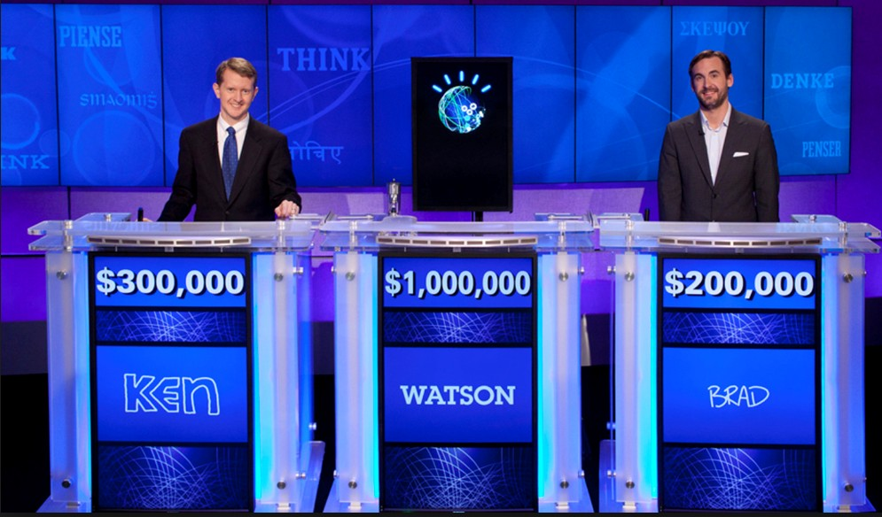
    Related Projects (1)
  IBM Watson (Ferrucci, 2012)
    On January 14, 2011, beat the two best Jeopardy! champions in a real-time two-game competition.
    Start from April 2007.
    Adopt the Unstructured Information Management Architecture to integrate a set of cooperating annotators

Slide 29
    Related Projects (2)
  Japan Todai Robot Project (Tainaka, 2013; Fujita et al., 2014)
    Attain high scores in the Japanese National Center Test for University Admissions by 2016, and pass the
    University of Tokyo’s entrance examination by 2021
    Initiated by the National Institute of Informatics in 2011 as an AI grand challenge
    Cover eleven subjects in the Center Test:
      Biology, Chemistry, Ethics, English (foreign language), Japanese (native language), Japanese History, Mathematics, Modern Society, Physics, Politics and Economics and World History

Slide 30
    Related Projects (3)
  China “Robot for College Entrance Exam” Project
    Target: Pass “一本” line at “高考” by the end of 2017
    Initiated by 863 Project at January 2015
      Key technologies of simulating human intelligence based on big data
    Cover four subjects in the Center Test:
      Chinese, History, Geography, Mathematics
    Principal Investigators
      Chinese: HIT (Harbin Institute of Technology)
      History: ISCAS (Institute of Software, CAS)
      Geography: Nanjing University
      Mathematics: UESTC (University of Electronic Science and Technology of China)

Slide 31






Reasoning Engine & ML
NLP
Knowledge Base
Rules & Functions

Slide 32


Knowledge Discovery through
Structural Document Understanding
Yuji Matsumoto
(Nara Institute of Science and Technology)
Big Data Application
（2015.10-2021.3)
October 27, 2015
Academia Sinica
Background
Rapid increase of scientific / technical documents
Web of Science and Scopus cover 23M and 53M technical papers
Unable for researchers to read all of related papers
Aim
Developing and deepening Text/Document analysis technologies
Implementing content-aware document retrieval and recommendation
Enabling novel knowledge acquisition and surveillance
All of those will be done through various levels of structure analysis of documents

Slide 33
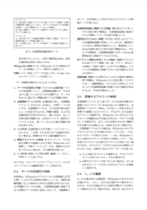
Overview of the Project
Text/Document Analysis
(T1, T5)
Knowledge Base Construction
(T2, T3, T4)
Structural Similarity Analysis
(T6, T7)
User Interface / Survey Generation
(T8, T9)
Inner-Document Analysis
Inter-Document Analysis
Text/Document
Analysis
Concept/Relation
Analysis
Event Chain Analysis
Document Structure Analysis
Document Summarization
Citation Analysis
Document Relation
Document Similarity
Multi-Document Summarization
Survey Generation
User Interface / Document Visualization

Slide 34

Machine Reading Contest
http://mrc2018.cipsc.org.cn/

Slide 35
    Turing test was considered harmful
  Original Turing test tries to distinguish a male from a female
    Depend on the interrogation skill
    Only give binary (Yes/No) answer
  Prefer Math/Science Standardized Tests
    Provide different types of knowledge and vary substantially in difficulty
      Basic questions
      Simple Inference
      More Complex World Knowledge

Slide 36
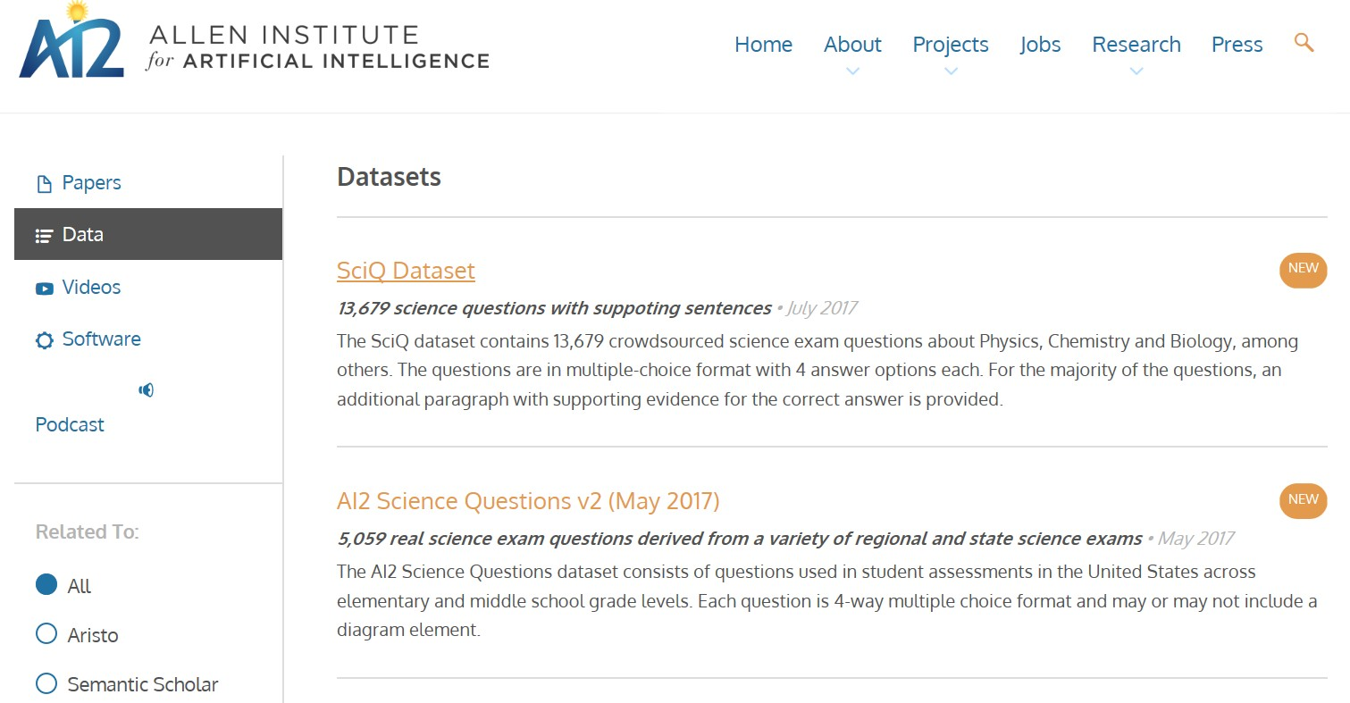
    Science Data-Sets
AI2 (http://allenai.org/data.html)

Slide 37
Outline
Big Data alone is not enough
Why Big Mechanism?
Why Machine Reading?
Introduction to ongoing projects:
*QA system
1. Solving Math Word Problems: The first test case
2. Q&A for Social Studies: The second test case
* Multi-Document Processing
1. Knowledge discovery
2. Up-to-date person/company profile

Slide 38
MWP: A First Case for MR
Math Word Problems (MWP):
Not Math Word Problems:
文具店進貨2361枝紅筆和1587枝藍筆, 文具店共進貨幾枝筆?
原子筆每枝20元，鉛筆每枝5元，姐姐買了24枝筆，共付了270元， 兩種筆各買幾枝？
一艘輪船20分鐘可以行駛25公里，2.5小時可以行駛多少公里？
小天的跳遠紀錄是1.3公尺，小美的紀錄是1.03公尺，小綜的紀錄是1.33公尺。三人中誰跳得最遠？
2 x 3 +5 = ?

Slide 39
Why is MWP the First Case for MR?
The answer cannot be extracted by simply performing keyword matching (beyond Q&A).
Adopts less complicated syntax; Requires less amount of domain knowledge.
Body part of MWP usually consists of only a few sentences.
Standalone applications (e.g., Computer Math Tutor, Helper for Math in Daily Life)

Slide 40
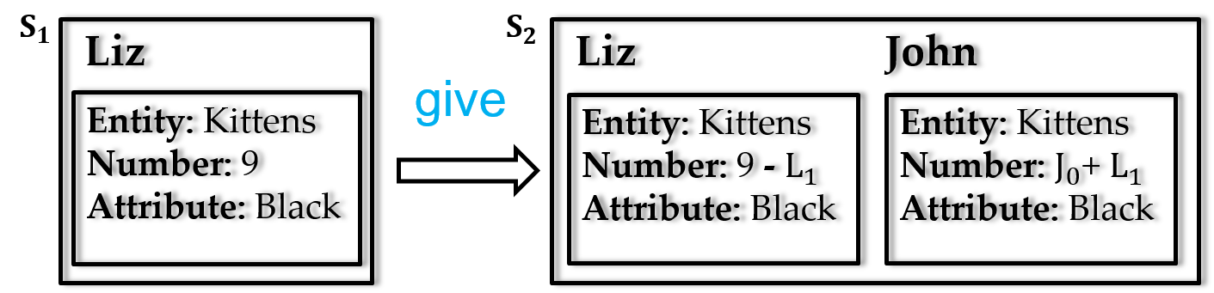
Rule-Based: Hosseini, 2014
Liz had 9 black kittens. She gave some of her kittens to John.
Grounding into Entities and Containers
[ give, 9 black kittens, Liz, John ]
Classify Verb Categories
(Liz, give): Negative
(John, give): Positive
Forming State Transitions and Equations

Slide 41
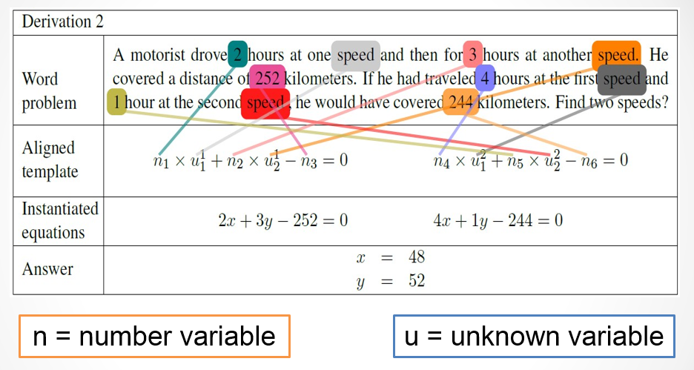
Pure Machine Learning Approaches
Purely statistical approaches (Kushman etc., 2014; Roy et al., 2015):
  Linear algebraic questions
  Mapping problem to a set of equations
  Generate numerical answers

Slide 42

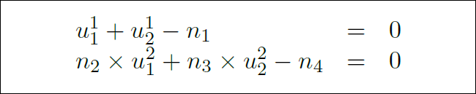
Kushman et al., 2014 (1/4)
Dataset: Algebra.com
  Linear algebra question (#514)
Manually label equation
Generalize equation to a template with two rules

Slide 43
Kushman et al., 2014 (2/4)
  Try each template and variable alignment with a score
u1 + u2 = n1
n3*u1 + n4*u2 = n5
u1 + n1*u2 = n2
n3*u1 + n4*u2 = n5
Word problem
. . . .
2X + 3Y = 252
4X + Y = 244
. . . .
u1 + u2 = n1
u1 + u2 = n2

Slide 44
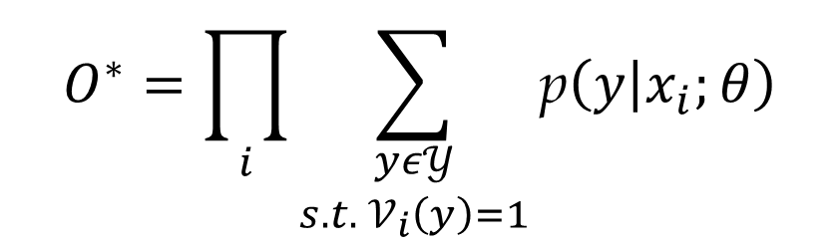
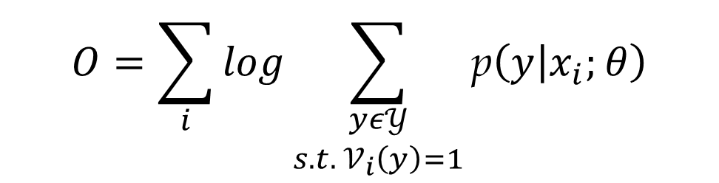
Kushman et al., 2014 (3/4)
  Objective function
$$O^{∗}=\prod_{i}{\sum_{\begin{aligned}yε𝒴 \\ s.t. 𝒱_{i}\left(y\right)=1\end{aligned}}{\text{p}\left(y | x_{i};θ\right)}}$$
$$O=\sum_{i}{log\sum_{\begin{aligned}yε𝒴 \\ s.t. 𝒱_{i}\left(y\right)=1\end{aligned}}{\text{p}\left(y | x_{i};θ\right)}}$$

Slide 45
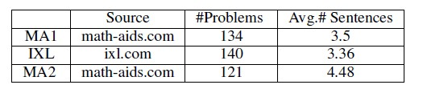
Experiment and Result (1/2)
Joan found 70 seashells on the beach . she gave Sam some of her seashells . She has 27 seashell . How many seashells did she give to Sam ?
MA1: Simple Problems
IXL: More complicated sentences
MA2: Irrelevant info
395 problems, 13,632 words, 188 verbs, and 1,483 sentences.

Slide 46
Experiment and Result (1/2)
Joan found 70 seashells on the beach . she gave Sam some of her seashells . She has 27 seashell . How many seashells did she give to Sam ?
MA1: Simple Problems
IXL: More complicated sentences
MA2: Irrelevant info
395 problems, 13,632 words, 188 verbs, and 1,483 sentences.
A ship is filled with 5973 tons of cargo . It stops in the Bahamas , where sailors load 8723 tons of cargo onboard . How many tons of cargo does the ship hold now ?

Slide 47
Experiment and Result (1/2)
Joan found 70 seashells on the beach . she gave Sam some of her seashells . She has 27 seashell . How many seashells did she give to Sam ?
MA1: Simple Problems
IXL: More complicated sentences
MA2: Irrelevant info
395 problems, 13,632 words, 188 verbs, and 1,483 sentences.
A ship is filled with 5973 tons of cargo . It stops in the Bahamas , where sailors load 8723 tons of cargo onboard . How many tons of cargo does the ship hold now ?
Jason found 49 seashells and 48 starfish on the beach . He gave 13 of the seashells to Tim . How many seashells does Jason now have ?

Slide 48
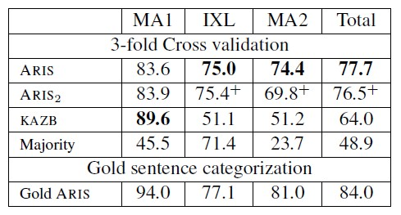
Experiment and Result (2/2)
KAZB: Learning to align problems to templates
ARIS2: No verb is repeated in train and test set
Majority: All verbs are assumed to be positive
Gold ARIS: Uses correct verb categories

Slide 49
Drawback of Previous Works
Weakness of rule-based approaches:
  Difficult to raise the coverage rate and deal with ambiguities.
  Expensive to construct.
Weakness of not adopting logic inference:
  Need to implement a new handling procedure for each new type of problems (as the general logic inference mechanism is not adopted).
  No inference engine to generate the reasoning chain, additional effort would be required for generating the explanation.
Weakness of purely statistical approaches:
  No understanding.
  System is sensitive to irrelevant information.

Slide 50
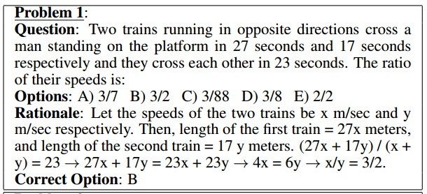
    DNN for Algebraic Word Problems (1)
  A DNN approach for AWP?
    “Program Induction by Rationale Generation:
    Learning to Solve and Explain Algebraic Word Problems”, Wang Lin et al., ACL-2017.

Slide 51
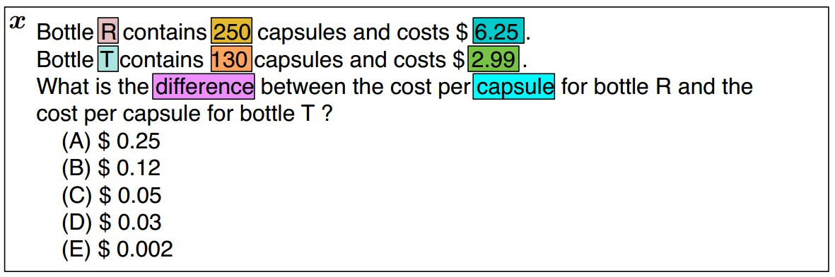
    DNN for Algebraic Word Problems (4)

Slide 52
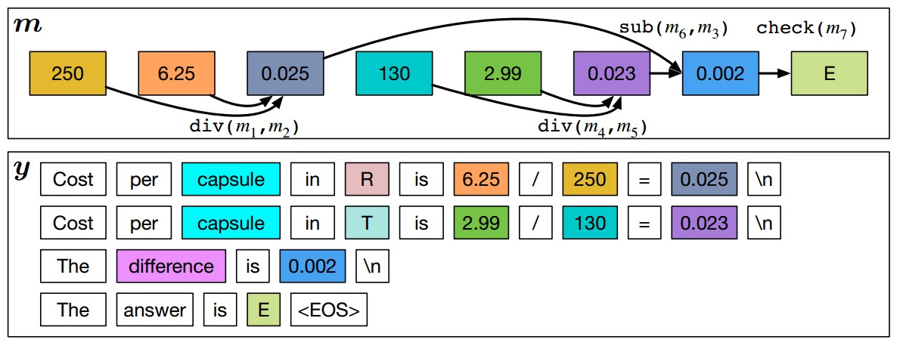
    DNN for Algebraic Word Problems (5)

Slide 53
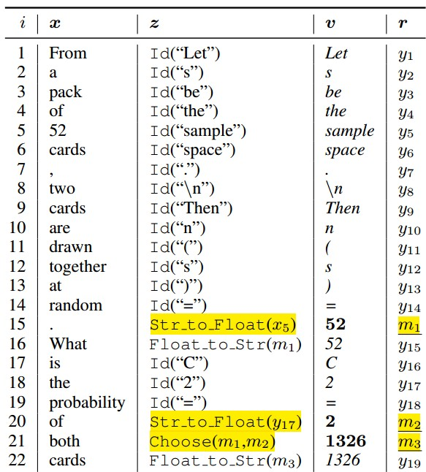
    DNN for Algebraic Word Problems (3)

Slide 54
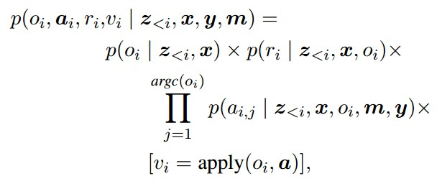
    DNN for Algebraic Word Problems (6)

Slide 55
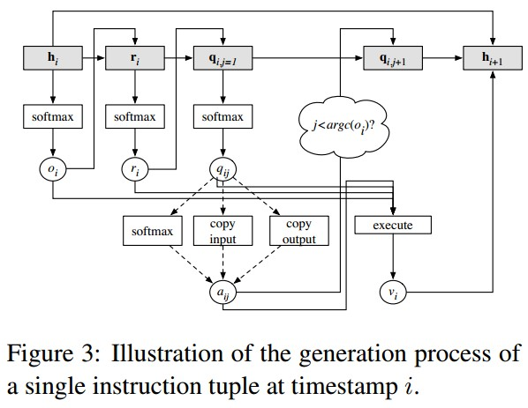
    DNN for Algebraic Word Problems (7)

Slide 56
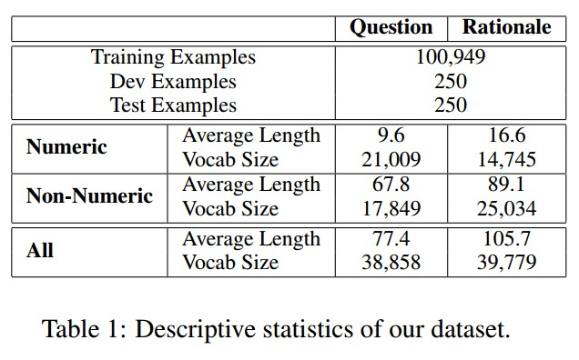
    DNN for Algebraic Word Problems (2)

Slide 57
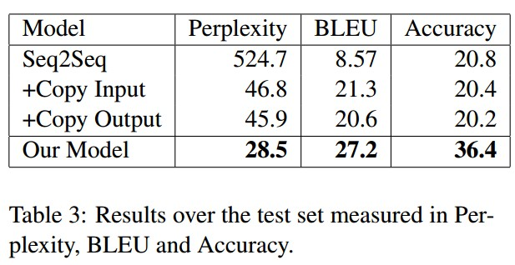
    DNN for Algebraic Word Problems (8)
The problems that can be solved correctly correspond to simple problems that can be solved in one or two operations

Slide 58
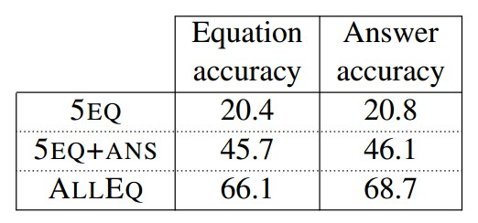
    DNN for Algebraic Word Problems (9)
People do not learn math concepts directly from those examples
  People first learn math concepts separately, then apply them to the problems
Rationale learnt here is not the math concept
Seems the learning efficiency and performance are far less than (Kushman et al., 2014)
  #514 Problems

Slide 59
Why Babies Learn Language Easily?
Human seems more efficient in learning
  Human does not need so much training text
Associated perplexity of two tasks are different
  Baby cannot learn foreign languages by just watching TV
  Seems human just learn the type of modes, not the details of a given mode (“The Language Instinct”, Steven Pinker, 1994)

Slide 60
    DNN with huge amount of data?
  What is intelligence?
    Question-answering, explanation, learning and reading, and dealing with novel problems
  Data-driven AI cannot reach our goal
    Understanding and Inference is essential

Slide 61
Design Principles (1/2)
Problems should be solved via understanding and inference
  versus the purely statistical approach which does not perform language analysis
  MWP is only our first task for MR
Able to handle various kinds of questions
文具店進貨2361枝紅筆和1587枝藍筆，賣了100枝藍筆，
還剩幾枝筆?還剩幾枝藍筆?共進貨幾枝紅筆? 共進貨幾枝筆?
共賣了幾枝筆? 小明共進貨幾枝筆?
Ref: "Seminar 2015-03-17 ProposedApproach.ppt" by Dr. Lin

Slide 62
How Human Solve a MWP ?
Math Word Problem
Understand Meaning
Figure out How to Solve It
Math lesson learnt from a math class
Elaborate Detailed Steps
Turning MWP into math equations
Calculation
Solving the equation

Slide 63
Framework
Math Word Problem Paragraph
(body text and questions)
Language Analysis
Semantic Sequences
Solution Type Classifier
Logic Form Converter
Inference Engine
Question-Answer Pairs
Explanation Texts
Explanation Generation

Slide 64
Task
Math word problem (MWP):
文具店進貨2361枝紅筆和1587枝藍筆, 文具店共進貨幾枝筆?
Language Analysis:
S(agent:NP(Head:Ncb:文具店)|Head:VA4:進貨|theme….
{進貨.buy|買:agent={[x1]文具店.{商店|shop:predication={or({buy|買},……
Logic Form (LF):
LF1: verb(v1,進貨)&agent(v1,文具店)&theme(v1,n1)& …
LF2: quan(q1,枝,n1)=2361&verb(q1,進貨)&agent(q1,文具店)&role(q1,theme) …
ASK Sum(quan(?q,枝,n3), verb(?q,進貨)&agent(?q,文具店))
Logic Inference Engine (IE):
(quan(q1,枝,n1_{p})=2361) + (quan(q2,枝,n2_{p})=1587) = 3948
Explanation generation:
共進貨 2361枝紅筆 + 1587枝藍筆 = 3948枝筆

Slide 65
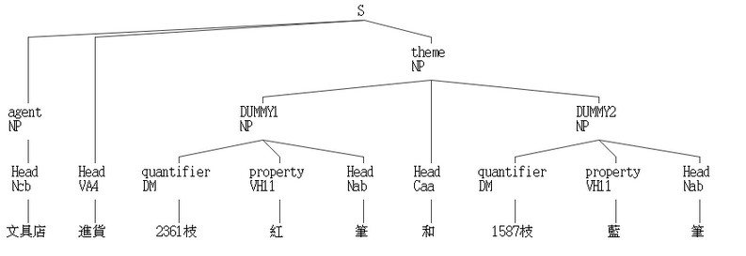
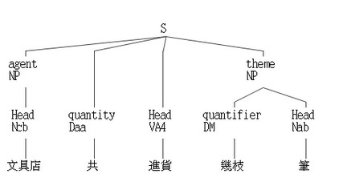
Syntactic/Semantic analysis (1/4)
CKIP Chinese parser
  Generate syntactic structure
Semantic Role Labeling
文具店進貨2361枝紅筆和1587枝藍筆，文具店共進貨幾枝筆？

Slide 66
Syntactic/Semantic Analysis (2/4)
E-Hownet Semantic Composition
  Anaphora: Finding the antecedent for a pronoun.
木工拿出一塊長40cm、寬20cm的長方形木板，他想從中裁出幾個半徑2cm的圓，他最多可以裁出幾個圓形？
{拿出.take|取:
agent={[x1]木工.工人|worker},
theme={[x2]木板.wood|木:
一.quantity={1},
長.length={cm.{公分}:
quantity={40}
},
寬.width={cm.{公分}:
quantity={20}
},
長方形.shape={square|方:length={LengthLong|長}}
},
source={[x]}
{想.{expect|期望}:
experiencer={[x1]他.3rdPerson|他人},
content={裁出.{cut|切削}:
從中.source={[x2]},
patient={[x3]圓.image|圖像:
幾.quantity={Ques|疑問},
半徑.length({[x3]})={cm.{公分}:
quantity={2}
}
},
agent={[x1]}
}
{裁出.{cut|切削}:
agent={[x1]他.3rdPerson|他人},
最多.range={extensive|泛:degree={extreme|極}},
可以.possibility={ish|稍},
patient={[x3]圓形.ShapeValue|形狀值:
幾.quantity={Ques|疑問}
}
}
}

Slide 67
Syntactic/Semantic Analysis (3/4)
Semantic Composition
  Zero-Anaphora:
妹妹1天存150元，365天共可存幾元？
{存.store|保存:
agent={[x1]妹妹.妹妹|YoungerSister},
duration={天.day|日:
quantity={1}
},
theme={元.money|貨幣:
quantity={150}
},
location={[x]}
}
{存.store|保存:
duration={天.day|日:
quantity={365}
},
共.quantity={all|全},
可.possibility={ish|稍},
theme={元.money|貨幣:
幾.quantity={Ques|疑問}
},
agent={[x1]},
location={[x]}
}

Slide 68
Syntactic/Semantic Analysis (4/4)
Semantic Composition
  Co-reference:
    Finding referring expressions that refer to the same entity.
文具店進貨2361枝紅筆和1587枝藍筆，該店共進貨幾枝筆？
{進貨.buy|買:
agent={[x1]文具店},
theme={和.and(
{筆.PenInk|筆墨:
quantity={2361},
color={紅.red|紅}
},
{筆.PenInk|筆墨:
quantity={1587},
color={藍.blue|藍}
}
)},
}
{進貨.buy|買:
agent={[x1]文具店},
共.quantity={all|全},
theme={筆.PenInk|筆墨:
幾.quantity={Ques|疑問}
},
}

Slide 69
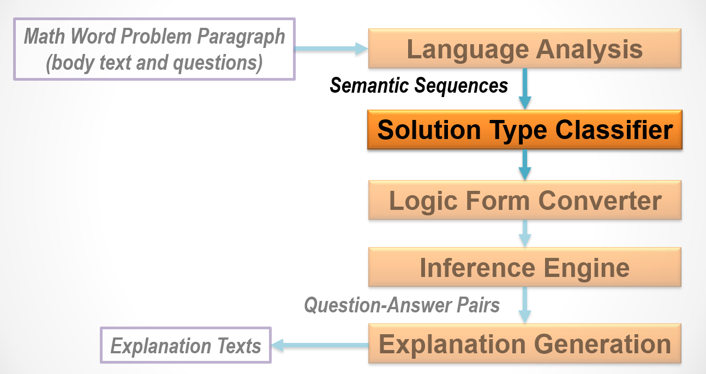
Notes:
到stc

Slide 70
Solution Type Identification (2/3)
Solution type (ST) with frequency in seed corpus (manually annotated 75 samples).
Multiplication (24%) | Utility (6%) | Surplus (4%) | L.C.M (2%)
Sum (14%) | Algebra (5%) | Difference (4%) | G.C.D (2%)
Subtraction (12%) | Comparison (5%) | Ceil-Division (3%) | Addition (1%)
Floor-Division (7%) | Ratio (5%) | Common-Division (3%) | Set-Operation (1%)
Notes:
在我們的seed corpus裡面 ,
multiplication和sum佔了較大的比例

Slide 71
Solution Type Identification (1/2)
Currently, a SVM classifier with linear kernel function is used and four different kinds of feature-sets are adopted
  Lexicon.
    Ques part with lexicon “共”
  Lexicon pair.
    lexicon pair like “?比?便宜”
  Lexicon and POS pair.
    Pair [Verb, asking unit in Ques part] e.g. [ VC(修築), 天]
  Pattern-matching indicators.
    Relation between object-unit in question sentences and object-unit in body sentences (currently manually created).
動作及物動詞
Notes:
目前stc 是採用svm with linear kernel,
還有四種不同的feature set下去train,
像是unig……

Slide 72
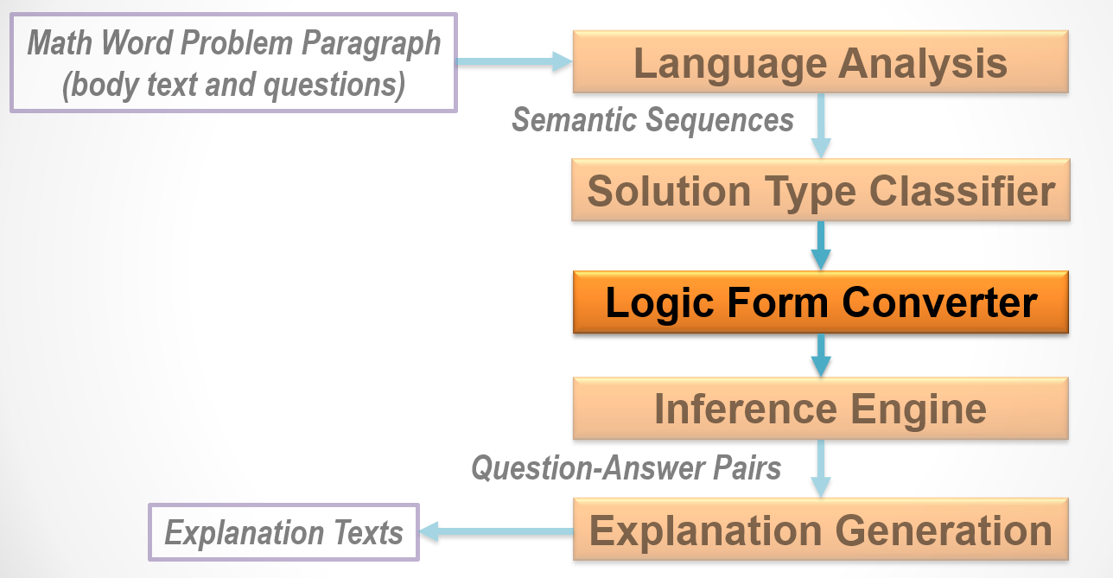

Slide 73
Math Concepts
Math Concepts
300朵玫瑰
→quan(q1,朵,玫瑰)=300
quan(id, unit, obj)=value
q_map(id, quan1, quan2)
u_map(id, unit1, obj1, unit2, obj2)=value
has(container, unit,obj, time-index)=value
circle(id, obj)
regular_triangle(id, obj)
trapezoid(id, obj)
radius(id, unit)=value
diameter(id, unit)=value
top_base(id, unit)=value
bottom_base(id, unit)=value
height(id, unit)=value
circumference(id, unit)=value
side_length(id, unit)=value
area(id, unit)=value
set(id)
member(id, obj)
Notes:
在lfc 有很多的math concepts
利入quantity, 舉個例子, 300朵玫瑰….

Slide 74
Input/Output of Logical Form Converter
SR:
{進貨:
agent={文具店},
theme={和.and(
{筆:
quantity={2361}, unit={枝}, color={紅}},
{筆:
quantity={1587}, unit={枝}, color={藍}})},
…
Semantic
Sequences
(Input)
Logic Form
Converter
LF1:
verb(v1,進貨)&agent(v1,文具店)&theme(v1,j1)
cj_op(j1,and)&cj_arg(j1,n1)&cj_arg(j1,n2)
head(n1,筆)&quantity(n1,2361)&unit(n1,枝)&color(n1,紅)
head(n2,筆)&quantity(n2,1587)&unit(n2,枝)&color(n2,藍)
LF2:
quan(q1,枝,n1)=2361&verb(q1,進貨)&agent(q1,文具店)&role(q1,theme)
quan(q2,枝,n2)=1587&verb(q2,進貨)&agent(q2,文具店)&role(q2,theme)
...
ANS=Sum(quan(?q,枝,n3),verb(?q,進貨)&agent(?q,文具店))
First order
logic
(FOL)-like
statements
(Output)

Slide 75
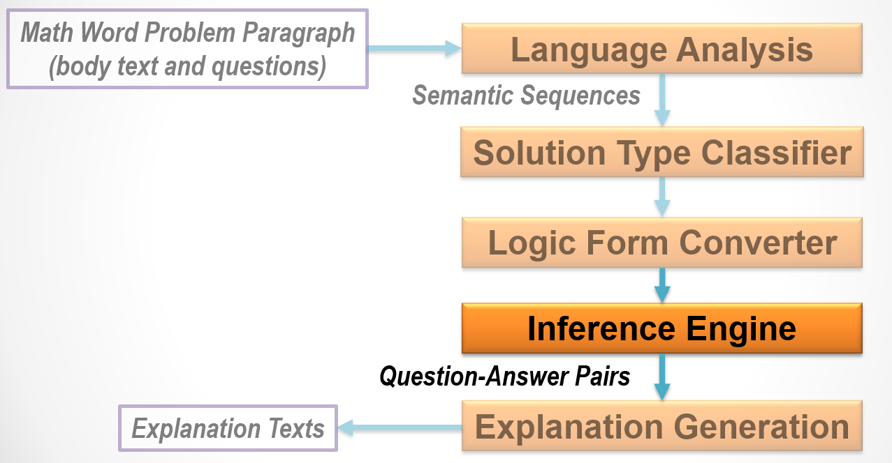

Slide 76
Logic Inference (3/8)
The problem which needs to derive new facts according to background knowledge:.
爸爸買了3本329元的故事書和2枝465元的鋼筆，爸爸共要付幾元?
quan(q1,本,n1_{p})=3&verb(q1,買)&agent(q1,爸爸)&
head(n1_{p},故事書)&price(n1_{p},329)
quan(q2,枝,n2_{p})=2&verb(q2,買)&agent(q2,爸爸)&
head(n2_{p},鋼筆)&price(n1_{p},465)
ASK Sum(quan(?q,元,#),verb(?q,付)&agent(?q,爸爸))
quan(q1,本,n1)&verb(q1,買)&agent(q1,爸爸)&price(n1,329)
→quan(q3,元,#)=quan(q1,本,n1)×329&verb(q3,付)&agent(q3,爸爸)
quan(q1,本,n1)×329=3×329=987
→quan(q3,元,#)=987&verb(q3,付)&agent(q3,爸爸)
Notes:
Ie 還會根據lfc 給的fact 產生新的fact,
像是”3本329元”
在lfc 會得到的fact 就是 q1…….q2……

Slide 77
Verb entailment (1/2)
The MWP might adopt different verbs among body text and question text.
爸爸買了3本329元的故事書和2枝465元的鋼筆，爸爸共要付幾元?
quan(?q,?u,?o)&verb(?q,買)&agent(?q,?a)&price(?o,?p)
→quan($q,元,#)=quan(?q,?u,?o)×?p&verb($q,付)&agent($q,?a)
Verb entailment required
Notes:
有些問題, 在q的verb 和 body 的verb 不一樣, 在binding 的時候可能會miss match
例如, 因為”買” , 所以要”付” ie 必須要了解 verb之間存在有意義的關係, 用v e

Slide 78
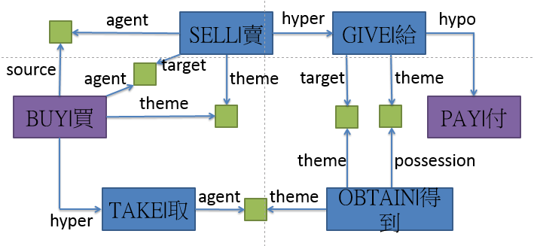
Verb entailment (2/2)
Given an order verb pair (買, 付) as input, we want to detect whether the entailment relation ‘買→付’ holds for this pair.
  E-HowNet is adopted as the knowledge base for solving this problems.

Slide 79
Logic Inference (2/8)
The problem which can be calculated from the facts directly derived from MWP:
花店進貨300朵玫瑰和600朵百合, 上午賣出186朵百合,下午賣出234朵，問花店共賣出幾朵百合?
quan(q1,朵,玫瑰)=300&verb(q1,進貨)&agent(q1,花店)&…
quan(q2,朵,百合)=600&verb(q2,進貨)&agent(q2,花店)&…
quan(q3,朵,百合)=186&verb(q3,賣出)&agent(q3,花店)&…
quan(q4,朵,百合)=234&verb(q4,賣出)&agent(q4,花店)&…
ASK Sum(quan(?q,朵,百合),verb(?q,賣出)&agent(?q,花店))
quan3 + quan4 = 186 + 234
= 420
Notes:
這樣的一個mwp , ie 根據lfc 產生的fact做binding
可以看到 最後問的是 “賣出, 花店”
Ie 在座binding 就不會去找到 不相關的 quantity (進貨) 可以filter掉 irrelevant information
相較於 以前的work, 不知道這些attribute, 就可能會把irrelevant quantity 來做計算.

Slide 80
Logical Form Converter (1/13)
E.g.文具店進貨2361枝紅筆和1587枝藍筆，文具店共進貨幾枝筆？
文具店共進貨幾枝筆？
SR:
{進貨(3):
agent={[x1]文具店(1)},
quantity={共(2)},
theme={筆(5):
quantifier={幾枝(4)}
}
}
文具店(1,Ncb): {商店|shop:predication={or({buy|買},{sell|賣}):possession={stationery|文具},agent={~}}}
共(2,Daa): {all|全}
進貨(3,VA4): {buy|買:agent={商店|shop},theme={商品|commodity}}
幾枝(4,DM): quantifier={枝.null|無義:幾.quantity={Ques|疑問}}
筆(5,Nab): {PenInk|筆墨}
LF1:
verb(v2,進貨)&agent(v2,n7)&head(n7,文具店)&
quantity(v2,共)&theme(v2,n3)&head(n3,筆)&
unit(n3,枝)&quantity(n3,幾)
LF2:
ANS=Addition(quan(q1,枝,紅筆),quan(q2,枝,藍筆))
quan(q1,枝,紅筆)=2361, quan(q2,枝,藍筆)=1587
Solution Type: Addition
Notes:
另外lfc 還會根據stc 所給的type
找到operation utilities 的argument.

Slide 81
Logical Form Converter (2/13)
E.g.奇幻森林裡有4256棵樹，每38棵劃分成1區，共可劃分成幾區？
共可劃分成幾區？
SR:
{劃分成(3):
quantity={共(1)},
epistemics={可(2)},
range={區(5):
quantifier={幾(4}
},
theme={[x1]}
}
共(1,Daa): {all|全}
可(2,Dbaa): possibility={ish|稍}
劃分成(3,VG2): {become|成為:means={classify|分類}}
幾(4,Neqa): quantity={Ques|疑問}
區(5,Ncb): {district|區}
LF1:
verb(v3,劃分成)&quantity(v3,共)&epistemics(v3,可)&
range(v3,n4)&head(n4,區)&quantity(n4,幾)
LF2:
ANS=CeilDiv(quan(q1,棵,樹),u_map(?m,#,區,棵,樹)&
verb(?m,劃分成))
quan(q1,棵,樹)=4256 & quan(q2,棵,樹)=38 & qmap(m1,q1,q2) & verb(m1,劃分成)
=> u_map(m1, #,區,棵,樹): 1區樹?棵
Solution Type: CeilDiv
Notes:
另外lfc 還會根據stc 所給的type
找到operation utilities 的argument.

Slide 82
Logical Form Converter (4/13)
E.g. 2.32公升的水和2.294公升的果汁，哪一種比較少？
哪一種比較少？
SR:
{少(3):
theme={飲料(1.1):
quantifier={[x1,x2]哪一種(1)}
},
degree={比較(2)}
}
哪一種(1,DM): quantifier={種.kind({entity|事物}):一.quantity={1}},哪.quantifier={Ques|疑問}
飲料(1.1,Naa): {drinks|飲品}
比較(2,Dfa): degree={more|較}
少(3,VH13): {few|少}
LF1:
verb(v1,少)&theme(v1,n3)&degree(v1,比較)&head(n3,j1)&quantifier(n3,哪)&qualification(n3,u3)&head(u3,種)&quantity(u3,1)
LF2:
set(s1)&member(s1,水)&member(s1,果汁)
Ans=ArgMin(quan(?q,?u,?o)&member(s1,?o))
Solution Type: Comparison
Notes:
另外lfc 還會根據stc 所給的type
找到operation utilities 的argument.

Slide 83
Logical Form Converter (5/13)
E.g.長３公尺、寬２公尺的長方形，面積是多少平方公尺？
面積是多少平方公尺？
SR:
{是(2):
theme={[x2]面積(1)},
range={多少平方公尺(3)}
}
面積(1,Nad): {area([x1])}
是(2,V_11): {be|是}
多少平方公尺(3,DM): 平方公尺.size={平方公尺:多少.quantity={Ques|疑問}}
長3公尺、寬2公尺的長方型，
SR:
{[x1]長方形(7):
property={的(6):
head={、(3):
DUMMY1={長(1):
range={３公尺(2)},
theme={[x1]}…,
DUMMY2={寬(4):
range={２公尺(5)},
theme={[x1]}
}…
長(1,VH12): length={}
３公尺(2,DM): 公尺.length…
、(3,Caa): {and()}
寬(4,VH12): width={}
２公尺(5,DM): 公尺.length…
的(6,DE): relation({entity|事物})
長方形(7,Nac): shape={square|方:length={LengthLong|長}}
LF1:
head(n1,長方形)&property(n1,的)&head(n1,、)&verb(n1,長)&range(n1,公尺)&quantity(n1,3)&theme(n1,長方形)&verb(n1,寬)&range(n1,公尺)&quantity(n1,2)&theme(n1,長方形)
LF2:
  quan(q1,公尺,#)=3&quan(q2,公尺,#)=2
  rectangle(o1)&length(o1,公尺)=3&width(o1,公尺)=2
LF1:
verb(v1,是)&theme(v1,n2)&range(v1,n2)&
head(n2,面積)&unit(n2,平方公尺)&quantity(n2,多少)
LF2:
ANS=Area(o1,平方公尺)
Solution Type: Utility
Notes:
另外lfc 還會根據stc 所給的type
找到operation utilities 的argument.

Slide 84
Logical Form Converter (7/13)
E.g.姐姐搭車到圖書館，從8時20分上車到8時35分下車，經過了幾分鐘？…
經過了幾分鐘？
SR:
{經過(1):
aspect={了(2)},
goal={幾分鐘(3)},
theme={[x]}
}
經過(1,VC1): {GoThrough|經過}
了(2,Di): aspect={Vachieve|達成}
幾分鐘(3,DM): 分鐘.time={minute|分鐘:幾.quantity={Ques|疑問}}
LF1:
verb(v5,經過)&aspect(v5,了)&goal(v5,n2)&head(n2,分鐘)&quantity(n2,幾)
LF2:
ANS=UnitTrans((Subtraction(quan(q2,#UD,#), quan(q1,#UD,#)),#UD), 分鐘)
quan(q1,#UD,#) = TimeTrans(8時20分, #UD)
quan(q2,#UD,#) = TimeTrans(8時35分, #UD)
Solution Type: Subtraction
Notes:
另外lfc 還會根據stc 所給的type
找到operation utilities 的argument.

Slide 85
Logical Form Converter (13/13)
E.g. 1包鐵蛋有8個，點點分8分之3包鐵蛋給妹妹，妹妹可以分到幾個鐵蛋？
妹妹可以分到幾個鐵蛋？
SR:
{
分到(3):
agent={[x1]妹妹(1)},
epistemics={可以(2)},
goal={鐵蛋(5):
quantifier={幾個(4)}
}
}
LF1:
verb(v3,分到)&agent(v3,n7)&head(n7,妹妹)&deontics(v3,可以)&goal(v3,n2)&head(n2,鐵蛋)&unit(n2,個)&quantity(n2,幾)
LF2:
ANS=ReducedFraction(Multiplication(quan(q3,包,鐵蛋),u_map(?m,包,鐵蛋,個,鐵蛋)))
sent1: 1包鐵蛋有8個
LF2:
quan(q1,包,鐵蛋)=1 & verb(q1,有) & role(q1,theme)
quan(q2,包,鐵蛋)=8 & verb(q2,有) & role(q2,theme)
q_map(m1,q1,q2)&verb(m1,有)
sent2: 點點分8分之3包鐵蛋給妹妹
LF2:
quan(q3,包,鐵蛋) = frac(#,3,8)
妹妹(1,Nab): {妹妹|YoungerSister}
可以(2,Dbaa): possibility={ish|稍}
分到(3,VC2): {issue|分發}
幾個(4,DM): quantifier={個.null|無義:幾.quantity={Ques|疑問}}
鐵蛋(5,Nab): {蛋|egg:qualification={hard|硬}}
Solution Type: Fraction
Notes:
另外lfc 還會根據stc 所給的type
找到operation utilities 的argument.

Slide 86
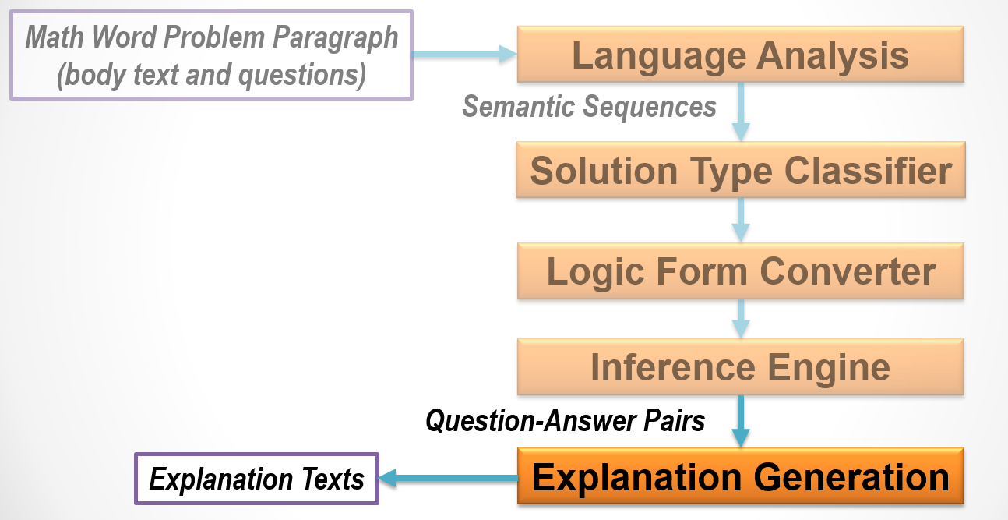

Slide 87
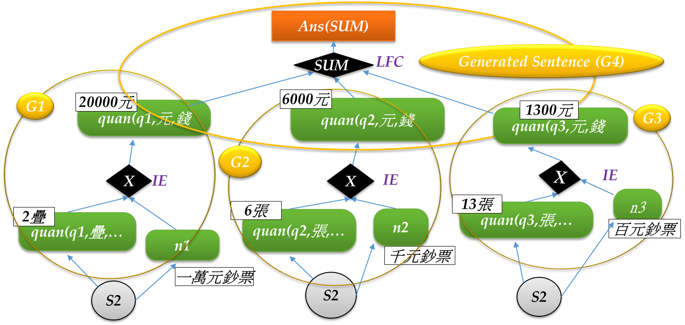
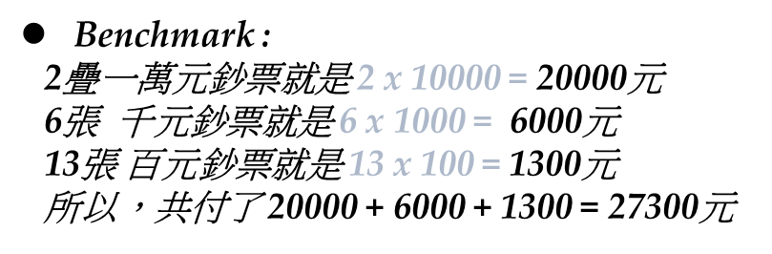
Explanation Generation (2/4)
1. 阿志買一臺冰箱和一臺電視機， 付2疊一萬元鈔票、6張千元鈔票和13張百元鈔票， 阿志共付了幾元？
SUM(quan(q?,…))
Notes:
Figure shows that three sets of facts are originated from the 2nd body sentence (indicated by three S2 nodes). Each set contains a corresponding quantity-fact (e.g.,
q1(疊), q2(元), and q3(張)) and its associated object (e.g., n1, n2, and n3). For example, the first set (the left most one) contains q1(疊) (for “2 疊”) and n1 (for “一萬元鈔票”). This figure also shows that the outputs of three IE-Multiplication operators (i.e., “20,000 元”, “6,000 元”, and “1,300 元”) will be fed into the last LFC-Sum to get the final desired result “27,300 元” (denoted by the “Ans(SUM)” node in the figure).

Slide 88
Explanation Generation (4/4)
[Sample1] 阿志買一臺冰箱和一臺電視機，付2疊一萬元鈔票、6張千元鈔票和13張百元鈔票，阿志共付了幾元？
Benchmark:
2疊 10,000元鈔票 就是 2 x 10,000 = 20,000元
6張 1,000元鈔票 就是 6 x 1,000 = 6,000元
13張 100元鈔票 就是 13 x 100 = 1,300元
所以，共付
20,000 + 6,000 + 1,300 = 27,300元
27,300元
SUM
6,000元
20,000元
1,300元
MUL
2疊
10,000元鈔票
MUL
6張
1,000元鈔票
13張
100元鈔票
MUL
Notes:
付怎麼來的要記得講

Slide 89

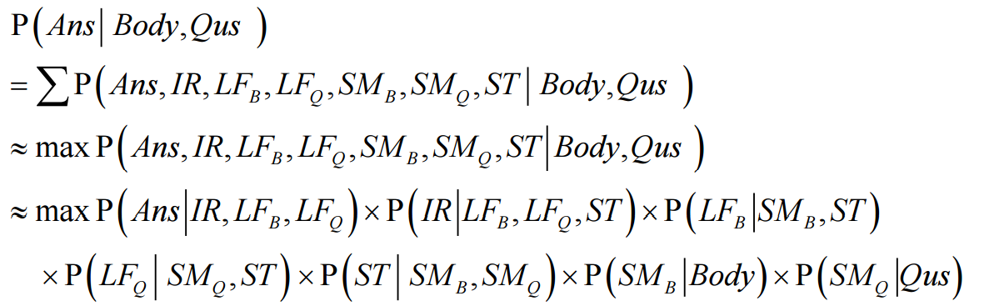

Statistical Framework
Perform weakly supervised learning (with Beam-Search) and fine tune the system.
: The obtained answer
Ans: A specific possible answer
Body: The given body text of the problem
Qus: The question text of the problem.
IR : Inference Rules.
LF_{B} : Logic Form of Body text.
LF_{Q} : Logic Form of Question text.
SM_{B} : Semantic Representation of Body text.
SM_{Q} : Semantic Representation of Question text.
ST : Solution Type.

Slide 90
Weakly Supervised Training (2/2)
uwds-0319: Tom bought a skateboard for
$ 9.46 , and spent $ 9.56 on marbles . Tom also spent $ 14.50 on shorts . In total , how much did Tom spend on toys ?
  quan(q1,dollar,skateboard)=9.46 & verb(q1, buy)
  quan(q2,dollar,marble)=9.56 & verb(q2, spend)
  quan(q3,dollar,short)=14.50 & verb(q3, spend)
Addition
q1+q2
19.02
Correct!
(Best Path)
Subtraction
q1+q3
23.95
Incorrect!
Sum
q2+q3
24.06
Incorrect!
….
ST
LFT
IE
Notes:
(1)Expand all solution types in ST
(2)Expand all possible operands in LFT
(3)Located the Best-Path
(4)Get involved quans
(5)Extract patterns(noun/verb) from relevant quans

Slide 91
English MWP
Solver
ChaoChun Liang
Institute of Information Science
Academia Sinica, Taipei
March 29, 2016

Slide 92
CHN vs. ENG Language Analysis
IIS Chinese
Language Analysis Pipeline
Stanford English
Language Analysis Pipeline
Sentence Splitting
Tokenization/PoS
Parsing
SRL
Semantic Composer
  Sense Disambiguation
  Co-Reference
Tokenization
Sentence Splitting
Lemmatization
Part of Speech
NER
Parsing
  Dependency
Co-Reference
However, we have “Dependency”
We don’t have “Semantic Role Labeling” and “Sense Disambiguation” in the English Flow
Notes:
(1)Adopting Stanford CoreNLP package to be the English Language Analysis
(2)Difference between Chinese and English
(i)Chinese: SRL / Sense(SR)
(ii)English: Lemma / NER / Dependency

Slide 93
UW-DS Performance Evaluation*
 | MA1 | IXL | MA2 | Total
3-fold cross validation
Our System (latest) | 94.78% | 73.38% | 88.43% | 85.28%
Roy-EMNLP-15 | - | - | - | 78.0%
ARIS | 83.6% | 75.0% | 74.4% | 77.7%
KAZB | 89.6% | 51.1% | 51.2% | 64.0%
Gold STC
Our System (latest) | 99.25% | 99.28% | 95.87% | 98.22%
Automatic STC*
STC | 94.80% | 74.10% | 83.50% | 84.00%
*Ref: Updated latest UW performance (v20160328)
Ref: Roy-EMNLP-15, “Solving General Arithmetic Word Problems”, S. Roy et al., EMNLP, 2015
Ref: KAZB, “Learning to Automatically Solve Algebra Word Problems”, Kushman et al. (MIT), 2014
Ref: ARIS, “Learning to Solve Arithmetic Word Problems with Verb Categorization”, Hosseini et al. (UW), 2014
Ref: MA1 (#=134), IXL(#=140, more language gap information), MA2 (#=121, more irrelevant information)
Notes:
Interesting Point:
The performance of MA2 in 3-fold cross validation is higher than the STC, which is due to the solver could get the correct answer even the STC is incorrect.
Ex:
gold:Addition/Subtraction
auto: FVQ-Final

Slide 94
SIM (Huang et al., 2016)
Similarity-based Approach 1/2
Step1: Template Selection
  Find the most similar MWP in the training set.
    Encode each MWP as TF-IDF Score Vector
    Weighted Jaccard Similarity
Step2: Template Slot Fitting
  Collect all MWPs with the same template in Traing-set
  Find the most similar MWP in the new set
    Minimum Editing Distance

Slide 95
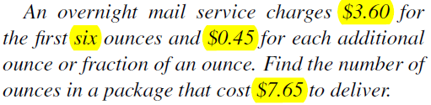




Similarity-based Approach (2/2)
Template Selection
Template Slot Fitting
(P2 in training set)
Resolved Problem
 | SIM | Kushman et al., 2014
Performance | 71.2% | 68.7%

Slide 96
Corpus Diversity is Essential
Accuracy degrades on AI2 (Hosseini et al., 2014) from 89.6% to:
  51.2% (with extra irrelevant quantities)
  51.1% (with information gap)
Performance will drop significant
  if the highly similarity MWP removed (Roy and Roth, 2017)
  Or in a diverse dataset (Huang et al., 2016)

Slide 97
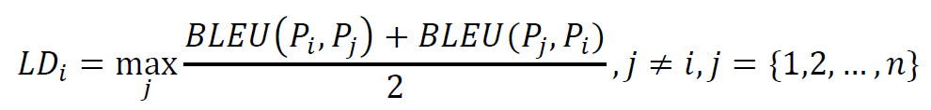
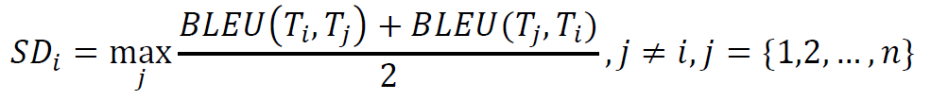
Proposed Corpus Diversity Measure 2/3
Lexicon Usage Diversity (LD_{i})
Syntactic Pattern Diversity (SD_{i})

Slide 98
Diversity Evaluation 1/3
Apply Normalization Processes before the diversity evaluation
  Stop word removal
  Named entity (person names and quantity values) normalization
“Sara has 16 red flowers and John has 24 yellow flowers.”
=>
“PERSON-1 has Quantity-1 red flowers and PERSON-2
has Quantity-2 yellow flowers.”

Slide 99
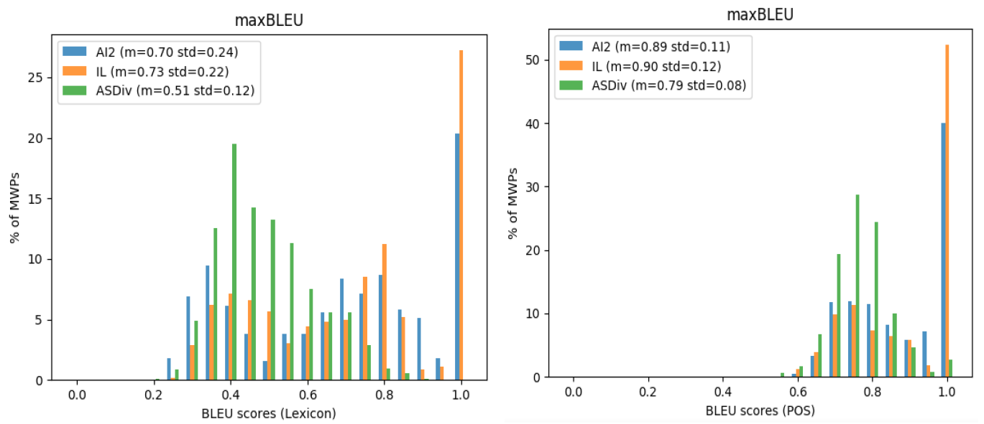
Diversity Evaluation 3/3
2.8% identical MWPs in ASDiv
40% identical MWPs in AI2
52% identical MWPs in IL
Distributions of Lexicon Usage
Diversity of IL, AI2 and ASDiv
Distributions of Syntactic Pattern
Diversity of IL, AI2 and ASDiv
0% identical MWPs in ASDiv
20% identical MWPs in AI2
27% identical MWPs in IL

Slide 100
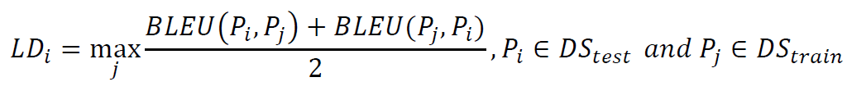
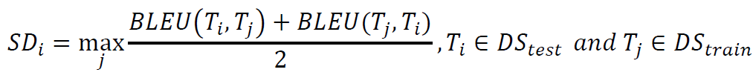
Diversity between Test and Train Set 1/2
Task difficulty of solving MWPs also depends on the degree of diversity between the MWPs in the test set and training set.
=> If P_{i} is with higher Diversity value, it could be easy to solve by similar patterns.

Slide 101
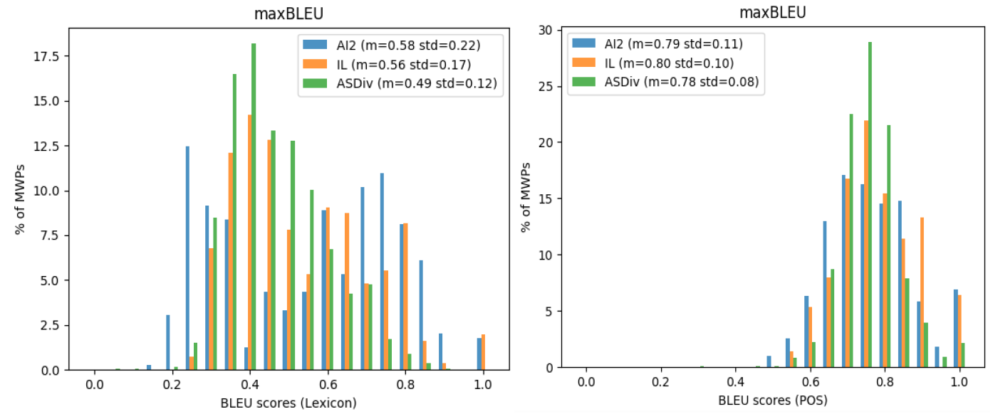
Diversity between Test and Train Set 2/2
Test-set to training-set Lexicon Usage
Diversity Distribution in IL, AI2 and ASDiv
Test-set to training-set Syntactic Pattern
Diversity Distribution in IL, AI2 and ASDiv
71% MWPs <= 0.5 in ASDiv
42% MWPs <= 0.5 in in AI2
54% MWPs <= 0.5 in IL

Slide 102
Experiments 3/6
Performance Evaluation
  AI2: 3 folds cross validation
  IL, ASDiv: 5 folds cross validation
Performance in ‘ALL’ sets
  Current state-of-the-art systems on ASDiv can’t provide satisfied performances on the real human test.
 | AI2 | IL | ASDiv
LCA++ | 0.76 | 0.72 | 0.36
UnitDep | 0.76 | 0.74 | 0.37

Slide 103
NLU Noisy Dataset
(a.1)Additional Irrelevant quantity to a new Subject
(a.2)Additional Irrelevant quantity to a new Entity
(a.3)Additional Irrelevant quantity to a new Modifier
(a.4)Re-Order the Quantities
(ORG) Tim has 10 yellow flowers and 12 red flowers. How many flowers does Tim has?
(a.1) Tim has ... Mary has 3 yellow flowers. How many …
(a.2) Tim has ... Tim also has 3 books. How many …
(ORG1) Tom has 9 yellow balloons. Sara has 8 yellow balloons. How many yellow balloons do they have in total ?
(a.3) Tom has 8 red balloons and …. Sara has 8 yellow balloons . How many …
(a.4) Tom has 9 yellow balloons and 8 red balloons. Sara has 8 yellow balloons . How many …

Slide 104
Single-step Dataset Performance
 | AI2 | ILDS | NDS1
Our System*¹ | 81.5 | 81.0 | 82.1
Roy2015 (MSMWP^{*2}) | 78.0 | 73.9 | 28.5^{*4}
Hosseini 2014 | 77.7 | - | -
Roy2015 (SMWP^{*3}) | - | 52.7 | -
Kushman 2014 | 64.0 | 73.7 | -
*1: ([Liang et al., 2017-2])
*2: MSMWP: multiple-step MWP solving system ([Roy and Roth, 2015])
*3: SMWP: single-step MWP solving system ([Roy et al., 2015])
*4: We submit MWPs to Illinois Math Solver (https://cogcomp.cs.illinois.edu/page/
demo_view/Math) in May and June, 2017.

Slide 105
DNN on MWP

Slide 106
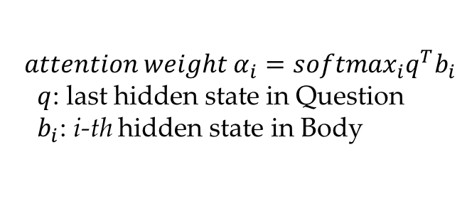
DNN-STC Architecture 2/2
Output
{ Addition, Subtraction, … }
Softmax
$${attention weight α}_{i}={softmax}_{i}q^{T}b_{i}$$
$q$: last hidden state in Question
$b_{i}$: i-th hidden state in Body
Attention
Bidirectional
GRU Encoder
…
…
Embedding
Input
Wb1 Wb2 … Wbn Wq1 Wq2 … Wqn
Body Sentences
Question Sentences
Bidirectional RNN model with Attention

Slide 107
Integration Performance
 | AI2 | IL
Our System (Statistic*) | 81.5 | 81.0
Our System (DNN**) | 66.5 | 71.4
Roy and Roth, 2015 | 78.0 | 73.9
Kushman et al., 2014 | 64.0 | 73.7
Statistic*: Statistical approaches in STC and LFT
DNN**: The DNN approach in STC and the statistical approach in LFT
Note:
1)AI2: 3-folds cross validation
2)IL: 5-folds cross validation

Slide 108
A Goal Oriented
Multi-Step
Math Word Problem Solver

Slide 109
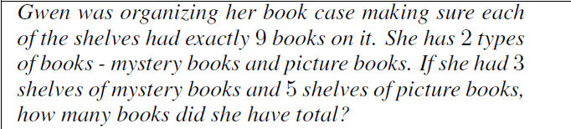
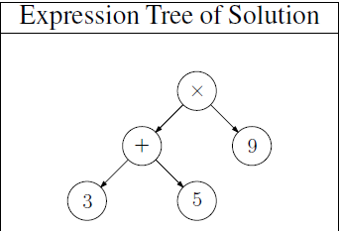
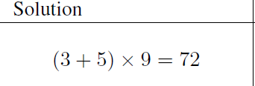
Multi-Step MWPs (1)
Solving General Arithmetic Word Problems, S. Roy et al., EMNLP, 2015
Decompose the Expression to a Monotonic Express Tree

Slide 110
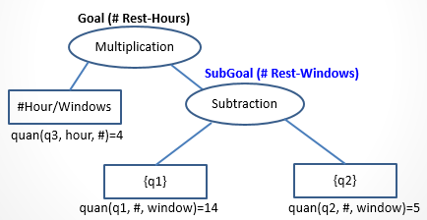
Multi-Step MWPs (2)
A new building needed 14 windows.
The builder had already installed 5 of them.
If it takes 4 hours to install each window,
how long will it take him to install the rest?
The ANSWER could be Solved by
  (#Rest-Windows)
  =14-windows – 5-windows
  (#Rest-Hours)
  =(#Rest-Windows)
  x 4 hours/window

Slide 111
Multiple-step Dataset Performance
 | CMDS
Our System^{*5} | 53.5
Roy2015 (MSMWP) | 45.2
Hosseini 2014 | -
Roy2015 (SMWP) | -
Kushman 2014 | 2.3
*5: ([Liang et al., 2017-1])
BACK

Slide 112
Comparison with [Roy and Roth, 2015]
 | Our Approach | Roy and Roth, 2015
Problem Solving & Reasoning | Goal oriented approach: recursively decompose the goal; and solve the problem with explicit physical meaning | Operand oriented approach: enumerating each possible operand configuration; and score various configurations with implicit physical meaning
Operator/Operands searching | Top-Down searching: Find associated operands based on the specified operator | Bottom-Up searching: Find associated operator based on the specified operands
Explanations | Solving the problem in a human comprehension way | Hard to explain how to solve the problem

Slide 113
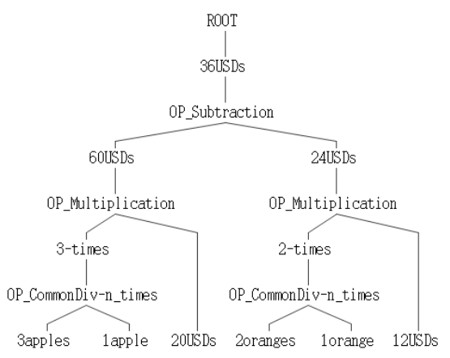
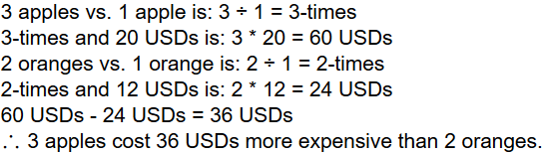
Demo System
http://nlul.iis.sinica.edu.tw/EnglishMathSolver/mathDemoMS.py
An apple is priced at $ 20 and an orange is priced at $ 12.
How much more expensive do 3 apples cost more than 2 oranges?
The generated explanation tree/text

Slide 114
Error Analysis (from gold-STC) (3/3)
uwds-349: Dan 's cat had kittens and 5 had spots . He gave 7 to Tim and 4 to Jason . He now has 5 kittens . How many kittens did he have to start with ?
  Lexical Gap: the meaning of “Dan's cat had kittens” equals “Dan had kittens” in this problem
  Similar: uwds-0388
uwds-329: After paying 6 dollars for the pie , Mary has 52 dollars , her friend has 43 dollars . How much money did she have before buying the pie ?
  Lexical Gap: “Mary” has 6 dollars
    Omitted subject “Mary” in Sent-1

Slide 115
Extra-linguistic Information
train.G1.03.000390
有9人排隊讓老師改作業，老師改好了4個小朋友的作業，剩下幾人在排隊？
  Need to know: “改好作業” 表示”離開排隊的隊伍”
    Classified to Category-I
train.G1.03.000400
有13位小朋友，想要給每人一頂帽子和一枝棒棒糖，但是帽子不夠2頂，棒棒糖多出4枝，帽子有幾頂？
  Classified to Category-I
Category-I: Problems Currently Skipped
(i)Complicated Math Domain Knowledge or
(ii)Need Domain Knowledge

Slide 116
Common Sense
train.G1.03.000264
小綠和阿夫猜拳，小綠出剪刀，阿夫出布，兩人共伸出了幾根手指頭？
  Need to know: “剪刀” 表示”伸出了兩根手指頭”
  “布” 表示”伸出了五根手指頭”
    Classified to Category-I
Category-I: Problems Currently Skipped
(i)Complicated Math Domain Knowledge or
(ii)Need Domain Knowledge
Back

Slide 117
Outline
Big Data alone is not enough
Why Big Mechanism?
Why Machine Reading?
Introduction to ongoing projects:
*QA system
1. Solving Math Word Problems: The first test case
2. Q&A for Social Studies: The second test case
* Multi-Document Processing
1. Knowledge discovery
2. Up-to-date person/company profile

Slide 118
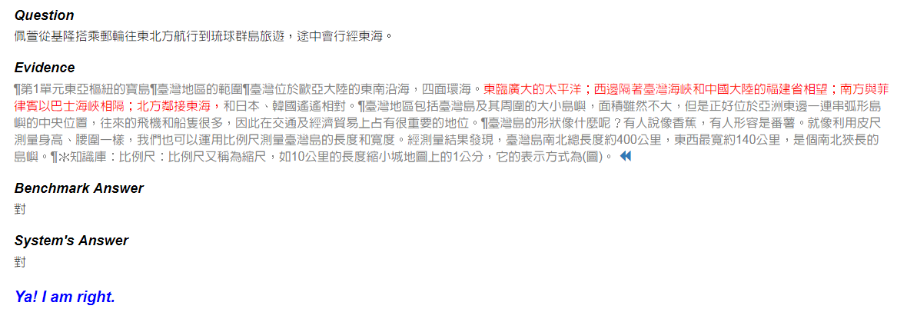
Social Studies Q&A Demo
  http://140.109.19.194/demo/page/

Slide 119
Sample-G3A-0101, QTP=LC (1~9)
QA-3: 父母來自不同國家的家庭，對子女付出的愛較少。...[錯]
  雖然父母來自不同的國家，但是對子女付出的愛是一樣
QA-5: 對於每一個人的家庭，都應該尊重。...[對]
  我們要學會尊重不同的家庭...並尊重他人的家庭。
QA-7: 所有小孩的父母都來自同一個國家。...[錯]
  有些家庭的父母來自不同的族群或國家
QA-10: 每個人都應該珍惜自己的家人。...[對]
  我們都要懂得珍惜家人
QA-14: 每個家庭的父母都來自相同的族群。...[錯]
  有些家庭的父母來自不同的族群或國家
QA-16: 家人能互助互愛、彼此關心，是充滿幸福的家庭。...[對]
  只要家人彼此支持、互助互愛，都是一個幸福的家庭。
QA-17: 對於和自己家庭特色不同的家庭，不需要尊重。...[錯]
  我們要學會尊重不同的家庭
QA-20: 來自不同國家的父母，對子女的關懷一定不一樣。...[錯]
  雖然父母來自不同的國家，但是對子女付出的愛是一樣。
QA-21: 隔代教養家庭是由父母負責養育子女。...[錯]
  隔代教養家庭是由祖父母或外祖父母負責養育小孩的家庭。 ←Def.
“好朋友是會規勸你的過錯的朋友” is not a complete definition of “好朋友”.

Slide 120
Sample-G5A-0101, QTP=LC
(1~8)
QA-2: 臺灣島的南北總長度比東西寬度長，是個南北較狹長的島嶼。...[對]
  臺灣島南北總長度約四百公里，東西最寬約一百四十公里，是個南北狹長的島嶼
QA-4: 臺灣島的東西寬度大於南北長度。...[錯]
  臺灣島南北總長度約四百公里，東西最寬約一百四十公里
QA-5: 臺灣西部的海域是太平洋。...[錯]
  東臨廣大的太平洋；西邊隔著臺灣海峽和中國大陸的福建省相望
QA-8: 臺灣位處偏僻，在世界交通上未能占有重要地位。...[錯]
  往來的飛機和船隻很多，因此在交通及經濟貿易上占有很重要的地位
QA-21: 臺灣位在亞洲東邊一連串弧形島嶼的頂端位置，在交通與貿易上占有很重要的地位。...[錯]
  但是正好位於亞洲東邊一連串孤形島嶼的中央位置…因此在交通及經濟貿易上占有很重要的地位
QA-24: 臺灣島的東西寬約400公里。...[錯]
  東西最寬約一百四十公里
QA-26: 臺灣島是個南北長度比東西長的島嶼。...[對]
  臺灣島南北總長度約四百公里，東西最寬約一百四十公里
QA-29: 站在臺灣的西部海岸，可欣賞太平洋的壯麗海景。...[錯]
  東臨廣大的太平洋
站在臺灣的東部海岸，可欣賞太平洋的壯麗海景。 →True
站在臺灣的東部海岸，可欣賞太平洋的壯麗日落。 →False

Slide 121

Block Diagram of SSQA-B1
Lesson Text
Y/N Question (T2)
Preprocessing
Lesson Text, T2
Evidence Search
T1, T2
Entailment Decision
Answer
(yes or no)
120

Slide 122
Probabilistic Entailment Decision

Slide 123
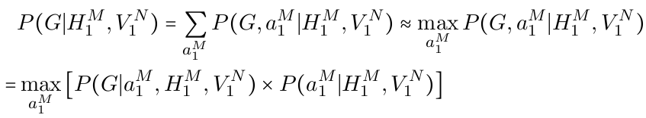

Model – Alignment and Entailment, V1.1
Alignment Model

Slide 124

Model – Alignment and Entailment, V1.1 (cont’d)
Entailment Model

Slide 125
DNN on SSQA

Slide 126





Decomposable Attention model
5
Hypothesis (ā)
Normalize
F ( āi ) ^{T ⋅} F ( ^{ƃ}j )
G ( [ āi, βi ] )
ŷ = H ( [ v1, v2] )
Y/N
Evidence (^{ƃ})
Attend
Compare
Aggregate

Slide 127
Simulation Results
Datasets:
  C-Set: Close-Set (i.e., Training Set), 11,131 yes-no questions
  D-Set: Development-Set, 1,508 yes-no questions
  O-Set: Open-Set (i.e., Test set), 1,464 yes-no questions
WV C-Set D-Set O-Set
---------- ------ ------ ------
gCNA.ckip 76.76% 73.28% 70.22%
wCNA.ckip 76.05% 74.34% 70.49% ← SSQA-B3
fWiki.ckip 63.74% 63.79% 63.25%
gCNA.cnlp 73.96% 72.41% 69.26%
wCNA.cnlp 74.23% 74.14% 70.08%
fWiki.cnlp 63.32% 62.20% 60.93%
---------- ------ ------ ------
SSQA-B1 63.28% 62.27% 60.45%
SSQA-B2 62.58% 62.80% 60.25%
memo_20170731_SSQA_Cyut_and_Simple_Prob.ppt

Slide 128
Multiple-Choice Questions (單選題)

Slide 129
Solve One MC Question with Multiple YN Questions
One MC question
  土地公又稱為什麼？ ←detect the question word/phrase
    (1) 關公
    (2) 孔夫子
    (3) 福德正神
    (4) 註生娘娘
Four YN questions
  土地公又稱為關公 →No
  土地公又稱為孔夫子 →No
  土地公又稱為福德正神 →Yes
  土地公又稱為註生娘娘 →No

Slide 130
SSQA-B3 NOT Really Understands
One correct prediction in the training set
  Benchmark:Y, Prediction:Y
  馬祖 位於 閩江 口 外 ， 島嶼 狹小 ， 又 無 高山 屏障 ， 全 年 多 風 少 雨 。
  馬祖 位於 閩江 口 外 ， 全 年 多 風 少 雨 。
Some predictions for manual examples
  Benchmark:Y, Prediction:N
  馬祖 位於 閩江 口 外 ， 全 年 多 風 少 雨 。
  馬祖 位於 閩江 口 外 ， 全 年 多 風 少 雨 。
  Benchmark:N, Prediction:N
  馬祖 位於 閩江 口 外 ， 全 年 多 風 少 雨 。
  馬祖 位於 愛河 口 外 ， 全 年 少 風 少 雨 。
  Benchmark:N, Prediction:N
  馬祖 位於 閩江 口 外 ， 全 年 多 風 少 雨 。
  馬祖 位於 愛河 口 外 ， 全 年 多 風 多 雨 。
  Benchmark:N, Prediction:N
  馬祖 位於 閩江 口 外 ， 全 年 多 風 少 雨 。
  馬祖 位於 愛河 口 外 ， 全 年 少 風 多 雨 。
All words have valid embeddings.

Slide 131
SSQA-B3 NOT Really Understands (cont’d)
  Benchmark:N, Prediction:Y
  馬祖 位於 閩江 口 外 ， 島嶼 狹小 ， 又 無 高山 屏障 ， 全 年 多 風 少 雨 。
  馬祖 位於 閩江 口 外 ， 全 年 少 風 少 雨 。
  Benchmark:N, Prediction:Y
  馬祖 位於 閩江 口 外 ， 島嶼 狹小 ， 又 無 高山 屏障 ， 全 年 多 風 少 雨 。
  馬祖 位於 愛河 口 外 ， 全 年 多 風 少 雨 。
All words have valid embeddings.

Slide 132
SSQA-B3 NOT Really Understands (cont’d)
One in correct prediction in the training set
  Benchmark:Y, Prediction:N
  臺灣 島 南北 總長度 約 四百 公里 ， 東西 最 寬 約 一百四十 公里 ，
  臺灣 南北 長 約 400 公里 ， 東西 寬 約 140 公里 。
Some predictions for manual examples
  Benchmark:Y, Prediction:N
  臺灣 南北 長 約 四百 公里 。
  臺灣 南北 長 約 400 公里 。
  Benchmark:Y, Prediction:N
  臺灣 南北 長 約 四百 公里 。
  臺灣 南北 長 約 四百 公里 。
  Benchmark:Y, Prediction:N
  臺灣 南北 長 約 400 公里 。
  臺灣 南北 長 約 400 公里 。
  Benchmark:N, Prediction:N
  臺灣 南北 長 約 400 公里 。
  臺灣 南北 長 約 140 公里 。
All words have valid embeddings.

Slide 133
Preference vs. Likelihood: an Example
Probability
0
1
Matching-Ratio

Slide 134

Example for selecting the mapping token
Let the Matching-Ratio be a function of linking related features such as String-Overlapping-Ratio, Semantic-Distance, etc. High Matching-Ratio is preferred by human.

Slide 135
NLP Remains the Domain Problems
  Christ Manning made the following claims (2015):
    “The gains so far have not so much been from true Deep Learning as from the use of distributed word representations”
    “problems in higher-level language processing have not seen the dramatic error rate reductions from deep learning that have been seen in speech recognition and in object recognition in vision….and this remains the case”
    “Our ﬁeld is the domain science of language technology; it’s not about the best method of machine learning—the central issue remains the domain problems”
Notes:
Jeopardy!** is a well-known television quiz show that has been on air in the United States about 30 years
It was conducted and taped by Jeopardy Productions, Inc. and was nationally televised over three nights on February 14–16, 2011

Slide 136
Integrate Domain-Concept into DNN (1/2)
  Preprocess the input text
    E.g., convert personal-names and numerical values into meta-tokens in MWP
  Add additional human-crafted features into DNN
    E.g., add Exactly-the-Same feature in Q&A task
  Adjust DNN architecture based on the domain knowledge
    E.g., add an alignment layer to DNN in entailment judgment
  Integrate DNN into original operation flow (instead of end-to-end)
    E.g., adopt STC in MWP
Notes:
Jeopardy!** is a well-known television quiz show that has been on air in the United States about 30 years
It was conducted and taped by Jeopardy Productions, Inc. and was nationally televised over three nights on February 14–16, 2011

Slide 137
Integrate Domain-Concept into DNN (2/2)
  Add constraints implied by domain knowledge during DNN training
    E.g., add human preferred tendency to train word-embeddings
  Train the DNN model iteratively/jointly with domain knowledge representation
    Enhance generalization and improve interpretability
    E.g., mutual distillation (Hu et al., 2016), which transfers information between DNN and structured constraints for effective knowledge learning
Notes:
Jeopardy!** is a well-known television quiz show that has been on air in the United States about 30 years
It was conducted and taped by Jeopardy Productions, Inc. and was nationally televised over three nights on February 14–16, 2011

Slide 138

Mutual Distillation (Hu et al., 2016)
Notes:
Jeopardy!** is a well-known television quiz show that has been on air in the United States about 30 years
It was conducted and taped by Jeopardy Productions, Inc. and was nationally televised over three nights on February 14–16, 2011

Slide 139
Outline
Big Data alone is not enough
Why Big Mechanism?
Why Machine Reading?
Introduction to ongoing projects:
*QA system
1. Solving Math Word Problems: The first test case
2. Q&A for Social Studies: The second test case
* Multi-Document Processing
1. Knowledge discovery
2. Up-to-date person/company profile

Slide 140
Task Definition
  What is Multi-Document Processing/Application?
    Processing/Application based on Multi-Document Analysis
      A document could be: a book chapter, a technical paper, a news report, a newswire, an email, a blog, a twitter message, chat log, etc.
  What is Multi-Document Analysis?
    Single-Document Analysis + Cross-Document Linking/Merging (NE co-reference, Relation/Event linking)
Notes:
Jeopardy!** is a well-known television quiz show that has been on air in the United States about 30 years
It was conducted and taped by Jeopardy Productions, Inc. and was nationally televised over three nights on February 14–16, 2011

Slide 141
Applications
  Applications of Multi-Document Processing:
    Bisociative Knowledge Discovery
    Multi-document Summarization
    Multi-document Event Tracking
    Enhanced Question-Answering
    Citation Analysis (Academic, legal, patent)
    Document Relation
    Similar Document Retrieval/Recommendation
    Decision Support System (e.g., financial broker)
    Link Analysis
    Knowledge-base (Graph) Completion
    Survey Generation
    Argumentation Mining

Slide 142
Why Cross-Document Linking/Merging?
  Problems with single-document analysis alone
    Redundancy among related documents is not utilized
      The quality of the information directly extracted from each individual document is poor.
        ACE event extraction systems barely exceeded 50% F-score on argument labeling (Ji and Grishman, 2008)
    Linking between the content embedded in different documents is not explored
      New knowledge could be deduced/explored from the interaction between various documents/domain
    Interaction between document content and document context is not explored

Slide 143



Tri-lingual Entity Discovery and Linking (EDL), Ji (2016)
Source Collection
13岁以前的杨丽萍，是云南一个山村小镇里光着脚丫到处拾麦穗的乡下小姑娘，在洱海之源过着艰苦而又不无乐趣的童年生活。
Now, Ms. Yang, one of China's best-known dancers, is the director, choreographer and star of …
Aunque nacida en Dali, a la edad de nueve años Yang se mudó con su familia a Xishuangbanna. Debido a su extraordinario talento, la eligieron para integrar la Agrupación Artística de Canto …
…
KB
Liping Yang
Liping Yang
Cross-lingual knowledge fusion: For certain entities and events, new and detailed information is only available in low-resource foreign incident languages
Cross-lingual Knowledge transfer: Build cross-lingual links to transfer resources (e.g., annotated data, gazetteers and rich knowledge representations) from English to foreign language EDL

Slide 144
Knowledge Discovery (2)
  Bisociative Knowledge Discovery (異類關聯知識挖掘)

Slide 145

Performance Evaluation (Yan and Jin, 2017) (2)
  Identiﬁed connection is “Bin Ladin” → “Al Qaeda” → “Abdullah Yusuf Azzam” → “Omar Abdel Rahman”

Slide 146



An Event Tracking Example (Ji et al, 2009)
Notes:
The distributions of an event trigger in the test document is closer to its distribution in the collection of related documents

Slide 147

Block Diagram of a Possible Architecture
  Proposed by Prof. 蘇克毅, Prof. 陳信希, Prof. 古倫維, and Prof. 李政德

Slide 148

Micro-Level Knowledge Representation

Slide 149

Macro-Level Knowledge Representation
  Proposed by C-T Li

Slide 150

Micro&Macro Linked KB

Slide 151
Outline
Big Data alone is not enough
Why Big Mechanism?
Why Machine Reading?
Introduction to ongoing projects:
*QA system
1. Solving Math Word Problems: The first test case
2. Q&A for Social Studies: The second test case
* Multi-Document Processing
1. Knowledge discovery
2. Up-to-date person/company profile

Slide 152
    Motivation/Application
Company/Person Profile is required in many different situations
  For example, if someone is going to invest慶富集團
Desired Company/Person Profile might not be found in an existing knowledge-base (e.g., Wikipedia)
The associated profile might not be updated even it can be found
  For example, the headquarters of慶富造船has just been impounded by Kaohsiung District Court on 2017/10/27

Slide 153

    System Block Diagram and Operation Flow

Slide 154

    Welcome to join us!

