Slide 1
Cryptographic Hash Functions (Ch. 11)
Applications of cryptographic hash functions
Simple hash functions
Requirements and security
Hash functions based on cipher block chaining
Secure hash algorithm (SHA)
SHA-3
Summary

Slide 2
Hash functions
Condenses arbitrary message to fixed size
  h = H(M)
Usually assume hash function is public
Hash used to detect changes to message
Properties of cryptographic hash function
  computationally infeasible to find data mapping to specific hash (one-way property)
  computationally infeasible to find two data to same hash (collision-free property)
Notes:
A hash function H accepts a variable-length block of data M as input and produces a fixed-size hash value h = H(M). A "good" hash function has the property that the results of applying the function to a large set of inputs will produce outputs that are evenly distributed, and apparently random. In general terms, the principal object of a hash function is data integrity. A change to any bit or bits in M results, with high probability, in a change to the hash code. The kind of hash function needed for security applications is referred to as a cryptographic hash function. A cryptographic hash function is an algorithm for which it is computationally infeasible (because no attack is significantly more efficient than brute force) to find either (a) a data object that maps to a pre-specified hash result (the one-way property) or (b) two data objects that map to the same hash result (the collision-free property). Because of these characteristics, hash functions are often used to determine whether or not data has changed.

Slide 3
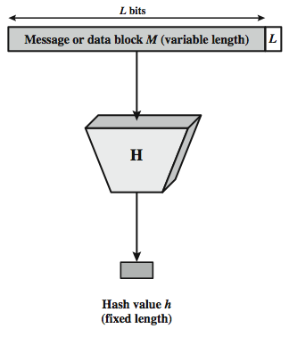
Cryptographic hash function
Notes:
Stallings Figure 11.1 depicts the general operation of a cryptographic hash function. Typically, the input is padded out to an integer multiple of some fixed length (e.g., 1024 bits) and the padding includes the value of the length of the original message in bits. The length field is a security measure to increase the difficulty for an attacker to produce an alternative message with the same hash value.

Slide 4
Message authentication
A mechanism or service used to verify the integrity of a message.
Message authentication assures that data received are exactly as sent.

Slide 5
Hash function for message authentication
Source
M
||
E
H
K
E(K,M||H(M))
M
H
D
Compare
H(M)
K
Destination

Slide 6
Hash function for message authentication (Cont.)
Source
Destination
M
H
M
||
K
K
Compare
H
E
D
E(K,H(M))

Slide 7
Hash function for message authentication (Cont.)
Source
Destination
M
||
H
M
S
||
Compare
||
H
S
H(M||S)

Slide 8
Hash function for message authentication (Cont.)
Source
M
||
E
||
H
K
S
E(KM||H(M||S))
M
||
H
S
D
Compare
K
H(M||S)
Destination

Slide 9
Hash function for message authentication
A→B:E(K,M||H(M))
  Provides confidentiality: only A and B share K
  Provides authentication:H(M) is cryptograpically protected
A→B:M||E(K,H(M))
  Provides authentication:H(M) is cryptograpically protected
A→B:M||H(M||S)
  Provides authentication: only A and B share S
A→B: E(K,[M||H(M||S))
  Provides authentication : only A and B share S
  Provides confidentiality: only A and B share K

Slide 10
Digital signature
The hash value of a message is encrypted with a user’s private key.
Anyone who knows the user’s public key can verify the integrity of the message that is associated with the digital signature.

Slide 11
Hash function for digital signature
Source
Destination
M
H
M
||
PR_{a}
PU_{a}
Compare
H
E
D
E(PR_{a},H(M))

Slide 12
Hash function for digital signature (Cont.)
Source
M
||
E
PR_{a}
H
E
K
E(K,[M||E(PR_{a},H(M))]
M
H
D
PU_{a}
Compare
K
D
E(PR_{a},H(M))
Destination

Slide 13
Hash function for digital signature (Cont.)
A→B: M||E(PR_{a},H(M))
  Provides authentication and digital signature: H(M) is cryptograpically protected and only A could create E(PR_{a},H(M))
A→B:E(K,[M||E(PR_{a},H(M)])
  Provides authentication and digital signature
  Provides confidentiality: only A and B share K

Slide 14
Other hash functions
To create a one-way password file
  store hash of password not actual password
For intrusion detection and virus detection
  keep & check hash of files on system
Pseudorandom function (PRF) or pseudorandom number generator (PRNG)
Notes:
Hash functions are commonly used to create a one-way password file. Chapter 20 explains a scheme in which a hash of a password is stored by an operating system rather than the password itself. Thus, the actual password is not retrievable by a hacker who gains access to the password file. In simple terms, when a user enters a password, the hash of that password is compared to the stored hash value for verification. This approach to password protection is used by most operating systems.
Hash functions can be used for intrusion detection and virus detection. Store H(F) for each file on a system and secure the hash values (e.g., on a CD-R that is kept secure). One can later determine if a file has been modified by recomputing H(F). An intruder would need to change F without changing H(F).
A cryptographic hash function can be used to construct a pseudorandom function (PRF) or a pseudorandom number generator (PRNG). A common application for a hash-based PRF is for the generation of symmetric keys. We discuss this application in Chapter 12.

Slide 15
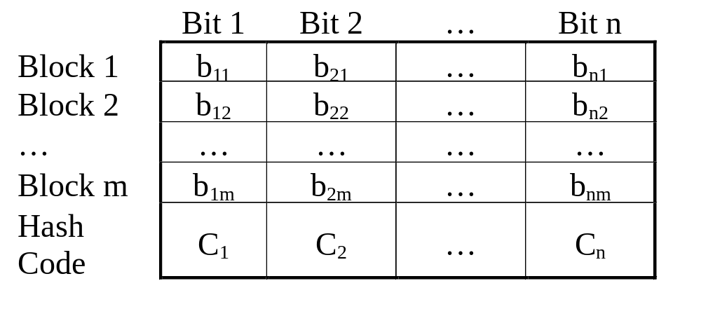
Simple hash functions

Slide 16
Simple hash functions
One of the simplest hash functions is the bit-by-bit XOR of every block. It can be expressed as follows.
C_{i}=b_{i1}⊕ b_{i2} ⊕ ... ⊕b_{im}
where C_{i}=ith bit of the hash code, 1<i<n
m=number of n-bit blocks
bij=ith bit in jth block

Slide 17
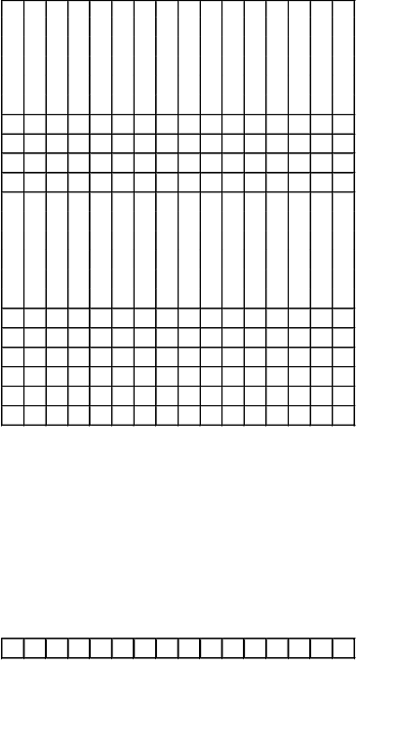
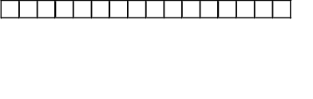
Simple hash function (Cont.)
XOR with 1-bit rotation to the right
XOR of every 16-bit block

Slide 18
Simple XOR or rotated XOR
Although a simple XOR or rotated XOR (RXOR) is insufficient if only the hash code is encrypted, you may still feel that such a simple function could be useful when the message as well as the hash code are encrypted.
However, you must be really careful.
Consider the cipher block chaining (CBC). Given a message consisting of a sequence of 64-bit blocks of X₁, X₂, …,X_{N}, define the hash code C as the block-by-block XOR or all blocks and append the hash code as the final block.
C=X_{N+1}=X₁ ⊕ X₂ ⊕ … ⊕ X_{N}

Slide 19
CBC
Next, encrypt the entire message plus hash code, using CBC mode to produce the encrypted message Y₁,Y₂, …, Y_{N+1}.
Then we have
X₁=IV ⊕D(K,Y₁)
X_{i}=Y_{i-1} ⊕D(K,Y_{i})
X_{N+1}=Y_{N} ⊕D(K,Y_{N+1})
But X_{N+1} is the hash code:
X_{N+1}=X₁ ⊕ X₂ ⊕ … ⊕ X_{N}
=[IV ⊕D(K,Y₁)] ⊕[Y₁ ⊕D(K,Y₂)] ⊕... ⊕[Y_{N-1} ⊕D(K,Y_{N})]
The hash code would not change if the ciphertext blocks were permuted.
Notes:
Yi=E(K, [Yi-1⊕ Xi]) -> Xi=Yi-1⊕D(K,Yi)

Slide 20
Requirement for a hash function
A hash function H can be applied to a block size of any size.
H produces a fixed-length output.
H(x) is relatively easy to compute for any given x.
For any given code h, it is computationally infeasible to find x such that H(x)=h. (preimage resistant; one-way)
For any given block x, it is computationally infeasible to find y≠x with H(y)=H(x). (second preimage resistant)
It is computationally infeasible to find any pair (x,y) such that H(x)=H(y). (collision resistant)

Slide 21
Attacks on hash functions
have brute-force attacks and cryptanalysis
a preimage or second preimage attack
  find y s.t. H(y)equals a given hash value (2^{m-1} attempts)
collision resistance
  find two messages x & y with the same hash so that H(x)=H(y) (2^{m/2} attempts)
hence value 2^{m/2} determines strength of hash code against brute-force attacks
  128-bits inadequate, 160-bits suspect
Notes:
As with encryption algorithms, there are two categories of attacks on hash functions: brute-force attacks and cryptanalysis. A brute-force attack does not depend on the specific algorithm but depends only on bit length. In the case of a hash function, a brute-force attack depends only on the bit length of the hash value. A cryptanalysis, in contrast, is an attack based on weaknesses in a particular cryptographic algorithm.
For a preimage or second preimage attack, an adversary wishes to find a value y such that H(y) is equal to a given hash value h. The brute force method is to pick values of y at random and try each value until a collision occurs. For an m-bit hash value, the level of effort is proportional to 2^{m}. Specifically, the adversary would have to try, on average, 2^{m–1} values of y to find one that generates a given hash value h.
For a collision resistant attack, an adversary wishes to find two messages or data blocks, x and y, that yield the same hash function: H(x) = H(y). This requires much less effort than a preimage or second preimage attack. The effort required is explained by a mathematical result referred to as the birthday paradox (next slide).
If collision resistance is required, then the value 2^{m/2} determines the strength of the hash code against brute-force attacks. Van Oorschot and Wiener presented a design for a $10 million collision search machine for MD5, which has a 128-bit hash length, that could find a collision in 24 days. Thus a 128-bit code may be viewed as inadequate. The next step up, if a hash code is treated as a sequence of 32 bits, is a 160-bit hash length. With a hash length of 160 bits, the same search machine would require over four thousand years to find a collision. With today's technology, the time would be much shorter, so that 160 bits now appears suspect.

Slide 22
Birthday attacks
Suppose that a 64-bit hash code is used. One might think this is quite secure.
For example, if an encrypted hash code C is transmitted with the corresponding unencrypted message M, then an opponent would need to find an M’ such that H(M’)=H(M) to substitute another message and fool the receiver.
On average, the opponent would have to try 2⁶³ messages to find one.

Slide 23
Birthday attacks (Cont.)
Yuval proposed the following attack strategy:
  The source A is prepared to “sign” a message by appending the appropriate m-bit MAC and encrypting that MAC with A’s private key.
  The opponent generates 2^{m/2} variations on the message, all of which convey essentially the same meaning. The opponent prepares for an equal number of messages, all of which are variations on the fraudulent message to be substituted for the real one.

Slide 24
Hash function: authentication and signature
Source
Destination
M
H
M
||
PR_{a}
PU_{a}
Compare
H
E
D
E(PR_{a},H(M))

Slide 25
Birthday attacks (Cont.)
  The two sets of messages are compared to find a pair of messages that produces the same hash code. If no match is found, additional valid and fraudulent messages are generated until a match is made.
  The opponent offers the valid variation to A for signature. This signature can then be attached to the fraudulent variation for transmission to the intended recipient.

Slide 26
Birthday attacks (Cont.)
Thus, if a 64-bit hash code is used, the level of effort required is only on the order of 2³².
The conclusion to be drawn from this is that the length of the hash code should be substantial.

Slide 27
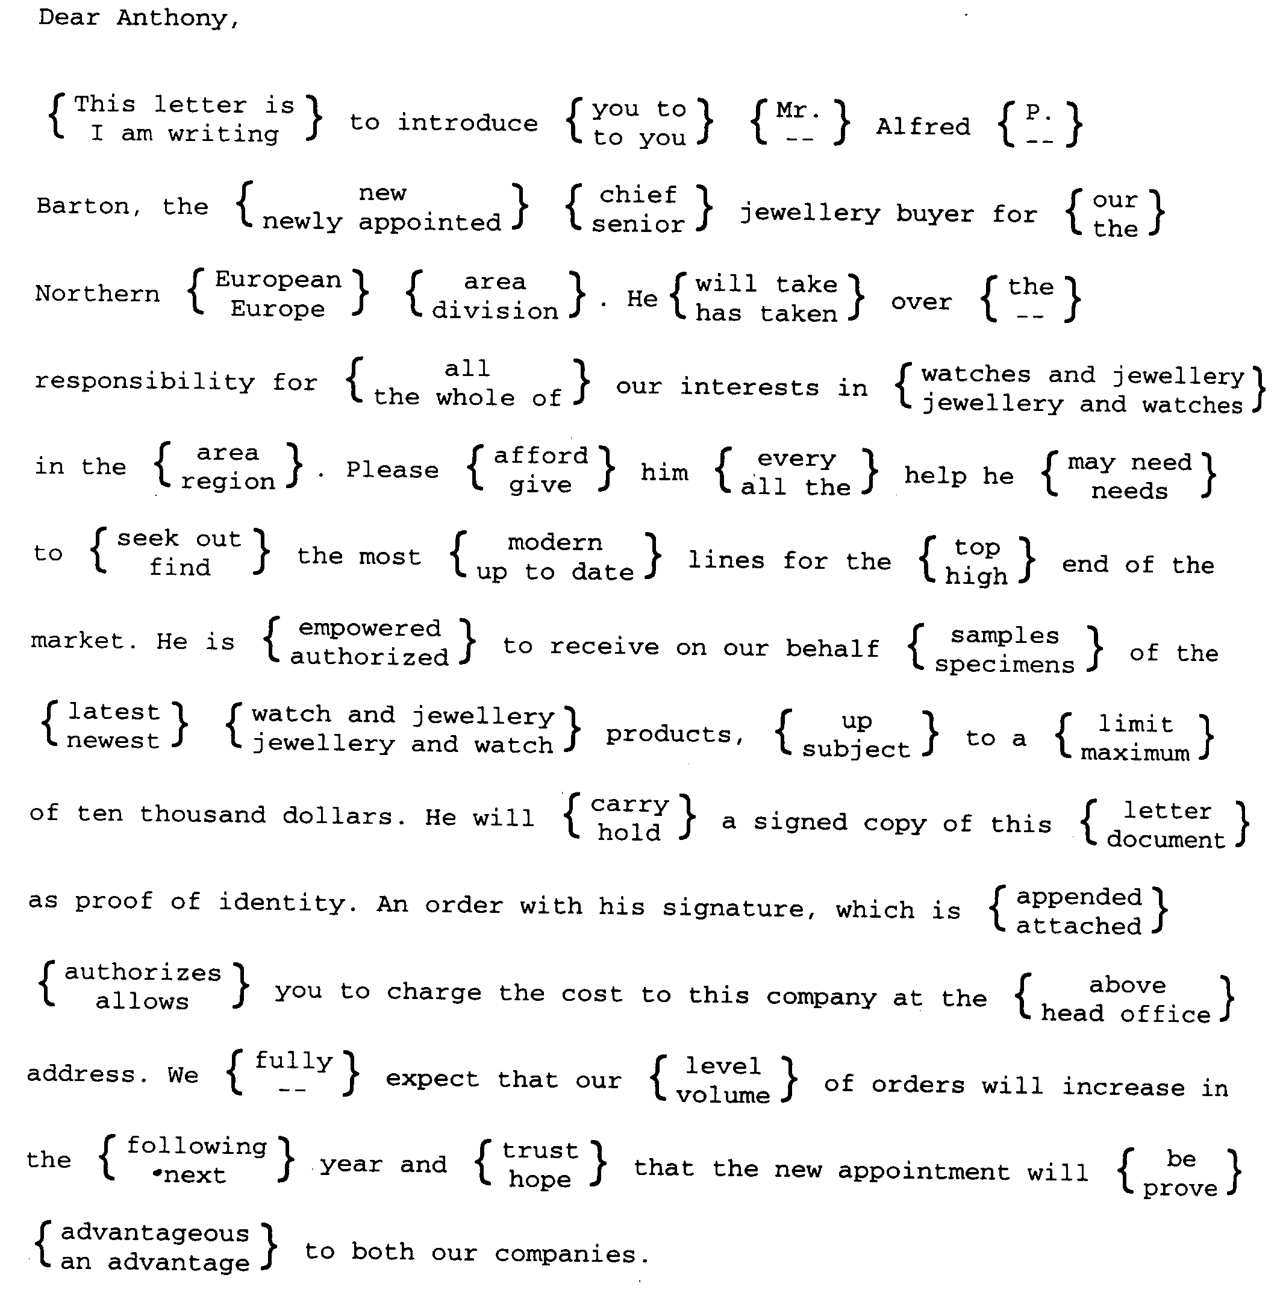
A letter in 2³⁷ variations

Slide 28
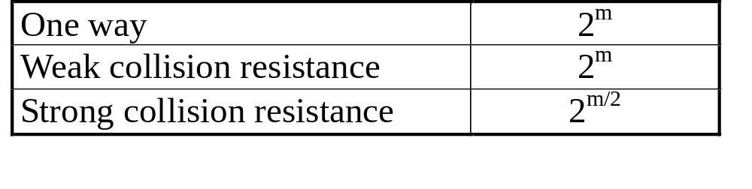
Security of hash functions
We can group attacks on hash functions into two categories: brute-force attacks and cryptanalysis.
The strength of a hash functions against brute-force attacks depends solely on the length of the hash code.
For a code of length m, the level of effort required is proportional to the following.

Slide 29
Another version of birthday attack
Assume that the opponent intercepts a message with a signature in the form of an encrypted hash code and that the unencrypted hash code is m bits long.
Use the algorithm defined at the beginning of this subsection to calculate the unencrypted has code G.
Construct any desired message in the form Q₁, Q₂, …,Q_{N-2}.
Compute H_{i}= E(Q_{i},H_{i-1}), for 1<i<(N-2).

Slide 30
Another version of birthday attack (Cont.)
Generate 2^{m/2} random blocks, for each block X, compute D(Y,G), where D is the decryption function corresponding to E.
Based on the birthday paradox, with high probability there will be an X and Y such that E(X,H_{N-2})=D(Y,G).
Form the message Q₁,Q₂,…,Q_{N-2},X,Y. This message has the hash code G and therefore can be used with the intercepted encrypted signature.

Slide 31
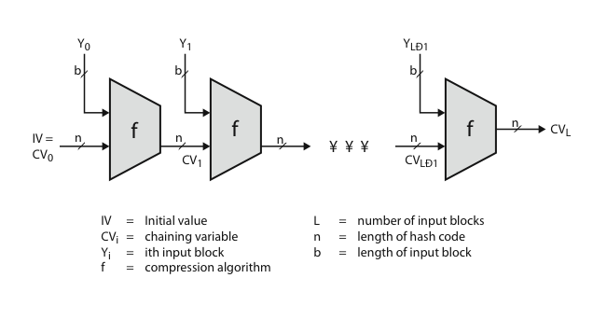
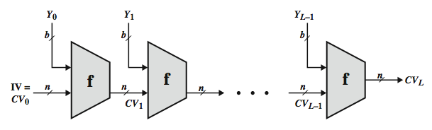
Hash algorithm structure
Notes:
Most important modern hash functions follow the basic structure shown in this figure, Stallings Figure 11.9. This has proved to be a fundamentally sound structure, and newer designs simply refine the structure and add to the hash code length. Within this basic structure, two approaches have been followed in the design of the compression function, as mentioned previously, which is the basic building block of the hash function.

Slide 32
Secure hash algorithm
SHA was originally designed by NIST & NSA in 1993 and revised in 1995 as SHA-1.
US standard for use with DSA signature scheme.
Based on design of MD4 with key differences.
SHA-1 produces 160-bit hash values.
Two messages deliver the same SHA-1 hash using 2⁶⁹ operations, far fewer than 2⁸⁰ operations. (王小雲)
Recent 2005 results on security of SHA-1 have raised concerns on its use in future applications.
Notes:
In recent years, the most widely used hash function has been the Secure Hash Algorithm (SHA). The Secure Hash Algorithm (SHA) was developed by the National Institute of Standards and Technology (NIST) and published as a federal information processing standard (FIPS 180) in 1993; a revised version was issued as FIPS 180-1 in 1995 and is generally referred to as SHA-1. The actual standards document is entitled Secure Hash Standard. SHA is based on the hash function MD4 and its design closely models MD4. SHA-1 produces a hash value of 160 bits. In 2005, a research team described an attack in which two separate messages could be found that deliver the same SHA-1 hash using 2^69 operations, far fewer than the 2^80 operations previously thought needed to find a collision with an SHA-1 hash [WANG05]. This result has hastened the transition to newer, longer versions of SHA.

Slide 33
Revised secure hash standard
NIST issued revision FIPS 180-2 in 2002.
Adds 3 additional versions (SHA-2)
  SHA-256, SHA-384, SHA-512
Designed for compatibility with increased security provided by the AES cipher.
Structure & detail is similar to SHA-1, hence analysis should be similar, but security levels are rather higher.
Notes:
In 2002, NIST produced a revised version of the standard, FIPS 180-2, that defined three new versions of SHA, with hash value lengths of 256, 384, and 512 bits, known as SHA-256, SHA-384, and SHA-512. Collectively, these hash algorithms are known as SHA-2. These new versions have the same underlying structure and use the same types of modular arithmetic and logical binary operations as SHA-1, hence analyses should be similar. A revised document was issued as FIP PUB 180-3 in 2008, which added a 224-bit version. SHA-2 is also specified in RFC 4634, which essentially duplicates the material in FIPS 180-3, but adds a C code implementation.
In 2005, NIST announced the intention to phase out approval of SHA-1 and move to a reliance on the other SHA versions by 2010.

Slide 34
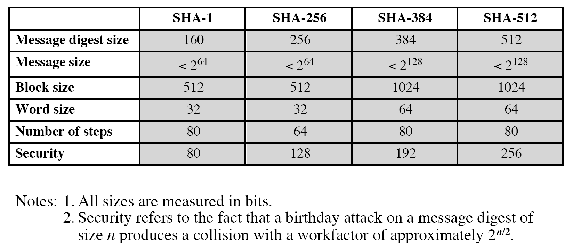
Comparison of SHA parameters

Slide 35
SHA-512 logic
Append padding bits: the length in bits is congruent to 896 mod 1024. The padding consists of a single 1-bit followed by 0-bits.
Append length: a 128-bit representation of the length in bits of the original message is appended.

Slide 36
SHA-512 logic (Cont.)
Initialize hash buffer:
  a 512-bit buffer is used to hold intermediate and final results of the hash function.
  The buffer can be represented as eight 64-bit registers (a,b,c,d,e,f,g,h). Their initial values are (hexadecimal)
  a=6A09E667F3BCC908 e=510E527FADE682D1
  b=BB67AE8584CAA73B f=9B05688C2B3E6C1F
  c=3C6EF372FE94F82B g=1F83D9ABFB41BD6B
  d=A54FF53A5F1D36F1 h=5BE0CDI9137E2179
  (taking the first 64 bits if the fractional parts of the square roots of the first eight prime number)

Slide 37
SHA-512 logic (Cont.)
Process message in 1024-bit (128 bytes, 16 words) blocks.
  The compression function contains 80 rounds.
Output.After all N 1024-bit blocks have been processed, the output from the Nth stage is the 512-bit message digest.

Slide 38
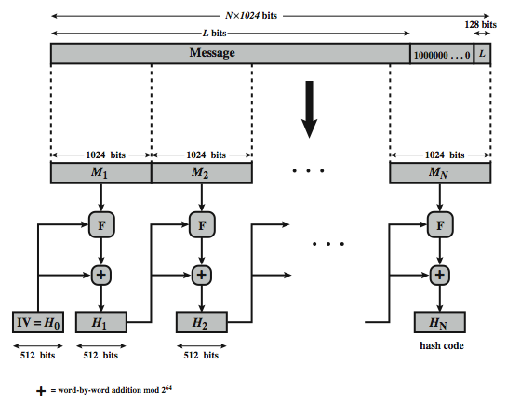
SHA-512 overview
Notes:
Now examine the structure of SHA-512, noting that the other versions are quite similar.
SHA-512 follows the structure depicted in Stallings Figure 12.1. The processing consists of the following steps:
• Step 1: Append padding bits
• Step 2: Append length
• Step 3: Initialize hash buffer
• Step 4: Process the message in 1024-bit (128-word) blocks, which forms the heart of the algorithm
• Step 5: Output the final state value as the resulting hash
See text for details.

Slide 39
SHA-512 compression function
Process message in 1024-bit blocks.
Contains 80 rounds.
  Updating a 512-bit buffer.
  Using a 64-bit value derived from the current message block.
  A round constant based on cube root of first 80 prime numbers.
Notes:
The SHA-512 Compression Function is the heart of the algorithm. In this Step 4, it processes the message in 1024-bit (128-word) blocks, using a module that consists of 80 rounds, labeled F in Stallings Figure 12, as shown in Figure 12.2. Each round takes as input the 512-bit buffer value, and updates the contents of the buffer. Each round t makes use of a 64-bit value Wt derived using a message schedule from the current 1024-bit block being processed. Each round also makes use of an additive constant Kt, based on the fractional parts of the cube roots of the first eighty prime numbers. The output of the eightieth round is added to the input to the first round to produce the final hash value for this message block, which forms the input to the next iteration of this compression function, as shown on the previous slide.

Slide 40
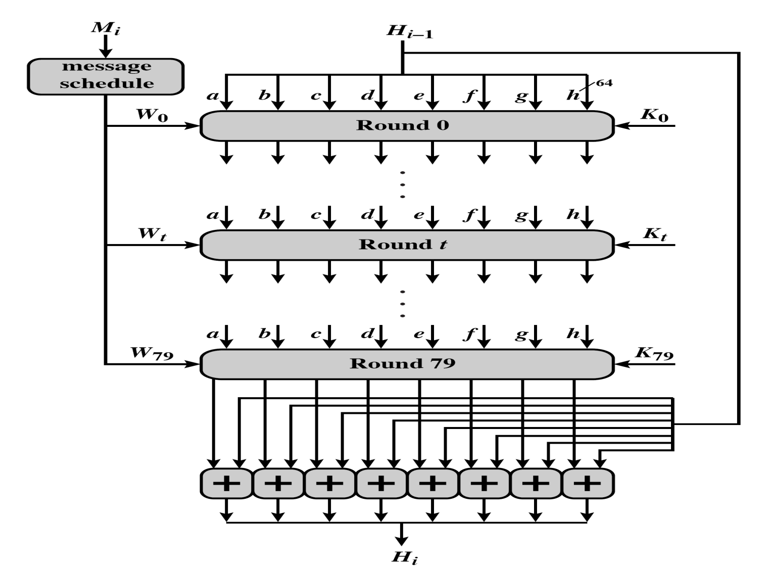
A single 1024-bit block
Notes:
Kt: taking the first 64 bits of the fractional parts of the cube roots of the first eighty prime numbers.

Slide 41
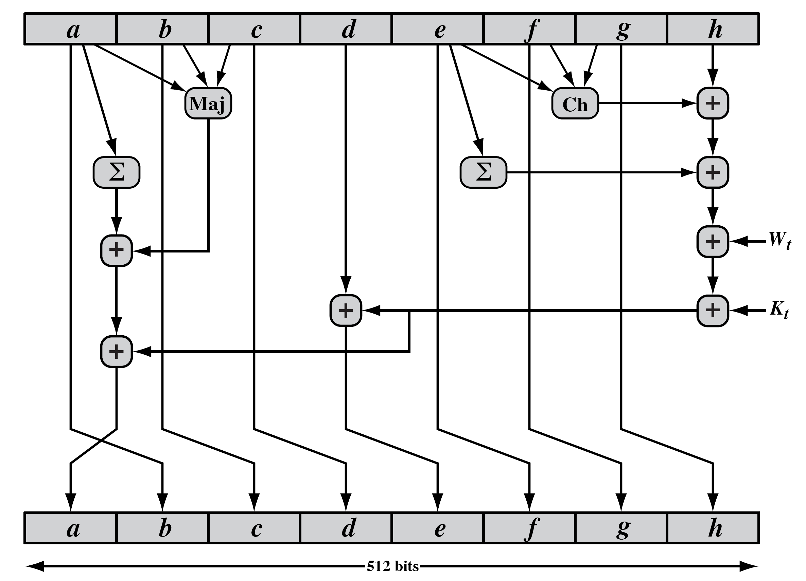
SHA-512 round function
Notes:
The structure of each of the 80 rounds is shown in Stallings Figure 12.3. Each 64-bit word shuffled along one place, and in some cases manipulated using a series of simple logical functions (ANDs, NOTs, ORs, XORs, ROTates), in order to provide the avalanche & completeness properties of the hash function. The elements are:
Ch(e,f,g) = (e AND f) XOR (NOT e AND g)
Maj(a,b,c) = (a AND b) XOR (a AND c) XOR (b AND c)
∑(a) = ROTR(a,28) XOR ROTR(a,34) XOR ROTR(a,39)
∑(e) = ROTR(e,14) XOR ROTR(e,18) XOR ROTR(e,41)
+ = addition modulo 2^64
Kt = a 64-bit additive constant
Wt = a 64-bit word derived from the current 512-bit input block.

Slide 42
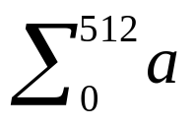
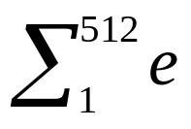
SHA-512 functions
Ch(e,f,g)=(e ∧ f) ⊕ (¬e ∧ g)
Maj(a,c)=(a ∧ b) ⊕(a ∧ c) ⊕ (b ∧ c)
=ROTR²⁸(a) ⊕ROTR³⁴(a) ⊕ROTR³⁹(a)
=ROTR¹⁴(e) ⊕ROTR¹⁸(e) ⊕ROTR⁴¹(e)
σ₀(x)= ROTR¹(x) ⊕ROTR⁸(x) ⊕SHR⁷(x)
σ₁(x)= ROTR¹⁹(x) ⊕ROTR⁶¹(x) ⊕SHR⁶(x)

Slide 43
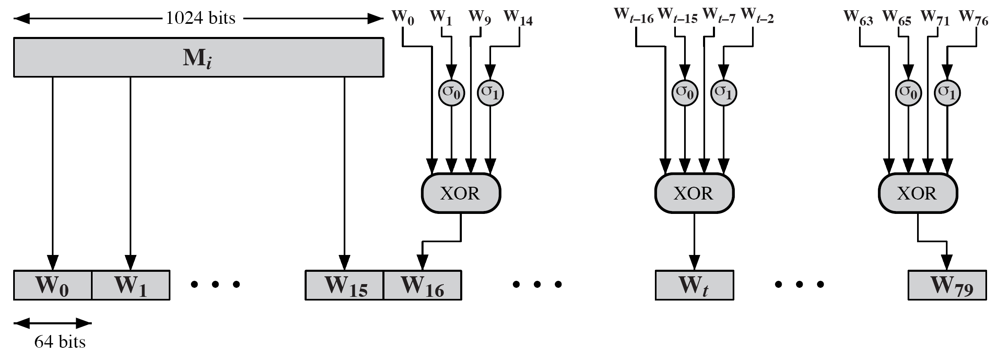
SHA-512 round function
Notes:
Stallings Figure 12.4 details how the 64-bit word values Wt are derived from the 1024-bit message. The first 16 values of Wt are taken directly from the 16 words of the current block. The remaining values are defined as a function of the earlier values using ROTates, SHIFTs and XORs as shown. The function elements are:
∂0(x) = ROTR(x,1) XOR ROTR(x,8) XOR SHR(x,7)
∂1(x) = ROTR(x,19) XOR ROTR(x,61) XOR SHR(x,6).

Slide 44
SHA-3
SHA-1 not yet "broken”.
  But similar to broken MD5 & SHA-0.
  So considered insecure.
SHA-2 (esp. SHA-512) seems secure.
  Shares the same structure and mathematical operations as predecessors.
Replace SHA-2 with SHA-3 in any use
  so use the same hash sizes
Preserve the online nature of SHA-2
  Must process small blocks (512 / 1024 bits).
Notes:
As yet, SHA-1 has not yet been "broken". That is, no one has demonstrated a technique for producing collisions in less than brute-force time. However, because SHA-1 is very similar in structure and in the basic mathematical operations used to MD5 and SHA-0, both of which have been broken, SHA-1 is considered insecure and has been phased out for SHA-2.
SHA-2, particularly the 512-bit version, would appear to provide unassailable security. However, SHA-2 shares the same structure and mathematical operations as its predecessors, and this is a cause for concern. Because it will take years to find a suitable replacement for SHA-2, should it become vulnerable, NIST decided to begin the process of developing a new hash standard. Accordingly, NIST announced in 2007 a competition to produce the next generation NIST hash function, to be called SHA-3. NIST would like to have a new standard in place by the end of 2012, but emphasizes that this is not a fixed timeline.

Slide 45
SHA-3 requirements
Evaluation criteria
  Security close to theoretical max for hash sizes
  Cost in time & memory
  Characteristics: such as flexibility & simplicity
NIST announced in 2007 a competition for the SHA-3 next genenation NIST hash function.
On October 2, 2012, Keccak was selected as the winner by NIST.
Keccak was designed by designed by Guido Bertoni et al.
Notes:
The basic requirements that must be satisfied by any candidate for SHA-3 are:
It must be possible to replace SHA-2 with SHA-3 in any application by a simple drop-in substitution. Therefore, SHA-3 must support hash value lengths of 224, 256, 384, and 512 bits.
SHA-3 must preserve the online nature of SHA-2. That is, the algorithm must process comparatively small blocks (512 or 1024 bits) at a time instead of requiring that the entire message be buffered in memory before
Beyond these basic requirements, NIST has defined a set of evaluation criteria. These criteria are designed to reflect the requirements for the main applications supported by SHA-2, and are:
• Security: The strength of SHA-3 should be close to the theoretical maximum for the different required hash sizes, and for both preimage resistance and collision resistance. SHA-3 algorithms must be designed to resist any potentially successful attack on SHA-2 functions
• Cost: be both time and memory efficient over a range of hardware platforms.
• Algorithm and implementation characteristics: such as flexibility (e.g., tunable parameters for security/performance tradeoffs, opportunity for parallelization, and so on), and simplicity (which makes it easier to analyze the security properties of the algorithm)

Slide 46
Homework
P378 (Chapter 11)
11.3 11.8 11.12

Slide 47
Homework
P378 (Chapter 11)
11.2 11.5 11.11

