Slide 1
Message Authentication Codes (Ch. 12)
Message authentication requirements
Message authentication functions
Requirements for message authentication codes
Security of MACs
MACs based on hash functions (HMAC)
MACs based on block ciphers (DAA and CMAC)
Authenticated encription (CCM and GCM)
Pseudorandom number generation using hash functions and MACs
Summary

Slide 2
Authentication requirements
Attacks can be identified
  Disclosure
  Traffic analysis
  Masquerade
  Content modification
  Sequence modification
  Timing modification
  Repudiation
Notes:
Masquerade: Insertion of messages into the network from a fraudulent source
Repudiation: Denial of receipt of message by destination or denial of transmission of message by source

Slide 3
Authentication functions
Any message authentication or digital signature mechanism can be viewed as having fundamentally two levels.
  At the lower level, there must be some sort of function that produces an authenticator.
  At the higher level, a receiver can verify the authenticity of a message.

Slide 4
Functions to produce an authenticator
Message encryption: The ciphertext of the entire message serves as its authenticator.
Message authentication code (MAC): A public function of the message and a secret key that produces a fixed-length value that serves as the authenticator.
Hash function: A public function that maps a message of any length into a fixed-length hash value, which serves as the authenticator.

Slide 5
Message encryption
Symmetric encryption
Public key encryption

Slide 6
Symmetric encryption: confidentiality and authentication
Source
Destination
M
M
E
D
K
E(K,M)
K

Slide 7
Confidentiality and authentication implications of message encryption
Symmetric encryption (A→B:E(K,M)
  Provides confidentiality
    Only A and B share K
  Provides a degree of authentication
    Could come only from A
    Has not been alter in transit
    Requires some formatting/redundancy
  Does not provide signature
    Receiver could forge message
    Sender could deny message

Slide 8
Symmetric encryption (Cont.)
Suppose M can be any bit pattern.
There is no way to determine automatically, at the destination, whether an incoming message is the ciphertext of a legitimate message.
Thus, in general, we require that only a small subset of all possible bit patterns is considered legitimate plaintext.
In that case, any spurious ciphertext is unlikely to produce legitimate plaintext.

Slide 9
Symmetric encryption (Cont.)
For example, suppose that we are transmitting messages using Caesar cipher with a shift of one (K=1).
A sends the following legitimate ciphertext
ipxbsfzpv
B decrypts to produce the following plaintext
howareyou
A simple frequency analysis confirms that this message has the profile of ordinary English.

Slide 10
Symmetric encryption (Cont.)
On other hand, if an opponent generates the following random sequence of letters.
zuvrsoevgqxlzw
It decrypts to
ytuqrndufpwkyv
which does not fit the profile of ordinary English.

Slide 11
Symmetric encryption (Cont.)
It may be difficult to determine automatically if incoming ciphertext decrypts to intelligible plaintext.
If the plaintext is, say, a binary object file or digitized images, determination of properly formed and therefore authentic plaintext may be difficult.
One solution to this problem is to force the plaintext to have some structure that is easily recognized but that cannot be replicated without recourse to the encryption function.
For example, we could append an error-detecting code, also known as a frame check sequence(FCS) or checksum, to each message before encryption.

Slide 12
Internal error control
Source
M
M
||
E
F(M)
F
K
E(K,M||F(M))
F
M
D
Compare
F(M)
K
Destination

Slide 13
External error control
Source
M
M
||
E
K
E(K,M)
F
D
M
F
F(M)
K
Compare
F(E(K,M))
Destination

Slide 14
TCP Segment
Bit:
0
4
10
16
31
Source port
Destination
Sequence number
Acknowledge number
Data offset
Reserved
Flags
Windows
Checksum
Urgent pointer
Options + padding
Applications data

Slide 15
Public-key encryption: confidentiality
Source
Destination
M
M
E
D
PU_{b}
E(PU_{b}, M)
PR_{b}

Slide 16
Public-key encryption: authentication and signature
Source
Destination
M
M
E
D
PR_{a}
E(PR_{a}, M)
PU_{a}

Slide 17
Public-key encryption: confidentiality, authentication and signature
Source
M
E
E
PR_{a}
E(PR_{a}, M)
PU_{b}
E(PU_{b},E(PR_{a},M))
M
D
D
PR_{b}
E(PR_{a}, M)
PU_{a}
Destination

Slide 18
Public-key encryption: confidentiality, authentication and signature
The disadvantage of this approach is that the public-key algorithm, which is complex, must be exercised four times rather than two in each communication.

Slide 19
Confidentiality and authentication implications of message encryption (Cont.)
Public-key encryption (A→B:E(PU_{b},M)
  Provides confidentiality
    Only B has PR_{b} to decrypt
  Provides no authentication
    Any party could use PU_{b} to encrypt message and claim to be A

Slide 20
Confidentiality and authentication implications of message encryption (Cont.)
Public-key encryption (A→B:E(PR_{a}, M)
  Provides authentication and signature
    Only A has PR_{a} to encrypt
    Has not been altered in transit
    Require some formatting/redundancy
    Any part can use PU_{a} to verify signature

Slide 21
Confidentiality and authentication implications of message encryption (Cont.)
Public-key encryption (A→B:E(PU_{b}, E(PR_{a}, M))
  Provides confidentiality because of PU_{b}.
  Provides authentication and signature because of PR_{a}.

Slide 22
Message authentication code (MAC)
An alternative authentication technique involves the use of a secret key to generate a small fixed-size block of data, known as a cryptographic checksum or MAC, that is appended to the message.
When A sends a message to B, it calculates the MAC=C(K,M), where K is the secret key.
The message plus MAC are send to B.
B performs the same calculation on the received message to generate new MAC which is compared to the received MAC.

Slide 23
Message authentication
Source
Destination
M
C
M
||
K
Compare
C(K,M)
K
C

Slide 24
MAC (Cont.)
Assume that only the receiver and sender know the identity of the secret key, and if the received MAC matches the calculated MAC.
  The receiver is assured that the message has not been altered.
  The receiver is assured that the message is from the alleged sender.
  If the message includes a sequence number, then the receiver can be assured of the proper sequence because an attacked cannot successfully alter the sequence number.

Slide 25
MAC (Cont.)
An MAC function is similar to encryption.
One difference is that the MAC algorithm need not be reversible, as it must for decryption.
It turns out that because of the mathematical properties of the authentication function, it is less vulnerable to being broken than encryption.

Slide 26
Message authentication and confidentiality; authentication tied to plaintext
Source
M
||
E
K₁
C
K₂
E(K₂,[M||C(K₁,M)])
M
C
D
Compare
C(K₁,M)
K₁
K₂
Destination

Slide 27
Message authentication and confidentiality; authentication tied to ciphertext
Source
M
E
||
K₁
K₂
C
E(K₂,M)
D
M
C
K₂
Compare
C(K₁,E(K₂,M))
K₁
Destination

Slide 28
The situations where an MAC is used
There are a number of applications in which the same message is broadcast to a number of destinations.
Another possible scenario is an exchange in which one side has a heavy load and cannot afford the time to decrypt all incoming messages.
Authentication of a computer program in plaintext is an attractive service.

Slide 29
The situations where an MAC is used (Cont.)
For some applications, it may not be of concern to keep messages secret, but it is important to authenticate messages.
Separation of authentication and confidentiality functions affords architectural flexibility.
Note that the MAC does not provide a digital signature because both sender and receiver share the same key.

Slide 30
Basic uses of an MAC
A→B:M||C(K,M)
  Provides authentication: only A and B share K
A→B:E(K₂, [M||C(K₁,M)])
  Provides authentication: only A and B share K₁
  Provides confidentiality: only A and B share K₂
A→B:C(K₁,E(K₂,M))
  Provides authentication: using K₁
  Provides confidentiality: using K₂

Slide 31
Message authentication codes (MACs)
An MAC, also known as a cryptographic checksum, is generated by a function C of
T=C(K,M)
where M is a variable-length message, K is a secret key shared only by sender and receiver and C(K,M) is the fixed-length authenticator.
In general, the MAC function is a many-to-one function.
If an n-bit MAC is used, then there are 2^{n} possible MACs, whereas there are N possible messages with N>>2^{n}.

Slide 32
Discovering a key
If confidentiality is not employed, the opponent has access to plaintext messages and their associated MACs.
Suppose k>n; that is, the key(guess) size is greater than the MAC size.
Given a known M₁ and T₁=C(K₁,M₁), the cryptanalyst can perform T_{i}=C(K_{i},M₁) for all possible key values.
At least one key is guaranteed to produce a match.
On average, a total of 2^{k}/2^{n}=2^{(k-n)} keys will produce a match.

Slide 33
Discovering a key (Cont.)
Thus, the opponent must iterate the attack.
Round 1
  Given: M₁, T₁=C(K,M₁)
  Compute T_{i}=C(K_{i},M₁) for all 2^{k} keys
  Number of matches 2^{(k-n)}
Round 2
  Given: M₂, MAC₂=C(K,M₂)
  Compute T_{i}=C(K_{i},M₂) for the remaining 2^{(k-n)} keys
  Number of matches≈ 2^{(k-2n)}
On average, α rounds will be needed if k=αn.

Slide 34
Discovering a key (Cont.)
For example, if an 80-bit key is used and the MAC is 32-bit long, then the first round will produce about 2⁴⁸ possible keys.
The second round will narrow the possible keys to about 2¹⁶ possibilities.
The third round will produce only the single key, which must be the one used by the sender.

Slide 35
Encrypted by DES algorithm
Let M=(X₁||X₂||…||X_{m}) be a message that is treated as a concatenation of 64-bit blocks X_{i}.
Then define
Δ(M)= X₁⊕X₂⊕…⊕X_{m}
MAC(K,M)=E(K,Δ(M))
where ⊕ is the exclusive-OR(XOR) operation and the encryption algorithm is DES in electronic codebook mode.
Thus, the key length is 56 bits and the MAC length is 64 bits.

Slide 36
Encrypted by DES algorithm (Cont.)
If an opponent observes {M||MAC(K,M)}, a brute-force attempt to determine K will require at least 2⁵⁶ encryptions.
But the opponent can attack the system by replacing X₁ through X_{m-1} with any desired values Y₁ through Y_{m-1} and X_{m} with Y_{m}, where Y_{m} is
Y_{m}=Y₁⊕Y₂⊕…⊕Y_{m-1} ⊕ Δ(M)

Slide 37
Encrypted by DES algorithm (Cont.)
The opponent can now concatenate the new message, which consists of Y₁ through Y_{m}, with the original MAC to form a message that will accepted as authentic by the receiver.
With this tactic, any message of length 64×(m-1) bits can be fraudulently inserted.

Slide 38
Properties of the MAC
Assume that an opponent knows the MAC function C but does not know K. Then the MAC function should have the following properties:
  If an opponent observes M and C(K,M), it should be computationally infeasible for the opponent to construct a message M’ such that C(K,M’)=C(K,M).
  C(K,M) should be uniformly distributed in the sense that for randomly chosen messages, M and M’, the probability that C(K,M)=C(K,M’) is 2^{-n}, where n is the number of bits in the MAC.
  Let M’ be equal to some known transformation on M. That is, M’=f(M). In that case, Pr[C(K,M)=C(K,M’)]=2^{-n}.

Slide 39
Brute-force attack on an MAC
Computation resistance: Given one or more text-MAC pairs (x_{i}, C(K,x_{i})), it is computationally infeasible to compute any text-MAC pair (x, C(K,x)) for any new input x ≠x_{i}.
The level of effort for brute-force attack on a MAC algorithm can be expressed as min (2^{k}, 2^{n}), where k is the length of key and n is the length of the MAC.
It would appear reasonable to require that the key length and MAC length satisfy a relationship such as min(k,n)>N, where N is perhaps in the range of 128 bits.

Slide 40
Cryptanalysis attacks
Cryptanalysis attacks on hash functions and MAC algorithms seek to exploit some property of the algorithm to perform some attack other than an exhaustive search.
An ideal hash of MAC algorithm will require a cryptanalytic effort greater than or equal to the brute-force attack.

Slide 41
Keyed hash functions as MACs
Want a MAC based on a hash function
  because hash functions are generally faster
  code for crypto hash functions widely available
Hash includes a key along with message
Original proposal:
  KeyedHash = Hash(Key|Message)
  some weaknesses were found with this
Eventually led to development of HMAC
Notes:
In recent years, there has been increased interest in developing a MAC derived from a cryptographic hash function. A hash function such as SHA was not designed for use as a MAC and cannot be used directly for that purpose because it does not rely on a secret key. There have been a number of proposals for the incorporation of a secret key into an existing hash algorithm, originally by just pre-pending a key to the message. Problems were found with these earlier, simpler proposals, but they resulted in the development of HMAC.

Slide 42
HMAC
There has been increased interest in developing an MAC derived from a cryptographic hash code.
The approach that has received the most support is HMAC.
HMAC has been chosen as the mandatory-to-implement HMAC for IP security.

Slide 43
HMAC design objectives
To use, without modifications, available hash functions.
To allow for easy replaceability of the embedded hash function in case faster or more secure hash functions are found or required.
To preserve the original performance of the hash function without incurring a significant degradation.
To use and handle keys in a simple way.
To have a well understood cryptographic analysis of the strength of the authentication mechanism.

Slide 44
HMAC
Specified as Internet standard RFC2104
Uses hash function on the message:
  HMAC_{K} = Hash[(K⁺ XOR opad) ||
  Hash[(K⁺ XOR ipad)||M)]]
where K⁺ is the key padded out to size,
opad, ipad are specified padding constants
Overhead is just 3 more hash calculations than the message needs alone
Any hash function can be used
  eg. MD5, SHA-1, RIPEMD-160, Whirlpool
Notes:
The idea of a keyed hash evolved into HMAC, designed to overcome some problems with the original proposals. It involves hashing padded versions of the key concatenated with the message, and then with another outer hash of the result prepended by another padded variant of the key. The hash function need only be used on 3 more blocks than when hashing just the original message (for the two keys + inner hash). HMAC can use any desired hash function, and has been shown to have the same security as the underlying hash function. Can choose the hash function to use based on speed/security concerns.

Slide 45
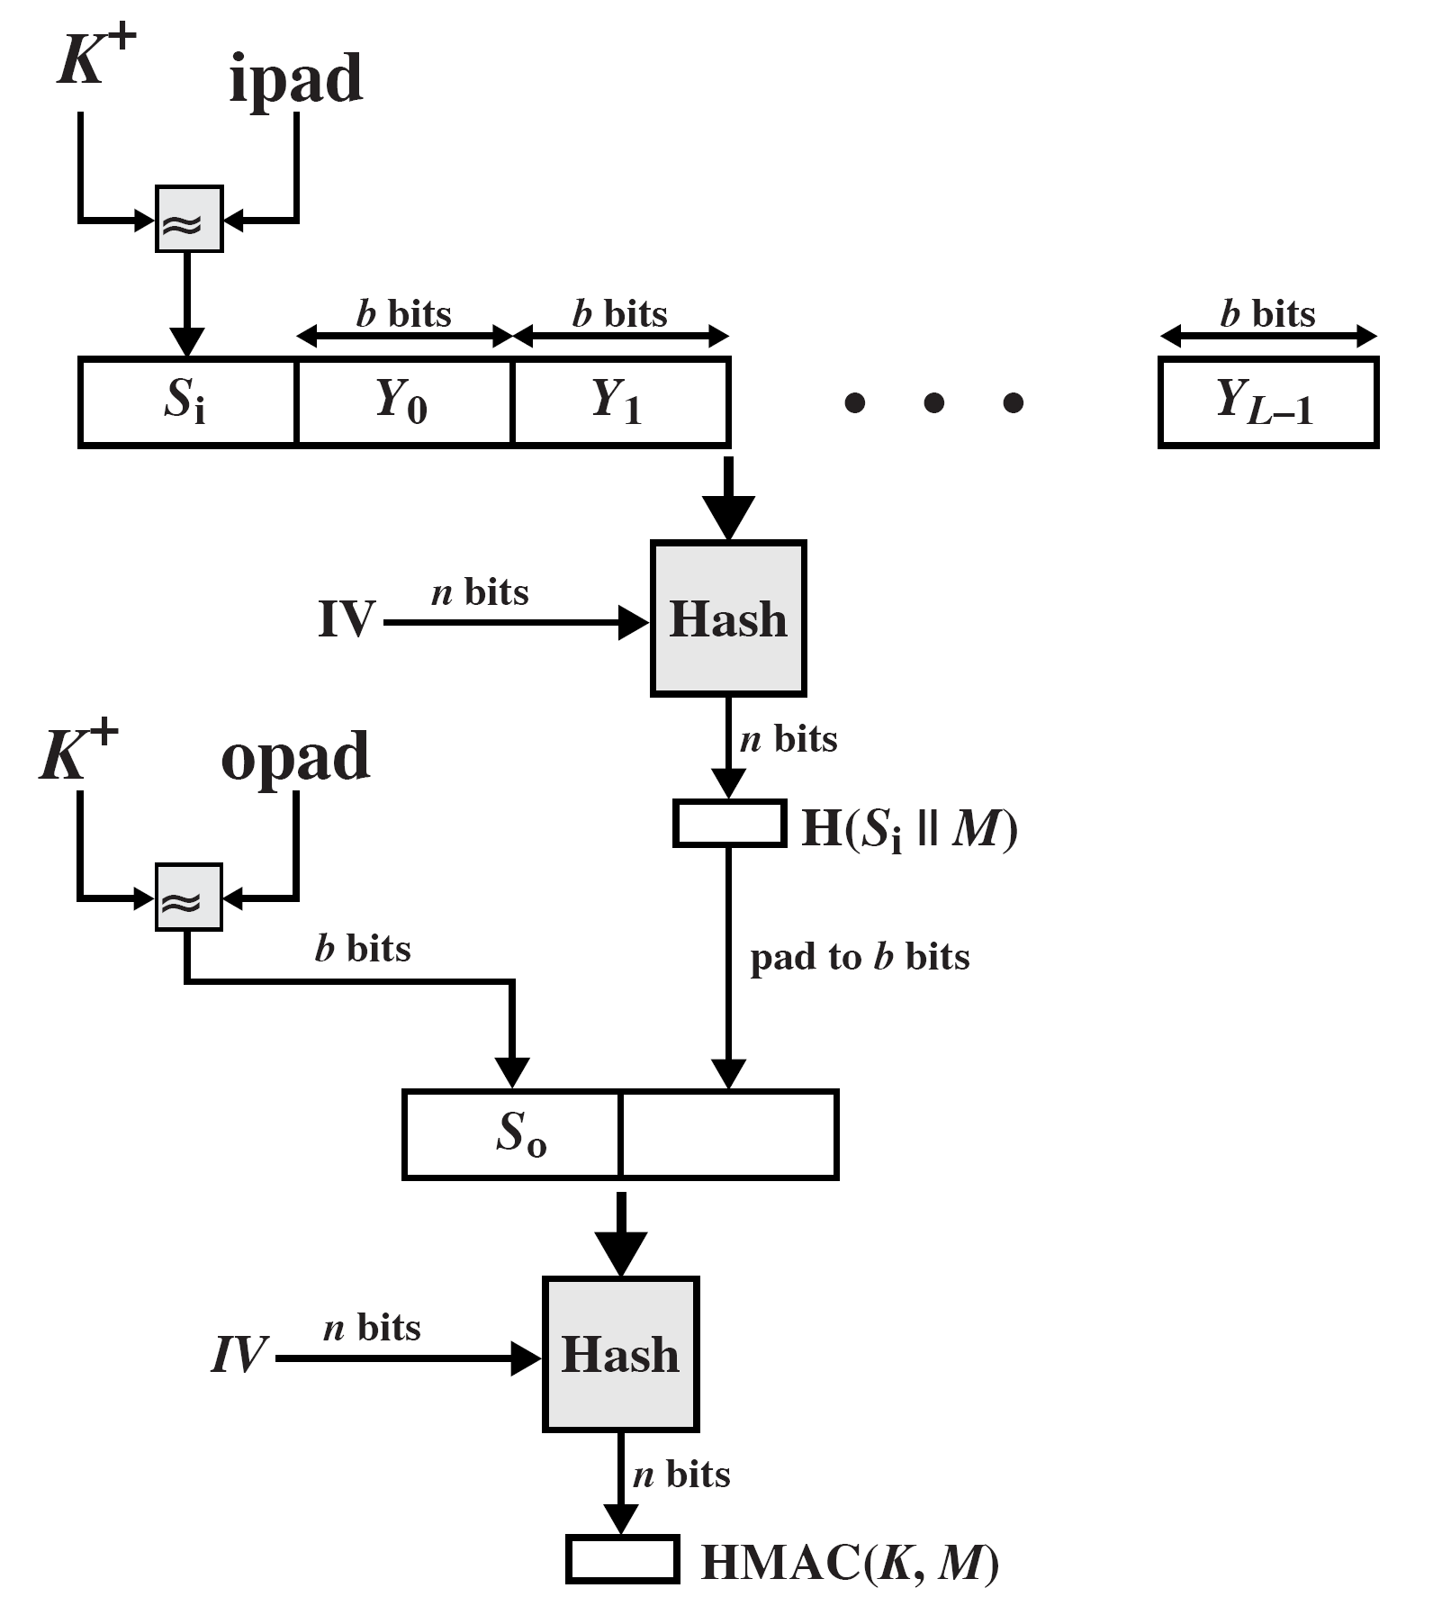
ipad=00110110 repeated b/8 times
opad=01011010 repeated b/8 times
HMAC structure

Slide 46
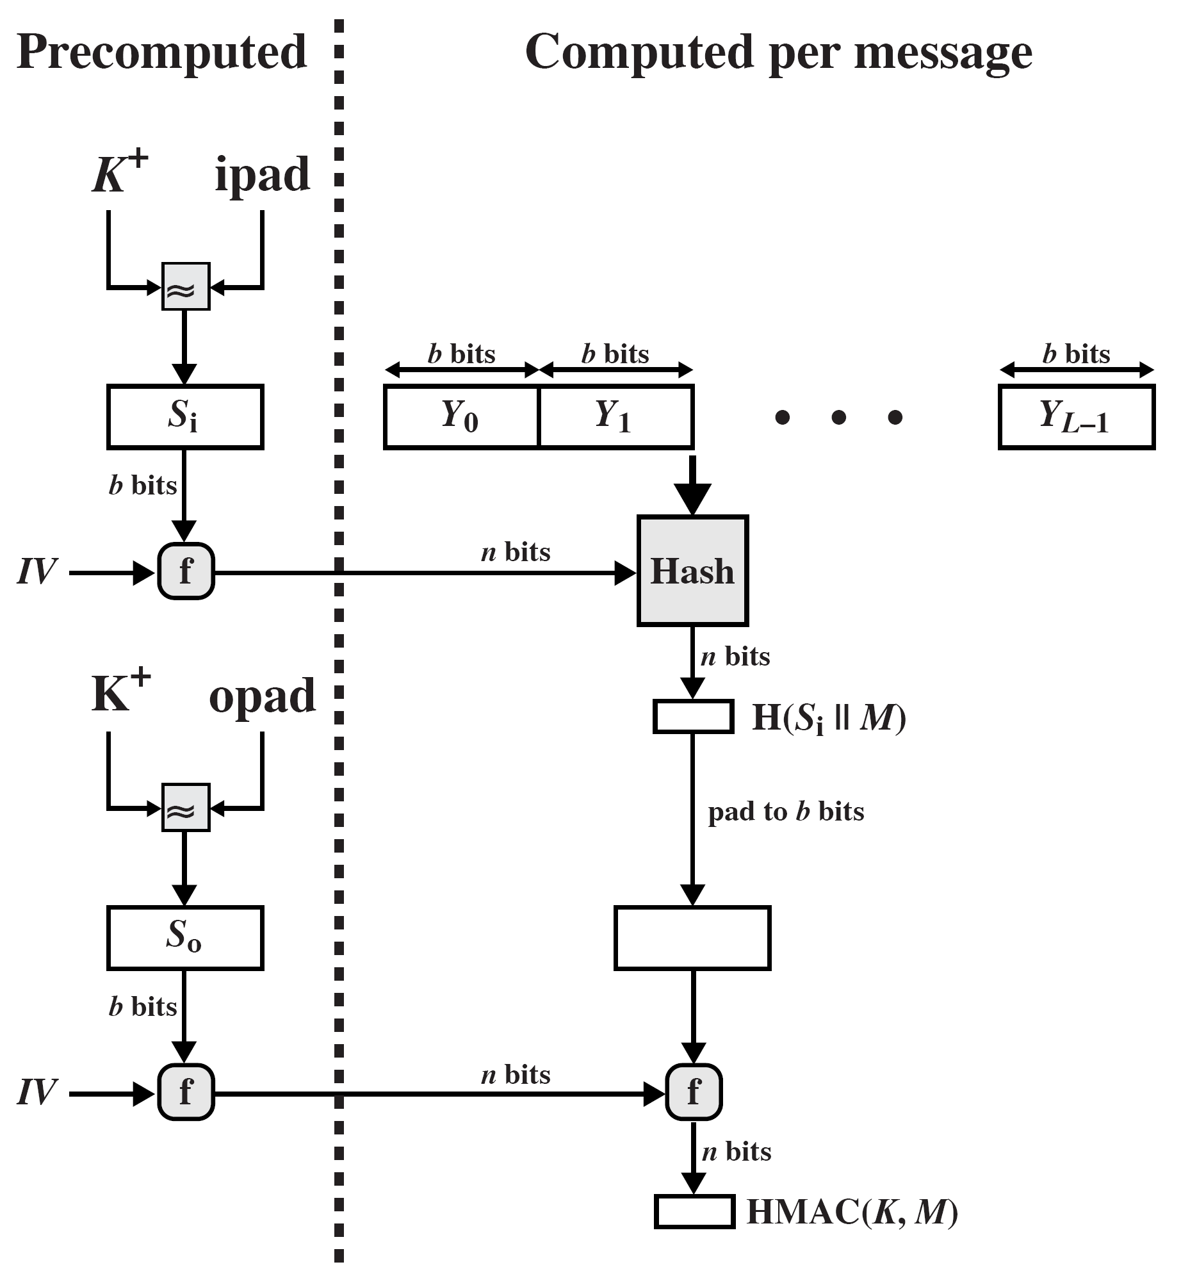
Efficient implementation of HMAC
Notes:
Stallings Figure 12.10 shows the structure of HMAC, which implements the function:
HMAC_{K} = Hash[(K⁺ XOR opad) || Hash[(K⁺ XOR ipad) || M)]
elements are:
K⁺ is K padded with zeros on the left so that the result is b bits in length
ipad is a pad value of 36 hex repeated to fill block
opad is a pad value of 5C hex repeated to fill block
M is the message input to HMAC (including the padding specified in the embedded hash function)

Slide 47
HMAC security
Proved security of HMAC relates to that of the underlying hash algorithm
Attacking HMAC requires either:
  brute force attack on key used
  birthday attack (but since keyed would need to observe a very large number of messages)
Choose hash function used based on speed verses security constraints
Attacking HMAC, the attacker cannot generate message/code pairs offline because the attacker does not know K.
Notes:
The appeal of HMAC is that its designers have been able to prove an exact relationship between the strength of the embedded hash function and the strength of HMAC. The security of a MAC function is generally expressed in terms of the probability of successful forgery with a given amount of time spent by the forger and a given number of message-MAC pairs created with the same key. Have two classes of attacks: brute force attack on key used which has work of order 2^n; or a birthday attack which requires work of order 2^(n/2) - but which requires the attacker to observe 2^n blocks of messages using the same key - very unlikely. So even MD5 is still secure for use in HMAC given these constraints.

Slide 48
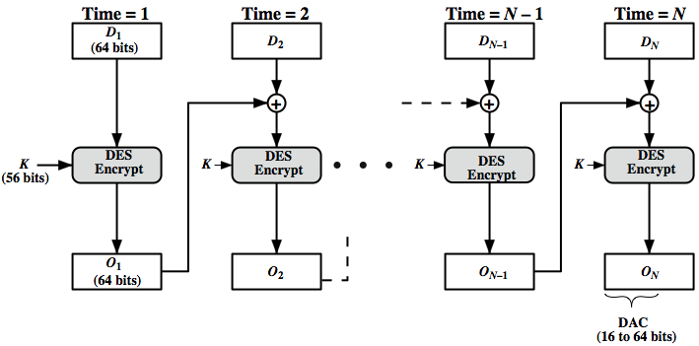
Data authentication algorithm
Notes:
The Data Authentication Algorithm, based on DES, has been one of the most widely used MACs for a number of years. The algorithm is both a FIPS publication (FIPS PUB 113) and an ANSI standard (X9.17). However, security weaknesses in this algorithm have been discovered and it is being replaced by newer and stronger algorithms. The algorithm is shown here in Stallings Figure 12.7, and can be defined as using the cipher block chaining (CBC) mode of operation of DES, with an initialization vector of zero, and 0-pad of the final block if needed. Resulting MAC can be 16-64 bits of the final block. But this is now too small for security.

Slide 49
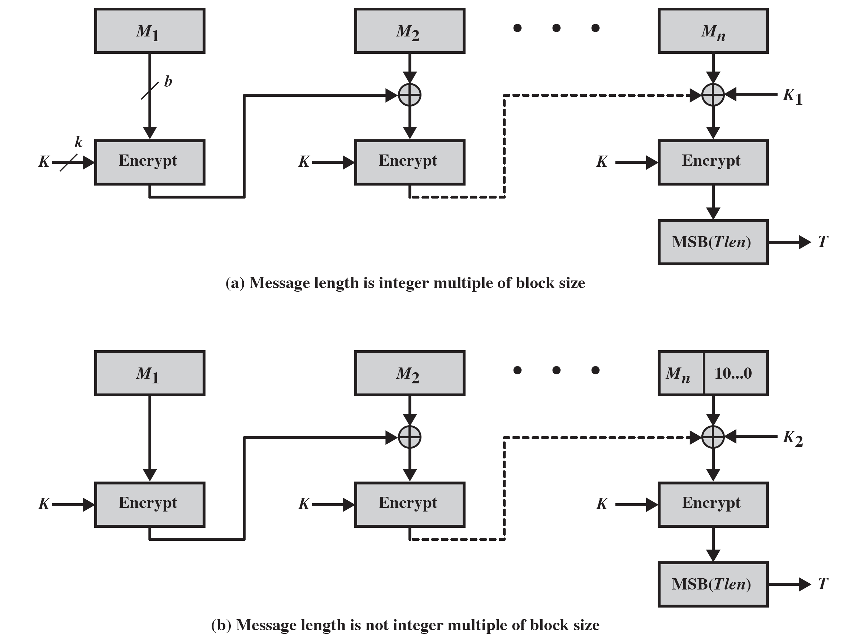
CMAC overview
L=E(K,0^{n}), K₁=Lx, K₂=Lx²
Notes:
Stallings Figure 12.12 shows the structure of CMAC.
It uses the blocksize of the underlying cipher (ie 128-bits for AES or 64-bits for triple-DES). The message is divided into n blocks M1..Mn, padded if necessary. The algorithm makes use of a k-bit encryption key K and an n-bit constant K1 or K2 (depending on whether the message was padded or not). For AES, the key size k is 128,192, or 256 bits; for triple DES, the key size is 112 or 168 bits. The two constants K1 & K2 are derived from the original key K using encryption of 0 and multiplication in GF(2^n), as detailed in the text.

Slide 50
Authenticated encryption
Simultaneously protect confidentiality and authenticity of communications
  often required but usually separate
Approaches
  Hash-then-encrypt: E(K, (M || H(M))
  MAC-then-encrypt: E(K₂, (M || MAC(K₁, M))
  Encrypt-then-MAC: (C=E(K₂, M), T=MAC(K₁, C)
  Encrypt-and-MAC: (C=E(K₂, M), T=MAC(K₁, M)
Decryption /verification straightforward
But security vulnerabilities with all these approaches
Notes:
Authenticated encryption (AE) is a term used to describe encryption systems that simultaneously protect confidentiality and authenticity (integrity) of communications. Many applications and protocols require both forms of security, but until recently the two services have been designed separately. [BLAC05] discussed four common approaches to providing both confidentiality and encryption for a message M:
• HtE: Hash-then-encrypt. First compute the cryptographic hash function over M as h = H(M). Then encrypt the message plus hash function: E(K, (M || h)
• MtE: MAC-then-encrypt. Use two keys. First authenticate the plaintext by computing the MAC value as T = MAC(K1, M). Then encrypt the message plus tag: E(K2, (M || T) cf SSL/TLS
• EtM: Encrypt-then-MAC. Use two keys. First encrypt the message to yield the ciphertext C = E(K 2, M). Then authenticate the ciphertext with T = MAC(K1, C) to yield the pair (C, T) cf IPsec
• E&M: Encrypt-and-MAC. Use two keys. Encrypt the message to yield the ciphertext C = E(K 2, M). Authenticate the plaintext with T = MAC(K1, M) to yield the pair (C, T). These operations can be performed in either order. cf SSH
Both decryption and verification are straightforward for each approach. There are security vulnerabilities with all of these approaches.

Slide 51
Counter with cipher block chaining-message authentication code (CCM)
NIST standard SP 800-38C for IEEE 802.11 WiFi
Variation of encrypt-and-MAC approach
Algorithmic ingredients
  AES encryption algorithm
  CTR mode of operation
  CMAC authentication algorithm
Single key used for both encryption & MAC
Notes:
The CCM mode of operation was standardized by NIST specifically to support the security requirements of IEEE 802.11 WiFi wireless local area networks (Chapter 17), but can be used in any networking application requiring authenticated encryption. CCM is a variation of the encrypt-and-MAC approach to authenticated encryption. It is defined in NIST SP 800-38C. The key algorithmic ingredients of CCM are the AES encryption algorithm (Chapter 5), the CTR mode of operation (Chapter 6), and the CMAC authentication algorithm (Section 12.6). A single key K is used for both encryption and MAC algorithms.

Slide 52
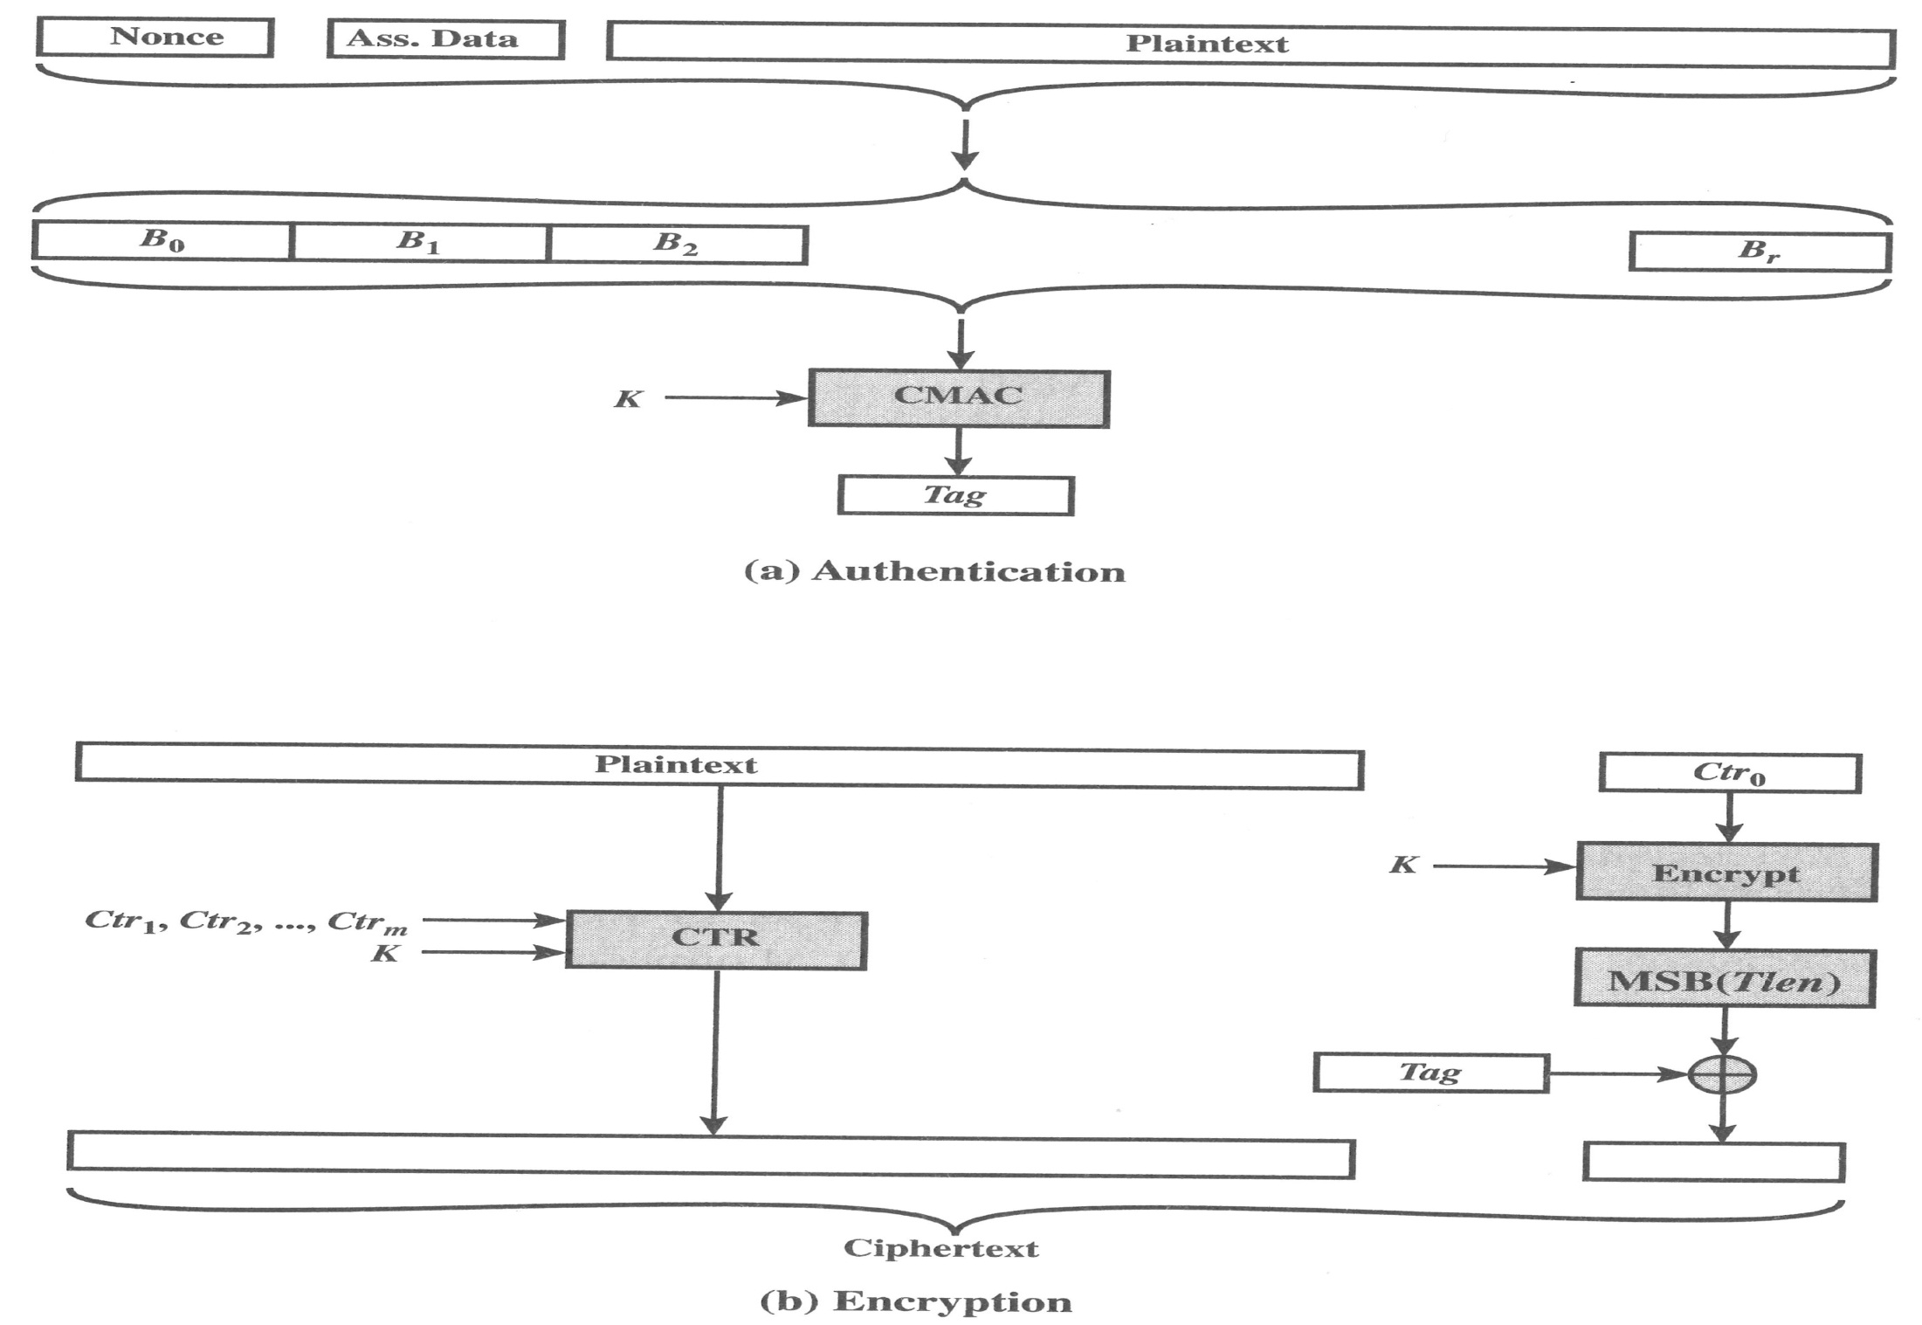
CCM Operation
Notes:
Stallings Figure 12.9 illustrates the operation of CCM. For authentication, the input includes the nonce, the associated data, and the plaintext. This input is formatted as a sequence of blocks B0 through Br. The first block contains the nonce plus some formatting bits that indicate the lengths of the N, A, and P elements. This is followed by zero or more blocks that contain A, followed by zero of more blocks that contain P. The resulting sequence of blocks serves as input to the CMAC algorithm, which produces a MAC value with length Tlen, which is less than or equal to the block length (Figure 12.9a). For encryption, a sequence of counters is generated that must be independent of the nonce. The authentication tag is encrypted in CTR mode using the single counter Ctr0. The Tlen most significant bits of the output are XORed with the tag to produce an encrypted tag. The remaining counters are used for the CTR mode encryption of the plaintext (Figure 6.7). The encrypted plaintext is concatenated with the encrypted tag to form the ciphertext output (Figure 12.9b). CCM is a relatively complex algorithm. Note that it requires two complete passes through the plaintext, once to generate the MAC value, and once for encryption. Further, the details of the specification require a tradeoff between the length of the nonce and the length of the tag, which is an unnecessary restriction. Also note that the encryption key is used twice with the CTR encryption mode, once to generate the tag and once to encrypt the plaintext plus tag. Whether these complexities add to the security of the algorithm is not clear. In any case, two analyses of the algorithm conclude that CCM provides a high level of security.

Slide 53
Galois/counter mode (GCM)
NIST standard SP 800-38D, parallelizable
Message is encrypted in variant of CTR
Ciphertext multiplied with key & length over in (2¹²⁸) to generate authenticator tag
Have GMAC MAC-only mode also
Uses two functions:
  GHASH - a keyed hash function
  GCTR - CTR mode with incremented counter
Notes:
The Galois/Counter Mode (GCM) mode of operation, standardized by NIST in NIST SP 800-38D, is designed to be parallelizable so that it can provide high throughput with low cost and low latency. In essence, the message is encrypted in variant of CTR mode. The resulting ciphertext is multiplied with key material and message length information over GF(2¹²⁸) to generate the authenticator tag. The standard also specifies a mode of operation that supplies the MAC only, known as GMAC. The GCM mode makes use of two functions: GHASH, which is a keyed hash function: and GCTR, which is essentially the CTR mode with the counters determined by a simple increment by one operation.

Slide 54
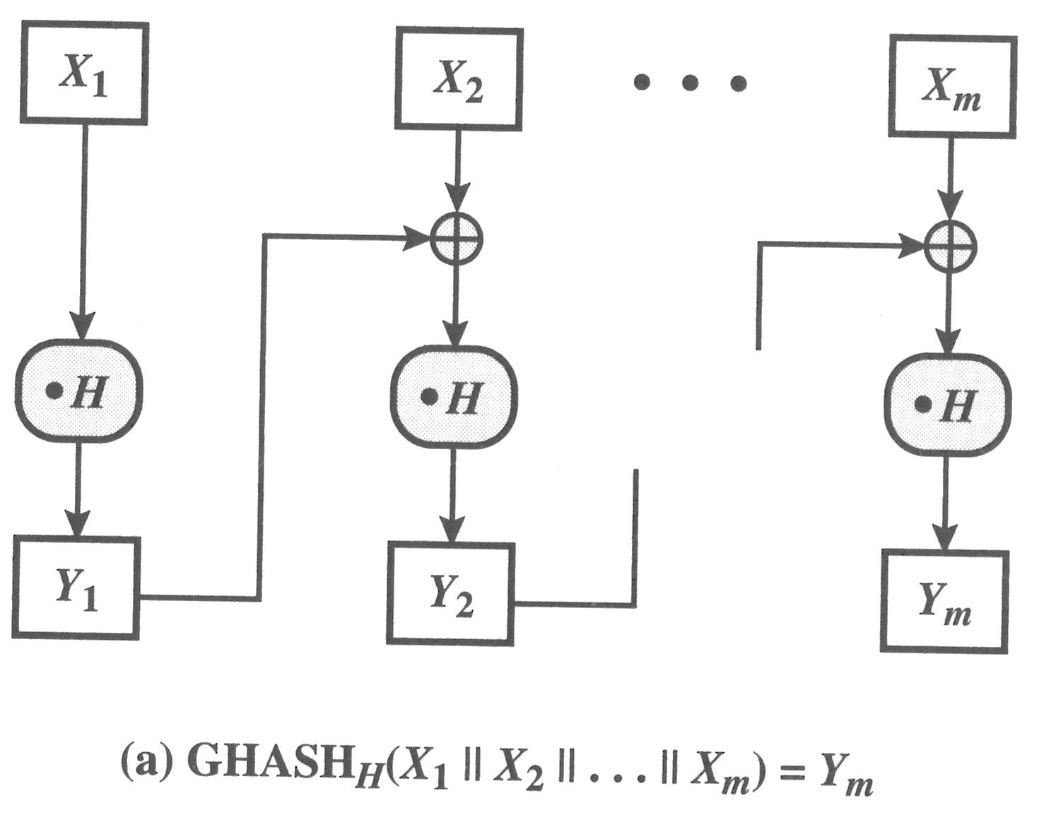
GCM functions
Notes:
Yi=(Yi-1 𝑥𝑜𝑟 Xi)H
GHASH_{H}(X) takes a input the hash key H and a bit string X such that len(X) = 128m bits for some positive integer m and produces a 128-bit MAC value. The function may be specified as shown in Stallings Figure 12.10a. The GHASH H(X) function can be expressed as:
(X₁ • H^{m} ) XOR (X₂ • H^{m–1} ) XOR ... XOR (X_{m–1} • H² ) XOR (X_{m} • H)
where • designates multiplication in GF(2¹²⁸ )
This formulation has desirable performance implications. If the same hash key is to be used to authenticate multiple messages, then the values H², H³ can be precalculated one time for use with each message to be authenticated. Then, the blocks of the data to be authenticated (X₁, X₂, … X_{m}) can be processed in parallel, because the computations are independent of one another.

Slide 55
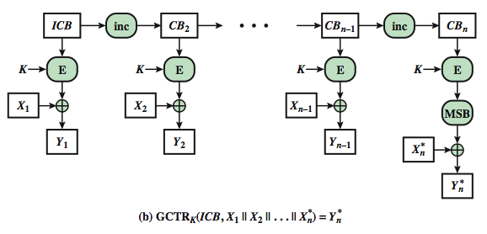
GCM functions (Cont.)
Notes:
GCTR_{K}(ICB, X) takes a input a secret key K and a bit string X arbitrary length and returns a ciphertext Y of bit length len(X). The function may be specified as as shown in Stallings Figure 12.10b. Here the inc₃₂(S) function increments the rightmost 32 bits of S by 1 mod 2³², and the remaining bits are unchanged. Note that the counter values can be quickly generated and that the encryption operations can be performed in parallel.

Slide 56
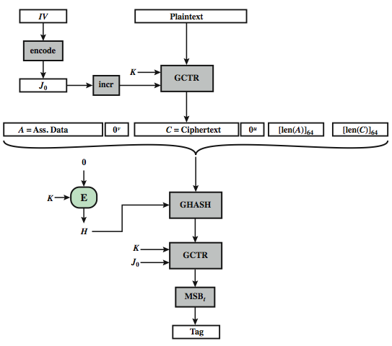
GCM mode overview
Notes:
We can now define the overall authenticated encryption function as shown in Stallings Figure 12.11. The input consists of a secret key K, an initialization vector IV, a plaintext P, and additional authenticated data A that will be authenticated but not encrypted. In step 1, the hash key is generated by encrypting a block of all zeros with the secret key K. In step 2, the pre-counter block (J₀) is generated from the IV. In particular, when the length of the IV is 96 bits, then the padding string 0³¹ || 1 is appended to the IV to form the pre-counter block. Otherwise, the IV is padded with the minimum number of 0 bits, possibly none, so that the length of the resulting string is a multiple of 128 bits (the block size); this string in turn is appended with 64 additional ‘0’ bits, followed by the 64-bit representation of the length of the IV, and the GHASH function is applied to the resulting string to form the pre-counter block.
Thus, GCM is based on the CTR mode of operation, and adds a MAC that authenticates both the message and additional data that requires only authentication. The function that computes the hash uses only multiplication in a Galois field. This choice was made because the operation of multiplication is easy to perform within a Galois field and is easily implemented in hardware. CTR- based authenticated encryption is the most efficient mode of operation for high-speed packet networks. The GCM mode meets a high level of security requirements.

Slide 57
Pseudorandom number generation (PRNG) using hash functions and MACs
Essential elements of PRNG are
  seed value
  deterministic algorithm
Seed must be known only as needed
Can base PRNG on
  encryption algorithm (Chs 7 & 10)
  hash function (ISO18031 & NIST SP 800-90)
  MAC (NIST SP 800-90)
Notes:
The essential elements of any pseudorandom number generator (PRNG) are a seed value and a deterministic algorithm for generating a stream of pseudorandom bits. If the algorithm is used as a pseudorandom function (PRF) to produce a required value, such as a session key, then the seed should only be known to the user of the PRF. If the algorithm is used to produce a stream encryption function, then the seed has the role of a secret key that must be known to the sender and the receiver. We noted in Chapters 7 and 10 that, because an encryption algorithm produces an apparently random output, it can serve as the basis of a (PRNG). Similarly, an hash function or MAC produces apparently random output and can be used to build a PRNG. Both ISO standard 18031 (Random Bit Generation) and NIST SP 800-90 (Recommendation for Random Number Generation Using Deterministic Random Bit Generators) define an approach for random number generation using a cryptographic hash function. SP 800-90 also defines a random number generator based on HMAC. We look at these two approaches in turn.

Slide 58
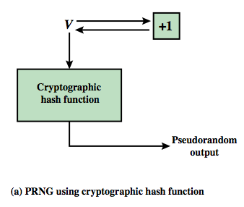
PRNG using a hash function
Hash PRNG from SP800-90 and ISO18031
  take seed V
  repeatedly add 1
  hash V
  use n-bits of hash as random value
Secure if good hash used
Notes:
Stallings Figure 12.12a shows the basic strategy for a hash-based PRNG specified in SP 800-90 and ISO 18031. The algorithm takes as input: V = seed; seedlen = bit length of V >= k + 64, where k is a desired security level expressed in bits; n = desired number of output bits. The algorithm uses the cryptographic hash function H with an hash value output of outlen bits. The basic operation of the algorithm is:
m = ceil(n/outlen)
data = V
W = the null string
for i = 1 to m
w_{i} = H(data)
W = W || w_{i}
data = (data + 1) mod 2^{seedlen}
return leftmost n bits of W
Thus, the pseudorandom bit stream is w 1 || w2 || … || wm, with the final block truncated if required. The SP 800-90 specification also provides for periodically updating V to enhance security. The specification also indicates that there are no known or suspected weaknesses in the hash- based approach for a strong cryptographic hash algorithm, such as SHA-2.

Slide 59
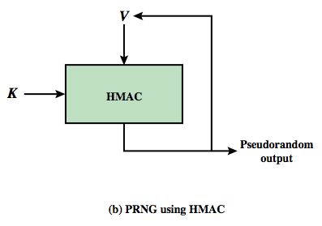
PRNG using a MAC
MAC PRNGs in SP800-90, IEEE 802.11i, TLS
  use key
  input based on last hash in various ways
Notes:
Although there are no known or suspected weaknesses in the use of a cryptographic hash function for a PRNG as shown on the previous slide, a higher degree of confidence can be achieved by using a MAC. Almost invariably, HMAC is used for constructing a MAC-based PRNG. For the MAC based approach, there are two inputs, a key K and a seed V. In effect, the combination of K and V form the overall seed for the PRNG specified in SP 800-90. Stallings Figure 12.12b shows the basic structure of the PRNG mechanism. Stallings Figure 12.13 shows the logic for 3 HMAC PRNG’s. Note that the key remains the same for each block of output, and in SP 800-90 the data input for each block is equal to the tag output of the previous block. The IEEE 802.11i form uses a counter for enhanced security. The TLS form uses two MAC uses per output block. The SP 800-90 specification also provides for periodically updating K and V to enhance security. The SP 800-90 logic is:
m = ceil(n/outlen)
w₀ = V
W = the null string
for i = 1 to m
w_{i} = MAC(K, w_{i-1})
W = W || w_{i}
data = (data + 1) mod 2^{seedlen}
return leftmost n bits of W

Slide 60
Homework
P417 (Chapter 12)
12.1

Slide 61
Homework
P417 (Chapter 12)
12.4 12.5 12.9

