Slide 1
Cryptographic Hash Functions (Ch. 11)
Applications of cryptographic hash functions
Simple hash functions
Requirements and security
Hash functions based on cipher block chaining
Secure hash algorithm (SHA)
SHA-3
Summary

Slide 2
Hash functions
Condenses arbitrary message to fixed size
  h = H(M)
Usually assume hash function is public
Hash used to detect changes to message
Properties of cryptographic hash function
  computationally infeasible to find data mapping to specific hash (one-way property)
  computationally infeasible to find two data to same hash (collision-free property)
Notes:
A hash function H accepts a variable-length block of data M as input and produces a fixed-size hash value h = H(M). A "good" hash function has the property that the results of applying the function to a large set of inputs will produce outputs that are evenly distributed, and apparently random. In general terms, the principal object of a hash function is data integrity. A change to any bit or bits in M results, with high probability, in a change to the hash code. The kind of hash function needed for security applications is referred to as a cryptographic hash function. A cryptographic hash function is an algorithm for which it is computationally infeasible (because no attack is significantly more efficient than brute force) to find either (a) a data object that maps to a pre-specified hash result (the one-way property) or (b) two data objects that map to the same hash result (the collision-free property). Because of these characteristics, hash functions are often used to determine whether or not data has changed.

Slide 3
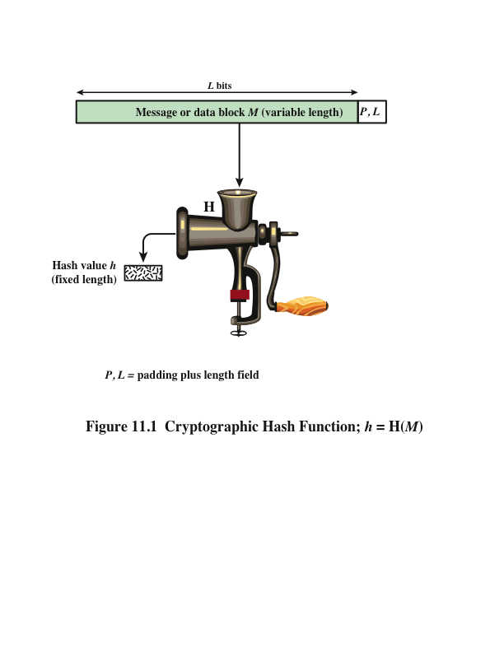
Notes:
Figure 11.1 depicts the general operation of a cryptographic hash function.
Typically, the input is padded out to an integer multiple of some fixed length
(e.g., 1024 bits), and the padding includes the value of the length of the original message
in bits. The length field is a security measure to increase the difficulty for an
attacker to produce an alternative message with the same hash value.

Slide 4
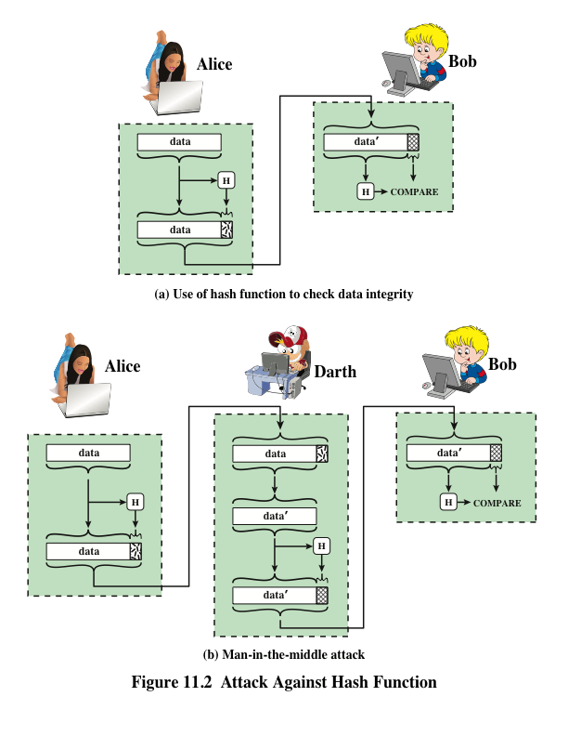
Notes:
Message authentication is a mechanism or service used to verify the integrity of
a message. Message authentication assures that data received are exactly as sent
(i.e., contain no modification, insertion, deletion, or replay). In many cases, there is
a requirement that the authentication mechanism assures that purported identity of
the sender is valid. When a hash function is used to provide message authentication,
the hash function value is often referred to as a message digest .
The essence of the use of a hash function for message authentication is as
follows. The sender computes a hash value as a function of the bits in the message
and transmits both the hash value and the message. The receiver performs the same
hash calculation on the message bits and compares this value with the incoming
hash value. If there is a mismatch, the receiver knows that the message (or possibly
the hash value) has been altered (Figure 11.2a).
The hash function must be transmitted in a secure fashion. That is, the hash
function must be protected so that if an adversary alters or replaces the message,
it is not feasible for adversary to also alter the hash value to fool the receiver. This
type of attack is shown in Figure 11.2b. In this example, Alice transmits a data block
and attaches a hash value. Darth intercepts the message, alters or replaces the data
block, and calculates and attaches a new hash value. Bob receives the altered data
with the new hash value and does not detect the change. To prevent this attack, the
hash value generated by Alice must be protected.

Slide 5
Message authentication
A mechanism or service used to verify the integrity of a message.
Message authentication assures that data received are exactly as sent.

Slide 6
Hash function for message authentication
Source
M
||
E
H
K
E(K,M||H(M))
M
H
D
Compare
H(M)
K
Destination

Slide 7
Hash function for message authentication (Cont.)
Source
Destination
M
H
M
||
K
K
Compare
H
E
D
E(K,H(M))

Slide 8
Hash function for message authentication (Cont.)
Source
Destination
M
||
H
M
S
||
Compare
||
H
S
H(M||S)

Slide 9
Hash function for message authentication (Cont.)
Source
M
||
E
||
H
K
S
E(K,M||H(M||S))
M
||
H
S
D
Compare
K
H(M||S)
Destination

Slide 10
Digital signature
The hash value of a message is encrypted with a user’s private key.
Anyone who knows the user’s public key can verify the integrity of the message that is associated with the digital signature.

Slide 11
Hash function for digital signature
Source
Destination
M
H
M
||
PR_{a}
PU_{a}
Compare
H
E
D
E(PR_{a},H(M))

Slide 12
Hash function for digital signature (Cont.)
Source
M
||
E
PR_{a}
H
E
K
E(K,[M||E(PR_{a},H(M))]
M
H
D
PU_{a}
Compare
K
D
E(PR_{a},H(M))
Destination

Slide 13
Other Hash Function Uses
Commonly used to create a one-way password file
When a user enters a password, the hash of that password is compared to the stored hash value for verification
This approach to password protection is used by most operating systems
Can be used for intrusion and virus detection
Store H(F) for each file on a system and secure the hash values
One can later determine if a file has been modified by recomputing H(F)
An intruder would need to change F without changing H(F)
Can be used to construct a pseudorandom function (PRF) or a pseudorandom number generator (PRNG)
A common application for a hash-based PRF is for the generation of symmetric keys
Notes:
Hash functions are commonly used to create a one-way password file . Chapter 21
explains a scheme in which a hash of a password is stored by an operating system
rather than the password itself. Thus, the actual password is not retrievable by
a hacker who gains access to the password file. In simple terms, when a user enters
a password, the hash of that password is compared to the stored hash value
for verification. This approach to password protection is used by most operating
systems.
Hash functions can be used for intrusion detection and virus detection . Store
H(F) for each file on a system and secure the hash values (e.g., on a CD-R that is
kept secure). One can later determine if a file has been modified by recomputing
H(F). An intruder would need to change F without changing H(F).
A cryptographic hash function can be used to construct a pseudorandom
function (PRF) or a pseudorandom number generator (PRNG) . A common application
for a hash-based PRF is for the generation of symmetric keys. We discuss this
application in Chapter 12.

Slide 14
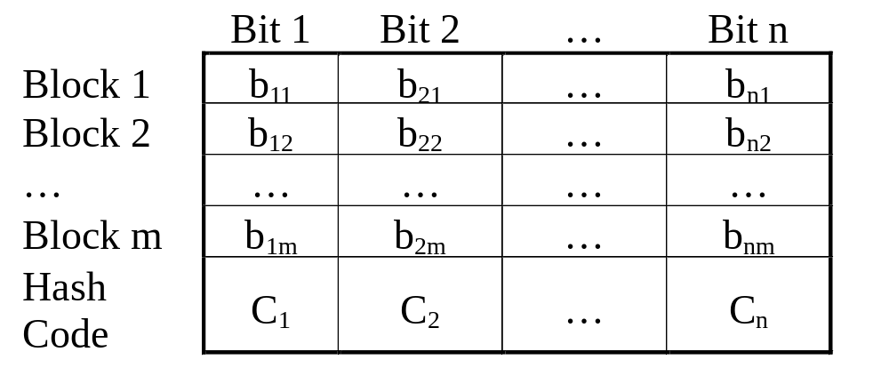
Simple hash functions

Slide 15
Simple hash functions
One of the simplest hash functions is the bit-by-bit XOR of every block. It can be expressed as follows.
C_{i}=b_{i1}⊕ b_{i2} ⊕ ... ⊕b_{im}
where C_{i}=ith bit of the hash code, 1<i<n
m=number of n-bit blocks
bij=ith bit in jth block

Slide 16
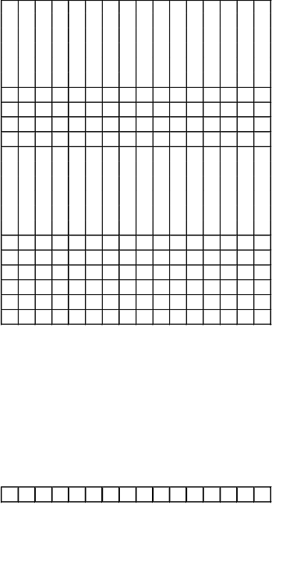
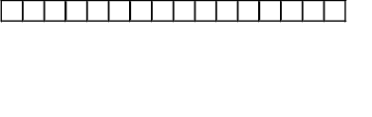
Simple hash function (Cont.)
XOR with 1-bit rotation to the right
XOR of every 16-bit block

Slide 17
Simple XOR or rotated XOR
Although a simple XOR or rotated XOR (RXOR) is insufficient if only the hash code is encrypted, you may still feel that such a simple function could be useful when the message as well as the hash code are encrypted.
However, you must be really careful.
Consider the cipher block chaining (CBC). Given a message consisting of a sequence of 64-bit blocks of X₁, X₂, …,X_{N}, define the hash code C as the block-by-block XOR or all blocks and append the hash code as the final block.
C=X_{N+1}=X₁ ⊕ X₂ ⊕ … ⊕ X_{N}

Slide 18

Requirements and Security
Preimage
Collision
x is the preimage of h for a hash value h = H(x)
Is a data block whose hash function, using the function H, is h
Because H is a many-to-one mapping, for any given hash value h, there will in general be multiple preimages
Occurs if we have x ≠ y and H(x) = H(y)
Because we are using hash functions for data integrity, collisions are clearly undesirable
Notes:
Before proceeding, we need to define two terms. For a hash value h = H(x ), we say
that x is the preimage of h . That is, x is a data block whose hash function, using the
function H, is h . Because H is a many-to-one mapping, for any given hash value h ,
there will in general be multiple preimages. A collision occurs if we have x ≠ y and
H(x ) = H(y ). Because we are using hash functions for data integrity, collisions are
clearly undesirable.

Slide 19
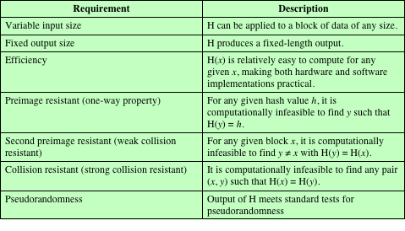
Table 11.1
Requirements for a Cryptographic Hash Function H
Notes:
Table 11.1 lists the generally accepted requirements for a cryptographic hash function.
The first three properties are requirements for the practical application of a
hash function.
The fourth property, preimage resistant , is the one-way property: it is easy
to generate a code given a message, but virtually impossible to generate a message
given a code. This property is important if the authentication technique involves the
use of a secret value (Figure 11.3c). The secret value itself is not sent.
The fifth property, second preimage resistant , guarantees that it is impossible
to find an alternative message with the same hash value as a given message. This
prevents forgery when an encrypted hash code is used (Figures 11.3b and 11.4a). If
this property were not true, an attacker would be capable of the following sequence:
First, observe or intercept a message plus its encrypted hash code; second, generate
an unencrypted hash code from the message; third, generate an alternate message
with the same hash code.
A hash function that satisfies the first five properties in Table 11.1 is referred
to as a weak hash function. If the sixth property, collision resistant , is also satisfied,
then it is referred to as a strong hash function. A strong hash function protects
against an attack in which one party generates a message for another party to sign.
For example, suppose Bob writes an IOU message, sends it to Alice, and she signs
it. Bob finds two messages with the same hash, one of which requires Alice to pay a
small amount and one that requires a large payment. Alice signs the first message,
and Bob is then able to claim that the second message is authentic
The final requirement in Table 11.1, pseudorandomness , has not traditionally
been listed as a requirement of cryptographic hash functions but is more or less implied.
[JOHN05] points out that cryptographic hash functions are commonly used
for key derivation and pseudorandom number generation, and that in message integrity
applications, the three resistant properties depend on the output of the hash
function appearing to be random. Thus, it makes sense to verify that in fact a given
hash function produces pseudorandom output..

Slide 20
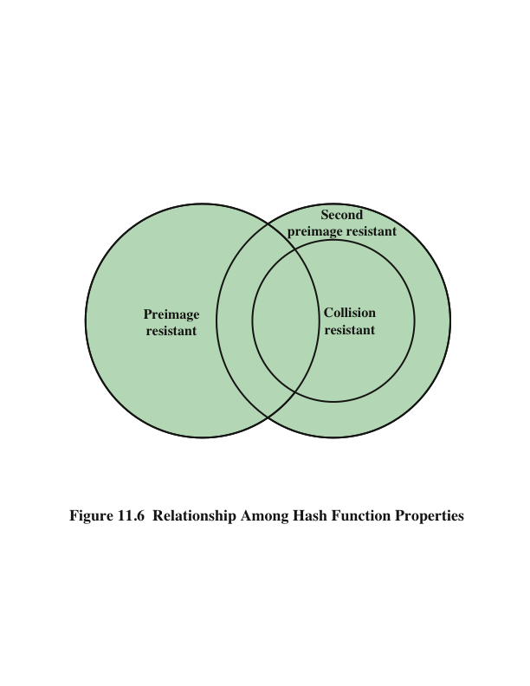
Notes:
Figure 11.6 shows the relationships among the three resistant properties.
A function that is collision resistant is also second preimage resistant, but the
reverse is not necessarily true. A function can be collision resistant but not preimage
resistant and vice versa. A function can be preimage resistant but not second
preimage resistant and vice versa. See [MENE97] for a discussion.

Slide 21
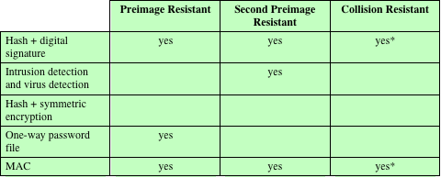
Table 11.2
Hash Function Resistance Properties Required for Various Data Integrity Applications
* Resistance required if attacker is able to mount a chosen message attack
Notes:
Table 11.2 shows the resistant properties required for various hash function
applications.

Slide 22
Attacks on Hash Functions
Brute-Force Attacks
Cryptanalysis
Does not depend on the specific algorithm, only depends on bit length
In the case of a hash function, attack depends only on the bit length of the hash value
Method is to pick values at random and try each one until a collision occurs
An attack based on weaknesses in a particular cryptographic algorithm
Seek to exploit some property of the algorithm to perform some attack other than an exhaustive search
Notes:
As with encryption algorithms, there are two categories of attacks on hash
functions: brute-force attacks and cryptanalysis. A brute-force attack does not depend
on the specific algorithm but depends only on bit length. In the case of a hash
function, a brute-force attack depends only on the bit length of the hash value. A
cryptanalysis, in contrast, is an attack based on weaknesses in a particular cryptographic
algorithm.

Slide 23

Birthday attacks
Suppose that a 64-bit hash code is used. One might think this is quite secure.
For example, if an encrypted hash code C is transmitted with the corresponding unencrypted message M, then an opponent would need to find an M’ such that H(M’)=H(M) to substitute another message and fool the receiver.
On average, the opponent would have to try 2⁶³ messages to find one.

Slide 24
Birthday attacks (Cont.)
Yuval proposed the following attack strategy:
  The source A is prepared to “sign” a message by appending the appropriate m-bit MAC and encrypting that MAC with A’s private key.
  The opponent generates 2^{m/2} variations on the message, all of which convey essentially the same meaning. The opponent prepares for an equal number of messages, all of which are variations on the fraudulent message to be substituted for the real one.

Slide 25
Hash function: authentication and signature
Source
Destination
M
H
M
||
PR_{a}
PU_{a}
Compare
H
E
D
E(PR_{a},H(M))

Slide 26
Birthday attacks (Cont.)
  The two sets of messages are compared to find a pair of messages that produces the same hash code. If no match is found, additional valid and fraudulent messages are generated until a match is made.
  The opponent offers the valid variation to A for signature. This signature can then be attached to the fraudulent variation for transmission to the intended recipient.

Slide 27
Birthday attacks (Cont.)
Thus, if a 64-bit hash code is used, the level of effort required is only on the order of 2³².
The conclusion to be drawn from this is that the length of the hash code should be substantial.

Slide 28

A letter in 2³⁷ variations

Slide 29
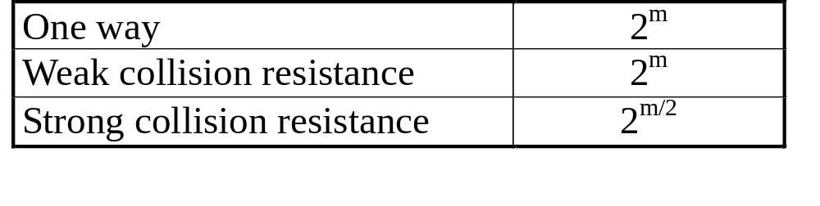
Security of hash functions
We can group attacks on hash functions into two categories: brute-force attacks and cryptanalysis.
The strength of a hash functions against brute-force attacks depends solely on the length of the hash code.
For a code of length m, the level of effort required is proportional to the following.

Slide 30
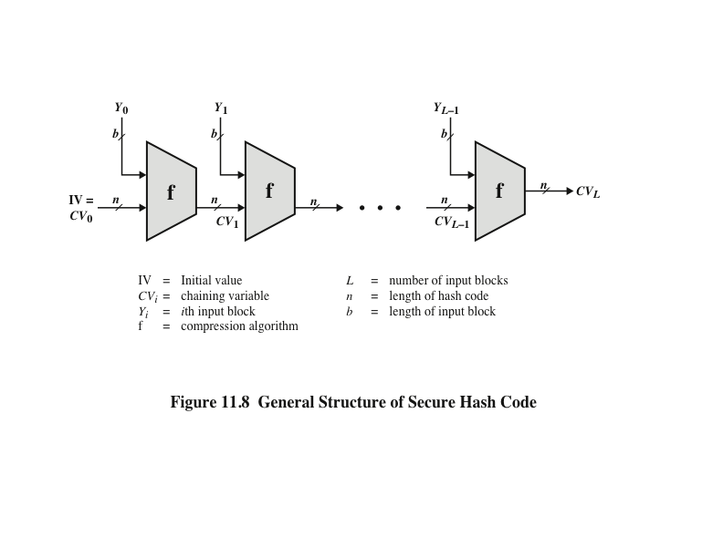
Notes:
In recent years, there has been considerable effort, and some successes,
in developing cryptanalytic attacks on hash functions. To understand these, we
need to look at the overall structure of a typical secure hash function, indicated in
Figure 11.8. This structure, referred to as an iterated hash function, was proposed
by Merkle [MERK79, MERK89] and is the structure of most hash functions in use
today, including SHA, which is discussed later in this chapter. The hash function
takes an input message and partitions it into L fixed-sized blocks of b bits each.
If necessary, the final block is padded to b bits. The final block also includes the
value of the total length of the input to the hash function. The inclusion of the
length makes the job of the opponent more difficult. Either the opponent must
find two messages of equal length that hash to the same value or two messages of
differing lengths that, together with their length values, hash to the same value.
The hash algorithm involves repeated use of a compression function , f, that
takes two inputs (an n -bit input from the previous step, called the chaining variable ,
and a b -bit block) and produces an n -bit output. At the start of hashing, the chaining
variable has an initial value that is specified as part of the algorithm. The final
value of the chaining variable is the hash value.

Slide 31
Secure hash algorithm
SHA was originally designed by NIST & NSA in 1993 and revised in 1995 as SHA-1.
US standard for use with DSA signature scheme.
Based on design of MD4 with key differences.
SHA-1 produces 160-bit hash values.
Two messages deliver the same SHA-1 hash using 2⁶⁹ operations, far fewer than 2⁸⁰ operations. (王小雲)
Recent 2005 results on security of SHA-1 have raised concerns on its use in future applications.
Notes:
In recent years, the most widely used hash function has been the Secure Hash Algorithm (SHA). The Secure Hash Algorithm (SHA) was developed by the National Institute of Standards and Technology (NIST) and published as a federal information processing standard (FIPS 180) in 1993; a revised version was issued as FIPS 180-1 in 1995 and is generally referred to as SHA-1. The actual standards document is entitled Secure Hash Standard. SHA is based on the hash function MD4 and its design closely models MD4. SHA-1 produces a hash value of 160 bits. In 2005, a research team described an attack in which two separate messages could be found that deliver the same SHA-1 hash using 2^69 operations, far fewer than the 2^80 operations previously thought needed to find a collision with an SHA-1 hash [WANG05]. This result has hastened the transition to newer, longer versions of SHA.

Slide 32
Revised secure hash standard
NIST issued revision FIPS 180-2 in 2002.
Adds 3 additional versions (SHA-2)
  SHA-256, SHA-384, SHA-512
Designed for compatibility with increased security provided by the AES cipher.
Structure & detail is similar to SHA-1, hence analysis should be similar, but security levels are rather higher.
Notes:
In 2002, NIST produced a revised version of the standard, FIPS 180-2, that defined three new versions of SHA, with hash value lengths of 256, 384, and 512 bits, known as SHA-256, SHA-384, and SHA-512. Collectively, these hash algorithms are known as SHA-2. These new versions have the same underlying structure and use the same types of modular arithmetic and logical binary operations as SHA-1, hence analyses should be similar. A revised document was issued as FIP PUB 180-3 in 2008, which added a 224-bit version. SHA-2 is also specified in RFC 4634, which essentially duplicates the material in FIPS 180-3, but adds a C code implementation.
In 2005, NIST announced the intention to phase out approval of SHA-1 and move to a reliance on the other SHA versions by 2010.

Slide 33
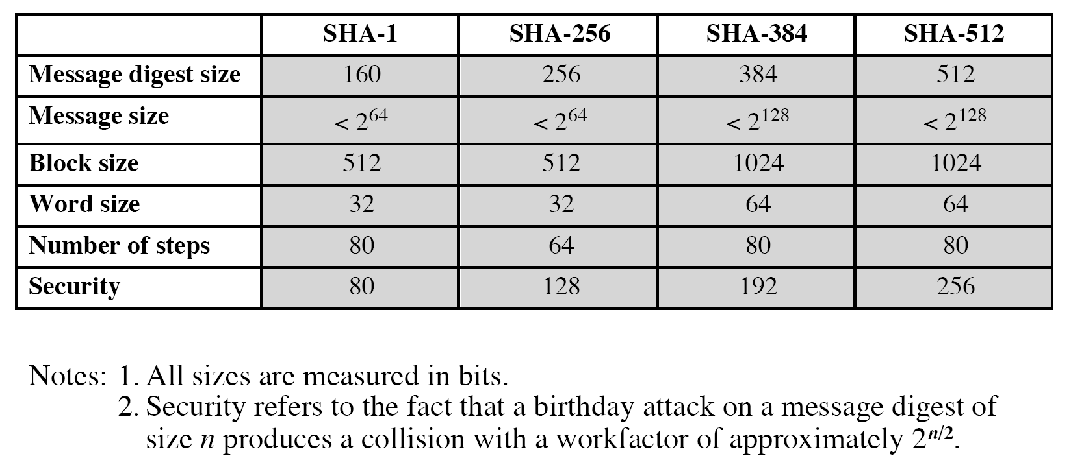
Comparison of SHA parameters

Slide 34
SHA-512 logic
Append padding bits: the length in bits is congruent to 896 mod 1024. The padding consists of a single 1-bit followed by 0-bits.
Append length: a 128-bit representation of the length in bits of the original message is appended.

Slide 35
SHA-512 logic (Cont.)
Initialize hash buffer:
  a 512-bit buffer is used to hold intermediate and final results of the hash function.
  The buffer can be represented as eight 64-bit registers (a,b,c,d,e,f,g,h). Their initial values are (hexadecimal)
  a=6A09E667F3BCC908 e=510E527FADE682D1
  b=BB67AE8584CAA73B f=9B05688C2B3E6C1F
  c=3C6EF372FE94F82B g=1F83D9ABFB41BD6B
  d=A54FF53A5F1D36F1 h=5BE0CDI9137E2179
  (taking the first 64 bits if the fractional parts of the square roots of the first eight prime number)

Slide 36
SHA-512 logic (Cont.)
Process message in 1024-bit (128 bytes, 16 words) blocks.
  The compression function contains 80 rounds.
Output.After all N 1024-bit blocks have been processed, the output from the Nth stage is the 512-bit message digest.

Slide 37
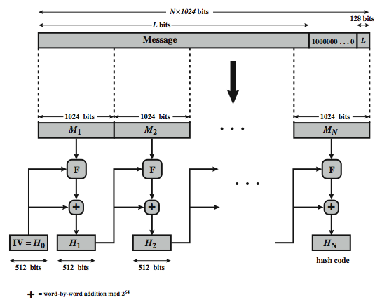
SHA-512 overview
Notes:
Now examine the structure of SHA-512, noting that the other versions are quite similar.
SHA-512 follows the structure depicted in Stallings Figure 12.1. The processing consists of the following steps:
• Step 1: Append padding bits
• Step 2: Append length
• Step 3: Initialize hash buffer
• Step 4: Process the message in 1024-bit (128-word) blocks, which forms the heart of the algorithm
• Step 5: Output the final state value as the resulting hash
See text for details.

Slide 38
SHA-512 compression function
Process message in 1024-bit blocks.
Contains 80 rounds.
  Updating a 512-bit buffer.
  Using a 64-bit value derived from the current message block.
  A round constant based on cube root of first 80 prime numbers.
Notes:
The SHA-512 Compression Function is the heart of the algorithm. In this Step 4, it processes the message in 1024-bit (128-word) blocks, using a module that consists of 80 rounds, labeled F in Stallings Figure 12, as shown in Figure 12.2. Each round takes as input the 512-bit buffer value, and updates the contents of the buffer. Each round t makes use of a 64-bit value Wt derived using a message schedule from the current 1024-bit block being processed. Each round also makes use of an additive constant Kt, based on the fractional parts of the cube roots of the first eighty prime numbers. The output of the eightieth round is added to the input to the first round to produce the final hash value for this message block, which forms the input to the next iteration of this compression function, as shown on the previous slide.

Slide 39
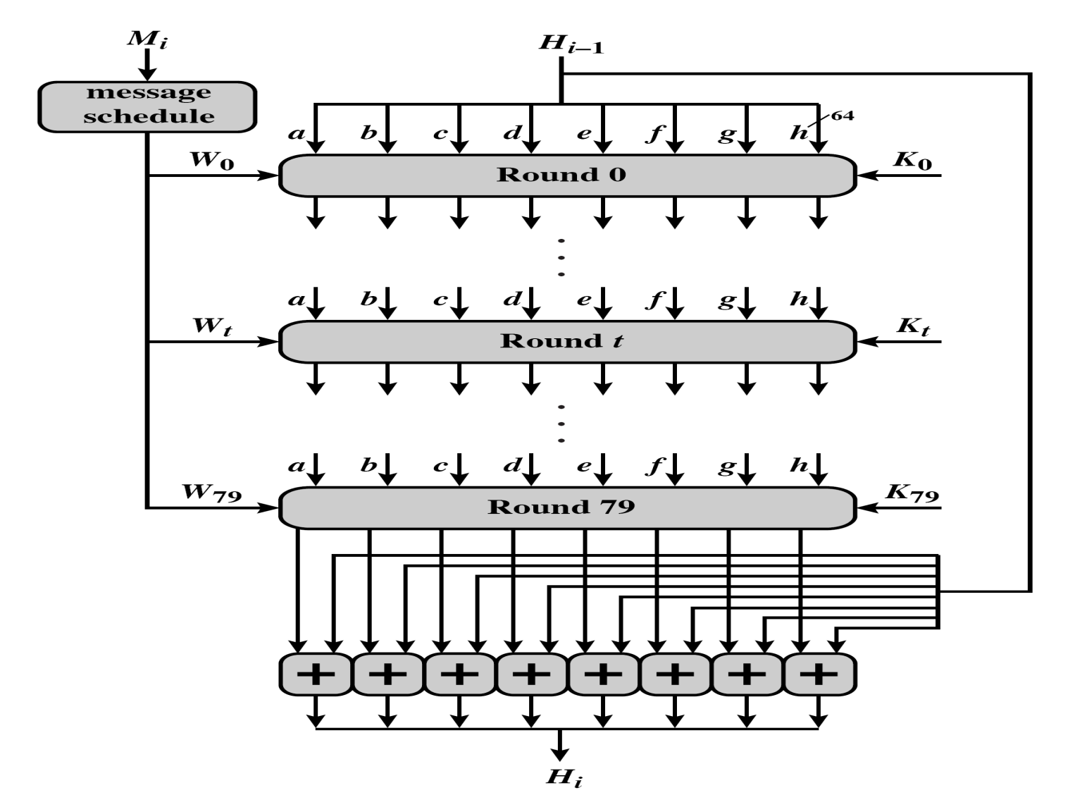
A single 1024-bit block
Notes:
Kt: taking the first 64 bits of the fractional parts of the cube roots of the first eighty prime numbers.

Slide 40
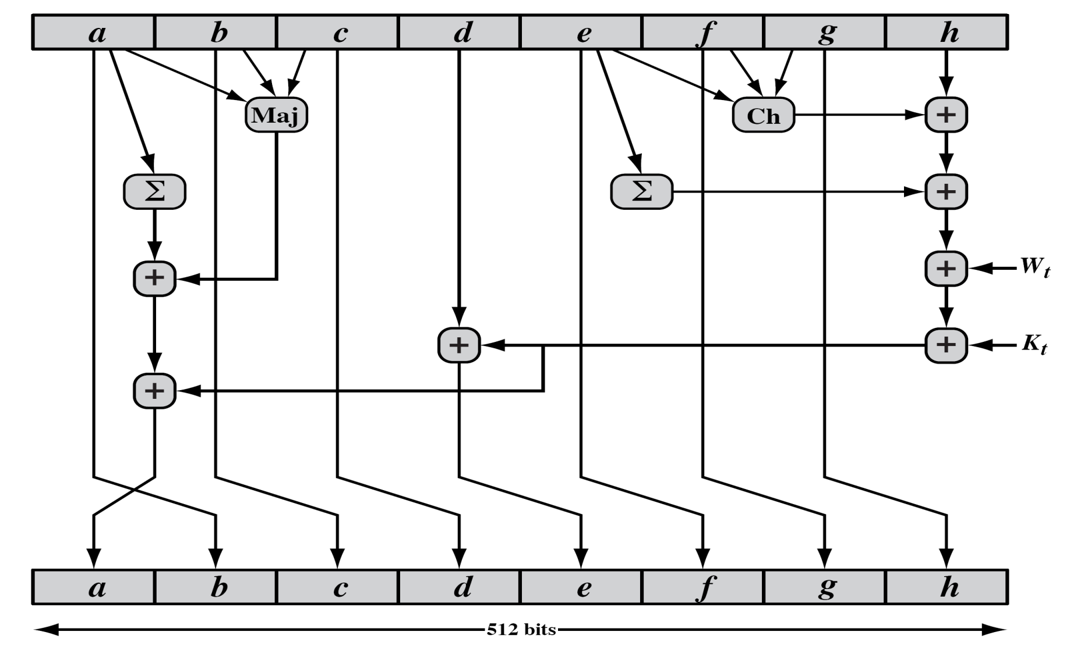
SHA-512 round function
Notes:
The structure of each of the 80 rounds is shown in Stallings Figure 12.3. Each 64-bit word shuffled along one place, and in some cases manipulated using a series of simple logical functions (ANDs, NOTs, ORs, XORs, ROTates), in order to provide the avalanche & completeness properties of the hash function. The elements are:
Ch(e,f,g) = (e AND f) XOR (NOT e AND g)
Maj(a,b,c) = (a AND b) XOR (a AND c) XOR (b AND c)
∑(a) = ROTR(a,28) XOR ROTR(a,34) XOR ROTR(a,39)
∑(e) = ROTR(e,14) XOR ROTR(e,18) XOR ROTR(e,41)
+ = addition modulo 2^64
Kt = a 64-bit additive constant
Wt = a 64-bit word derived from the current 512-bit input block.

Slide 41
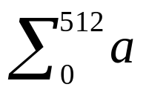
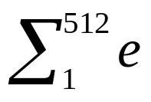
SHA-512 functions
Maj(a,b,c)=(a ∧ b) ⊕(a ∧ c) ⊕ (b ∧ c)
Ch(e,f,g)=(e ∧ f) ⊕ (¬e ∧ g)
=ROTR²⁸(a) ⊕ROTR³⁴(a) ⊕ROTR³⁹(a)
=ROTR¹⁴(e) ⊕ROTR¹⁸(e) ⊕ROTR⁴¹(e)
σ₀(x)= ROTR¹(x) ⊕ROTR⁸(x) ⊕SHR⁷(x)
σ₁(x)= ROTR¹⁹(x) ⊕ROTR⁶¹(x) ⊕SHR⁶(x)

Slide 42
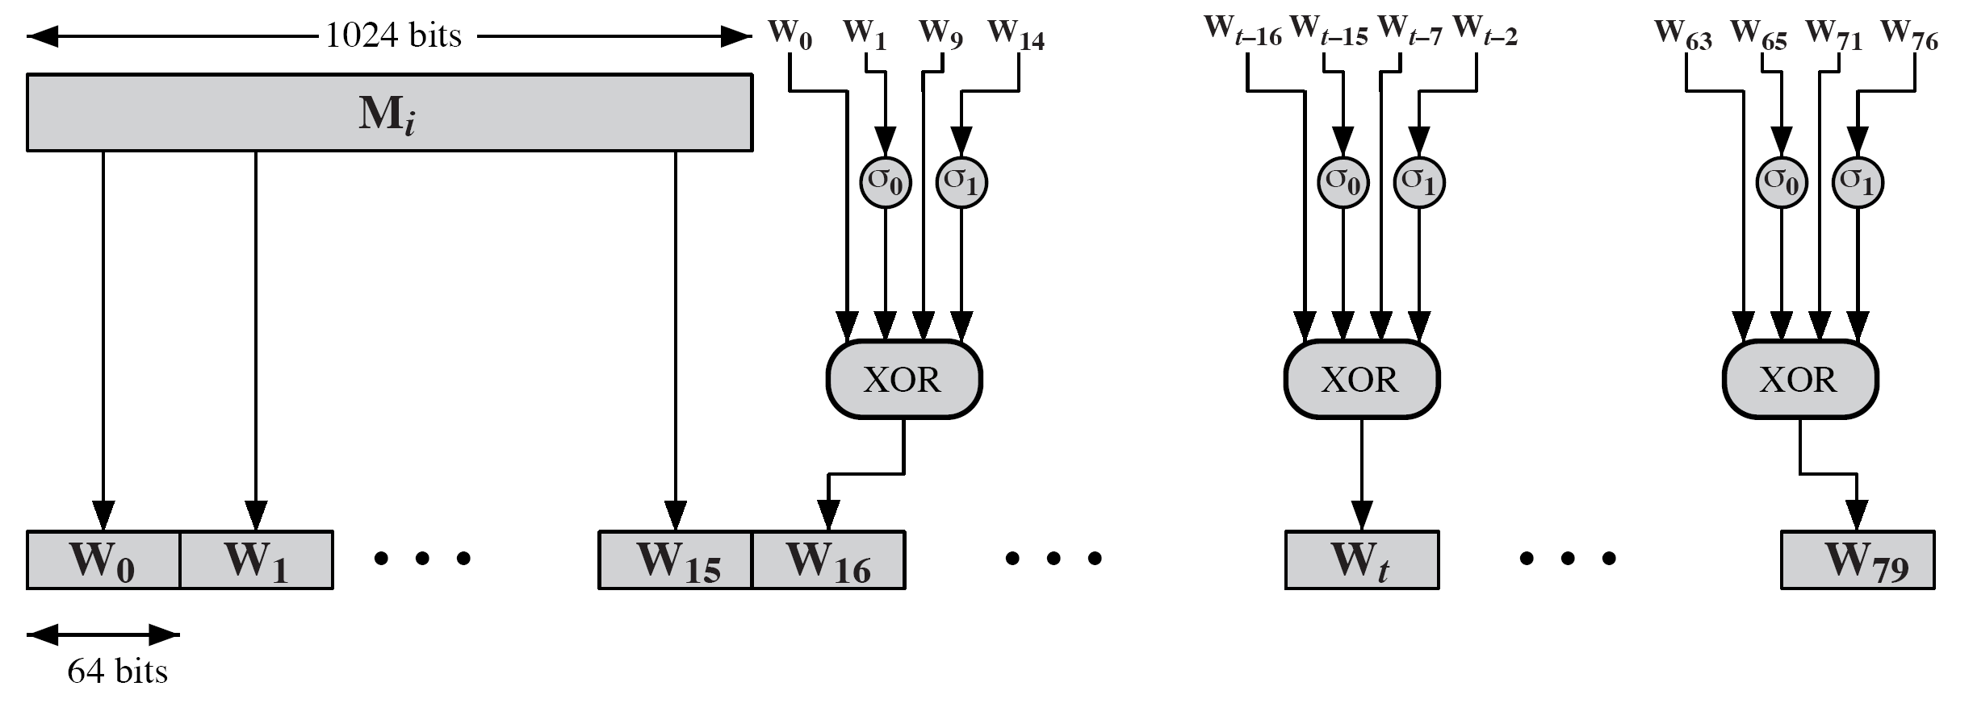
SHA-512 round function
Notes:
Stallings Figure 12.4 details how the 64-bit word values Wt are derived from the 1024-bit message. The first 16 values of Wt are taken directly from the 16 words of the current block. The remaining values are defined as a function of the earlier values using ROTates, SHIFTs and XORs as shown. The function elements are:
∂0(x) = ROTR(x,1) XOR ROTR(x,8) XOR SHR(x,7)
∂1(x) = ROTR(x,19) XOR ROTR(x,61) XOR SHR(x,6).

Slide 43
SHA-3
SHA-1 has not yet been "broken”
No one has demonstrated a technique for producing collisions in a practical amount of time
Considered to be insecure and has been phased out for SHA-2
SHA-2 shares the same structure and mathematical operations as its predecessors so this is a cause for concern
Because it will take years to find a suitable replacement for SHA-2 should it become vulnerable, NIST decided to begin the process of developing a new hash standard
NIST announced in 2007 a competition for the SHA-3 next generation NIST hash function
Winning design was announced by NIST in October 2012
SHA-3 is a cryptographic hash function that is intended to complement SHA-2 as the approved standard for a wide range of applications
Notes:
As of this writing, the Secure Hash Algorithm (SHA-1) has not yet been “broken.”
That is, no one has demonstrated a technique for producing collisions in a practical
amount of time. However, because SHA-1 is very similar, in structure and in the
basic mathematical operations used, to MD5 and SHA-0, both of which have been
broken, SHA-1 is considered insecure and has been phased out for SHA-2.
SHA-2, particularly the 512-bit version, would appear to provide unassailable
security. However, SHA-2 shares the same structure and mathematical operations
as its predecessors, and this is a cause for concern. Because it will take years to find
a suitable replacement for SHA-2, should it become vulnerable, NIST decided to
begin the process of developing a new hash standard.
Accordingly, NIST announced in 2007 a competition to produce the next generation
NIST hash function, to be called SHA-3. The winning design for SHA-3
was announced by NIST in October 2012. SHA-3 is a cryptographic hash function
that is intended to complement SHA-2 as the approved standard for a wide range
of applications.
Appendix V looks at the evaluation criteria used by NIST to select from
among the candidates for AES, plus the rationale for picking Keccak, which was
the winning candidate. This material is useful in understanding not just the SHA-3
design but also the criteria by which to judge any cryptographic hash algorithm.

Slide 44

The Sponge Construction
Underlying structure of SHA-3 is a scheme referred to by its designers as a sponge construction
Takes an input message and partitions it into fixed-size blocks
Each block is processed in turn with the output of each iteration fed into the next iteration, finally producing an output block
The sponge function is defined by three parameters:
  f = the internal function used to process each input block
  r = the size in bits of the input blocks, called the bitrate
  pad = the padding algorithm
Notes:
The underlying structure of SHA-3 is a scheme referred to by its designers as a
sponge construction [BERT07, BERT11]. The sponge construction has the same
general structure as other iterated hash functions (Figure 11.8). The sponge function
takes an input message and partitions it into fixed-size blocks. Each block is
processed in turn with the output of each iteration fed into the next iteration, finally
producing an output block.
The sponge function is defined by three parameters:
f = the internal function used to process each input block
r = the size in bits of the input blocks, called the bitrate
pad = the padding algorithm

Slide 45
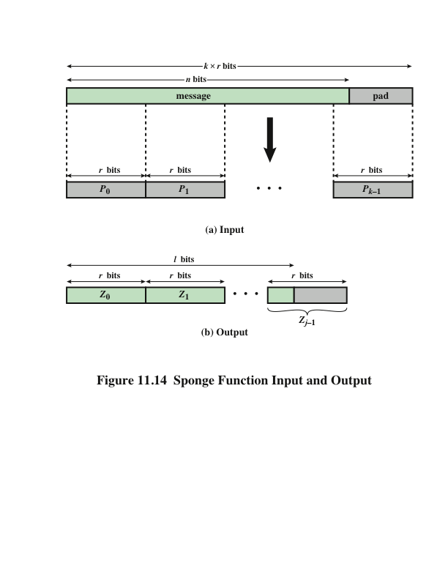
Notes:
A sponge function allows both variable length input and output, making it a
flexible structure that can be used for a hash function (fixed-length output), a pseudorandom
number generator (fixed-length input), and other cryptographic functions.
Figure 11.14 illustrates this point.
The sponge specification proposes [BERT11] proposes
two padding schemes:
• Simple padding: Denoted by pad10*, appends a single bit 1 followed by the
minimum number of bits 0 such that the length of the result is a multiple of the
block length.
• Multirate padding: Denoted by pad10*1, appends a single bit 1 followed by
the minimum number of bits 0 followed by a single bit 1 such that the length of
the result is a multiple of the block length. This is the simplest padding scheme
that allows secure use of the same f with different rates r .

Slide 46
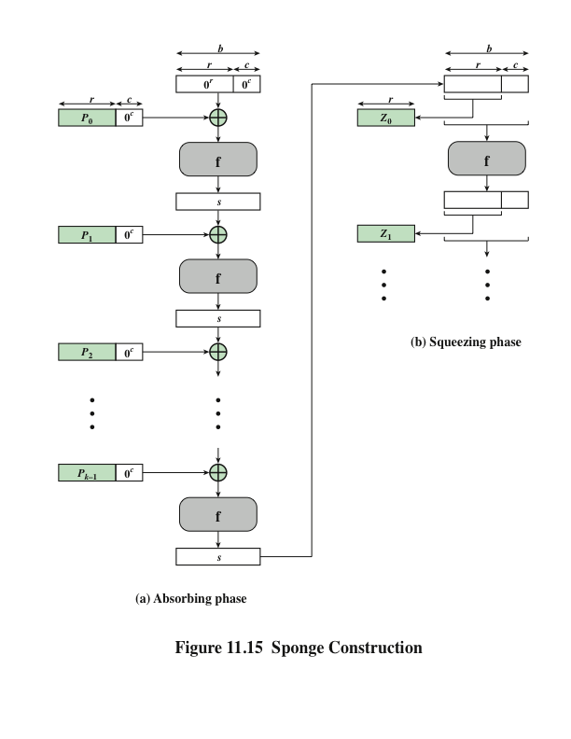
Notes:
Figure 11.15 shows the iterated structure of the sponge function. The sponge
construction operates on a state variable s of b = r + c bits, which is initialized to all
zeros and modified at each iteration. The value r is called the bitrate. This value is
the block size used to partition the input message. The term bitrate reflects the fact
that r is the number of bits processed at each iteration: the larger the value of r , the
greater the rate at which message bits are processed by the sponge construction.
The value c is referred to as the capacity . A discussion of the security implications of
the capacity is beyond our scope. In essence, the capacity is a measure of the achievable
complexity of the sponge construction and therefore the achievable level of
security. A given implementation can trade claimed security for speed by increasing
the capacity c and decreasing the bitrate r accordingly, or vice versa. The default
values for Keccak are c = 1024 bits, r = 576 bits, and therefore b = 1600 bits.

Slide 47
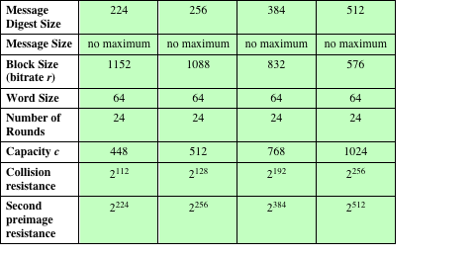
Table 11.5
SHA-3 Parameters
Notes:
Table 11.5 shows
the supported values of r and c . As Table 11.5 shows, the hash function security associated
with the sponge construction is a function of the capacity c .

Slide 48
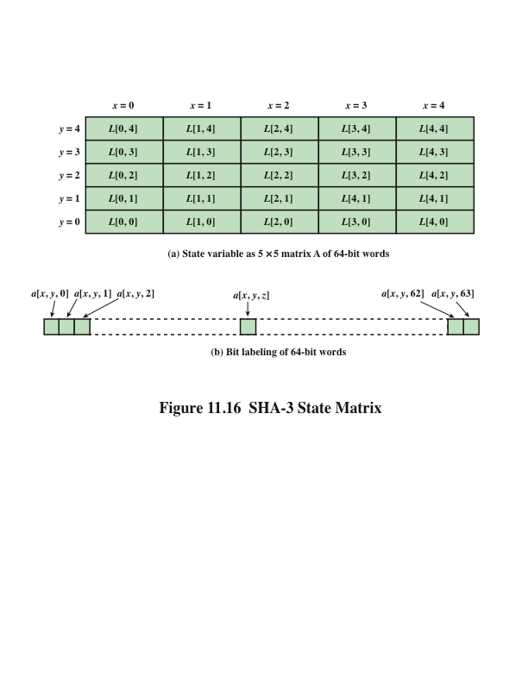
Notes:
We now examine the iteration function Keccak-f used to process each successive
block of the input message. Recall that f takes as input a 1600-bit variable s consisting
of r bits, corresponding to the message block size followed by c bits, referred to as the
capacity. For internal processing within f , the input state variable s is organized as a
5 * 5 * 64 array a . The 64-bit units are referred to as lanes . For our purposes, we generally
use the notation a [x , y , z ] to refer to an individual bit with the state array. When
we are more concerned with operations that affect entire lanes, we designate the
5 * 5 matrix as L [x , y ], where each entry in L is a 64-bit lane. The use of indices
within this matrix is shown in Figure 11.16. Thus, the columns are labeled x = 0
through x = 4, the rows are labeled y = 0 through y = 4, and the individual bits
within a lane are labeled z = 0 through z = 63.
The mapping between the bits of s
and those of a is
s [64(5y + x ) + z ] = a [x , y , z ]
We can visualize this with respect to the matrix in Figure 11.16. When treating
the state as a matrix of lanes, the first lane in the lower left corner, L [0, 0], corresponds
to the first 64 bits of s . The lane in the second column, lowest row, L [1, 0],
corresponds to the next 64 bits of s . Thus, the array a is filled with the bits of s starting
with row y = 0 and proceeding row by row.

Slide 49
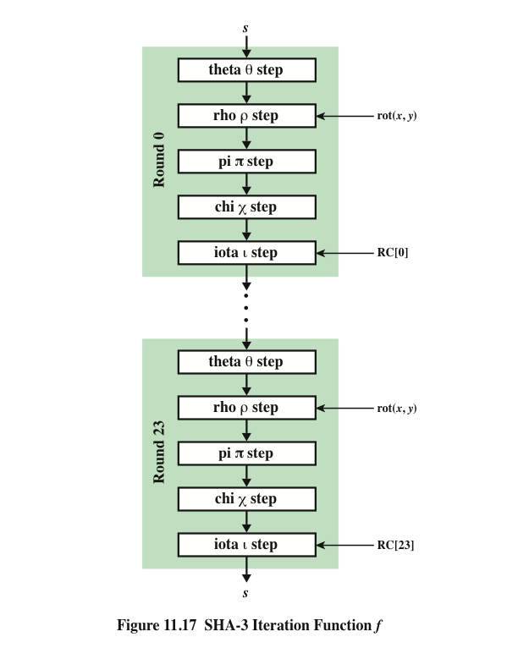
SHA-3
Iteration Function f
Notes:
The function f is executed once for each input block of the message
to be hashed. The function takes as input the 1600-bit state variable and converts
it into a 5 * 5 matrix of 64-bit lanes. This matrix then passes through 24 rounds of
processing. Each round consists of five steps, and each step updates the state matrix
by permutation or substitution operations. As shown in Figure 11.17, the rounds are
identical with the exception of the final step in each round, which is modified by a
round constant that differs for each round.

Slide 50
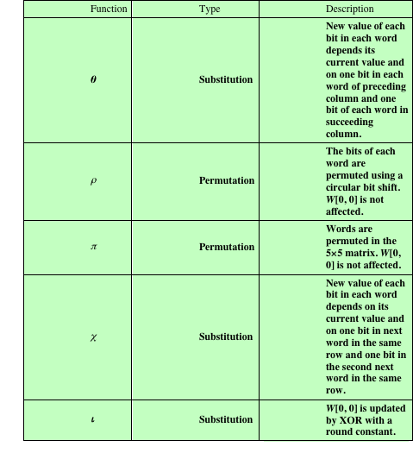
Table 11.6
Step Functions
in SHA-3
Notes:
Table 11.6 summarizes the operation of the five steps. The steps have a simple
description leading to a specification that is compact and in which no trapdoor
can be hidden. The operations on lanes in the specification are limited to bitwise
Boolean operations (XOR, AND, NOT) and rotations. There is no need for table
lookups, arithmetic operations, or data-dependent rotations. Thus, SHA-3 is easily
and efficiently implemented in either hardware or software.

Slide 51
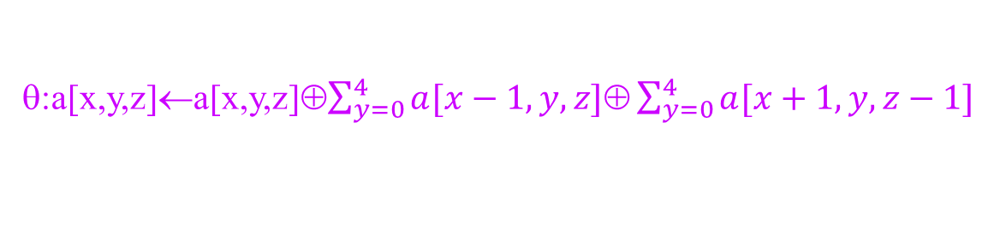
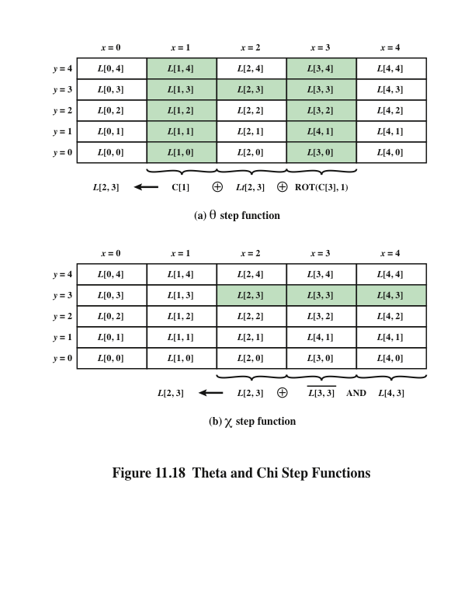
θ:a[x,y,z]←a[x,y,z]⊕$\sum_{y=0}^{4}{a[x−1,y,z]\text{⊕}\sum_{y=0}^{4}{a[x+1,y,z−1]}}$
χ:a[x] ← a[x] ⊕((a[x+1] ⊕ 1) ∧ a[x+2])
Notes:
Figure 11.18.a illustrates the operation on L [3, 2]. The same operation is performed
on all of the other lanes in the matrix.

Slide 52
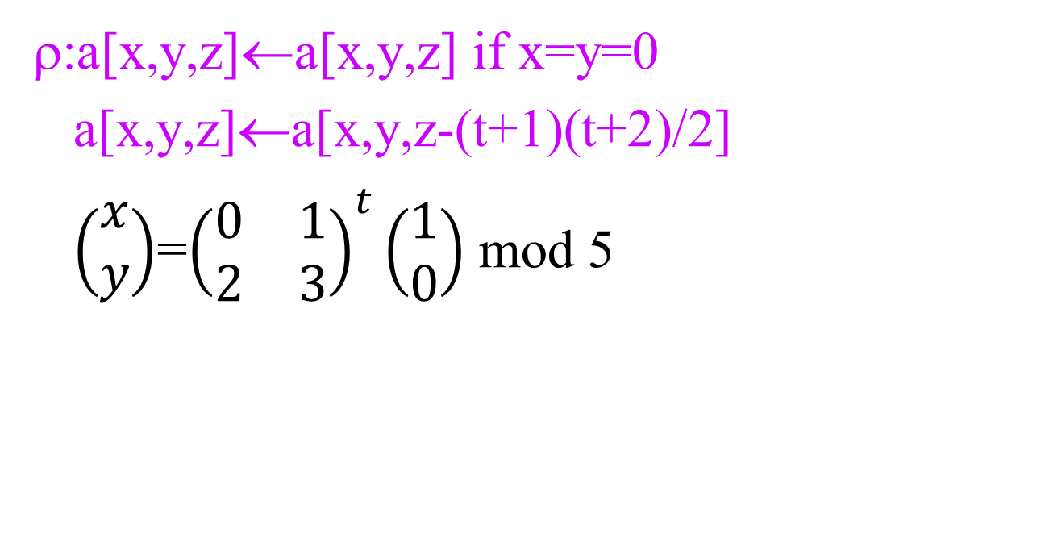
ρ step function
ρ:a[x,y,z]←a[x,y,z] if x=y=0
a[x,y,z]←a[x,y,z-(t+1)(t+2)/2]
$\left(\begin{matrix}x \\ y\end{matrix}\right)$=${\left(\begin{matrix}0 & 1 \\ 2 & 3\end{matrix}\right)}^{t}\left(\begin{matrix}1 \\ 0\end{matrix}\right)$ mod 5

Slide 53
Calculation of values and positions
t | g(t) | g(t) mod 64 | x,y |  | t | g(t) | g(t) mod 64 | x,y
0 | 1 | 1 | 1,0 |  | 12 | 91 | 27 | 4,0
1 | 3 | 3 | 0,2 |  | 13 | 105 | 41 | 0,3
2 | 6 | 6 | 2,1 |  | 14 | 120 | 56 | 3,4
3 | 10 | 10 | 1,2 |  | 15 | 136 | 8 | 4,3
4 | 15 | 15 | 2,3 |  | 16 | 153 | 25 | 3,2
5 | 21 | 21 | 3,3 |  | 17 | 171 | 43 | 2,2
6 | 28 | 28 | 3,0 |  | 18 | 190 | 62 | 2,0
7 | 36 | 36 | 0,1 |  | 19 | 210 | 18 | 0,4
8 | 45 | 45 | 1,3 |  | 20 | 231 | 39 | 4,2
9 | 55 | 55 | 3,1 |  | 21 | 253 | 61 | 2,4
10 | 66 | 2 | 1,4 |  | 22 | 276 | 20 | 4,1
11 | 78 | 14 | 4,4 |  | 23 | 300 | 44 | 1,1
x=0 x=1 x=2 x=3 x=4
y=4
y=3
y=2
y=1
y=0
18 | 2 | 61 | 56 | 14
41 | 45 | 15 | 21 | 8
3 | 10 | 43 | 25 | 39
36 | 44 | 6 | 55 | 20
0 | 1 | 62 | 28 | 27
Rotation values by word position in matrix

Slide 54
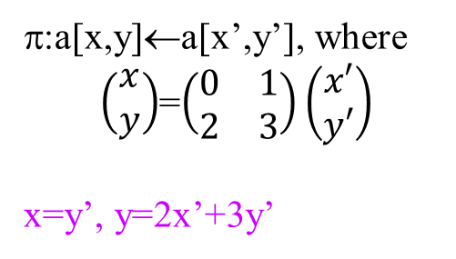
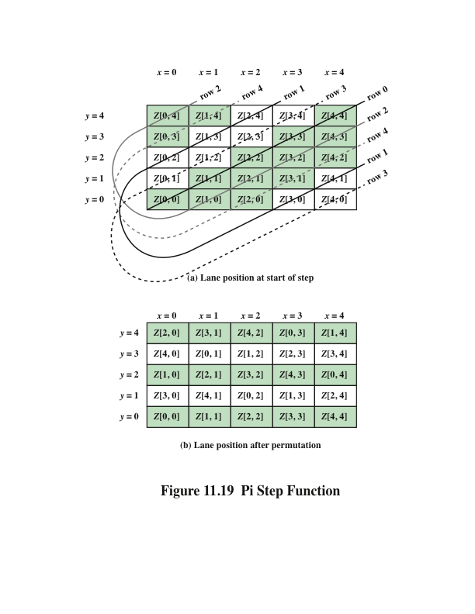
π:a[x,y]←a[x’,y’], where
$\left(\begin{matrix}x \\ y\end{matrix}\right)$=$\left(\begin{matrix}0 & 1 \\ 2 & 3\end{matrix}\right)\left(\begin{matrix}x′ \\ y′\end{matrix}\right)$
x=y’, y=2x’+3y’
Notes:
Figure 11.19 Pi Step Function

Slide 55
IOTA step function ι: a←a⊕RC[i_{r}]
L[0,0] ← L[0,0] ⊕RC[i_{r}] 0<i_{r}<24
Round | Constant | # of 1’s |  | Round | Constant | # of 1’s
0 | 0000000000000001 | 1 |  | 12 | 000000008000808B | 6
1 | 0000000000008082 | 3 |  | 13 | 800000000000008B | 5
2 | 800000000000808A | 5 |  | 14 | 8000000000008089 | 5
3 | 8000000080008000 | 3 |  | 15 | 8000000000008003 | 4
4 | 000000000000808B | 5 |  | 16 | 8000000000008002 | 3
5 | 0000000080000001 | 2 |  | 17 | 8000000000000080 | 2
6 | 8000000080008081 | 5 |  | 18 | 000000000000800A | 3
7 | 8000000000008009 | 4 |  | 19 | 800000008000000A | 4
8 | 000000000000008A | 3 |  | 20 | 8000000080008081 | 5
9 | 0000000000000088 | 2 |  | 21 | 8000000000008080 | 3
10 | 0000000080008009 | 4 |  | 22 | 0000000080000001 | 2
11 | 000000008000000A | 3 |  | 23 | 8000000080008008 | 4
RC[0]∨RC[1]∨…∨RC[23]=800000008000808B (7 1’s)

Slide 56
Homework
P378 (Chapter 11)
11.3 11.8 11.12

Slide 57
Homework
P372 (Chapter 11)
11.2 11.5 11.11

