Slide 1
Cryptographic
Hash Functions
Yih-Kuen Tsay
Dept. of Information Management
National Taiwan University
(Based on [Lee 2013, Stallings 2014])

Slide 2
Outline
Applications of cryptographic hash functions
  Message Authentication
  Digital Signatures
Simple hash functions
Requirements and security
Hash functions based on cipher block chaining
Secure Hash Algorithm (SHA)
SHA-3

Slide 3
Hash Functions
Condense an arbitrary message M to a fixed size
  h = H(M)
Usually assume hash functions are public
Used to detect changes to a message
Properties of a cryptographic hash function
  computationally infeasible to find data mapping to a specific hash value (one-way property)
  computationally infeasible to find two data to the same hash value (collision-free property)

Slide 4
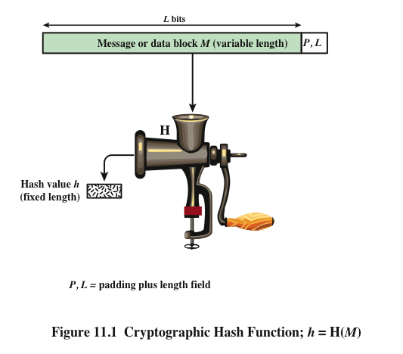

Slide 5
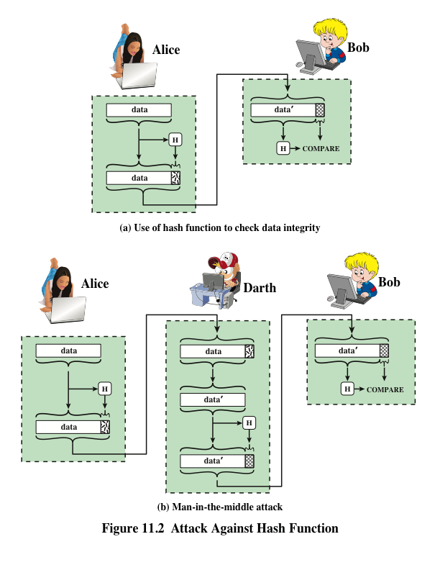

Slide 6
Message Authentication
A mechanism or service used to verify the integrity of a message.
Message authentication assures that data received are exactly as sent.

Slide 7
Hash Function for Message Authentication
provides confidentiality
Source
M
||
E
H
K
E(K,M||H(M))
M
H
D
Compare
H(M)
K
Destination

Slide 8
Hash Function for Message Authentication (cont.)
Source
Destination
M
H
M
||
K
K
Compare
H
E
D
E(K,H(M))

Slide 9
Hash Function for Message Authentication (cont.)
Source
Destination
M
||
H
M
S
||
Compare
||
H
S
H(M||S)

Slide 10
Hash Function for Message Authentication (cont.)
provides confidentiality
Source
M
||
E
||
H
K
S
E(K,M||H(M||S))
M
||
H
S
D
Compare
K
H(M||S)
Destination

Slide 11
Digital Signature
The hash value of a message is encrypted with a user’s private key.
Anyone who knows the user’s public key can verify the integrity of the message that is associated with the digital signature.

Slide 12
Hash Function for Digital Signature
Source
Destination
M
H
M
||
PR_{a}
PU_{a}
Compare
H
E
D
E(PR_{a},H(M))

Slide 13
Hash Function for Digital Signature (cont.)
provides confidentiality
Source
M
||
E
PR_{a}
H
E
K
E(K,[M||E(PR_{a},H(M))]
M
H
D
PU_{a}
Compare
K
D
E(PR_{a},H(M))
Destination

Slide 14
Other Hash Function Uses
Commonly used to create a one-way password file
When a user enters a password, the hash of that password is compared to the stored hash value for verification
This approach to password protection is used by most operating systems
Can be used for intrusion and virus detection
Store H(F) for each file on a system and secure the hash values
One can later determine if a file has been modified by recomputing H(F)
An intruder would need to change F without changing H(F)
Can be used to construct a pseudorandom function (PRF) or a pseudorandom number generator (PRNG)
A common application for a hash-based PRF is for the generation of symmetric keys

Slide 15
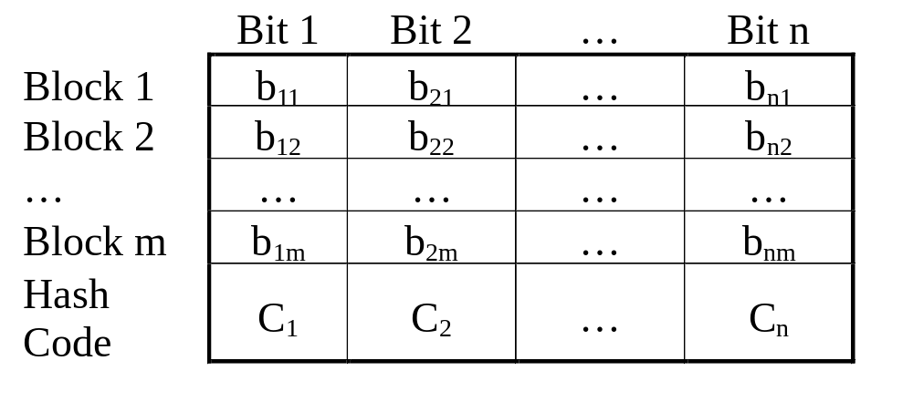
Simple Hash Functions

Slide 16
Simple Hash Functions (cont.)
One of the simplest hash functions is the bit-by-bit XOR of every block. It can be expressed as follows.
C_{i}=b_{i1}⊕ b_{i2} ⊕ ... ⊕b_{im}
where C_{i}=ith bit of the hash code, 1<i<n
m=number of n-bit blocks
bij=ith bit in jth block

Slide 17

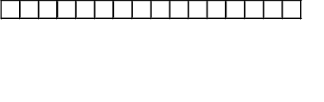
Simple Hash Functions (cont.)
XOR with 1-bit rotation to the right
XOR of every 16-bit block
1. Circular-shift the current hash value
2. XOR the block into the hash value

Slide 18
Simple But Not Secure
A simple XOR or rotated XOR (RXOR) is insufficient if only the hash code is encrypted.
You may still feel that such a simple function could be useful when the message as well as the hash code are encrypted.
However, you must be really careful.
Consider the cipher block chaining (CBC).
Given a message consisting of a sequence of 64-bit blocks of X₁, X₂, …,X_{N}, define the hash code C as the block-by-block XOR of all blocks and append the hash code as the final block.
C=X_{N+1}=X₁ ⊕ X₂ ⊕ … ⊕ X_{N}

Slide 19
Simple But Not Secure (cont.)
X_{N+1}
= X₁ ⊕ X₂ ⊕ X₃ ⊕ … ⊕ X_{N}
= [IV⊕D(K, Y₁)] ⊕ [Y₁ ⊕D(K, Y₂)] ⊕ [Y₂ ⊕D(K, Y₃)] ⊕
[Y₃ ⊕D(K, Y₄)] ⊕ … ⊕ [Y_{N-1} ⊕D(K, Y_{N})]
{suppose Y₁ and Y₂ are exchanged}
= [IV⊕D(K, Y₂)] ⊕ [Y₂ ⊕D(K, Y₁)] ⊕ [Y₁ ⊕D(K, Y₃)] ⊕
[Y₃ ⊕D(K, Y₄)] ⊕ … ⊕ [Y_{N-1} ⊕D(K, Y_{N})]
So, even if two ciphertext blocks are permuted, the hash code remains the same.

Slide 20

Requirements and Security
Preimage
Collision
x is the preimage of h for a hash value h = H(x)
Is a data block whose hash function, using the function H, is h
Because H is a many-to-one mapping, for any given hash value h, there will in general be multiple preimages
Occurs if we have x ≠ y and H(x) = H(y)
Because we are using hash functions for data integrity, collisions are clearly undesirable

Slide 21
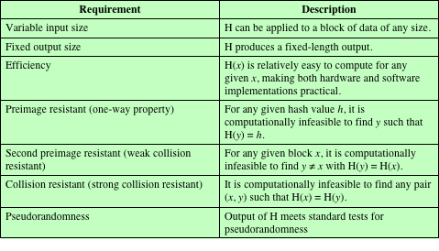
Table 11.1 Requirements for a Cryptographic Hash Function H

Slide 22
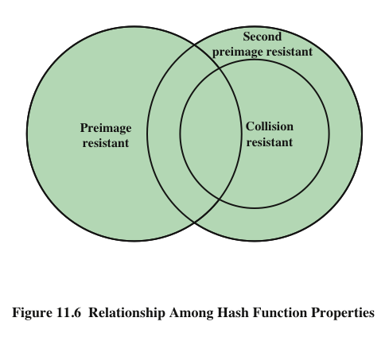

Slide 23
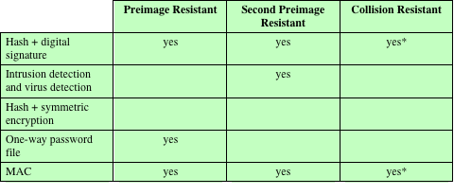
Table 11.2 Hash Function Resistance Properties Required for Various Data Integrity Applications
* Resistance required if attacker is able to mount a chosen message attack

Slide 24
Attacks on Hash Functions
Brute-Force Attacks
Cryptanalysis
Does not depend on the specific algorithm, only depends on bit length
In the case of a hash function, attack depends only on the bit length of the hash value
Method is to pick values at random and try each one until a collision occurs
An attack based on weaknesses in a particular cryptographic algorithm
Seek to exploit some property of the algorithm to perform some attack other than an exhaustive search

Slide 25

Birthday Attacks
Suppose that a 64-bit hash code is used. One might think this is quite secure.
For example, if an encrypted hash code C is transmitted with the corresponding unencrypted message M, then an opponent would need to find an M’ such that H(M’)=H(M) to substitute another message and fool the receiver.
On average, the opponent would have to try 2⁶³ (=2⁶⁴ /2) messages to find one.

Slide 26
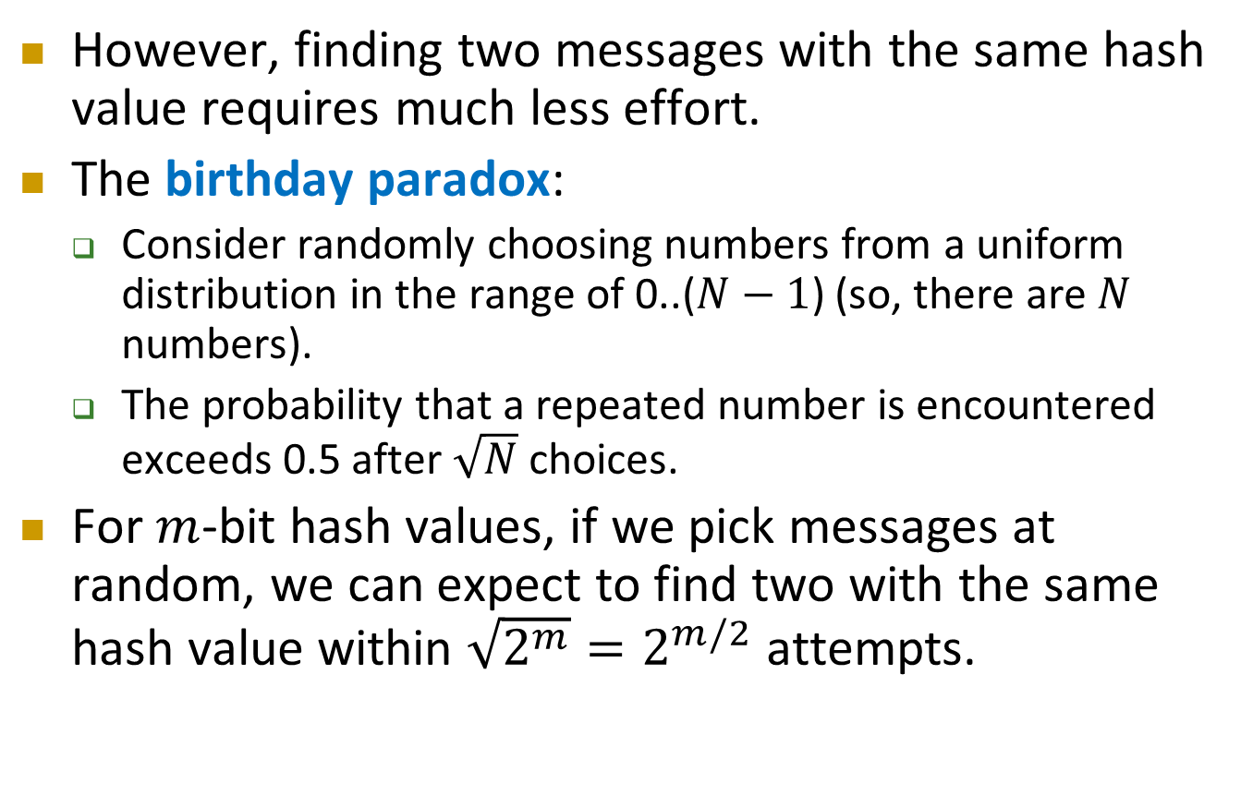
Birthday Attacks (cont.)
However, finding two messages with the same hash value requires much less effort.
The birthday paradox:
  Consider randomly choosing numbers from a uniform distribution in the range of 0..($N−1$) (so, there are $N$ numbers).
  The probability that a repeated number is encountered exceeds 0.5 after $\sqrt{N}$ choices.
For $m$-bit hash values, if we pick messages at random, we can expect to find two with the same hash value within $\sqrt{2^{m}}=2^{m/2}$ attempts.

Slide 27
Birthday Attacks (cont.)
[Yuval 1979] proposed the following attack strategy that exploits the birthday paradox:
  The source A is prepared to “sign” a message by appending the appropriate m-bit MAC and encrypting that MAC with A’s private key.
  The opponent generates 2^{m/2} variations on the message, all of which convey essentially the same meaning.
  The opponent prepares for an equal number of messages, all of which are variations on the fraudulent message to be substituted for the real one.

Slide 28
Birthday Attacks (cont.)
  The two sets of messages are compared to find a pair of messages that produces the same hash code. If no match is found, additional valid and fraudulent messages are generated until a match is made.
  The opponent offers the valid variation to A for signature. This signature can then be attached to the fraudulent variation for transmission to the intended recipient.
Thus, if a 64-bit hash code is used, the level of effort required is only on the order of 2³².
The conclusion to be drawn from this is that the length of the hash code should be substantial.

Slide 29

A letter in 2³⁷ variations

Slide 30
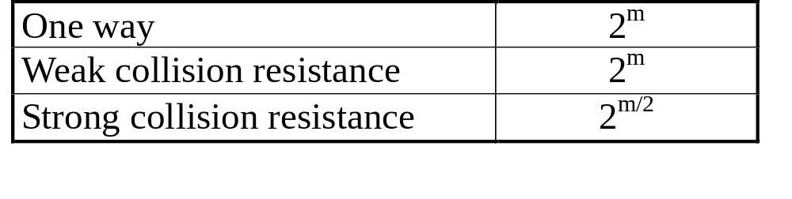
Security of Hash Functions
We can group attacks on hash functions into two categories: brute-force attacks and cryptanalysis.
The strength of a hash functions against brute-force attacks depends solely on the length of the hash code.
For a code of length m, the level of effort required is proportional to the following.

Slide 31
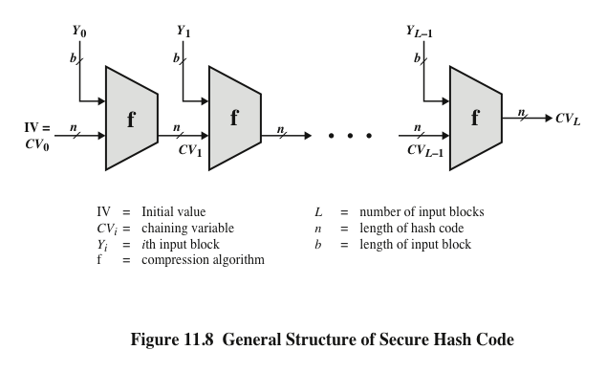

Slide 32
Secure Hash Algorithm
SHA was originally designed by NIST & NSA in 1993 and revised in 1995 as SHA-1.
US standard for use with DSA signature scheme.
Based on design of MD4 with key differences.
SHA-1 produces 160-bit hash values.
Two messages deliver the same SHA-1 hash using 2⁶⁹ operations, far fewer than 2⁸⁰ operations. [王小雲2005]
The 2005 result on security of SHA-1 has raised concerns on its use in future applications.

Slide 33
Revised Secure Hash Standard
NIST issued revision FIPS 180-2 in 2002.
Adds 3 additional versions (SHA-2)
  SHA-256, SHA-384, SHA-512
  SHA-224 added in 2008 (FIPS 180-3)
Designed for compatibility with increased security provided by the AES cipher.
Structure & detail is similar to SHA-1, hence analysis should be similar, but security levels are rather higher.

Slide 34
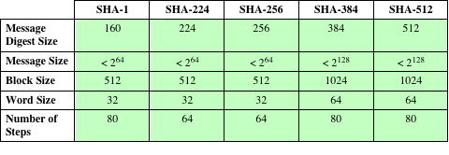
Comparison of SHA Parameters
Note: All sizes are measured in bits.

Slide 35
SHA-512 Logic
Append padding bits: the length in bits is congruent to 896 (= 1024 – 128) mod 1024. The padding consists of a single 1-bit followed by 0-bits (1000…0).
Append length (of message): a 128-bit representation of the length in bits of the original message is appended.

Slide 36
SHA-512 Logic (cont.)
Initialize hash buffer:
  a 512-bit buffer is used to hold intermediate and final results of the hash function.
  The buffer can be represented as eight 64-bit registers (a,b,c,d,e,f,g,h). Their initial values are (hexadecimal)
  a=6A09E667F3BCC908 e=510E527FADE682D1
  b=BB67AE8584CAA73B f=9B05688C2B3E6C1F
  c=3C6EF372FE94F82B g=1F83D9ABFB41BD6B
  d=A54FF53A5F1D36F1 h=5BE0CDI9137E2179
  (taking the first 64 bits of the fractional parts of the square roots of the first eight prime number)

Slide 37
SHA-512 Logic (cont.)
Process message in 1024-bit (128 bytes, 16 words) blocks.
  The compression function contains 80 rounds.
Output. After all N 1024-bit blocks have been processed, the output from the Nth stage is the 512-bit message digest.

Slide 38
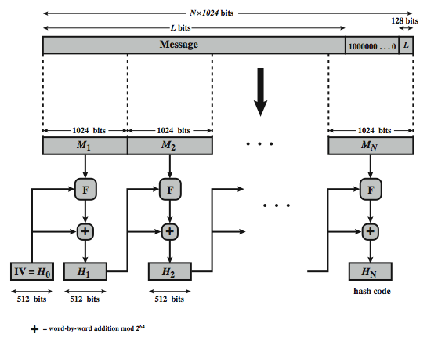
SHA-512 Overview

Slide 39
SHA-512 Compression Function
Process message in 1024-bit blocks.
Contains 80 rounds.
  Updating a 512-bit buffer.
  Using a 64-bit value derived from the current message block.
  A round constant based on the cube roots of the first 80 prime numbers.

Slide 40
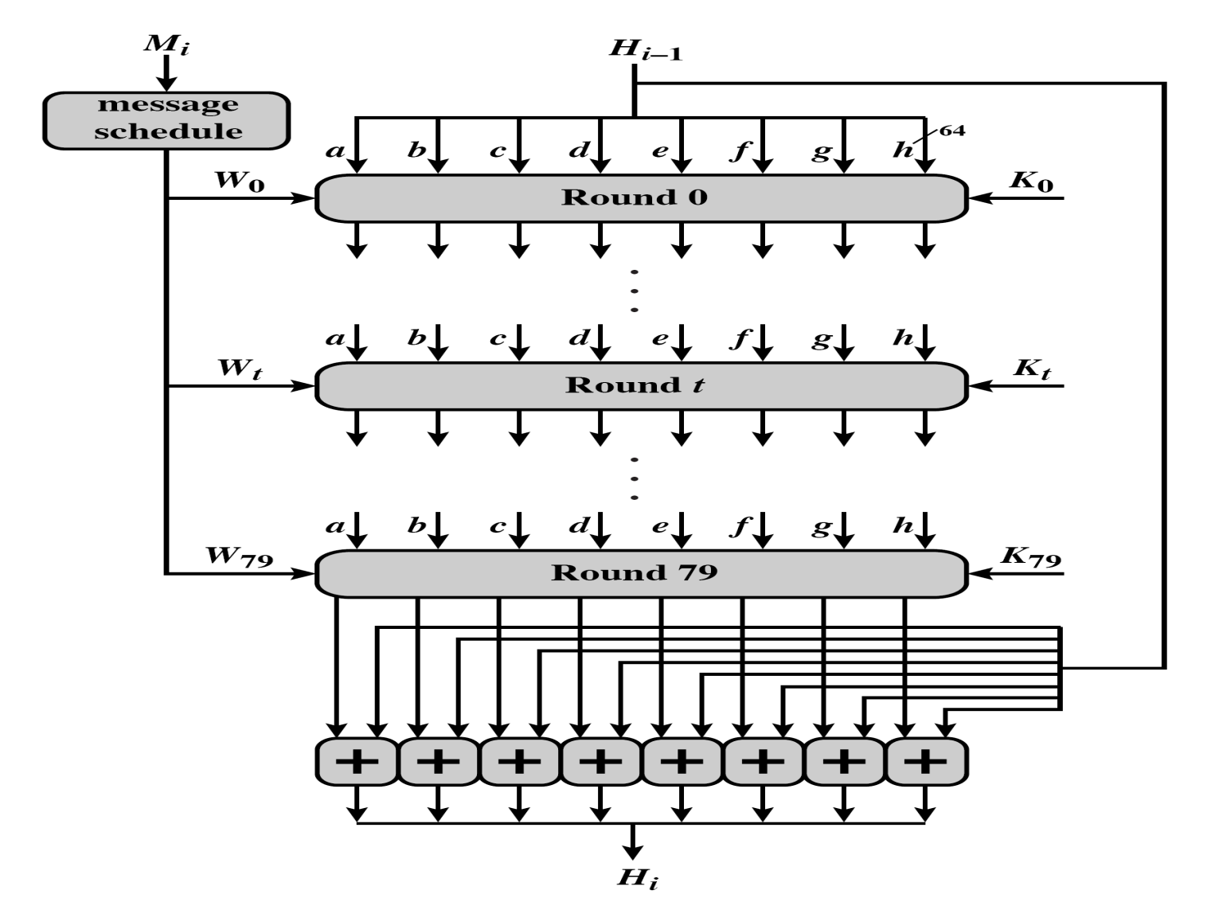
A Single 1024-Bit Block

Slide 41
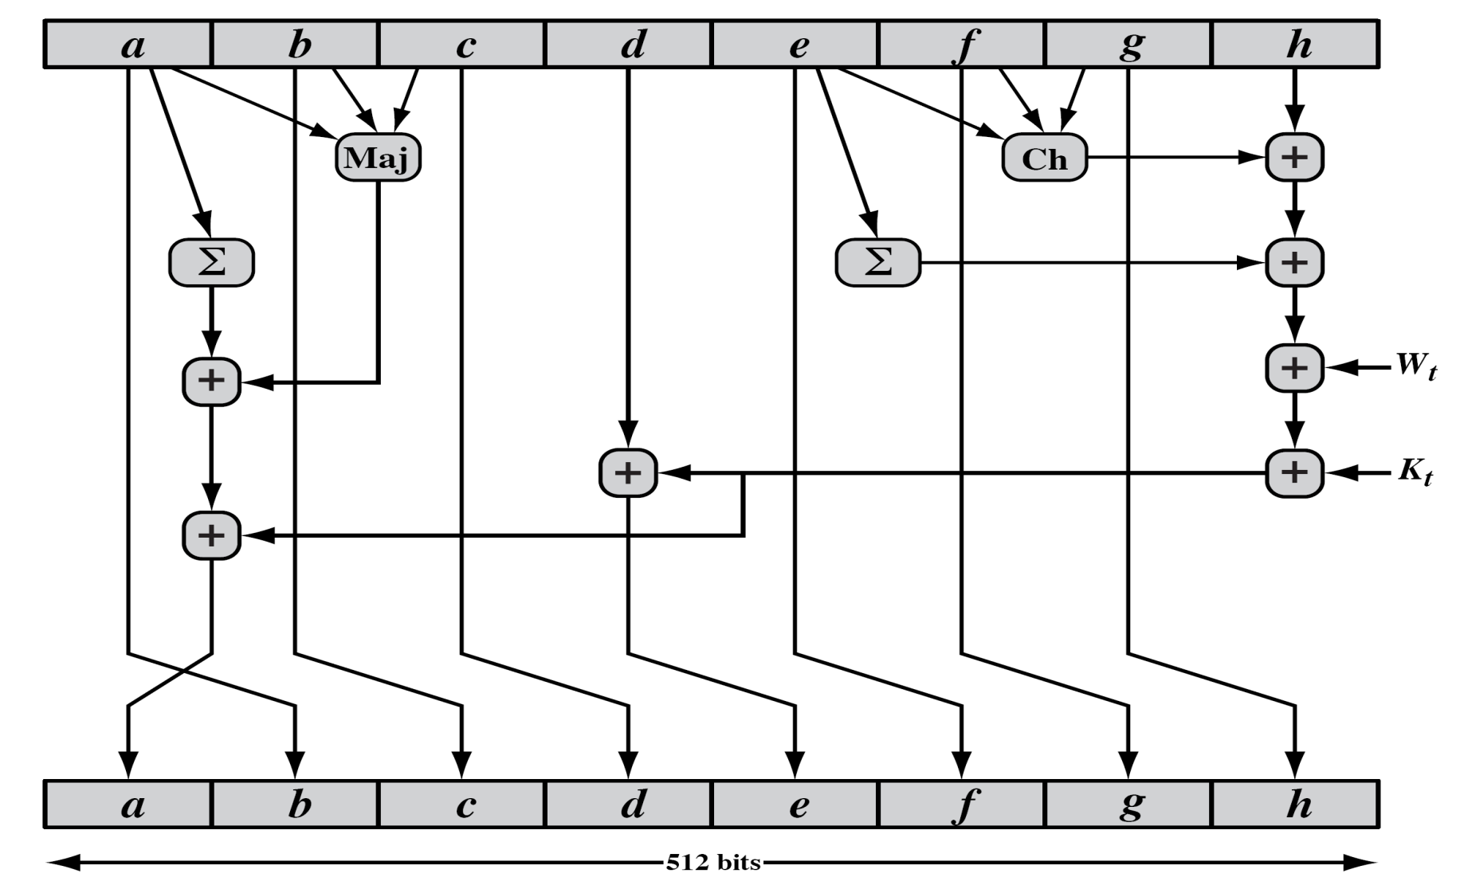
SHA-512 Round Function

Slide 42
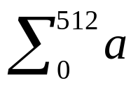
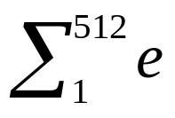
SHA-512 Functions
Maj(a,b,c)=(a ∧ b) ⊕(a ∧ c) ⊕ (b ∧ c)
Ch(e,f,g)=(e ∧ f) ⊕ (¬e ∧ g)
=ROTR²⁸(a) ⊕ROTR³⁴(a) ⊕ROTR³⁹(a)
=ROTR¹⁴(e) ⊕ROTR¹⁸(e) ⊕ROTR⁴¹(e)
σ₀(x)= ROTR¹(x) ⊕ROTR⁸(x) ⊕SHR⁷(x)
σ₁(x)= ROTR¹⁹(x) ⊕ROTR⁶¹(x) ⊕SHR⁶(x)

Slide 43
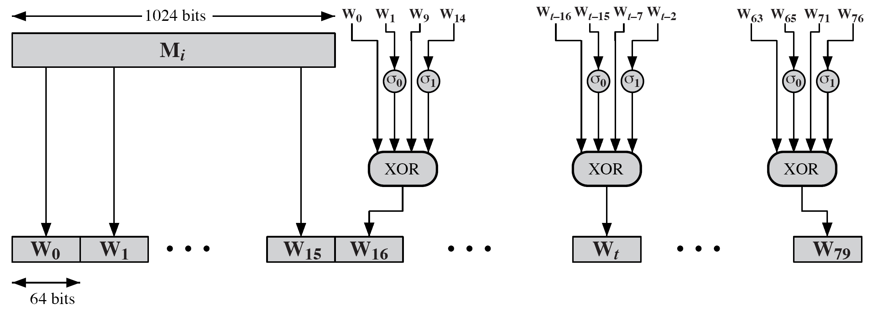
SHA-512 Round Function

Slide 44
SHA-3
SHA-1 has not yet been "broken”
No one has demonstrated a technique for producing collisions in a practical amount of time
Considered to be insecure and has been phased out for SHA-2
SHA-2 shares the same structure and mathematical operations as its predecessors so this is a cause for concern
Because it will take years to find a suitable replacement for SHA-2 should it become vulnerable, NIST decided to begin the process of developing a new hash standard
NIST announced in 2007 a competition for the SHA-3 next generation NIST hash function
Winning design was announced by NIST in October 2012
SHA-3 is a cryptographic hash function that is intended to complement SHA-2 as the approved standard for a wide range of applications

Slide 45

The Sponge Construction
Underlying structure of SHA-3 is a scheme referred to by its designers as a sponge construction
Takes an input message and partitions it into fixed-size blocks
Each block is processed in turn with the output of each iteration fed into the next iteration, finally producing an output block
The sponge function is defined by three parameters:
  f = internal function used to process each input block
  r = size in bits of the input blocks, called the bitrate
  pad = padding algorithm

Slide 46
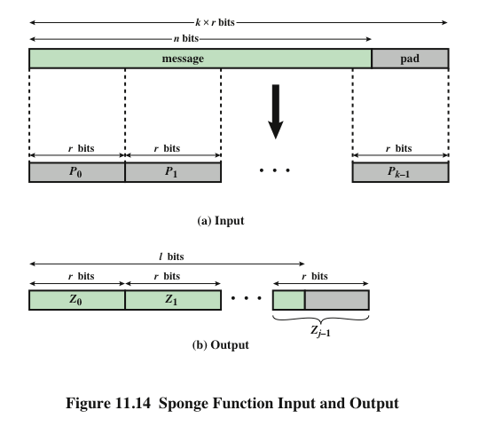

Slide 47
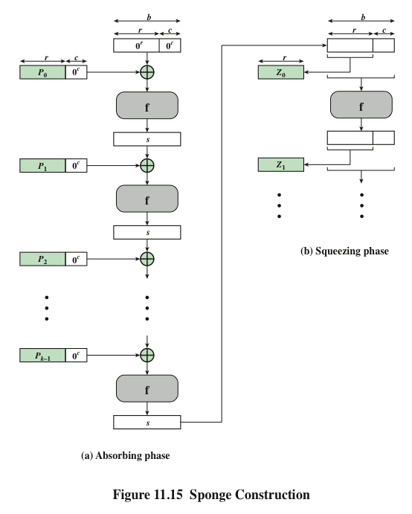

Slide 48
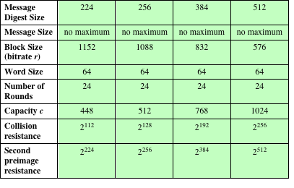
Table 11.5 SHA-3 Parameters

Slide 49
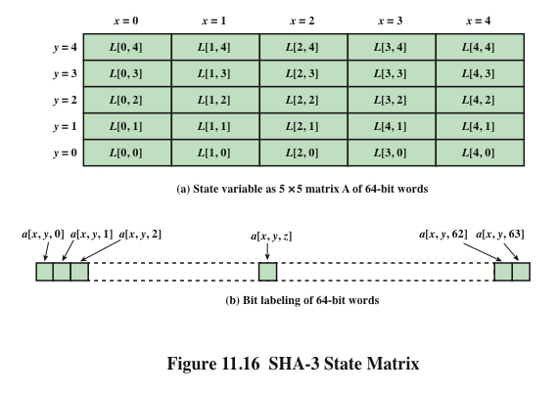

Slide 50
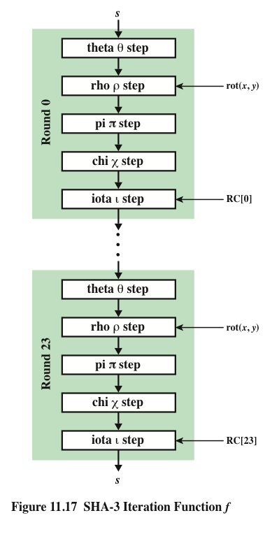
SHA-3
Iteration Function f

Slide 51
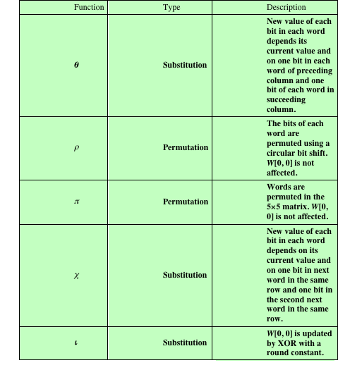
Table 11.6
Step Functions
in SHA-3

Slide 52
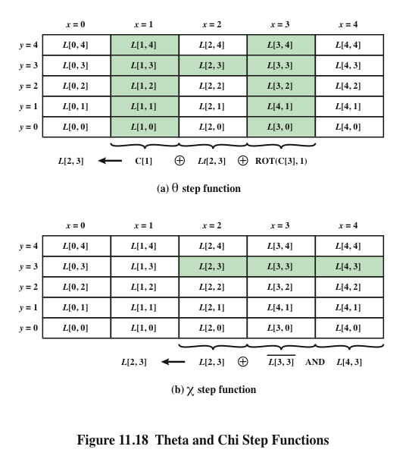

Slide 53
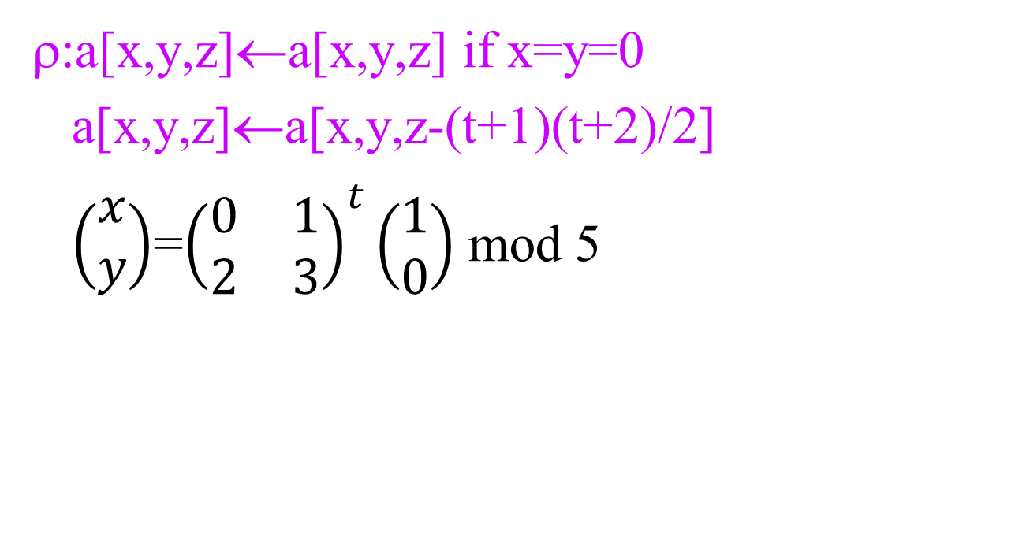
ρ Step Function
ρ:a[x,y,z]←a[x,y,z] if x=y=0
a[x,y,z]←a[x,y,z-(t+1)(t+2)/2]
$\left(\begin{matrix}x \\ y\end{matrix}\right)$=${\left(\begin{matrix}0 & 1 \\ 2 & 3\end{matrix}\right)}^{t}\left(\begin{matrix}1 \\ 0\end{matrix}\right)$ mod 5

Slide 54
t | g(t) | g(t) mod 64 | x,y |  | t | g(t) | g(t) mod 64 | x,y
0 | 1 | 1 | 1,0 |  | 12 | 91 | 27 | 4,0
1 | 3 | 3 | 0,2 |  | 13 | 105 | 41 | 0,3
2 | 6 | 6 | 2,1 |  | 14 | 120 | 56 | 3,4
3 | 10 | 10 | 1,2 |  | 15 | 136 | 8 | 4,3
4 | 15 | 15 | 2,3 |  | 16 | 153 | 25 | 3,2
5 | 21 | 21 | 3,3 |  | 17 | 171 | 43 | 2,2
6 | 28 | 28 | 3,0 |  | 18 | 190 | 62 | 2,0
7 | 36 | 36 | 0,1 |  | 19 | 210 | 18 | 0,4
8 | 45 | 45 | 1,3 |  | 20 | 231 | 39 | 4,2
9 | 55 | 55 | 3,1 |  | 21 | 253 | 61 | 2,4
10 | 66 | 2 | 1,4 |  | 22 | 276 | 20 | 4,1
11 | 78 | 14 | 4,4 |  | 23 | 300 | 44 | 1,1
Calculation of values and positions
x=0 x=1 x=2 x=3 x=4
18 | 2 | 61 | 56 | 14
41 | 45 | 15 | 21 | 8
3 | 10 | 43 | 25 | 39
36 | 44 | 6 | 55 | 20
0 | 1 | 62 | 28 | 27
Rotation values by word position in matrix

Slide 55
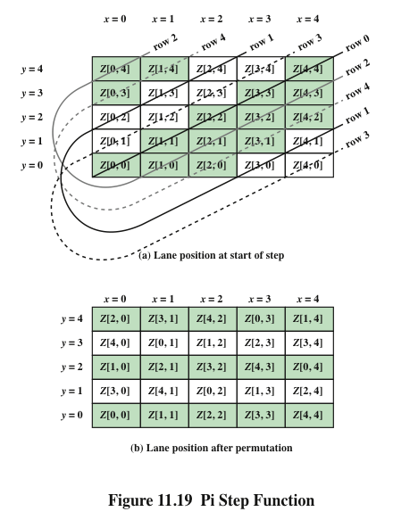
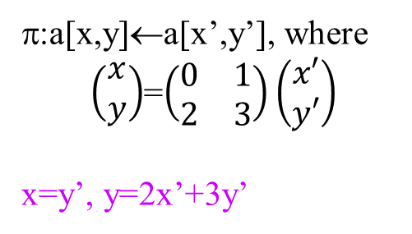

Slide 56
Round | Constant | # of 1’s |  | Round | Constant | # of 1’s
0 | 0000000000000001 | 1 |  | 12 | 000000008000808B | 6
1 | 0000000000008082 | 3 |  | 13 | 800000000000008B | 5
2 | 800000000000808A | 5 |  | 14 | 8000000000008089 | 5
3 | 8000000080008000 | 3 |  | 15 | 8000000000008003 | 4
4 | 000000000000808B | 5 |  | 16 | 8000000000008002 | 3
5 | 0000000080000001 | 2 |  | 17 | 8000000000000080 | 2
6 | 8000000080008081 | 5 |  | 18 | 000000000000800A | 3
7 | 8000000000008009 | 4 |  | 19 | 800000008000000A | 4
8 | 000000000000008A | 3 |  | 20 | 8000000080008081 | 5
9 | 0000000000000088 | 2 |  | 21 | 8000000000008080 | 3
10 | 0000000080008009 | 4 |  | 22 | 0000000080000001 | 2
11 | 000000008000000A | 3 |  | 23 | 8000000080008008 | 4
IOTA step function
ι: a←a⊕RC[i_{r}]
L[0,0] ← L[0,0] ⊕RC[i_{r}]
0<i_{r}<24

