Slide 1
Message Authentication
Yih-Kuen Tsay
Dept. of Information Management
National Taiwan University
(Based on [Lee 2013, Stallings 2014])

Slide 2
Outline
Message authentication requirements
Message authentication functions
Requirements for message authentication codes
Security of MACs
MACs based on hash functions (HMAC)
MACs based on block ciphers (DAA and CMAC)
Authenticated encryption (CCM and GCM)
Key Wrapping
Pseudorandom number generation using hash functions and MACs

Slide 3
Authentication Requirements
Attacks in networked communications
  Disclosure
  Traffic analysis
  Masquerade
  Content modification
  Sequence modification
  Timing modification
  Source repudiation
  Destination repudiation
Message authentication verifies that received messages come from the alleged source and have not been altered, against Attacks 3-6 (and 7 partly).

Slide 4
Message Authentication Functions
Two levels of functionality:
  Hash function
  A function that maps a message of any length into a fixed-length hash value, which serves as the authenticator
  Message encryption
  The ciphertext of the entire message serves as its authenticator
  Message authentication code (MAC)
  A function of the message and a secret key that produces a fixed-length value that serves as the authenticator
Lower level
There must be some sort of function that produces an authenticator
Higher level
Use the lower-level function as a primitive in an authentication protocol that enables a receiver to verify the authenticity of a message

Slide 5
Functions to Produce an Authenticator
Hash function:
A function that maps a message of any length into a fixed-length hash value, which serves as the authenticator.
Message encryption:
The ciphertext of the entire message serves as its authenticator.
Message authentication code (MAC):
A public function of the message and a secret key that produces a fixed-length value that serves as the authenticator.

Slide 6
Message Encryption
Symmetric encryption
Public-key encryption

Slide 7
Symmetric Encryption: Confidentiality and Authentication
Source
Destination
M
M
E
D
K
E(K,M)
K

Slide 8
Confidentiality and Authentication Implications of Message Encryption
Symmetric encryption A→B: E(K,M)
  Provides confidentiality
    Only A and B share K
  Provides a degree of authentication
    Could come only from A
    Has not been altered in transit
    Requires some formatting/redundancy
  Does not provide signature
    Receiver could forge message
    Sender could deny message

Slide 9
Symmetric Encryption (cont.)
Suppose M can be any bit pattern.
There is no way to determine automatically, at the destination, whether an incoming message is the ciphertext of a legitimate message.
Thus, in general, we require that only a small subset of all possible bit patterns is considered legitimate plaintext.
In that case, any spurious ciphertext is unlikely to produce legitimate plaintext.

Slide 10
Symmetric Encryption (cont.)
For example, suppose that we are transmitting messages using Caesar cipher with a shift of one (K=1).
A sends the following legitimate ciphertext
ipxbsfzpv
B decrypts to produce the following plaintext
howareyou
A simple frequency analysis confirms that this message has the profile of ordinary English.

Slide 11
Symmetric Encryption (cont.)
On other hand, if an opponent generates the following random sequence of letters.
zuvrsoevgqxlzw
It decrypts to
ytuqrndufpwkyv
which does not fit the profile of ordinary English.

Slide 12
Symmetric Encryption (cont.)
It may be difficult to determine automatically if incoming ciphertext decrypts to intelligible plaintext.
If the plaintext is, say, a binary object file or digitized images, determination of properly formed and therefore authentic plaintext may be difficult.
One solution to this problem is to force the plaintext to have some structure that is easily recognized but that cannot be replicated without recourse to the encryption function.
For example, we could append an error-detecting code, also known as a frame check sequence (FCS) or checksum, to each message before encryption.

Slide 13
Internal Error Control
Source
M
M
||
E
F(M)
F
K
E(K,M||F(M))
F
M
D
Compare
F(M)
K
Destination

Slide 14
External Error Control
Source
M
M
||
E
K
E(K,M)
F
D
M
F
F(M)
K
Compare
F(E(K,M))
Destination

Slide 15
TCP Segment
Bit:
0
4
10
16
31
Source port
Destination
Sequence number
Acknowledge number
Data offset
Reserved
Flags
Windows
Checksum
Urgent pointer
Options + padding
Applications data
A TCP segment has a meaningful header, which can serve as
the needed structuring of the plaintext for authentication.

Slide 16
Public-Key Encryption: Confidentiality
Source
Destination
M
M
E
D
PU_{b}
E(PU_{b}, M)
PR_{b}

Slide 17
Public-Key Encryption: Authentication and Signature
Source
Destination
M
M
E
D
PR_{a}
E(PR_{a}, M)
PU_{a}

Slide 18
Public-Key Encryption: Confidentiality, Authentication, and Signature
Source
M
E
E
PR_{a}
E(PR_{a}, M)
PU_{b}
E(PU_{b},E(PR_{a},M))
M
D
D
PR_{b}
E(PR_{a}, M)
PU_{a}
Destination

Slide 19
Public-Key Encryption: Confidentiality, Authentication, and Signature (cont.)
The disadvantage of this approach is that the public-key algorithm, which is complex, must be exercised four times rather than two in each communication.

Slide 20
Confidentiality and Authentication Implications of Message Encryption (cont.)
Public-key encryption, using the public key PU_{b} of B, i.e., A→B: E(PU_{b},M)
  Provides confidentiality
    Only B has PR_{b} to decrypt
  Provides no authentication
    Any party could use PU_{b} to encrypt message and claim to be A

Slide 21
Confidentiality and Authentication Implications of Message Encryption (cont.)
Public-key encryption, using the private key PR_{a} of A, i.e., A→B: E(PR_{a}, M)
  Provides authentication and signature
    Only A has PR_{a} to encrypt
    Has not been altered in transit
    Require some formatting/redundancy
    Any part can use PU_{a} to verify signature

Slide 22
Confidentiality and Authentication Implications of Message Encryption (cont.)
Public-key encryption, using both PU_{b} and PR_{a}, i.e., A→B: E(PU_{b}, E(PR_{a}, M))
  Provides confidentiality because of PU_{b}.
  Provides authentication and signature because of PR_{a}.

Slide 23
Message Authentication Code (MAC)
An alternative authentication technique involves the use of a secret key to generate a small fixed-size block of data, known as a cryptographic checksum or MAC, that is appended to the message.
When A sends a message to B, it calculates the MAC=C(K,M), where K is the secret key.
The message plus MAC are send to B.
B performs the same calculation on the received message to generate new MAC which is compared to the received MAC.

Slide 24
Message Authentication
Source
Destination
M
C
M
||
K
Compare
C(K,M)
K
C

Slide 25
MAC (cont.)
Assume that only the receiver and sender know the identity of the secret key, and if the received MAC matches the calculated MAC.
  The receiver is assured that the message has not been altered.
  The receiver is assured that the message is from the alleged sender.
  If the message includes a sequence number, then the receiver can be assured of the proper sequence because an attacked cannot successfully alter the sequence number.

Slide 26
MAC (cont.)
A MAC function is similar to encryption.
One difference is that the MAC algorithm need not be reversible, as it must for decryption.
It turns out that because of the mathematical properties of the authentication function, it is less vulnerable to being broken than encryption.

Slide 27
Message Authentication and Confidentiality; Authentication Tied to Plaintext
Source
M
||
E
K₁
C
K₂
E(K₂,[M||C(K₁,M)])
M
C
D
Compare
C(K₁,M)
K₁
K₂
Destination

Slide 28
Message Authentication and Confidentiality; Authentication Tied to Ciphertext
Source
M
E
||
K₁
K₂
C
E(K₂,M)
D
M
C
K₂
Compare
C(K₁,E(K₂,M))
K₁
Destination

Slide 29
Where a MAC Is Used
There are a number of applications in which the same message is broadcast to a number of destinations.
E.g., notification to network users, alarm signal in a military control center, etc.
Another possible scenario is an exchange in which one side has a heavy load and cannot afford the time to decrypt all incoming messages.
Authentication of a computer program in plaintext is an attractive service.

Slide 30
Where a MAC Is Used (cont.)
For some applications (e.g., SNMP), it may not be of concern to keep messages secret, but it is important to authenticate messages.
Separation of authentication and confidentiality functions affords architectural flexibility.
Note that the MAC does not provide a digital signature because both sender and receiver share the same key.

Slide 31
Basic Uses of a MAC
A→B: M∥C(K,M)
  Provides authentication: only A and B share K
A→B: E(K₂, [M∥C(K₁,M)])
  Provides authentication: only A and B share K₁
  Provides confidentiality: only A and B share K₂
A→B: C(K₁,E(K₂,M))
  Provides authentication: using K₁
  Provides confidentiality: using K₂

Slide 32
Message Authentication Codes (MACs)
A MAC, also known as a cryptographic checksum, is generated by a function C of
T=C(K,M)
where M is a variable-length message, K is a secret key shared only by sender and receiver and C(K,M) is the fixed-length authenticator.
In general, the MAC function is a many-to-one function.
If an n-bit MAC is used, then there are 2^{n} possible MACs, whereas there are N possible messages with N≫2^{n}.

Slide 33
Discovering a Key
If confidentiality is not employed, the opponent has access to plaintext messages and their associated MACs.
Suppose k>n; that is, the key (guess) size is greater than the MAC size.
Given a known M₁ and T₁=C(K₁,M₁), the cryptanalyst can perform T_{i}=C(K_{i},M₁) for all possible key values.
At least one key is guaranteed to produce a match.
On average, a total of 2^{k}/2^{n}=2^{(k-n)} keys will produce a match.

Slide 34
Discovering a Key (cont.)
Thus, the opponent must iterate the attack.
Round 1
  Given: M₁, T₁=C(K,M₁)
  Compute T_{i}=C(K_{i},M₁) for all 2^{k} keys
  Number of matches ≈ 2^{(k-n)}
Round 2
  Given: M₂, MAC₂=C(K,M₂)
  Compute T_{i}=C(K_{i},M₂) for the remaining 2^{(k-n)} keys
  Number of matches ≈ 2^{(k-2n)}
On average, α rounds will be needed if k=αn.

Slide 35
Discovering a Key (cont.)
For example, if an 80-bit key is used and the MAC is 32-bit long, then the first round will produce about 2⁴⁸ possible keys.
The second round will narrow the possible keys to about 2¹⁶ possibilities.
The third round will produce only the single key, which must be the one used by the sender.

Slide 36
A Simple But Weak MAC
Let M=(X₁∥X₂∥…∥X_{m}) be a message that is treated as a concatenation of 64-bit blocks X_{i}.
Then define
Δ(M)= X₁⊕X₂⊕…⊕X_{m}
MAC(K,M)=E(K,Δ(M))
where ⊕ is the exclusive-OR(XOR) operation and the encryption algorithm is DES in electronic codebook mode.
Thus, the key length is 56 bits and the MAC length is 64 bits.

Slide 37
A Simple But Weak MAC (cont.)
If an opponent observes {M∥MAC(K,M)}, a brute-force attempt to determine K will require at least 2⁵⁶ encryptions.
But the opponent can attack the system by replacing X₁ through X_{m-1} with any desired values Y₁ through Y_{m-1} and X_{m} with Y_{m}, where Y_{m} is
Y_{m}=Y₁⊕Y₂⊕…⊕Y_{m-1} ⊕ Δ(M)
That is, the fabricated plaintext
M’ = Y₁ ∥ Y₂ ∥ … ∥ Y_{m-1} ∥ [Y₁⊕Y₂⊕…⊕Y_{m-1} ⊕ Δ(M)]
Note that
Y₁ ⊕ Y₂ ⊕ … ⊕ Y_{m-1} ⊕[Y₁⊕Y₂⊕…⊕Y_{m-1} ⊕ Δ(M)] = Δ(M)

Slide 38
A Simple But Weak MAC (cont.)
The opponent can now concatenate the new message, which consists of Y₁ through Y_{m}, with the original MAC to form a message that will accepted as authentic by the receiver.
That is, the following is sent to the receiver:
M’ ∥ E(K,Δ(M))
where M’ = Y₁ ∥ Y₂ ∥ … ∥ Y_{m-1} ∥ [Y₁⊕Y₂⊕…⊕Y_{m-1} ⊕ Δ(M)]
With this tactic, any message of length 64×(m-1) bits can be fraudulently inserted.

Slide 39
Properties of a MAC
Assume that an opponent knows the MAC function C but does not know K. Then the MAC function should have the following properties:
  If an opponent observes M and C(K,M), it should be computationally infeasible for the opponent to construct a message M’ such that C(K,M’)=C(K,M).
  C(K,M) should be uniformly distributed in the sense that for randomly chosen messages, M and M’, the probability that C(K,M)=C(K,M’) is 2^{-n}, where n is the number of bits in the MAC.
  Let M’ be equal to some known transformation on M. That is, M’=f(M). In that case, Pr[C(K,M)=C(K,M’)]=2^{-n}.

Slide 40
Brute-Force Attack on a MAC
Computation resistance: Given one or more text-MAC pairs (x_{i}, C(K,x_{i})), it is computationally infeasible to compute any text-MAC pair (x, C(K,x)) for any new input x ≠x_{i}.
The level of effort for brute-force attack on a MAC algorithm can be expressed as min (2^{k}, 2^{n}), where k is the length of key and n is the length of the MAC.
It would appear reasonable to require that the key length and MAC length satisfy a relationship such as min(k,n)>N, where N is perhaps in the range of 128 bits.

Slide 41
Cryptanalysis Attacks
Cryptanalysis attacks on hash functions and MAC algorithms seek to exploit some property of the algorithm to perform some attack other than an exhaustive search.
An ideal hash of MAC algorithm will require a cryptanalytic effort greater than or equal to the brute-force attack.

Slide 42
Keyed Hash Functions as MACs
Want a MAC based on a hash function
  because hash functions are generally faster
  code for crypto hash functions widely available
Hash includes a key along with message
Original proposal:
  KeyedHash = Hash(Key ∥ Message)
  some weaknesses were found with this
Eventually led to development of HMAC

Slide 43
HMAC
There has been increased interest in developing an MAC derived from a cryptographic hash code.
The approach that has received the most support is HMAC.
HMAC has been chosen as the mandatory-to-implement HMAC for IP security.

Slide 44
HMAC Design Objectives
To use, without modifications, available hash functions.
To allow for easy replaceability of the embedded hash function in case faster or more secure hash functions are found or required.
To preserve the original performance of the hash function without incurring a significant degradation.
To use and handle keys in a simple way.
To have a well understood cryptographic analysis of the strength of the authentication mechanism.

Slide 45
HMAC
Specified as Internet standard RFC 2104
Uses hash function on the message:
  HMAC_{K} = Hash[(K⁺ ⊕ opad) ∥
  Hash[(K⁺ ⊕ ipad) ∥ M ]]
where K⁺ is the key padded out to size,
opad, ipad are specified padding constants
Overhead is just 3 more hash calculations than the message needs alone
Any hash function can be used
  E.g., MD5, SHA-1, RIPEMD-160

Slide 46
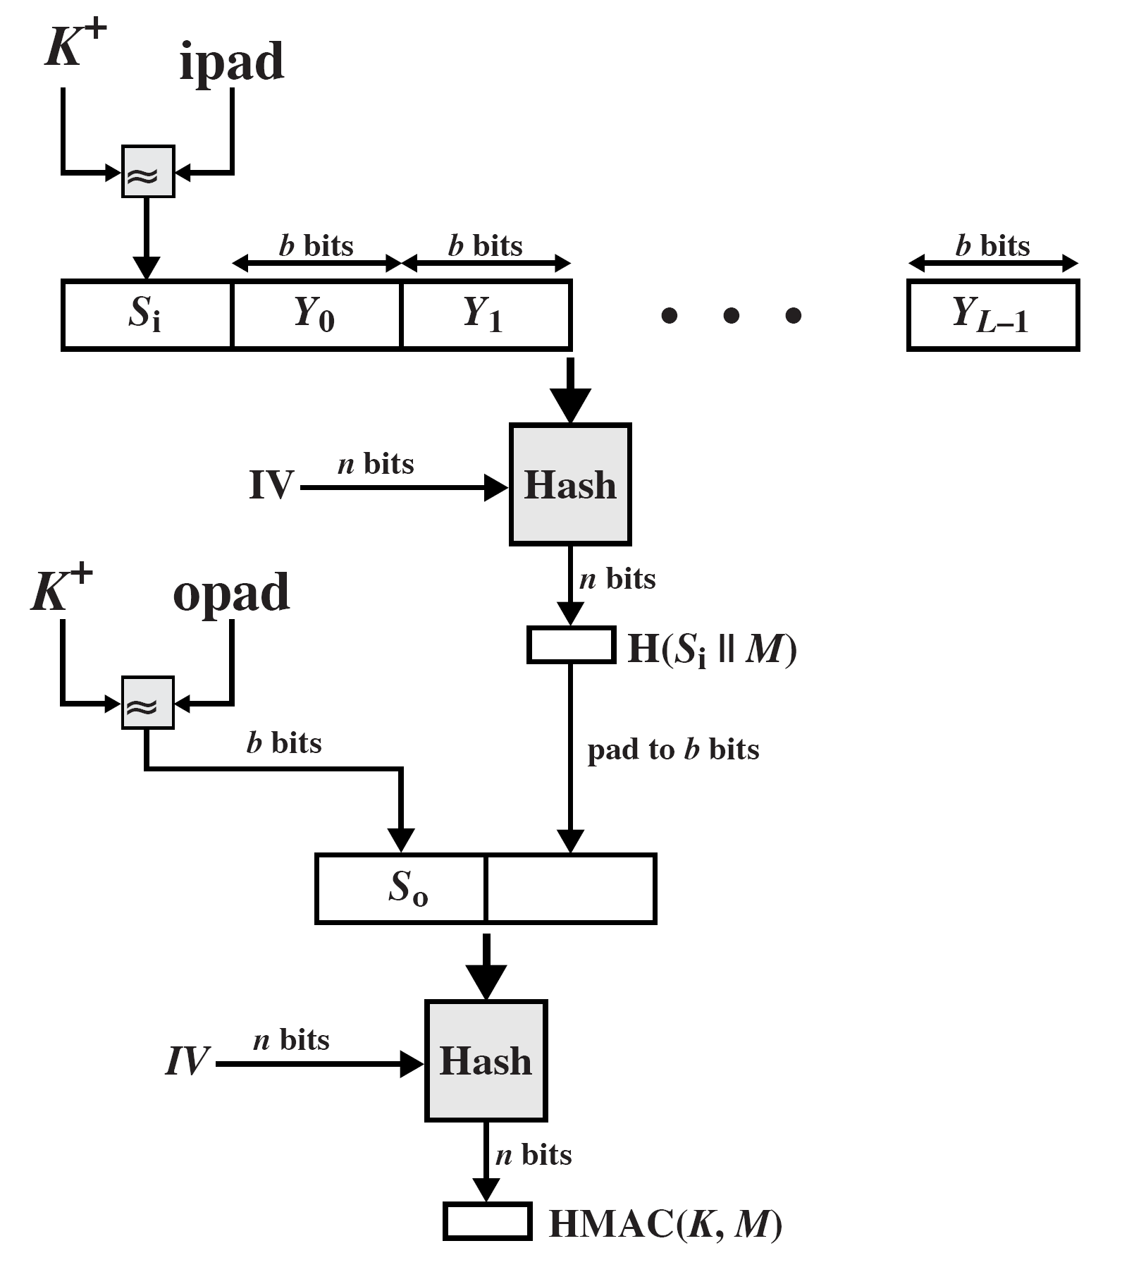
ipad=00110110 repeated b/8 times
opad=01011010 repeated b/8 times

Slide 47
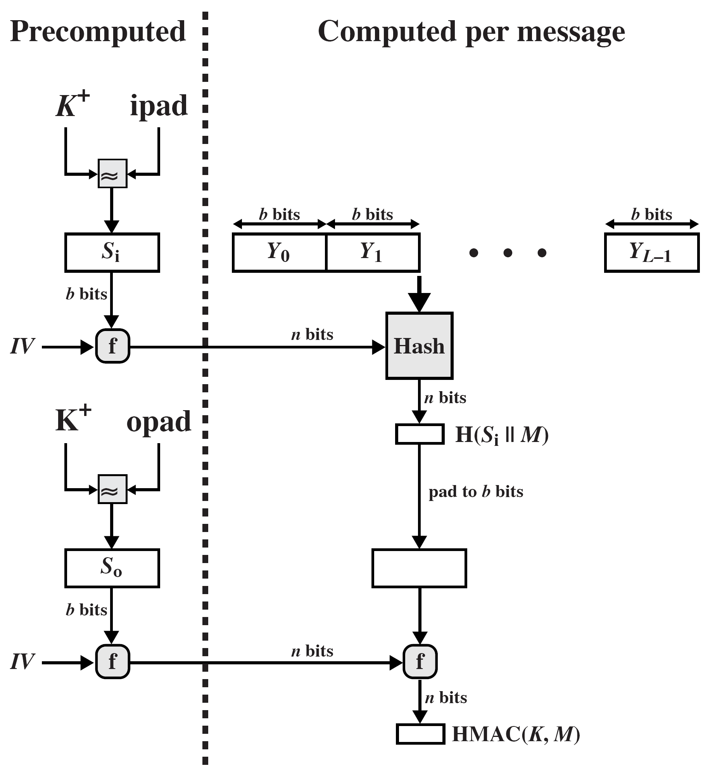
Efficient implementation of HMAC

Slide 48
HMAC Security
Proved security of HMAC relates to that of the underlying hash algorithm
Attacking HMAC requires either:
  brute force attack on key used
  birthday attack (but since keyed would need to observe a very large number of messages)
Choose hash function used based on speed verses security constraints
Attacking HMAC, the attacker cannot generate message/code pairs offline because the attacker does not know K.

Slide 49
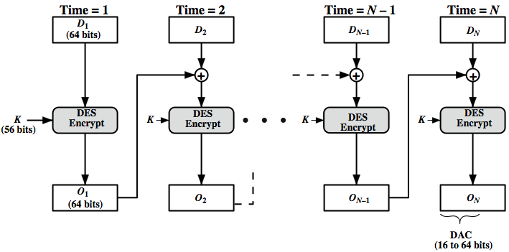
Data Authentication Algorithm

Slide 50
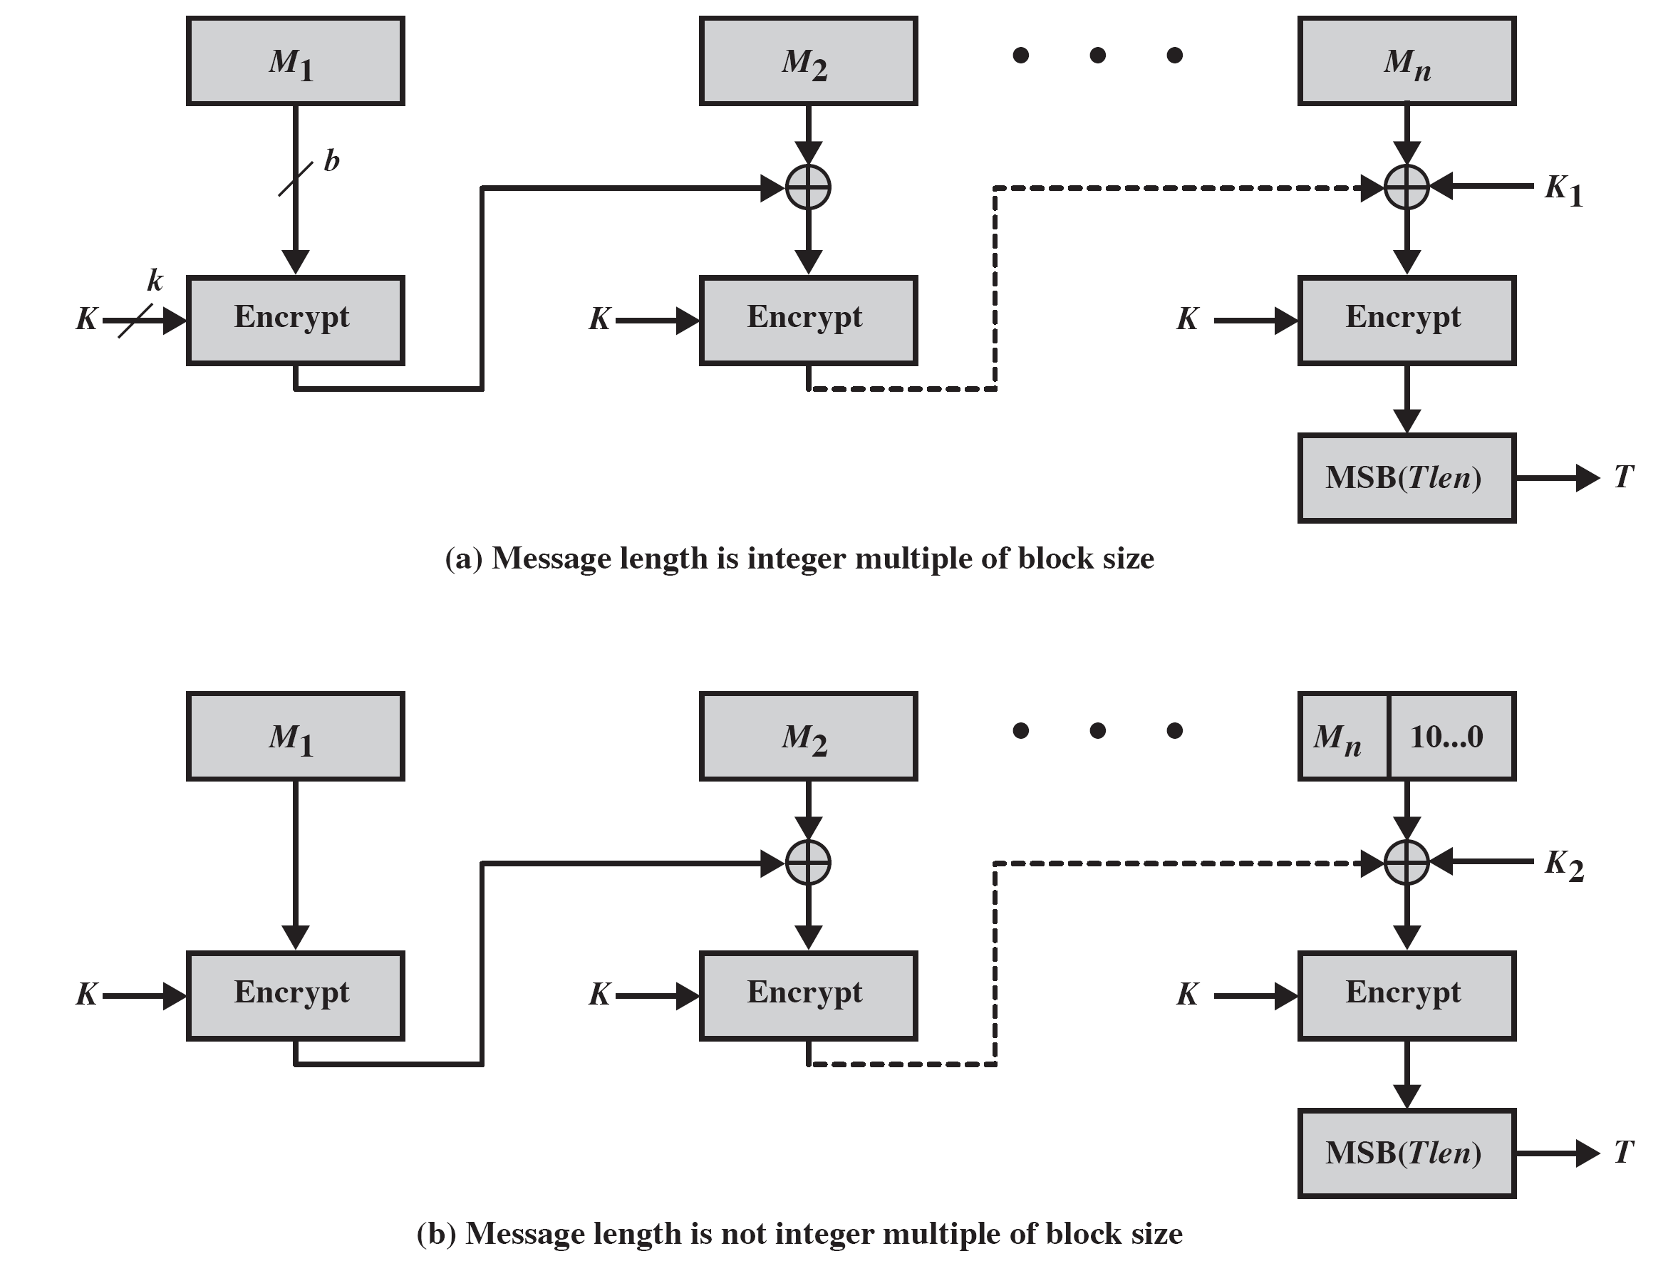
L=E(K,0^{n}), K₁=Lx, K₂=Lx²
CMAC overview

Slide 51
Authenticated Encryption
Simultaneously protect confidentiality and authenticity of communications
  often required but usually separate
Approaches
  Hash-then-encrypt: E(K, (M || H(M))
  MAC-then-encrypt: E(K₂, (M || MAC(K₁, M))
  Encrypt-then-MAC: C=E(K₂, M), T=MAC(K₁, C)
  Encrypt-and-MAC: C=E(K₂, M), T=MAC(K₁, M)
Decryption /verification straightforward
But security vulnerabilities with all these approaches

Slide 52
Counter with Cipher Block Chaining-Message Authentication Code (CCM)
NIST standard SP 800-38C for IEEE 802.11 WiFi
Variation of encrypt-and-MAC approach
Algorithmic ingredients
  AES encryption algorithm
  CTR mode of operation
  CMAC authentication algorithm
Single key used for both encryption & MAC

Slide 53
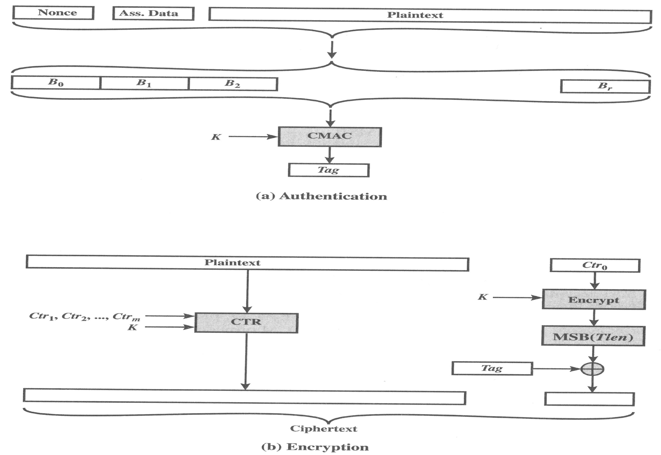
CCM Operation

Slide 54
Galois/Counter Mode (GCM)
NIST standard SP 800-38D, parallelizable
Message is encrypted in variant of CTR
Ciphertext multiplied with key & length over in (2¹²⁸) to generate authenticator tag
Have GMAC MAC-only mode also
Uses two functions:
  GHASH - a keyed hash function
  GCTR - CTR mode with incremented counter

Slide 55
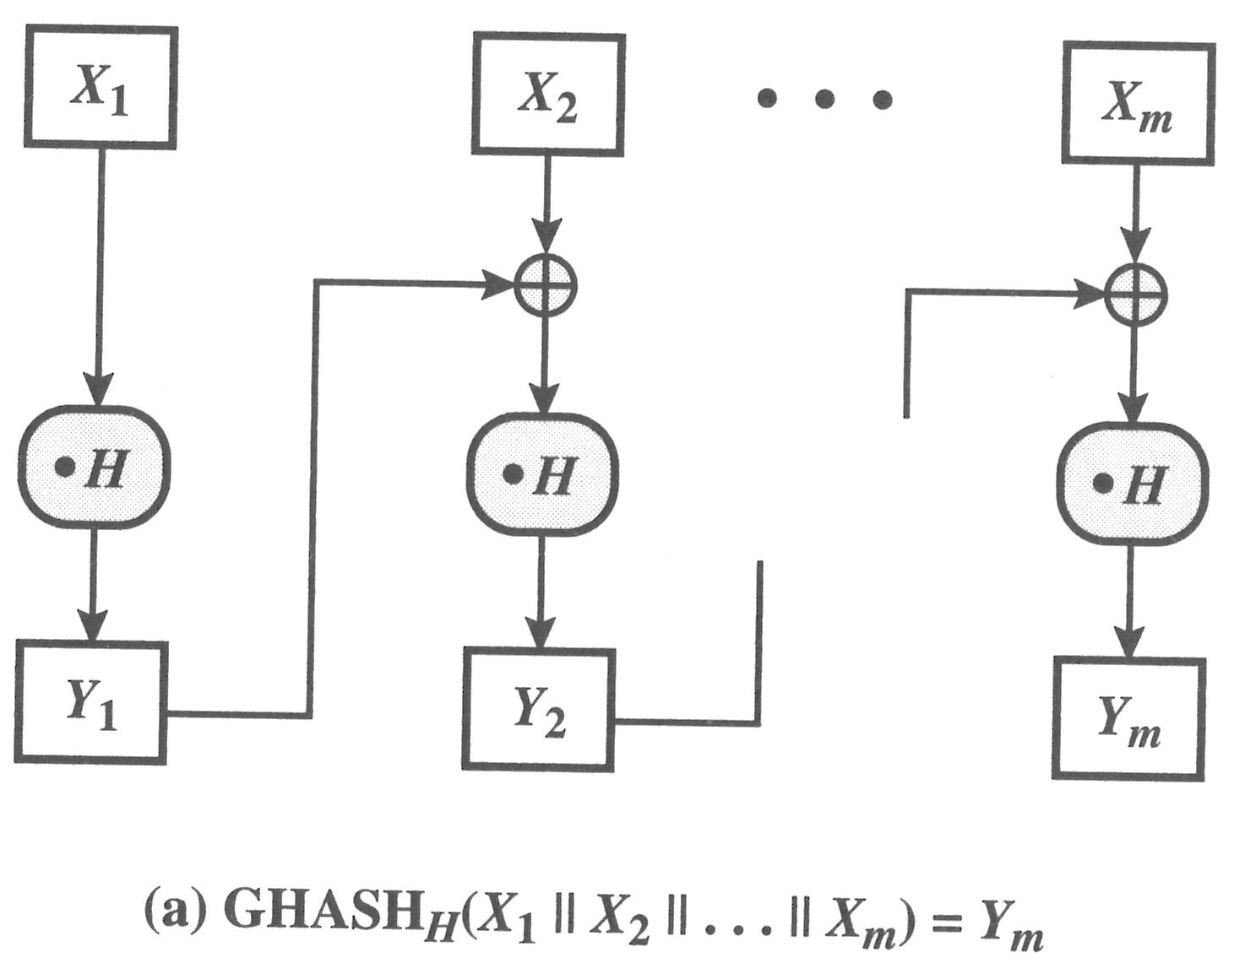
GCM Functions

Slide 56
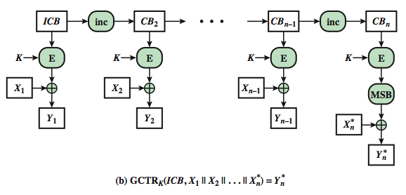
GCM Functions (cont.)

Slide 57
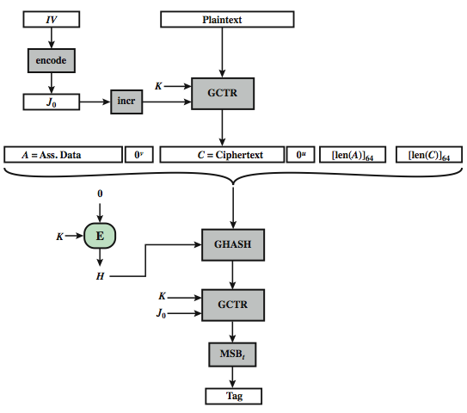
GCM mode overview

Slide 58
The Key Wrap (KW) Mode
Most recent block cipher mode of operation defined by NIST (SP 800-38F)
  Uses AES or triple DEA as the underlying encryption algorithm
To securely exchange a symmetric key to be shared by two parties, using a symmetric key already shared by these parties
  The latter key is called a key encryption key (KEK)
  Robust in the sense that each bit of output can be expected to depend in a nontrivial fashion on each bit of input
  Only used for small amounts of plaintext

Slide 59
Pseudorandom Number Generation (PRNG) Using Hash Functions and MACs
Essential elements of PRNG are
  seed value
  deterministic algorithm
Seed must be known only as needed
Can base PRNG on
  encryption algorithm (Chs 7 & 10)
  hash function (ISO18031 & NIST SP 800-90)
  MAC (NIST SP 800-90)

Slide 60
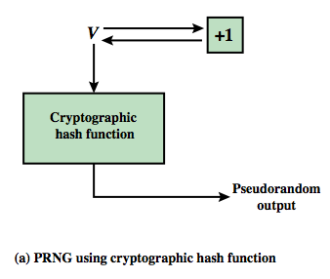
PRNG Using a Hash Function
Hash PRNG from SP800-90 and ISO18031
  take seed V
  repeatedly add 1
  hash V
  use n-bits of hash as random value
Secure if good hash used

Slide 61
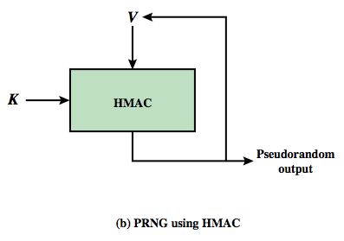
PRNG Using a MAC
MAC PRNGs in SP800-90, IEEE 802.11i, TLS
  use key
  input based on last hash in various ways

