Slide 1
Key Management and Distribution
Yih-Kuen Tsay
Dept. of Information Management
National Taiwan University
(Based on [Stallings 2014])

Slide 2
Key Distribution Technique
The term refers to the means of delivering a key to two parties who wish to exchange data without allowing others to see the key
Why is it needed?
  For symmetric encryption to work, the two parties to an exchange must share the same key, and that key must be protected from access by others
  Frequent key changes are desirable to limit the amount of data compromised if an attacker learns the key

Slide 3

Symmetric Key Distribution
Given parties A and B, key distribution can be achieved in a number of ways:
A can select a key and physically deliver it to B
A third party can select the key and physically deliver it to A and B
If A and B have previously and recently used a key, one party can transmit the new key to the other, encrypted using the old key
If A and B each has an encrypted connection to a third party C, C can deliver a key on the encrypted links to A and B

Slide 4
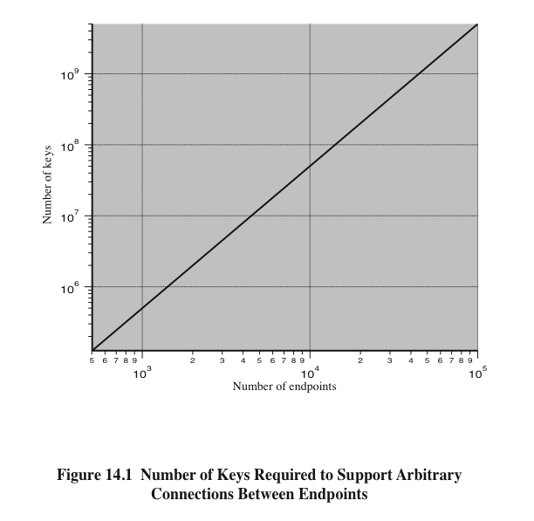

Slide 5
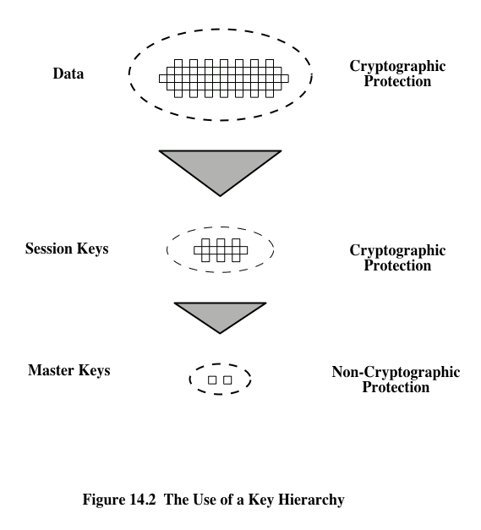

Slide 6
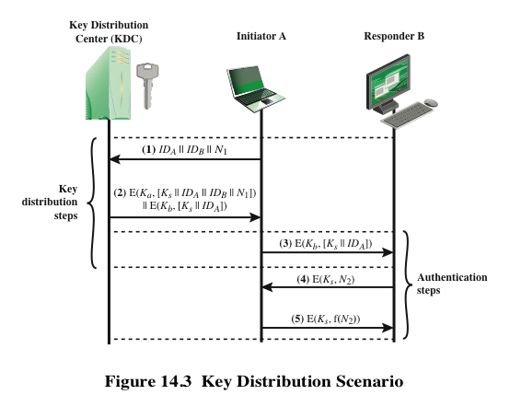

Slide 7
Hierarchical Key Control
For communication among entities within the same local domain, the local KDC is responsible for key distribution
  If two entities in different domains desire a shared key, then the corresponding local KDC’s can communicate through a global KDC
The hierarchy can be of three or more layers
A hierarchy minimizes the effort involved in master key distribution, because most master keys are those shared by a local KDC with its local entities
  Limits the range of a faulty or subverted KDC to its local area only

Slide 8
Session Key Lifetime
A security manager must balance competing considerations:
The more frequently session keys are exchanged, the more secure they are
The distribution of session keys delays the start of any exchange and places a burden on network capacity
For connection-oriented protocols one choice is to use the same session key for the length of time that the connection is open, using a new session key for each new session
For a connectionless protocol there is no explicit connection initiation or termination, thus it is not obvious how often one needs to change the session key

Slide 9
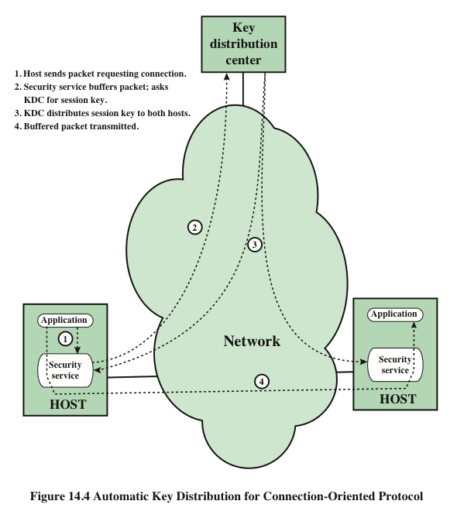

Slide 10
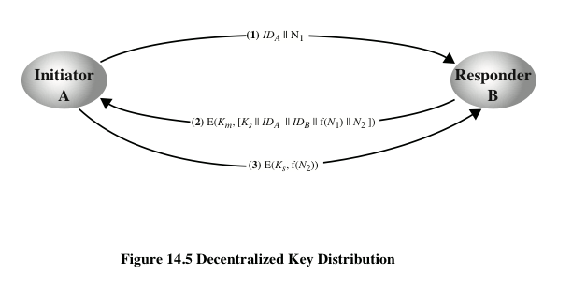

Slide 11

Controlling Key Usage
The concept of a key hierarchy and the use of automated key distribution techniques greatly reduce the number of keys that must be manually managed and distributed
It may also be desirable to impose some control on the way in which automatically distributed keys are used
  For example, in addition to separating master keys from session keys, we may wish to define different types of session keys on the basis of use

Slide 12

Key Controls
Associate a tag with each key
  For use with DES and making use of the extra 8 bits in each 64-bit DES key
  The eight non-key bits ordinarily reserved for parity checking form the key tag
  As the tag is embedded in the key, it is encrypted along with the key when that key is distributed, thus providing protection
Drawbacks:
The tag length is limited to 8 bits, limiting its flexibility and functionality
Because the tag is not transmitted in clear form, it can be used only at the point of decryption, limiting the ways in which key use can be controlled

Slide 13
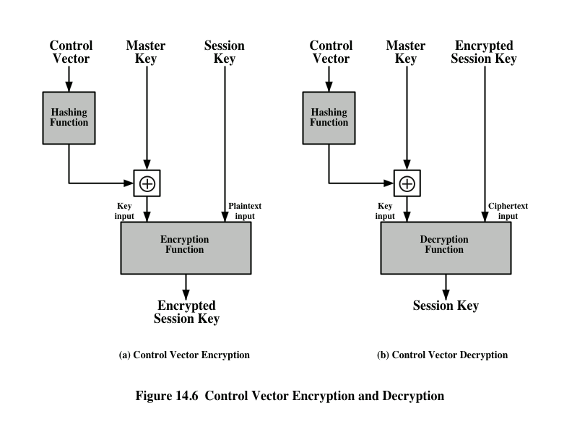

Slide 14
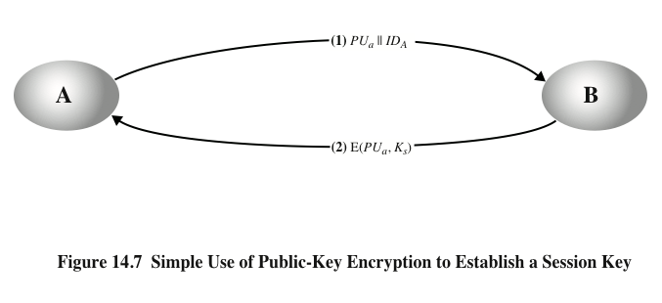
Simple Key Distribution Using Asymmetric Encryption
But the scheme is vulnerable to man-in-the-middle attacks.

Slide 15
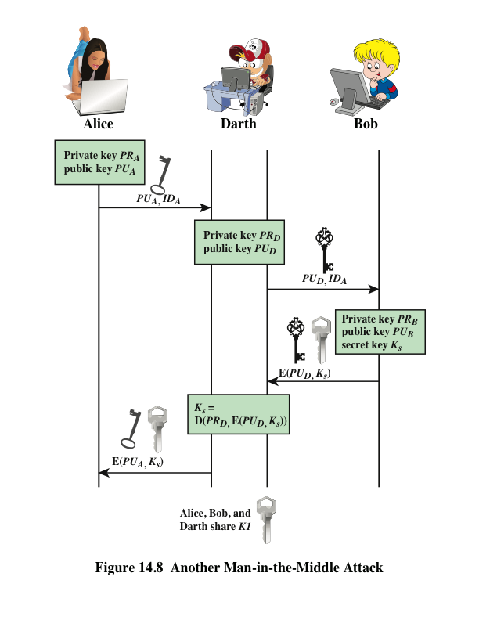
Man-in-the-Middle Attack

Slide 16
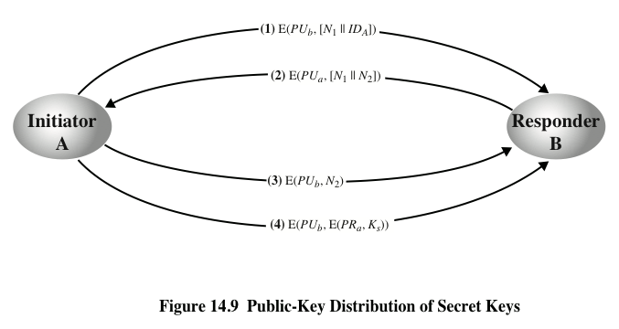
Secret Key Distribution with Confidentiality and Authentication

Slide 17
A Hybrid Scheme
In use on IBM mainframes
Retains the use of a key distribution center (KDC) that shares a secret master key with each user and distributes secret session keys encrypted with the master key
A public-key scheme is used to distribute the master keys
Rationale:
Performance
Backward compatibility

Slide 18
Distribution of Public Keys
Several techniques have been proposed for the distribution of public keys. They may be grouped into the following schemes:
Public announcement
Publicly available directory
Public-key authority
Public-key certificates

Slide 19
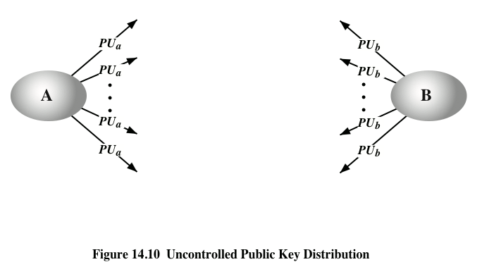
Public Announcement

Slide 20
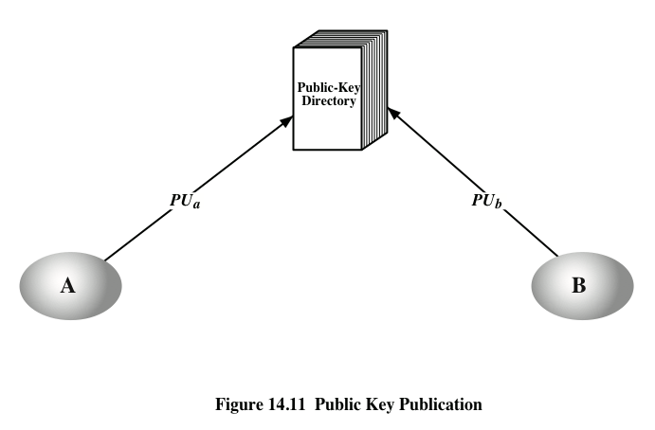

Slide 21
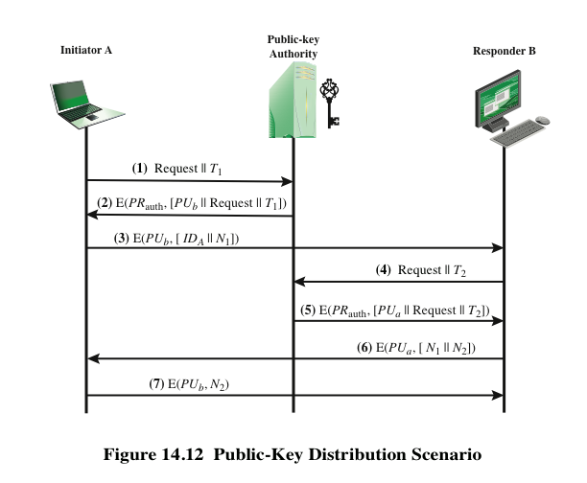

Slide 22
Certificates
The public-key authority could somehow become the bottleneck of performance
An alternative is to use certificates
  They work reliably as if the keys were obtained directly from a public-key authority
  A certificate essentially consists of:
    A public key
    An identifier of the key owner
    The whole block signed by a trusted certificate authority

Slide 23
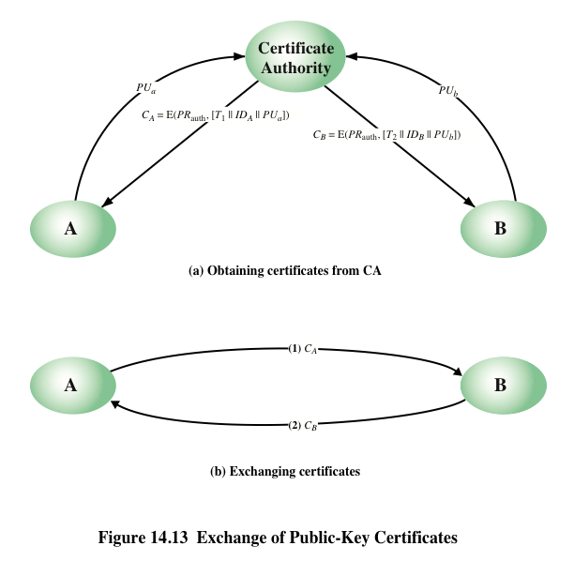

Slide 24
X.509 Certificates
Part of the X.500 series of recommendations that define a directory service
  The directory is a server or distributed set of servers that maintains a database of information about users
X.509 defines a framework for the provision of authentication services by the X.500 directory to its users
  Was initially issued in 1988 with the latest revision in 2000
  Based on the use of public-key cryptography and digital signatures

Slide 25
X.509 Certificates (cont.)
  Does not dictate the use of a specific algorithm but recommends RSA
  Does not dictate a specific hash algorithm
Each certificate contains the public key of a user and is signed with the private key of a trusted certification authority
X.509 defines alternative authentication protocols based on the use of public-key certificates

Slide 26
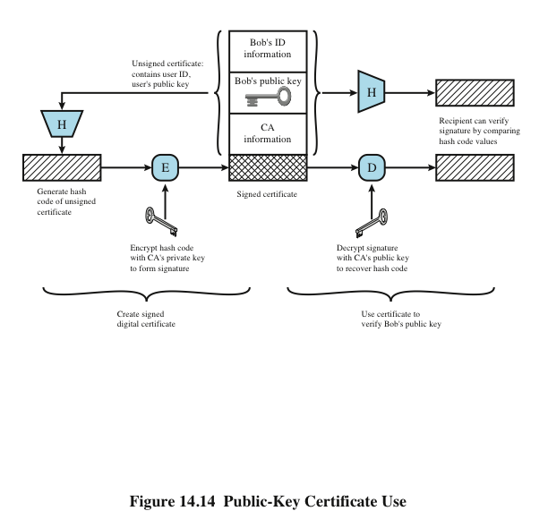
Source: Figure 14.14 in [Stallings 2014].

Slide 27
Certificates
  Version
  Serial number
  Signature algorithm identifier
  Issuer name
  Period of validity
  Subject name
  Subject’s public-key information
  Issuer unique identifier
  Subject unique identifier
  Extensions
  Signature
Created by a trusted Certification Authority (CA) and have the following elements:

Slide 28
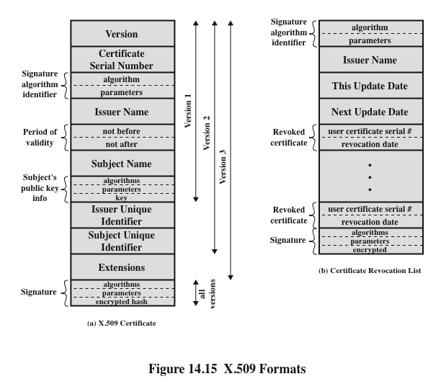

Slide 29
Obtaining a Certificate
User certificates generated by a CA have the following characteristics:
Any user with access to the public key of the CA can verify the user public key that was certified
No party other than the certification authority can modify the certificate without this being detected
  Because certificates are unforgeable, they can be placed in a directory without the need for the directory to make special efforts to protect them
  In addition, a user can transmit his or her certificate directly to other users
Once B is in possession of A’s certificate, B has confidence that messages it encrypts with A’s public key will be secure from eavesdropping and that messages signed with A’s private key are unforgeable

Slide 30
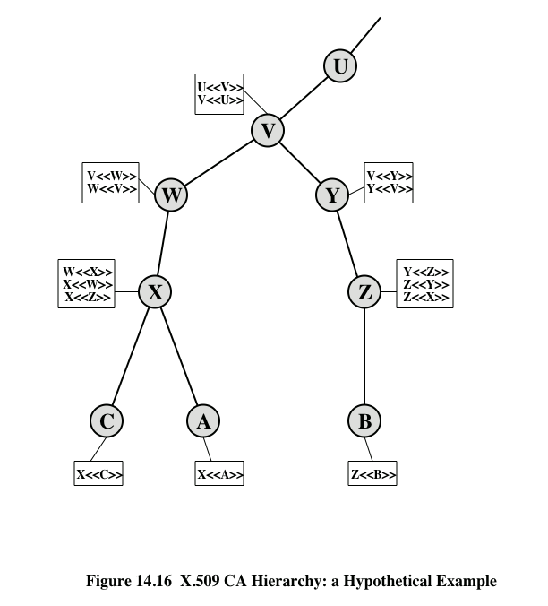

Slide 31
Certificate Revocation
Each certificate includes a period of validity
  Typically, a new certificate is issued just before the expiration of the old one
It may be desirable on occasion to revoke a certificate before it expires, for one of the following reasons:
  The user’s private key is assumed to be compromised
  The user is no longer certified by this CA
  The CA’s certificate is assumed to be compromised
  Each CA must maintain a list consisting of all revoked but not expired certificates issued by that CA
  These lists should be posted on the directory

Slide 32
X.509 Version 3
Version 2 format does not convey all of the information that recent design and implementation experience has shown to be needed
Rather than continue to add fields to a fixed format, standards developers felt that a more flexible approach was needed
  Version 3 includes a number of optional extensions
  The certificate extensions fall into three main categories:
  Key and policy information
  Subject and issuer attributes
  Certification path constraints
An extension identifier
A criticality indicator
An extension value
Each extension consists of:

Slide 33

Key and Policy Information
These extensions convey additional information about the subject and issuer keys plus indicators of certificate policy
A certificate policy is a named set of rules that indicates the applicability of a certificate to a particular community and/or class of application with common security requirements
Included are:
Authority key identifier
Subject key identifier
Key usage
Private-key usage period
Certificate policies
Policy mappings

Slide 34

Certificate Subject and Issuer Attributes
These extensions support alternative names, in alternative formats, for a certificate subject or certificate issuer
Can convey additional information about the certificate subject to increase a certificate user’s confidence that the certificate subject is a particular person or entity
The extension fields in this area include:
  Subject alternative name
  Issuer alternative name
  Subject directory attributes

Slide 35

Certification Path Constraints
These extensions allow constraint specifications to be included in certificates issued for CAs by other CAs
The constraints may restrict the types of certificates that can be issued by the subject CA or that may occur subsequently in a certification chain
The extension fields in this area include:
  Basic constraints
  Name constraints
  Policy constraints

Slide 36
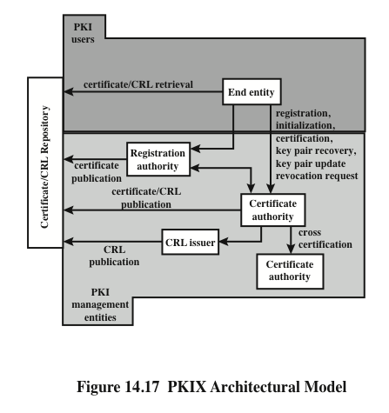

Slide 37
PKIX Management Functions
PKIX identifies a number of management functions that potentially need to be supported by management protocols:
  Registration
  Initialization
  Certification
  Key pair recovery
  Key pair update
  Revocation request
  Cross certification

