Slide 1
User Authentication
Yih-Kuen Tsay
Dept. of Information Management
National Taiwan University
(Based on [Stallings 2014])

Slide 2
Remote User-Authentication Principles
The process of verifying an identity claimed by or for a system entity
An authentication process consists of two steps:
Identification step
Presenting an identifier to the security system
Verification step
Presenting or generating authentication information that corroborates the binding between the entity and the identifier

Slide 3
Means of User Authentication
There are four general means of authenticating a user’s identity, which can be used alone or in combination
Something the individual knows
Examples include a password, a personal identification number (PIN), or answers to a prearranged set of questions
Something the individual possesses
Examples include cryptographic keys, electronic keycards, smart cards, and physical keys
This is referred to as a token
Something the individual is (static biometrics)
Examples include recognition by fingerprint, retina, and face
Something the individual does (dynamic biometrics)
Examples include recognition by voice pattern, handwriting characteristics, and typing rhythm
    For network-based user authentication, the most important methods involve cryptographic keys and something the individual knows, such as a password

Slide 4
Mutual Authentication
Protocols which enable communicating parties to satisfy themselves mutually about each other’s identity and to exchange session keys
Central to the problem of authenticated key exchange are two issues:
Confidentiality
Essential identification and session-key information must be communicated in encrypted form
This requires the prior existence of secret or public keys that can be used for this purpose
Timeliness
Important because of the threat of message replays
Such replays could allow an opponent to:
successfully impersonate another party
disrupt operations by presenting parties with messages that appear genuine but are not
compromise a session key

Slide 5
Replay Attacks
Simplest replay attack: the opponent simply copies a message and replays it later
An opponent can replay a time-stamped message within the valid time window
If the opponent also suppresses the original message; thus, the repetition cannot be detected
Another attack involves a backward (to the sender) replay without modification and is possible if symmetric encryption is used and the sender cannot easily recognize the difference between messages sent and messages received on the basis of content

Slide 6
Approaches to Coping with Replay Attacks
Attach a sequence number to each message used in an authentication exchange
  A new message is accepted only if its sequence number is in the proper order
  Difficulty with this approach is that it requires each party to keep track of the last sequence number for each claimant it has dealt with
  Generally not used for authentication and key exchange because of overhead

Slide 7
Approaches to Coping with Replay Attacks (cont.)
  Timestamps
  Requires that clocks among the various participants be synchronized
  Party A accepts a message as fresh only if the message contains a timestamp that, in A’s judgment, is close enough to A’s knowledge of current time
  Challenge/response
  Party A, expecting a fresh message from B, first sends B a nonce (challenge) and requires that the subsequent message (response) received from B contain the correct nonce value

Slide 8
One-Way Authentication
One application for which encryption is growing in popularity is electronic mail (e-mail)
Header of the e-mail message must be in the clear so that the message can be handled by the store-and-forward e-mail protocol, such as SMTP or X.400
The e-mail message should be encrypted such that the mail-handling system is not in possession of the decryption key
A second requirement is that of authentication
The recipient wants some assurance that the message is from the alleged sender

Slide 9
Remote User-Authentication Using Symmetric Encryption
A two-level hierarchy of symmetric keys can be used to provide confidentiality for communication in a distributed environment
Strategy involves the use of a trusted key distribution center (KDC)
Each party shares a secret key, known as a master key, with the KDC
KDC is responsible for generating keys to be used for a short time over a connection between two parties and for distributing those keys using the master keys to protect the distribution

Slide 10
Needham and Schroeder
A→KDC: ID_{A}∥ID_{B}∥N₁
KDC→A: E(K_{a},[K_{s}∥ID_{B}∥N₁∥E(K_{b},[K_{s}∥ID_{A}])])
A→B: E(K_{b},[K_{s}∥ID_{A}])
B→A: E(K_{s},N₂)
A→B: E(K_{s},f(N₂))
It is vulnerable to a replay attack (replaying Step 3), if an old key has been compromised

Slide 11
Adding a Timestamp
A→KDC: ID_{A}∥ID_{B}
KDC→A: E(K_{a},[K_{s}∥ID_{B}∥T∥E(K_{b},[K_{s}∥ID_{A}∥T])])
A→B: E(K_{b},[K_{s}∥ID_{A}∥T])
B→A: E(K_{s},N₁)
A→B: E(K_{s},f(N₁))
This protocol requires synchronization of clocks throughout the network, because of the need to check the difference between a local clock and T.
May be vulnerable to suppress-replay attacks

Slide 12
Suppress-Replay Attacks
The addition of a timestamp requires reliance on clocks that are synchronized throughout the network
A risk involved is based on the fact that the distributed clocks can become unsynchronized as a result of sabotage on or faults in the clocks or the synchronization mechanism
The problem occurs when a sender’s clock is ahead of the intended recipient’s clock
  An opponent can intercept a message from the sender and replay it later when the timestamp in the message becomes current at the recipient’s site
  Such attacks are referred to as suppress-replay attacks

Slide 13
Using Nonces and Local Clocks
A→B: ID_{A}∥N_{a}
B→KDC: ID_{B}∥N_{b}∥E(K_{b},[ID_{A}∥N_{a}∥T_{b}])
KDC→A: E(K_{a},[ID_{B}∥N_{a}∥K_{s}∥T_{b}])∥E(K_{b},[ID_{A}∥K_{s}∥T_{b}])∥N_{b}
A→B: E(K_{b},[ID_{A}∥K_{s}∥T_{b}])∥E(K_{s},N_{b})
The time in T_{b} is relative to B’s clock; no need of synchronized clocks
If within the time limit, the same ticket may be used by A to initiate a new session without involving the KDC.
like a “ticket”

Slide 14
One-Way Authentication Using Symmetric Encryption
A→KDC: ID_{A}∥ID_{B}∥N₁
KDC→A: E(K_{a},[K_{s}∥ID_{B}∥N₁∥E(K_{b},[K_{s}∥ID_{A}])])
A→B: E(K_{b},[K_{s}∥ID_{A}])∥E(K_{s},M)
This is essentially the first three steps of Needham and Schroeder, where Step 3 is refined to transmit an encrypted message

Slide 15
Kerberos
  Authentication service developed as part of Project Athena at MIT
  A workstation cannot be trusted to identify its users correctly to network services
  A user may gain access to a particular workstation and pretend to be another user operating from that workstation
  A user may alter the network address of a workstation so that the requests sent from the altered workstation appear to come from the impersonated workstation
  A user may eavesdrop on exchanges and use a replay attack to gain entrance to a server or to disrupt operations

Slide 16
Kerberos (cont.)
  Kerberos provides a centralized authentication server whose function is to authenticate users to servers and servers to users
    Relies exclusively on symmetric encryption, making no use of public-key encryption

Slide 17
Kerberos Requirements
The first published report on Kerberos listed the following requirements:
Secure
A network eavesdropper should not be able to obtain the necessary information to impersonate a user
Reliable
Should be highly reliable and should employ a distributed server architecture with one system able to back up another
Transparent
Ideally, the user should not be aware that authentication is taking place beyond the requirement to enter a password
Scalable
The system should be capable of supporting large numbers of clients and servers

Slide 18
Kerberos Version 4
Makes use of DES to provide the authentication service
Authentication server (AS)
  Knows the passwords of all users and stores these in a centralized database
  Shares a unique secret key with each server
Ticket
  Created once the AS authenticates the user; contains the user’s ID and network address and the server’s ID
  Encrypted using the secret key shared by the AS and the server

Slide 19
Kerberos Version 4 (cont.)
  Ticket-granting server (TGS)
  Issues tickets to users who have been authenticated to AS
  Each time the user requires access to a new service the client applies to the TGS using the ticket to authenticate itself
  The TGS then grants a ticket for the particular service
  The client saves each service-granting ticket and uses it to authenticate its user to a server each time a particular service is requested

Slide 20
The Version 4 Authentication Dialogue
The lifetime associated with the ticket-granting ticket creates a problem:
If the lifetime is very short (e.g., minutes), the user will be repeatedly asked for a password
If the lifetime is long (e.g., hours), then an opponent has a greater opportunity for replay
A network service (the TGS or an application service) must be able to prove that the person using a ticket is the same person to whom that ticket was issued
Servers need to authenticate themselves to users

Slide 21
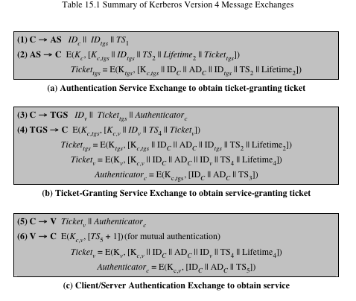
Table 15.1 Summary of Kerberos Version 4 Message Exchanges

Slide 22
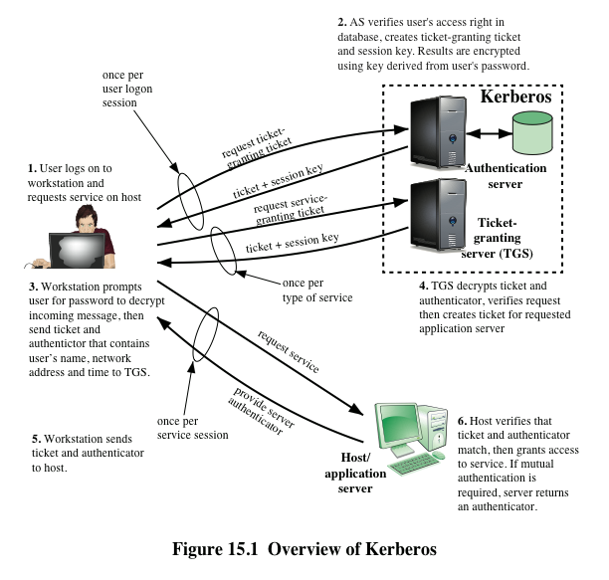

Slide 23
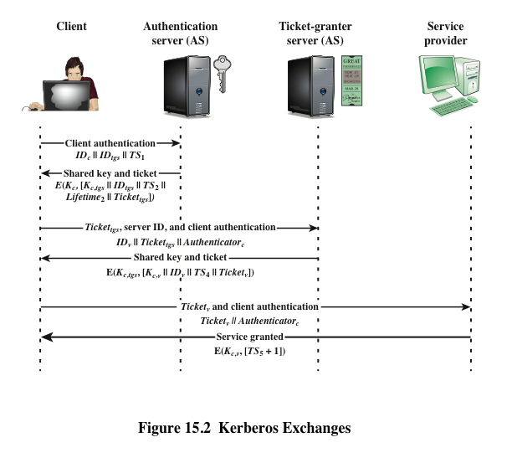

Slide 24
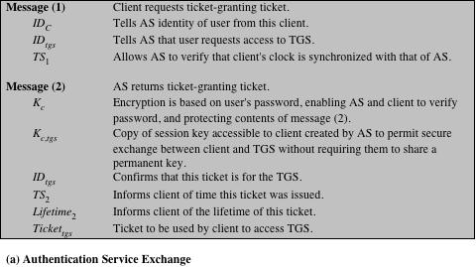
Table 15.2 Rationale for the Elements of Kerberos 4

Slide 25
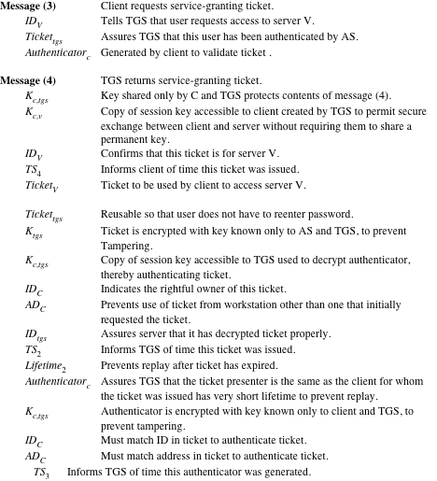
(page 2 of 3)

Slide 26
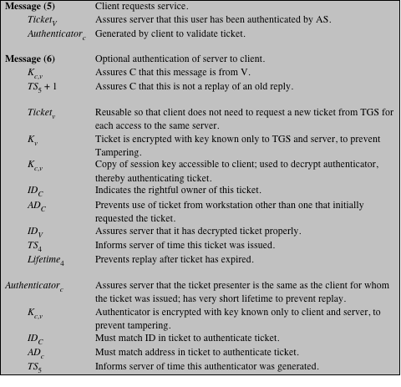
(page 3 of 3)

Slide 27
Kerberos Realms and Multiple Kerberi
A full-service Kerberos environment consisting of a Kerberos server, a number of clients, and a number of application servers requires that:
  The Kerberos server must have the user ID and hashed passwords of all participating users in its database; all users are registered with the Kerberos server
  The Kerberos server must share a secret key with each server; all servers are registered with the Kerberos server
  The Kerberos server in each interoperating realm shares a secret key with the server in the other realm; the two Kerberos servers are registered with each other

Slide 28
Kerberos Realm
A set of managed nodes that share the same Kerberos database
The database resides on the Kerberos master computer system, which should be kept in a physically secure room
A read-only copy of the Kerberos database might also reside on other Kerberos computer systems
All changes to the database must be made on the master computer system
Changing or accessing the contents of a Kerberos database requires the Kerberos master password

Slide 29
Kerberos Principal
Three parts of a principal name
A service or user name
An instance name
A realm name
A service or user that is known to the Kerberos system
Identified by its principal name

Slide 30
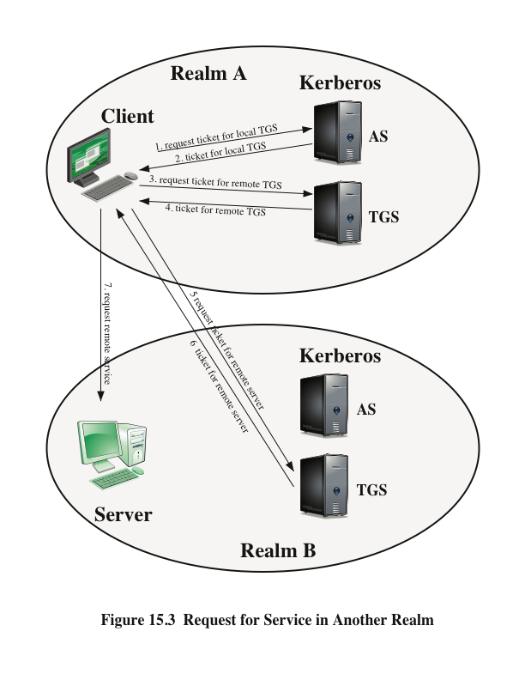

Slide 31
Differences Between Versions 4 and 5
Version 5 is intended to address the limitations of version 4 in two areas:
Environmental shortcomings
Encryption system dependence
Internet protocol dependence
Message byte ordering
Ticket lifetime
Authentication forwarding
Interrealm authentication
Technical deficiencies
Double encryption
PCBC encryption
Session keys
Password attacks

Slide 32
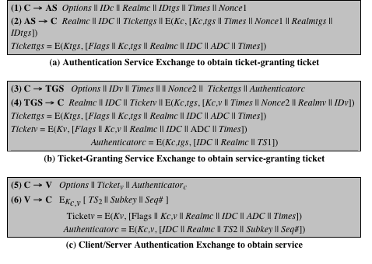
Table 15.3 Summary of Kerberos Version 5 Message Exchanges

Slide 33
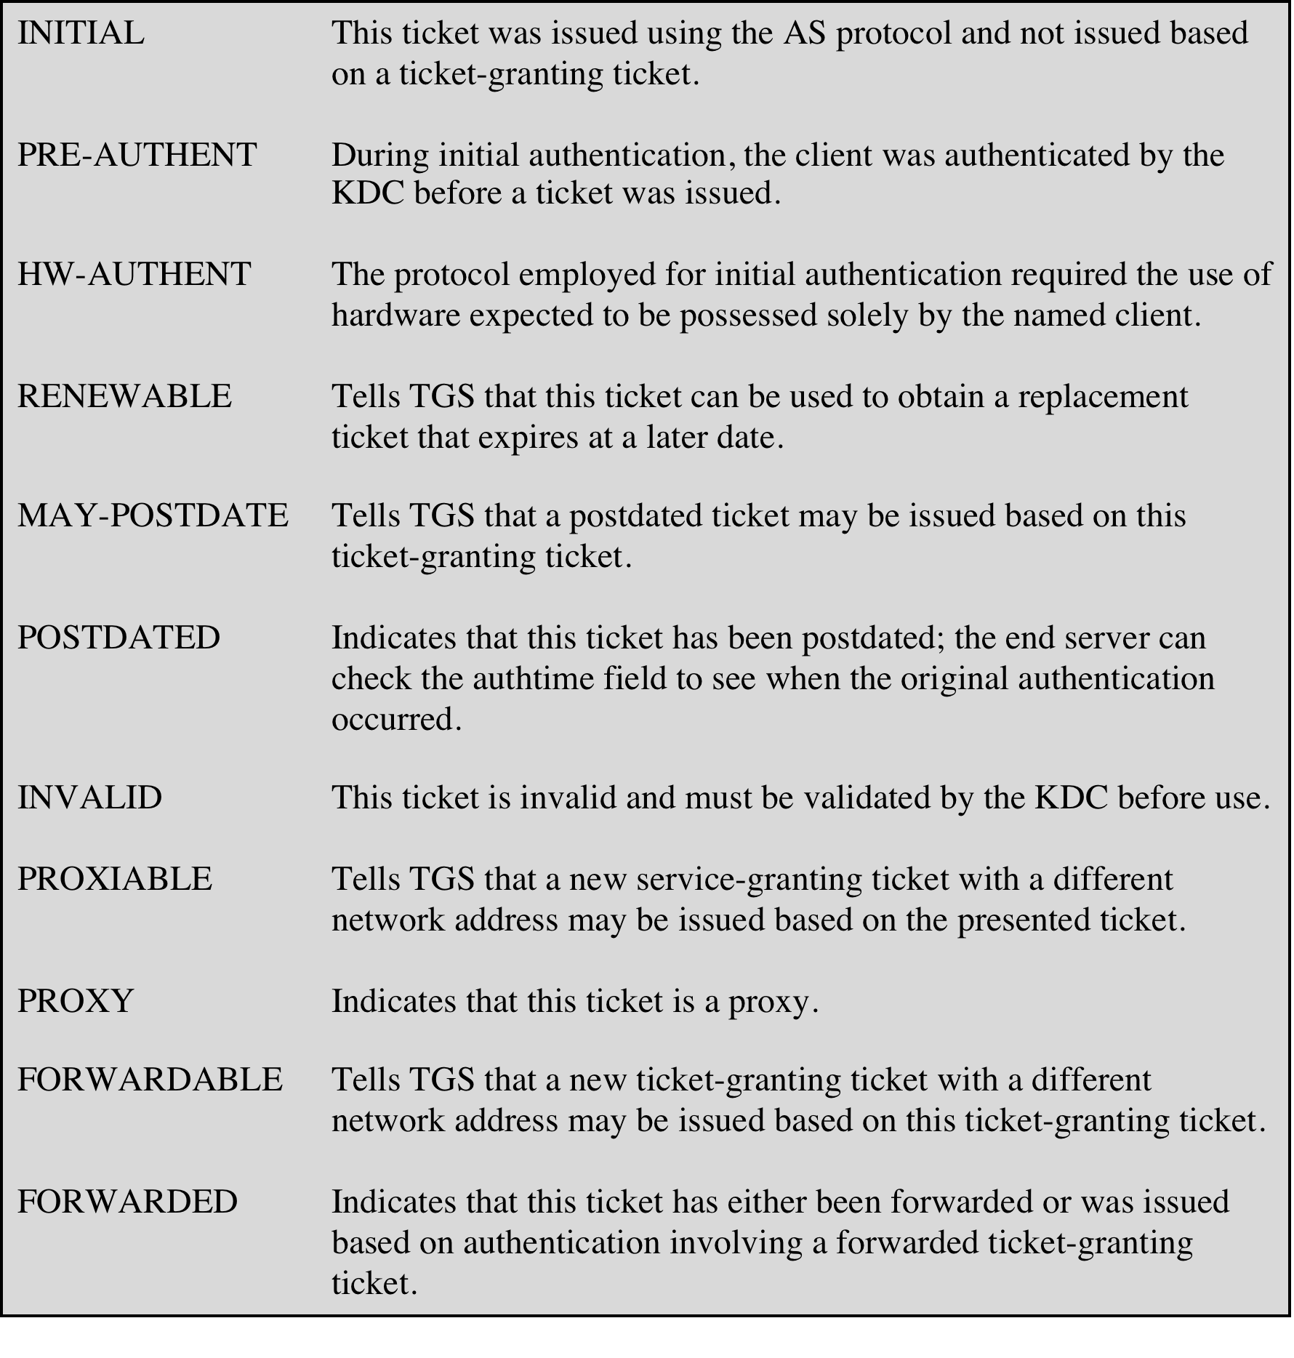
Table 15.4
Kerberos Version 5 Flags
(Table can be found on page 474 in textbook)

Slide 34
Mutual Authentication Using Asymmetric Encryption
Public-key encryption for session key distribution
  Assumes each of the two parties is in possession of the current public key of the other
  May not be practical to require this assumption
Denning protocol using timestamps
  Uses an authentication server (AS) to provide public-key certificates
  Requires the synchronization of clocks
Woo and Lam makes use of nonces
  Care needed to ensure no protocol flaws

Slide 35
A Protocol [Denning 1981]
A→AS: ID_{A}∥ID_{B}
AS→A: E(PR_{as},[ID_{A}∥PU_{a}∥T])∥E(PR_{as},[ID_{B}∥PU_{b}∥T])
A→B: E(PR_{as},[ID_{A}∥PU_{a}∥T])∥E(PR_{as},[ID_{B}∥PU_{b}∥T])∥E(PU_{b},E(PR_{a},[K_{s}∥T]))
This requires synchronization of clocks throughout the network

Slide 36
Using Nonces
A→KDC: ID_{A}∥ID_{B}
KDC→A: E(PR_{auth},[ID_{B}∥PU_{b}])
A→B: E(PU_{b},[N_{a}∥ID_{A}])
B→KDC: ID_{A}∥ID_{B}∥E(PU_{auth},N_{a})
KDC→B: E(PR_{auth},[ID_{A}∥PU_{a}])∥E(PU_{b},E(PR_{auth},[N_{a}∥K_{s}∥ID_{B}]))
B→A: E(PU_{a},[E(PR_{auth},[N_{a}∥K_{s}∥ID_{B}])∥N_{b})
A→B: E(K_{s},N_{b})

Slide 37
Refined Usage of Nonces
A→KDC: ID_{A}∥ID_{B}
KDC→A: E(PR_{auth},[ID_{B}∥PU_{b}])
A→B: E(PU_{b},[N_{a}∥ID_{A}])
B→KDC: ID_{A}∥ID_{B}∥E(PU_{auth},N_{a})
KDC→B: E(PR_{auth},[ID_{A}∥PU_{a}])∥E(PU_{b},E(PR_{auth},[N_{a}∥K_{s} ∥ID_{A}∥ID_{B}]))
B→A: E(PU_{a},[E(PR_{auth},[N_{a}∥K_{s}∥ID_{A}∥ID_{B}])∥N_{b}])
A→B: E(K_{s},N_{b})

Slide 38
One-Way Authentication Using Asymmetric Encryption
Have public-key approaches for e-mail
  Encryption of message for confidentiality, authentication, or both
  The public-key algorithm must be applied once or twice to what may be a long message
For confidentiality encrypt message with one-time secret key, public-key encrypted
If authentication is the primary concern, a digital signature may suffice

Slide 39

Federated Identity Management
Relatively new concept dealing with the use of a common identity management scheme across multiple enterprise and numerous applications and supporting many users
Services provided include:
  Point of contact
  SSO protocol services
  Trust services
  Key services
  Identity services
  Authorization
  Provisioning
  Management

Slide 40
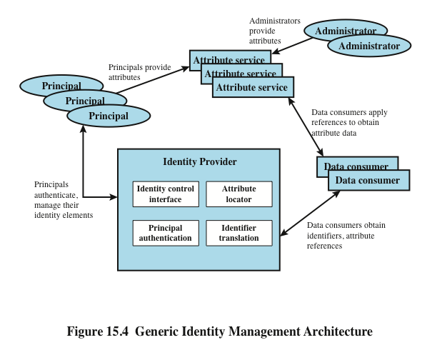

Slide 41
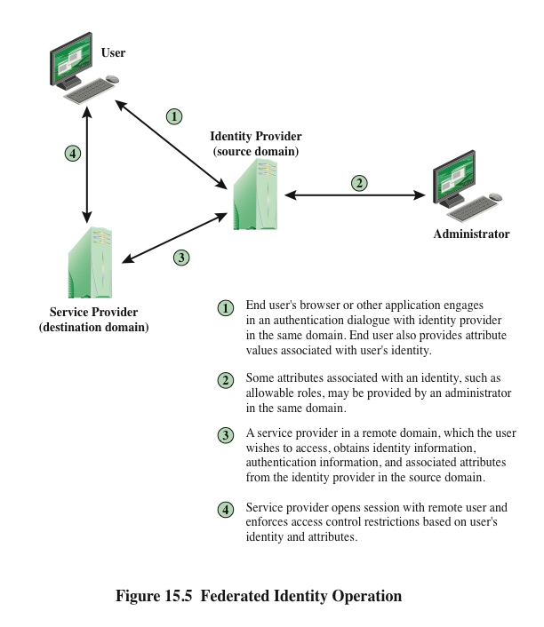

Slide 42
Key Standards
The Extensible Markup Language (XML)
A markup language that uses sets of embedded tags or labels to characterize text elements within a document so as to indicate their appearance, function, meaning, or context
The Simple Object Access Protocol (SOAP)
Enables applications to request services from one another with XML-based requests and receive responses as data formatted with XML
WS-Security
A set of SOAP extensions for implementing message integrity and confidentiality in Web services
Security Assertion Markup Language (SAML)
An XML-based language for the exchange of security information between online business partners

Slide 43
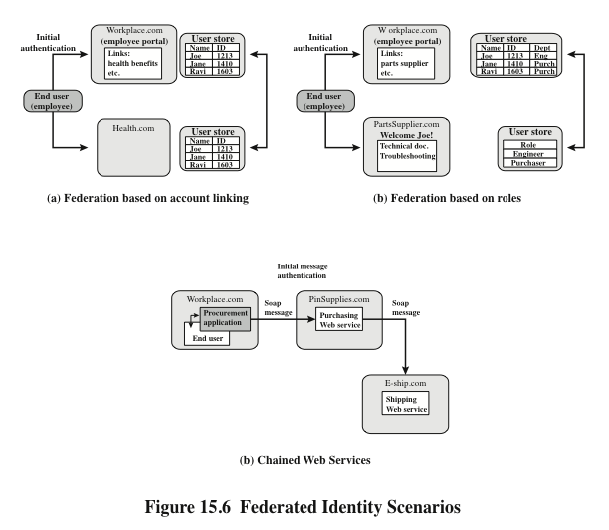

Slide 44
Personal Identity Verification
User authentication based on the possession of a smart card is becoming more widespread
  Has the appearance of a credit card
  Has an electronic interface
  May use a variety of authentication protocols
A smart card contains within it an entire microprocessor, including processor, memory, and I/O ports

Slide 45
Personal Identity Verification (cont.)
A smart card includes three types of memory:
  Read-only memory (ROM) stores data that does not change during the card’s life
  Electronically erasable programmable ROM (EEPROM) holds application data and programs; also holds data that may vary with time
  Random access memory (RAM) holds temporary data generated when applications are executed

Slide 46
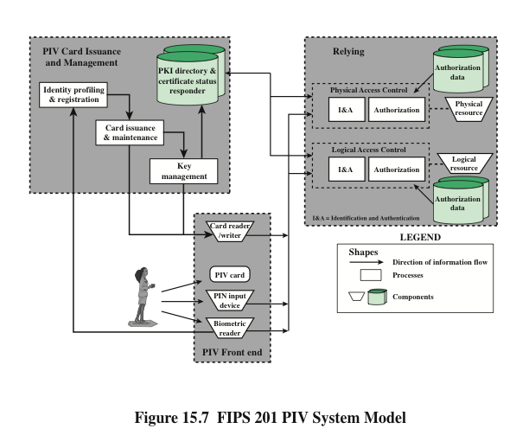

Slide 47
PIV Documentation
FIPS 201-2—Personal Identity Verification (PIV) of Federal Employees and Contractors
  Specifies the physical card characteristics, storage media, and data elements that make up the identity credentials resident on the PIV card
SP 800-73-3—Interfaces for Personal Identity Verification
  Specifies the interfaces and card architecture for storing and retrieving identity credentials from a smart card, and provides guidelines for the use of authentication mechanisms and protocols
SP 800-76-2—Biometric Data Specification for Personal Identity Verification
  Describes technical acquisition and formatting specifications for the biometric credentials of the PIV system
SP 800-78-3—Cryptographic Algorithms and Key Sizes for Personal Identity Verification
  Identifies acceptable symmetric and asymmetric encryption algorithms, digital signature algorithms, and message digest algorithms, and specifies mechanisms to identify the algorithms associated with PIV keys or digital signatures
SP 800-104—A Scheme for PIV Visual Card Topography
  Provides additional recommendations on the PIV card color-coding for designating employee affiliation
SP 800-116—A Recommendation for the Use of PIV Credentials in Physical Access Control Systems (PACS)
  Describes a risk-based approach for selecting appropriate PIV authentication mechanisms to manage physical access to Federal government facilities and assets
SP 800-79-1—Guidelines for the Accreditation of Personal Identity Verification Card Issuers
  Provides guidelines for accrediting the reliability of issuers of PIV cards that collect, store, and disseminate personal identity credentials and issue smart cards
SP 800-96—PIV Card to Reader Interoperability Guidelines
  Provides requirements that facilitate interoperability between any card and any reader

Slide 48
PIV Credentials and Keys
Personal Identification Number (PIN)
  Required to activate the card for privileged operation
Cardholder Unique Identifier (CHUID)
  Includes the Federal Agency Smart Credential Number (FASC-N) and the Global Unique Identification Number (GUID), which uniquely identify the card and the cardholder
PIV Authentication Key
  Asymmetric key pair and corresponding certificate for user authentication
Two fingerprint templates
  For biometric authentication
Electronic facial image
  For biometric authentication
Asymmetric Card Authentication Key
  Asymmetric key pair and corresponding certificate used for card authentication
Optional elements include the following:
Digital Signature Key
  Asymmetric key pair and corresponding certificate that supports document signing and signing of data elements such as the CHUID
Key Management Key
  Asymmetric key pair and corresponding certificate supporting key establishment and transport
Symmetric Card Authentication Key
  For supporting physical access applications
PIV Card Application Administration Key
  Symmetric key associated with the card management system
One or two iris images
  For biometric authentication

Slide 49
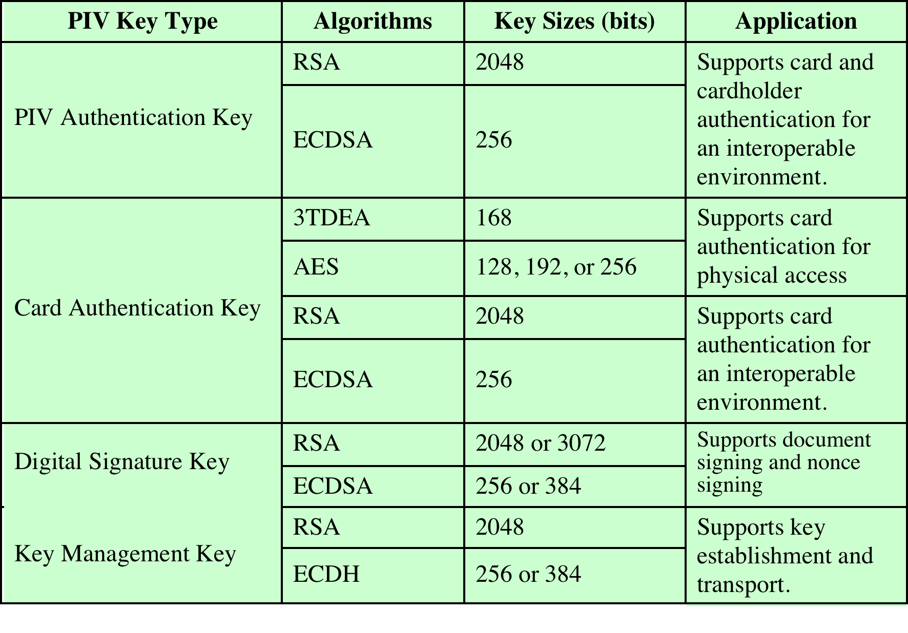
Table 15.5 PIV Algorithms and Key Sizes

Slide 50
Authentication
Using the electronic credentials resident on a PIV card, the card supports the following authentication mechanisms:
  CHUID
    The cardholder is authenticated using the signed CHUID data element on the card. The PIN is not required. This mechanism is useful in environments where a low level of assurance is acceptable and rapid contactless authentication is necessary
  Card Authentication Key
    The PIV card is authenticated using the Card Authentication Key in a challenge response protocol. The PIN is not required. This mechanism allows contact (via card reader) or contactless (via radio waves) authentication of the PIV card without the holder’s active participation, and provides a low level of assurance
• BIO
  The cardholder is authenticated by matching his or her fingerprint sample(s) to the signed biometric data element in an environment without a human attendant in view. The PIN is required to activate the card. This mechanism achieves a high level of assurance and requires the cardholder’s active participation is submitting the PIN as well as the biometric sample
  BIO-A
  The cardholder is authenticated by matching his or her fingerprint sample(s) to the signed biometric data element in an environment with a human attendant in view. The PIN is required to activate the card. This mechanism achieves a very high level of assurance when coupled with full trust validation of the biometric template retrieved from the card, and requires the cardholder’s active participation is submitting the PIN as well as the biometric sample
• PKI
  The cardholder is authenticated by demonstrating control of the PIV authentication private key in a challenge response protocol that can be validated using the PIV authentication certificate. The PIN is required to activate the card. This mechanism achieves a very high level of identity assurance and requires the cardholder’s knowledge of the PIN

Slide 51
