Slide 1
PL HW#2 Solution
助教 賴瑞舜

Slide 2
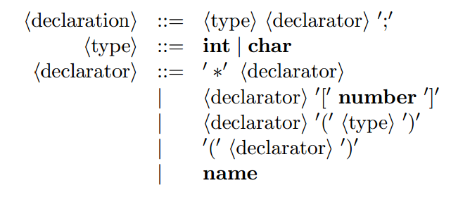
Problem 1
1. The following grammar in EBNF is motivated by declarations in C:
Show that the grammar is ambiguous

Slide 3
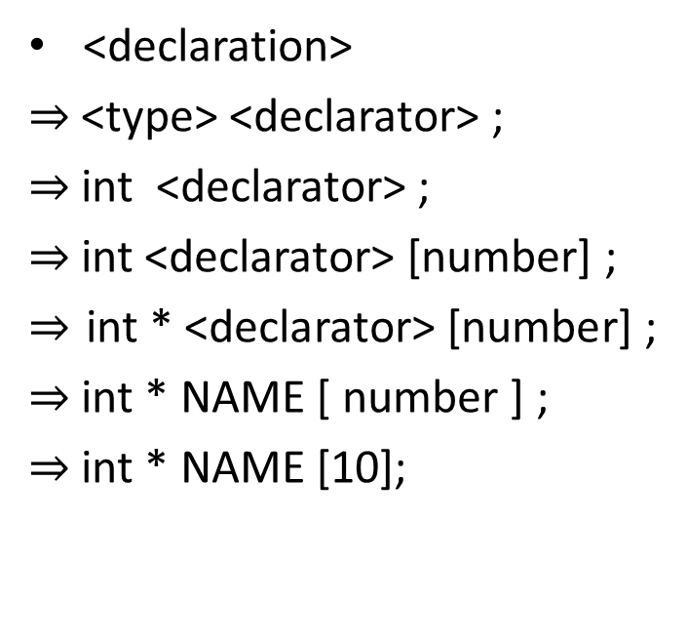
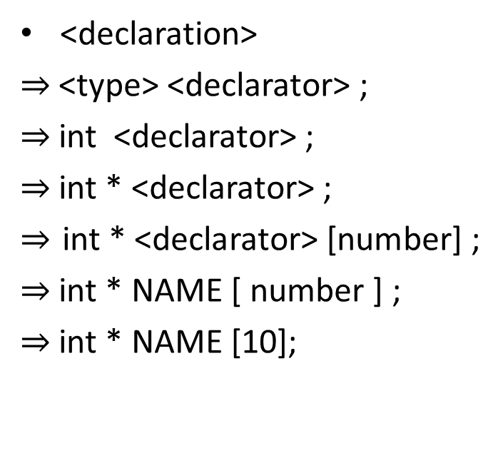
Problem 1 (cont.)
int * NAME [10] ;
<declaration>
$⇒$ <type> <declarator> ;
$⇒$ int <declarator> ;
$⇒$ int * <declarator> ;
$⇒$ int * <declarator> [number] ;
$⇒$ int * NAME [ number ] ;
$⇒$ int * NAME [10];
<declaration>
$⇒$ <type> <declarator> ;
$⇒$ int <declarator> ;
$⇒$ int <declarator> [number] ;
$⇒$int * <declarator> [number] ;
$⇒$ int * NAME [ number ] ;
$⇒$ int * NAME [10];

Slide 4
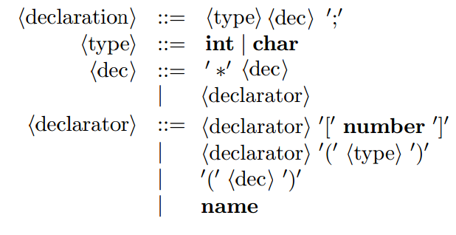
Problem 2
2. Rewrite the grammar in Problem 1 so that the new grammar is unambiguous and still generates the same declarations.
Notes:
改”‘”

Slide 5
Problem 3
3. The dangling-else ambiguity arises if a grammar has the following two productions:
  S ::= if E then S
  S ::= if E then S else S
Write an unambiguous grammar that generates the same conditionals and matches an else with the nearest unmatched if.

Slide 6
Problem 3 (cont.)
S’ is the condition of matched pair
S’’ is the condition of opened situation
S ::= S’ | S’’
S’ ::= if E then S’ else S’
S’’ ::= if E then S
| if E then S’ else S’’

Slide 7
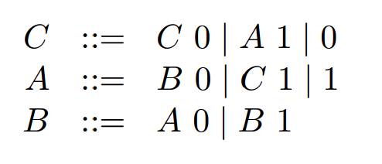
Problem 4
4. The grammar below generates numbers in the binary notation.
Show that the generated numbers are all multiples of 3 (i.e., divisable by 3).

Slide 8
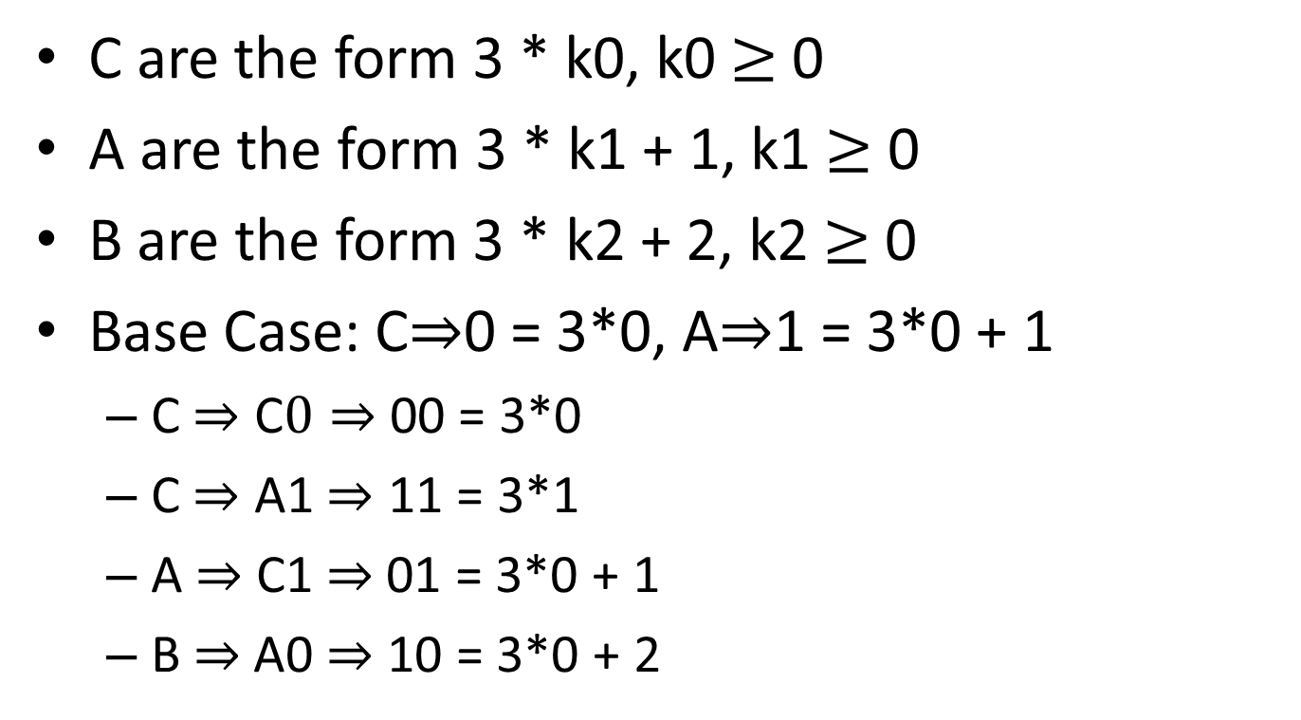
Problem 4 (cont.)
C are the form 3 * k0, k0 $≥$ 0
A are the form 3 * k1 + 1, k1 $≥$ 0
B are the form 3 * k2 + 2, k2 $≥$ 0
Base Case: C$⇒$0 = 3*0, A$⇒$1 = 3*0 + 1
  C $⇒$ C$0⇒$ 00 = 3*0
  C $⇒$ A1 $⇒$ 11 = 3*1
  A $⇒$ C1 $⇒$01 = 3*0 + 1
  B$⇒$ A0 $⇒$ 10 = 3*0 + 2

Slide 9
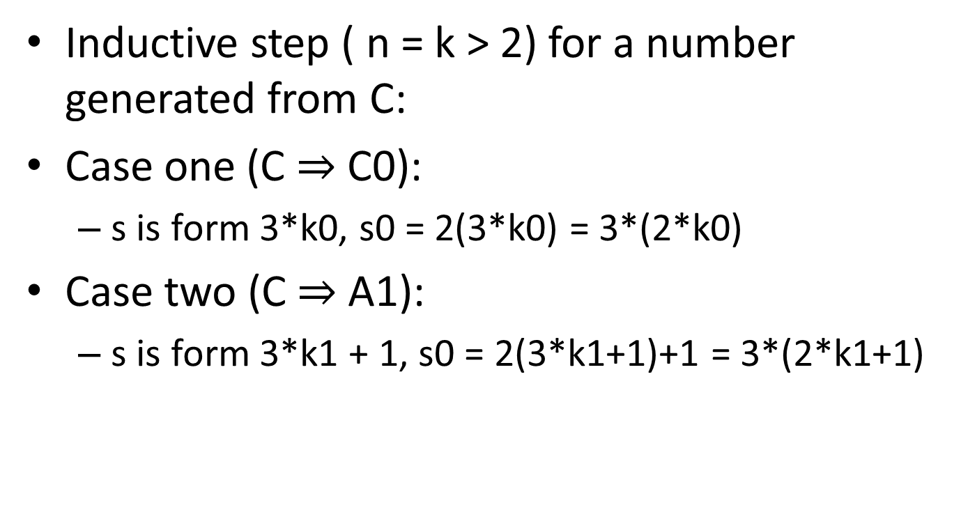
Problem 4 (cont.)
Inductive step ( n = k > 2) for a number generated from C:
Case one (C $⇒$ C0):
  s is form 3*k0, s0 = 2(3*k0) = 3*(2*k0)
Case two (C $⇒$ A1):
  s is form 3*k1 + 1, s0 = 2(3*k1+1)+1 = 3*(2*k1+1)
Notes:
Soundness/completeness

Slide 10
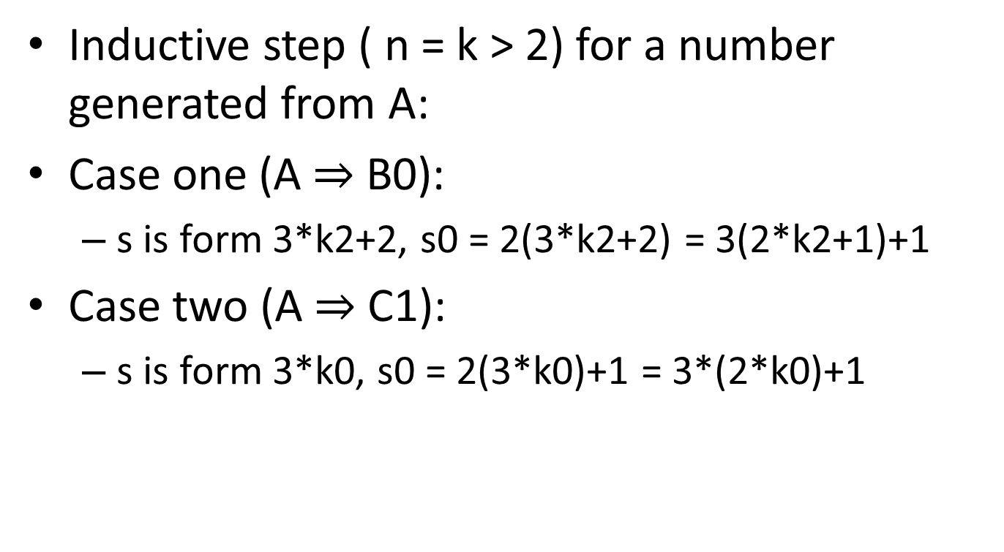
Problem 4 (cont.)
Inductive step ( n = k > 2) for a number generated from A:
Case one (A $⇒$ B0):
  s is form 3*k2+2, s0 = 2(3*k2+2) = 3(2*k2+1)+1
Case two (A $⇒$ C1):
  s is form 3*k0, s0 = 2(3*k0)+1 = 3*(2*k0)+1

Slide 11
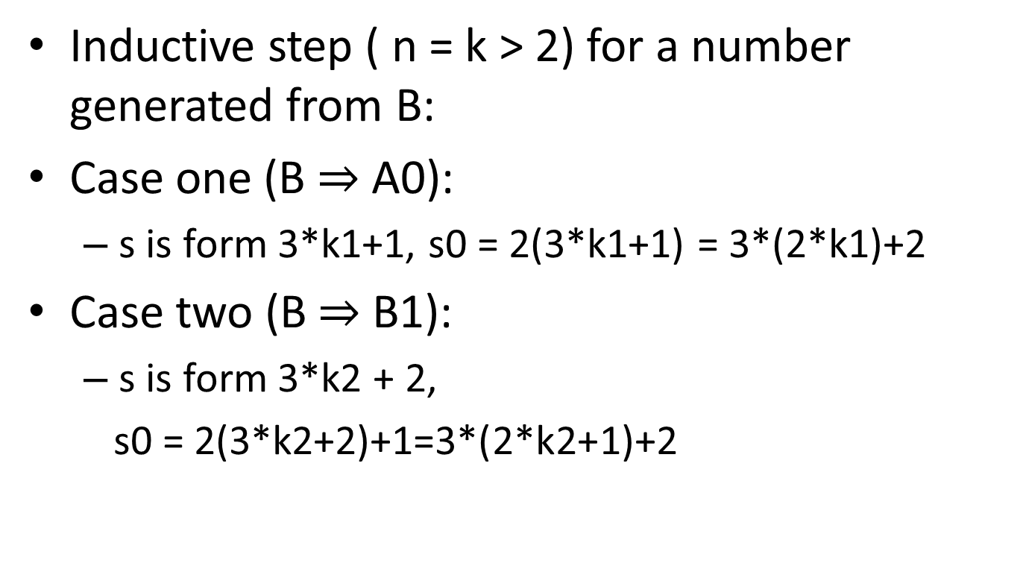
Problem 4 (cont.)
Inductive step ( n = k > 2) for a number generated from B:
Case one (B $⇒$ A0):
  s is form 3*k1+1, s0 = 2(3*k1+1) = 3*(2*k1)+2
Case two (B $⇒$ B1):
  s is form 3*k2 + 2,
  s0 = 2(3*k2+2)+1=3*(2*k2+1)+2

Slide 12
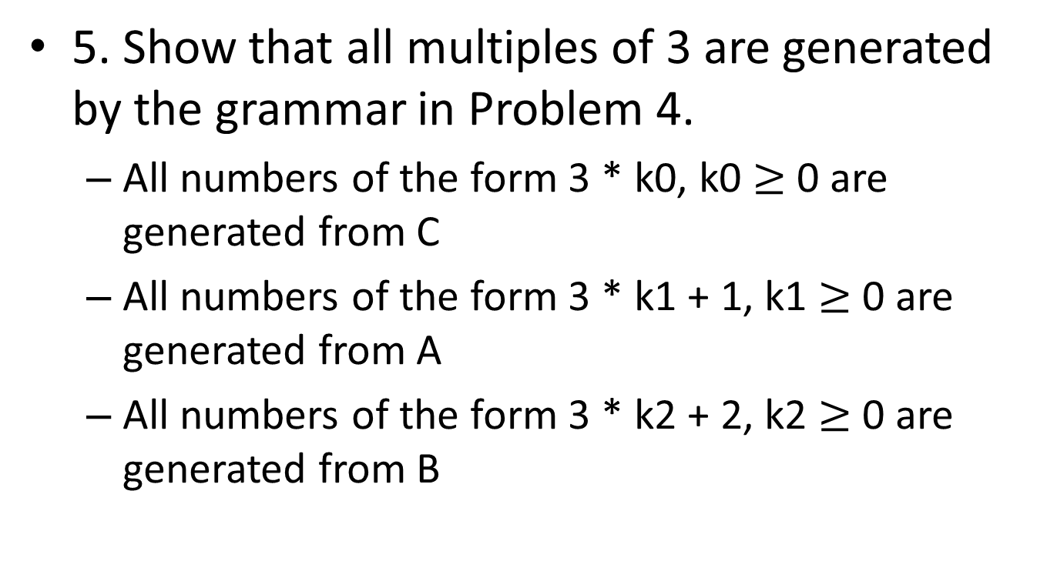
Problem 5
5. Show that all multiples of 3 are generated by the grammar in Problem 4.
  All numbers of the form 3 * k0, k0 $≥$ 0 are generated from C
  All numbers of the form 3 * k1 + 1, k1 $≥$ 0 are generated from A
  All numbers of the form 3 * k2 + 2, k2 $≥$ 0 are generated from B

Slide 13
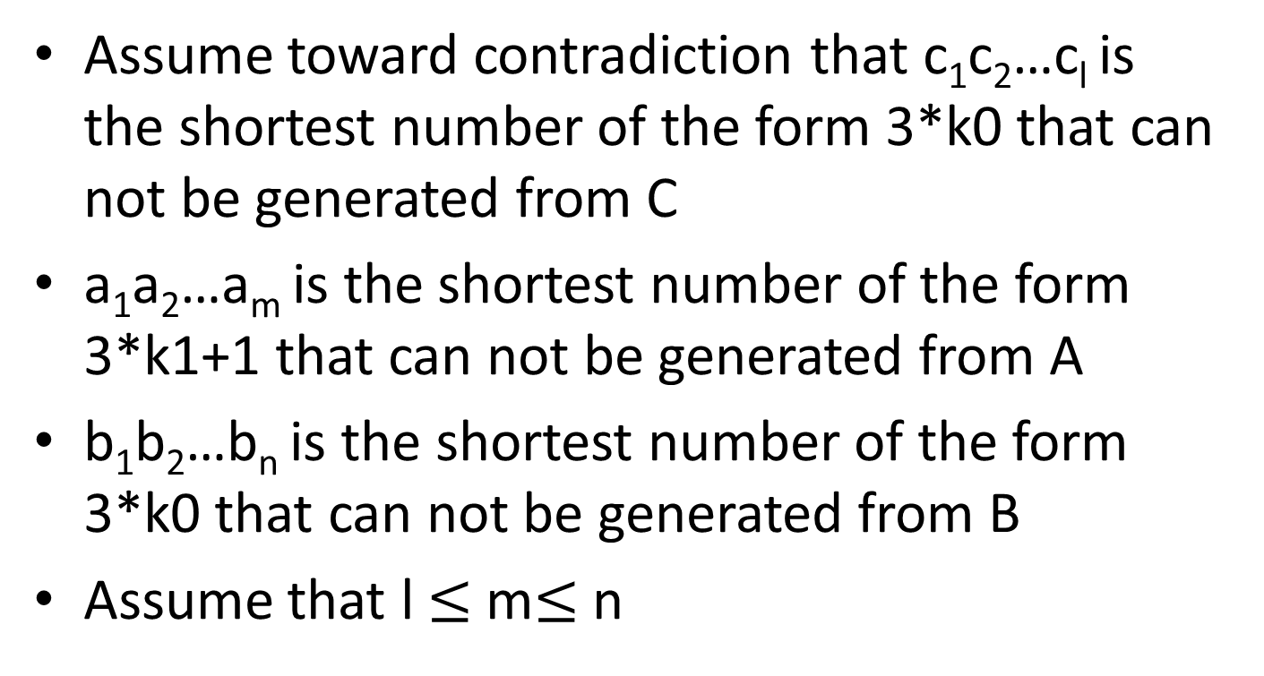
Problem 5 (cont.)
Assume toward contradiction that c₁c₂…c_{l} is the shortest number of the form 3*k0 that can not be generated from C
a₁a₂…a_{m} is the shortest number of the form 3*k1+1 that can not be generated from A
b₁b₂…b_{n} is the shortest number of the form 3*k0 that can not be generated from B
Assume that l $≤$ m$≤$ n

Slide 14
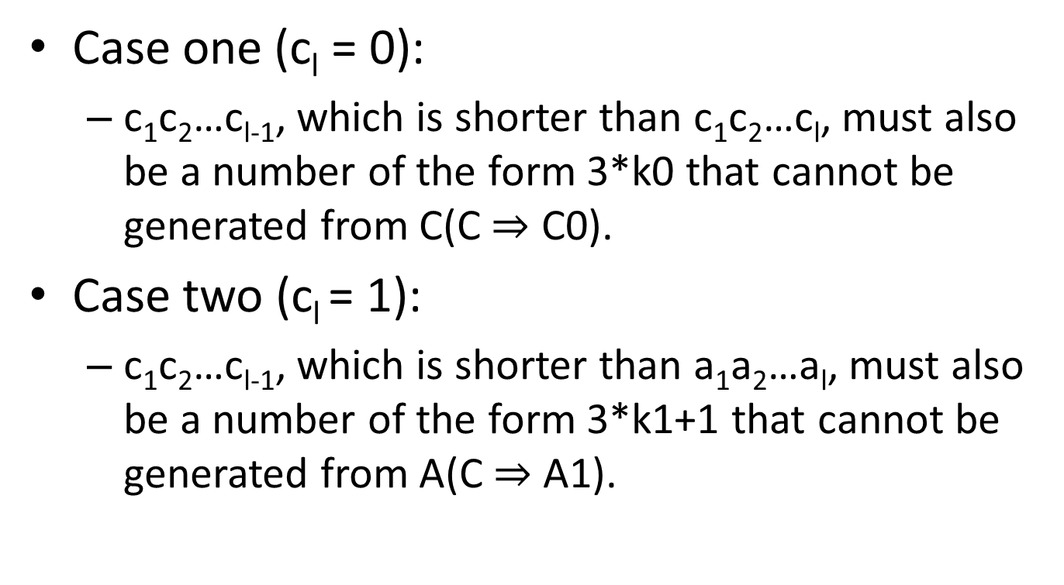
Problem 5 (cont.)
Case one (c_{l} = 0):
  c₁c₂…c_{l-1}, which is shorter than c₁c₂…c_{l}, must also be a number of the form 3*k0 that cannot be generated from C(C $⇒$ C0).
Case two (c_{l} = 1):
  c₁c₂…c_{l-1}, which is shorter than a₁a₂…a_{l}, must also be a number of the form 3*k1+1 that cannot be generated from A(C $⇒$ A1).

