Slide 1
PL HW#3 Solution
助教 賴瑞舜

Slide 2
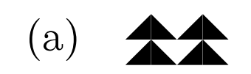

Problem 1
1. Specify the following two quilts (i.e., write two “symbolic” expressions that denote respec-tively these two quilts) in Little Quilt.

Slide 3
Problem 1 (cont.)
(a)
let left = turn ( sew b b ) in
let right = turn ( sew ( turn b ) ( turn b ) ) in
sew ( sew left right ) ( sew left right )
(b)
let lbb = unturn ( sew ( unturn b ) b ) in
let laa = unturn ( sew ( unturn a ) a ) in
let rbb = turn ( sew ( unturn b ) b ) in
let raa = turn ( sew ( unturn a ) a ) in
sew ( sew lbb raa) ( sew laa rbb )
Notes:
(b)簡化

Slide 4
Problem 2
2. Each evaluation of a function body is called an invocation of the function. Consider a function g defined as follows.
let rec g n =
if n = 1 then 1
else g (if even n then n / 2 else 3 * n + 1)
where even n returns true if is even.

Slide 5
Problem 2 (cont.)
How many invocations of g are there in the evaluation of g 12?
A: 10
What is the sequence of numbers formed by the values of the actuals in these invocations?
A: g 12 → g 6 → g 3 → g 10 → g 5 → g 16 →
g 8 → g 4 → g 2 → g 1 → 1

Slide 6
Problem 3
3. Sketch the innermost evaluation of f 98, where f is the 91-function given below.
  let rec f n = if n > 100 then n - 10 else f (f (n + 11))
You may assume that f 100 evaluates to 91 (which we obtained in class).
Notes:
寫清楚if else, 投影片有

Slide 7
Problem 3 (cont.)
f 98 = if 98 > 100 then 98 – 10 else f (f (98 + 11))
= f (f (98 + 11)) = f (f 109)
= f (if 109 > 100 then 109 -10 else …)
= f (109 - 10) = f 99
= if 99 > 100 then 99 - 10 else f (f ( 99 + 11))
= f (f (99 + 11)) = f (f 110)
= f (if 110 > 100 then 110 -10 else …)
= f (110 - 10) = f 100 = 91

Slide 8
Problem 4
4. Innermost evaluation corresponds to tree rewriting. Below is a sequence of trees that correspond to the expressions encountered during an innermost evaluation of 6*6 - 4*1*5. For instance, the subtree for 6*6 is rewritten as a node for 36, representing that the immediate result of evaluating 6 * 6 is 36.

Slide 9
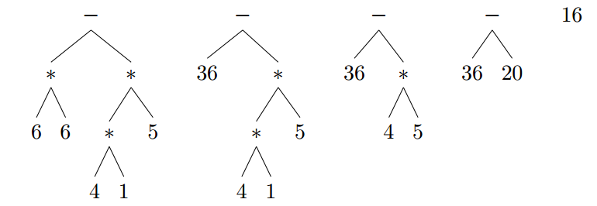
Problem 4 (cont.)
Draw a sequence of trees that correspond to the innermost evaluation of each of the following expressions.

Slide 10



















Problem 4 (cont.)
(a) 1 = 2 || 1 = 1
(b) 1 = 1 || 1 = 2
$$∥$$
$$∥$$
$$∥$$
$$true$$
$$=$$
$$=$$
$$false$$
$$=$$
$$false$$
$$true$$
1
2
1
1
1
1
$$∥$$
$$∥$$
$$∥$$
$$true$$
$$=$$
$$=$$
t$rue$
$$=$$
$$true$$
$$false$$
1
1
1
2
1
2

Slide 11
















Problem 5
5. Function fib computes Fibonacci numbers:
let rec fib n = if n = 0 || n = 1 then 1
else fib (n - 2) + fib (n - 1)
(a) Draw an abstract syntax tree for the function body.
$$if−then−else$$
$$∥$$
1
$$+$$
$$=$$
$$=$$
$$fib$$
$$fib$$
$$n$$
$$0$$
$$n$$
$$1$$
$$−$$
$$−$$
$$n$$
$$2$$
$$n$$
$$1$$

Slide 12
Problem 5 (cont.)
(b) Draw a sequence of trees that correspond to the innermost evaluation of fib 2. A subtree for fib m should be rewritten as another subtree for the function body of fib with m substituted for each occurrence of the formal.

Slide 13
























































Problem 5 (cont.)
(1)
(2)
$$if−then−else$$
$$if−then−else$$
$$∥$$
1
$$+$$
$$∥$$
1
$$+$$
$$=$$
$$=$$
$$fib$$
$$fib$$
$$false$$
$$=$$
$$fib$$
$$fib$$
$$2$$
$$0$$
$$2$$
$$1$$
$$−$$
$$−$$
$$2$$
$$1$$
$$−$$
$$−$$
$$2$$
$$2$$
$$2$$
$$1$$
$$2$$
$$2$$
$$2$$
$$1$$
(3)
$$if−then−else$$
(4)
$$if−then−else$$
$$∥$$
$$+$$
$$false$$
1
$$+$$
1
$$false$$
$$false$$
$$fib$$
$$fib$$
$$fib$$
$$fib$$
$$−$$
$$−$$
$$−$$
$$−$$
$$2$$
$$2$$
$$2$$
$$1$$
$$2$$
$$2$$
$$2$$
$$1$$

Slide 14



















































Problem 5 (cont.)
(5)
(6) fib 0
$$if−then−else$$
$$+$$
$$fib$$
$$fib$$
$$∥$$
1
$$+$$
$$0$$
$$−$$
$$=$$
$$=$$
$$fib$$
$$fib$$
$$2$$
$$1$$
$$0$$
$$0$$
$$0$$
$$1$$
$$−$$
$$−$$
$$0$$
$$2$$
$$0$$
$$1$$
(7) fib 0
(8) fib 0
$$if−then−else$$
$$if−then−else$$
$$∥$$
1
$$+$$
$$∥$$
1
$$+$$
$$true$$
$$=$$
$$fib$$
$$fib$$
$$true$$
$$flase$$
$$fib$$
$$fib$$
$$0$$
$$1$$
$$−$$
$$−$$
$$−$$
$$−$$
$$0$$
$$2$$
$$0$$
$$1$$
$$0$$
$$2$$
$$0$$
$$1$$

Slide 15














































Problem 5 (cont.)
(9) fib 0
$$if−then−else$$
(10)
$$+$$
$$true$$
1
$$+$$
1
$$fib$$
$$fib$$
$$fib$$
$$1$$
$$−$$
$$−$$
$$0$$
$$2$$
$$0$$
$$1$$
(11) fib 1
(12) fib 1
$$if−then−else$$
$$if−then−else$$
$$∥$$
1
$$+$$
$$∥$$
1
$$+$$
$$=$$
$$=$$
$$fib$$
$$fib$$
$$false$$
$$=$$
$$fib$$
$$fib$$
$$1$$
$$0$$
$$1$$
$$1$$
$$−$$
$$−$$
$$1$$
$$1$$
$$−$$
$$−$$
$$1$$
$$2$$
$$1$$
$$1$$
$$1$$
$$2$$
$$1$$
$$1$$

Slide 16



























Problem 5 (cont.)
(13) fib 1
(14) fib 1
$$if−then−else$$
$$if−then−else$$
$$∥$$
1
$$+$$
$$true$$
1
$$+$$
$$false$$
$$true$$
$$fib$$
$$fib$$
$$fib$$
$$fib$$
$$−$$
$$−$$
$$−$$
$$−$$
$$1$$
$$2$$
$$1$$
$$1$$
$$1$$
$$2$$
$$1$$
$$1$$
(15)
(16)
$$+$$
$$2$$
1
$$1$$

